Slide 1
Data Fusion –
Resolving Data Conflicts in Integration
Tutorial at
VLDB 2009
Xin Luna Dong – AT&T Labs-Research
Felix Naumann – Hasso Plattner Institute (HPI)

Slide 2
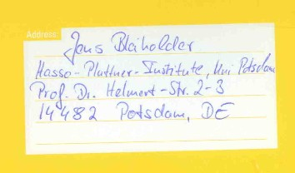
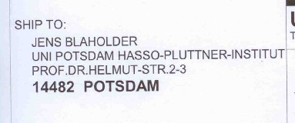
Origins of Data Conflicts
Original
ACM Computing
Survey [BN08]
Scanned

Slide 3
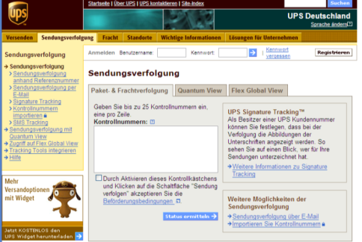
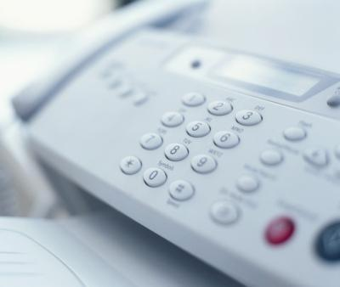
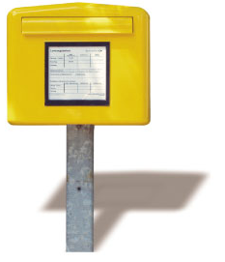
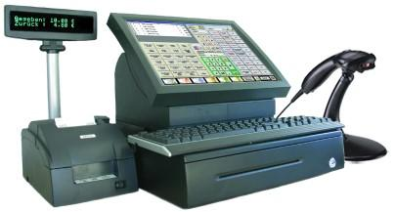
Origins of Data Conflicts

Slide 4






Origins of Data Conflicts
Integrated data
Schering CRM
Bayer CRM

Slide 5
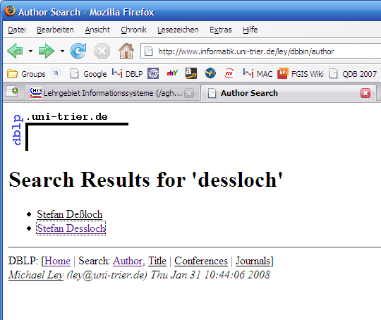
Origins of Data Conflicts: German Names

Slide 6
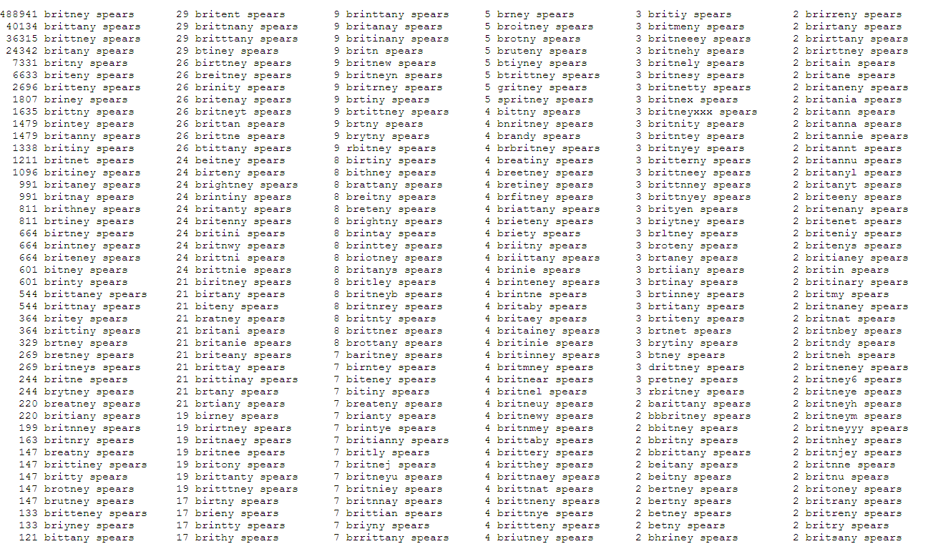
Origins of Data Conflicts: Difficult Names

Slide 7
Origins of Intra-Source Conflicts
No integrity or consistency checks
Redundant schemata
Typos, transmission errors, incorrect calculations
Variants
  Kantstr. / Kantstrasse / Kant Str. / Kant Strasse
  Kolmogorov / Kolmogoroff / Kolmogorow
Typical confusion (OCR)
  U<->V, 0<->o, 1<->l, etc.
Obsolete values
  Different update frequencies, forgotten update

Slide 8


Origins of Inter-Source Conflicts
Locally consistent but globally inconsistent
Different data types
Local spelling variations and conventions
  Addresses
    St → Street, Ave → Avenue, etc.
    R.-Breitscheid-Str. 72 a → Rudolf-Breitscheid.-Str. 72A
    128 spellings for Frankfurt am Main
      Frankfurt a.M., Frankfurt/M, Frankfurt, Frankfurt a. Main, …
  Names
    Dr. Ing. h.c. F. Porsche AG
    Hewlett-Packard Development Company, L.P.
  Numerical data
    10.000 € = 10T EURO = 10k EUR = 10.000,00€ = 10,000.- €
  Phone numbers, birth dates, etc.

Slide 9

Resolution of Data Conflicts?
tables.googlelabs.com
“… focus is on fusing data management and collaboration: merging multiple data sources, discussion of the data, querying, visualization, and Web publishing.”
“The power of data is truly harnessed when you combine data from multiple sources. Fusion Tables enables you to fuse multiple sets of data when they are about the same entities. In database speak, we call this a join on a primary key but the data originates from multiple independent sources.”

Slide 10
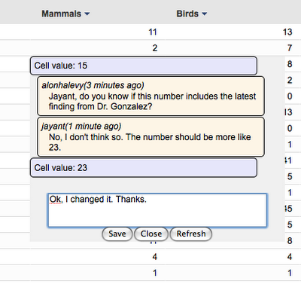
Web Integration—Google Fusion Tables
  Allows discussion of values between users

Slide 11
Data Conflict Elimination
Error correction
  Reference tables
    Cities, countries, products ...
    Similarity measures
  Standardization and transformation
  Domain-knowledge (meta data)
    Conventions (country/region-specific spelling)
    Ontologies
    Thesauri, dictionaries for homonyms, synonyms, ...
  Outlier detection and elimination
And data fusion…

Slide 12
Overview
  Data fusion in the integration process
Foundations of data fusion
  Conflict resolution strategies and functions
  Conflict resolution operators
Advanced truth-discovery techniques
Existing data fusion systems
Open problems

Slide 13
Information Integration
<pub>
<Titel> Federated Database
Systems </Titel>
<Autoren>
<Autor> Amit Sheth </Autor>
<Autor> James Larson </Autor>
</Autoren>
</pub>
Source A
<publication>
<title> Federated Database
Systems for Managing
Distributed, Heterogeneous,
and Autonomous
Databases </title>
<author> Scheth & Larson </author>
<year> 1990 </year>
</publication>
Source B
Schema Mapping
Duplicate Detection
Data Fusion
Data Transformation

Slide 14
Information Integration
<pub>
<Titel> Federated Database
Systems </Titel>
<Autoren>
<Autor> Amit Sheth </Autor>
<Autor> James Larson </Autor>
</Autoren>
</pub>
<pub>
<title> </title>
<Autoren>
<author> </author>
<author> </author>
</Autoren>
<year> </year>
</pub>
Source A
<publication>
<title> Federated Database
Systems for Managing
Distributed, Heterogeneous,
and Autonomous
Databases </title>
<author> Scheth & Larson </author>
<year> 1990 </year>
</publication>
Source B
Schema Integration
Schema Mapping
Schema Mapping
Duplicate Detection
Data Fusion
Data Transformation

Slide 15
Information Integration
Transformation queries or views
<pub>
<Titel> Federated Database
Systems </Titel>
<Autoren>
<Autor> Amit Sheth </Autor>
<Autor> James Larson </Autor>
</Autoren>
</pub>
<pub>
<title> Federated Database
Systems </title>
<Autoren>
<author> Amit Sheth </author>
<author> James Larson </author>
</Autoren>
</pub>
<pub>
<title> Federated Database Systems for
Managing Distributed,
Heterogeneous, and Autonomous
Databases </title>
<Autoren>
<author> Scheth & Larson </author>
</Autoren>
<year> 1990 </year>
</pub>
Source A
XQuery
<publication>
<title> Federated Database
Systems for Managing
Distributed, Heterogeneous,
and Autonomous
Databases </title>
<author> Scheth & Larson </author>
<year> 1990 </year>
</publication>
Source B
XQuery
Schema Mapping
Duplicate Detection
Data Fusion
Data Transformation

Slide 16
Information Integration
<pub>
<Titel> Federated Database
Systems </Titel>
<Autoren>
<Autor> Amit Sheth </Autor>
<Autor> James Larson </Autor>
</Autoren>
</pub>
<pub>
<title> Federated Database
Systems </title>
<Autoren>
<author> Amit Sheth </author>
<author> James Larson </author>
</Autoren>
</pub>
<pub>
<title> Federated Database Systems for
Managing Distributed,
Heterogeneous, and Autonomous
Databases </title>
<Autoren>
<author> Scheth & Larson </author>
</Autoren>
<year> 1990 </year>
</pub>
Source A
<publication>
<title> Federated Database
Systems for Managing
Distributed, Heterogeneous,
and Autonomous
Databases </title>
<author> Scheth & Larson </author>
<year> 1990 </year>
</publication>
Source B
Schema Mapping
Duplicate Detection
Data Fusion
Data Transformation

Slide 17
Information Integration
<pub>
<Titel> Federated Database
Systems </Titel>
<Autoren>
<Autor> Amit Sheth </Autor>
<Autor> James Larson </Autor>
</Autoren>
</pub>
<pub>
<title> Federated Database
Systems </title>
<Autoren>
<author> Amit Sheth </author>
<author> James Larson </author>
</Autoren>
</pub>
<pub>
<title> Federated Database Systems for
Managing Distributed,
Heterogeneous, and Autonomous
Databases </title>
<Autoren>
<author> Scheth & Larson </author>
</Autoren>
<year> 1990 </year>
</pub>
Source A
<publication>
<title> Federated Database
Systems for Managing
Distributed, Heterogeneous,
and Autonomous
Databases </title>
<author> Scheth & Larson </author>
<year> 1990 </year>
</publication>
Source B
Schema Mapping
Duplicate Detection
Data Fusion
Data Transformation

Slide 18
Information Integration
<pub>
<title> Federated Database
Systems </title>
<Autoren>
<author> Amit Sheth </author>
<author> James Larson </author>
</Autoren>
</pub>
<pub>
<title> Federated Database Systems for
Managing Distributed,
Heterogeneous, and Autonomous
Databases </title>
<Autoren>
<author> Scheth & Larson </author>
</Autoren>
<year> 1990 </year>
</pub>
<pub>
<title> Federated Database Systems for
Managing Distributed,
Heterogeneous, and
Autonomous Databases </title>
<Autoren>
<author> Amit Sheth </author>
<author> James Larson </author>
</Autoren>
<year> 1990 </year>
</pub>
Source A
Source B
Preserve lineage
Schema Mapping
Duplicate Detection
Data Fusion
Data Transformation

Slide 19
Completeness, Conciseness, and Correctness
Schema Matching:
Same attribute semantics

Slide 20
Completeness, Conciseness, and Correctness
Duplicate detection:
Same real-world entities

Slide 21
Completeness, Conciseness, and Correctness
Intensional conciseness
Data Fusion: Resolve uncertainties and contradictions
Extensional completeness
Extensional
conciseness
Intensional completeness

Slide 22
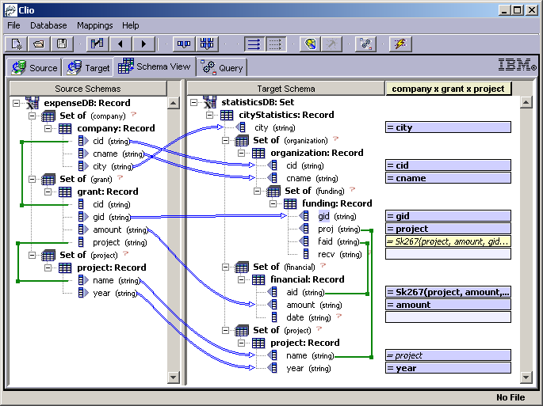
Schema Matching
Problem
  Given two schemata, find all correspondences between their attributes
Difficulties
  Schematic heterogeneity
  (synonyms & homonyms)
  Data heterogeneity
  n:m mappings
  Transformation functions
  User interaction
Then: Derive a schema mapping

Slide 23
Duplicate Detection
Problem
  Given one or more data sets, find all sets of objects that represent the same real-world entity.
Difficulties
  Duplicates are not identical
    Similarity measures – Levenshtein, Soundex, Jaccard, etc.
  Large volume, cannot compare all pairs
    Partitioning strategies – Sorted neighborhood, Blocking, etc.
Duplicates
CRM1
sim > θ₂
CRM1 x CRM2
Partitioning
Similarity measure
???
CRM2
sim < θ₁
Non-Duplicates

Slide 24
Ironically, “Duplicate Detection” has many Duplicates
Doubles
Household matching
Duplicate detection
Mixed and split citation problem
Record linkage
Object identification
Match
Deduplication
Fuzzy match
Object consolidation
Entity resolution
Entity clustering
Approximate match
Identity uncertainty
Reference reconciliation
Merge/purge
Hardening soft databases
Householding
Reference matching

Slide 25
Data Fusion
Problem
  Given a duplicate, create a single object representation while resolving conflicting data values.
Difficulties
  Null values: Subsumption and complementation
  Contradictions in data values
  Uncertainty & truth: Discover the true value and model uncertainty in this process
  Metadata: Preferences, recency, correctness
  Lineage: Keep original values and their origin
  Implementation in DBMS: SQL, extended SQL, UDFs, etc.

Slide 26
The Field of Data Fusion
Data Fusion
Conflict types
Resolution strategies
Operators
Resolution functions
Uncertainty
Contradiction
Join-based
Possible worlds
Subsumption
Aggregation
Union-based
Consistent answers
Complementation
Advanced
functions
Ignorance
Avoidance
Resolution
Instance-based
Metadata-based
Instance-based
Metadata-based

Slide 27
Overview
  Data fusion in the integration process
Foundations of data fusion
  Conflict resolution strategies and functions
  Conflict resolution operators
Advanced truth-discovery techniques
Existing data fusion systems
Open problems

Slide 28
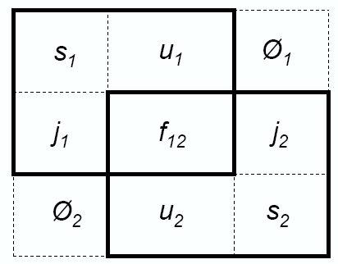
Uncertainty and Contradiction
Uncertainty
  NULL value vs. non-NULL value
  “Easy” case
Contradiction
  Non-NULL value
  vs. (different)
  non-NULL value
Uncer-
tainty
Contra-
diction
Uncer-
tainty

Slide 29
Semantics of NULL
“unknown”
  There is a value, but I do not know it.
  E.g.: Unknown date-of-birth
“not applicable”
  There is no meaningful value.
  E.g.: Spouse for singles
“withheld”
  There is a value, but we are not authorized to see it.
  E.g.: Private phone line

Slide 30
Classification of Strategies
conflict resolution
strategies
conflict
ignorance
conflict
avoidance
conflict
resolution
Pass it on
instance
based
metadata
based
instance
based
metadata
based
Take the
information
No Gossiping
Trust your
friends
deciding
mediating
deciding
mediating
Cry with the wolves
Roll the dice
Meet in
the middle
Nothing is older than the news from yesterday

Slide 31
Conflict Resolution Functions
Function | Description | Examples
Min, Max, Sum, Count, Avg | Standard aggregation | NumChildren, Salary, Height
Random | Random choice | Shoe size
Longest, Shortest | Longest/shortest value | First_name
Choose(source) | Value from a particular source | DoB (DMV), CEO (SEC)
ChooseDepending(val, col) | Value depends on value chosen in other column | city & zip, e-mail & employer
Vote | Majority decision | Rating
Coalesce | First non-null value | First_name
Group, Concat | Group or concatenate all values | Book_reviews
MostRecent | Most recent (up-to-date) value | Address
MostAbstract, MostSpecific, CommonAncestor | Use a taxonomy / ontology | Location
Escalate | Export conflicting values | gender
… | … | …
Notes:
Strategie und funktion trennen
Eigene folie zu den funktionen
Katalog der funktionen

Slide 32
Classification of Functions
conflict resolution
strategies
conflict
ignorance
conflict
avoidance
conflict
resolution
Escalate
instance
based
metadata
based
instance
based
metadata
based
Coalesce
ChooseDepending
Concat
Choose
deciding
mediating
deciding
mediating
MIN, MAX
Random
Vote
AVG, SUM
MostRecent
MostAbstract
MostSpecific
CommonAncestor

Slide 33
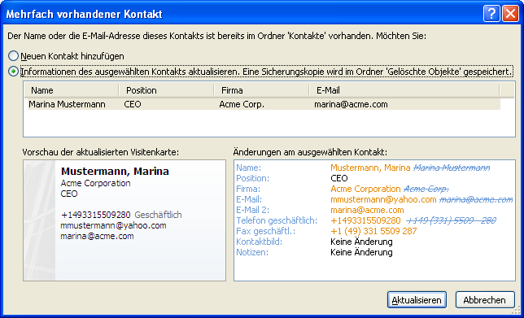
Data Fusion in MS Outlook 2007

Slide 34
Overview
  Data fusion in the integration process
Foundations of data fusion
  Conflict resolution strategies and functions
  Conflict resolution operators
Advanced truth-discovery techniques
Existing data fusion systems
Open problems

Slide 35
Data Fusion Goals
Source 1(A,B,C) →
a, b, -
a, b, -, -
→
→
a, b, -, -
Identical tuples
Source 2(A,B,D) →
a, b, -
a, b, -, -
a, b, c
a, b, c, -
→
→
a, b, c, -
Subsumed tuples
a, b, -
a, b, -, -
a, b, c
a, b, c, -
→
→
a, b, c, d
Complementing tuples
a, b, d
a, b, -, d
a, b, c
a, b, c, -
→
→
a, f(b,e), c, d
Conflicting tuples
a, e, d
a, e, -, d

Slide 36
Relational Operators – Overview
Identical tuples
  UNION, OUTER UNION
Subsumed tuples (uncertainty)
  MINIMUM UNION
Complementing tuples (uncertainty)
  COMPLEMENT UNION, MERGE
Conflicting tuples (contradiction)
  Relational approaches: Match, Group, Fuse, …
Other approaches
  Possible worlds, probabilistic answers, consistent answers

Slide 37
Minimum Union
A | B | C
a | b | c
e | f | g
m | n | o
A | B | D
a | b | ⊥
e | f | h
m | p | ⊥
A | B | C | D
a | b | c | ⊥
a | b | ⊥ | ⊥
e | f | g | ⊥
e | f | ⊥ | h
m | n | o | ⊥
m | p | ⊥ | ⊥
Union: Elimination of exact duplicates
Minimum Union: Elimination of subsumed tuples
  Outer union
  Subsumption
∪
=
+
A tuple t1 subsumes a tuple t2, if it has same schema, has less NULL-values, and coincides in all non-NULL-values.
R↓
A | B | C | D
a | b | c | ⊥
e | f | g | ⊥
e | f | ⊥ | h
m | n | o | ⊥
m | p | ⊥ | ⊥
Rewriting in SQL using DWH extensions (Windows) and assuming existence of favorable ordering [RPZ04]

Slide 38
Full Disjunction
A | B | C
a | b | c
e | f | g
k | ⊥ | o
k | m | ⊥
A | B | D
a | b | ⊥
e | f | h
m | p | ⊥
k | q | r
A | B | C | D
a | b | c | ⊥
e | f | g | h
m | p | ⊥ | ⊥
k | ⊥ | o | ⊥
k | m | ⊥ | ⊥
k | q | ⊥ | r
Represents all
possible
combinations of
source tuples
  Full outer join on all common attributes
    All combinations for more than two sources
  Minimum union over results
Combines complementing tuples
(only inter-source)
Algorithms: [GL94,RU96,CS05]
|⋈|
=
R↓
A | B | C | D
a | b | c | ⊥
e | f | g | h
m | p | ⊥ | ⊥
k | ⊥ | o | ⊥
k | m | ⊥ | ⊥
k | q | ⊥ | r

Slide 39
Complement Union – Proposal
A | B | C
a | b | c
e | f | g
m | n | o
A | B | D
a | b | ⊥
e | f | h
m | p | ⊥
A | B | C | D
a | b | c | ⊥
a | b | ⊥ | ⊥
e | f | g | ⊥
e | f | ⊥ | h
m | n | o | ⊥
m | p | ⊥ | ⊥
Elimination of complementing tuples
  Outer union
  Complementation
No known SQL rewriting
∪
=
+
A tuple t1 complements a tuple t2, if it has same schema and coincides in all non-NULL-values.
R⇅
A | B | C | D
a | b | c | ⊥
e | f | g | h
m | n | o | ⊥
m | p | ⊥ | ⊥
Includes duplicate removal and subsumption

Slide 40
Merge and Prioritized Merge
Mixes Join and Union to a new operator [GPZ01]
  Idea: Build two versions for each common attribute, one “favoring” S1, the other “favoring” S2.
  Nulls in a source are replaced using COALESCE.
  Fuses complementing tuples, but only for inter-source duplicates
  Priorization possible: Removes conflicting tuples from right relation.
( SELECT R.A, COALESCE(R.B, S.B), R.C, S.D
FROM R LEFT OUTER JOIN S ON R.A = S.A )
UNION
( SELECT S.A, COALESCE(S.B, R.B), R.C, S.D
FROM R RIGHT OUTER JOIN S ON R.A = S.A )

Slide 41
Merge and Prioritized Merge
A is real-world ID
A | B | C
a | b | c
e | f | g
m | n | o
m | n | ⊥
q | r | s
A | B | D
a | b | ⊥
e | f | h
m | p | ⊥
A | B | C | D
a | COAL(b,b) | c | ⊥
e | COAL(f,f) | g | h
m | COAL(n,p) | o | ⊥
m | COAL(n,p) | ⊥ | ⊥
q | r | s | ⊥
A | B | C | D
a | b | c | ⊥
e | f | g | h
m | n | o | ⊥
m | n | ⊥ | ⊥
q | r | s | ⊥
|⋈
=
=
∪
A | B | C
a | b | c
e | f | g
m | n | o
m | n | ⊥
q | r | s
A | B | D
a | b | ⊥
e | f | h
m | p | ⊥
A | B | C | D
a | COAL(b,b) | c | ⊥
e | COAL(f,f) | g | h
m | COAL(p,n) | o | ⊥
m | COAL(p,n) | ⊥ | ⊥
A | B | C | D
a | b | c | ⊥
e | f | g | h
m | p | o | ⊥
m | p | ⊥ | ⊥
⋈|
=
=

Slide 42
Match Join
Context: AURORA Project [YÖ99]
Handles columns individually using projections (with IDs)
Performs UNION on each column across all sources
Reassembles using FULL OUTER JOINS
Uses “conflict-tolerant query model” to query these possible worlds.
WITH OU(A,B,C,D) AS (
( SELECT A, B, C, NULL AS D FROM U1 )
UNION
( SELECT A, B, NULL AS C, D FROM U2 ) ),
B_V (A,B) AS ( SELECT DISTINCT A, B FROM OU ),
C_V (A,C) AS ( SELECT DISTINCT A, C FROM OU ),
D_V (A,D) AS ( SELECT DISTINCT A, D FROM OU ),
SELECT A, B, C, D
FROM B_V FULL OUTER JOIN C_V FULL OUTER JOIN D_V
ON B_V.A=C_V.A AND C_V.A=D_V.A

Slide 43
Match Join
Conflict-tolerant query model
  Chooses tuples from result of MatchJoin
Three semantics
  HighConfidence, RandomEvidence, PossibleAtAll
Resolution functions
  SUM, AVG, MAX, MIN, ANY, DISCARD
SELECT ID, Name[ANY], Age[MAX]
FROM MatchJoin(U1,U2)
WHERE Age>22
WITH PossibleAtAll

Slide 44
Grouping and Aggregation
Outer union then group by real-world ID
Aggregate all other columns using conflict resolving aggregate function
Efficient implementations
Catches inter- and intra-source duplicates
Restricted to built-in
aggregate-functions
  MAX, MIN, AVG,
  VAR, STDDEV, SUM,
  COUNT
WITH OU AS (
( SELECT A, B, C, NULL AS D FROM U1 )
UNION (ALL)
( SELECT A, B, NULL AS C, D FROM U2 ) ),
SELECT A, MAX(B), MIN(C), SUM(D)
FROM OU
GROUP BY A

Slide 45
FUSE BY
SQL extensions to resolve uncertainties and contradictions [BN05,BBB+05]
FUSE FROM implies OUTER UNION
  Removes subsumed and duplicate tuples by default
FUSE BY declares real-world ID
RESOLVE specifies conflict resolution function from catalog
  Default: COALESCE
Implemented on top of relational DBMS “XXL”
SELECT ID,
RESOLVE(Title, Choose(IMDB)),
RESOLVE(Year, Max), RESOLVE(Director),
RESOLVE(Rating), RESOLVE(Genre, Concat)
FUSE FROM IMDB, Filmdienst
FUSE BY (ID)
ON ORDER Year DESC

Slide 46
Summary of Operators
 | Duplicates | Subsumed tuples | Complementing tuples | Contradictions
Union, Outer Union | ✓ | ✗ | ✗ | ✗
Minimum Union | ✓ | ✓ | ✗ | ✗
Full Disjunction | ✓ | ✓ | ✓ (inter-source)
Complement Union | ✓ | ✓ | ✓ | ✗
Merge | ✓ | ✓ (inter-source) | ✓ (inter-source) | ✗
MatchJoin + CTQM | ✓ | ✓ | ✓ | ✗ ✓
Group By | ✓ | ✓ | ✓ | ✓
Fuse By | ✓ | ✓ | ✓ | ✓

Slide 47
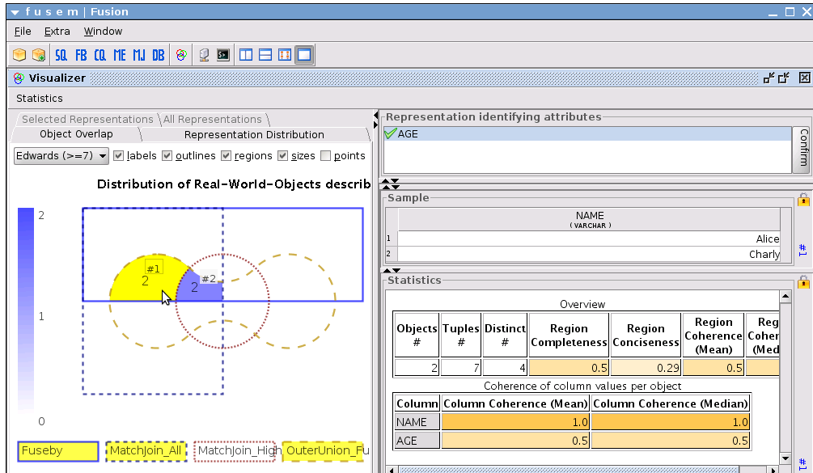
FuSem
Tool to query and fuse data from diverse data sources [BDN07]
  Based on HumMer project [BBB+05].
  http://www.hpi.uni-potsdam.de/naumann/sites/fusem/
Explore data and find interesting subsets
Execute, explore and compare five different data fusion semantics, specified in their respective syntax:
  SQL (and extensions,
  such as Subsumption)
  Merge
  MatchJoin
  FuseBy
  ConQuer

Slide 48
What else is there?
Consistent Query Answering
  Avoid conflicts and report only certain tuples
    Those that appear in every repair [FFM05]
“Possible worlds” models
  Build all possible solutions, annotated with likelihood
    Yes/No/Maybe [DeM89]
    Probability value [LSS94]
  Probabilistic databases [SD05]
    Extend algebra to produce probabilities
    Extend query language to query and export probabilities

Slide 49
Overview
  Data fusion in the integration process
Foundations of data fusion
  Conflict resolution strategies and functions
  Conflict resolution operators
Advanced truth-discovery techniques
Existing data fusion systems
Open problems

Slide 50
Outline
  Data fusion in the integration process
Foundations of data fusion
  Conflict resolution strategies and functions
  Conflict resolution operators
Advanced truth-discovery techniques
Data fusion in existing integration systems
Open problems

Slide 51
Basic Strategies
conflict resolution
strategies
conflict
ignorance
conflict
avoidance
conflict
resolution
Pass it on
instance
based
metadata
based
instance
based
metadata
based
Take the
information
No Gossiping
Trust your
friends
deciding
mediating
deciding
mediating
Cry with the wolves
Roll the dice
Meet in
the middle
Nothing is older than the news from yesterday

Slide 52
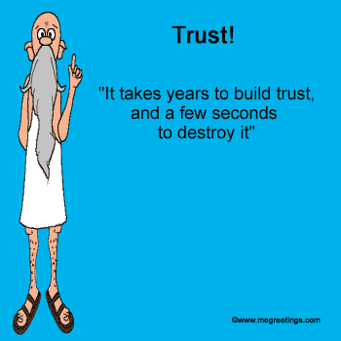
Intuitions
Data sources are of different quality and we trust data from accurate sources more

Slide 53
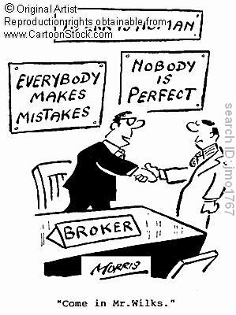
Intuitions
Data sources are of different quality and we trust data from accurate sources more

Slide 54
Basic Strategies
conflict resolution
strategies
conflict
ignorance
conflict
avoidance
conflict
resolution
Pass it on
instance
based
metadata
based
instance
based
metadata
based
Take the
information
No Gossiping
Trust your
friends
deciding
mediating
deciding
mediating
Cry with the wolves
Roll the dice
Meet in
the middle
Nothing is older than the news from yesterday

Slide 55
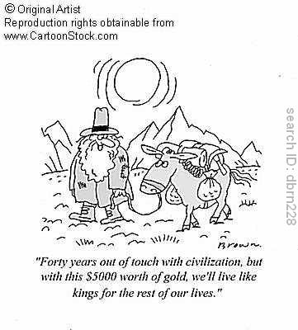
Intuitions
Data sources are of different quality and we trust data from accurate sources more
The real world is dynamic and the true value often evolves over time
  E.g., person affiliation, business contact phone

Slide 56
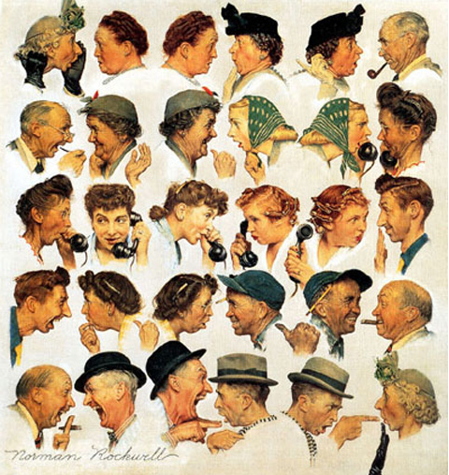
Intuitions
Data sources are of different quality and we trust data from accurate sources more
The real world is dynamic and the true value often evolves over time
  E.g., person affiliation, business contact phone
Data sources can copy from each other and errors can be propagated quickly

Slide 57
Advanced Truth-Discovery Techniques
Consider accuracy of sources
Consider freshness of sources
Consider dependence between sources
Data sources are of different quality and we trust data from accurate sources more
The real world is dynamic and the true value often evolves over time
  E.g., person affiliation, business contact phone
Data sources can copy from each other and errors can be propagated quickly

Slide 58
Advanced Truth-Discovery Techniques
Consider accuracy of sources
Consider freshness of sources
Consider dependence between sources
Data sources are of different quality and we trust data from accurate sources more
The real world is dynamic and the true value often evolves over time
  E.g., person affiliation, business contact phone
Data sources can copy from each other and errors can be propagated quickly

Slide 59
Trust Accurate Sources
Considering accuracy can often improve truth discovery
 | S1 | S2 | S3
Stonebraker | MIT | Berkeley | MIT
Dewitt | MSR | MSR | UWisc
Bernstein | MSR | MSR | MSR
Carey | UCI | AT&T | BEA
Halevy | Google | Google | UW
Notes:
(American short-story Writer and Novelist, Nobel Prize for Literature in 1949, 1897-1962)

Slide 60
Trust Accurate Sources
Considering accuracy can often improve truth discovery
 | S1 | S2 | S3
Stonebraker | MIT | Berkeley | MIT
Dewitt | MSR | MSR | UWisc
Bernstein | MSR | MSR | MSR
Carey | UCI | AT&T | BEA
Halevy | Google | Google | UW
S1 is more accurate; trusting it more can help find the correct affiliation for Carey
Notes:
(American short-story Writer and Novelist, Nobel Prize for Literature in 1949, 1897-1962)

Slide 61
Trust Accurate Sources
Considering accuracy can often improve truth discovery
 | S1 | S2 | S3
Stonebraker | MIT | Berkeley | MIT
Dewitt | MSR | MSR | UWisc
Bernstein | MSR | MSR | MSR
Carey | UCI | AT&T | BEA
Halevy | Google | Google | UW
S1 is more accurate; trusting it more can help find the correct affiliation for Carey
Notes:
(American short-story Writer and Novelist, Nobel Prize for Literature in 1949, 1897-1962)

Slide 62
Find Trustable Sources (I)
Deciding authority based on link analysis and source popularity
  Survey: “Link analysis ranking: algorithms, theory, and experiments” [Borodin et al., 05]
  PageRank [Brin and Page, 98]
  Authority-hub analysis [Kleinberg, 98]
S

Slide 63
Find Trustable Sources (II)
Assign a global trust rating to each data source based on its behavior in a P2P network
  TrustMe [Singh and Liu, 03]
  EigenTrust [Kamvar et al., 03]
    Peer i&j:
S
S’

Slide 64
Find Trustable Sources (III)
Compute accuracy of sources
  Corroborating answers from web sources [Wu and Marian, 07]
  TruthFinder [Yin et al., 07]
  Solomon [Dong et al., 09a]
  -values provided by S; P(v)-pr of value v being true
  How to compute P(v)?

Slide 65
Apply Source Accuracy in Truth Discovery
[Yin et al., 07] [Dong et al., 09a]
Input:
  Object O
  Dom(O)={v₀,v₁,…,v_{n}}
  Observation Ф on O
Output: Pr(v_{i} true|Ф) for each i=0,…, n (sum up to 1)
According to the Bayes Rule, we need to know
Pr(Ф|v_{i} true)
  Assuming independence of sources, we need to know
  Pr(Ф(S) |v_{i} true)
  If S provides v_{i} : Pr(Ф(S) |v_{i} true) =A(S)
  If S does not provide v_{i} : Pr(Ф(S) |v_{i} true) =(1-A(S))/n

Slide 66
Model and Algorithm [Dong et al., 09a]
Properties
A value provided by more accurate sources has a higher probability to be true
Assuming uniform accuracy, a value provided by more sources has a higher probability to be true
Source accuracy
Source trustworthy
Value confidence
Value probability
  Consider value similarity
Continue until source accuracy converges

Slide 67
An Example
 | S1 | S2 | S3
Stonebraker | MIT | Berkeley | MIT
Dewitt | MSR | MSR | UWisc
Bernstein | MSR | MSR | MSR
Carey | UCI | AT&T | BEA
Halevy | Google | Google | UW
Value Confidence | Carey
 | UCI | AT&T | BEA
Round 1 | 1.61 | 1.61 | 1.61
Round 2 | 2.40 | 1.89 | 1.42
Round 3 | 3.05 | 2.16 | 1.26
Round 4 | 3.51 | 2.23 | 1.19
Round 5 | 3.86 | 2.20 | 1.18
Round 6 | 4.17 | 2.15 | 1.19
Round 7 | 4.47 | 2.11 | 1.20
Round 8 | 4.76 | 2.09 | 1.20
Accuracy | S1 | S2 | S3
Round 1 | .69 | .57 | .45
Round 2 | .81 | .63 | .41
Round 3 | .87 | .65 | .40
Round 4 | .90 | .64 | .39
Round 5 | .93 | .63 | .40
Round 6 | .95 | .62 | .40
Round 7 | .96 | .62 | .40
Round 8 | .97 | .61 | .40
Notes:
(American short-story Writer and Novelist, Nobel Prize for Literature in 1949, 1897-1962)

Slide 68
Advanced Truth-Discovery Techniques
Consider accuracy of sources
Consider freshness of sources
Consider dependence between sources
Data sources are of different quality and we trust data from accurate sources more
The real world is dynamic and the true value often evolves over time
  E.g., person affiliation, business contact phone
Data sources can copy from each other and errors can be propagated quickly

Slide 69
A Dynamic World
True values can evolve over time
  A subtle third case: out-of-date
 | S1 | S2 | S3
Stonebraker | (03, MIT) | (00, Berkeley) | (06, MIT)
Dewitt | (09, MSR) | (08, MSR) | (01, UWisc)
Bernstein | (00, MSR) | (00, MSR) | (01, MSR)
Carey | (09, UCI) | (05, AT&T) | (06, BEA)
Halevy | (07, Google) | (05, Google) | (06, UW)

Slide 70
A Dynamic World
True values can evolve over time
  A subtle third case: out-of-date
Low-quality data can be caused by different reasons
 | S1 | S2 | S3
Stonebraker (Ѳ, Berkeley), (02, MIT) | (03, MIT) | (00, Berkeley) | (01, Berkeley) (06, MIT)
Dewitt (Ѳ, UWisc), (08, MSR) | (00, UWisc) (09, MSR) | (00, UW) (01, UWisc) (08, MSR) | (01, UWisc)
Bernstein (Ѳ, MSR) | (00, MSR) | (00, MSR) | (01, MSR)
Carey (Ѳ, Propell), (02, BEA), (08, UCI) | (04, BEA) (09, UCI) | (05, AT&T) | (06, BEA)
Halevy (Ѳ, UW), (05, Google) | (00, UW) (07, Google) | (00, UWisc) (02, UW) (05, Google) | (01, UWisc) (06, UW)
OUT-OF-DATE!
OUT-OF-DATE!
ERR!
OUT-OF-DATE!
SLOW!

Slide 71
Refine Accuracy of Sources [Dong et al., 09b]
Exact
ness
Cove
rage
Fresh
ness
Accuracy
How many transitions are captured
How many transitions are
not mis-captured
How quickly transitions are captured
Mis-capturable
Mis-capturable
Mis-capturable
Mis-capturable
Mis-capturable
UWisc
Capturable
Capturable
Capturable
MSR
Capturable
Dewitt
Ѳ(2000)
2008
UW
⊥
UWisc
S
2003
2005
2007
Mis-captured
Mis-captured
Captured
Coverage = #Captured/#Capturable (e.g., ¼=.25)
Exactness = 1-#Mis-Captured/#Mis-Capturable (e.g., 1-2/5=.6)
Freshness(Δ) = #(Captured w. length<=Δ)/#Captured (e.g., F(0)=0, F(1)=0, F(2)=1/1=1…)

Slide 72
Freshness Measures in Other Work
Other work on data freshness: Compare a materialized view with the original source
  [Peralta, Ph.D. Thesis’06]: timeliness, currency
  [Guo et al., 05]: completeness, consistency, currency
  [Olston and Widom, 05]: divergence
  [Labrinidis and Roussopoulos, 04]: QoD(freshness)
  [Theodoratos and Bouzeghoub, 01]: consistency
  [Cho and Garcia-Molina, 00]: freshness, age

Slide 73
Discover Evolving True Values
Decide the initial
value v₀
Decide the next transition (t,v)
Terminate when no more transition

Slide 74
Discover Evolving True Values
Decide the initial
value v₀
Decide the next transition (t,v)
Terminate when no more transition
Decide the initial value: according to the Bayes Rule, we need to know
  Pr(Ф(S)|v_{i}) for each value v_{i}
    If S provides v_{i} : E(S)C(S)
    If S does not provide any value: E(S)(1-C(S))
    If S provides another value: (1-E(S))/n
  Pr(Ф(S)|⊥)—the object does not exist initially
    If S does not provide any value: E(S)
    If S provides a value : (1-E(S))/(n+1)

Slide 75
Discover Evolving True Values
Decide the initial
value v₀
Decide the next transition (t,v)
Terminate when no more transition
O
v'
v
t'
t
S₁
v'
v
S₂
v'
v
S₃
v'
v
…
S_{k}
v'
v

Slide 76
Discover Evolving True Values
Decide the initial
value v₀
Decide the next transition (t,v)
Terminate when no more transition
O
v_{j}
t_{i}
S
v_{j}
Decide the next transition (t,v): according to the Bayes Rule, we need to know
  Pr(Ф(S)|(t_{i},v_{j})) for each time t_{i} and value v_{j}
    If S provides v_{j} at time t : E(S)C(S)F(S, t-t_{i})
    If S does not update any more: E(S)(1-C(S)F(S, t_{n}-t_{i}))
    If S makes a wrong update: (1-E(S))/n(t_{n}-t’)
    (t_{n}—the last obs point, t’—time of the prev update)
  Pr(Ф(S)|no more transition): similarly computed
    If S does not update any more: E(S)
    If S makes an update: (1-E(S))/(n+1)(t_{n}-t’)
t
O
v_{j}
t_{i}
S
v_{j}
O
t_{i}
S
v<>v_{j}
t
v_{j}
O
t_{i}
S
v
t

Slide 77
An Example
 | S1 | S2 | S3
Halevy (Ѳ, UW), (05, Google) | (00, UW) (07, Google) | (00, UWisc) (02, UW) (05, Google) | (01, UWisc) (06, UW)
Affiliation for Halevy:
UWisc
UW
Google
Rnd1
2000
2002
2004
UW
Google
Rnd2
2000
2004
UW
Google
Rnd3
2000
2005

Slide 78
Advanced Truth-Discovery Techniques
Consider accuracy of sources
Consider freshness of sources
Consider dependence between sources
Data sources are of different quality and we trust data from accurate sources more
The real world is dynamic and the true value often evolves over time
  E.g., person affiliation, business contact phone
Data sources can copy from each other and errors can be propagated quickly

Slide 79
Copied Data Can Change Truth Discovery Results
Previous methods assume source independence
 | S1 | S2 | S3 | S4 | S5
Stonebraker | MIT | Berkeley | MIT | MIT | MS
Dewitt | MSR | MSR | UWisc | UWisc | UWisc
Bernstein | MSR | MSR | MSR | MSR | MSR
Carey | UCI | AT&T | BEA | BEA | BEA
Halevy | Google | Google | UW | UW | UW
 | S1 | S2 | S3
Stonebraker | MIT | Berkeley | MIT
Dewitt | MSR | MSR | UWisc
Bernstein | MSR | MSR | MSR
Carey | UCI | AT&T | BEA
Halevy | Google | Google | UW
Notes:
(American short-story Writer and Novelist, Nobel Prize for Literature in 1949, 1897-1962)

Slide 80
Voting for Independence Sources
10 sources voting for an object
Count =5
Count =3
1
S₄
S₂
2
S₅
S₆
S₁
S₃
S₇
S₈
Count=2
S₉
S₁₀
3

Slide 81
Voting w. Knowledge of Copying
10 sources voting for an object
Count =2
Count =1
1
S₄
S₂
2
S₅
S₆
S₁
S₃
S₇
S₈
Count=1
S₉
S₁₀
3

Slide 82
Voting w. Probabilistic Copying
10 sources voting for an object
How to compute vote count?
Count =?
Count =?
1
S₄
S₂
1
2
.4
.4
S₅
S₆
1
S₁
S₃
1
.4
S₇
S₈
Count=?
How to detect copying?
.7
S₉
S₁₀
3

Slide 83
Considering Dependence
Opinion pooling: combine probability distribution from multiple experts
  Combination of opinions [Chang, Ph.D. thesis’85]
  Reconciliation of probability distributions [Lindley, 83]
  Updating of belief in the light of someone else’s opinion [French, 80]
Data fusion w. source dependence
  [Dong et al., 09a][Dong et al., 09b]
See Tomorrow’s talks in “Data Integration I”

Slide 84
Outline
  Data fusion in the integration process
Foundations of data fusion
  Conflict resolution strategies and functions
  Conflict resolution operators
Advanced truth-discovery techniques
Data fusion in existing integration systems
Open problems

Slide 85
Web Integration—Google Fusion Tables
  Allows discussion of values between users

Slide 86
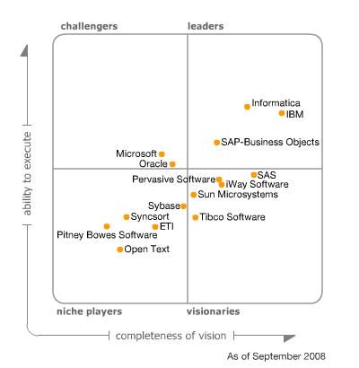
Commercial DI Tools
Source: Gartner
  Typical ETL tools support rule-based fusion
    IIS (IBM Information Server)
    SSIS (Microsoft’s SQL Server Integration Services)
    Etc.
See details in survey [Bleiholder and Naumann, 08]

Slide 87
Research DI Systems w. Awareness of Data Conflicts
System | Conflict types | Methodology | Strategy | Specification
Multibase | Schematic, data | Resolution | Choose, Avg, Min, Max, Sum, … | Manually, in query
Hermes | Schematic, data | Resolution | MostRecent, Choose | Manually, in mediator
Fusionplex | Schematic, object, data | Resolution | MostRecent, Min, Max, Avg, … | Manually, in query
HumMer | Schematic, object, data | Resolution | MostAbstract, Vote, Min, ChooseDepen… | Manually, in query
Ajax | Schematic, object, data | Resolution | Various | Manually, in workflow definition
TSIMMIS | Schematic, data | Avoidance | Choose | Manually, rules in mediator
SIMS/Ariadne | Schematic, data | Avoidance | Choose | Automatically
Infomix | Schematic, data | Avoidance | onlyConsistentValue | Automatically
Hippo | Schematic, object, data | Avoidance | onlyConsistentValue | Automatically
ConQuer | Schematic, object, data | Avoidance | onlyConsistentValue | Automatically
Rainbow | Schematic, object, data | Avoidance | onlyConsistentValue | Automatically
Pegasus | Schematic, data | Ignorance | Escalate | Manually
Nimble | Unknown | Ignorance | Escalate | Manually
Carnot | Schematic | Ignorance | Escalate | Automatically
InfoSleuth | Schematic | Ignorance | Escalate | Unknown
Potter’s Wheel | Schematic | Ignorance | Escalate | Manually, transformation
See details in survey [Bleiholder and Naumann, 08]

Slide 88
Other DI Systems
  Research DI systems
    Trio: including accuracy and lineage into data model
    Information Manifold
    Garlic
    Disco (Distributed Information Search Component)
    etc.
  Peer data management systems
    Orchestra: allowing multiple viewpoints
    Hyper: isolating the minimum amount of data to reach consistency
See details in survey [Bleiholder and Naumann, 08]

Slide 89
Outline
  Data fusion in the integration process
Foundations of data fusion
  Conflict resolution strategies and functions
  Conflict resolution operators
Advanced truth-discovery techniques
Data fusion in existing integration systems
Open problems

Slide 90
Open Problems
Accuracy of fusion
Efficiency of fusion
Usability of fusion
Interaction with other components of data integration

Slide 91
Accuracy of Fusion (I)
Challenge 1: Correlated values
  E.g.1, (firstName, lastName) from 4 sources
    S1: (Xin, Dong)
    S2: (Xin Luna, Dong)
    S3: (Dong, Xin)
    S4: (Dong, Xin Luna)
  E.g.2, (ISBN, authors) from 3 sources
    S1: (**1, Peter Loshin) (**2, Peter Loshin)
    S2: (**1, Pete Loshin)
    S3: (**1, Pete Loshin)
Current effort: ChooseDepending(val, col)
Directions: consider correlation at the attribute level and at the instance level.
Voting
(Dong, Dong)
Voting
(**1, Pete Loshin)
(**2, Peter Loshin)

Slide 92
Accuracy of Fusion (II)
Challenge 2: Different formating styles
  E.g., (ISBN, authors) from 4 sources
Skip middle-names
Src1
(**1, Pete Loshin)
(**2, Dennis Suhanovs)
(**3, Zhigang Xiang, Roy A Plastock)
(**4, Peter Aiken, David M Allen)…
Src2
(**1, Pete Loshin)
(**2, Dennis Suhanovs)
(**3, Zhigang Xiang, Roy Plastock)
(**4, Peter Aiken, David Allen)…
Src3
(**1, Pete Loshin)
(**2, Dennis Suhanovs)
(**3, Zhigang Xiang)
(**4, David Allen, Peter Aiken)…

Slide 93
Accuracy of Fusion (II)
Challenge 2: Different formating styles
  E.g., (ISBN, authors) from 4 sources
Current effort: consider value similarity
Directions: consider formatting styles used by each source.
Skip middle-names
Src1
(**1, Pete Loshin)
(**2, Dennis Suhanovs)
(**3, Zhigang Xiang, Roy A Plastock)
(**4, Peter Aiken, David M Allen)…
Src2
(**1, Pete Loshin)
(**2, Dennis Suhanovs)
(**3, Zhigang Xiang, Roy Plastock)
(**4, Peter Aiken, David Allen)…
Src3
(**1, Pete Loshin)
(**2, Dennis Suhanovs)
(**3, Zhigang Xiang)
(**4, David Allen, Peter Aiken)…
Src4
(**1, Pete Loshin)
(**2, Dennis uhanovs)
(**3, Zhigang Xiang)
(**4, Peter Aiken)…
Only first-authors

Slide 94





Accuracy of Fusion (III)
Exact
ness
Cove
rage
Fresh
ness
Accuracy
Challenge 3: Source profiling
  Current effort: accuracy (coverage, exactness, freshness)
  Data properties can be different for different categories of data
    Source A is a vertical source on restaurants
    Source B knows very well about NYC
  Data properties can evolve over time
    Source C improves its data over time
Directions: partition data into different portions and profile on each portion

Slide 95
Efficiency of Fusion (I)
Challenge 4: Incremental fusion
  When we have more data sources (e.g., Src4) or lose some data sources, shall we do data fusion from scratch?
  When more data come, shall we start from scratch?
Directions: maintain metadata or statistics, retain data lineage.
Src1
(**1, Pete Loshin)
(**2, Dennis Suhanovs)
(**3, Zhigang Xiang, Roy A Plastock)
(**4, Peter Aiken, David M Allen)…
Src2
(**1, Pete Loshin)
(**2, Dennis Suhanovs)
(**3, Zhigang Xiang, Roy Plastock)
(**4, Peter Aiken, David Allen)…
Src3
(**1, Pete Loshin)
(**2, Dennis Suhanovs)
(**3, Zhigang Xiang)
(**4, David Allen, Peter Aiken)…
Src4
(**1, Pete Loshin)
(**2, Dennis uhanovs)
(**3, Zhigang Xiang)
(**4, Peter Aiken)…

Slide 96
Efficiency of Fusion (II)
Challenge 5: Runtime fusion
  In some applications fusing data upfront is infeasible
Directions: maintain source profiles by sampling; emphasize efficiency.
Q
Mediated Schema
D1
D5
D2
D4
D3

Slide 97
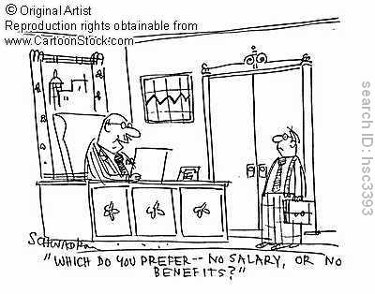
Usability of Fusion (I)
Challenge 6: Personalized fusion
  Express preference on certain sources
  Emphasize certain property; e.g., up-to-date vs. high coverage
  Use certain formats; e.g., full author list vs. only first author
Current effort:
  Function choose(src)
  Operator Prioritized-Merge
Directions:
  A language to express such user preferences
  Algorithms for efficient execution.

Slide 98

Usability of Fusion (II)
Challenge 7: User feedback
  Correct certain errors
Directions:
  Critical questions that can best improve the fusion results
  A way for users to browse source data and fusion results, and correct mistakes
  Quickly fixing errors and propagation to related items

Slide 99
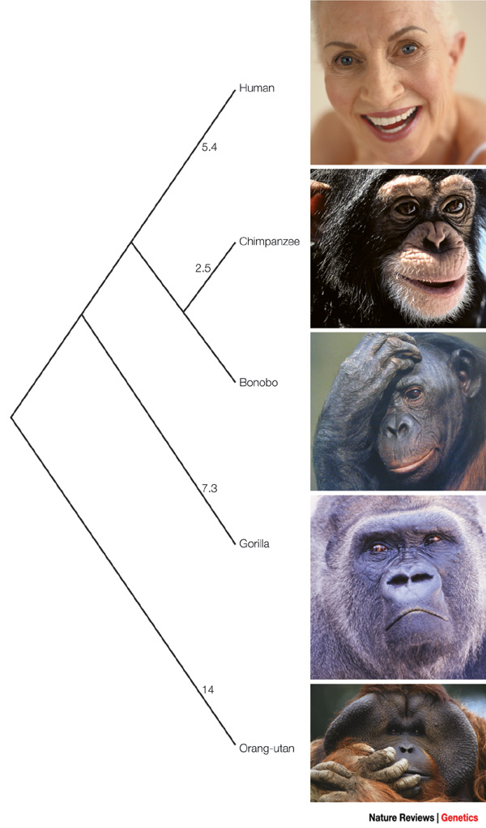
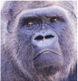
Usability of Fusion (III)
Challenge 8: Data Lineage
  Legal requirement
  Application requirement: e.g., fusing two customers
  HCI requirement: HOW did you merge the data? And WHY?
Directions:
  Effective representation of lineage information
  Explanation of merging decisions
  Effective way to find disappeared data items
  Reversibility and repeatability

Slide 100
Interaction with Other Components of DI (I)
Challenge 9: Fuse data w. different schemas
  E.g., Contact information from three sources
    S1: (pid = “1”, work phone = “1234”, home phone = “8765”, mobile phone = “4321”)
    S2: (pid = “1”, daytime phone = “1234”, evening phone = “4321”)
    S3: (pid = “1”, phone = “4321”)
Directions: Combine data fusion w. schema matching

Slide 101
Interaction with Other Components of DI (II)
Challenge 10: Distinguish wrong values from alternative representations of correct values
  E.g., A quiz

Slide 102
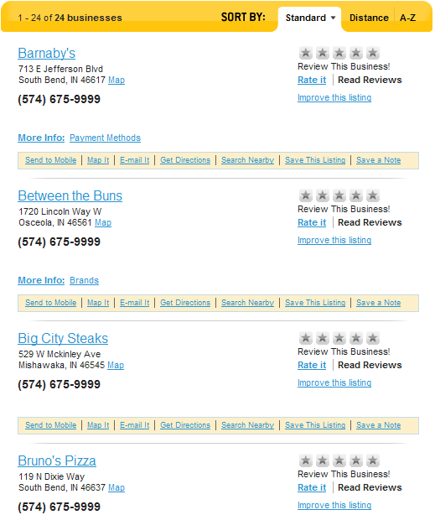
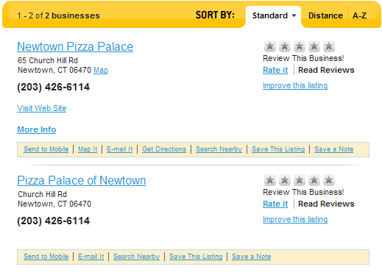
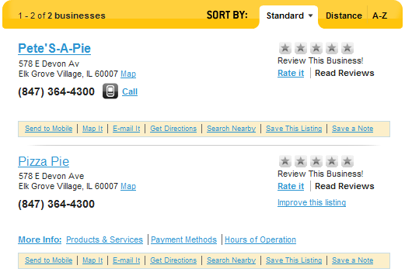
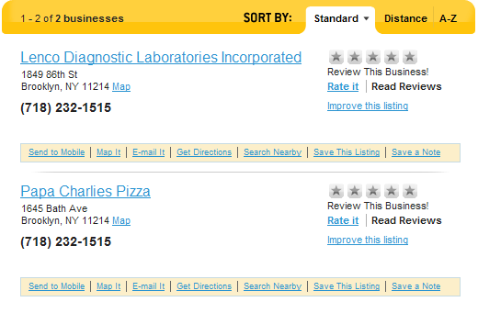
A Quiz
Which type of listing are they?
A: are the same business
B: are different businesses sharing the same phone#
C: are different businesses, only one with correct phone#
102

Slide 103
Interaction with Other Aspects of DI (II)
Challenge 10: Distinguish wrong values from alternative representations of correct values
  E.g., A quiz
Directions: Combine data fusion w. record linkage

Slide 104
Conclusions
Cleaned
Data
Foundations
  Strategies and functions
  Operators
Advanced techniques
  Consider accuracy
  Consider freshness
  Consider dependence
Open problems
  Accuracy
  Efficiency
  Usability
  Interaction with other components of DI
Data Fusion
Duplicate Detection
Schema Mapping
s
s
s
s
s
s

Slide 105
References
Survey
  [BN08] J. Bleiholder, F. Naumann. Data Fusion. ACM Computing Survey 2009.
Foundations of Fusion
  [BBB+05] A. Bilke, J. Bleiholder, C. Böhm, K. Draba, F. Naumann and M. Weis. Automatic Data Fusion with HumMer. VLDB demo 2005.
  [BDN07] Jens Bleiholder, Karsten Draba, and Felix Naumann. FuSem - Exploring Different Semantics of Data Fusion (demo) VLDB demo 2007.
  [BN05] J. Bleiholder, F. Naumann. Declarative Data Fusion - Syntax, Semantics, and Implementation. ADBIS 2005.
  [CS05] S. Cohen and Y. Sagiv. An incremental algorithm for computing ranked full disjunctions. PODS 2005.
  [DeM89] DeMichiel, L. G. Resolving database incompatibility: An approach to performing relational operations over mismatched domains. TKDE 1989.
  [FFM05] Ariel Fuxman, Elham Fazli, Renee J. Miller. ConQuer: Efficient Management of Inconsistent Databases. SIGMOD 2005.
  [GL94] C. A. Galindo-Legaria. Outerjoins as disjunctions. SIGMOD 1994.
  [GPZ01] S. Greco, L. Pontieri, and E. Zumpano. Integrating and managing conflicting data. International Andrei Ershov Memorial Conference on Perspectives of System Informatics, 2001.
  [LSS94] Lim, E.-P., Srivastava, J., and Shekhar, S. Resolving attribute incompatibility in database integration: An evidential reasoning approach. ICDE 1994.
  [RPZ04] J. Rao, H. Pirahesh, and C. Zuzarte. Canonical abstraction for outerjoin optimization. SIGMOD 2004.
  [RU96] A. Rajaraman and J. D. Ullman. Integrating information by outerjoins and full disjunctions. PODS1996.
  [SD05] Dan Suciu and Nilesh Dalvi. Probabilistic Databases. Tutorial at SIGMOD 2005.
  [YÖ99] L. L. Yan and M. T. Özsu. Conflict tolerant queries in AURORA. CoopIS 1999.

Slide 106
References (con’t)
Advanced truth-discovery techniques
  [ESD+09] L. Berti-Equille, A. D. Sarma, X. L. Dong, A. Marian, and D. Srivastava. Sailing the information ocean with awareness of currents: Discovery and application of source dependence. In CIDR, 2009.
  [BRR+05] A. Borodin, G. Roberts, J. Rosenthal, and P. Tsaparas. Link analysis ranking: algorithms, theory, and experiments. ACM TOIT, 5:231–297, 2005.
  [BP98] S. Brin and L. Page. The anatomy of a large-scale hypertextual Web search engine. Computer Networks and ISDN Systems, 30(1–7):107–117, 1998.
  [CG00] J. Cho and H. Garcia-Molina. Synchronizing a database to improve freshness. In SIGMOD, 2000.
  [Cha85] K. Chang. Combination of opinions: the expert problem and the group consensus problem. PhD thesis, University of California, Berkeley, 1985.
  [DBS09a] X. L. Dong, L. Berti-Equille, and D. Srivastava. Integrating conflicting data: the role of source dependence. VLDB, 2009.
  [DBS09b] X. L. Dong, L. Berti-Equille, and D. Srivastava. Truth discovery and copying detection in a dynamic world. In VLDB, 2009
  [French80] S. French. Updating of belief in the light of someone else’s opinion. Jour. of Roy. Statist. Soc. Ser. A, 143:43–48, 1980.
  [GLR05] H. Guo, P.- A. Larson, and R. Ramakrishnan. Caching with ’good enough’ currency, consistency, and completeness. In VLDB, 2005.
  [KSG03] S. Kamvar, M. Schlosser, and H. Garcia-Molina. The Eigentrust algorithm for reputation management in P2P networks. In Proc. of WWW, 2003.
  [Kle98] J. M. Kleinberg. Authoritative sources in a hyperlinked environment. In SODA, 1998.
  [Lin83] D. Lindley. Reconciliation of probability distributions. Oper. Res., 31:866–880, 1983.

Slide 107
References (con’t)
  [LR04] A. Labrinidis and N. Roussopoulos. Exploring the tradeoff between performance and data freshness in database-driven web servers. VLDB J., 13(3):240–255, 2004.
  [OW05] C. Olston and J. Widom. Efficient monitoring and querying of distributed, dynamic data via approximate replication. IEEE Data Eng. Bull., 28(1):11–18, 2005.
  [SL03] A. Singh and L. Liu. TrustMe: anonymous management of trust relationships in decentralized P2P systems. In IEEE Intl. Conf. on Peer-to-Peer Computing, 2003.
  [TB01] D. Theodoratos and M. Bouzeghoub. Data currency quality satisfaction in the design of a data warehouse. Int. J. ooperative Inf. Syst., 10(3):299–326, 2001.
  [WM07] M. Wu and A. Marian. Corroborating answers from multiple web sources. In Proc. of WebDB, 2007.
  [YHY07] X. Yin, J. Han, and P. S. Yu. Truth discovery with multiple conflicting information providers on the Web. In Proc. Of SIGKDD, 2007.

