Slide 1
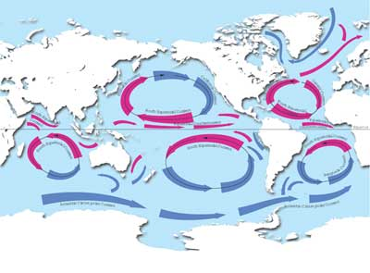
Sailing the Information Ocean with Awareness of Currents
Xin Luna Dong
Data Management Dept @AT&T
Joint work w. Divesh Srivastava (AT&T), Laure Berti (Universite de Rennes 1)
Other collaborators: Songtao Guo (YellowPages.com), Alon Halevy (Google),
Xuan Liu (National Univ. of Singapore), Amelie Marian (Rutgers),
Anish Das Sarma (Stanford)

Slide 2
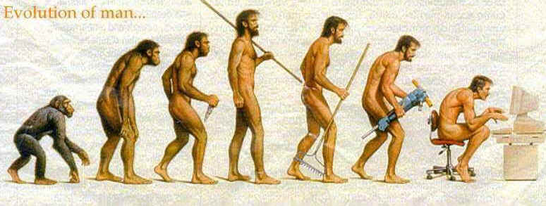
The WWW is Great

Slide 3
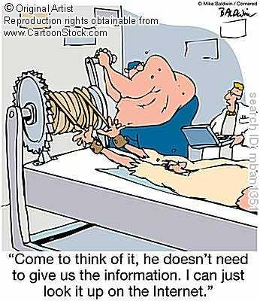
A Lot of Information on the Web!

Slide 4
Is the Web Trustable?
When I first saw 1968 on the web page, I thought, 'Wow, apparently, all those Brady Bunch books I've read listing 1969 as the show's first year were wrong’. But even though I obviously trusted the Internet, I was still kind of puzzled. So I checked other Brady Bunch fan sites, and all of them said 1969. After a while, it slowly began to sink in that the World Wide Web might be tainted with unreliable information.
—Caryn Wisniewski, a Pueblo, CO, legal secretary and diehard Brady Bunch fan [News from the Onion]

Slide 5
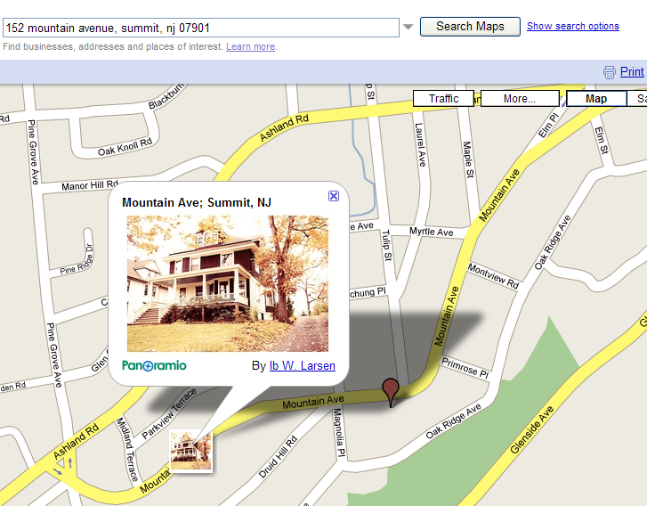

Information Can Be Erroneous (I)
7/2009

Slide 6
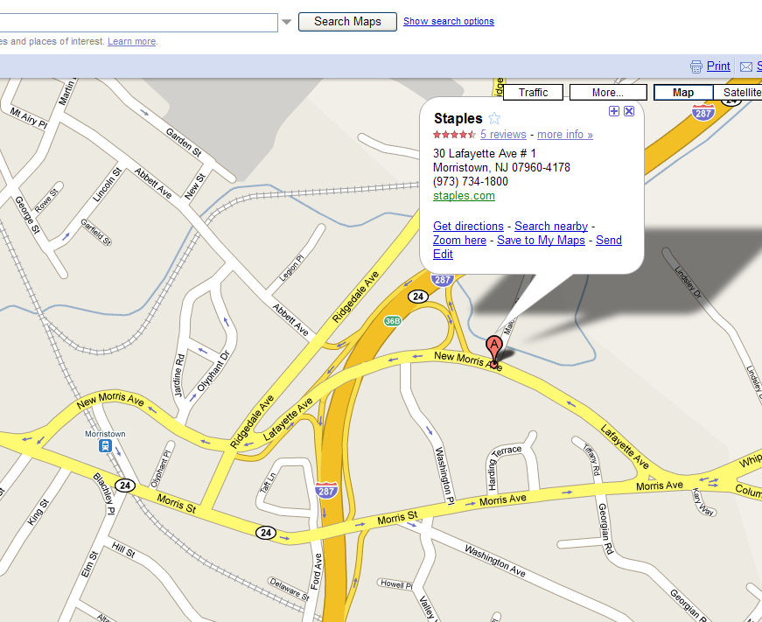

Information Can Be Erroneous (II)
7/2009

Slide 7
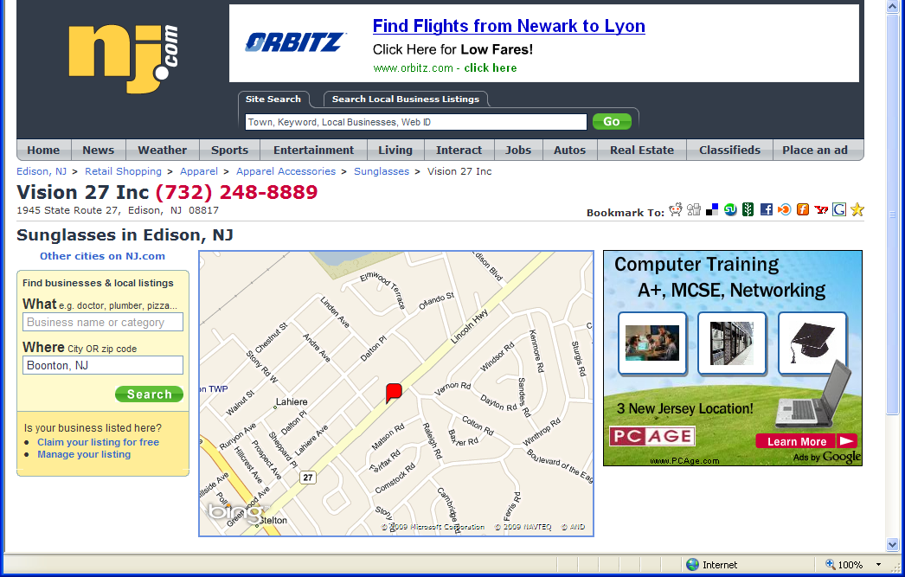
Information Can Be Out-Of-Date (I)
7/2009

Slide 8
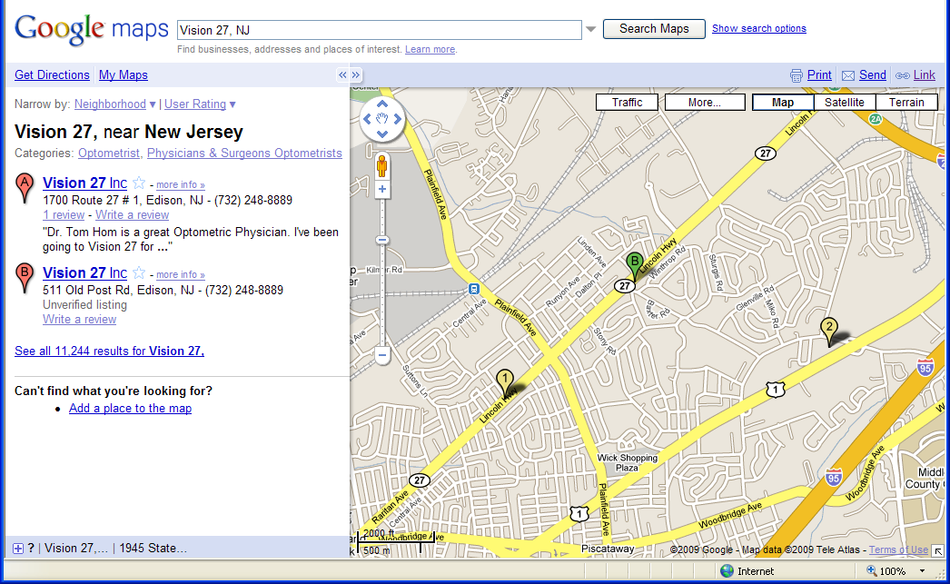
Information Can Be Out-Of-Date (I)
7/2009

Slide 9
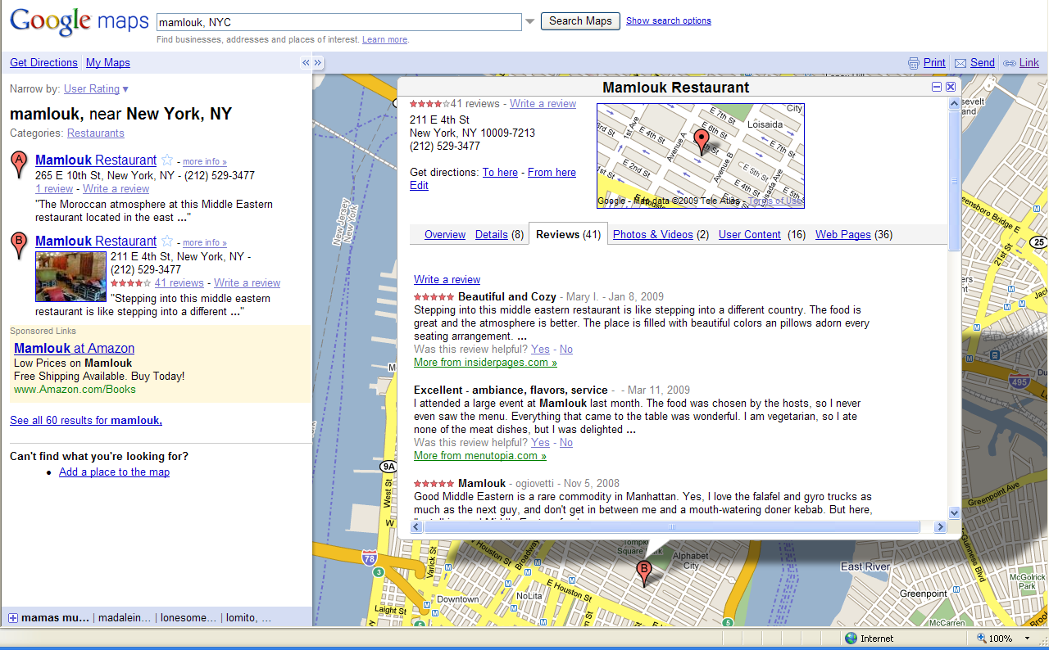
Information Can Be Out-Of-Date (II)
7/2009

Slide 10
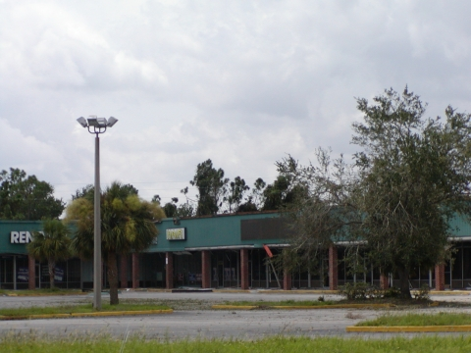
This Might Be What You See

Slide 11
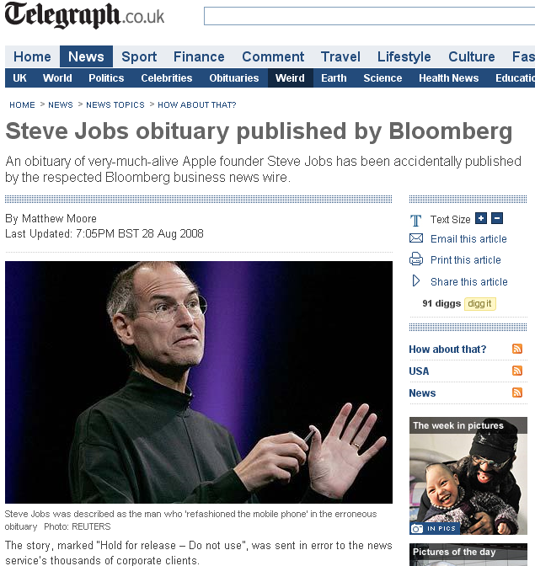
Sometimes, Information Can Be Ahead-Of-Time
The story, marked “Hold for release – Do not use”, was sent in error to the news service’s thousands of corporate clients.

Slide 12


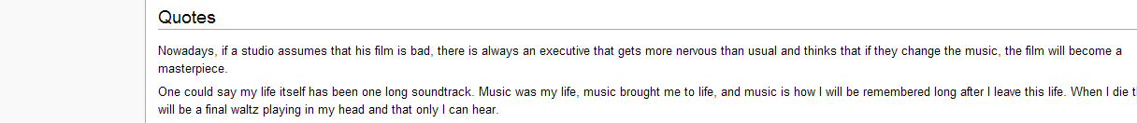
False Information Can Be Propagated (I)
Maurice Jarre (1924-2009) French Conductor and Composer
“One could say my life itself has been one long soundtrack. Music was my life, music brought me to life, and music is how I will be remembered long after I leave this life. When I die there will be a final waltz playing in my head and that only I can hear.”
2:29, 30 March 2009
Notes:
While I expected online blogs and maybe some smaller papers to use the quote, I did not think it would have a major impact. I was wrong. Quality newspapers in England, India, America and as far away as Australia had my words in their reports of Jarre’s death. I was shocked that highly respected newspapers would use material from Wikipedia without first sourcing and referencing it properly.

Slide 13
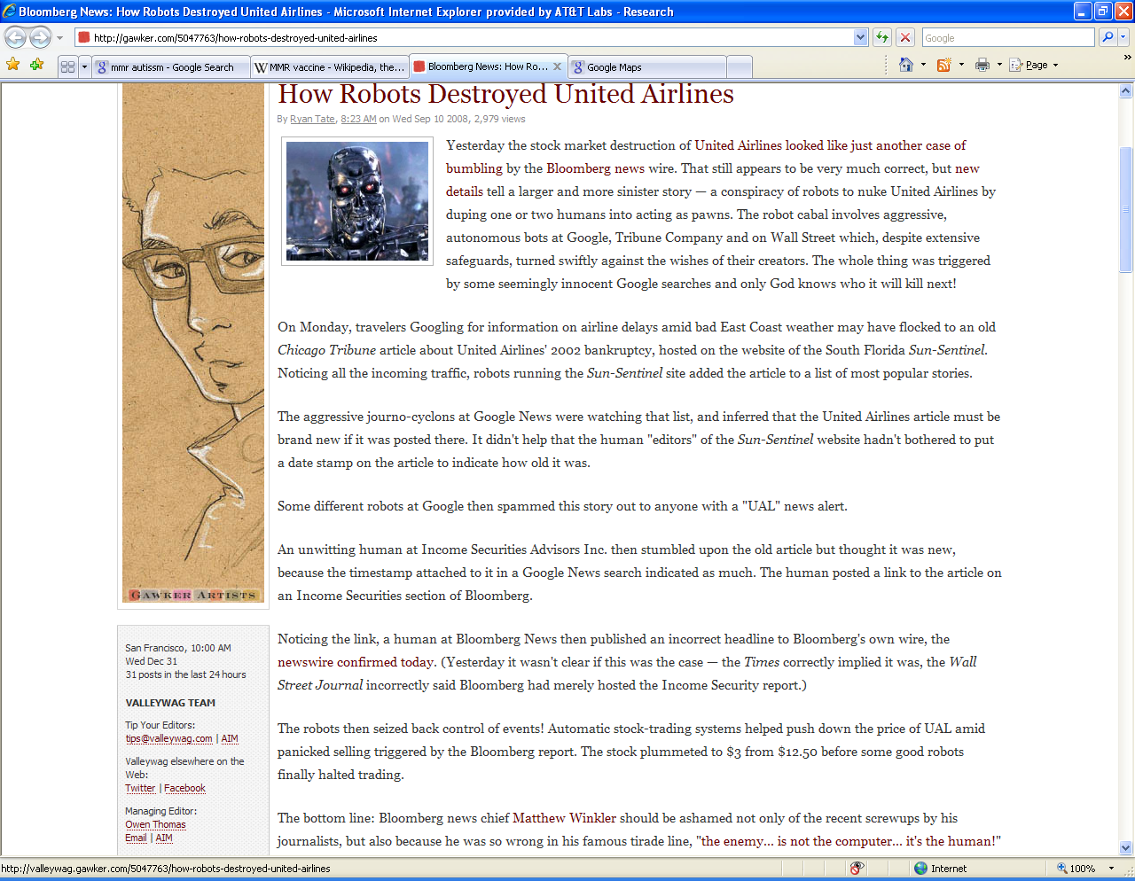
False Information Can Be Propagated (II)
UA’s bankruptcy
Chicago Tribune, 2002
Sun-Sentinel.com
Google News
Bloomberg.com
The UAL stock plummeted to $3 from $12.5

Slide 14
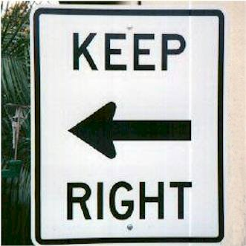
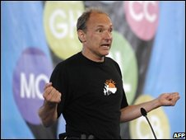
Wrong information can be just as bad as lack of information.
The Internet needs a way to help people separate rumor from real science.
– Tim Berners-Lee

Slide 15
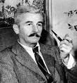
Why is the Problem Hard?
(A Well-Predicted Problem)
Facts and truth really don’t have much to do with each other.
— William Faulkner
 | S1 | S2 | S3
Stonebraker | MIT | Berkeley | MIT
Dewitt | MSR | MSR | UWisc
Bernstein | MSR | MSR | MSR
Carey | UCI | AT&T | BEA
Halevy | Google | Google | UW
Notes:
(American short-story Writer and Novelist, Nobel Prize for Literature in 1949, 1897-1962)

Slide 16
Why is the Problem Hard?
(A Well-Predicted Problem)
Facts and truth really don’t have much to do with each other.
— William Faulkner
 | S1 | S2 | S3
Stonebraker | MIT | Berkeley | MIT
Dewitt | MSR | MSR | UWisc
Bernstein | MSR | MSR | MSR
Carey | UCI | AT&T | BEA
Halevy | Google | Google | UW
Naïve voting works
Notes:
(American short-story Writer and Novelist, Nobel Prize for Literature in 1949, 1897-1962)

Slide 17
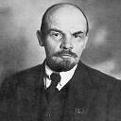
Why is the Problem Hard?
(A Well-Predicted Problem)
A lie told often enough becomes the truth. — Vladimir Lenin
众口铄金，积毁销骨
 | S1 | S2 | S3 | S4 | S5
Stonebraker | MIT | Berkeley | MIT | MIT | MS
Dewitt | MSR | MSR | UWisc | UWisc | UWisc
Bernstein | MSR | MSR | MSR | MSR | MSR
Carey | UCI | AT&T | BEA | BEA | BEA
Halevy | Google | Google | UW | UW | UW
Naïve voting works only if data sources are independent.
Notes:
(American short-story Writer and Novelist, Nobel Prize for Literature in 1949, 1897-1962)

Slide 18
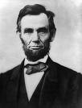
Our Goal: Truth Discovery w. Awareness of Dependence Between Sources
You can fool some of the people all the time, and all of the people some of the time, but you cannot fool all of the people all the time. – Abraham Lincoln
 | S1 | S2 | S3 | S4 | S5
Stonebraker | MIT | Berkeley | MIT | MIT | MS
Dewitt | MSR | MSR | UWisc | UWisc | UWisc
Bernstein | MSR | MSR | MSR | MSR | MSR
Carey | UCI | AT&T | BEA | BEA | BEA
Halevy | Google | Google | UW | UW | UW
Naïve voting works only if data sources are independent.

Slide 19
Challenges in Dependence Discovery
1. Sharing common data does not in itself imply copying.
2. With only a snapshot it is hard to decide which source is a copier.
 | S1 | S2 | S3 | S4 | S5
Stonebraker | MIT | Berkeley | MIT | MIT | MS
Dewitt | MSR | MSR | UWisc | UWisc | UWisc
Bernstein | MSR | MSR | MSR | MSR | MSR
Carey | UCI | AT&T | BEA | BEA | BEA
Halevy | Google | Google | UW | UW | UW
3. A copier can also provide or verify some data by itself, so it is inappropriate to ignore all of its data.

Slide 20
High-Level Intuitions for Dependence Detection
Intuition I: decide dependence (w/o direction)
  Let D1, D2 be data from two sources. D1 and D2 are dependent if
  Pr(D1, D2) <> Pr(D1) * Pr(D2).

Slide 21
Dependence?
Are Source 1 and Source 2 dependent?
Not necessarily
Source 1 on USA Presidents:
1st : George Washington
2nd : John Adams
3rd : Thomas Jefferson
4th : James Madison
…
41st : George H.W. Bush
42nd : William J. Clinton
43rd : George W. Bush
44th: Barack Obama
Source 2 on USA Presidents:
1st : George Washington
2nd : John Adams
3rd : Thomas Jefferson
4th : James Madison
…
41st : George H.W. Bush
42nd : William J. Clinton
43rd : George W. Bush
44th: Barack Obama
✓
✓
✓
✓
✓
✓
✓
✓

Slide 22
Dependence?
-- Common Errors
Are Source 1 and Source 2 dependent?
Very likely
Source 1 on USA Presidents:
1st : George Washington
2nd : Benjamin Franklin
3rd : Tom Jefferson
4th : Abraham Lincoln
…
41st : George W. Bush
42nd : Hillary Clinton
43rd : Mickey Mouse
44th: Barack Obama
Source 2 on USA Presidents:
1st : George Washington
2nd : Benjamin Franklin
3rd : Tom Jefferson
4th : Abraham Lincoln
…
41st : George W. Bush
42nd : Hillary Clinton
43rd : Mickey Mouse
44th: John McCain
✓
✗
✗
✗
✗
✗
✗

Slide 23
High-Level Intuitions for Dependence Detection
Intuition I: decide dependence (w/o direction)
  Let D1, D2 be data from two sources. D1 and D2 are dependent if
  Pr(D1, D2) <> Pr(D1) * Pr(D2).
Intuition II: decide copying direction
  Let F be a property function of the data; e.g., accuracy of data. D1 is likely to be dependent on D2 if
  |F(D1 ∩ D2)-F(D1-D2)| > |F(D1 ∩ D2)-F(D2-D1)| .

Slide 24
Dependence?
-- Different Accuracy
Are Source 1 and Source 2 dependent?
S1 more likely to be a copier
Source 1 on USA Presidents:
1st : George Washington
2nd : John Adams
3rd : Thomas Jefferson
4th : Abraham Lincoln
…
41st : George W. Bush
42nd : Hillary Clinton
43rd : George W. Bush
44th: John McCain
Source 2 on USA Presidents:
1st : George Washington
2nd : Benjamin Franklin
3rd : Tom Jefferson
4th : Abraham Lincoln
…
41st : George W. Bush
42nd : Hillary Clinton
43rd : Mickey Mouse
44th: John McCain
✓
✓
✗
✓
✗
✗
✗
✗
✓
✗
✗

Slide 25


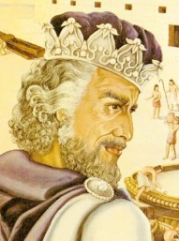
Outline
Motivation and intuitions for solution
For a static world [VLDB’09]
  Techniques
  Experimental Results
For a dynamic world [VLDB’09]
  Techniques
  Experimental Results
  Framework of the Solomon project and future work [CIDR’09]

Slide 26
Problem Definition
INPUT
  Objects: an aspect of a real-world entity
    E.g., director of a movie, author list of a book
    Each associated with one true value
  Sources: each providing values for a subset of objects
OUTPUT: the true value for each object

Slide 27
Source Dependence
Source dependence: two sources S and T deriving the same part of data directly or transitively from a common source (can be one of S or T).
  Independent source
  Copier
    copying part (or all) of data from other sources
    may verify or revise some of the copied values
    may add additional values
Assumptions
  Independent values
  Independent copying
  No loop copying

Slide 28
Models for a Static World
Core case
  Conditions
    Same source accuracy
    Uniform false-value distribution
    Categorical value
  Proposition: W. independent “good” sources, Naïve voting selects values with highest probability to be true.
Models
Consider value probabilities
in dependence analysis
AccuPR
Remove Cond 1
Remove Cond 3
Depen
Accu
Sim
Remove Cond 2
NonUni

Slide 29
Models for a Static World
Core case
  Conditions
    Same source accuracy
    Uniform false-value distribution
    Categorical value
  Proposition: W. independent “good” sources, Naïve voting selects values with highest probability to be true.
Models
Consider value probabilities
in dependence analysis
AccuPR
Remove Cond 1
Remove Cond 3
Depen
Accu
Sim
Remove Cond 2
NonUni

Slide 30
I. Dependence Detection
Intuition I. If two sources share a lot of true values, they are not necessarily dependent.
S1 ∩ S2
Different Values
Same Values
TRUE

Slide 31
I. Dependence Detection
Intuition I. If two sources share a lot of false values, they are more likely to be dependent.
S1 ∩ S2
Different Values
Same Values
TRUE
FALSE

Slide 32
Bayesian Analysis – Basic
S1 ∩ S2
Different Values O_{d}
Same Values
TRUE O_{t}
FALSE O_{f}
Observation: Ф
Goal: Pr(S1⊥S2| Ф), Pr(S1∼S2| Ф) (sum up to 1)
According to the Bayes Rule, we need to know
Pr(Ф|S1⊥S2), Pr(Ф|S1∼S2)
Key: computing Pr(Ф(O)|S1⊥S2), Pr(Ф(O)|S1∼S2)
for each O∈S1 ∩ S2

Slide 33
Bayesian Analysis – Probability Computation
S1 ∩ S2
Different Values O_{d}
Same Values
TRUE O_{t}
FALSE O_{f}
Pr | Independence | Dependence
O_{t}
O_{f}
O_{d}
<
<
>
ε-error rate; n-#wrong-values; c-copy rate

Slide 34
II. Finding the True Value
10 sources voting for an object
Count =2
Count =2.14
1
S₄
S₂
(1-.4*.8=.68)
1
2
.4
.4
S₅
S₆
1
S₁
S₃
1
.4
(1)
(.68²)
S₇
S₈
Count=1.44
.7
S₉
S₁₀
Order?
See paper
3

Slide 35
Models in This Paper
Core case conditions
    Same source accuracy
    Uniform false-value distribution
    Categorical value
Consider value probabilities
in dependence analysis
AccuPR
Remove Cond 1
Remove Cond 3
Depen
Accu
Sim
Remove Cond 2
NonUni

Slide 36
III. Considering Source Accuracy
Intuition II. S1 is more likely to copy from S2, if the accuracy of the common data is highly different from the accuracy of S1.
Pr | Independence | Dependence
O_{t}
O_{f}
O_{d}

Slide 37
III. Considering Source Accuracy
Intuition II. S1 is more likely to copy from S2, if the accuracy of the common data is highly different from the accuracy of S1.
Pr | Independence | S1 Copies S2 | S2 Copies S1
O_{t}
O_{f}
O_{d}
≠
≠

Slide 38
Source Accuracy
Source accuracy
Source trustworthy
Value confidence
Value probability
Consider dependence

Slide 39
IV. Combining Accuracy and Dependence
Step 2
Truth
Discovery
Source-accuracy
Computation
Dependence
Detection
Step 3
Step 1
Theorem: w/o accuracy, converges
Observation: w. accuracy, converges when #objs >> #srcs

Slide 40
The Motivating Example
 | S1 | S2 | S3 | S4 | S5
Stonebraker | MIT | Berkeley | MIT | MIT | MS
Dewitt | MSR | MSR | UWisc | UWisc | UWisc
Bernstein | MSR | MSR | MSR | MSR | MSR
Carey | UCI | AT&T | BEA | BEA | BEA
Halevy | Google | Google | UW | UW | UW
S₁
S₁
.14
.87
.2
S₂
.08
S₃
S₂
.2
.99
S₃
Rnd 2
.49
.99
.49
.49
.49
.49
S₄
.99
S₅
S₄
.49
S₅
S₁
Rnd 3
…
Rnd 11
S₂
.49
S₃
.49
.44
.55
.55
S₄
.44
S₅
Notes:
(American short-story Writer and Novelist, Nobel Prize for Literature in 1949, 1897-1962)

Slide 41
The Motivating Example
Accuracy | S1 | S2 | S3 | S4 | S5
Round 1 | .52 | .42 | .53 | .53 | .53
Round 2 | .63 | .46 | .55 | .55 | .55
Round 3 | .71 | .52 | .53 | .53 | .37
Round 4 | .79 | .57 | .48 | .48 | .31
… | … | … | … | … | …
Round 11 | .97 | .61 | .40 | .40 | .21
Value Confidence | Carey |  |  | Halevy
 | UCI | AT&T | BEA | Google | UW
Round 1 | 1.61 | 1.61 | 2.0 | 2.1 | 2.0
Round 2 | 1.68 | 1.3 | 2.12 | 2.74 | 2.12
Round 3 | 2.12 | 1.47 | 2.24 | 3.59 | 2.24
Round 4 | 2.51 | 1.68 | 2.14 | 4.01 | 2.14
… | … | … | … | … | …
Round 11 | 4.73 | 2.08 | 1.47 | 6.67 | 1.47
Notes:
(American short-story Writer and Novelist, Nobel Prize for Literature in 1949, 1897-1962)

Slide 42
Experimental Setup
Dataset: AbeBooks
  877 bookstores
  1263 CS books
  24364 listings, w. ISBN, author-list
  After pre-cleaning, each book on avg has 19 listings and 4 author lists (ranges from 1-23)
Golden standard: 100 random books
  Manually check author list from book cover
Measure: Precision=#(Corr author lists)/#(All lists)
Parameters: c=.8, ε=.2, n=100
  ranging the paras did not change the results much
WindowsXP, 64 2 GHz CPU, 960MB memory

Slide 43
Naïve Voting and Types of Errors
Naïve voting has precision .71
Error type | Num
Missing authors | 23
Additional authors | 4
Mis-ordering | 3
Mis-spelling | 2
Incomplete names | 2

Slide 44
Contributions of Various Components
Considering dependence improves the results most
Methods | Prec | #Rnds | Time(s)
Naïve | .71 | 1 | .2
Only value similarity | .74 | 1 | .2
Only source accuracy | .79 | 23 | 1.1
Only source dependence | .83 | 3 | 28.3
Depen+accu | .87 | 22 | 185.8
Depen+accu+sim | .89 | 18 | 197.5
Precision improves by 25.4% over Naïve
Reasonably fast

Slide 45
Discovered Dependence
2916 bookstore pairs provide data on at least the same 10 books; 508 pairs are likely to be dependent
Bookstore | #Copiers | #Books | Accu
Caiman | 17.5 | 1024 | .55
MildredsBooks | 14.5 | 123 | .88
COBU GmbH & Co. KG | 13.5 | 131 | .91
THESAINTBOOKSTORE | 13.5 | 321 | .84
Limelight Bookshop | 12 | 921 | .54
Revaluation Books | 12 | 1091 | .76
Players Quest | 11.5 | 212 | .82
AshleyJohnson | 11.5 | 77 | .79
Powell’s Books | 11 | 547 | .55
AlphaCraze.com | 10.5 | 157 | .85
Avg | 12.8 | 460 | .75
Among all bookstores, on avg each provides 28 books; conforming to the intuition that small bookstores are more likely to copy from large ones
Accuracy not very high; applying Naïve obtains precision of only .58

Slide 46
Computed Source Accuracy
46 bookstores provide data on more than 10 books in the golden standard
 | Avg accu | Avg diff
Sampled | .542 | -
Only Accuracy | .623 | .096
Depen+Accu | .614 | .087
Depen+Accu+Sim | .607 | .082
Considering dependence makes improvement
Effective in computation of source accuracy

Slide 47
Outline
Motivation and intuitions for solution
For a static world [VLDB’09]
  Techniques
  Experimental Results
For a dynamic world [VLDB’09]
  Techniques
  Experimental Results
  Framework of the Solomon project and future work [CIDR’09]

Slide 48
Challenges for a Dynamic World
 | S1 | S2 | S3 | S4 | S5
Stonebraker | MIT | UCB | MIT | MIT | MS
Dewitt | MSR | MSR | Wisc | Wisc | Wisc
Bernstein | MSR | MSR | MSR | MSR | MSR
Carey | UCI | AT&T | BEA | BEA | BEA
Halevy | Google | Google | UW | UW | UW

Slide 49
Challenges for a Dynamic World
 | S1 | S2 | S3 | S4 | S5
Stonebraker (Ѳ, UCB), (02, MIT) | (03, MIT) | (00, UCB) | (01, UCB) (06, MIT) | (05, MIT) | (03, UCB) (05, MS)
Dewitt (Ѳ, Wisc), (08, MSR) | (00, Wisc) (09, MSR) | (00, UW) (01, Wisc) (08, MSR) | (01, UW) (02, Wisc) | (05, Wisc) | (03, UW) (05, ⊥) (07, Wisc)
Bernstein (Ѳ, MSR) | (00, MSR) | (00, MSR) | (01, MSR) | (07, MSR) | (03, MSR)
Carey (Ѳ, Propell), (02, BEA), (08, UCI) | (04, BEA) (09, UCI) | (05, AT&T) | (06, BEA) | (07, BEA) | (07, BEA)
Halevy (Ѳ, UW), (05, Google) | (00, UW) (07, Google) | (00, Wisc) (02, UW) (05, Google) | (01, Wisc) (06, UW) | (05, UW) | (03, Wisc) (05, Google) (07, UW)
Out-of-date!
ERR!
Out-of-date!
Out-of-date!
ERR!
Out-of-date!
Out-of-date!
Out-of-date!
SLOW!
SLOW!
True values can evolve over time
Low-quality data can be caused by different reasons
Copying relationship can evolve over time as well
SLOW!

Slide 50
Challenges for a Dynamic World
 | S1 | S2 | S3 | S4 | S5
Stonebraker (Ѳ, UCB), (02, MIT) | (03, MIT) | (00, UCB) | (01, UCB) (06, MIT) | (05, MIT) | (03, UCB) (05, MS)
Dewitt (Ѳ, Wisc), (08, MSR) | (00, Wisc) (09, MSR) | (00, UW) (01, Wisc) (08, MSR) | (01, UW) (02, Wisc) | (05, Wisc) | (03, UW) (05, ⊥) (07, Wisc)
Bernstein (Ѳ, MSR) | (00, MSR) | (00, MSR) | (01, MSR) | (07, MSR) | (03, MSR)
Carey (Ѳ, Propell), (02, BEA), (08, UCI) | (04, BEA) (09, UCI) | (05, AT&T) | (06, BEA) | (07, BEA) | (07, BEA)
Halevy (Ѳ, UW), (05, Google) | (00, UW) (07, Google) | (00, Wisc) (02, UW) (05, Google) | (01, Wisc) (06, UW) | (05, UW) | (03, Wisc) (05, Google) (07, UW)
S₁
S₁
(06-now)
S₂
.49
S₃
S₂
(00-05)
S₃
.49
.44
.55
(05-now)
(03, 07)
.55
S₄
.44
S₅
S₄
S₅

Slide 51
Problem Definition
Problem Definition | Static World | Dynamic World
Objects | Each associated with a value; e.g., Google for Halevy | Each associated with a lifespan; e.g., (00, UW), (05, Google) for Halevy
Sources | Each can provide a value for an object; e.g., S1 providing Google | Each can have a list of updates for an object; e.g., S1’s updates for Halevy (00, UW), (07, Google)
OUTPUT | true value for each object | Life span: true value for each object at each time point Copying: pr of S1 is a copier of S2 and pr of S1 being actively copying at each time point

Slide 52
Contributions
Quality measures of data sources
Dependence detection (HMM model)
Lifespan discovery (Bayesian model)
Considering delayed publishing

Slide 53
I. Quality of Data Sources
Exact
ness
Cove
rage
Fresh
ness
Accuracy
Three orthogonal quality measures
CEF-measure
  Coverage: how many transitions are captured
  Exactness: how many transitions are not mis-captured
  Freshness: how quickly transitions are captured
Mis-capturable
Mis-capturable
Mis-capturable
Mis-capturable
Mis-capturable
Wisc
Capturable
Capturable
Capturable
MSR
Capturable
Dewitt
Ѳ(2000)
2008
UW
⊥
Wisc
S5
2003
2005
2007
Mis-captured
Mis-captured
Captured
Coverage = #Captured/#Capturable (e.g., ¼=.25)
Exactness= 1-#Mis-Captured/#Mis-Capturable (e.g., 1-2/5=.6)
Freshness(Δ)= #(Captured w. length<=Δ)/#Captured (e.g., F(0)=0, F(1)=0, F(2)=1/1 = 1…)

Slide 54
II. Copying Detection
Review of HMM model
II. Transition prs
Pr | S1 | … | Sn
S1 | .3 | … | .55
… | … | … | …
Sn | .6 | … | .2
I. Init prs
S1 | .4
… | …
Sn | .3
State_{t0}
State_{t1}
State_{t2}
Observation_{t0}
Observation_{t1}
Observation_{t2}
III. Observation prs
Pr | O1 | … | On
S1 | .9 | … | .05
… | … | … | …
Sn | .2 | … | .4
Forward-backward inference to decide pr of each state at each time
Baum-Welch for parameter learning

Slide 55
The Copying-Detection HMM Model
ft_{c}
1-f
(1-f)t_{c}
C1c (S1 as an active copier)
C1~c (S1 as an
idle copier)
(1-t_{i})/2
f
pr_{i}= α
(1-t_{c})t_{i}
pr_{i}= (1-α)/2
pr_{i}= 0
t_{i}
I (S1 and S2 independent)
(1-t_{c})(1-t_{i})
(1-t_{c})(1-t_{i})
(1-t_{c})t_{i}
pr_{i}= (1-α)/2
pr_{i}= 0
(1-t_{i})/2
C2c (S2 as an active copier)
f
C2~c (S2 as an
idle copier)
(1-f)t_{c}
ft_{c}
1-f
A period of copying starts from and ends with a real copying.
Parameters:
  α – Pr(init independence) ; f – Pr(a copier actively copying);
  t_{i} – Pr(remaining independent); t_{c} – Pr(remaining as a copier);

Slide 56
Observation Probability (I)
A huge number of possible observations, so we need an equation to compute probability
Intuition II. If S1 and S2 are dependent, S1 is likely to be a copier if its updates often follow S2’s
On the other hand, if S1’s updates often follow S2’s, S1 is not necessarily a copier of S2.

Slide 57
Observation Probability (II)
Intuition I. S1 and S2 are likely to be dependent if
  common mistakes
  overlapping updates are performed after the real values have already changed
  low coverage but highly overlapping updates in a close time frame
 | S1 | S2 | S3 | S4 | S5
Stonebraker (00, UCB), (02, MIT) | (03, MIT) | (00, UCB) | (01, UCB) (06, MIT) | (05, MIT) | (03, UCB) (05, MS)
Dewitt (00, Wisc), (08, MSR) | (00, Wisc) (09, MSR) | (00, UW) (01, Wisc) (08, MSR) | (01, UW) (02, Wisc) | (05, Wisc) | (03, UW) (05, ⊥) (07, Wisc)
Bernstein (00, MSR) | (00, MSR) | (00, MSR) | (01, MSR) | (07, MSR) | (03, MSR)
Carey (00, Propell), (02, BEA), (08, UCI) | (04, BEA) (09, UCI) | (05, AT&T) | (06, BEA) | (07, BEA) | (07, BEA)
Halevy (00, UW), (05, Google) | (00, UW) (07, Google) | (00, Wisc) (02, UW) (05, Google) | (01, Wisc) (06, UW) | (05, UW) | (03, Wisc) (05, Google) (07, UW)

Slide 58
Observation Probability (III)
S2’s updates since S1’s last “copying”
U_{~S1, S2}
V0
V0’
O(transition)
tr
tr'
U_{S1, S2}
(O,V)
U_{S1, ~S2}
S1’s updates
S1(update)
t
Pr | S1 not copying S2 | S1 copying S2
U_{S1,~S2} |  | P_{c} (U)
U_{S1,S2} |  | s+(1-s)P_{c}(U)
U_{~S1, S2} | 1-P(U) | (1-s)(1-P_{c}(U))
n – #(wrong values); s – selectivity
P_{c}(U) – similar to P(U) but use independent CEF-measure

Slide 59
III. Lifespan Discovery
Algorithm: for each object O
  (Details in the paper)
Decide the initial
value v₀
(Bayesian model)
Decide the next transition (t,v)
(Bayesian model)
Terminate when no more transition

Slide 60
Iterating Dependence Detection and Lifespan Discovery
Step 2
Lifespan
Discovery
CEF-measure
Computation
Dependence
Detection
Step 3
Step 1
Typically converges when #objs >> #srcs.

Slide 61
The Motivating Example
S₁
Copying probability bet S5 vs. S3
(06-now)
S₂
S₃
(00-05)
(05-now)
(03, 07)
S₄
S₅
 | 03 | 04 | 05 | 06 | 07 | 08 | 09
Copy (C1c) | 1 | .43 | .02 | .43 | 1 | .39 | .12
Idle (C1~c) | 0 | .51 | .89 | .51 | 0 | .35 | .52
Sum | 1 | .94 | .91 | .94 | 1 | .74 | .64
Notes:
(American short-story Writer and Novelist, Nobel Prize for Literature in 1949, 1897-1962)

Slide 62
The Motivating Example
Lifespan for Halevy and CEF-measure for S1 and S2
 | S1 | S2 | S3 | S4 | S5
Halevy (Ѳ, UW), (05, Google) | (00, UW) (07, Google) | (00, Wisc) (02, UW) (05, Google) | (01, Wisc) (06, UW) | (05, UW) | (03, Wisc) (05, Google) (07, UW)
Rnd | Halevy | C(S1) | E(S1) | F(S1,0) | F(S1,1) | C(S2) | E(S2) | F(S2,0) | F(S2,1)
0 |  | .99 | .95 | .1 | .2 | .99 | .95 | .1 | .2
1 | (Ѳ, Wisc) (2002, UW) (2003, Google) | .97 | .94 | .27 | .4 | .57 | .83 | .17 | .3
2 | (Ѳ, UW) (2002, Google) | .92 | .99 | .27 | .4 | .64 | .8 | .18 | .27
3 | (Ѳ, UW) (2005, Google) | .92 | .99 | .27 | .4 | .64 | .8 | .25 | .42
Notes:
(American short-story Writer and Novelist, Nobel Prize for Literature in 1949, 1897-1962)

Slide 63
Experimental Setup
Dataset: Manhattan restaurants
  Data crawled from 12 restaurant websites
  8 versions: weekly from 1/22/2009 to 3/12/2009
  5269 restaurants, 5231 appearing in the first crawling and 5251 in the last crawling
  467 restaurants deleted from some websites, 280 closed before 3/15/2009 (Golden standard)
Measure: Precision, Recall, F-measure
  G: really closed restaurants; R: detected closed restaurants
Parameters: s=.8, α=f=.5, t_{i}=t_{c}=.99, n=1 (open/close)
WindowsXP, 64 2 GHz CPU, 960MB memory

Slide 64
Contributions of Various Components
Naïve missed a lot of restaurants.
Applying rules is inadequate.
Method | Ever-existing | Closed |  |  | #Rnds | Time(s)
 | #Rest | Prec | Rec | F-msr
ALL | - | .60 | 1.0 | .75 | - | -
ALL2 | - | .94 | .34 | .50 | - | -
Naïve | 1192 | .70 | .93 | .80 | 1 | 158
CEF | 5068 | .83 | .88 | .85 | 7 | 637
CopyCEF | 5186 | .86 | .87 | .86 | 6 | 1408
Google | - | .84 | .19 | .30 | - | -
CEF and CopyCEF obtain High precision and recall
Google Map lists a lot of out-of-business restaurants

Slide 65
Computed CEF-Measure
Sources | Coverage | Exactness | Freshness | #Closed-rest
MenuPages | .66 | .98 | .85 | 35
TasteSpace | .44 | .97 | .30 | 123
NYMagazine | .43 | .99 | .52 | 69
NYTimes | .44 | .98 | .38 | 75
ActiveDiner | .44 | .96 | .93 | 81
TimeOut | .42 | .996 | .64 | 45
SavoryCities | .26 | .99 | .42 | 34
VillageVoice | .22 | .94 | .40 | 47
FoodBuzz | .18 | .93 | .36 | 65
NewYork | .14 | .92 | .43 | 34
OpenTable | .12 | .92 | .40 | 11
DiningGuide | .1 | .90 | .10 | 52
GoogleMaps | - | - | - | 228

Slide 66
Discovered Dependence
12 out of 66 pairs are likely to be dependent
TasteSpace
NYTimes
NewYork
FoodBuzz
TimeOut
OpenTable
VillageVoice
MenuPages
DiningGuide
ActiveDiner
NYMagazine
SavoryCities

Slide 67
Outline
Motivation and intuitions for solution
For a static world [VLDB’09]
  Techniques
  Experimental Results
For a dynamic world [VLDB’09]
  Techniques
  Experimental Results
  Framework of the Solomon project and future work [CIDR’09]

Slide 68
Data Integration Faces 3 Challenges
Data Conflicts
Instance Heterogeneity
Structure Heterogeneity

Slide 69
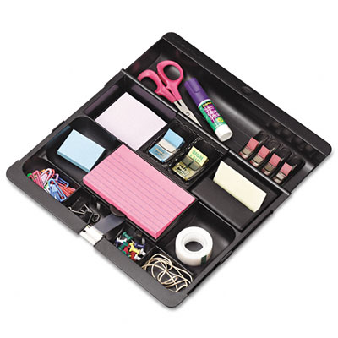
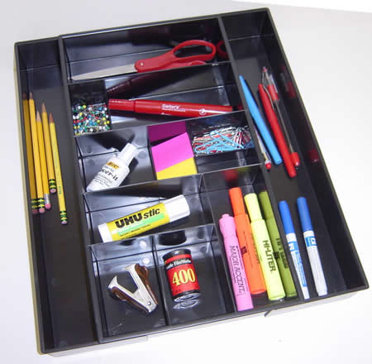
Data Integration Faces 3 Challenges
Data Conflicts
Instance Heterogeneity
Structure Heterogeneity

Slide 70
Data Integration Faces 3 Challenges
Scissors
Data Conflicts
Instance Heterogeneity
Structure Heterogeneity
Paper Scissors

Slide 71
Data Integration Faces 3 Challenges
Scissors
Data Conflicts
Instance Heterogeneity
Structure Heterogeneity
Glue

Slide 72
Existing Solutions Assume Independence of Data Sources
Data Conflicts
Instance Heterogeneity
Structure Heterogeneity
Assume INDEPENDENCE
of data sources
Data fusion
Truth discovery
String matching (edit distance, token-based, etc.)
Object matching (aka. record linkage, reference reconciliation, …)
Schema matching
Model management
Query answering using views
Information extraction

Slide 73
Source Dependence Adds A New Dimension to Data Integration
Data Conflicts
Instance Heterogeneity
Structure Heterogeneity
Query
Answering
Data
Fusion
Record
Linkage
Truth discovery
Integrating probabilistic data
Improve record linkage
Distinguish bet wrong values and alter representations
Query optimization
Improve schema matching
Source Recom-mendation
Recommend trustworthy , up-to-date, and independent sources

Slide 74

Research Agenda:
Solomon
Data Conflicts
Instance Heterogeneity
Structure Heterogeneity
Discovery
Discovery of copying for update history
Applications
Truth discovery
Record linkage
Source recommendation
…
Discovery of opinion influence in reviews
Discovery of copying for snapshots of data
Query optimization
…
Visualization of dependence relationship

Slide 75
Related Work
Data provenance [Buneman et al., PODS’08]
  Focus on effective presentation and retrieval
  Assume knowledge of provenance/lineage
Opinion pooling [Clemen&Winkler, 1985]
  Combine pr distributions from multiple experts
  Again, assume knowledge of dependence
Detect plagiarism of programs [Schleimer, Sigmod’03]
  Unstructured data

Slide 76
Thank you!

Slide 77
Bayesian Analysis – Properties
The probability of dependence increases in three cases.
S1 ∩ S2
Different Values
Same Values
TRUE
FALSE

Slide 78
II. Vote Count w. Probabilistic Dependence
S₂
S₂
S₂
S₂
S₁
S₃
S₁
S₃
S₁
S₃
S₁
S₃
S₂
S₂
Pr = (1-.4)^3=.216
Vote count = 3
Pr = .4^3=.096
Vote count
= 1+.2+.2^2=1.24
S₁
S₃
S₁
S₃
S₂
S₂
S₁
S₃
S₁
S₃
Pr = .4*.6^2=.144
Vote count = 1+1+.2
Pr = .4^2*.6=.096
Vote count = ?

Slide 79
II. Vote Count w. Probabilistic Dependence
S₂
S₂
S₂
S₂
S₁
S₃
S₁
S₃
S₁
S₃
S₁
S₃
Vote count
= 1+.2+.2=1.4
Pr = .32*.096=.03
Vote count
= 1+.2+.2=1.24
Pr = .32*.096=.03
Vote count
= 1+.2+.2=1.4
Pr = .32*.096=.03
Vote count
= 1+1+.2^2=2.04
Pr = .04*.096=.004

Slide 80
III. Algorithm
Challenge: inter-dependence between truth discovery and dependence detection
Solution: VOTE
  Iteratively compute dependence probability and decide true values
  Important to consider dependence from the beginning
Theorem: VOTE converges in at most 2ln₀ rounds.
  l - #obj; n₀ – max{#values for an object}

Slide 81
An Example
 | S1 | S2 | S3 | S4 | S5
Stonebraker | MIT | Berkeley | MIT | MIT | MS
Dewitt | MSR | MSR | UWisc | UWisc | UWisc
Bernstein | MSR | MSR | MSR | MSR | MSR
Carey | UCI | AT&T | BEA | BEA | BEA
Halevy | Google | Google | UW | UW | UW
S₁
.87
.2
S₂
.2
.99
S₃
.99
S₄
.99
S₅
 | Carey |  |  | Halevy
 | UCI | AT&T | BEA | Google | UW
Round 1 | 1 | 1 | 1.24 | 1.3 | 1.24
Notes:
(American short-story Writer and Novelist, Nobel Prize for Literature in 1949, 1897-1962)

Slide 82
An Example
 | S1 | S2 | S3 | S4 | S5
Stonebraker | MIT | Berkeley | MIT | MIT | MS
Dewitt | MSR | MSR | UWisc | UWisc | UWisc
Bernstein | MSR | MSR | MSR | MSR | MSR
Carey | UCI | AT&T | BEA | BEA | BEA
Halevy | Google | Google | UW | UW | UW
S₁
S₁
.87
.2
.18
S₂
S₃
S₂
.99
S₃
.2
.99
.99
.97
.99
S₄
.97
S₅
S₄
S₅
 | Carey |  |  | Halevy
 | UCI | AT&T | BEA | Google | UW
Round 1 | 1 | 1 | 1.24 | 1.3 | 1.24
Round 2 | 1 | 1 | 1.25 | 1.85 | 1.25
Notes:
(American short-story Writer and Novelist, Nobel Prize for Literature in 1949, 1897-1962)

