Slide 1
Big Data Integration
Xin Luna Dong (Google Inc.)
Divesh Srivastava (AT&T Labs-Research)

Slide 2
What is “Big Data Integration?”
Big data integration = Big data + data integration
Data integration: easy access to multiple data sources [DHI12]
  Virtual: mediated schema, query reformulation, link + fuse answers
  Warehouse: materialized data, easy querying, consistency issues
Big data: all about the V’s ☺
  Size: large volume of data, collected and analyzed at high velocity
  Complexity: huge variety of data, of questionable veracity
  Utility: data of considerable value

Slide 3
What is “Big Data Integration?”
Big data integration = Big data + data integration
Data integration: easy access to multiple data sources [DHI12]
  Virtual: mediated schema, query reformulation, link + fuse answers
  Warehouse: materialized data, easy querying, consistency issues
Big data in the context of data integration: still about the V’s ☺
  Size: large volume of sources, changing at high velocity
  Complexity: huge variety of sources, of questionable veracity
  Utility: sources of considerable value

Slide 4
Outline
Motivation
  Why do we need big data integration?
  How has “small” data integration been done?
  Challenges in big data integration
Schema alignment
Record linkage
Data fusion
Emerging topics

Slide 5

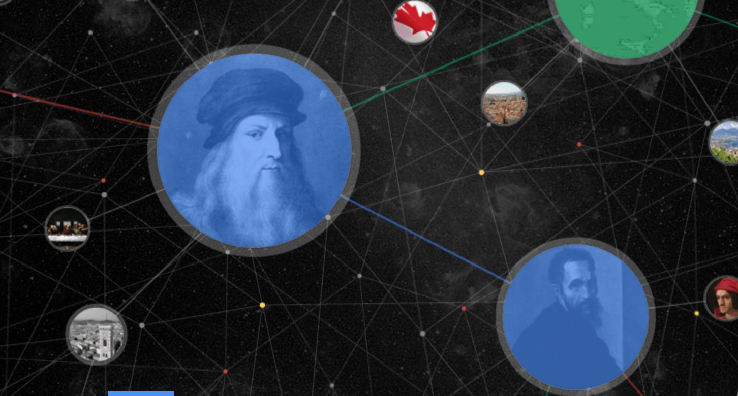



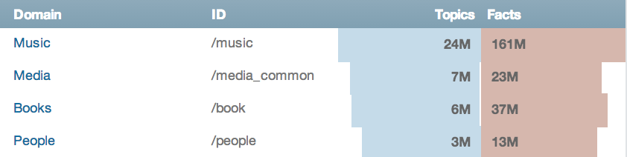
Why Do We Need “Big Data Integration?”
Building web-scale knowledge bases
MSR knowledge base
A Little Knowledge Goes a Long Way.
NELL
Google knowledge graph

Slide 6
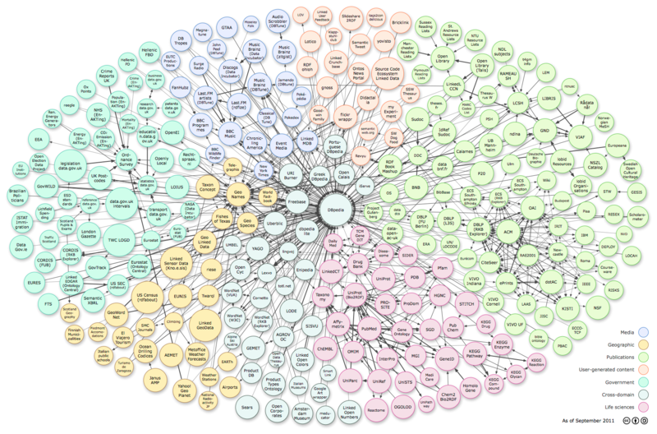
Why Do We Need “Big Data Integration?”
Reasoning over linked data

Slide 7
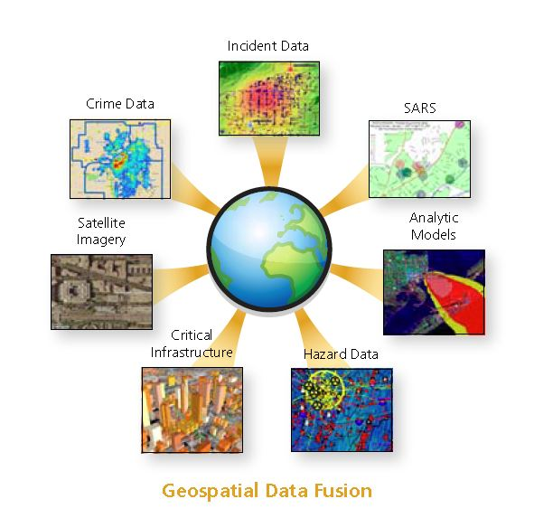
Why Do We Need “Big Data Integration?”
Geo-spatial data fusion
http://axiomamuse.wordpress.com/2011/04/18/

Slide 8
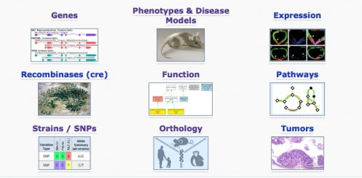
Why Do We Need “Big Data Integration?”
Scientific data analysis
http://scienceline.org/2012/01/from-index-cards-to-information-overload/

Slide 9
Outline
Motivation
  Why do we need big data integration?
  How has “small” data integration been done?
  Challenges in big data integration
Schema alignment
Record linkage
Data fusion
Emerging topics

Slide 10
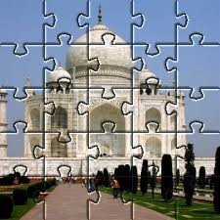


“Small” Data Integration: What Is It?
Data integration = solving lots of jigsaw puzzles
  Each jigsaw puzzle (e.g., Taj Mahal) is an integrated entity
  Each piece of a puzzle comes from some source
  Small data integration → solving small puzzles

Slide 11




“Small” Data Integration: How is it Done?
✓
“Small” data integration: alignment + linkage + fusion
  Schema alignment: mapping of structure (e.g., shape)
Schema Alignment
?
Record Linkage
Data Fusion

Slide 12
“Small” Data Integration: How is it Done?
X
“Small” data integration: alignment + linkage + fusion
  Schema alignment: mapping of structure (e.g., shape)
Schema Alignment
?
Record Linkage
Data Fusion

Slide 13




“Small” Data Integration: How is it Done?
“Small” data integration: alignment + linkage + fusion
  Record linkage: matching based on content (e.g., color, pattern)
Schema Alignment
Record Linkage
Data Fusion

Slide 14
“Small” Data Integration: How is it Done?
X
“Small” data integration: alignment + linkage + fusion
  Record linkage: matching based on content (e.g., color, pattern)
Schema Alignment
Record Linkage
Data Fusion

Slide 15
“Small” Data Integration: How is it Done?
✓
“Small” data integration: alignment + linkage + fusion
  Record linkage: matching based on content (e.g., color, pattern)
Schema Alignment
Record Linkage
Data Fusion

Slide 16
“Small” Data Integration: How is it Done?
“Small” data integration: alignment + linkage + fusion
  Data fusion: reconciliation of mismatching content (e.g., pattern)
Schema Alignment
Record Linkage
Data Fusion

Slide 17
“Small” Data Integration: How is it Done?
X
“Small” data integration: alignment + linkage + fusion
  Data fusion: reconciliation of mismatching content (e.g., pattern)
Schema Alignment
Record Linkage
Data Fusion

Slide 18
“Small” Data Integration: How is it Done?
✓
“Small” data integration: alignment + linkage + fusion
  Data fusion: reconciliation of mismatching content (e.g., pattern)
Schema Alignment
Record Linkage
Data Fusion

Slide 19
Outline
Motivation
  Why do we need big data integration?
  How has “small” data integration been done?
  Challenges in big data integration
Schema alignment
Record linkage
Data fusion
Emerging topics

Slide 20

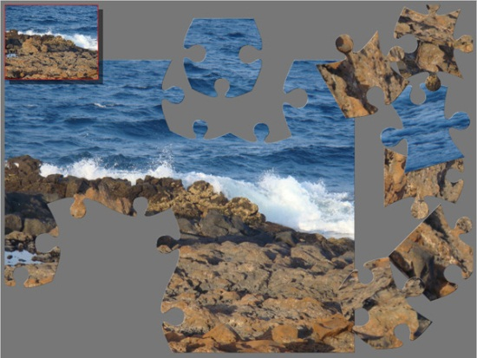
BDI: Why is it Challenging?
Data integration = solving lots of jigsaw puzzles
  Big data integration → big, messy puzzles
  E.g., missing, duplicate, damaged pieces

Slide 21
Case Study I: Domain Specific Data [DMP12]
Goal: analysis of domain-specific structured data across the Web
Questions addressed:
  How is the data about a given domain spread across the Web?
  How easy is it to discover entities, sources in a given domain?
  How much value do the tail entities in a given domain have?

Slide 22
Domain Specific Data: Spread
How many sources needed to build a complete DB for a domain?
[DMP12] looked at 9 domains with the following properties
  Access to large comprehensive databases of entities in the domain
  Entities have attributes that are (nearly) unique identifiers, e.g., ISBN for Books, phone number or homepage for Restaurants
Methodology of case study:
  Used the entire web cache of Yahoo! search engine
  Webpage has an entity if it contains an identifying attribute
  Aggregate the set of all entities found on each website (source)

Slide 23
Domain Specific Data: Spread
1-coverage
top-10: 93%
top-100: 100%
recall
strong aggregator source
# of sources

Slide 24
Domain Specific Data: Spread
5-coverage
top-5000: 90%
top-100K: 95%
recall
# of sources

Slide 25
Domain Specific Data: Spread
recall
1-coverage
top-100: 80%
top-10K: 95%
# of sources

Slide 26
Domain Specific Data: Spread
recall
5-coverage
top-100: 35%
top-10K: 65%
# of sources

Slide 27
Domain Specific Data: Spread
recall
All reviews are distinct
top-100: 65%
top-1000: 85%
# of sources

Slide 28
Domain Specific Data: Connectivity
How well are the sources “connected” in a given domain?
  Do you have to be a search engine to find domain-specific sources?
[DMP12] considered the entity-source graph for various domains
  Bipartite graph with entities and sources (websites) as nodes
  Edge between entity e and source s if some webpage in s contains e
Methodology of case study:
  Study graph properties, e.g., diameter and connected components

Slide 29
Domain Specific Data: Connectivity
Almost all entities are connected to each other
  Largest connected component has more than 99% of entities

Slide 30
Domain Specific Data: Connectivity
High redundancy and overlap enable use of bootstrapping
  Low diameter ensures that most sources can be found quickly

Slide 31
Domain Specific Data: Lessons Learned
Spread:
  Even for domains with strong aggregators, we need to go to the long tail of sources to build a reasonably complete database
  Especially true if we want k-coverage for boosting confidence
Connectivity:
  Sources in a domain are well-connected, with a high degree of content redundancy and overlap
  Remains true even when head aggregator sources are removed

Slide 32
Case Study II: Deep Web Quality [LDL+13]
Study on two domains
  Belief of clean data
  Poor quality data can have big impact
 | #Sources | Period | #Objects | #Local-attrs | #Global-attrs | Considered items
Stock | 55 | 7/2011 | 1000*20 | 333 | 153 | 16000*20
Flight | 38 | 12/2011 | 1200*31 | 43 | 15 | 7200*31

Slide 33
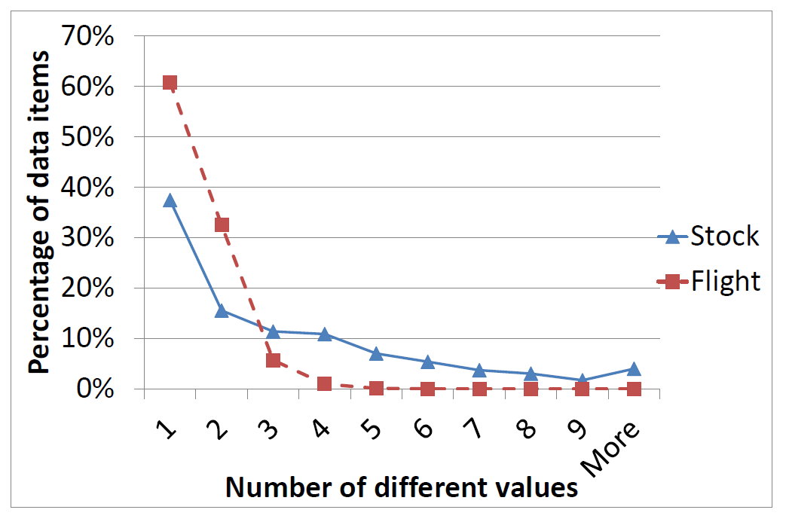
Deep Web Quality
Is the data consistent?
  Tolerance to 1% value difference

Slide 34
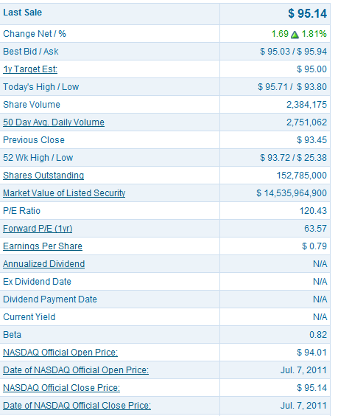
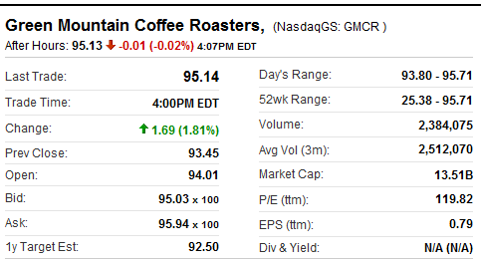
Deep Web Quality
Why such inconsistency?
  Semantic ambiguity
Nasdaq
Yahoo! Finance
Day’s Range: 93.80-95.71
52wk Range: 25.38-95.71
52 Wk: 25.38-93.72

Slide 35


Deep Web Quality
Why such inconsistency?
  Unit errors
76.82B
76,821,000

Slide 36
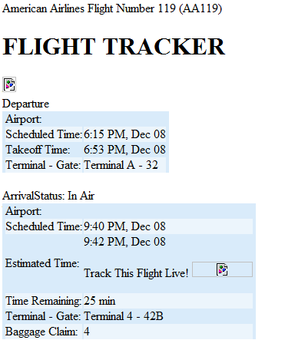
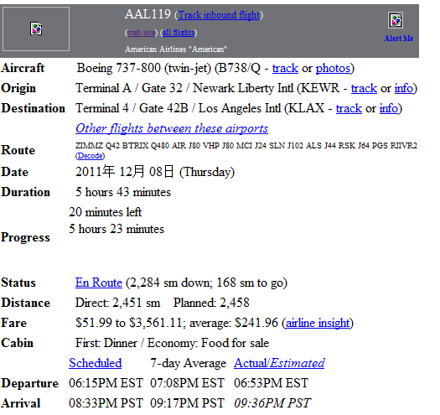
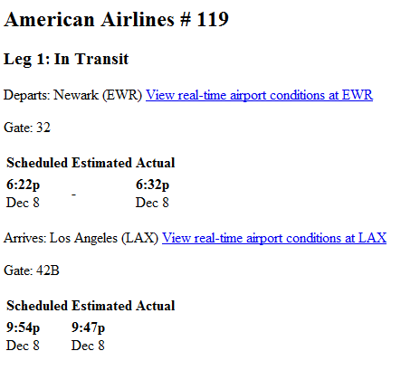
Deep Web Quality
Why such inconsistency?
  Pure errors
FlightView
FlightAware
Orbitz
6:15 PM
6:22 PM
6:15 PM
9:40 PM
9:54 PM
8:33 PM

Slide 37
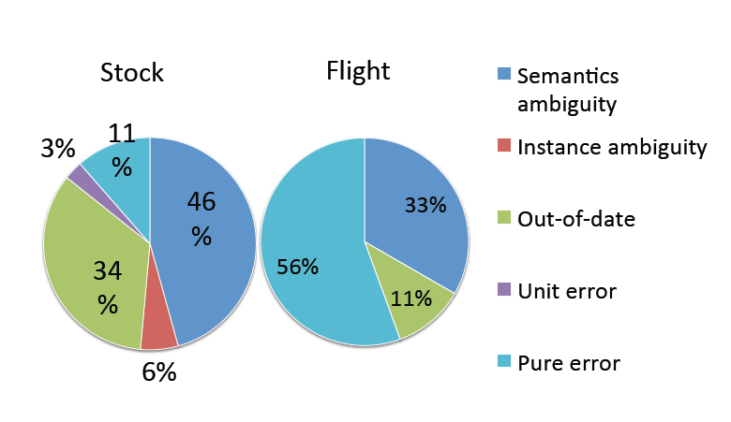
Deep Web Quality
Why such inconsistency?
  Random sample of 20 data items + 5 items with largest # of values

Slide 38

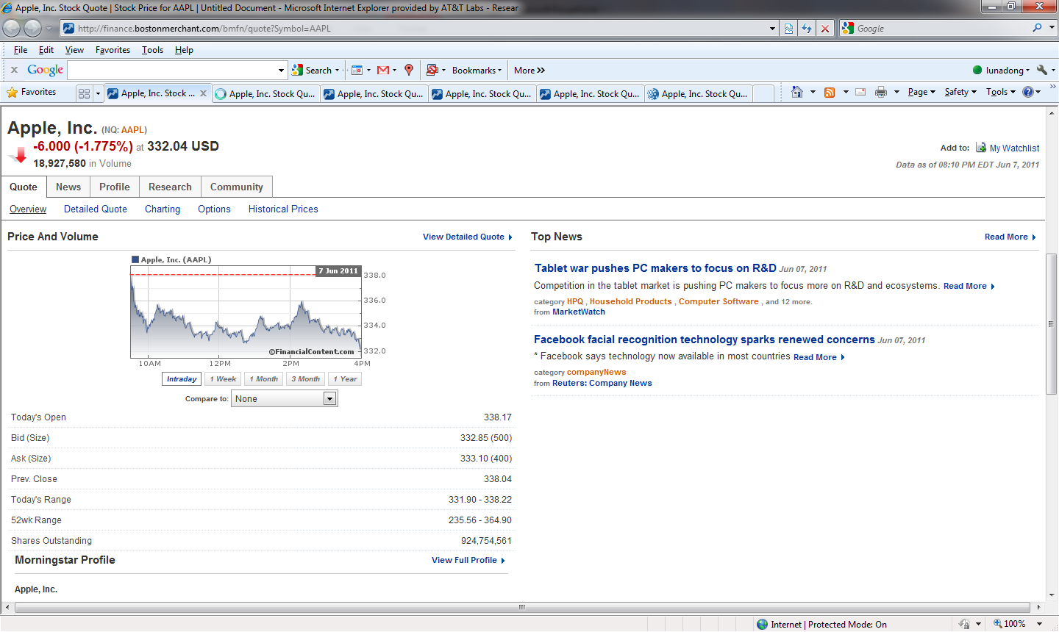
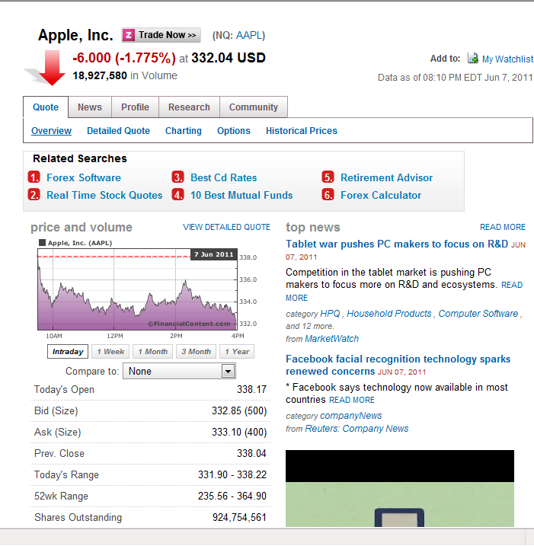
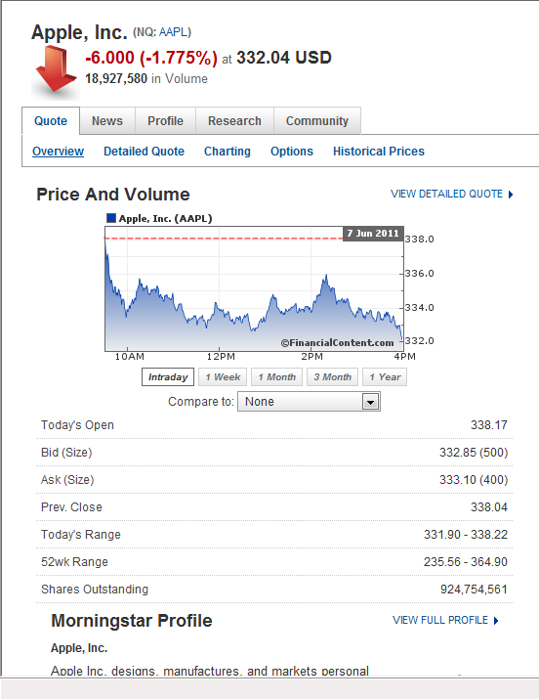
Deep Web Quality
Copying between sources?

Slide 39
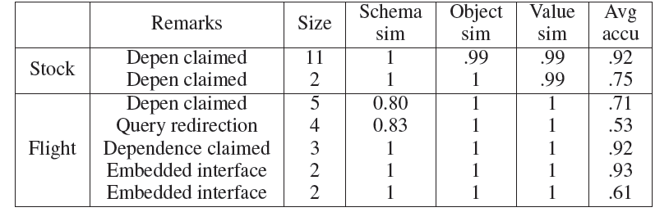
Deep Web Quality
Copying on erroneous data?

Slide 40
Deep Web Quality: Lessons Learned
Deep Web data has considerable inconsistency
  Even in domains where poor quality data can have big impact
  Semantics ambiguity, out of date data, unexplainable errors
Deep Web sources often copy from each other
  Copying can happen on erroneous data, spreading poor quality data

Slide 41
BDI: Why is it Challenging?
Number of structured sources: Volume
  Millions of websites with domain specific structured data [DMP12]
  154 million high quality relational tables on the web [CHW+08]
  10s of millions of high quality deep web sources [MKK+08]
  10s of millions of useful relational tables from web lists [EMH09]
Challenges:
  Difficult to do schema alignment
  Expensive to warehouse all the integrated data
  Infeasible to support virtual integration

Slide 42
BDI: Why is it Challenging?
Rate of change in structured sources: Velocity
  43,000 – 96,000 deep web sources (with HTML forms) [B01]
  450,000 databases, 1.25M query interfaces on the web [CHZ05]
  10s of millions of high quality deep web sources [MKK+08]
  Many sources provide rapidly changing data, e.g., stock prices
Challenges:
  Difficult to understand evolution of semantics
  Extremely expensive to warehouse data history
  Infeasible to capture rapid data changes in a timely fashion

Slide 43
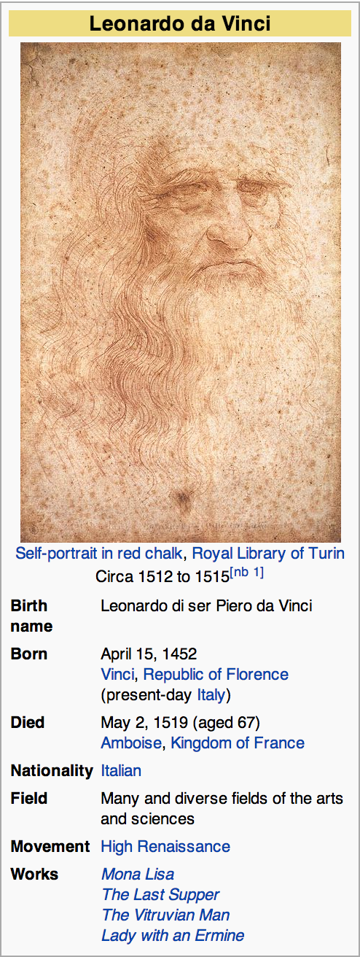
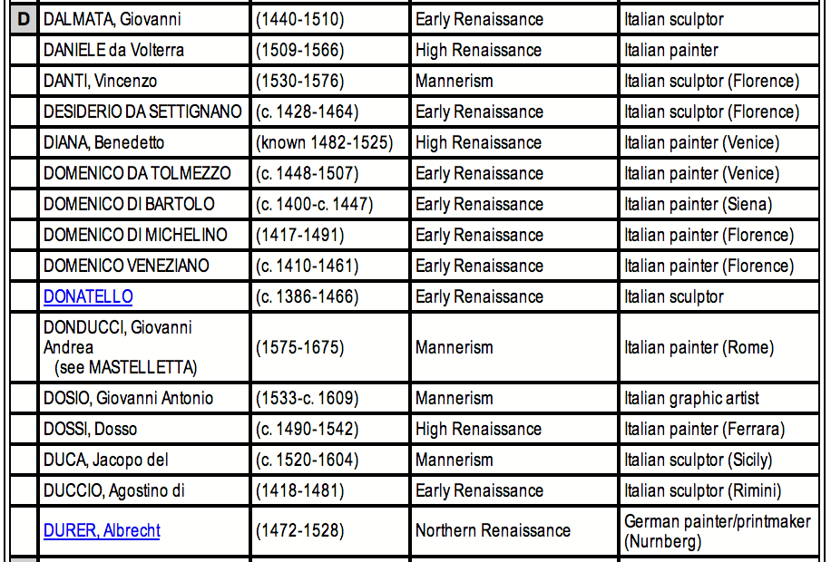
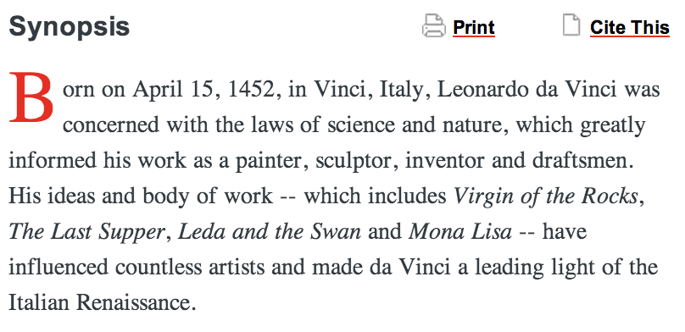
BDI: Why is it Challenging?
Representation differences among sources: Variety
Free-text extractors

Slide 44
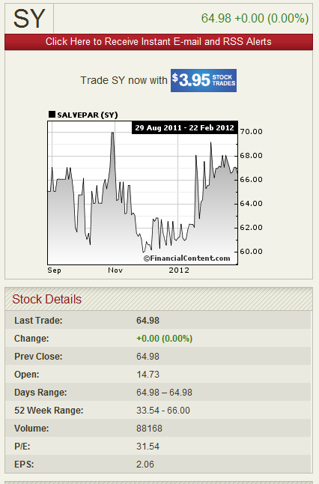
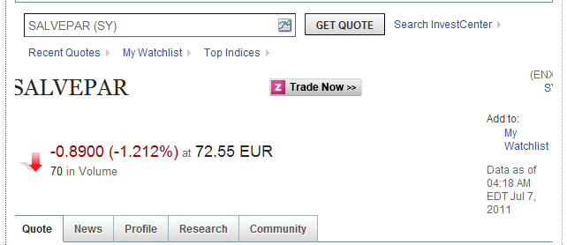
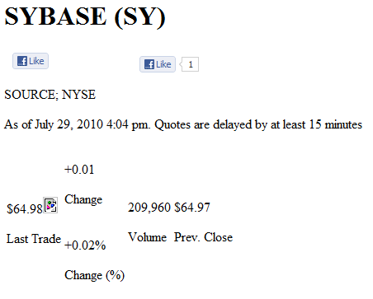
BDI: Why is it Challenging?
Poor data quality of deep web sources [LDL+13]: Veracity

Slide 45
Outline
Motivation
Schema alignment
  Overview
  Techniques for big data
Record linkage
Data fusion
Emerging topics

Slide 46
Schema Alignment
✓
Matching based on structure (e.g., shape)
?

Slide 47
Schema Alignment
X
Matching based on structure (e.g., shape)
?

Slide 48
Schema Alignment: Three Steps [BBR11]
Schema alignment: mediated schema + matching + mapping
  Enables linkage, fusion to be semantically meaningful
S1 | (name, hPhone, hAddr, oPhone, oAddr)
S2 | (name, phone, addr, email)
S3 | a: (id, name); b: (id, resPh, workPh)
S4 | (name, pPh, pAddr)
S5 | (name, wPh, wAddr)
Mediated Schema
Attribute Matching
Schema Mapping

Slide 49
Schema Alignment: Three Steps
Schema alignment: mediated schema + matching + mapping
  Enables domain specific modeling
S1 | (name, hPhone, hAddr, oPhone, oAddr)
S2 | (name, phone, addr, email)
S3 | a: (id, name); b: (id, resPh, workPh)
S4 | (name, pPh, pAddr)
S5 | (name, wPh, wAddr)
S1 | (name, hPhone, hAddr, oPhone, oAddr)
S2 | (name, phone, addr, email)
S3 | a: (id, name); b: (id, resPh, workPh)
S4 | (name, pPh, pAddr)
S5 | (name, wPh, wAddr)
MS | (n, pP, pA, wP, wA)
Mediated Schema
Attribute Matching
Schema Mapping

Slide 50
Schema Alignment: Three Steps
Schema alignment: mediated schema + matching + mapping
  Identifies correspondences between schema attributes
S1 | (name, hPhone, hAddr, oPhone, oAddr)
S2 | (name, phone, addr, email)
S3 | a: (id, name); b: (id, resPh, workPh)
S4 | (name, pPh, pAddr)
S5 | (name, wPh, wAddr)
MS | (n, pP, pA, wP, wA)
Mediated Schema
Attribute Matching
MSAM | MS.n: S1.name, S2.name, S3a.name, … MS.pP: S1.hPhone, S3b.resPh, S4.pPh MS.pA: S1.hAddr, S4.pAddr MS.wP: S1.oPhone, S2.phone, … MS.wA: S1.oAddr, S2.addr, S5.wAddr
Schema Mapping

Slide 51
Schema Alignment: Three Steps
Schema alignment: mediated schema + matching + mapping
  Specifies transformation between records in different schemas
S1 | (name, hPhone, hAddr, oPhone, oAddr)
S2 | (name, phone, addr, email)
S3 | a: (id, name); b: (id, resPh, workPh)
S4 | (name, pPh, pAddr)
S5 | (name, wPh, wAddr)
MS | (n, pP, pA, wP, wA)
Mediated Schema
Attribute Matching
MSSM (GAV) | MS(n, pP, pA, wP, wA) :- S1(n, pP, pA, wP, wA) MS(n, _, _, wP, wA) :- S2(n, wP, wA, e) MS(n, pP, _, wP, _) :- S3a(i, n), S3b(i, pP, wP) MS(n, pP, pA, _, _) :- S4(n, pP, pA) MS(n, _, _, wP, wA) :- S5(n, wP, wA)
Schema Mapping

Slide 52
Outline
Motivation
Schema alignment
  Overview
  Techniques for big data
Record linkage
Data fusion
Emerging topics

Slide 53
BDI: Schema Alignment
Volume, Variety
  Integrating deep web query interfaces [WYD+04, CHZ05]
  Crawl, index deep web data [MKK+08]
  Extract structured data from web tables [CHW+08, LSC10, PS12, DFG+12] and web lists [GS09, EMH09]
  Dataspace systems [FHM05, HFM06, DHY07]
  Keyword search based data integration [TJM+08]
Velocity
  Keyword search-based dynamic data integration [TIP10]

Slide 54
Space of Strategies
Now: keyword search over all data sources
  Keywords used to query, integrate sources [CHW+08, TJM+08]
Now and soon: automatic lightweight integration
  Model uncertainty: probabilistic schema, mappings [DDH09, DHY07]
  Cluster sources, enable domain specific integration [CHZ05]
Tomorrow: full-fledged semantic data integration across domains

Slide 55
Space of Strategies
Full semantic integration
Now Soon Tomorrow
Availability of Integration Results
Domain Specific Integration
Probabilistic Integration
Keyword Search
Low Medium High
Level of Semantic Integration

Slide 56
Dataspace Approach [FHM05, HFM06]
Motivation: SDI approach (as-is) is infeasible for BDI
  Volume, variety of sources → unacceptable up-front modeling cost
  Velocity of sources → expensive to maintain integration results
Key insight: pay-as-you-go approach may be feasible
  Start with simple, universally useful service
  Iteratively add complexity when and where needed [JFH08]
Approach has worked for RDBMS, Web, Hadoop …

Slide 57
Bootstrapping DI Systems [DDH08]
Thesis: completely automated data integration is feasible, but …
  Need to model uncertainty about semantics of attributes in sources
Automatically create a mediated schema from a set of sources
  Uncertainty → probabilistic mediated schemas
  P-mediated schemas offer benefits in modeling uncertainty
Automatically create mappings from sources to mediated schema
  Probabilistic mappings use weighted attribute correspondences

Slide 58
Probabilistic Mediated Schemas [DDH08]
Mediated schemas: automatically created by inspecting sources
  Clustering of source attributes
  Volume, variety of sources → uncertainty in accuracy of clustering
S1
S4
name hPhone hAddr oPhone oAddr name pPh pAddr

Slide 59
Probabilistic Mediated Schemas [DDH08]
Example P-mediated schema MS
  M1({name}, {hPhone, pPh}, {oPhone}, {hAddr, pAddr}, {oAddr})
  M2({name}, {hPhone}, {pPh, oPhone}, {hAddr}, {pAddr, oAddr})
  M3({name}, {hPhone, pPh}, {oPhone}, {hAddr}, {pAddr}, {oAddr})
  M4({name}, {hPhone}, {pPh, oPhone}, {hAddr}, {pAddr}, {oAddr})
  MS = {(M1, 0.6), (M2, 0.4)}
S1
S4
name hPhone hAddr oPhone oAddr name pPh pAddr

Slide 60
Probabilistic Mappings [DHY07, DDH08]
Mapping between P-mediated schema and a source schema
Example mappings between M1 and S1
  G1({M1.n, name}, {M1.phP, hPhone}, {M1.phA, hAddr}, …)
  G2({M1.n, name}, {M1.phP, oPhone}, {M1.phA, oAddr}, …)
  G = {(G1, 0.6), (G2, 0.4)}
S1
S4
name hPhone hAddr oPhone oAddr name pPh pAddr

Slide 61
Probabilistic Mappings
Mapping between P-mediated schema and a source schema
Answering queries on P-mediated schema based on P-mappings
  By table semantics: one mapping for all tuples in a table
  By tuple semantics: different mappings are okay in a table
S1
S4
name hPhone hAddr oPhone oAddr name pPh pAddr

Slide 62
Probabilistic Mappings: By Table Semantics
Consider query Q1: SELECT name, pPh, pAddr FROM MS
Result of Q1, under by table semantics, in a possible world
  G1({M1.n, name}, {M1.phP, hPhone}, {M1.phA, hAddr}, …)
S1 | name | hPhone | hAddr | oPhone | oAddr
 | Ken | 111-1111 | New York | 222-2222 | Summit
 | Barbie | 333-3333 | Summit | 444-4444 | New York
Q1R (Prob = 0.60) | name | pPh | pAddr | Map
 | Ken | 111-1111 | New York | G1
 | Barbie | 333-3333 | Summit | G1

Slide 63
Probabilistic Mappings: By Table Semantics
Consider query Q1: SELECT name, pPh, pAddr FROM MS
Result of Q1, under by table semantics, in a possible world
  G2({M1.n, name}, {M1.phP, oPhone}, {M1.phA, oAddr}, …)
S1 | name | hPhone | hAddr | oPhone | oAddr
 | Ken | 111-1111 | New York | 222-2222 | Summit
 | Barbie | 333-3333 | Summit | 444-4444 | New York
Q1R (Prob = 0.40) | name | pPh | pAddr | Map
 | Ken | 222-2222 | Summit | G2
 | Barbie | 444-4444 | New York | G2

Slide 64
Probabilistic Mappings: By Table Semantics
Now consider query Q2: SELECT pAddr FROM MS
Result of Q2, under by table semantics, across all possible worlds
S1 | name | hPhone | hAddr | oPhone | oAddr
 | Ken | 111-1111 | New York | 222-2222 | Summit
 | Barbie | 333-3333 | Summit | 444-4444 | New York
Q2R | pAddr | Prob
 | Summit | 1.0
 | New York | 1.0

Slide 65
Probabilistic Mappings: By Tuple Semantics
Consider query Q1: SELECT name, pPh, pAddr FROM MS
Result of Q1, under by tuple semantics, in a possible world
  G1({M1.n, name}, {M1.phP, hPhone}, {M1.phA, hAddr}, …)
  G2({M1.n, name}, {M1.phP, oPhone}, {M1.phA, oAddr}, …)
S1 | name | hPhone | hAddr | oPhone | oAddr
 | Ken | 111-1111 | New York | 222-2222 | Summit
 | Barbie | 333-3333 | Summit | 444-4444 | New York
Q1R (Prob = 0.36) | name | pPh | pAddr | Map
 | Ken | 111-1111 | New York | G1
 | Barbie | 333-3333 | Summit | G1

Slide 66
Probabilistic Mappings: By Tuple Semantics
Consider query Q1: SELECT name, pPh, pAddr FROM MS
Result of Q1, under by tuple semantics, in a possible world
  G1({M1.n, name}, {M1.phP, hPhone}, {M1.phA, hAddr}, …)
  G2({M1.n, name}, {M1.phP, oPhone}, {M1.phA, oAddr}, …)
S1 | name | hPhone | hAddr | oPhone | oAddr
 | Ken | 111-1111 | New York | 222-2222 | Summit
 | Barbie | 333-3333 | Summit | 444-4444 | New York
Q1R (Prob = 0.16) | name | pPh | pAddr | Map
 | Ken | 222-2222 | Summit | G2
 | Barbie | 444-4444 | New York | G2

Slide 67
Probabilistic Mappings: By Tuple Semantics
Consider query Q1: SELECT name, pPh, pAddr FROM MS
Result of Q1, under by tuple semantics, in a possible world
  G1({M1.n, name}, {M1.phP, hPhone}, {M1.phA, hAddr}, …)
  G2({M1.n, name}, {M1.phP, oPhone}, {M1.phA, oAddr}, …)
S1 | name | hPhone | hAddr | oPhone | oAddr
 | Ken | 111-1111 | New York | 222-2222 | Summit
 | Barbie | 333-3333 | Summit | 444-4444 | New York
Q1R (Prob = 0.24) | name | pPh | pAddr | Map
 | Ken | 111-1111 | New York | G1
 | Barbie | 444-4444 | New York | G2

Slide 68
Probabilistic Mappings: By Tuple Semantics
Consider query Q1: SELECT name, pPh, pAddr FROM MS
Result of Q1, under by tuple semantics, in a possible world
  G1({M1.n, name}, {M1.phP, hPhone}, {M1.phA, hAddr}, …)
  G2({M1.n, name}, {M1.phP, oPhone}, {M1.phA, oAddr}, …)
S1 | name | hPhone | hAddr | oPhone | oAddr
 | Ken | 111-1111 | New York | 222-2222 | Summit
 | Barbie | 333-3333 | Summit | 444-4444 | New York
Q1R (Prob = 0.24) | name | pPh | pAddr | Map
 | Ken | 222-2222 | Summit | G2
 | Barbie | 333-3333 | Summit | G1

Slide 69
Probabilistic Mappings: By Tuple Semantics
Now consider query Q2: SELECT pAddr FROM MS
Result of Q2, under by tuple semantics, across all possible worlds
  Note the difference with the result of Q2, under by table semantics
S1 | name | hPhone | hAddr | oPhone | oAddr
 | Ken | 111-1111 | New York | 222-2222 | Summit
 | Barbie | 333-3333 | Summit | 444-4444 | New York
Q2R | pAddr | Prob
 | Summit | 0.76
 | New York | 0.76

Slide 70
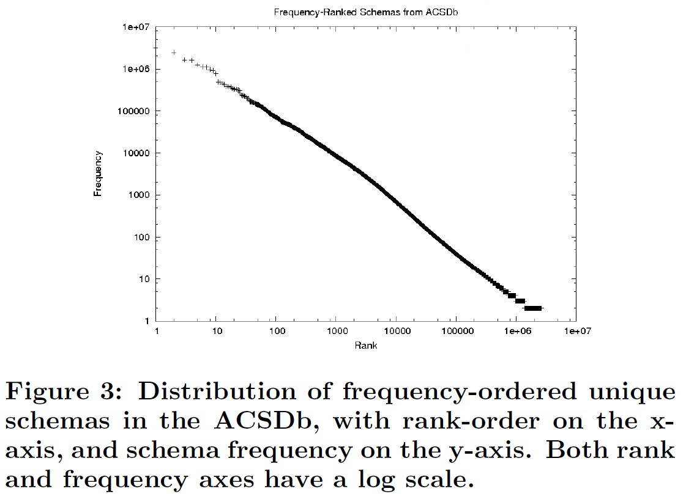
WebTables [CHW+08]
Background: Google crawl of the surface web, reported in 2008
  154M good relational tables, 5.4M attribute names, 2.6M schemas
ACSDb
  (schema, count)
Frequency-Ranked schemas from ACSDb
Frequency
Rank

Slide 71
WebTables: Keyword Search [CHW+08]
Query model: keyword search
Goal: Rank tables on web in response to query keywords
  Not web pages (can have multiple tables), not individual records
Challenges:
  Web page features apply ambiguously to embedded tables
  Web tables on a page may not all be relevant to a query
  Web tables have specific features (e.g., schema elements)

Slide 72
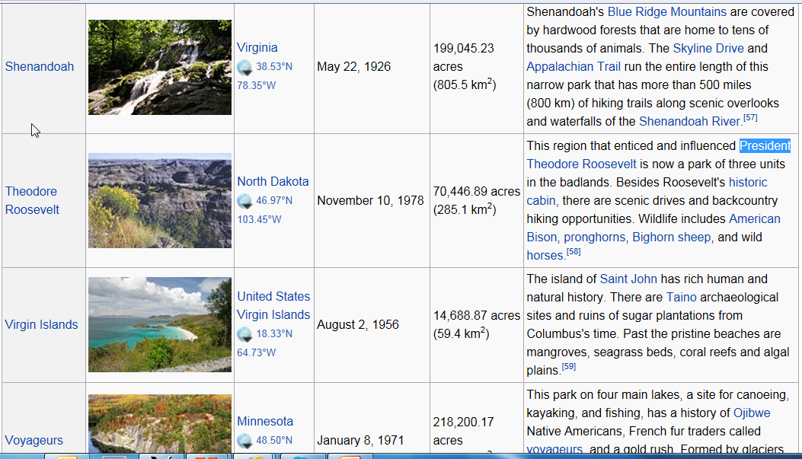
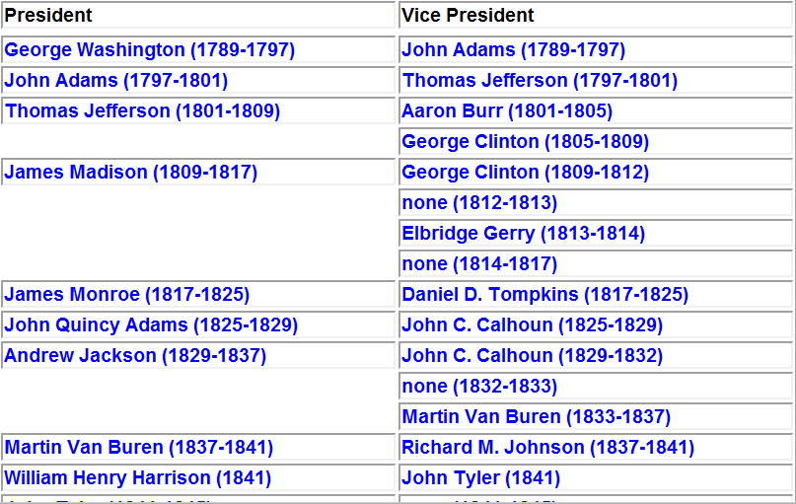
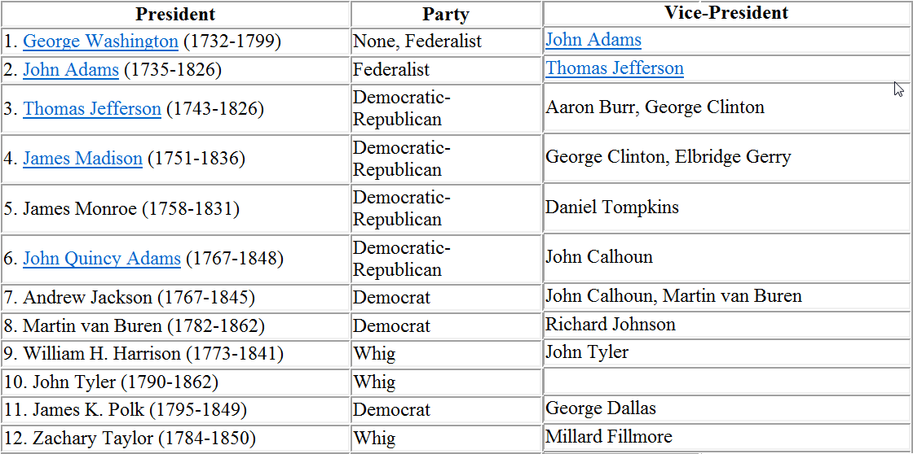
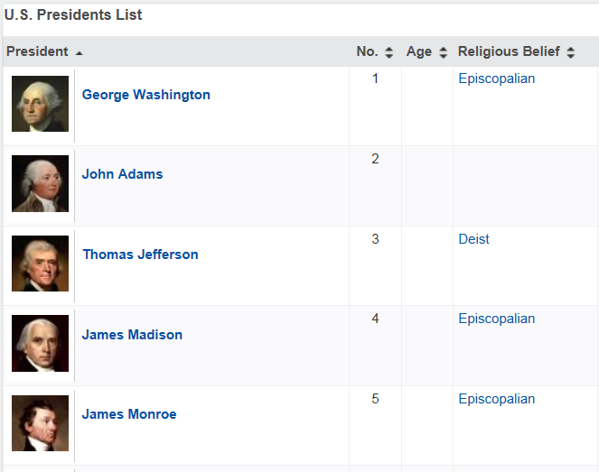
WebTables: Keyword Search
Example keyword query: “presidents of the US”

Slide 73
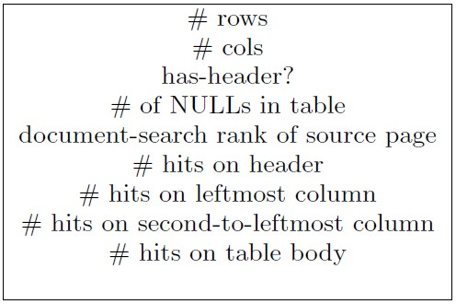
WebTables: Keyword Search
FeatureRank: use table specific features
  Query independent features
  Query dependent features
  Linear regression estimator
  Heavily weighted features
Result quality: fraction of high scoring relevant tables
k | Naïve | FeatureRank
10 | 0.26 | 0.43
20 | 0.33 | 0.56
30 | 0.34 | 0.66

Slide 74
WebTables: Keyword Search
Example keyword query: “presidents of the US”

Slide 75
WebTables: Keyword Search
SchemaRank: also include schema coherency as a table feature
  Use point-wise mutual information (pmi) derived from ACSDb
  p(a) = fraction of unique schemas containing attributes a
  pmi(a,b) = log₂(p(a,b)/(p(a)*p(b)))
  Coherency = average pmi(a,b) over all a, b in attrs(R)
Result quality: fraction of high scoring relevant tables
k | Naïve | FeatureRank | SchemaRank
10 | 0.26 | 0.43 | 0.47
20 | 0.33 | 0.56 | 0.59
30 | 0.34 | 0.66 | 0.68

Slide 76
WebTables: Keyword Search
Example keyword query: “presidents of the US”
  T1(President, Vice President)
  T2(President, Term, Party, Vice President)
  T3(State, Governor, Party, Term)
  T4(State, Senator, Party, Term, Born On)
  T5(Chief Justice, Nominated By, Term)

Slide 77
WebTables: Keyword Search
Example keyword query: “presidents of the US”
  T1(President, Vice President)
  T2(President, Term, Party, Vice President)
  T3(State, Governor, Party, Term)
  T4(State, Senator, Party, Term, Born On)
  T5(Chief Justice, Nominated By, Term)
pmi(a,b) = log₂(p(a,b)/(p(a)*p(b)))
  pmi(President, Vice President) = log₂(0.4/(0.4 * 0.4)) = 1.32

Slide 78
WebTables: Keyword Search
Example keyword query: “presidents of the US”
  T1(President, Vice President)
  T2(President, Term, Party, Vice President)
  T3(State, Governor, Party, Term)
  T4(State, Senator, Party, Term, Born On)
  T5(Chief Justice, Nominated By, Term)
pmi(a,b) = log₂(p(a,b)/(p(a)*p(b)))
  pmi(President, Vice President) = log₂(0.4/(0.4 * 0.4)) = 1.32
  pmi(President, Term) = log₂(0.2/(0.4*0.8)) = -0.68

Slide 79
WebTables: Keyword Search
Example keyword query: “presidents of the US”
  T1(President, Vice President)
  T2(President, Term, Party, Vice President)
  T3(State, Governor, Party, Term)
  T4(State, Senator, Party, Term, Born On)
  T5(Chief Justice, Nominated By, Term)
Schema coherency = average pmi(a,b) over all a, b in attrs(R)
  coherency(T1) = avg({1.32}) = 1.32
  coherency(T2) = avg({1.32, -0.68, -0.26, 0.32, -0.26, -0.68}} = -0.15
1
2

Slide 80
Annotating Web Tables [LSC10]
Goal: given a Web table, which entities occur in which cells, what are the column types, and the relationships between columns?
Why is this challenging?
  Text in table cells often mention entities, but can be ambiguous
  Column headers, if present, do not use controlled vocabulary
Benefits of solving this problem
  Permits use of relational, metadata-aware queries on Web tables
  Extracts knowledge from Web tables

Slide 81
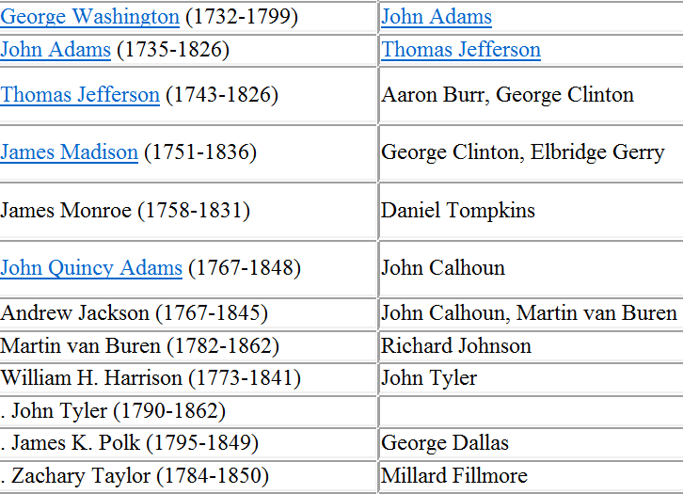
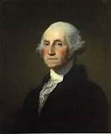
Annotating Web Tables: Entities
Goal: given a Web table, which entities occur in which cells, what are the column types, and the relationships between columns?

Slide 82
Annotating Web Tables: Column Types
Goal: given a Web table, which entities occur in which cells, what are the column types, and the relationships between columns?
US Politician

Slide 83
Annotating Web Tables: Relationships
Goal: given a Web table, which entities occur in which cells, what are the column types, and the relationships between columns?
US President –
US Vice President

Slide 84
Annotating Web Tables: Using a Catalog
A catalog consists of a type hierarchy, entities that are instances of (possibly multiple) types, and binary relationships
US President | US Vice President
P401 | P420
P420 | P471
Entity
Person
University
Politician
U101
U107
P401
P420
George Washington
University
University of
Washington
George
Washington
John
Adams

Slide 85
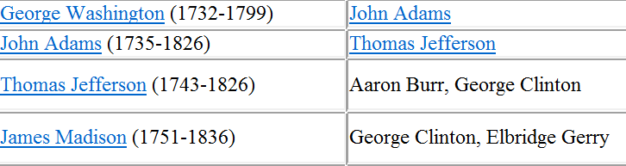
Annotating Web Tables: Using a Catalog
✓
How good is it to label cell (r, c), containing text D_{rc}, with entity E?
  Similarity between D_{rc} and L(E)
Entity
Person
University
Politician
U101
U107
P401
P420
George Washington
University
University of
Washington
George
Washington
John
Adams

Slide 86
Annotating Web Tables: Using a Catalog
✓
How good is it to label cell (r, c), containing text D_{rc}, with entity E?
  Similarity between D_{rc} and L(E)
Entity
Person
University
Politician
U101
U107
P401
P420
George Washington
University
University of
Washington
George
Washington
John
Adams

Slide 87
Annotating Web Tables: Using a Catalog
X
How good is it to label cell (r, c), containing text D_{rc}, with entity E?
  Similarity between D_{rc} and L(E)
Entity
Person
University
Politician
U101
U107
P401
P420
George Washington
University
University of
Washington
George
Washington
John
Adams

Slide 88
Annotating Web Tables: Using a Catalog
✓
How good is it to label column c with type T and cell (r, c) with E?
  Entity E should belong to type T (but catalog may be incomplete)
Entity
Person
University
Politician
U101
U107
P401
P420
George Washington
University
University of
Washington
George
Washington
John
Adams

Slide 89
Annotating Web Tables: Using a Catalog
✓
How good is it to label column c with type T and cell (r, c) with E?
  Entity E should belong to type T (but catalog may be incomplete)
Entity
Person
University
Politician
U101
U107
P401
P420
George Washington
University
University of
Washington
George
Washington
John
Adams

Slide 90
Annotating Web Tables: Using a Catalog
X
How good is it to label column c with type T and cell (r, c) with E?
  Entity E should belong to type T (but catalog may be incomplete)
Entity
Person
University
Politician
U101
U107
P401
P420
George Washington
University
University of
Washington
George
Washington
John
Adams

Slide 91
Annotating Web Tables: Using a Catalog
✓
Do entity annotations e_{rc} for cell (r, c) and e_{rc’} for cell (r, c’) vote for or against annotating column pair (c, c’) with relation R?
Entity
Person
University
Politician
U101
U107
US President | US Vice President
P401 | P420
P420 | P471
P401
P420
George Washington
University
University of
Washington
George
Washington
John
Adams

Slide 92
Annotating Web Tables: Using a Catalog
Model table annotation using interrelated random variables, represented by a probabilistic graphical model
  Cell text (in Web table) and entity label (in catalog)
  Column header (in Web table) and type label (in catalog)
  Column type and cell entity (in Web table)
  Pair of column types (in Web table) and relation (in catalog)
  Entity pairs (in Web table) and relation (in catalog)

Slide 93
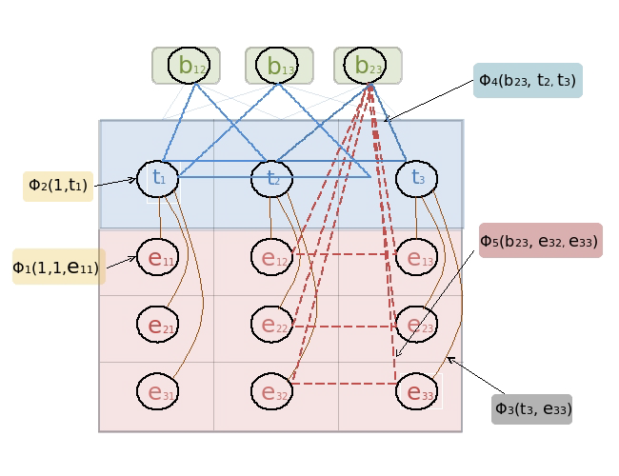
Annotating Web Tables: Using a Catalog
Model table annotation using interrelated random variables, represented by a probabilistic graphical model
  Cell text (in Web table) and entity label (in catalog)
  Column header (in Web table) and type label (in catalog)
  Column type and cell entity (in Web table)

Slide 94
Annotating Web Tables: Using a Catalog
Model table annotation using interrelated random variables, represented by a probabilistic graphical model
  Pair of column types (in Web table) and relation (in catalog)
  Entity pairs (in Web table) and relation (in catalog)

Slide 95
Annotating Web Tables: Using a Catalog
Model table annotation using interrelated random variables, represented by a probabilistic graphical model
  Cell text (in Web table) and entity label (in catalog)
  Column header (in Web table) and type label (in catalog)
  Column type and cell entity (in Web table)
  Pair of column types (in Web table) and relation (in catalog)
  Entity pairs (in Web table) and relation (in catalog)
Task of annotation amounts to searching for an assignment of values to the variables that maximizes the joint probability
  Problem is NP-hard in the general case
  Use iterative belief propagation in “factor graphs” until convergence

Slide 96
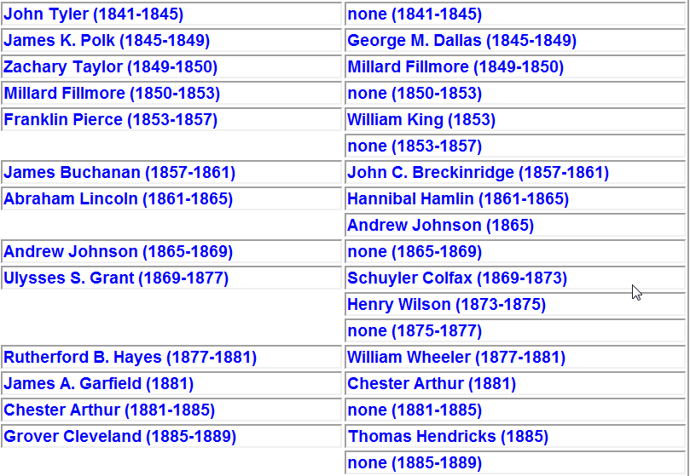
Finding Related Tables [DFG+12]
✓
Motivation: given a table T and a corpus C of tables, find tables T’ in C that can be integrated with T to augment T’s information

Slide 97
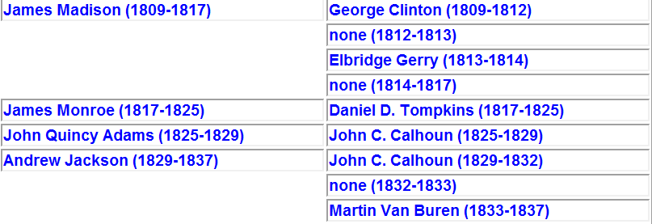
Finding Related Tables
X
Motivation: given a table T and a corpus C of tables, find tables T’ in C that can be integrated with T to augment T’s information

Slide 98
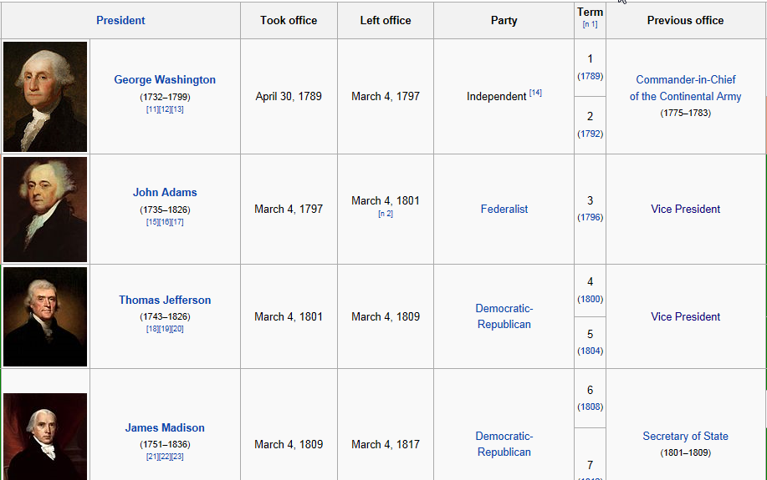
Finding Related Tables
✓
Motivation: given a table T and a corpus C of tables, find tables T’ in C that can be integrated with T to augment T’s information

Slide 99
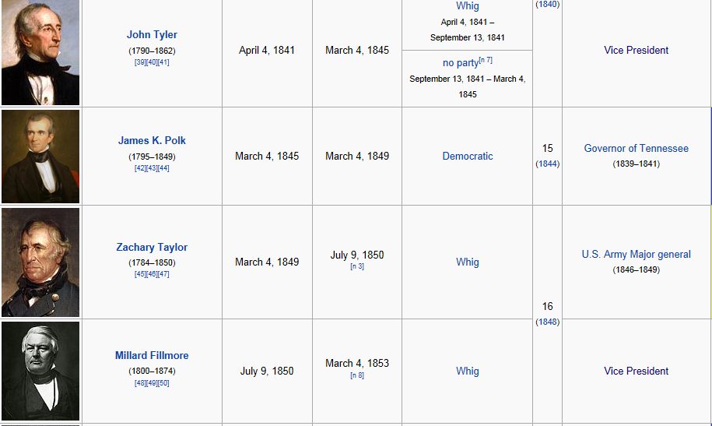
Finding Related Tables
?
Motivation: given a table T and a corpus C of tables, find tables T’ in C that can be integrated with T to augment T’s information

Slide 100
Finding Related Tables
X
Motivation: given a table T and a corpus C of tables, find tables T’ in C that can be integrated with T to augment T’s information

Slide 101
Finding Related Tables
Motivation: given a table T and a corpus C of tables, find tables T’ in C that can be integrated with T to augment T’s information
Examples of related tables
  Tables that are candidates for union, and add new entities
  Tables that are candidates for join, and add new attributes

Slide 102
Finding Related Tables
Motivation: given a table T and a corpus C of tables, find tables T’ in C that can be integrated with T to augment T’s information
More generally:
  Are tables T and T’ the results of applying queries Q and Q’ on U?
  Are Q and Q’ different, but have a similar select-project structure?
  Is virtual table U coherent?
Problem: Find top-k tables with highest relatedness scores to T

Slide 103
Finding Related Tables: Entity Complement
Goal: Find top-k tables T’ that are candidates for union with T
Methodology
  Entity consistency: T’ should have the same type of entities as T
  Entity expansion: T’ should substantially add new entities to T
  Schema consistency: T and T’ should have similar schemas

Slide 104
Finding Related Tables: Entity Complement
Goal: Find top-k tables T’ that are candidates for union with T
  Entity consistency, entity expansion

Slide 105
Finding Related Tables: Entity Complement
✓
Goal: Find top-k tables T’ that are candidates for union with T
  Schema consistency

Slide 106
Finding Related Tables: Entity Complement
Goal: Find top-k tables T’ that are candidates for union with T
[DFG+12] use three signals to ensure entity complement tables
  WebIsA: noisy database of entities (155M) and types (1.5M)
  Freebase: curated database of entities (16M) and types (600K)
  WebTable labels: count co-occurrence of entities in Web tables
Relatedness score:
  Use weighted Jaccard similarity on label sets for entity consistency
  Use bipartite max-weight matching for schema consistency

Slide 107
Finding Related Tables: Schema Complement
Goal: Find top-k tables T’ that are candidates for join with T
Methodology
  Coverage of entity set: T’ should contain most of T’s entities
  Coherent schema expansion: use the ACSDb to measure the maximum benefit that a subset of attributes of T’ can provide to T
Recall, ACSDb(Schema, Count) can be used for schema coherency

Slide 108
Finding Related Tables: Schema Complement
Goal: Find top-k tables T’ that are candidates for join with T
  Entity coverage

Slide 109
Finding Related Tables: Schema Complement
✓
Goal: Find top-k tables T’ that are candidates for join with T
  Coherent schema expansion

Slide 110
Finding Related Tables: Efficiency Issues
Naïve approach: compute relatedness score for every table pair
  Very expensive on large table corpora
Key idea: use filters to scale up computation of table relatedness
  Fewer comparisons: use filters as blocking criteria to bucketize tables, and only perform relatedness comparisons within buckets
  Faster comparisons: apply sequence of filters, based on selectivity and computational efficiency of filters
Useful filters:
  Two tables must share entity column name or inferred label
  Two tables must share at least n entities, n = 1, 2, 3

Slide 111
Outline
Motivation
Schema alignment
Record linkage
  Overview
  Techniques for big data
Data fusion
Emerging topics

Slide 112






Record Linkage
Matching based on identifying content: color, pattern

Slide 113
Record Linkage
Matching based on identifying content: color, pattern

Slide 114





Record Linkage: Three Steps [EIV07, GM12]
Record linkage: blocking + pairwise matching + clustering
  Scalability, similarity, semantics
Blocking
Pairwise Matching
Clustering

Slide 115
Record Linkage: Three Steps
Blocking: efficiently create small blocks of similar records
  Ensures scalability
Blocking
Pairwise Matching
Clustering

Slide 116
Record Linkage: Three Steps
Pairwise matching: compares all record pairs in a block
  Computes similarity
Blocking
Pairwise Matching
Clustering

Slide 117
Record Linkage: Three Steps
Clustering: groups sets of records into entities
  Ensures semantics
Blocking
Pairwise Matching
Clustering

Slide 118
Outline
Motivation
Schema alignment
Record linkage
  Overview
  Techniques for big data
Data fusion
Emerging topics

Slide 119
BDI: Record Linkage
Volume: dealing with billions of records
  Map-reduce based record linkage [VCL10, KTR12]
  Adaptive record blocking [DNS+12, MKB12, VN12]
  Blocking in heterogeneous data spaces [PIP+12, PKP+13]
Velocity
  Incremental record linkage [WGM10, WGM13]

Slide 120
BDI: Record Linkage
Variety
  Matching structured and unstructured data [KGA+11, KTT+12]
  Matching Web tables and catalogs [LSC10]
Veracity
  Linking temporal records [LDM+11]

Slide 121
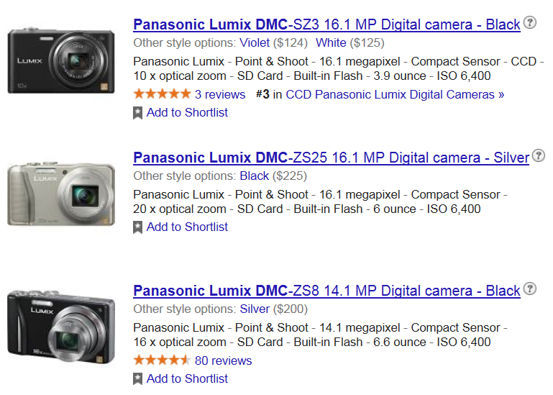
Matching with Unstructured Data
Matching product offers: 1000s of stores, millions of products
  Product offers are terse, unstructured text
  Many similar but different product offers

Slide 122
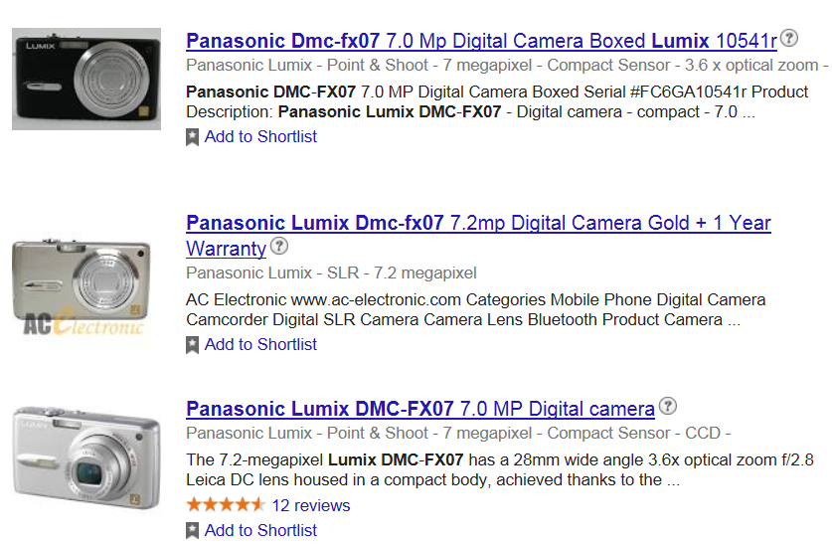
Matching with Unstructured Data
Matching product offers: 1000s of stores, millions of products
  Product offers are terse, unstructured text
  Many similar but different product offers
  Same product has different descriptions, missing + wrong values

Slide 123
Matching with Unstructured Data
Matching product offers: 1000s of stores, millions of products
  Product offers are terse, unstructured text
  Many similar but different product offers
  Same product has different descriptions, missing + wrong values
Challenging scenarios for record linkage
  Matching structured specifications with unstructured offers
  Matching unstructured offers with each other

Slide 124
Structured + Unstructured Data [KGA+11]
Motivation: matching offers to specifications with high precision
  Product specifications are structured: set of (name, value) pairs
  Product offers are terse, unstructured text
Attribute Name | Attribute Value
category | digital camera
brand | Panasonic
product line | Panasonic Lumix
model | DMC-FX07
resolution | 7 megapixel
color | silver

Slide 125
Structured + Unstructured Data
Motivation: matching offers to specifications with high precision
  Product specifications are structured: set of (name, value) pairs
  Product offers are terse, unstructured text
Attribute Name | Attribute Value
category | digital camera
brand | Panasonic
product line | Panasonic Lumix
model | DMC-FX07
resolution | 7 megapixel
color | silver
Panasonic Lumix DMC-FX07 digital camera
7.2 megapixel, 2.5”, 3.6x , LCD monitor
Panasonic DMC-FX07EB digital
camera silver
Lumix FX07EB-S, 7.2MP

Slide 126
Structured + Unstructured Data
Key idea: optimal parse of (unstructured) offer wrt specification
Semantic parse of offers: tagging
  Use inverted index built on specification values
  Tag all n-grams
product line
brand
model
Panasonic Lumix DMC-FX07 digital camera
7.2 megapixel, 2.5”, 3.6x, LCD monitor
resolution
zoom
diagonal,
height,
width
display type

Slide 127
Structured + Unstructured Data
Key idea: optimal parse of (unstructured) offer wrt specification
Semantic parse of offers: tagging, plausible parse
  Combination of tags such that each attribute has distinct value
product line
brand
model
Panasonic Lumix DMC-FX07 digital camera
7.2 megapixel, 2.5”, 3.6x, LCD monitor
resolution
zoom
diagonal,
height,
width
display type

Slide 128
Structured + Unstructured Data
Key idea: optimal parse of (unstructured) offer wrt specification
Semantic parse of offers: tagging, plausible parse
  Combination of tags such that each attribute has distinct value
product line
brand
model
Panasonic Lumix DMC-FX07 digital camera
7.2 megapixel, 2.5”, 3.6x, LCD monitor
resolution
zoom
diagonal,
height,
width
display type

Slide 129
Structured + Unstructured Data
Key idea: optimal parse of (unstructured) offer wrt specification
Semantic parse of offers: tagging, plausible parse
  Combination of tags such that each attribute has distinct value
  # depends on ambiguities
product line
brand
model
Panasonic Lumix DMC-FX07 digital camera
7.2 megapixel, 2.5”, 3.6x, LCD monitor
resolution
zoom
diagonal,
height,
width
display type

Slide 130
Structured + Unstructured Data
Key idea: optimal parse of (unstructured) offer wrt specification
Semantic parse of offers: tagging, plausible parse, optimal parse
  Optimal parse depends on the product specification
Product specification | Optimal Parse
brand Panasonic product line Lumix model DMC-FX05 diagonal 2.5 in
brand Panasonic model DMC-FX07 resolution 7.2 megapixel zoom 3.6x
Panasonic Lumix DMC-FX07 digital camera
7.2 megapixel, 2.5”, 3.6x, LCD monitor
Panasonic Lumix DMC-FX07 digital camera
7.2 megapixel, 2.5”, 3.6x, LCD monitor

Slide 131
Structured + Unstructured Data
Key idea: optimal parse of (unstructured) offer wrt specification
Semantic parse of offers: tagging, plausible parse, optimal parse
Finding specification with largest match probability is now easy
  Similarity feature vector between offer and specification: {-1, 0, 1}*
  Use binary logistic regression to learn weights of each feature
  Blocking 1: use classifier to categorize offers into product categories
  Blocking 2: identify candidates with ≥ 1 high-weighted features

Slide 132
Matching Unstructured Data [KTT+12]
Motivation: matching product offers with each other
  No structured specification available
✓
X

Slide 133
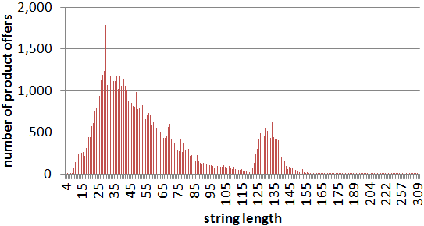
Matching Unstructured Data
Challenge: product titles are verbose, heterogeneous [KTT+12]

Slide 134
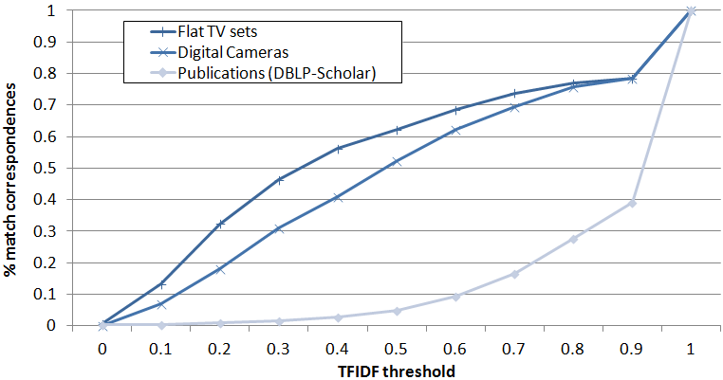
Matching Unstructured Data
Challenge: matching based on product titles is difficult [KTT+12]

Slide 135
Matching Unstructured Data
Potential solution: extract and use identifiers
  UPC, GTIN (global trade item number) often unavailable
Product code
  Manufacturer-specific identifier, e.g., DMC-FX07, DMC-SZ3
  Utilize to differentiate similar but different products

Slide 136
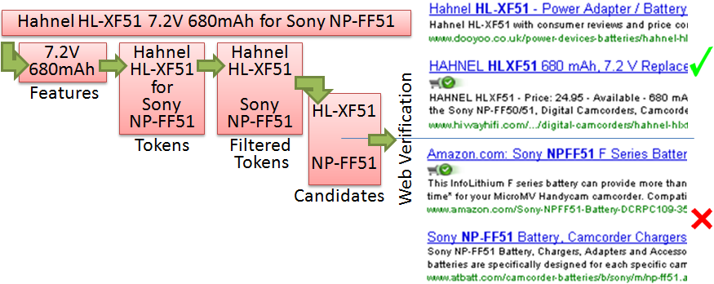
Matching Unstructured Data
Product code extraction
  Key step: web verification via consistency of manufacturer

Slide 137
Record Linkage Using MapReduce [KTR12]
Motivation: despite use of blocking, record linkage is expensive
  Can record linkage be effectively parallelized?
Basic: use MapReduce to execute blocking-based RL in parallel
  Map tasks can read records, redistribute based on blocking key
  All entities of the same block are assigned to same Reduce task
  Different blocks matched in parallel by multiple Reduce tasks

Slide 138

Record Linkage Using MapReduce
Challenge: data skew → unbalanced workload

Slide 139
Record Linkage Using MapReduce
Challenge: data skew → unbalanced workload
  Speedup: 39/36 = 1.083
3 pairs
36 pairs

Slide 140
Load Balancing
Challenge: data skew → unbalanced workload
  Difficult to tune blocking function to get balanced workload
Key ideas for load balancing
  Preprocessing MR job to determine blocking key distribution
  Redistribution of Match tasks to Reduce tasks to balance workload
Two load balancing strategies:
  BlockSplit: split large blocks into sub-blocks
  PairRange: global enumeration and redistribution of all pairs

Slide 141
Load Balancing: BlockSplit
Small blocks: processed by a single match task (as in Basic)
3 pairs

Slide 142
Load Balancing: BlockSplit
Large blocks: split randomly into multiple sub-blocks
36 pairs

Slide 143
Load Balancing: BlockSplit
Large blocks: split randomly into multiple sub-blocks

Slide 144
Load Balancing: BlockSplit
Large blocks: split randomly into multiple sub-blocks
  Each sub-block processed (like unsplit block) by single match task
6 pairs
10 pairs

Slide 145
Load Balancing: BlockSplit
Large blocks: split into multiple sub-blocks
  Pair of sub-blocks is processed by “cartesian product” match task
20 pairs

Slide 146
Load Balancing: BlockSplit
BlockSplit → balanced workload
  2 Reduce nodes: 20 versus 19 (6 + 10 + 3)
  Speedup: 39/20 = 1.95 ≈ 2 (ideal)
3 pairs
6 pairs
10 pairs
20 pairs

Slide 147
Improving Blocking Recall
Observation: a single, pairwise-disjoint blocking has poor recall
Id | First Name | Last Name | YOB | State | Elected
e1 | Bob | Menendez | 1954 | New Jersey | 2006
e2 | Bob | Casey | 1960 | Pennsylvania | 2007
e3 | Robert | Casey, Jr | 1960 | Pennsylvania | 2007
e4 | Robert | Menendez | 1954 | NJ | 2006
e5 | Robert | Menendez | 1954 | New Jersey | 2007
e6 | Bob | Casey, Jr | 1961 | Pennsylvania | 2007

Slide 148
Improving Blocking Recall
Observation: a single, pairwise-disjoint blocking has poor recall
Id | First Name | Last Name | YOB | State | Elected
e1 | Bob | Menendez | 1954 | New Jersey | 2006
e2 | Bob | Casey | 1960 | Pennsylvania | 2007
e3 | Robert | Casey, Jr | 1960 | Pennsylvania | 2007
e4 | Robert | Menendez | 1954 | NJ | 2006
e5 | Robert | Menendez | 1954 | New Jersey | 2007
e6 | Bob | Casey, Jr | 1961 | Pennsylvania | 2007
e1
e2
e3
e4
e5
e6

Slide 149
Improving Blocking Recall
Observation: a single, pairwise-disjoint blocking has poor recall
Block by Last Name: {{e1, e4, e5}, {e2}, {e3, e6}}
Id | First Name | Last Name | YOB | State | Elected
e1 | Bob | Menendez | 1954 | New Jersey | 2006
e2 | Bob | Casey | 1960 | Pennsylvania | 2007
e3 | Robert | Casey, Jr | 1960 | Pennsylvania | 2007
e4 | Robert | Menendez | 1954 | NJ | 2006
e5 | Robert | Menendez | 1954 | New Jersey | 2007
e6 | Bob | Casey, Jr | 1961 | Pennsylvania | 2007
e1
e2
e3
e4
e5
e6

Slide 150
Improving Blocking Recall
Observation: a single, pairwise-disjoint blocking has poor recall
Block by First Name: {{e1, e2, e6}, {e3, e4, e5}}
Id | First Name | Last Name | YOB | State | Elected
e1 | Bob | Menendez | 1954 | New Jersey | 2006
e2 | Bob | Casey | 1960 | Pennsylvania | 2007
e3 | Robert | Casey, Jr | 1960 | Pennsylvania | 2007
e4 | Robert | Menendez | 1954 | NJ | 2006
e5 | Robert | Menendez | 1954 | New Jersey | 2007
e6 | Bob | Casey, Jr | 1961 | Pennsylvania | 2007
e1
e2
e3
e4
e5
e6

Slide 151
Improving Blocking Recall
Observation: a single, pairwise-disjoint blocking has poor recall
Block by Elected: {{e1, e4}, {e2, e3, e5, e6}}
Id | First Name | Last Name | YOB | State | Elected
e1 | Bob | Menendez | 1954 | New Jersey | 2006
e2 | Bob | Casey | 1960 | Pennsylvania | 2007
e3 | Robert | Casey, Jr | 1960 | Pennsylvania | 2007
e4 | Robert | Menendez | 1954 | NJ | 2006
e5 | Robert | Menendez | 1954 | New Jersey | 2007
e6 | Bob | Casey, Jr | 1961 | Pennsylvania | 2007
e1
e2
e3
e4
e5
e6

Slide 152
Improving Blocking Recall
Solution: use multiple, overlapping blocking strategies
Block by Elected: {{e1, e4}, {e2, e3, e5, e6}}
Id | First Name | Last Name | YOB | State | Elected
e1 | Bob | Menendez | 1954 | New Jersey | 2006
e2 | Bob | Casey | 1960 | Pennsylvania | 2007
e3 | Robert | Casey, Jr | 1960 | Pennsylvania | 2007
e4 | Robert | Menendez | 1954 | NJ | 2006
e5 | Robert | Menendez | 1954 | New Jersey | 2007
e6 | Bob | Casey, Jr | 1961 | Pennsylvania | 2007
e1
e2
e3
e4
e5
e6

Slide 153
Improving Blocking Recall
Solution: use multiple, overlapping blocking strategies
Also block by Last Name: {{e1, e4, e5}, {e2}, {e3, e6}}
Id | First Name | Last Name | YOB | State | Elected
e1 | Bob | Menendez | 1954 | New Jersey | 2006
e2 | Bob | Casey | 1960 | Pennsylvania | 2007
e3 | Robert | Casey, Jr | 1960 | Pennsylvania | 2007
e4 | Robert | Menendez | 1954 | NJ | 2006
e5 | Robert | Menendez | 1954 | New Jersey | 2007
e6 | Bob | Casey, Jr | 1961 | Pennsylvania | 2007
e1
e2
e3
e4
e5
e6

Slide 154
Improving Blocking Recall
Solution: use multiple, overlapping blocking strategies
Also block by Last Name: {{e1, e4, e5}, {e2}, {e3, e6}}
Id | First Name | Last Name | YOB | State | Elected
e1 | Bob | Menendez | 1954 | New Jersey | 2006
e2 | Bob | Casey | 1960 | Pennsylvania | 2007
e3 | Robert | Casey, Jr | 1960 | Pennsylvania | 2007
e4 | Robert | Menendez | 1954 | NJ | 2006
e5 | Robert | Menendez | 1954 | New Jersey | 2007
e6 | Bob | Casey, Jr | 1961 | Pennsylvania | 2007
e1
e2
e3
e4
e5
e6

Slide 155
Meta-Blocking [PKP+13]
Observation: using multiple blocking strategies can be inefficient
If we block by each of: First Name, Last Name, YOB, State, Elected
  (e1, e4) is compared 3 times, (e3, e5) is compared 2 times
  Total number of pair comparisons is worse than not using blocking
Id | First Name | Last Name | YOB | State | Elected
e1 | Bob | Menendez | 1954 | New Jersey | 2006
e2 | Bob | Casey | 1960 | Pennsylvania | 2007
e3 | Robert | Casey, Jr | 1960 | Pennsylvania | 2007
e4 | Robert | Menendez | 1954 | NJ | 2006
e5 | Robert | Menendez | 1954 | New Jersey | 2007
e6 | Bob | Casey, Jr | 1961 | Pennsylvania | 2007

Slide 156
Meta-Blocking: Dealing with BDI Variety
Why consider blocking using all possible values?
  Variety in BDI schemas may effectively result in schema-less data
Efficiency can be improved using ad hoc approaches
  Block purging drops the largest blocks (akin to “stop words”)
  May (or may not) result in big drop in recall
e1 | Menendez | New Jersey | 2006 | Bob | 1954
e2 | Bob | Casey | 1960 | Pennsylvania | 2007
e3 | Robert | Casey, Jr | 1960 | Pennsylvania | 2007
e4 | Menendez | NJ | 1954 | Robert | 2006
e5 | Menendez | New Jersey | 1954 | Robert | 2007
e6 | Bob | Casey, Jr | 2007 | Pennsylvania | 1961

Slide 157
Meta-Blocking: Improve Blocking Efficiency
Goal: substantially fewer pair comparisons, equally high recall
Approach: represent multiple blockings using a weighted graph
  Each record e_{i} in the data set is a node n_{i} in the graph
  Create edge (n_{i}, n_{j}) if e_{i} and e_{j} are in same block in some blocking
  Weight of edge (n_{i}, n_{j}) depends on the likelihood of a match
  Choose high weighted subset of edges for pair comparisons
Benefits: substantially reduce the number of pair comparisons

Slide 158
Meta-Blocking: Improve Blocking Efficiency
Example: represent multiple blockings using a (weighted) graph
e1 | Menendez | New Jersey | 2006 | Bob | 1954
e2 | Bob | Casey | 1960 | Pennsylvania | 2007
e3 | Robert | Casey, Jr | 1960 | Pennsylvania | 2007
e4 | Menendez | NJ | 1954 | Robert | 2006
e5 | Menendez | New Jersey | 1954 | Robert | 2007
e6 | Bob | Casey, Jr | 2007 | Pennsylvania | 1961
e1
e2
e4
e3
e5
e6

Slide 159
Meta-Blocking: Improve Blocking Efficiency
Example: represent multiple blockings using a (weighted) graph
e1 | Menendez | New Jersey | 2006 | Bob | 1954
e2 | Bob | Casey | 1960 | Pennsylvania | 2007
e3 | Robert | Casey, Jr | 1960 | Pennsylvania | 2007
e4 | Menendez | NJ | 1954 | Robert | 2006
e5 | Menendez | New Jersey | 1954 | Robert | 2007
e6 | Bob | Casey, Jr | 2007 | Pennsylvania | 1961
e1
e2
e4
e3
e5
e6

Slide 160
Meta-Blocking: Improve Blocking Efficiency
Example: represent multiple blockings using a (weighted) graph
e1 | Menendez | New Jersey | 2006 | Bob | 1954
e2 | Bob | Casey | 1960 | Pennsylvania | 2007
e3 | Robert | Casey, Jr | 1960 | Pennsylvania | 2007
e4 | Menendez | NJ | 1954 | Robert | 2006
e5 | Menendez | New Jersey | 1954 | Robert | 2007
e6 | Bob | Casey, Jr | 2007 | Pennsylvania | 1961
e1
e2
e4
e3
e5
e6

Slide 161
Meta-Blocking: Improve Blocking Efficiency
Example: represent multiple blockings using a (weighted) graph
e1 | Menendez | New Jersey | 2006 | Bob | 1954
e2 | Bob | Casey | 1960 | Pennsylvania | 2007
e3 | Robert | Casey, Jr | 1960 | Pennsylvania | 2007
e4 | Menendez | NJ | 1954 | Robert | 2006
e5 | Menendez | New Jersey | 1954 | Robert | 2007
e6 | Bob | Casey, Jr | 2007 | Pennsylvania | 1961
e1
e2
e4
e3
e5
e6

Slide 162
Meta-Blocking: Improve Blocking Efficiency
Example: weight of edge is number of co-occurring blocks
e1 | Menendez | New Jersey | 2006 | Bob | 1954
e2 | Bob | Casey | 1960 | Pennsylvania | 2007
e3 | Robert | Casey, Jr | 1960 | Pennsylvania | 2007
e4 | Menendez | NJ | 1954 | Robert | 2006
e5 | Menendez | New Jersey | 1954 | Robert | 2007
e6 | Bob | Casey, Jr | 2007 | Pennsylvania | 1961
1
e1
e2
1
3
3
3
e4
1
e3
3
3
1
3
2
e5
e6
1

Slide 163
Meta-Blocking: Improve Blocking Efficiency
Example: drop all edges with weight < average edge weight (2.08)
e1 | Menendez | New Jersey | 2006 | Bob | 1954
e2 | Bob | Casey | 1960 | Pennsylvania | 2007
e3 | Robert | Casey, Jr | 1960 | Pennsylvania | 2007
e4 | Menendez | NJ | 1954 | Robert | 2006
e5 | Menendez | New Jersey | 1954 | Robert | 2007
e6 | Bob | Casey, Jr | 2007 | Pennsylvania | 1961
1
e1
e2
1
3
3
3
e4
1
e3
3
3
1
3
2
e5
e6
1

Slide 164
Meta-Blocking: Improve Blocking Efficiency
Example: drop all edges with weight < average edge weight (2.08)
e1 | Menendez | New Jersey | 2006 | Bob | 1954
e2 | Bob | Casey | 1960 | Pennsylvania | 2007
e3 | Robert | Casey, Jr | 1960 | Pennsylvania | 2007
e4 | Menendez | NJ | 1954 | Robert | 2006
e5 | Menendez | New Jersey | 1954 | Robert | 2007
e6 | Bob | Casey, Jr | 2007 | Pennsylvania | 1961
e1
e2
3
3
3
e4
e3
3
3
3
e5
e6

Slide 165
Meta-Blocking: Improve Blocking Efficiency
Alternate edge weighting strategies
  Edge weight (n_{i}, n_{j}) = number of co-occurring blocks of e_{i} and e_{j}
  Edge weight = ∑_{Bk} (1/|B_{k}|), e_{i} and e_{j} co-occur in B_{k}
Alternate edge pruning strategies
  Prune edges with weight below threshold (average edge weight)
  Prune all but edges with top-k edge weights
  For each node, prune edges based on local thresholds, counts

Slide 166
Meta-Blocking: Improve Blocking Efficiency
Why does meta-blocking improve blocking efficiency?
  Cost of graph construction = O (# of pair comparisons)
  But, pair comparison is more expensive than weight computation
  Use inverted indexes for implementation efficiency
  Each high weight record pair is compared only once
  A large number of low weight record pairs are not compared
When does meta-blocking preserve a high recall?
  High weight record pairs correspond to high likelihood of match

Slide 167

Linking Temporal Records [LDM+11]
How many Wei Wang’s are in DBLP, with which publications?

Slide 168
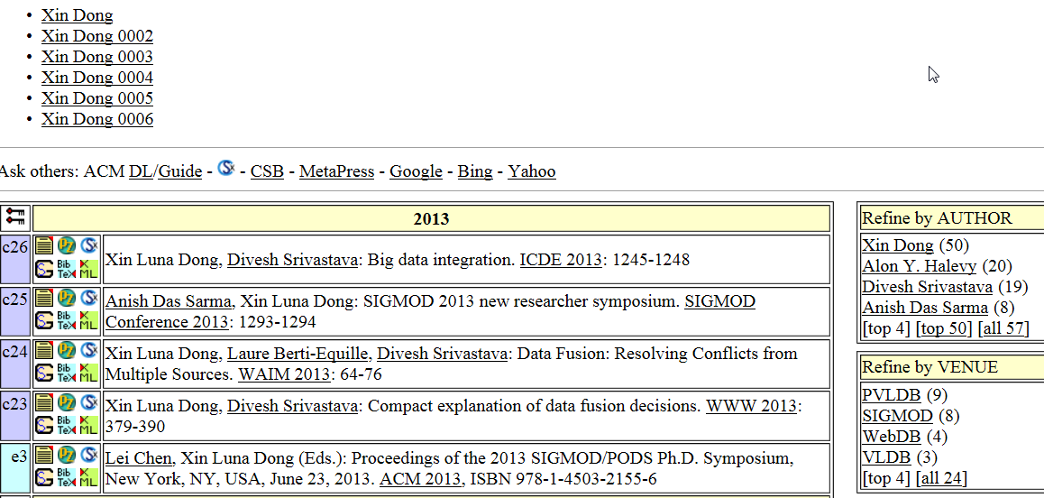
Linking Temporal Records
How many Xin Dong’s are in DBLP, with which publications?

Slide 169
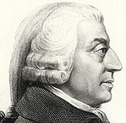
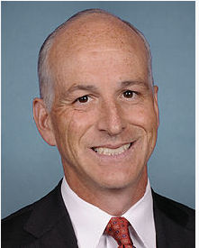
Linking Temporal Records: Motivation
Traditional record linkage
  Links records of an entity from multiple sources at a point in time
Record linkage in Long Data
  Links records of an entity over a long time period
  Attribute values of an entity evolve over time
  Different entities across time may have the same attribute value
  Adam Smith (1723-1790)
  Adam Smith (1965-)

Slide 170

Linking Temporal Records: Challenges
r1: Xin Dong
R. Polytechnic Institute
r4: Xin Luna Dong
University of Washington
r2: Xin Dong
University of Washington
r5: Xin Luna Dong
AT&T Labs-Research
r3: Xin Dong
University of Washington
r6: Xin Luna Dong
AT&T Labs-Research
1991
2004
2005
2006
2007
2008
2009
2010
2011
Who authored what?
r11: Dong Xin
Microsoft Research
r9: Dong Xin
Microsoft Research
r12: Dong Xin
Microsoft Research
r10: Dong Xin
University of Illinois
r7: Dong Xin
University of Illinois
r8:Dong Xin
University of Illinois

Slide 171
Linking Temporal Records: Challenges
r1: Xin Dong
R. Polytechnic Institute
r4: Xin Luna Dong
University of Washington
r2: Xin Dong
University of Washington
r5: Xin Luna Dong
AT&T Labs-Research
r3: Xin Dong
University of Washington
r6: Xin Luna Dong
AT&T Labs-Research
1991
2004
2005
2006
2007
2008
2009
2010
2011
Ground truth
r11: Dong Xin
Microsoft Research
r9: Dong Xin
Microsoft Research
r12: Dong Xin
Microsoft Research
r10: Dong Xin
University of Illinois
r7: Dong Xin
University of Illinois
r8:Dong Xin
University of Illinois

Slide 172
Linking Temporal Records: Challenges
r1: Xin Dong
R. Polytechnic Institute
r4: Xin Luna Dong
University of Washington
r2: Xin Dong
University of Washington
r5: Xin Luna Dong
AT&T Labs-Research
r3: Xin Dong
University of Washington
r6: Xin Luna Dong
AT&T Labs-Research
1991
2004
2005
2006
2007
2008
2009
2010
2011
Traditional solution 1:
high value consistency
r11: Dong Xin
Microsoft Research
r9: Dong Xin
Microsoft Research
r12: Dong Xin
Microsoft Research
r10: Dong Xin
University of Illinois
r7: Dong Xin
University of Illinois
r8:Dong Xin
University of Illinois

Slide 173
Linking Temporal Records: Challenges
r1: Xin Dong
R. Polytechnic Institute
r4: Xin Luna Dong
University of Washington
r2: Xin Dong
University of Washington
r5: Xin Luna Dong
AT&T Labs-Research
r3: Xin Dong
University of Washington
r6: Xin Luna Dong
AT&T Labs-Research
1991
2004
2005
2006
2007
2008
2009
2010
2011
Traditional solution 2:
using similar names
r11: Dong Xin
Microsoft Research
r9: Dong Xin
Microsoft Research
r12: Dong Xin
Microsoft Research
r10: Dong Xin
University of Illinois
r7: Dong Xin
University of Illinois
r8:Dong Xin
University of Illinois

Slide 174
Linking Temporal Records: Opportunities
Smooth transition in one attribute, despite evolution of another
ID | Name | Affiliation | Co-authors | Year
r1 | Xin Dong | R. Polytechnic Institute | Wozny | 1991
r2 | Xin Dong | University of Washington | Halevy, Tatarinov | 2004
r7 | Dong Xin | University of Illinois | Han, Wah | 2004
r3 | Xin Dong | University of Washington | Halevy | 2005
r4 | Xin Luna Dong | University of Washington | Halevy, Yu | 2007
r8 | Dong Xin | University of Illinois | Wah | 2007
r9 | Dong Xin | Microsoft Research | Wu, Han | 2008
r10 | Dong Xin | University of Illinois | Ling, He | 2009
r11 | Dong Xin | Microsoft Research | Chaudhuri, Ganti | 2009
r5 | Xin Luna Dong | AT&T Labs-Research | Das Sarma, Halevy | 2009
r6 | Xin Luna Dong | AT&T Labs-Research | Naumann | 2010
r12 | Dong Xin | Microsoft Research | He | 2011

Slide 175
Linking Temporal Records: Opportunities
Erratic changes in an attribute value are quite unlikely
ID | Name | Affiliation | Co-authors | Year
r1 | Xin Dong | R. Polytechnic Institute | Wozny | 1991
r2 | Xin Dong | University of Washington | Halevy, Tatarinov | 2004
r7 | Dong Xin | University of Illinois | Han, Wah | 2004
r3 | Xin Dong | University of Washington | Halevy | 2005
r4 | Xin Luna Dong | University of Washington | Halevy, Yu | 2007
r8 | Dong Xin | University of Illinois | Wah | 2007
r9 | Dong Xin | Microsoft Research | Wu, Han | 2008
r10 | Dong Xin | University of Illinois | Ling, He | 2009
r11 | Dong Xin | Microsoft Research | Chaudhuri, Ganti | 2009
r5 | Xin Luna Dong | AT&T Labs-Research | Das Sarma, Halevy | 2009
r6 | Xin Luna Dong | AT&T Labs-Research | Naumann | 2010
r12 | Dong Xin | Microsoft Research | He | 2011

Slide 176
Linking Temporal Records: Opportunities
Typically, there is continuity of history, i.e., no big gaps in time
ID | Name | Affiliation | Co-authors | Year
r1 | Xin Dong | R. Polytechnic Institute | Wozny | 1991
r2 | Xin Dong | University of Washington | Halevy, Tatarinov | 2004
r7 | Dong Xin | University of Illinois | Han, Wah | 2004
r3 | Xin Dong | University of Washington | Halevy | 2005
r4 | Xin Luna Dong | University of Washington | Halevy, Yu | 2007
r8 | Dong Xin | University of Illinois | Wah | 2007
r9 | Dong Xin | Microsoft Research | Wu, Han | 2008
r10 | Dong Xin | University of Illinois | Ling, He | 2009
r11 | Dong Xin | Microsoft Research | Chaudhuri, Ganti | 2009
r5 | Xin Luna Dong | AT&T Labs-Research | Das Sarma, Halevy | 2009
r6 | Xin Luna Dong | AT&T Labs-Research | Naumann | 2010
r12 | Dong Xin | Microsoft Research | He | 2011

Slide 177
Linking Temporal Records: Solution
High penalty for value disagreement over a short time period
ID | Name | Affiliation | Co-authors | Year
r1 | Xin Dong | R. Polytechnic Institute | Wozny | 1991
r2 | Xin Dong | University of Washington | Halevy, Tatarinov | 2004
r7 | Dong Xin | University of Illinois | Han, Wah | 2004
r3 | Xin Dong | University of Washington | Halevy | 2005
r4 | Xin Luna Dong | University of Washington | Halevy, Yu | 2007
r8 | Dong Xin | University of Illinois | Wah | 2007
r9 | Dong Xin | Microsoft Research | Wu, Han | 2008
r10 | Dong Xin | University of Illinois | Ling, He | 2009
r11 | Dong Xin | Microsoft Research | Chaudhuri, Ganti | 2009
r5 | Xin Luna Dong | AT&T Labs-Research | Das Sarma, Halevy | 2009
r6 | Xin Luna Dong | AT&T Labs-Research | Naumann | 2010
r12 | Dong Xin | Microsoft Research | He | 2011

Slide 178
Linking Temporal Records: Solution
Lower penalty for value disagreement over a long time period
ID | Name | Affiliation | Co-authors | Year
r1 | Xin Dong | R. Polytechnic Institute | Wozny | 1991
r2 | Xin Dong | University of Washington | Halevy, Tatarinov | 2004
r7 | Dong Xin | University of Illinois | Han, Wah | 2004
r3 | Xin Dong | University of Washington | Halevy | 2005
r4 | Xin Luna Dong | University of Washington | Halevy, Yu | 2007
r8 | Dong Xin | University of Illinois | Wah | 2007
r9 | Dong Xin | Microsoft Research | Wu, Han | 2008
r10 | Dong Xin | University of Illinois | Ling, He | 2009
r11 | Dong Xin | Microsoft Research | Chaudhuri, Ganti | 2009
r5 | Xin Luna Dong | AT&T Labs-Research | Das Sarma, Halevy | 2009
r6 | Xin Luna Dong | AT&T Labs-Research | Naumann | 2010
r12 | Dong Xin | Microsoft Research | He | 2011

Slide 179
Linking Temporal Records: Solution
High reward for value agreement across a small time gap
ID | Name | Affiliation | Co-authors | Year
r1 | Xin Dong | R. Polytechnic Institute | Wozny | 1991
r2 | Xin Dong | University of Washington | Halevy, Tatarinov | 2004
r7 | Dong Xin | University of Illinois | Han, Wah | 2004
r3 | Xin Dong | University of Washington | Halevy | 2005
r4 | Xin Luna Dong | University of Washington | Halevy, Yu | 2007
r8 | Dong Xin | University of Illinois | Wah | 2007
r9 | Dong Xin | Microsoft Research | Wu, Han | 2008
r10 | Dong Xin | University of Illinois | Ling, He | 2009
r11 | Dong Xin | Microsoft Research | Chaudhuri, Ganti | 2009
r5 | Xin Luna Dong | AT&T Labs-Research | Das Sarma, Halevy | 2009
r6 | Xin Luna Dong | AT&T Labs-Research | Naumann | 2010
r12 | Dong Xin | Microsoft Research | He | 2011

Slide 180
Linking Temporal Records: Solution
Lower reward for value agreement across a big time gap
ID | Name | Affiliation | Co-authors | Year
r1 | Xin Dong | R. Polytechnic Institute | Wozny | 1991
r2 | Xin Dong | University of Washington | Halevy, Tatarinov | 2004
r7 | Dong Xin | University of Illinois | Han, Wah | 2004
r3 | Xin Dong | University of Washington | Halevy | 2005
r4 | Xin Luna Dong | University of Washington | Halevy, Yu | 2007
r8 | Dong Xin | University of Illinois | Wah | 2007
r9 | Dong Xin | Microsoft Research | Wu, Han | 2008
r10 | Dong Xin | University of Illinois | Ling, He | 2009
r11 | Dong Xin | Microsoft Research | Chaudhuri, Ganti | 2009
r5 | Xin Luna Dong | AT&T Labs-Research | Das Sarma, Halevy | 2009
r6 | Xin Luna Dong | AT&T Labs-Research | Naumann | 2010
r12 | Dong Xin | Microsoft Research | He | 2011

Slide 181
Linking Temporal Records: Intuitions
Consider records in time order for clustering
ID | Name | Affiliation | Co-authors | Year
r1 | Xin Dong | R. Polytechnic Institute | Wozny | 1991
r2 | Xin Dong | University of Washington | Halevy, Tatarinov | 2004
r7 | Dong Xin | University of Illinois | Han, Wah | 2004
r3 | Xin Dong | University of Washington | Halevy | 2005
r4 | Xin Luna Dong | University of Washington | Halevy, Yu | 2007
r8 | Dong Xin | University of Illinois | Wah | 2007
r9 | Dong Xin | Microsoft Research | Wu, Han | 2008
r10 | Dong Xin | University of Illinois | Ling, He | 2009
r11 | Dong Xin | Microsoft Research | Chaudhuri, Ganti | 2009
r5 | Xin Luna Dong | AT&T Labs-Research | Das Sarma, Halevy | 2009
r6 | Xin Luna Dong | AT&T Labs-Research | Naumann | 2010
r12 | Dong Xin | Microsoft Research | He | 2011

Slide 182
Outline
Motivation
Schema alignment
Record linkage
Data fusion
  Overview
  Techniques for big data
Emerging topics

Slide 183

Data Fusion
Reconciliation of conflicting content: pattern

Slide 184
Data Fusion
Reconciliation of conflicting content: pattern

Slide 185
Data Fusion
Reconciliation of conflicting content: pattern

Slide 186
Data Fusion: Three Components [DBS09a]
Data fusion: voting + source quality + copy detection
  Resolves inconsistency across diversity of sources
USP
Voting
 | S1 | S2 | S3 | S4 | S5
Jagadish | UM | ATT | UM | UM | UI
Dewitt | MSR | MSR | UW | UW | UW
Bernstein | MSR | MSR | MSR | MSR | MSR
Carey | UCI | ATT | BEA | BEA | BEA
Franklin | UCB | UCB | UMD | UMD | UMD
Source Quality
Copy Detection

Slide 187
Data Fusion: Three Components [DBS09a]
Data fusion: voting + source quality + copy detection
USP
Voting
 | S1 | S2 | S3
Jagadish | UM | ATT | UM
Dewitt | MSR | MSR | UW
Bernstein | MSR | MSR | MSR
Carey | UCI | ATT | BEA
Franklin | UCB | UCB | UMD
Source Quality
Copy Detection

Slide 188
Data Fusion: Three Components [DBS09a]
Data fusion: voting + source quality + copy detection
  Supports difference of opinion
USP
Voting
 | S1 | S2 | S3
Jagadish | UM | ATT | UM
Dewitt | MSR | MSR | UW
Bernstein | MSR | MSR | MSR
Carey | UCI | ATT | BEA
Franklin | UCB | UCB | UMD
Source Quality
Copy Detection

Slide 189
Data Fusion: Three Components [DBS09a]
Data fusion: voting + source quality + copy detection
USP
Voting
 | S1 | S2 | S3
Jagadish | UM | ATT | UM
Dewitt | MSR | MSR | UW
Bernstein | MSR | MSR | MSR
Carey | UCI | ATT | BEA
Franklin | UCB | UCB | UMD
Source Quality
Copy Detection

Slide 190
Data Fusion: Three Components [DBS09a]
Data fusion: voting + source quality + copy detection
  Gives more weight to knowledgeable sources
USP
Voting
 | S1 | S2 | S3
Jagadish | UM | ATT | UM
Dewitt | MSR | MSR | UW
Bernstein | MSR | MSR | MSR
Carey | UCI | ATT | BEA
Franklin | UCB | UCB | UMD
Source Quality
Copy Detection

Slide 191
Data Fusion: Three Components [DBS09a]
Data fusion: voting + source quality + copy detection
USP
Voting
 | S1 | S2 | S3 | S4 | S5
Jagadish | UM | ATT | UM | UM | UI
Dewitt | MSR | MSR | UW | UW | UW
Bernstein | MSR | MSR | MSR | MSR | MSR
Carey | UCI | ATT | BEA | BEA | BEA
Franklin | UCB | UCB | UMD | UMD | UMD
Source Quality
Copy Detection

Slide 192
Data Fusion: Three Components [DBS09a]
Data fusion: voting + source quality + copy detection
USP
Voting
 | S1 | S2 | S3 | S4 | S5
Jagadish | UM | ATT | UM | UM | UI
Dewitt | MSR | MSR | UW | UW | UW
Bernstein | MSR | MSR | MSR | MSR | MSR
Carey | UCI | ATT | BEA | BEA | BEA
Franklin | UCB | UCB | UMD | UMD | UMD
Source Quality
Copy Detection

Slide 193
Data Fusion: Three Components [DBS09a]
Data fusion: voting + source quality + copy detection
  Reduces weight of copier sources
USP
Voting
 | S1 | S2 | S3 | S4 | S5
Jagadish | UM | ATT | UM | UM | UI
Dewitt | MSR | MSR | UW | UW | UW
Bernstein | MSR | MSR | MSR | MSR | MSR
Carey | UCI | ATT | BEA | BEA | BEA
Franklin | UCB | UCB | UMD | UMD | UMD
Source Quality
Copy Detection

Slide 194
Outline
Motivation
Schema alignment
Record linkage
Data fusion
  Overview
  Techniques for big data
Emerging topics

Slide 195
BDI: Data Fusion
Veracity
  Using source trustworthiness [YHY08, GAM+10, PR11, YT11, GSH11, PR13]
  Combining source accuracy and copy detection [DBS09a, QAH+13]
  Multiple truth values [ZRG+12]
  Erroneous numeric data [ZH12]
  Experimental comparison on deep web data [LDL+13]

Slide 196
BDI: Data Fusion
Volume:
  Online data fusion [LDO+11]
Velocity
  Truth discovery for dynamic data [DBS09b, PRM+12]
Variety
  Combining record linkage with data fusion [GDS+10]

Slide 197
Basic Solution: Naïve Voting
Supports difference of opinion, allows conflict resolution
Works well for independent sources that have similar accuracy
When sources have different accuracies
  Need to give more weight to votes by knowledgeable sources
When sources copy from other sources
  Need to reduce the weight of votes by copiers

Slide 198
Source Accuracy [YHY08, DBS09a]
Need to give more weight to knowledgeable sources
Computing source accuracy: A(S) = Avg _{vi(D) ∈ S} Pr(v_{i}(D) true | Ф)
  v_{i}(D) ∈ S : S provides value v_{i} on data item D
  Ф: observations on all data items by sources S
  Pr(v_{i}(D) true | Ф) : probability of v_{i}(D) being true
How to compute Pr(v_{i}(D) true | Ф)?

Slide 199
Source Accuracy
Input: data item D, val(D) = {v₀,v₁,…,v_{n}}, Ф
Output: Pr(v_{i}(D) true | Ф), for i=0,…, n (sum=1)
Based on Bayes Rule, need Pr(Ф | v_{i}(D) true)
  Under independence, need Pr(Ф_{D}(S)|v_{i}(D) true)
  If S provides v_{i} : Pr(Ф_{D}(S) |v_{i}(D) true) = A(S)
  If S does not : Pr(Ф_{D}(S) |v_{i}(D) true) =(1-A(S))/n
Challenge:
  Inter-dependence between source accuracy and value probability?

Slide 200
Source Accuracy
Continue until source accuracy converges
Source Accuracy
Value Probability
Source Vote Count
Value Vote Count

Slide 201
Source Accuracy
Continue until source accuracy converges
  Use value similarity in vote count
Source Accuracy
Value Probability
Source Vote Count
Value Vote Count

Slide 202
Copy Detection
Are Source 1 and Source 2 dependent?
Not necessarily
Source 1 on USA Presidents:
1st : George Washington
2nd : John Adams
3rd : Thomas Jefferson
4th : James Madison
…
41st : George H.W. Bush
42nd : William J. Clinton
43rd : George W. Bush
44th: Barack Obama
Source 2 on USA Presidents:
1st : George Washington
2nd : John Adams
3rd : Thomas Jefferson
4th : James Madison
…
41st : George H.W. Bush
42nd : William J. Clinton
43rd : George W. Bush
44th: Barack Obama
✓
✓
✓
✓
✓
✓
✓
✓

Slide 203
Copy Detection
Are Source 1 and Source 2 dependent?
Very likely
Source 1 on USA Presidents:
1st : George Washington
2nd : Benjamin Franklin
3rd : John F. Kennedy
4th : Abraham Lincoln
…
41st : George W. Bush
42nd : Hillary Clinton
43rd : Dick Cheney
44th: Barack Obama
Source 2 on USA Presidents:
1st : George Washington
2nd : Benjamin Franklin
3rd : John F. Kennedy
4th : Abraham Lincoln
…
41st : George W. Bush
42nd : Hillary Clinton
43rd : Dick Cheney
44th: John McCain
✓
✗
✗
✗
✗
✗
✗

Slide 204
Copy Detection: Bayesian Analysis
Goal: Pr(S1⊥S2| Ф), Pr(S1∼S2| Ф) (sum = 1)
  According to Bayes Rule, we need Pr(Ф|S1⊥S2), Pr(Ф|S1∼S2)
  Key: compute Pr(Ф_{D}|S1⊥S2), Pr(Ф_{D}|S1∼S2), for each D ∈ S1 ∩ S2
Different Values O_{d}
Same Values
TRUE O_{t}
FALSE O_{f}
S1 ∩ S2

Slide 205
Copy Detection: Bayesian Analysis
Different Values O_{d}
Same Values
TRUE O_{t}
FALSE O_{f}
S1 ∩ S2
Pr | Independence | Copying
O_{t}
O_{f}
O_{d}
<
<<
>

Slide 206
Discount Copied Values
Continue until convergence
Source Accuracy
Value Probability
Source Vote Count
ValueVote Count

Slide 207
Discount Copied Values
Continue until convergence
  Consider dependence
  I(S): pr of independently providing value v
Source Accuracy
Value Probability
Source Vote Count
ValueVote Count

Slide 208
Iterative Process
Typically converges when #objs >> #srcs
Step 2
Truth
Discovery
Accuracy
Computation
Copy
Detection
Step 3
Step 1

Slide 209
Challenges in a Dynamic World [DBS09b]
 | S1 | S2 | S3 | S4 | S5
Stonebraker | MIT | UCB | MIT | MIT | MS
Dewitt | MSR | MSR | Wisc | Wisc | Wisc
Bernstein | MSR | MSR | MSR | MSR | MSR
Carey | UCI | AT&T | BEA | BEA | BEA
Halevy | Google | Google | UW | UW | UW

Slide 210
Challenges in a Dynamic World [DBS09b]
 | S1 | S2 | S3 | S4 | S5
Stonebraker (Ѳ, UCB), (02, MIT) | (03, MIT) | (00, UCB) | (01, UCB) (06, MIT) | (05, MIT) | (03, UCB) (05, MS)
Dewitt (Ѳ, Wisc), (08, MSR) | (00, Wisc) (09, MSR) | (00, UW) (01, Wisc) (08, MSR) | (01, UW) (02, Wisc) | (05, Wisc) | (03, UW) (05, ⊥) (07, Wisc)
Bernstein (Ѳ, MSR) | (00, MSR) | (00, MSR) | (01, MSR) | (07, MSR) | (03, MSR)
Carey (Ѳ, Propell), (02, BEA), (08, UCI) | (04, BEA) (09, UCI) | (05, AT&T) | (06, BEA) | (07, BEA) | (07, BEA)
Halevy (Ѳ, UW), (05, Google) | (00, UW) (07, Google) | (00, Wisc) (02, UW) (05, Google) | (01, Wisc) (06, UW) | (05, UW) | (03, Wisc) (05, Google) (07, UW)
Out-of-date!
ERR!
Out-of-date!
Out-of-date!
ERR!
Out-of-date!
Out-of-date!
Out-of-date!
SLOW!
SLOW!
SLOW!
True values can evolve over time
Low-quality data can be caused by different reasons

Slide 211
Problem Definition
Problem Definition | Static World | Dynamic World
Objects | Each associated with a value; e.g., Google for Halevy | Each associated with a lifespan; e.g., (00, UW), (05, Google) for Halevy
Sources | Each can provide a value for an object; e.g., S1 providing Google | Each can have a list of updates for an object; e.g., S1’s updates for Halevy (00, UW), (07, Google)
Output | true value for each object | Life span: true value for each object at each time point Copying: pr of S1 being a copier of S2 and pr of S1 being actively copying at each time point

Slide 212
Quality of Data Sources
CEF: three orthogonal quality measures
  Coverage: how many transitions are captured
  Exactness: how many transitions are not mis-captured
  Freshness: how quickly transitions are captured
Mis-capturable
Mis-capturable
Mis-capturable
Mis-capturable
Mis-capturable
Wisc
Capturable
Capturable
Capturable
MSR
Capturable
Dewitt
Ѳ(2000)
2008
UW
⊥
Wisc
S5
2003
2005
2007
Mis-captured
Mis-captured
Captured
Coverage = #Captured/#Capturable (e.g., ¼=.25)
Exactness= 1-#Mis-Captured/#Mis-Capturable (e.g., 1-2/5=.6)
Freshness(Δ)= #(Captured w. length<=Δ)/#Captured (e.g., F(0)=0, F(1)=0, F(2)=1/1 = 1…)

Slide 213
Copy Detection
Intuition: Copying is likely between S1 and S2 if
  They make common mistakes
  Overlapping updates are performed after real values have changed
 | S1 | S2 | S3 | S4 | S5
Stonebraker (00, UCB), (02, MIT) | (03, MIT) | (00, UCB) | (01, UCB) (06, MIT) | (05, MIT) | (03, UCB) (05, MS)
Dewitt (00, Wisc), (08, MSR) | (00, Wisc) (09, MSR) | (00, UW) (01, Wisc) (08, MSR) | (01, UW) (02, Wisc) | (05, Wisc) | (03, UW) (05, ⊥) (07, Wisc)
Bernstein (00, MSR) | (00, MSR) | (00, MSR) | (01, MSR) | (07, MSR) | (03, MSR)
Carey (00, Propell), (02, BEA), (08, UCI) | (04, BEA) (09, UCI) | (05, AT&T) | (06, BEA) | (07, BEA) | (07, BEA)
Halevy (00, UW), (05, Google) | (00, UW) (07, Google) | (00, Wisc) (02, UW) (05, Google) | (01, Wisc) (06, UW) | (05, UW) | (03, Wisc) (05, Google) (07, UW)

Slide 214
The Copying Detection HMM Model
ft_{c}
1-f
(1-f)t_{c}
C1c (S1 as an active copier)
C1~c (S1 as an
idle copier)
(1-t_{i})/2
f
pr_{i}= α
(1-t_{c})t_{i}
pr_{i}= (1-α)/2
pr_{i}= 0
t_{i}
I (S1 and S2 independent)
(1-t_{c})(1-t_{i})
(1-t_{c})(1-t_{i})
(1-t_{c})t_{i}
pr_{i}= (1-α)/2
pr_{i}= 0
(1-t_{i})/2
C2c (S2 as an active copier)
f
C2~c (S2 as an
idle copier)
(1-f)t_{c}
ft_{c}
1-f
A period of copying starts from and ends with a real copying
α – Pr(init independence); f – Pr(a copier actively copying); t_{i} – Pr(remaining independent); t_{c} – Pr(remaining as a copier);

Slide 215
Lifespan Discovery
Algorithm: for each object O
Decide the initial
value v₀
(Bayesian model)
Decide the next transition (t,v)
(Bayesian model)
Terminate when no more transition

Slide 216
Iterative Process
Typically converges when #objs >> #srcs
Step 2
Lifespan
Discovery
CEF-measure
Computation
Copy
Detection
Step 3
Step 1

Slide 217
Example Revisited
 | S1 | S2 | S3 | S4 | S5
Halevy (Ѳ, UW), (05, Google) | (00, UW) (07, Google) | (00, Wisc) (02, UW) (05, Google) | (01, Wisc) (06, UW) | (05, UW) | (03, Wisc) (05, Google) (07, UW)
Lifespan for Halevy and CEF-measure for S1 and S2
Rnd | Halevy | C(S1) | E(S1) | F(S1,0) | F(S1,1) | C(S2) | E(S2) | F(S2,0) | F(S2,1)
0 |  | .99 | .95 | .1 | .2 | .99 | .95 | .1 | .2
1 | (Ѳ, Wisc) (2002, UW) (2003, Google) | .97 | .94 | .27 | .4 | .57 | .83 | .17 | .3
2 | (Ѳ, UW) (2002, Google) | .92 | .99 | .27 | .4 | .64 | .8 | .18 | .27
3 | (Ѳ, UW) (2005, Google) | .92 | .99 | .27 | .4 | .64 | .8 | .25 | .42

Slide 218
Summary
 | Schema alignment | Record linkage | Data fusion
Volume | Integrating deep web Web tables | Adaptive blocking Meta blocking | Online fusion
Velocity | Keyword-based integration for dynamic data | Incremental linkage | Fusion for dynamic data
Variety | Data spaces Keyword-based integration | Linking text to structured data | Combining fusion with linkage
Veracity |  | Value-variety tolerant linkage | Truth discovery

Slide 219
Outline
Motivation
Schema alignment
Record linkage
Data fusion
Emerging topics
  Source selection, future work

Slide 220
BDI: Source Selection [DSS13]
Is it best to integrate all data?
  Some data may be redundant or low-quality
Schema Alignment
Record Linkage
Data Fusion

Slide 221
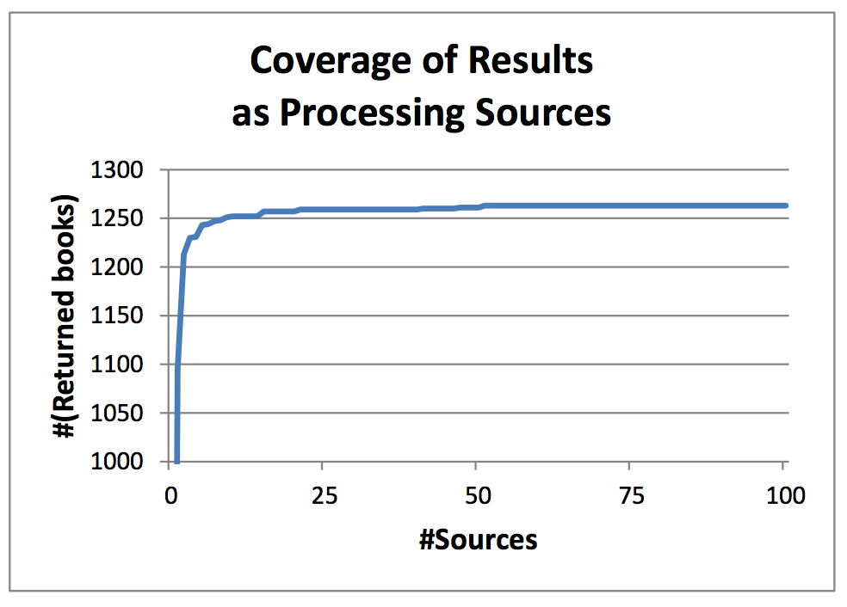
Redundant Data Do Not Bring Much Gain
1260 books from the first 35 sources
All 1265 books from the first 537 sources
In total 894 sources, 1265 CS books
1250 books from the 10 largest sources
1213 books from the 2 largest sources
1096 books from the largest source
CS books from AbeBooks.com

Slide 222
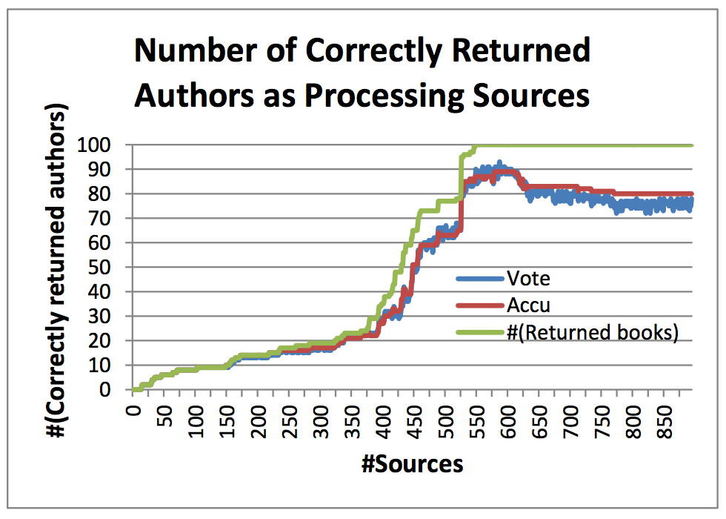
Erroneous Data May Hurt Quality
All 100 books (gold standard) from the first 548 sources
78 books w. correct authors for Vote
80 books w. correct authors for Accu
93 > 80 books w. correct authors after 583 sources (Vote)
90 > 80 books w. correct authors after 579 sources (Accu)
CS books from AbeBooks.com

Slide 223
BDI: Source Selection [DSS13]
How to wisely select sources before integration to balance gain and cost?
Source Selection
Schema Alignment
Record Linkage
Data Fusion

Slide 224
Maximize Quality Under Budget?
17 books w. correct authors from 300 sources (budget)
14 books (17.6% fewer) w. correct authors from the first 200 (33% less resources) sources
CS books from AbeBooks.com

Slide 225
Minimize Cost with Certain Quality?
81 books (25% more) w. correct authors from 526 sources (1% more)
65 books w. correct authors (quality requirement) from the first 520 sources
CS books from AbeBooks.com

Slide 226
Marginalism Principle in Economic Theory
Marginal gain
II
Marginal cost
The law of Diminishing Returns
Largest profit

Slide 227
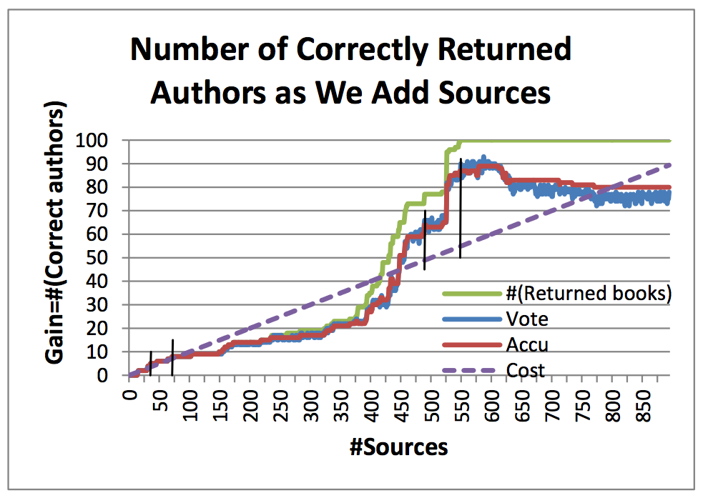
Marginalism for Source Selection
Marginal point with the largest profit in this ordering: 548 sources
Challenge 1. The Law of Diminishing Returns does not necessarily hold, so multiple marginal points
Challenge 2. Each source is different in quality, so different ordering leads to different marginal points: best solution integrates 26 sources
CS books from AbeBooks.com

Slide 228



Future Work
Reconsider the architecture
Data warehousing
Virtual integration

Slide 229
Future Work
Combining different components
Schema Alignment
Record Linkage
Data Fusion

Slide 230
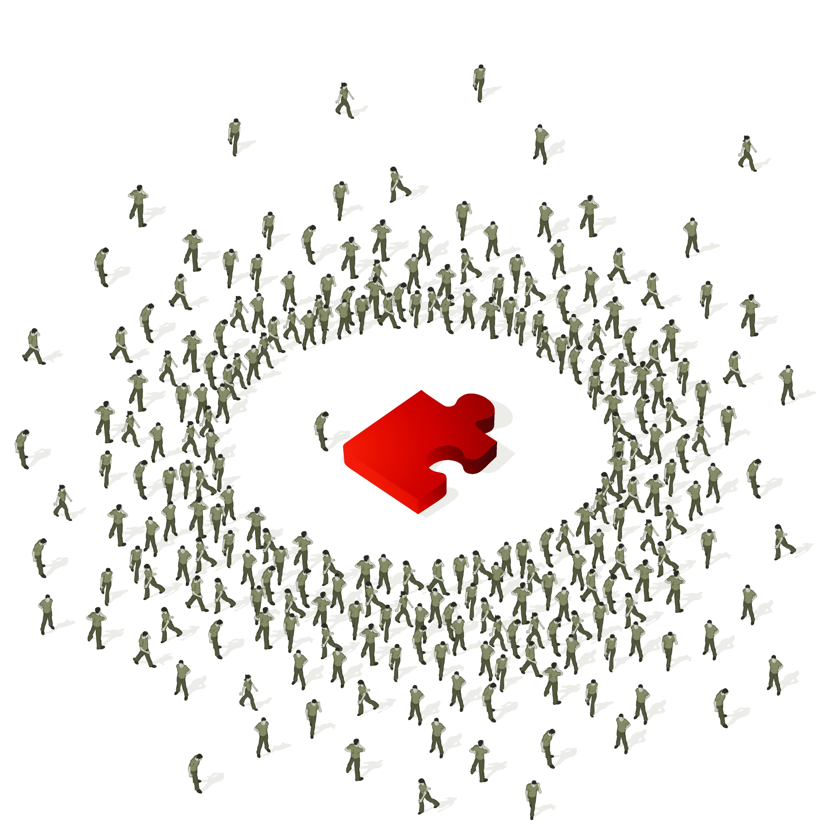
Future Work
Active integration by crowdsourcing

Slide 231

Future Work
Quality diagnosis

Slide 232


Future Work
Source exploration tool
Data.gov

Slide 233

Future Work
Integrate data over time

Slide 234
Conclusions
Big data integration is an important area of research
  Knowledge bases, linked data, geo-spatial fusion, scientific data
Much interesting work has been done in this area
  Schema alignment, record linkage, data fusion
  Challenges due to volume, velocity, variety, veracity
A lot more research needs to be done!

Slide 235
Thank You!

Slide 236
References
[B01] Michael K. Bergman: The Deep Web: Surfacing Hidden Value (2001)
[BBR11] Zohra Bellahsene, Angela Bonifati, Erhard Rahm (Eds.): Schema Matching and Mapping. Springer 2011
[CHW+08] Michael J. Cafarella, Alon Y. Halevy, Daisy Zhe Wang, Eugene Wu, Yang Zhang: WebTables: exploring the power of tables on the web. PVLDB 1(1): 538-549 (2008)
[CHZ05] Kevin Chen-Chuan Chang, Bin He, Zhen Zhang: Toward Large Scale Integration: Building a MetaQuerier over Databases on the Web. CIDR 2005: 44-55

Slide 237
References
[DBS09a] Xin Luna Dong, Laure Berti-Equille, Divesh Srivastava: Integrating Conflicting Data: The Role of Source Dependence. PVLDB 2(1): 550-561 (2009)
[DBS09b] Xin Luna Dong, Laure Berti-Equille, Divesh Srivastava: Truth Discovery and Copying Detection in a Dynamic World. PVLDB 2(1): 562-573 (2009)
[DDH08] Anish Das Sarma, Xin Dong, Alon Y. Halevy: Bootstrapping pay-as-you-go data integration systems. SIGMOD Conference 2008: 861-874
[DDH09] Anish Das Sarma, Xin Luna Dong, Alon Y. Halevy: Data Modeling in Dataspace Support Platforms. Conceptual Modeling: Foundations and Applications 2009: 122-138
[DFG+12] Anish Das Sarma, Lujun Fang, Nitin Gupta, Alon Y. Halevy, Hongrae Lee, Fei Wu, Reynold Xin, Cong Yu: Finding related tables. SIGMOD Conference 2012: 817-828

Slide 238
References
[DHI12] AnHai Doan, Alon Y. Halevy, Zachary G. Ives: Principles of Data Integration. Morgan Kaufmann 2012
[DHY07] Xin Luna Dong, Alon Y. Halevy, Cong Yu: Data Integration with Uncertainty. VLDB 2007: 687-698
[DMP12] Nilesh N. Dalvi, Ashwin Machanavajjhala, Bo Pang: An Analysis of Structured Data on the Web. PVLDB 5(7): 680-691 (2012)
[DNS+12] Uwe Draisbach, Felix Naumann, Sascha Szott, Oliver Wonneberg: Adaptive Windows for Duplicate Detection. ICDE 2012: 1073-1083
[DSS13] Xin Luna Dong, Barna Saha, Divesh Srivastava: Less is More: Selecting Sources Wisely for Integration. PVLDB 6(2): 37-48 (2013)

Slide 239
References
[EIV07] Ahmed K. Elmagarmid, Panagiotis G. Ipeirotis, Vassilios S. Verykios: Duplicate Record Detection: A Survey. IEEE Trans. Knowl. Data Eng. 19(1): 1-16 (2007)
[EMH09] Hazem Elmeleegy, Jayant Madhavan, Alon Y. Halevy: Harvesting Relational Tables from Lists on the Web. PVLDB 2(1): 1078-1089 (2009)
[FHM05] Michael J. Franklin, Alon Y. Halevy, David Maier: From databases to dataspaces: a new abstraction for information management. SIGMOD Record 34(4): 27-33 (2005)

Slide 240
References
[GAM+10] Alban Galland, Serge Abiteboul, Amélie Marian, Pierre Senellart: Corroborating information from disagreeing views. WSDM 2010: 131-140
[GDS+10] Songtao Guo, Xin Dong, Divesh Srivastava, Remi Zajac: Record Linkage with Uniqueness Constraints and Erroneous Values. PVLDB 3(1): 417-428 (2010)
[GM12] Lise Getoor, Ashwin Machanavajjhala: Entity Resolution: Theory, Practice & Open Challenges. PVLDB 5(12): 2018-2019 (2012)

Slide 241
References
[GS09] Rahul Gupta, Sunita Sarawagi: Answering Table Augmentation Queries from Unstructured Lists on the Web. PVLDB 2(1): 289-300 (2009)
[GSH11] Manish Gupta, Yizhou Sun, Jiawei Han: Trust analysis with clustering. WWW (Companion Volume) 2011: 53-54
[HFM06] Alon Y. Halevy, Michael J. Franklin, David Maier: Principles of dataspace systems. PODS 2006: 1-9

Slide 242
References
[JFH08] Shawn R. Jeffery, Michael J. Franklin, Alon Y. Halevy: Pay-as-you-go user feedback for dataspace systems. SIGMOD Conference 2008: 847-860
[KGA+11] Anitha Kannan, Inmar E. Givoni, Rakesh Agrawal, Ariel Fuxman: Matching unstructured product offers to structured product specifications. KDD 2011: 404-412
[KTR12] Lars Kolb, Andreas Thor, Erhard Rahm: Load Balancing for MapReduce-based Entity Resolution. ICDE 2012: 618-629
[KTT+12] Hanna Köpcke, Andreas Thor, Stefan Thomas, Erhard Rahm: Tailoring entity resolution for matching product offers. EDBT 2012: 545-550

Slide 243
References
[LDL+13] Xian Li, Xin Luna Dong, Kenneth B. Lyons, Weiyi Meng, Divesh Srivastava: Truth Finding on the deep web: Is the problem solved? PVLDB, 6(2) (2013)
[LDM+11] Pei Li, Xin Luna Dong, Andrea Maurino, Divesh Srivastava: Linking Temporal Records. PVLDB 4(11): 956-967 (2011)
[LDO+11] Xuan Liu, Xin Luna Dong, Beng Chin Ooi, Divesh Srivastava: Online Data Fusion. PVLDB 4(11): 932-943 (2011)
[LSC10] Girija Limaye, Sunita Sarawagi, Soumen Chakrabarti: Annotating and Searching Web Tables Using Entities, Types and Relationships. PVLDB 3(1): 1338-1347 (2010)

Slide 244
References
[MKB12] Bill McNeill, Hakan Kardes, Andrew Borthwick : Dynamic Record Blocking: Efficient Linking of Massive Databases in MapReduce. QDB 2012
[MKK+08] Jayant Madhavan, David Ko, Lucja Kot, Vignesh Ganapathy, Alex Rasmussen, Alon Y. Halevy: Google's Deep Web crawl. PVLDB 1(2): 1241-1252 (2008)
[MSS10] Claire Mathieu, Ocan Sankur, Warren Schudy: Online Correlation Clustering. STACS 2010: 573-584

Slide 245
References
[PKP+13] George Papadakis, Georgia Koutrika, Themis Palpanas, Wolfgang Nejdl: Meta-blocking: taking entity resolution to the next level. TKDE (2013).
[PIP+12] George Papadakis, Ekaterini Ioannou, Themis Palpanas, Claudia Niederee, Wolfgang Nejdl: A blocking framework for entity resolution in highly heterogeneous information spaces. TKDE (2012)
[PR11] Jeff Pasternack, Dan Roth: Making Better Informed Trust Decisions with Generalized Fact-Finding. IJCAI 2011: 2324-2329
[PR13] Jeff Pasternack, Dan Roth: Latent credibility analysis. WWW 2013: 1009-1020

Slide 246
References
[PRM+12] Aditya Pal, Vibhor Rastogi, Ashwin Machanavajjhala, Philip Bohannon: Information integration over time in unreliable and uncertain environments. WWW 2012: 789-798
[PS12] Rakesh Pimplikar, Sunita Sarawagi: Answering Table Queries on the Web using Column Keywords. PVLDB 5(10): 908-919 (2012)

Slide 247
References
[QAH+13] Guo-Jun Qi, Charu C. Aggarwal, Jiawei Han, Thomas S. Huang: Mining collective intelligence in diverse groups. WWW 2013: 1041-1052
[TIP10] Partha Pratim Talukdar, Zachary G. Ives, Fernando Pereira: Automatically incorporating new sources in keyword search-based data integration. SIGMOD Conference 2010: 387-398
[TJM+08] Partha Pratim Talukdar, Marie Jacob, Muhammad Salman Mehmood, Koby Crammer, Zachary G. Ives, Fernando Pereira, Sudipto Guha: Learning to create data-integrating queries. PVLDB 1(1): 785-796 (2008)
[VCL10] Rares Vernica, Michael J. Carey, Chen Li: Efficient parallel set-similarity joins using MapReduce. SIGMOD Conference 2010: 495-506
[VN12] Tobias Vogel, Felix Naumann: Automatic Blocking Key Selection for Duplicate Detection based on Unigram Combinations. QDB 2012

Slide 248
References
[WGM10] Steven Whang, Hector Garcia-Molina: Entity Resolution with Evolving Rules. PVLDB 3(1): 1326-1337 (2010)
[WGM13] Steven Whang, Hector Garcia-Molina: Incremental Entity Resolution on Rules and Data. VLDB J. (2013)
[WYD+04] Wensheng Wu, Clement T. Yu, AnHai Doan, Weiyi Meng: An Interactive Clustering-based Approach to Integrating Source Query interfaces on the Deep Web. SIGMOD Conference 2004: 95-106

Slide 249
References
[YHY08] Xiaoxin Yin, Jiawei Han, Philip S. Yu: Truth Discovery with Multiple Conflicting Information Providers on the Web. IEEE Trans. Knowl. Data Eng. 20(6): 796-808 (2008)
[YT11] Xiaoxin Yin, Wenzhao Tan: Semi-supervised truth discovery. WWW 2011: 217-226
[ZH12] Bo Zhao, Jiawei Han: A probabilistic model for estimating real-valued truth from conflicting sources. QDB 2012
[ZRG+12] Bo Zhao, Benjamin I. P. Rubinstein, Jim Gemmell, Jiawei Han: A Bayesian Approach to Discovering Truth from Conflicting Sources for Data Integration. PVLDB 5(6): 550-561 (2012)

