Slide 1
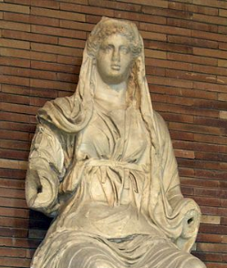
Ceres: Harvesting Knowledge from Semi-Structured Web
Xin Luna Dong, Amazon
July, 2019

Slide 2
Knowledge Graph Example
Entity
name
“Robin Wright”
name
starring
mid127
“Robin Wright Penn”
name
name
mid345
“罗宾·怀特”
“Forrest Gump”
starring
directed_by
name
Movie
type
mid128
“Tom Hanks”
type
starring
birth_date
July 9th, 1956
“Larry Crowne”
mid346
name
name
starring
mid129
“Julia Roberts”
Entity type
Relationship
type
Person

Slide 3

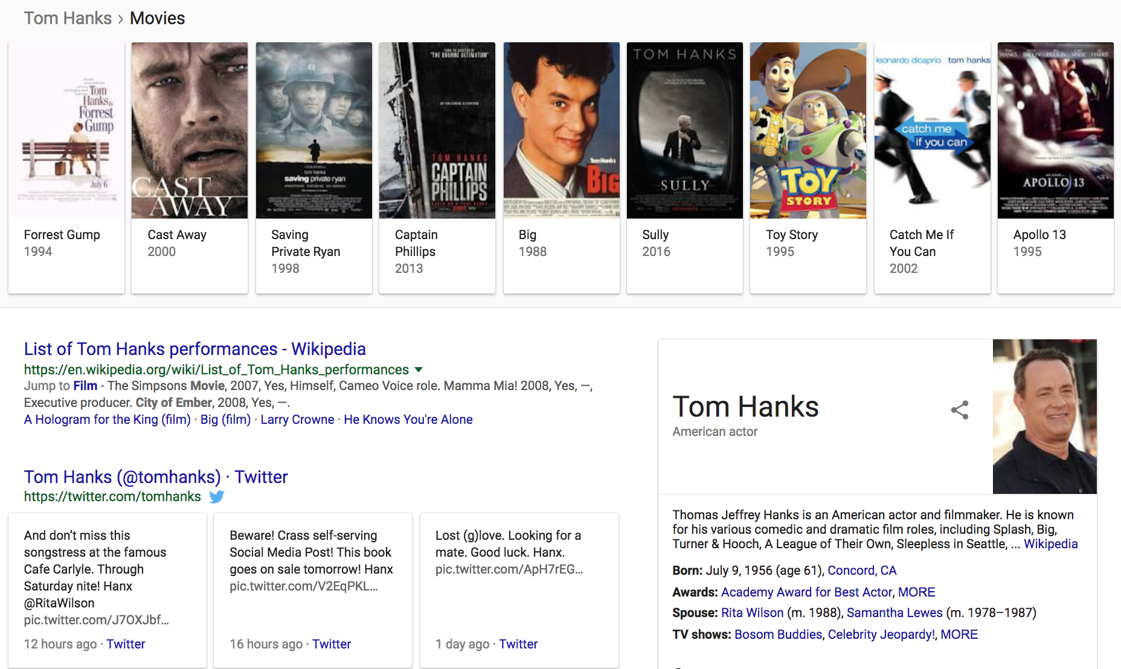
Knowledge Graph in Search

Slide 4

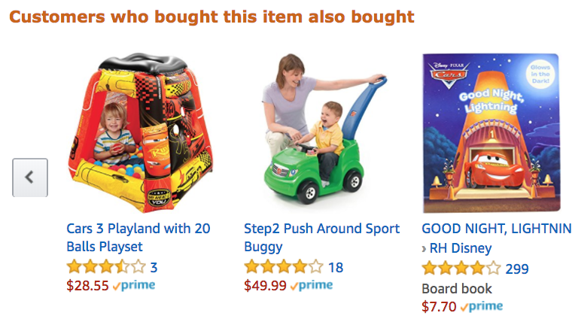
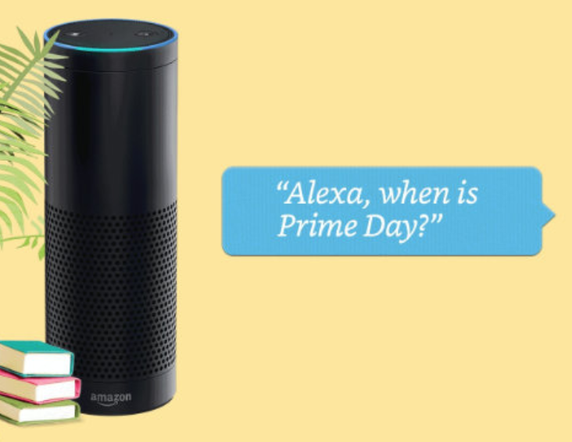
Product Graph
Mission: To answer any question about products and related knowledge in the world

Slide 5
Where Are We in Building Knowledge Graphs?

Slide 6
Knowledge Graph Type I: Rich Graph
Entity
name
“Robin Wright”
name
starring
mid127
“Robin Wright Penn”
name
name
mid345
“罗宾·怀特”
“Forrest Gump”
starring
directed_by
name
Movie
type
mid128
“Tom Hanks”
type
starring
birth_date
July 9th, 1956
“Larry Crowne”
mid346
name
name
starring
mid129
“Julia Roberts”
Entity type
Relationship
type
Person

Slide 7
Knowledge Graph Type I: Rich Graph
Rich Graph
    Comprehensive ontology on a few verticals
    Rich data collected from a few sources in each vertical
    Wiki (Wikipedia, WikiData) to cover the rest of verticals
Example: Freebase
    1500 types, 35K predicates
    130M entities, 2.3B triples

Slide 8
Knowledge Graph Type II: Broad Graph
Tide Plus Feb…
Tide Plus Col…
type
function
brand
form
HE
function
Detergent
Odor remover
Tide
Liquid
No
Detergent

Slide 9
Knowledge Graph Type II: Broad Graph
[ICDE’19]
Broad Graph
    Bi-partite graph
    Start with core types and relationships
    Grow and clean the graph in a pay-as-you-go fashion
Example: Amazon Product Graph
    Coverage: +8%~68%
    Accuracy: +2%~22%
    Ontology design and extension: 2W

Slide 10
From Broad Graph to Rich Graph
Broad, shallow
graph
Rich, deep graph

Slide 11
Knowledge Graph Types
Rich Graph: e.g., Freebase, Google KG, Bing KG
Broad Graph: e.g., Amazon Product Graph
Commonality
  Build a graph for each vertical and then assemble graphs for different verticals
  Collect knowledge from a few sources
  Apply techniques such as data extraction, integration, cleaning

Slide 12

Still Missing A Lot of Long-tail Knowledge
 | A₁ | A₂ | A₃ | A₄ | A₅ | A₆ | ... | ... | A_{n} | UNKNOWN ATTRIBUTES
E₁
E₂ |  |  |  |  | EXISTING KNOWLEDGE
E₃
E₄
E₅
E₆
... |  |  | UNKNOWN VALUES
E_{m}
UNKNOWN ENTITIES
Head knowledge curated, integrated, and cleaned from large data sets
Missing long-tail knowledge

Slide 13
Still Missing A Lot of Long-tail Knowledge
 | A₁ | A₂ | A₃ | A₄ | A₅ | A₆ | ... | ... | A_{n} | UNKNOWN ATTRIBUTES
E₁
E₂ |  |  |  |  | EXISTING KNOWLEDGE
E₃
E₄
E₅
E₆
... |  |  | UNKNOWN VALUES
E_{m}
UNKNOWN ENTITIES
- Alexa, does Taylor Swift have a pet?
- Yes, Taylor Swift has at least one nickname
- Alexa, when did Van Gogh live in Paris?
- Sorry, I’m not sure.
- Alexa, tell me the recent movies by Ziyi Zhang
- Sorry, I don’t know that
- Alexa, which body part does the lotus position in yoga stretch?
- Here’s something I found on Wikipedia: Lotus position is…

Slide 14
Still Missing A Lot of Long-tail Knowledge
 | A₁ | A₂ | A₃ | A₄ | A₅ | A₆ | ... | ... | A_{n} | UNKNOWN ATTRIBUTES
E₁
E₂ |  |  |  |  | EXISTING KNOWLEDGE
E₃
E₄
E₅
E₆
... |  |  | UNKNOWN VALUES
E_{m}
UNKNOWN ENTITIES
How can we collect long-tail knowledge

Slide 15
Our Mission
Leaving NO Valuable Data Behind

Slide 16

How to Scale Up Knowledge Graph Construction?
Hierarchy of thousands of types
Thousands-to-millions of sources
One vertical,
A few sources
Big challenge: Limited training labels for large-scale, rich data
Effective search, mining and analysis

Slide 17
How to Get to the Next Level of Success?
Challenges: Limited training labels for large-scale,
rich data
Solution: Unsupervised learning
✘

Slide 18
How to Get to the Next Level of Success?
Challenges: Limited training labels for large-scale,
rich data
Solution: Learning with limited labels
  Active learning
  Weak learning (e.g., distance supervision, data programming)
  Semi-supervised learning (e.g., graph-based learning)
  Transfer learning
  Meta-learning (including one/few-shot learning)
✓

Slide 19
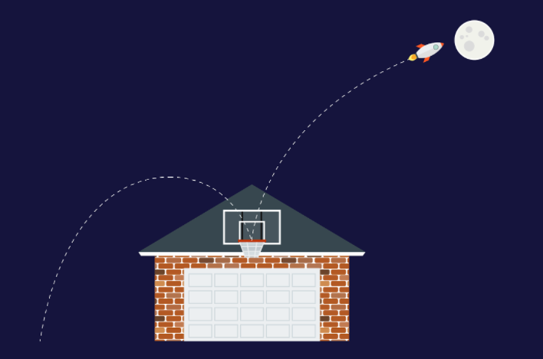
Research Philosophy
Moonshots: Strive to apply and invent the state-of-the-art
Roofshots: Deliver incrementally and make production impacts

Slide 20
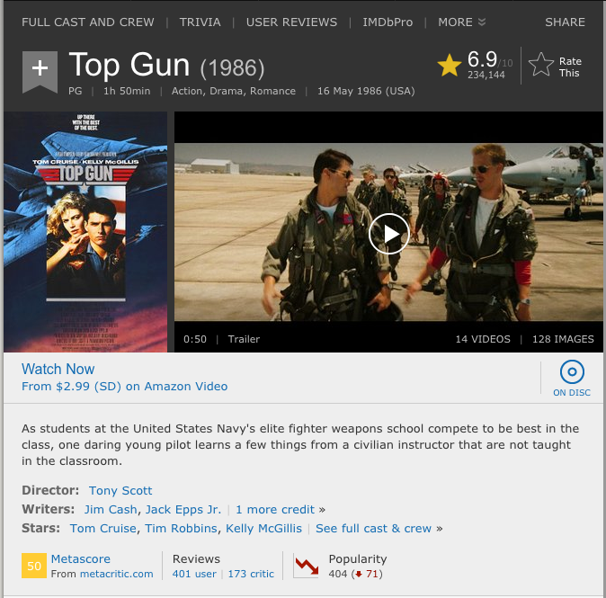
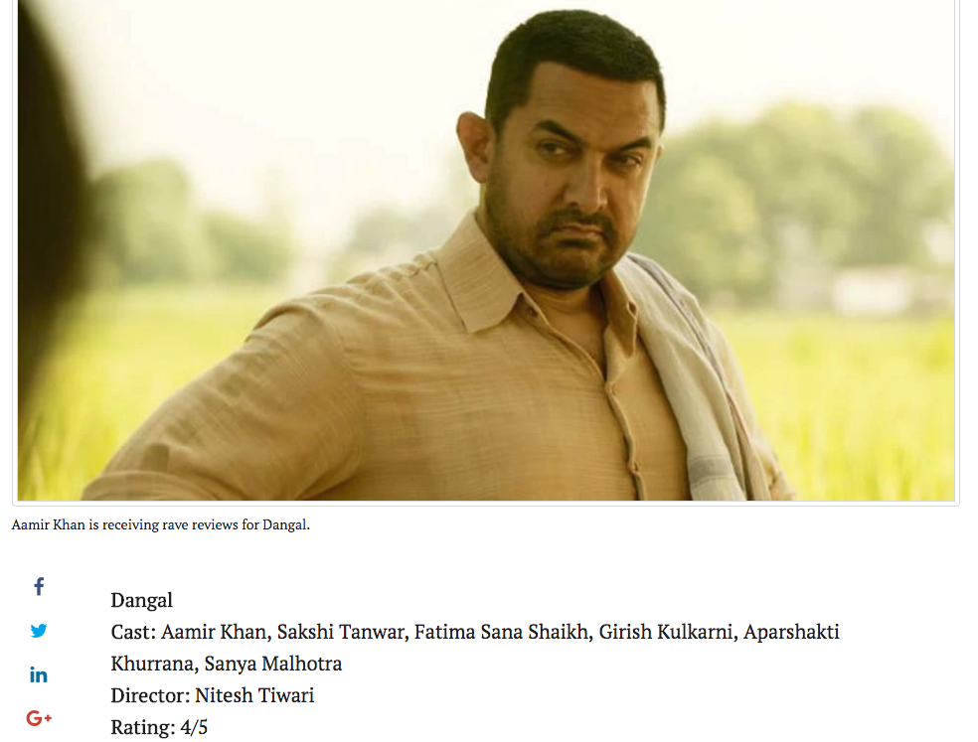
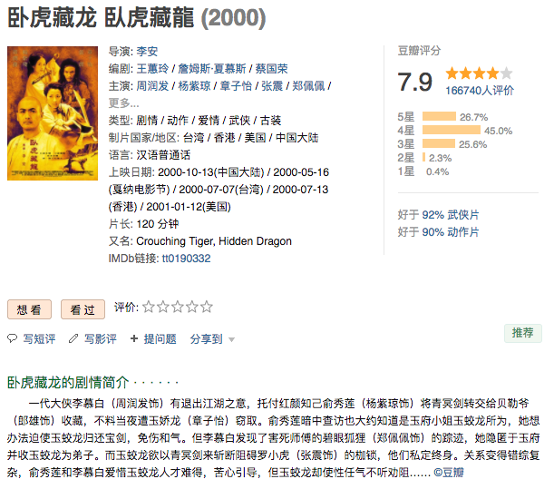
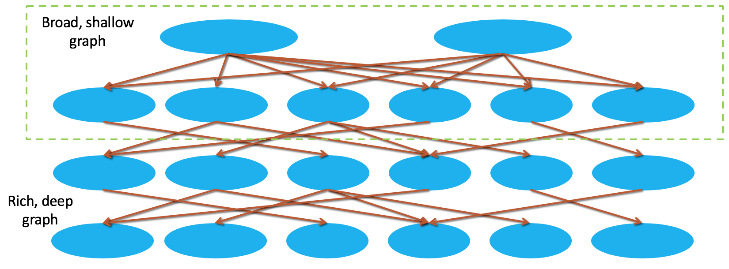
Moonshot: Open Knowledge Extraction and QA from Semi-Structured Web
QA
Notes:
Galaxy

Slide 21
Why Semi-Structured Websites?

Slide 22
Semi-Structured Data on the Web

Slide 23
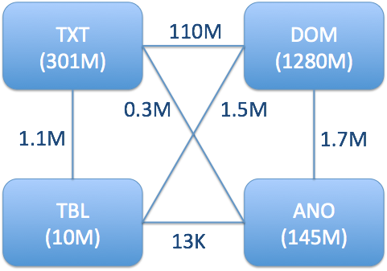
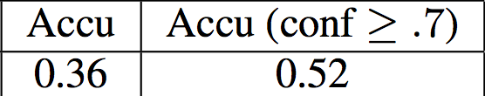
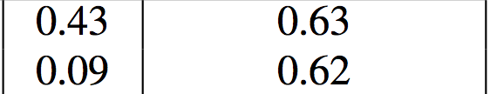
Big Promise from Semi-Structured Data
Knowledge Vault @ Google showed big potential from DOM-tree extraction [Dong et al., KDD’14][Dong et al., VLDB’14]

Slide 24
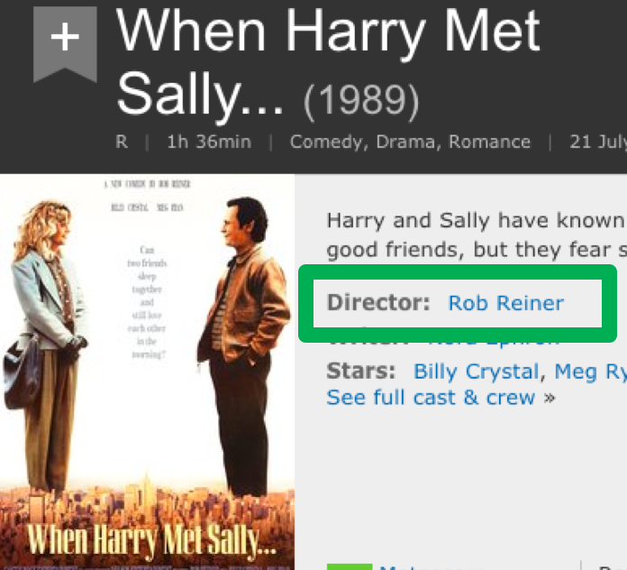
ClosedIE from Semi-Structured Web
ClosedIE: Only extracting facts corresponding to ontology
  (“When Harry Met Sally…”, film.film.directed_by, “Rob Reiner”)

Slide 25

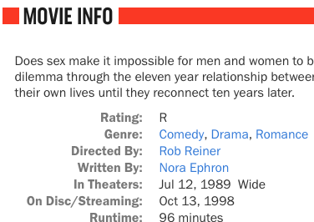
ClosedIE from Semi-Structured Web
ClosedIE: Normalize predicates by ontology
  (“When Harry Met Sally…”, film.film.directed_by, “Rob Reiner”)

Slide 26
Knowledge Gap to Fill by ClosedIE
 | A₁ | A₂ | A₃ | A₄ | A₅ | A₆ | ... | ... | A_{n} | UNKNOWN ATTRIBUTES
E₁
E₂ |  |  |  |  | EXISTING KNOWLEDGE
E₃
E₄
E₅
E₆
...
E_{m}
UNKNOWN ENTITIES
 |  |  |  | ClosedIE

Slide 27
OpenIE from Semi-Structured Web
ClosedIE: Only extracting facts corresponding to ontology
  (“When Harry Met Sally…”, film.film.directed_by, “Rob Reiner”)
OpenIE: Extract all relations expressed on the webpage
  (“When Harry Met Sally…”,
  “Director”, “Rob Reiner”)

Slide 28
OpenIE from Semi-Structured Web
ClosedIE: Normalize predicates by ontology
  (“When Harry Met Sally…”, film.film.directed_by, “Rob Reiner”)
OpenIE: Predicates are unnormalized strings
  (“When Harry Met Sally…”,
  “Directed By”, “Rob Reiner”)

Slide 29
OpenIE from Semi-Structured Web
(“When Harry Met Sally”, “Rating:”, “R”)
(“When Harry Met Sally”, “Genre:”, “Comedy”)
(“When Harry Met Sally”, “Genre:”, “Drama”)
(“When Harry Met Sally”, “Genre:”, “Romance”)
(“When Harry Met Sally”, “Directed By:”, “Rob Reiner”)
(“When Harry Met Sally”, “Written By:”, “Nora Ephron”)
(“When Harry Met Sally”, “In Theaters”, “Jul 12, 1989 Wide”)
(“When Harry Met Sally”, “On Disc/Streaming”, “Oct 13, 1998”)
(“When Harry Met Sally”, “Runtime”, “96 minutes”)

Slide 30
OpenIE from Semi-Structured Web
(“When Harry Met Sally”, “Rating:”, “R”)
(“When Harry Met Sally”, “Genre:”, “Comedy”)
(“When Harry Met Sally”, “Genre:”, “Drama”)
(“When Harry Met Sally”, “Genre:”, “Romance”)
(“When Harry Met Sally”, “Directed By:”, “Rob Reiner”)
(“When Harry Met Sally”, “Written By:”, “Nora Ephron”)
(“When Harry Met Sally”, “In Theaters”, “Jul 12, 1989 Wide”)
(“When Harry Met Sally”, “On Disc/Streaming”, “Oct 13, 1998”)
(“When Harry Met Sally”, “Runtime”, “96 minutes”)

Slide 31
Knowledge Gap To Fill by OpenIE
 | A₁ | A₂ | A₃ | A₄ | A₅ | A₆ | ... | ... | A_{n} | UNKNOWN ATTRIBUTES
E₁
E₂ |  |  |  |  | EXISTING KNOWLEDGE
E₃
E₄
E₅
E₆
...
E_{m} |  |  |  |  |  |  |  |  |  |  | OpenIE
UNKNOWN ENTITIES
 |  |  |  | ClosedIE

Slide 32
Okay, Isn’t This Trivial?

Slide 33
Knowledge Extraction from Semi-Structured Web
Opportunities
    Large volume of semi-structured data on Web
    Similar format for webpages from the same website
Challenges
    Formatting can vary slightly on different webpages
    Data are formatted differently across websites
    Impossible to manually collect training data for each predicate on each website

Slide 34
Knowledge Extraction from
Semi-Structured Web
Title
Genre
Release Date
Extracted relationships
(Top Gun, type.object.name, “Top Gun”)
(Top Gun, film.film.genre, Action)
(Top Gun, film.film.directed_by, Tony Scott)
(Top Gun, film.film.starring, Tom Cruise)
(Top Gun, film.film.runtime, “1h 50min”)
(Top Gun, film.film.release_Date_s, “16 May 1986”)
Runtime
Director
Actors

Slide 35
Knowledge Extraction from Semi-Structured Web
Opportunities
    Large volume of semi-structured data on Web
    Similar format for webpages from the same website
Challenges
    Formatting can vary slightly on different webpages
    Data are formatted differently across websites
    Impossible to manually collect training data for each predicate on each website

Slide 36
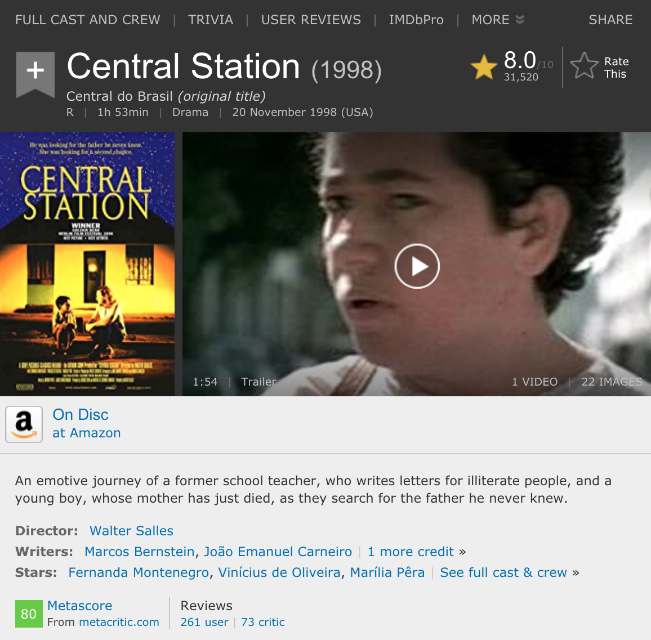
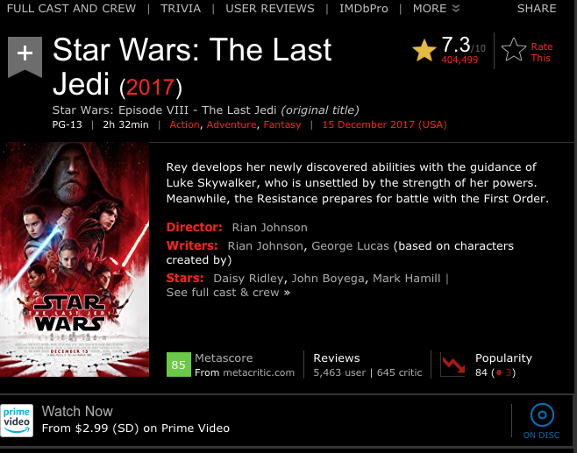
Ceres: Knowledge Extraction from
Semi-Structured Web
Same pred may corr. to diff DOM tree nodes

Slide 37
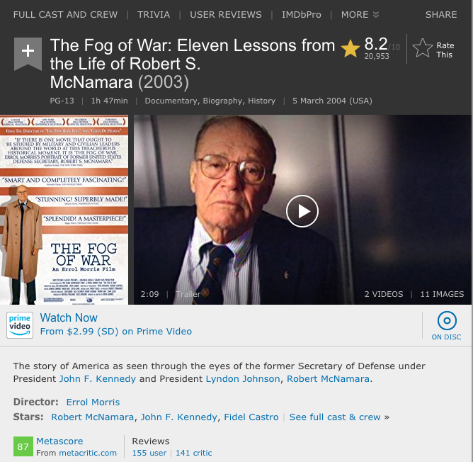
Ceres: Knowledge Extraction from
Semi-Structured Web
Same DOM tree node may correspond to diff preds

Slide 38
Knowledge Extraction from Semi-Structured Web
Opportunities
    Large volume of semi-structured data on Web
    Similar format for webpages from the same website
Challenges
    Formatting can vary slightly on different webpages
    Data are formatted differently across websites
    Impossible to manually collect training data for each predicate on each website

Slide 39
Semi-Structured Data on the Web

Slide 40
Knowledge Extraction from Semi-Structured Web
Opportunities
    Large volume of semi-structured data on Web
    Similar format for webpages from the same website
Challenges
    Formatting can vary slightly on different webpages
    Data are formatted differently across websites
    Impossible to manually collect training data for each predicate on each website

Slide 41
How to Harvest Knowledge from Semi-Structured Web?

Slide 42
Ceres: Open Knowledge Extraction and QA from Semi-Structured Web
 | A₁ | A₂ | A₃ | A₄ | A₅ | A₆ | ... | ... | A_{n} | UNKNOWN ATTRIBUTES
E₁
E₂ |  |  |  |  | EXISTING KNOWLEDGE
E₃
E₄
E₅
E₆
...
E_{m}
UNKNOWN ENTITIES
ClosedIE
Knowledge
Graph
Schema
Alignment
Search/QA
Open KG
OpenIE
 | A₁ | A₂ | A₃ | A₄ | A₅ | A₆ | ... | ... | A_{n} | UNKNOWN ATTRIBUTES
E₁
E₂ |  |  |  |  | EXISTING KNOWLEDGE
E₃
E₄
E₅
E₆
...
E_{m}
UNKNOWN ENTITIES
Notes:
Galaxy

Slide 43
Ceres: Open Knowledge Extraction and QA from Semi-Structured Web
 | A₁ | A₂ | A₃ | A₄ | A₅ | A₆ | ... | ... | A_{n} | UNKNOWN ATTRIBUTES
E₁
E₂ |  |  |  |  | EXISTING KNOWLEDGE
E₃
E₄
E₅
E₆
...
E_{m}
UNKNOWN ENTITIES
ClosedIE
Knowledge
Graph
Schema
Alignment
Search/QA
Open KG
OpenIE
 | A₁ | A₂ | A₃ | A₄ | A₅ | A₆ | ... | ... | A_{n} | UNKNOWN ATTRIBUTES
E₁
E₂ |  |  |  |  | EXISTING KNOWLEDGE
E₃
E₄
E₅
E₆
...
E_{m}
UNKNOWN ENTITIES
Notes:
Galaxy

Slide 44
Review: Distant Supervision
Relation
Annotation
Training
(on noisy labels)
Corpus Text
Training Data
Bill Gates founded Microsoft in 1975.
Bill Gates, founder of Microsoft, …
Bill Gates attended Harvard from …
Google was founded by Larry Page ...
Freebase
(Bill Gates, Founder, Microsoft)
(Larry Page, Founder, Google)
(Bill Gates, CollegeAttended, Harvard)
[Adapted example from Luke Zettlemoyer]

Slide 45
Review: Distant Supervision
Relation
Annotation
Training
(on noisy labels)
Corpus Text
Training Data
Bill Gates founded Microsoft in 1975.
Bill Gates, founder of Microsoft, …
Bill Gates attended Harvard from …
Google was founded by Larry Page ...
(Bill Gates, Microsoft)
Label: Founder
Feature: X founded Y
Freebase
Founder: (Bill Gates, Microsoft)
Founder: (Larry Page, Google)
CollegeAttended: (Bill Gates, Harvard)
(Bill Gates, Founder, Microsoft)
(Larry Page, Founder, Google)
(Bill Gates, CollegeAttended, Harvard)
[Adapted example from Luke Zettlemoyer]

Slide 46
Review: Distant Supervision
Relation
Annotation
Training
(on noisy labels)
Corpus Text
Training Data
Bill Gates founded Microsoft in 1975.
Bill Gates, founder of Microsoft, …
Bill Gates attended Harvard from …
Google was founded by Larry Page ...
(Bill Gates, Microsoft)
Label: Founder
Feature: X founded Y
Feature: X, founder of Y
Freebase
(Bill Gates, Founder, Microsoft)
(Larry Page, Founder, Google)
(Bill Gates, CollegeAttended, Harvard)
[Adapted example from Luke Zettlemoyer]

Slide 47
Review: Distant Supervision
Relation
Annotation
Training
(on noisy labels)
Corpus Text
Training Data
Bill Gates founded Microsoft in 1975.
Bill Gates, founder of Microsoft, …
Bill Gates attended Harvard from …
Google was founded by Larry Page ...
(Bill Gates, Microsoft)
Label: Founder
Feature: X founded Y
Feature: X, founder of Y
Freebase
(Bill Gates, Harvard)
Label: CollegeAttended
Feature: X attended Y
Founder: (Bill Gates, Microsoft)
Founder: (Larry Page, Google)
CollegeAttended: (Bill Gates, Harvard)
Founder: (Bill Gates, Microsoft)
Founder: (Larry Page, Google)
CollegeAttended: (Bill Gates, Harvard)
(Bill Gates, Founder, Microsoft)
(Larry Page, Founder , Google)
(Bill Gates, CollegeAttended, Harvard)
[Adapted example from Luke Zettlemoyer]

Slide 48
ClosedIE Solution: Distant Supervision [VLDB’18]
Entity
Identification
Relation
Annotation
Training
(on noisy labels)
Automatic Label Generation
Movie entity
Genre
Release Date
Extracted triples
(Top Gun, type.object.name, “Top Gun”)
(Top Gun, film.film.genre, Action)
(Top Gun, film.film.directed_by, Tony Scott)
(Top Gun, film.film.starring, Tom Cruise)
(Top Gun, film.film.runtime, “1h 50min”)
(Top Gun, film.film.release_Date_s, “16 May 1986”)
Runtime
Director
Actors

Slide 49
ClosedIE Solution: Distant Supervision [VLDB’18]
Entity
Identification
Relation
Annotation
Training
(on noisy labels)
Automatic Label Generation
Key to success
    2-Step annotation to automatically create training labels from seed knowledge
    Leverage similarity across webpages in the same website to improve labelling accuracy

Slide 50
ClosedIE Solution: Distant Supervision [VLDB’18]
Weak learning
Entity
Identification
Relation
Annotation
Training
(on noisy labels)
Automatic Label Generation
Key to success
    2-Step annotation to automatically create training labels from seed knowledge
    Leverage similarity across webpages in the same website to improve labelling accuracy

Slide 51
Ceres: Automatic Knowledge Extraction from Semi-structured Web [VLDB’18]
Extraction experiments on http://swde.codeplex.com/ (2011)
 | Vertex (Gulhane et al, 2011) |  |  |  | Ceres
 | Prec | Rec | F1 | #Pred | Prec | Rec | F1 | #Pred
Movie | 0.97 | 0.97 | 0.97 | 4 | 0.97 | 0.99 | 0.98 | 4
NBAPlayer | 1.00 | 1.00 | 1.00 | 4 | 0.98 | 0.98 | 0.98 | 4
University | 0.99 | 0.98 | 0.99 | 4 | 0.87 | 0.94 | 0.90 | 4
Book | 0.93 | 0.93 | 0.93 | 5 | 0.94 | 0.63 | 0.70 | 5
Very high precision
Competent w. rule-based wrapper induction
Notes:
Change the numbers here

Slide 52
Ceres: Automatic Knowledge Extraction from Semi-structured Web [VLDB’18]
Extraction on long-tail movie websites
#Websites / #Webpages | 33 / 434K
Language | English and 6 other languages
Domains | Animated films, Documentary films, Financial performance, etc.
# Annotated pages | 70K (16%)
Annotated : Extracted #entities | 1 : 2.6
Annotated : Extracted #triples | 1 : 3.0
# Extractions | 1.25 M
Precision | 90%
Notes:
Change the numbers here

Slide 53
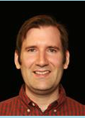
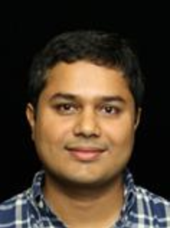
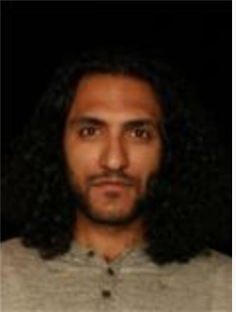
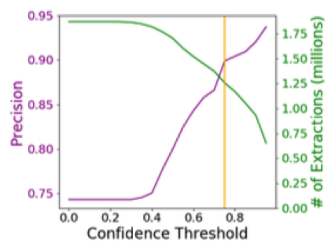
Ceres: Automatic Knowledge Extraction from Semi-structured Web [VLDB’18]
Extraction on long-tail movie websites
Notes:
Change the numbers here

Slide 54
ClosedIE on Semi-Structured Web Data
 | A₁ | A₂ | A₃ | A₄ | A₅ | A₆ | ... | ... | A_{n} | UNKNOWN ATTRIBUTES
E₁
E₂ |  |  |  |  | EXISTING KNOWLEDGE
E₃
E₄
E₅
E₆
...
E_{m}
UNKNOWN ENTITIES
 |  |  |  | ClosedIE

Slide 55
Ceres: Open Knowledge Extraction and QA from Semi-Structured Web
 | A₁ | A₂ | A₃ | A₄ | A₅ | A₆ | ... | ... | A_{n} | UNKNOWN ATTRIBUTES
E₁
E₂ |  |  |  |  | EXISTING KNOWLEDGE
E₃
E₄
E₅
E₆
...
E_{m}
UNKNOWN ENTITIES
ClosedIE
Knowledge
Graph
Schema
Alignment
Search/QA
Open KG
OpenIE
 | A₁ | A₂ | A₃ | A₄ | A₅ | A₆ | ... | ... | A_{n} | UNKNOWN ATTRIBUTES
E₁
E₂ |  |  |  |  | EXISTING KNOWLEDGE
E₃
E₄
E₅
E₆
...
E_{m}
UNKNOWN ENTITIES
Notes:
Galaxy

Slide 56
OpenCeres: OpenIE Knowledge Extraction from Semi-Structured Web [NAACL’19]
ClosedIE: Only extracting facts corresponding to ontology
  (“When Harry Met Sally…”, film.film.directed_by, “Rob Reiner”)
OpenIE: Extract all relations expressed on the webpage
  (“When Harry Met Sally…”,
  “Director”, “Rob Reiner”)

Slide 57
OpenCeres: OpenIE Knowledge Extraction from Semi-Structured Web [NAACL’19]
ClosedIE: Normalize predicates by ontology
  (“When Harry Met Sally…”, film.film.directed_by, “Rob Reiner”)
OpenIE: Predicates are unnormalized strings
  (“When Harry Met Sally…”,
  “Directed By”, “Rob Reiner”)

Slide 58
OpenCeres: OpenIE Knowledge Extraction from Semi-Structured Web [NAACL’19]
(“When Harry Met Sally”, “Rating:”, “R”)
(“When Harry Met Sally”, “Genre:”, “Comedy”)
(“When Harry Met Sally”, “Genre:”, “Drama”)
(“When Harry Met Sally”, “Genre:”, “Romance”)
(“When Harry Met Sally”, “Directed By:”, “Rob Reiner”)
(“When Harry Met Sally”, “Written By:”, “Nora Ephron”)
(“When Harry Met Sally”, “In Theaters”, “Jul 12, 1989 Wide”)
(“When Harry Met Sally”, “On Disc/Streaming”, “Oct 13, 1998”)
(“When Harry Met Sally”, “Runtime”, “96 minutes”)

Slide 59
OpenCeres: OpenIE Knowledge Extraction from Semi-Structured Web [NAACL’19]
(“When Harry Met Sally”, “Rating:”, “R”)
(“When Harry Met Sally”, “Genre:”, “Comedy”)
(“When Harry Met Sally”, “Genre:”, “Drama”)
(“When Harry Met Sally”, “Genre:”, “Romance”)
(“When Harry Met Sally”, “Directed By:”, “Rob Reiner”)
(“When Harry Met Sally”, “Written By:”, “Nora Ephron”)
(“When Harry Met Sally”, “In Theaters”, “Jul 12, 1989 Wide”)
(“When Harry Met Sally”, “On Disc/Streaming”, “Oct 13, 1998”)
(“When Harry Met Sally”, “Runtime”, “96 minutes”)

Slide 60
OpenIE Solution: Belief Propagation [NAACL’19]
Auto (Pred, Obj)
Annotation
Label
Propagation
Training
Obj
Obj
Obj
Obj
Extracted triples
(“Top Gun”, “Director”, “Tony Scott”)
(“Top Gun”, “Writers”, “Jim Cash”)
(“Top Gun”, “Writers”, “Jack Epps Jr.”)
(“Top Gun”, “Stars”, “Tom Cruise”)
(“Top Gun”, “Stars”, “Tim Robbins”)
Obj
Obj
(Pred, Obj)
(Pred, Obj)
(Pred, Obj)

Slide 61
OpenIE Solution: Belief Propagation [NAACL’19]
Semi-supervised learning
Auto (Pred, Obj)
Annotation
Label
Propagation
Training
Obj
Obj
Obj
Obj
Extracted triples
(“Top Gun”, “Director”, “Tony Scott”)
(“Top Gun”, “Writers”, “Jim Cash”)
(“Top Gun”, “Writers”, “Jack Epps Jr.”)
(“Top Gun”, “Stars”, “Tom Cruise”)
(“Top Gun”, “Stars”, “Tim Robbins”)
Obj
Obj
(Pred, Obj)
(Pred, Obj)
(Pred, Obj)

Slide 62
OpenCeres: OpenIE Knowledge Extraction from Semi-Structured Web [NAACL’19]
Extraction experiments on http://swde.codeplex.com/ (2019)
 | Vertex (Gulhane et al, 2011) |  |  |  | Ceres |  |  |  | OpenCeres
 | Prec | Rec | F1 | #Pred | Prec | Rec | F1 | #Pred | Prec | Rec | F1 | #Pred
Movie | 0.97 | 0.97 | 0.97 | 4 | 0.97 | 0.99 | 0.98 | 4 | 0.77 | 0.68 | 0.72 | 18
NBAPlayer | 1.00 | 1.00 | 1.00 | 4 | 0.98 | 0.98 | 0.98 | 4 | 0.74 | 0.48 | 0.58 | 17
University | 0.99 | 0.98 | 0.99 | 4 | 0.87 | 0.94 | 0.90 | 4 | 0.65 | 0.29 | 0.40 | 92
Book | 0.93 | 0.93 | 0.93 | 5 | 0.94 | 0.63 | 0.70 | 5 | - | - | - | -
Precision much lower
Much more predicates

Slide 63
OpenCeres: OpenIE Knowledge Extraction from Semi-Structured Web [NAACL’19]
Movie
  Seed: Director, Writer, Producer, Actor, Release Date, Genre, Alternate Title
  New: Country, Filmed In, Language, MPAA Rating, Set In, Reviewed by, Studio, Metascore, Box Office, Distributor, Tagline, Budget, Sound Mix
NBA Player
  Seed: Height, Weight, Team
  New: Birth Date, Birth Place, Salary, Age, Experience, Position, College, Year Drafted
University
  Seed: Phone Number, Web address, Type (public/private)
  New: Calendar System, Enrollment, Highest Degree, Local Area, Student Services, President

Slide 64
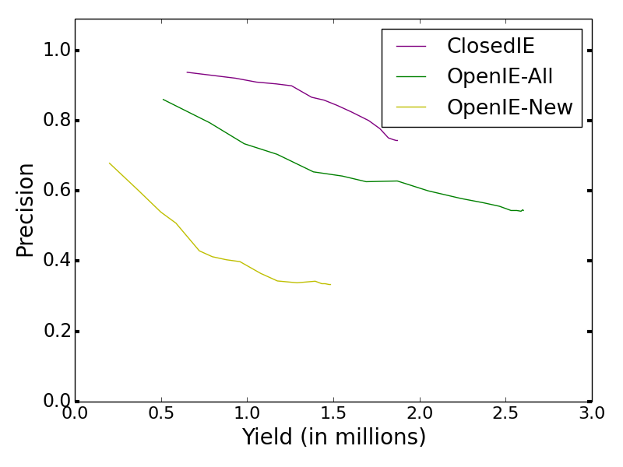
OpenCeres: OpenIE Knowledge Extraction from Semi-Structured Web [NAACL’19]
Extraction on long-tail movie websites
OpenIE added significant amount of knowledge
Still need prec improvement on new relations

Slide 65
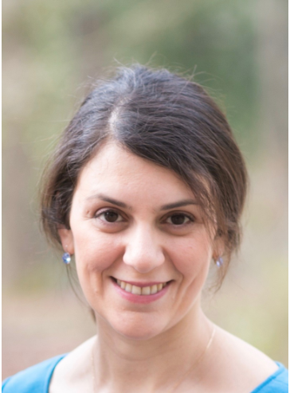
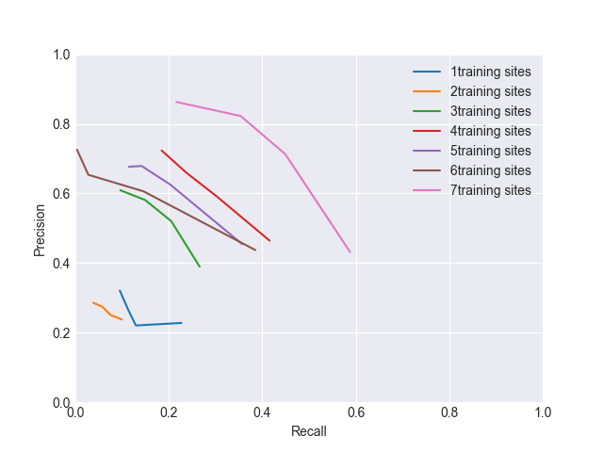
Across-Site Ceres : OpenIE Across
Websites (Preliminary Results)
Learning from a few websites and apply on a new sites
Reasonable prec across websites
The more training data, the better

Slide 66
Ceres: Open Knowledge Extraction and QA from Semi-Structured Web
ClosedIE
Knowledge
Graph
Schema
Alignment
Search/QA
Open KG
OpenIE
Notes:
Galaxy

Slide 67
Relation Alignment—Motivation
Are they the same relationship?—Important for OpenIE

Slide 68

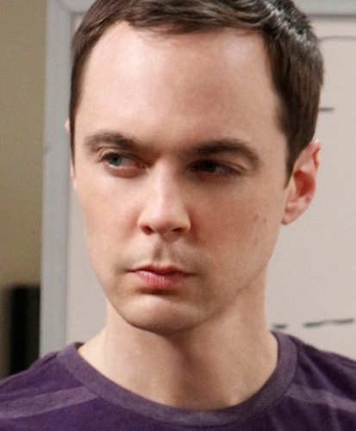
Relation Alignment—More Intuition
P2
OpenIE
KB
“Cast:”
M1
M1
Both entities known
“Full cast and crew”
Neighbor’s power
@film.actor
@film.director
One entity unknown
P1
P1
Both entities unknown
@film.director
@film.director
M2
M3

Slide 69

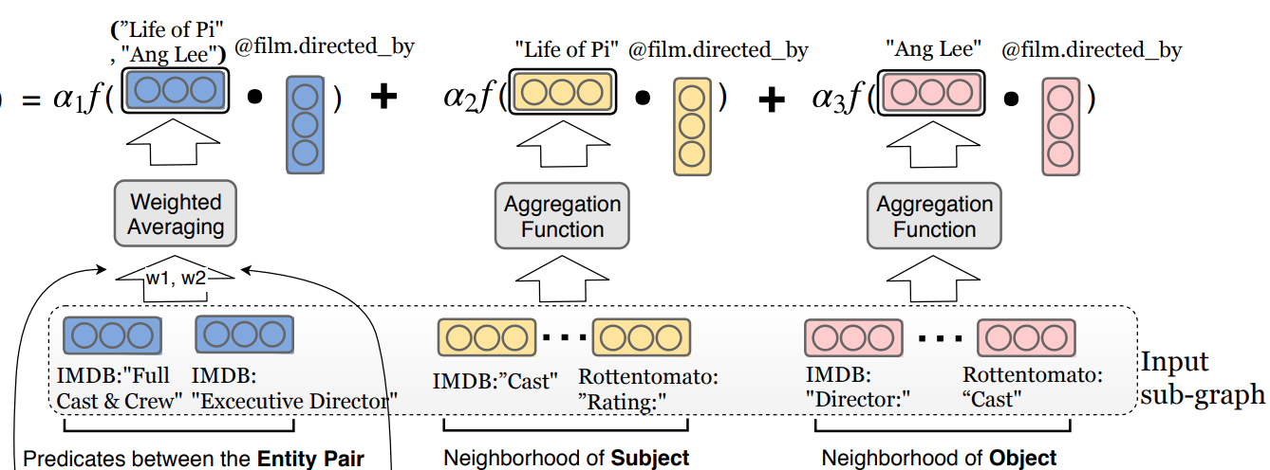
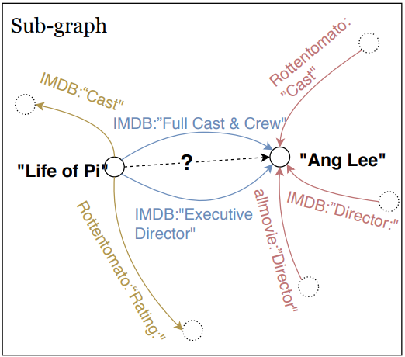
OpenKI: Universal Schema to Cluster OpenIE Predicates [NAACL’19]
Alignment between existing relations and predicted relation
Consistency between object’s neighbors and predicted relation

Slide 70
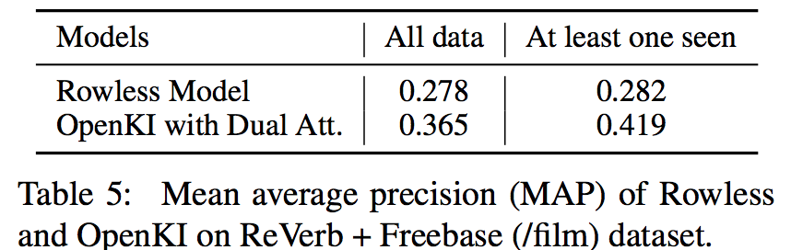
OpenKI: Universal Schema to Cluster OpenIE Predicates [NAACL’19]
Both known
One unknown
Both unknown
Consider neighbors help

Slide 71
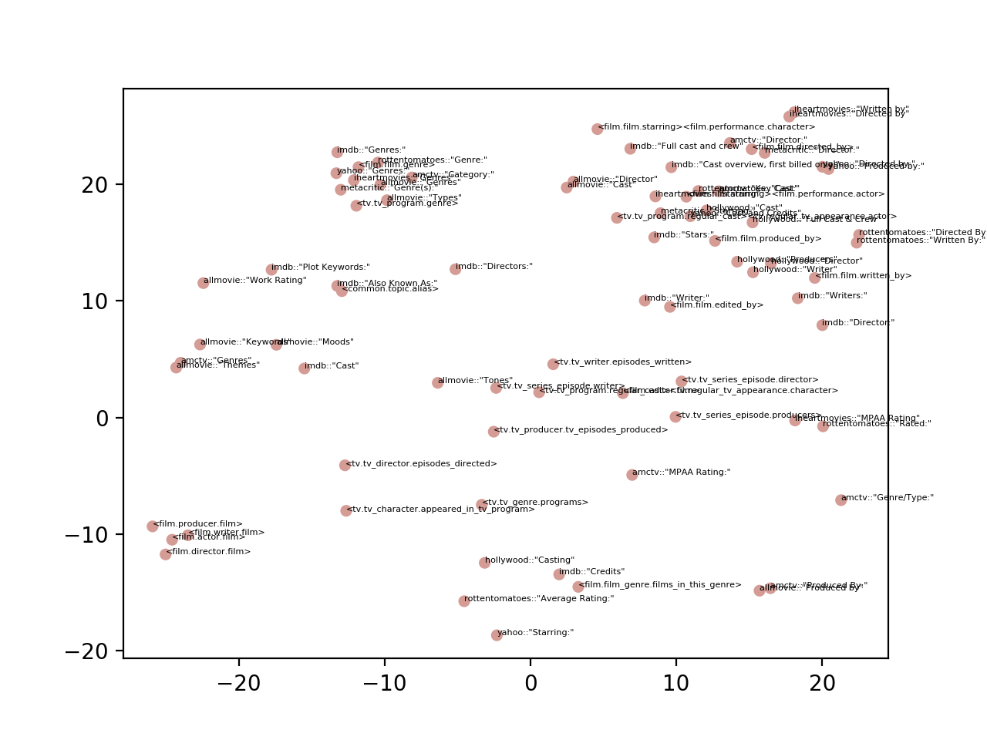
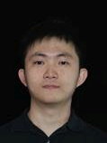
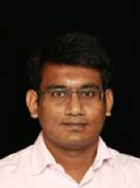
OpenKI: Universal Schema to Cluster OpenIE Predicates [NAACL’19]
Film
Writer
Film.Genre
Film
Director
Film.Actor
Keywords/
Themes
TV
Writer
Rating
Film.Actor
Producer
Unsupervised pre-training for different granularities

Slide 72
OpenIE on Semi-Structured Web Data
 | A₁ | A₂ | A₃ | A₄ | A₅ | A₆ | ... | ... | A_{n} | UNKNOWN ATTRIBUTES
E₁
E₂ |  |  |  |  | EXISTING KNOWLEDGE
E₃
E₄
E₅
E₆
...
E_{m} |  |  |  |  |  |  |  |  |  |  | OpenIE
UNKNOWN ENTITIES
 |  |  |  | ClosedIE

Slide 73
Ceres: Open Knowledge Extraction and QA from Semi-Structured Web
ClosedIE
Knowledge
Graph
Schema
Alignment
Search/QA
Open KG
OpenIE
Notes:
Galaxy

Slide 74
Search Prototype: Question→Predicate
Easy questions we get right
  “How many calories are there in X” -> caloriesPerServing
  “Can I eat X while on a low carbohydrates diet?” -> carbsPerServing
  “Is X nonGMO?” -> isGMOFree
Hard questions we get right
  “Is X OK for people with celiac disease” -> isGlutenFree
  “Was X grown without pesticides” -> IsOrganic
  “How long can I store X” -> shelfLife
  “How many ounces of X do I get” -> Weight
  “Is X a Halal food” -> IsKosher

Slide 75
Question→Question: VAE Preliminary Interpolation Examples
is it vegetarian ?
is it vegetarian friendly
is this vegetarian friendly
is it vegetarian healthy
is vegetarian considered raw
is this contain msg
does it contain gelatine
does it contain gelatine ?
does it contain meat ?
were the tomatoes grown without pesticides ?
were the seed been grown irradiated ?
have the seed been chemically irradiated ?
have the seed been pesticide tested ?
have the honey been irradiated tested ?
does the seed contain sulfites ?
Is the fennel usda irradiated ?
does your fennel seeds irradiated
does these fennel seeds irradiated
are the seeds organic ?
are the seeds organic
are the tomatoes organic ?
are the ingredients all vegetarian ?
are the products any vegetarian
are any contain vegetarian ?
does it contain msg ?
does it contain gelatine ?
does it contain meat ?

Slide 76


Predicate→Query Phrase Mining Output
isGlutenFree | contains_wheat, gluten_free, gluten, fermented_soy, soy
packageSize | how_many_ounces, bulk_package, 1_lb, 10_oz, ounces, lb, bulk, oz, package
flavor | taste_like, taste, flavored, flavors
kosher | kosher_certified, kosher, halal, certified_kosher
fatPerServing | saturated_fat, saturated, fat
isVegetarian | suitable_for_vegetarians, meat, vegetarians, vegetarian
Preliminary evaluation: Accuracy =89%
Unsupervised
pre-training

Slide 77
GENI: Estimating Entity Importance [KDD’19]
performer
Input
  Knowledge Graph
  Importance scores for some nodes (e.g., listen count)
Output
Importance scores for all nodes, in different types
Artist 1
Song 3
1K
performer
performer
Song 2
Song 1
10K
1M
Add up listen count?

Slide 78
GENI: Estimating Entity Importance [KDD’19]
performer
Input
  Knowledge Graph
  Importance scores for some nodes (e.g., listen count)
Output
Importance scores for all nodes, in different types
Artist 2
Artist 1
Song 3
1K
performer
performer
performer
Song 2
Song 1
10K
1M
What if… ?

Slide 79
GENI: Estimating Entity Importance [KDD’19]
performer
Input
  Knowledge Graph
  Importance scores for some nodes (e.g., listen count)
Output
Importance scores for all nodes, in different types
Artist 2
Artist 1
Song 3
1K
performer
performer
performer
Song 2
Song 1
10K
1M
composer
Person 3
Is composer less important?

Slide 80
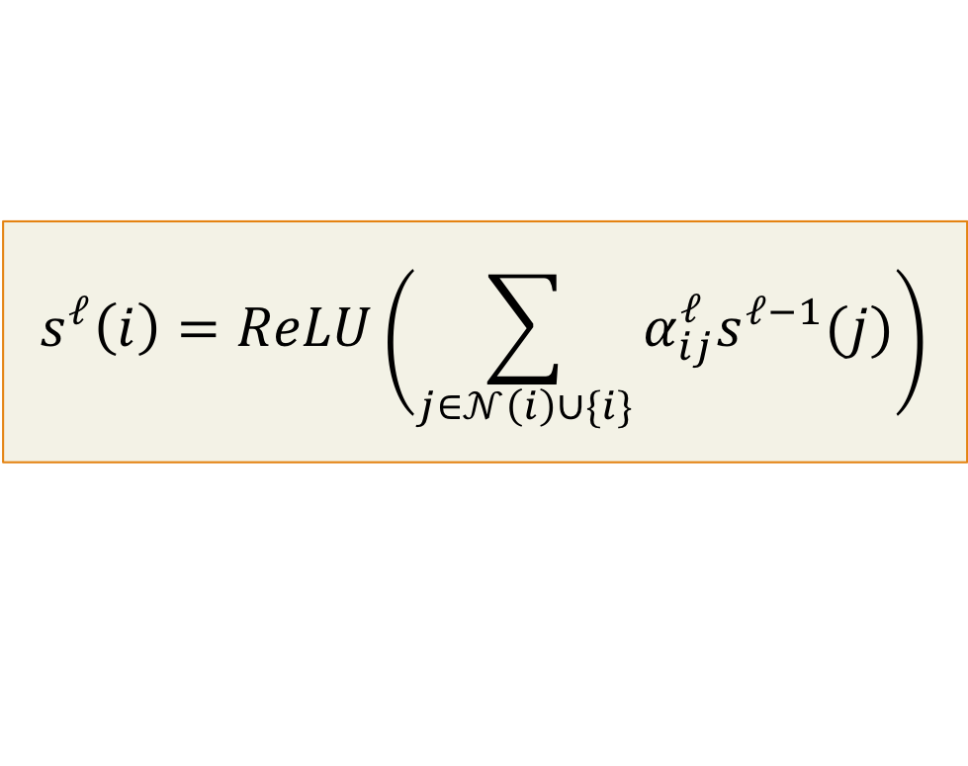





GENI: Estimating Entity Importance [KDD’19]
$${Score}_{2}$$
Idea 1. Score propagation
$${Score}_{1}$$
$$s^{ℓ}\left(i\right)=ReLU\left(\sum_{j∈𝒩\left(i\right)∪\{i\}}{α_{ij}^{ℓ}s^{ℓ−1}(j)}\right)$$
$${Score}_{3}$$
$${Score}_{5}$$
Score of a neighbor
$${Score}_{4}$$

Slide 81





GENI: Estimating Entity Importance [KDD’19]
$${Score}_{2}$$
Idea 2. Predicate-aware attention
$${Score}_{1}$$
$$s^{ℓ}\left(i\right)=ReLU\left(\sum_{j∈𝒩\left(i\right)∪\{i\}}{α_{ij}^{ℓ}s^{ℓ−1}(j)}\right)$$
$${Score}_{3}$$
$${Score}_{5}$$
Attention considers predicate
$${Score}_{4}$$

Slide 82

GENI: Estimating Entity Importance [KDD’19]
$${Score}_{2}$$
Idea 3. Centrality adjustment
$${Score}_{1}$$
$$s^{∗}\left(i\right)=Adjustment(s^{L}\left(i\right),d(i))$$
$${Score}_{3}$$
$${Score}_{5}$$
In-degree of a node
$${Score}_{4}$$

Slide 83
GENI: Estimating Entity Importance [KDD’19]
NDCG@100,
higher is better

Slide 84


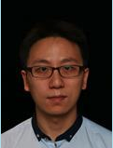

GENI: Estimating Entity Importance [KDD’19]
Semi-supervised
learning with GNN
NDCG@100,
higher is better

Slide 85
Ceres: Open Knowledge Extraction and QA from Semi-Structured Web
 | A₁ | A₂ | A₃ | A₄ | A₅ | A₆ | ... | ... | A_{n} | UNKNOWN ATTRIBUTES
E₁
E₂ |  |  |  |  | EXISTING KNOWLEDGE
E₃
E₄
E₅
E₆
...
E_{m}
UNKNOWN ENTITIES
ClosedIE
Knowledge
Graph
Schema
Alignment
Search/QA
Open KG
OpenIE
 | A₁ | A₂ | A₃ | A₄ | A₅ | A₆ | ... | ... | A_{n} | UNKNOWN ATTRIBUTES
E₁
E₂ |  |  |  |  | EXISTING KNOWLEDGE
E₃
E₄
E₅
E₆
...
E_{m}
UNKNOWN ENTITIES
Notes:
Galaxy

Slide 86
Take Aways
We aim at harvesting knowledge from all semi-structured data on the web
We aim at high accuracy and we are open
Learning with limited labels is the rescue to get knowledge collection to the next level of success
Two new benchmark datasets:
  Extended SWDE benchmark:
  https://homes.cs.washington.edu/lockardc/expanded_swde.html
  DI2KG Challenge: http://di2kg.dia.uniroma3.it/#challenge

Slide 87
Thank You!
WE ARE HIRING!
lunadong@amazon.com

