Slide 1
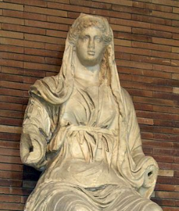
Ceres: Harvesting Knowledge from Semi-Structured Web
Xin Luna Dong, Amazon
CIKM, October 2020

Slide 2


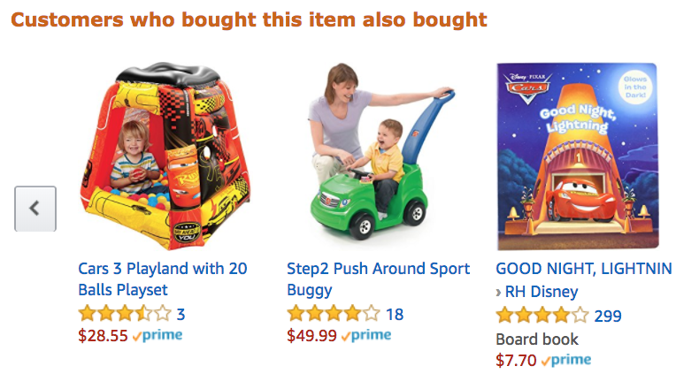
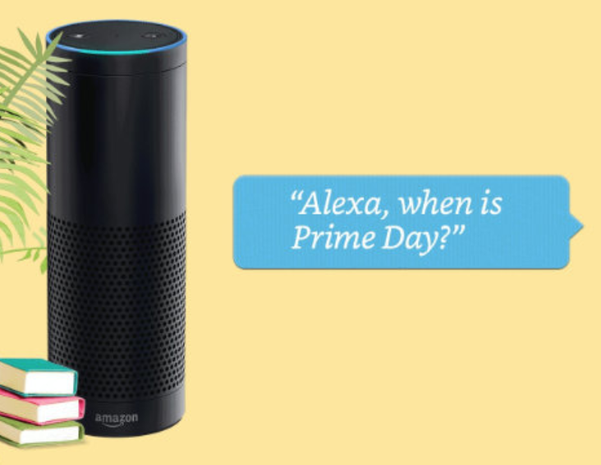
Product Graph
Mission: To answer any question about products and related knowledge in the world

Slide 3
Knowledge Graph Example for 2 Songs
Entity
name
“Pop”
name
genre
mid127
“Dance-pop”
name
mid345
name
“Taylor Alison Swift”
“Shake it off”
artist
name
“Taylor Swift”
Recording
type
artist
mid128
type
song_writer
birth_date
12/13/1989
“Love Story”
mid346
name
name
genre
mid129
“Country pop”
Entity type
Relationship
type
Genre
Notes:
Entity ID

Slide 4
Product Graph Example for 2 Songs
“Shake it off”
name
“Pop”
name
name
genre
mid127
“Dance-pop”
mid345
name
“Taylor Alison Swift”
artist
artist
name
“Taylor Swift”
mid128
song_writer
birth_date
12/13/1989
mid346
mid129
name
name
genre
“Country pop”
“Love Story”
type
Genre

Slide 5
Product Graph Example for 2 Songs
“Shake it off”
name
“Pop”
B0035QUXWQ
ASIN
mid567
name
name
genre
mid127
“Dance-pop”
product
B0035QUXWR
ASIN
mid568
mid345
name
“Taylor Alison Swift”
product
artist
Release
name
type
artist
mid128
“Taylor Swift”
mid569
product
Track
song_writer
birth_date
12/13/1989
product
mid570
mid346
B0067XLIG8
ASIN
product
mid129
name
name
genre
“Country pop”
B0067XLIG4
mid571
ASIN
“Love Story”
type
Genre

Slide 6
Product Graph for Media Products
Heterogeneous
Main challenge: Data everywhere
Key techniques
  Support ~20 Amazon Music applications; Live on Alexa QA
Sources
>90% recall @ prec=99%
Linkage
Fusion
Web
Extraction
>90% prec
Product Graph

Slide 7
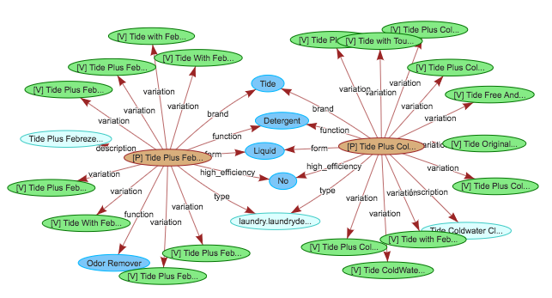
Product Graph for Retail Products
Amazon Confidential

Slide 8
Product Graph for Retail Products
Main challenge: Data everywhere
niques
e on Alexa Shopping, Detail Page, and Amazon Search

Slide 9
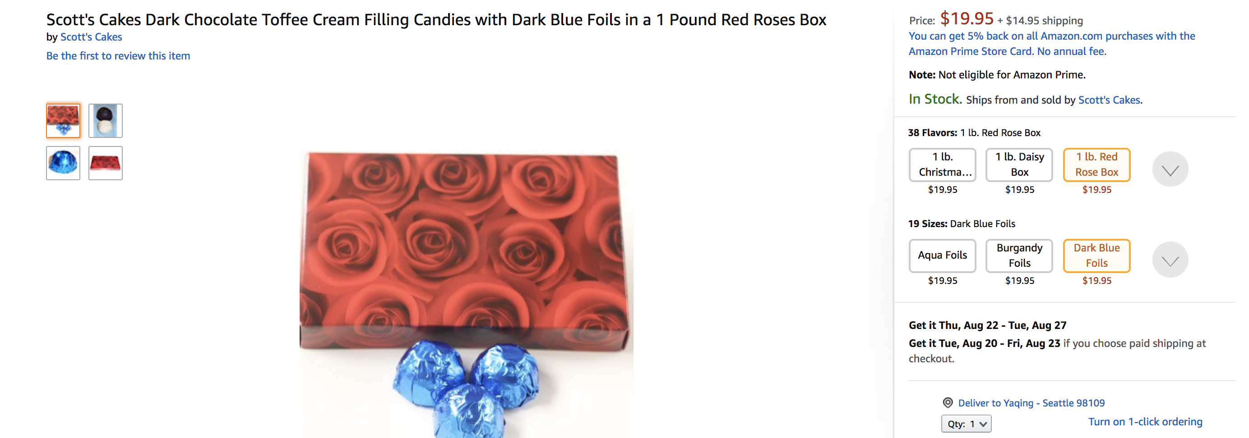
Product Graph for Retail Products

Slide 10
Product Graph for Retail Products
Sparse & Noisy
Main challenge: Data everywhere
Key techniques
Live on Alexa Shopping, Amazon Search, and Detail Page
Coverage 12X
Accuracy 8%
Catalog
Imputation
Cleaning
Product Graph
Dong et al., AutoKnow: Self-driving knowledge collection for products of thousands of types, SigKDD, 2020.

Slide 11
Today’s Talk: Ceres Web Extraction
Sources
>90% recall @ prec=99%
Linkage
Fusion
Web
Extraction
>90% prec
Product Graph
Focus of this talk

Slide 12
Why Extraction from
Semi-Structured Websites?

Slide 13
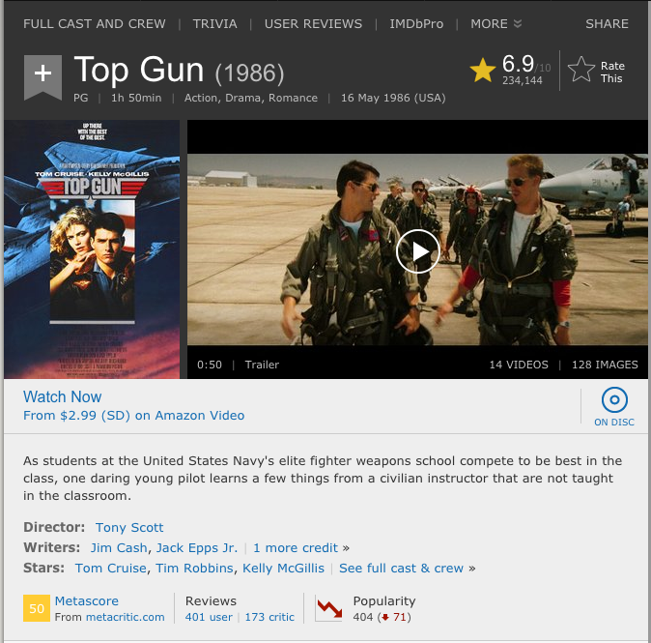
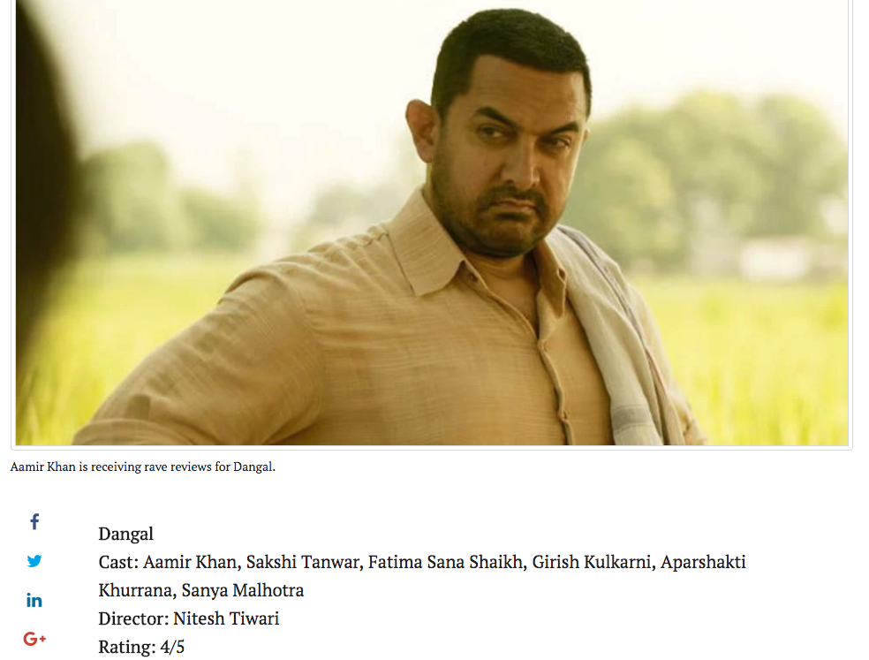
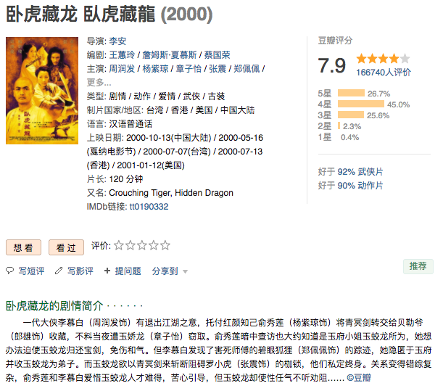
Example Semi-Structured Websites

Slide 14
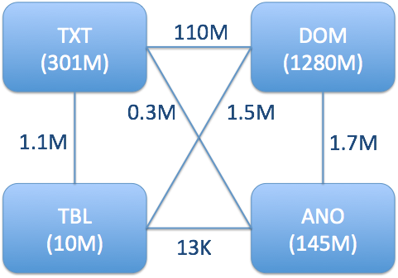
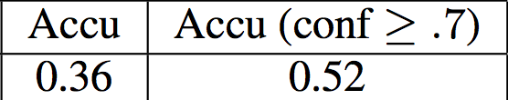
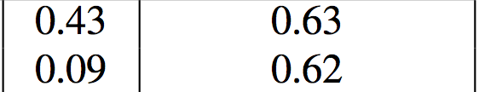
Big Promise from Semi-Structured Data
Knowledge Vault @ Google showed big potential from DOM-tree extraction
Dong et al., Knowledge Vault: A Web-scale approach to probabilistic knowledge fusion. SigKDD, 2014.

Slide 15
Opportunities from Semi-Structured Data

Slide 16
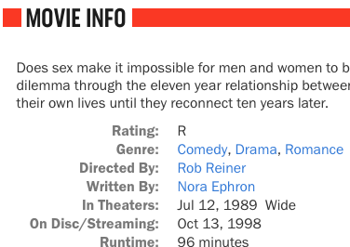
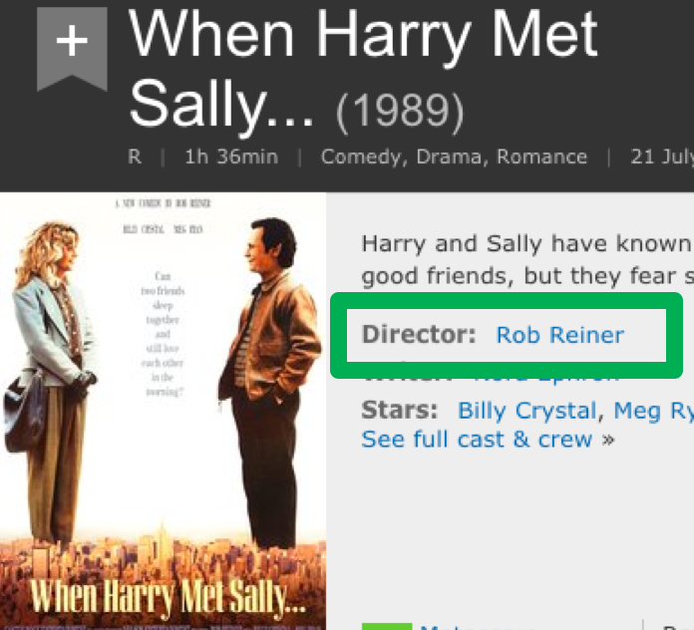
Opportunities from Semi-Structured Data
Knowledge about existing attributes

Slide 17
Opportunities from Semi-Structured Data
Knowledge about unknown attributes
On 10 semi-structured movie websites, the IMDb ontology covers only 7% of relations.

Slide 18
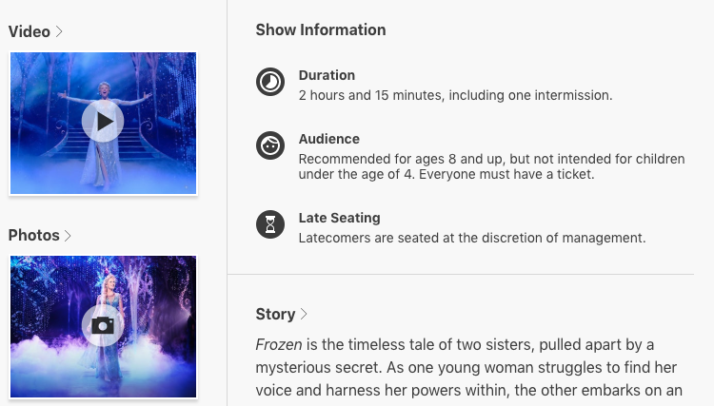
Opportunities from Semi-Structured Data
Knowledge about unknown domains

Slide 19
Where Were We in Extraction?
Heavily rely on manual annotations
  Manual annotation: Prec > 95%
  Automatic extraction: Prec = 63% [Knowledge Vault, KDD’14]
Restricted to--
  Existing schema from existing domains
  Good quality only on easy attributes: e.g., single value

Slide 20
Why Is It Hard to Extract Knowledge from Semi-Structured Web
  Formatting can vary slightly on different webpages in the same website
  Data are formatted differently across websites
  Impossible to manually collect training data for each predicate on each website

Slide 21
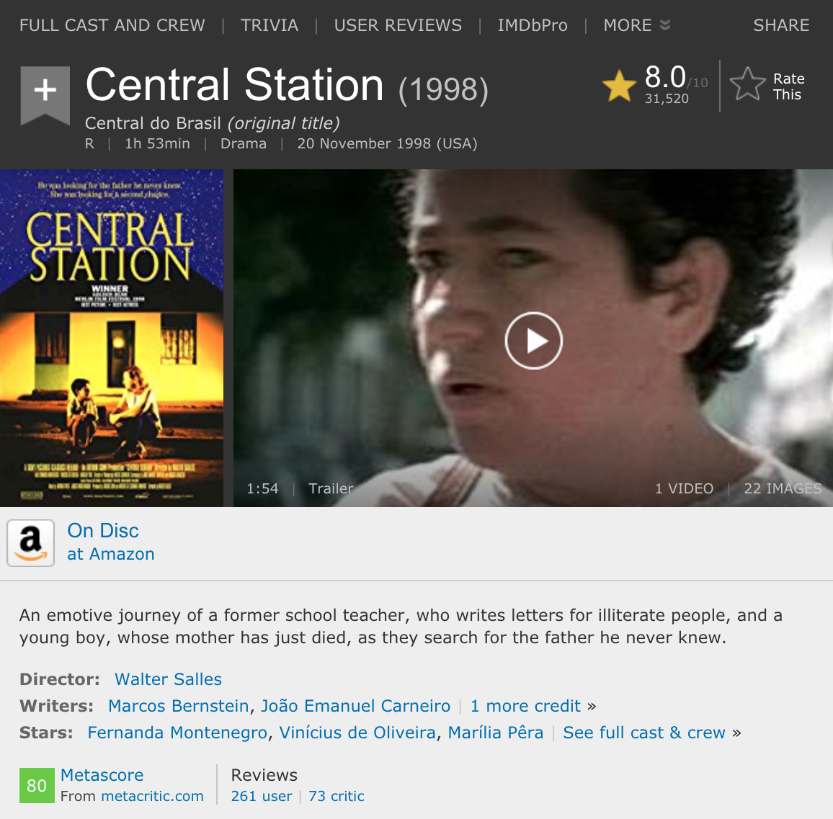

Different Formats on the Same Website

Slide 22
Why Is It Hard to Extract Knowledge from Semi-Structured Web
  Formatting can vary slightly on different webpages in the same website
  Data are formatted differently across websites
  Impossible to manually collect training data for each predicate on each website

Slide 23
Different Formats from Different Websites

Slide 24
Why Is It Hard to Extract Knowledge from Semi-Structured Web
  Formatting can vary slightly on different webpages in the same website
  Data are formatted differently across websites
  Impossible to manually collect training data for each predicate on each website

Slide 25
Can We Get the Whole Iceberg?

Slide 26
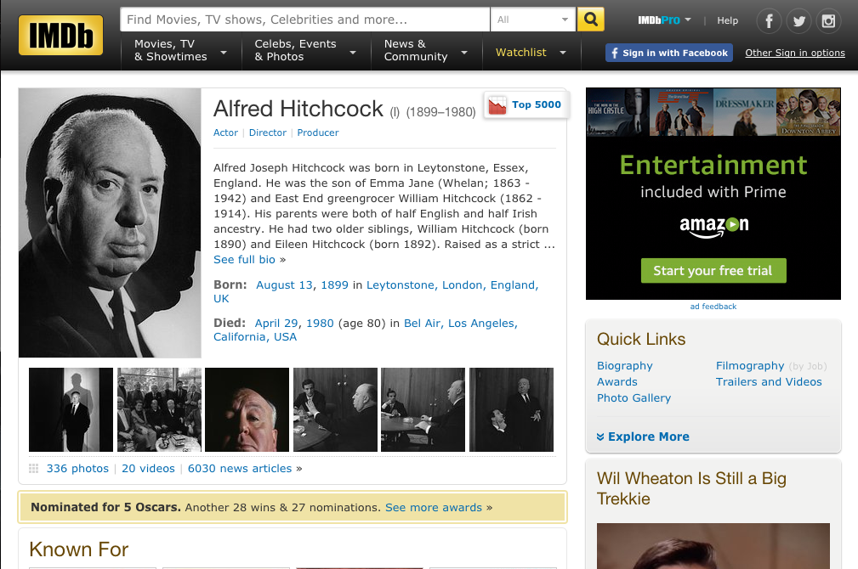
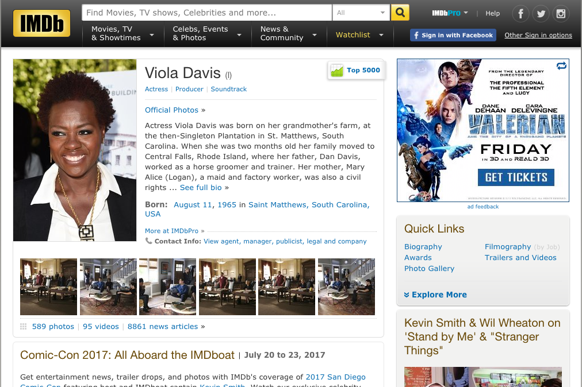
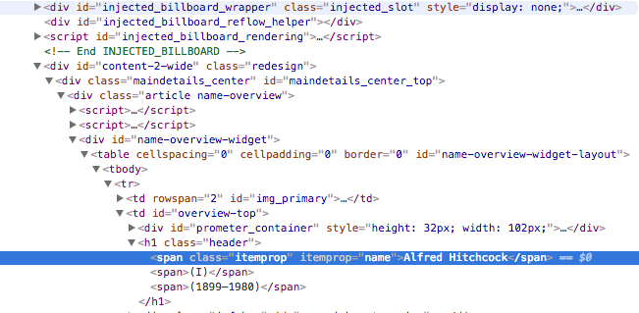
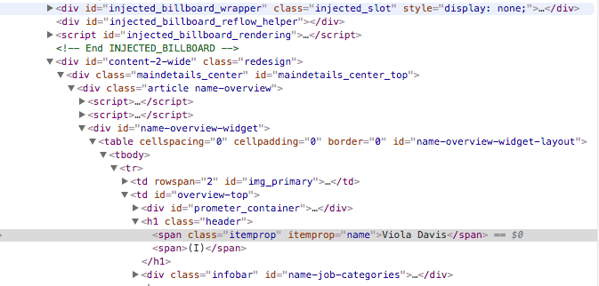
Clue 1. Site-Wide Commonality
All pages are generated from the same template
Previous works
  Wrapper induction w. manual annotation: Prec > 95%
  Relation extraction w. distant supervision: Prec = 63%
DOM tree
Gulhane et al., Web-scale information extraction with Vertex. ICDE, 2011.
Dong et al., Knowledge Vault: A Web-scale approach to probabilistic knowledge fusion. SigKDD, 2014.

Slide 27
Clue 1. Site-Wide Commonality
All pages are generated from the same template
➔Ceres: automatic extraction
  Two-stage extraction:
  Identify subject
  →Identify (attr, value) pairs
  Leverage site-wide global information to help make page-level local decisions in distant supervision
  Prec = 63% → >90%
DOM tree
Lockard et al., Ceres: Distantly supervised relation extraction from the semi-structured web. VLDB, 2018.

Slide 28
Ceres: Automatic Knowledge Extraction
Extraction experiments on http://swde.codeplex.com/ (2011)
 | Vertex (Gulhane et al, 2011) |  |  |  | Ceres
 | Prec | Rec | F1 | #Pred | Prec | Rec | F1 | #Pred
Movie | 0.97 | 0.97 | 0.97 | 4 | 0.97 | 0.99 | 0.98 | 4
NBAPlayer | 1.00 | 1.00 | 1.00 | 4 | 0.98 | 0.98 | 0.98 | 4
University | 0.99 | 0.98 | 0.99 | 4 | 0.87 | 0.94 | 0.90 | 4
Book | 0.93 | 0.93 | 0.93 | 5 | 0.94 | 0.63 | 0.70 | 5
Very high precision
Competent w. annotation-based wrapper induction
Lockard et al., Ceres: Distantly supervised relation extraction from the semi-structured web. VLDB, 2018.
Notes:
Change the numbers here

Slide 29
Ceres: Automatic Knowledge Extraction
Extraction on long-tail movie websites
#Websites / #Webpages | 33 / 434K
Language | English and 6 other languages
Domains | Animated films, Documentary films, Financial performance, etc.
# Annotated pages | 70K (16%)
Annotated : Extracted #entities | 1 : 2.6
Annotated : Extracted #triples | 1 : 3.0
# Extractions | 1.25 M
Precision | 90%
Lockard et al., Ceres: Distantly supervised relation extraction from the semi-structured web. VLDB, 2018.
Notes:
Change the numbers here

Slide 30
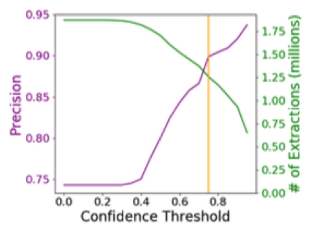
Ceres: Automatic Knowledge Extraction
Extraction on long-tail movie websites
Lockard et al., Ceres: Distantly supervised relation extraction from the semi-structured web. VLDB, 2018.
Notes:
Change the numbers here

Slide 31
Clue 2. Layout on the Page
Vertical and Horizontal Alignment
➔OpenCeres: OpenIE for new attributes
  Weak learning
  Prec = 65%
  Increase #attributes by 10X
Lockard et al., OpenCeres: When open information extraction meets the semi-structured web. NAACL, 2019.

Slide 32
OpenCeres: OpenIE Knowledge Extraction
Extraction experiments on http://swde.codeplex.com/ (2019)
 | Vertex (Gulhane et al, 2011) |  |  |  | Ceres |  |  |  | OpenCeres
 | Prec | Rec | F1 | #Pred | Prec | Rec | F1 | #Pred | Prec | Rec | F1 | #Pred
Movie | 0.97 | 0.97 | 0.97 | 4 | 0.97 | 0.99 | 0.98 | 4 | 0.77 | 0.68 | 0.72 | 18
NBAPlayer | 1.00 | 1.00 | 1.00 | 4 | 0.98 | 0.98 | 0.98 | 4 | 0.74 | 0.48 | 0.58 | 17
University | 0.99 | 0.98 | 0.99 | 4 | 0.87 | 0.94 | 0.90 | 4 | 0.65 | 0.29 | 0.40 | 92
Book | 0.93 | 0.93 | 0.93 | 5 | 0.94 | 0.63 | 0.70 | 5 | - | - | - | -
Precision much lower
Much more predicates
Lockard et al., OpenCeres: When open information extraction meets the semi-structured web. NAACL, 2019.

Slide 33
OpenCeres: OpenIE Knowledge Extraction
Movie
  Seed: Director, Writer, Producer, Actor, Release Date, Genre, Alternate Title
  New: Country, Filmed In, Language, MPAA Rating, Set In, Reviewed by, Studio, Metascore, Box Office, Distributor, Tagline, Budget, Sound Mix
NBA Player
  Seed: Height, Weight, Team
  New: Birth Date, Birth Place, Salary, Age, Experience, Position, College, Year Drafted
University
  Seed: Phone Number, Web address, Type (public/private)
  New: Calendar System, Enrollment, Highest Degree, Local Area, Student Services, President
Lockard et al., OpenCeres: When open information extraction meets the semi-structured web. NAACL, 2019.

Slide 34
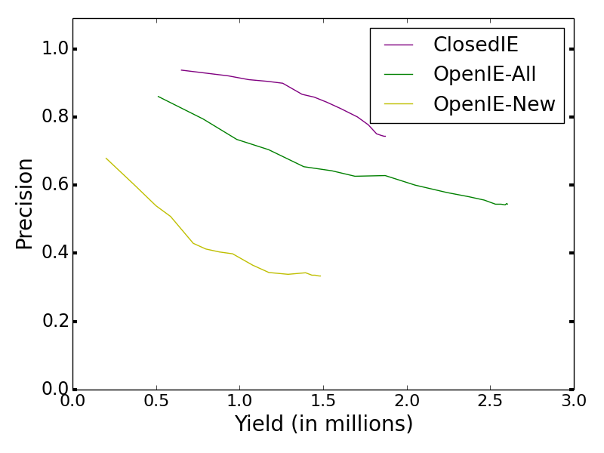
OpenCeres: OpenIE Knowledge Extraction
Extraction on long-tail movie websites
Still need prec improvement on new relations
OpenIE added significant amount of knowledge
Lockard et al., OpenCeres: When open information extraction meets the semi-structured web. NAACL, 2019.

Slide 35
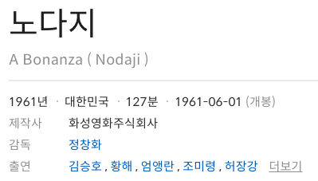



Clue 3. Visual Patterns
Visual patterns
  Font, color, size, etc.
  Location, alignment
➔ZeroShotCeres: Zero-shot extraction for new domains
  Graph Neural Network (GNN) to learn representation for each field
  F2 = 46% (P=47% / R=45%)
    Baseline: F2=35% (P=48% / R=28%)
Extracted knowledge triples
( , , )
( , - , 1961-06-01)
Lockard et al., ZeroShotCeres: Zero-shot relation extraction from semi-structured webpages, ACL 2020.

Slide 36
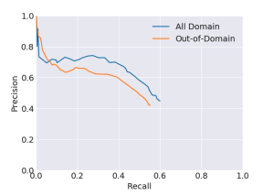
ZeroShotCeres: Zero-Shot Relation Extraction on
New Domains
Extraction on SWDE
Lockard et al., ZeroShotCeres: Zero-shot relation extraction from semi-structured webpages, ACL 2020.

Slide 37


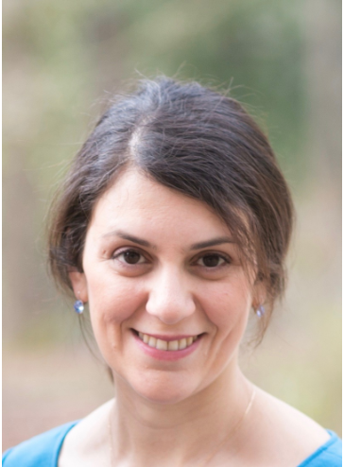
How to Do Zero-Shot Extraction from Semi-Structured Websites?
Lockard et al., ZeroShotCeres: Zero-shot relation extraction from semi-structured webpages, ACL 2020.

Slide 38
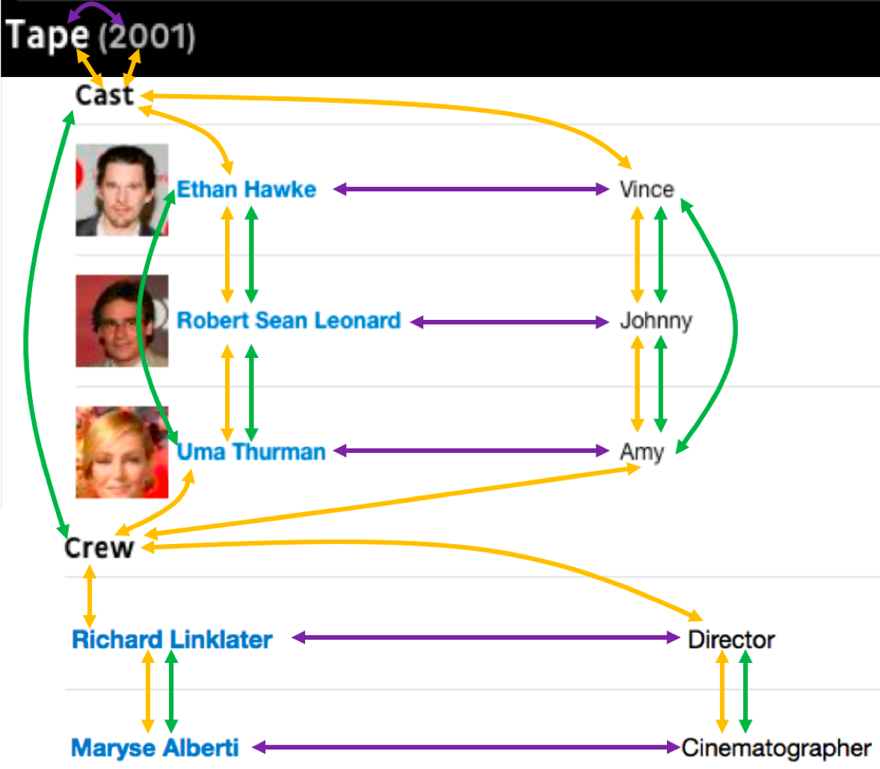
Key Tech: GNN w. Page Layout Graph
Nodes: text fields
Edges:
  Horizontal edges: left/right
  Vertical edges: above/below
  DOM edges: nodes that are siblings/cousins in DOM tree
Lockard et al., ZeroShotCeres: Zero-shot relation extraction from semi-structured webpages, ACL 2020.

Slide 39
Text Field Features
Textual
  BERT embedding
  IDF across website
  Text length
Visual
  Font size
  Bold, underlined, italic
  Font Color
  Text field dimensions
  …
Lockard et al., ZeroShotCeres: Zero-shot relation extraction from semi-structured webpages, ACL 2020.

Slide 40
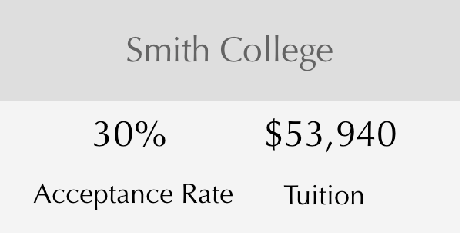
Process Overview
Lockard et al., ZeroShotCeres: Zero-shot relation extraction from semi-structured webpages, ACL 2020.

Slide 41
Process Overview
Visual
Textual
t₁
t₂
…
t_{n}
“Smith College”
“30%”
“Tuition”
Text field features
Web Page Encoder
Lockard et al., ZeroShotCeres: Zero-shot relation extraction from semi-structured webpages, ACL 2020.

Slide 42
Process Overview
Smith College
30%
$53,940
Acceptance Rate
Tuition
Page layout graph
Visual
Textual
t₁
t₂
…
t_{n}
“Smith College”
“30%”
“Tuition”
Text field features
Web Page Encoder
Lockard et al., ZeroShotCeres: Zero-shot relation extraction from semi-structured webpages, ACL 2020.

Slide 43
Process Overview
Smith College
30%
$53,940
Acceptance Rate
Tuition
Graph Attention Network
Page layout graph
Visual
Textual
t₁
t₂
…
t_{n}
“Smith College”
“30%”
“Tuition”
Text field features
Web Page Encoder
Propagates information about neighboring text fields
New contextual representation of each text field
Lockard et al., ZeroShotCeres: Zero-shot relation extraction from semi-structured webpages, ACL 2020.

Slide 44
Process Overview
Smith College
30%
$53,940
Acceptance Rate
Tuition
Graph Attention Network
Page layout graph
Contextual
features
Visual
Textual
t₁
t₂
…
t_{n}
“Smith College”
“30%”
“Tuition”
Text field features
Web Page Encoder
Propagates information about neighboring text fields
New contextual representation of each text field
Lockard et al., ZeroShotCeres: Zero-shot relation extraction from semi-structured webpages, ACL 2020.

Slide 45
Process Overview
Smith College
30%
$53,940
Acceptance Rate
Tuition
Graph Attention Network
Page layout graph
Contextual
features
Visual
Textual
t₁
t₂
…
t_{n}
“$53,940”
ClosedIE
“Smith College”
“30%”
“Tuition”
Multi-class Classifier
Predicted Relation
Text field features
Web Page Encoder
Lockard et al., ZeroShotCeres: Zero-shot relation extraction from semi-structured webpages, ACL 2020.

Slide 46
Process Overview
OpenIE
Smith College
Candidate relation
30%
$53,940
“Tuition”
Acceptance Rate
Tuition
Graph Attention Network
Page layout graph
“$53,940”
Contextual
features
Candidate object
Visual
Textual
t₁
t₂
…
t_{n}
“$53,940”
ClosedIE
“Smith College”
“30%”
“Tuition”
Multi-class Classifier
Predicted Relation
Text field features
Web Page Encoder
Lockard et al., ZeroShotCeres: Zero-shot relation extraction from semi-structured webpages, ACL 2020.

Slide 47
Process Overview
OpenIE
Smith College
Candidate relation
30%
$53,940
“Tuition”
Acceptance Rate
Tuition
Pairwise features
Graph Attention Network
Page layout graph
“$53,940”
Contextual
features
Candidate object
Visual
Textual
t₁
t₂
…
t_{n}
“$53,940”
ClosedIE
“Smith College”
“30%”
“Tuition”
Multi-class Classifier
Predicted Relation
Text field features
Web Page Encoder
Lockard et al., ZeroShotCeres: Zero-shot relation extraction from semi-structured webpages, ACL 2020.

Slide 48
Process Overview
OpenIE
Smith College
Candidate relation
30%
$53,940
“Tuition”
Yes/No Relation Prediction
Pairwise features
Binary Classifier
Acceptance Rate
Tuition
Graph Attention Network
Page layout graph
“$53,940”
Contextual
features
Candidate object
Visual
Textual
t₁
t₂
…
t_{n}
“$53,940”
ClosedIE
“Smith College”
“30%”
“Tuition”
Multi-class Classifier
Predicted Relation
Text field features
Web Page Encoder
Lockard et al., ZeroShotCeres: Zero-shot relation extraction from semi-structured webpages, ACL 2020.

Slide 49
Training
Pre-train on simplified IE tasks
Freeze GNN weights
Train extraction layers on IE tasks
3-way classification in {relation string, object string, other}
Lockard et al., ZeroShotCeres: Zero-shot relation extraction from semi-structured webpages, ACL 2020.

Slide 50
Are We There Yet?

Slide 51
I. How to Do Better for Extraction?
Can we improve extraction precision to >90%?
  Combine zero-shot with distant supervision
Can we learn representations for semi-structured data to support various applications
  Question answering, Search, Validation, as well as IE

Slide 52
II. How to Align Relations for OpenIE?
Are they the same relationship?—Important for OpenIE

Slide 53


Relation Alignment—Intuition
P2
OpenIE
KB
“Cast:”
M1
M1
Both entities known
“Full cast and crew”
Neighbor’s power
@film.actor
@film.director
One entity unknown
P1
P1
Both entities unknown
@film.director
@film.director
M2
M3
Zhang et al., OpenKI: Integrating Open Information Extraction and Knowledge Bases with Relation Inference, NAACL 2019.

Slide 54
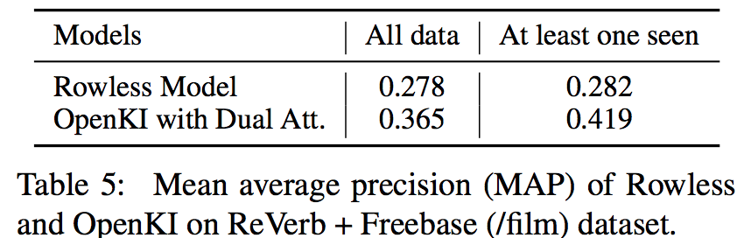
Relation Alignment—Results
Both known
One unknown
Both unknown
Consider neighbors help
Still low MAP
Zhang et al., OpenKI: Integrating Open Information Extraction and Knowledge Bases with Relation Inference, NAACL 2019.

Slide 55
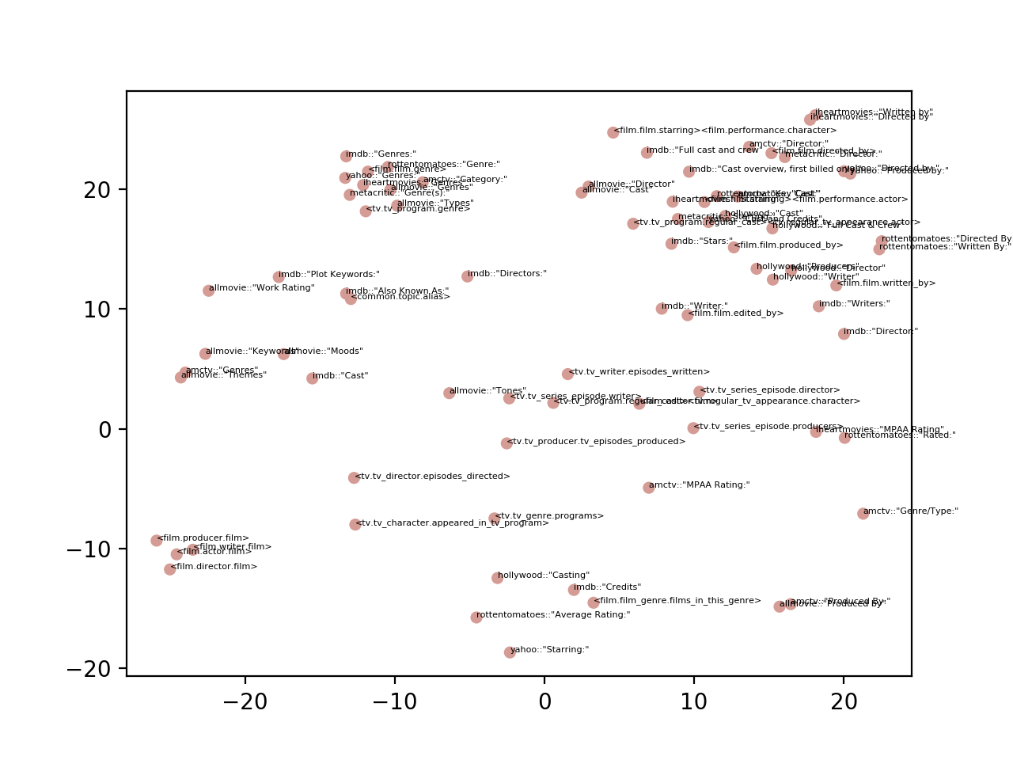
Film
Writer
Film.Genre
Film
Director
Film.Actor
Keywords/
Themes
TV
Writer
Rating
Film.Actor
Producer
Zhang et al., OpenKI: Integrating Open Information Extraction and Knowledge Bases with Relation Inference, NAACL 2019.

Slide 56
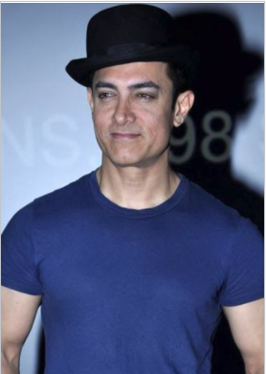
III. How to Link Entities from Different Sources?
Are they the same person?
Aamir Khan
Mohammed Aamir Hussain Khan

Slide 57
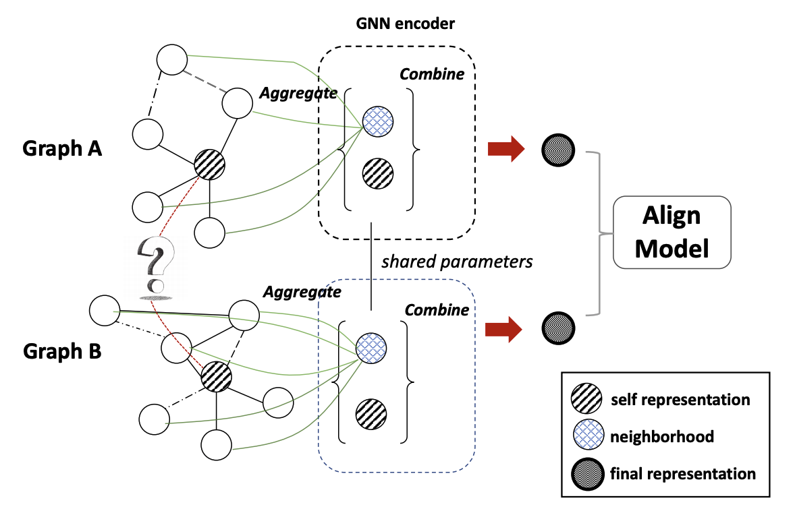
Challenge 1. Thousands of Types
Collective Multi-Type Entity Alignment
Zhu et al., Collective Multi-type Entity Alignment Between Knowledge Graphs, WebConf 2020.

Slide 58
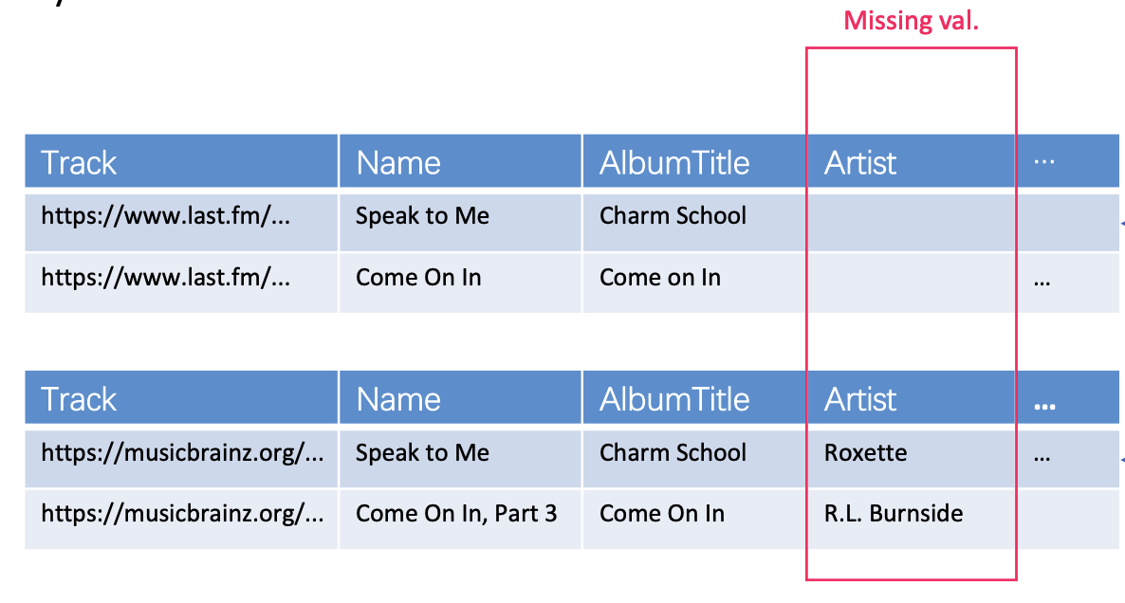
Challenge 2. Millions of Sources
Data from different sources have different distributions
last.fm
MusicBrainz

Slide 59
Challenge 2. Millions of Sources
Data from different sources have different distributions
Settings | PR-AUC
 | Track | Artist | Album
Train on all 7 sources, Apply on 4 of the sources | 0.912 | 0.944 | 0.845

Slide 60
Challenge 2. Millions of Sources
Data from different sources have different distributions
Settings | PR-AUC
 | Track | Artist | Album
Train on all 7 sources, Apply on 4 of the sources | 0.912 | 0.944 | 0.845
Train on 3 sources, Apply on the other 4 sources | 0.763 | 0.913 | 0.806
Much lower PR-AUC, when training data unavailable from new sources

Slide 61
Take Aways
We aim at harvesting knowledge from all semi-structured data on the web
We aim at high accuracy and we are open
Two new benchmark datasets
  Extended SWDE benchmark:
  https://homes.cs.washington.edu/lockardc/expanded_swde.html
  DI2KG Challenge: http://di2kg.dia.uniroma3.it/#challenge

Slide 62
Thank You!
Questions?

