Slide 1
Knowledge Curation and Knowledge Fusion: Challenges, Models, and Applications
Xin Luna Dong (Google Inc.)
Divesh Srivastava (AT&T Labs-Research)

Slide 2



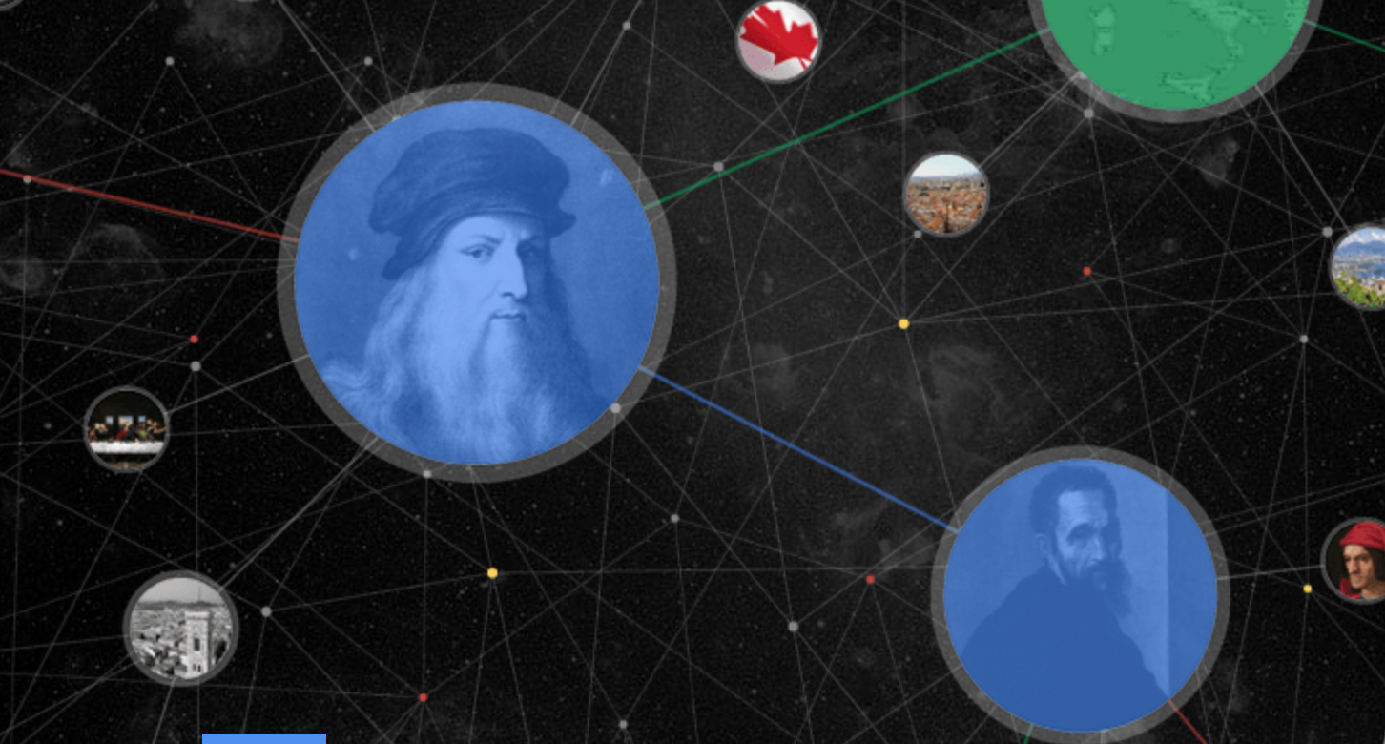







Knowledge Is Power
Many knowledge bases (KB)
Google knowledge graph

Slide 3
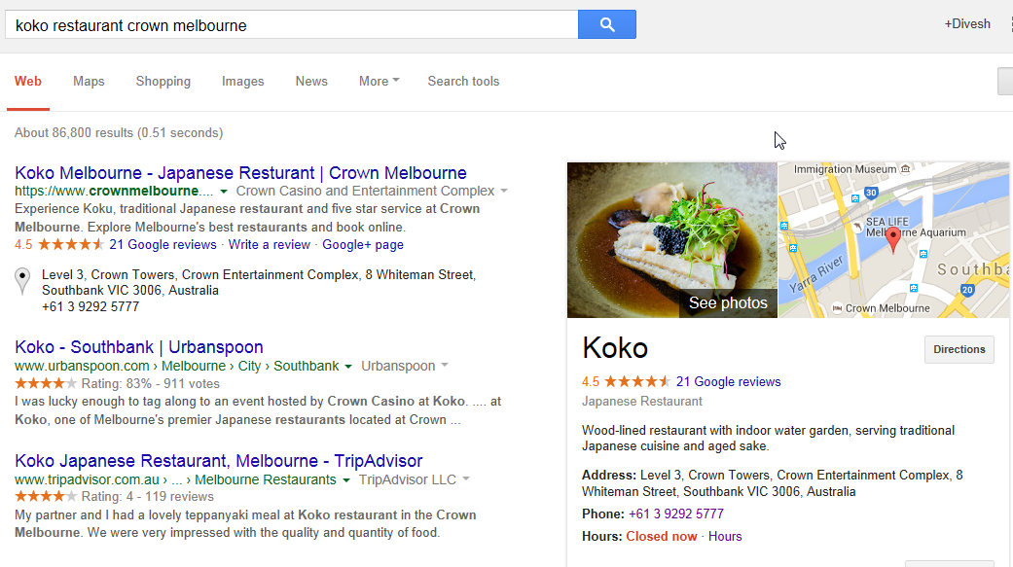
Using KB in Search

Slide 4
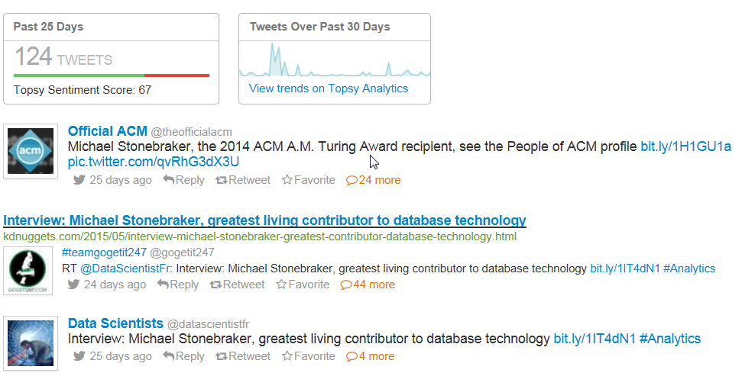
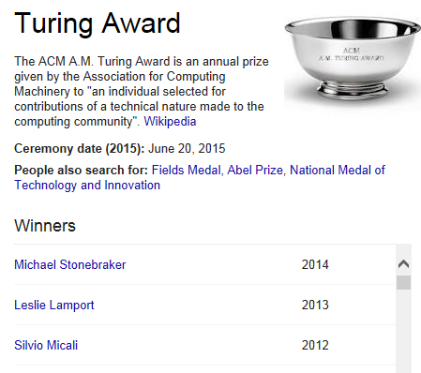
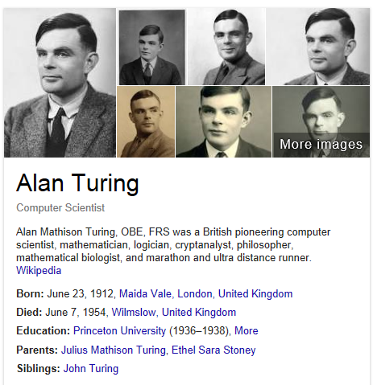
Using KB in Social Media

Slide 5


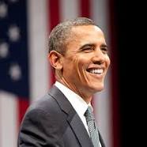
What Is A Knowledge Base?
Entities, entity types
  An entity is an instance of an entity type
  Entity types organized in a hierarchy
all
person
place
politician

Slide 6
What Is A Knowledge Base?
Entities, entity types
Predicates, subject-predicate-object triples
  An SPO triple is an instance of a predicate
Other modeling constructs: rules, reification, etc.
is-born-in
person
place

Slide 7
What Is A Knowledge Base?
Entities, entity types
Predicates, subject-predicate-object triples
Knowledge base: graph with entity nodes and SPO triple edges
is-born-in
is-located-in
is-born-in

Slide 8
Knowledge Bases: Scope
Domain-specific knowledge base
  Focus is on a well-defined domain
  E.g., IMDB for movies, Music-Brainz for music

Slide 9
Knowledge Bases: Scope
Domain-specific knowledge base
Global knowledge base
  Covers a variety of knowledge across domains
  Intensional: Cyc, WordNet
  Extensional: Freebase, Knowledge Graph, Yago/Yago2, DeepDive, NELL, Prospera, ReVerb, Knowledge Vault
Global KBs
Domain-specific KBs

Slide 10
Knowledge Bases: Comparison [DGH+14]
Name | # of Entity Types | # Entities | # Predicates | # Confident Triples
Knowledge Vault (KV) | 1100 | 45M | 4469 | 271M
DeepDive | 4 | 2.7M | 34 | 7M
NELL | 271 | 5.1M | 306 | 0.435M
PROSPERA | 11 | N/A | 14 | 0.1M
Yago2 | 350,000 | 9.8M | 100 | 150M
Freebase | 1500 | 40M | 35,000 | 637M
Knowledge Graph | 1500 | 570M | 35,000 | 18,000M

Slide 11
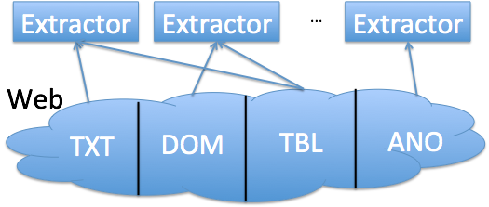
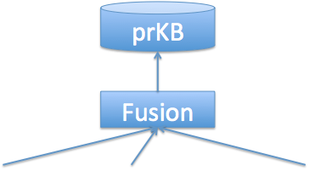
Outline
Motivation
Knowledge extraction
Knowledge fusion
Interesting applications
Future directions

Slide 12
Knowledge Bases: Population
Use well-structured sources, manual curation
  Manual curation is resource intensive
  E.g., Cyc, Wordnet, Freebase, Yago, Knowledge Graph

Slide 13
Knowledge Bases: Population
Use well-structured sources, manual curation
Use less structured sources, automated knowledge extraction
  (Possibly) bootstrap from existing knowledge bases
  Extractors extract knowledge from a variety of sources

Slide 14
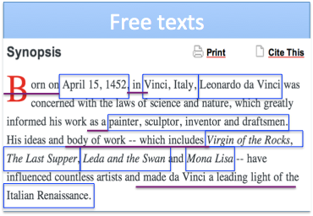
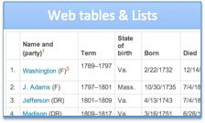
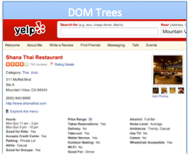
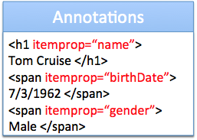

Knowledge Bases: Population
Use well-structured sources, manual curation
Use less structured sources, automated knowledge extraction

Slide 15
Knowledge Extraction: Challenges
Identifying semantically meaningful triples is challenging
  Hamas claimed responsibility for the Gaza attack

Slide 16
Knowledge Extraction: Challenges
Identifying semantically meaningful triples is challenging
  Hamas claimed responsibility for the Gaza attack

Slide 17
Knowledge Extraction: Challenges
Identifying semantically meaningful triples is challenging
Synonyms: multiple representations of same entities, predicates
  (DC, is capital of, United States); (Washington, is capital city of, US)

Slide 18
Knowledge Extraction: Challenges
Identifying semantically meaningful triples is challenging
Synonyms: multiple representations of same entities, predicates
  (DC, is capital of, United States); (Washington, is capital city of, US)
  Linkage is more challenging than in structured databases, where one can take advantage of schema information

Slide 19
Knowledge Extraction: Challenges
Identifying semantically meaningful triples is challenging
Synonyms: multiple representations of same entities, predicates
Polysemy: similar representations of different entities
  I enjoyed watching Chicago on Broadway
  Chicago has the largest population in the Midwest
  Distinguishing them is more challenging than in structured databases, where one can take advantage of schema information

Slide 20
Knowledge Extraction: Challenges
Identifying semantically meaningful triples is challenging
Synonyms: multiple representations of same entities, predicates
Polysemy: similar representations of different entities

Slide 21


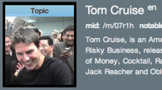
Knowledge Extraction: Tasks
Triple identification
Entity linkage
Predicate linkage
/people/person/date_of_birth

Slide 22
Triple Identification: Paradigms (I)
Domain-specific knowledge base 1: pattern based [FGG+14]
  Supervised, uses labeled training examples
  High precision, low recall because of linguistic variety
Domain-specific knowledge base 2: iterative, pattern based
  Strengths: Higher recall than domain-specific 1
  Weaknesses: Lower precision due to concept drift
/people/person/date_of_birth

Slide 23
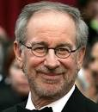

Triple Identification: Paradigms (II)
Global knowledge base: distant supervision [MBS+09]
  Weakly supervised, via large existing KB (e.g., Freebase)
  Use entities, predicates in KB to provide training examples
  Extractors focus on learning ways KB predicates expressed in text
Example: ( , /film/director/film, )
  Spielberg’s film Saving Private Ryan is based on the brothers’ story
  Allison co-produced Saving Private Ryan, directed by Spielberg

Slide 24
Triple Identification: Distant Supervision
Key assumption:
  If a pair of entities participate in a KB predicate, a sentence containing that pair of entities is likely to express that predicate
Example:
  Spielberg’s film Saving Private Ryan is based on the brothers’ story
  Allison co-produced Saving Private Ryan, directed by Spielberg
Solution approach: obtains robust combination of noisy features
  Uses named entity tagger to label candidate entities in sentences
  Trains a multiclass logistic regression classifier, using all features

Slide 25
Triple Identification: Distant Supervision
Lexical and syntactic features:
  Sequence of words, POS-tags in [entity1 – K, entity2 + K] window
  Parsed dependency path between entities + adjacent context nodes
  Use exact matching of conjunctive features: rely on big data!
Example: new triples identified using Freebase
Predicate | Size | New triples
/location/location/contains | 253,223 | Paris, Montmartre
/people/person/profession | 208,888 | Thomas Mellon, Judge

Slide 26
Triple Identification: Distant Supervision
Strengths:
  Canonical names for predicates in triples
  Robustness: benefits of supervised IE without concept drift
  Scalability: extracts large # of triples for quite a large # of predicates
Weaknesses:
  Triple identification limited by the predicates in KB

Slide 27
Triple Identification: Paradigms (III)
Global knowledge base: open information extraction (Open IE)
  No pre-specified vocabulary
  Extractors focus on generic ways to express predicates in text
  Systems: TextRunner (1st gen), ReVerb (2nd gen) [FSE11]
Example:
  McCain fought hard against Obama, but finally lost the election

Slide 28
Triple Identification: Paradigms (III)
Global knowledge base: open information extraction (Open IE)
  No pre-specified vocabulary
  Extractors focus on generic ways to express predicates in text
  Systems: TextRunner (1st gen), ReVerb (2nd gen) [FSE11]
Example:
  McCain fought hard against Obama, but finally lost the election

Slide 29
Triple Identification: Open IE [EFC+11]
X
Architecture for (subject, predicate, object) identification
  Use POS-tagged and NP-chunked sentence in text
  First, identify predicate phrase
  Second, find pair of NP arguments – subject and object
  Finally, compute confidence score using logistic regression classifier
Example:
  Hamas claimed responsibility for the Gaza attack

Slide 30
Triple Identification: Open IE [EFC+11]
✓
Architecture for (subject, predicate, object) identification
  Use POS-tagged and NP-chunked sentence in text
  First, identify predicate phrase
  Second, find pair of NP arguments – subject and object
  Finally, compute confidence score using logistic regression classifier
Example:
  Hamas claimed responsibility for the Gaza attack

Slide 31
Triple Identification: Open IE [EFC+11]
Predicate phrase identification: use syntactic constraints
  For each verb, find longest sequence of words expressed as a light verb construction (LVC) regular expression
  Avoids incoherent, uninformative predicates
Example:
  Hamas claimed responsibility for the Gaza attack

Slide 32
Triple Identification: Open IE [EFC+11]
X
Subject, object identification: use classifiers to learn boundaries
  Heuristics, e.g., using simple noun phrases, are inadequate
  Subject: learn left and right boundaries
  Object: need to learn only right boundary
Examples:
  The cost of the war against Iraq has risen above 500 billion dollars
  The plan would reduce the number of teenagers who start smoking

Slide 33
Triple Identification: Open IE [EFC+11]
✓
Subject, object identification: use classifiers to learn boundaries
  Heuristics, e.g., using simple noun phrases, are inadequate
  Subject: learn left and right boundaries
  Object: need to learn only right boundary
Example:
  The cost of the war against Iraq has risen above 500 billion dollars
  The plan would reduce the number of teenagers who start smoking

Slide 34
Triple Identification: Open IE
Strengths:
  No limitation to pre-specified vocabulary
  Scalability: extracts large # of triples for large # of predicates
Weaknesses:
  No canonical names for entities, predicates in triples

Slide 35
Knowledge Extraction: Tasks
Triple identification
Entity linkage
Predicate linkage
/people/person/date_of_birth

Slide 36
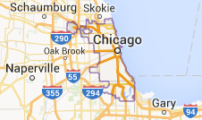

Entity Linkage: Disambiguation to Wikipedia
Goal: Output Wiki titles corresponding to NPs in text
  Identifies canonical entities
Examples:
  I enjoyed watching Chicago on Broadway
  Chicago has the largest population in the Midwest

Slide 37
Entity Linkage: Disambiguation to Wikipedia
Local D2W approaches [BP06, MC07]
  Each mention in a document is disambiguated independently
  E.g., use similarity of text near mention with candidate Wiki page
Global D2W approaches [C07, RRD+11]
  All mentions in a document are disambiguated simultaneously
  E.g., utilize Wikipedia link graph to estimate coherence

Slide 38
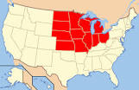
Global D2W Approach
Chicago Midwest
Goal: many-to-1 matching on a bipartite graph
Approach: solve an optimization problem involving
  Φ(m, t): relatedness between mention and Wiki title
  Ψ(t, t’): pairwise relatedness between Wiki titles
Φ
Ψ

Slide 39
Global D2W Approach
Chicago Midwest
Goal: many-to-1 matching on a bipartite graph
Φ(m1,t1) + Φ(m2,t3) + Ψ(t1,t3) > Φ(m1,t2) + Φ(m2,t3) + Ψ(t2,t3)
Φ
Ψ

Slide 40
Global D2W Approach [RRD+11]
Represent Φ and Ψ as weighted sum of local and global features
  Φ(m,t) = ∑ w_{i} * Φ_{i}(m,t)
  Learn weights w_{i} using SVM
Build an index (Anchor Text, Wiki Title, Frequency)

Slide 41
Global D2W Approach [RRD+11]
Represent Φ and Ψ as weighted sum of local and global features
Build an index (Anchor Text, Wiki Title, Frequency)
Local features Φ_{i}(m, t): relatedness between mention and title
  P(t|m): fraction of times title t is target page of anchor text m
  P(t): fraction of all Wiki pages that link to title t
  Cosine-sim(Text(t), Text(m)), Cosine-sim(Text(t), Context(m)), etc.

Slide 42
Global D2W Approach [RRD+11]
Represent Φ and Ψ as weighted sum of local and global features
Build an index (Anchor Text, Wiki Title, Frequency)
Local features Φ_{i}(m, t): relatedness between mention and title
Global features Ψ(t, t’): relatedness between Wiki titles
  I _{[t-t’]} * PMI(InLinks(t), InLinks(t’))
  I _{[t-t’]} * NGD(InLinks(t), InLinks(t’))

Slide 43
Global D2W Approach [RRD+11]
Algorithm (simplified)
  Use shallow parsing and NER to get (additional) potential mentions
  Efficiency: for each mention m, take top-k most frequent targets t
  Use objective function to find most appropriate disambiguation
Chicago Midwest
Φ
Ψ

Slide 44
Predicate Linkage: Using Distant Supervision
Global knowledge base: distant supervision [MBS+09]
  Weakly supervised, via large existing KB (e.g., Freebase)
  Use entities, predicates in KB to provide training examples
  Extractors focus on learning ways KB predicates expressed in text
Example: ( , /film/director/film, )
  Spielberg’s film Saving Private Ryan is based on the brothers’ story
  Allison co-produced Saving Private Ryan, directed by Spielberg

Slide 45
Predicate Linkage: Using Redundancy [YE09]
Goal: Given Open IE triples, output synonymous predicates
  Use unsupervised method
Motivation: Open IE creates a lot of redundancy in extractions
  (DC, is capital of, United States); (Washington, is capital city of, US)
  Top-80 entities had an average of 2.9, up to about 10, synonyms
  Top-100 predicates had an average of 4.9 synonyms

Slide 46
Predicate Linkage: Using Redundancy
Key assumption: Distributional hypothesis
  Similar entities appear in similar contexts
Use generative model to estimate probability that strings co-refer
  Probability depends on number of shared, non-shared properties
  Formalize using a ball-and-urn abstraction
Scalability: use greedy agglomerative clustering
  Strings with no, or only popular, shared properties not compared
  O(K*N*log(N)) algorithm, if at most K synonyms, N triples

Slide 47

Case Study: Knowledge Vault [DGH+14]
Text, DOM (document object model): use distant supervision
Web tables, lists: use schema mapping
Annotations: use semi-automatic mapping
/people/person/date_of_birth

Slide 48
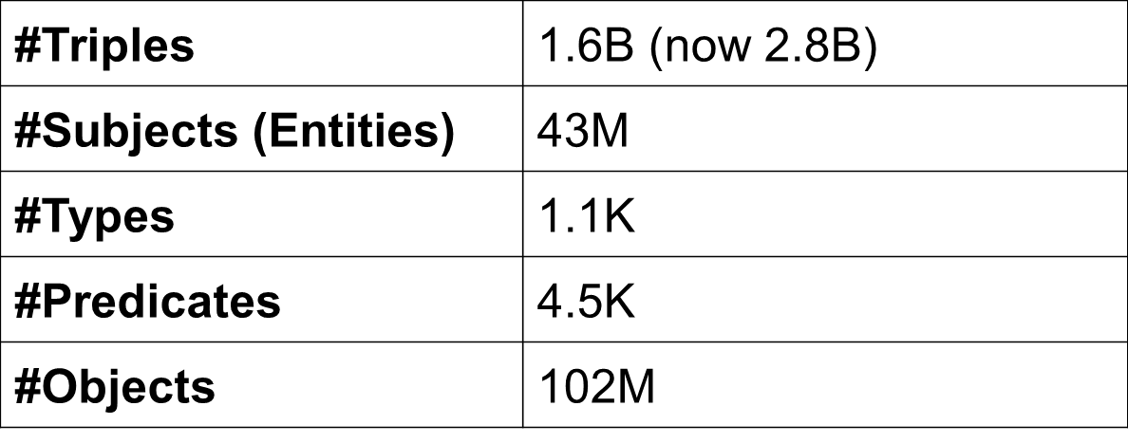
Knowledge Vault: Statistics
A large knowledge base
Highly skewed data – fat head, long tail
  #Triples/type: 1–14M (location, organization, business)
  #Triples/entity: 1–2M (USA, UK, CA, NYC, TX)
As of 11/2013

Slide 49
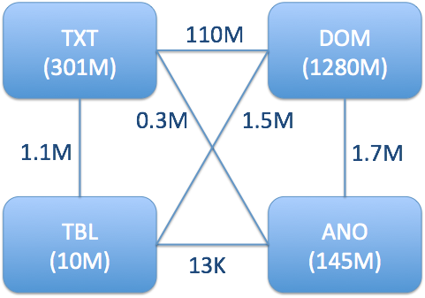
Knowledge Vault: Statistics
1B+ Webpages over the Web
  Contribution is skewed: 1- 50K
As of 11/2013

Slide 50
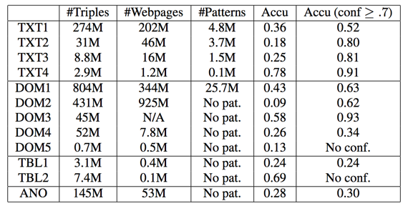
Knowledge Vault: Statistics
12 extractors; high variety
As of 11/2013

Slide 51
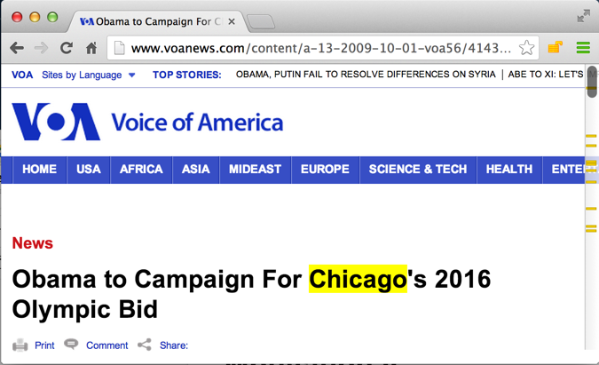
KV: Errors Can Creep in at Every Stage
Extraction error: (Obama, nationality, Chicago)
9/2013

Slide 52
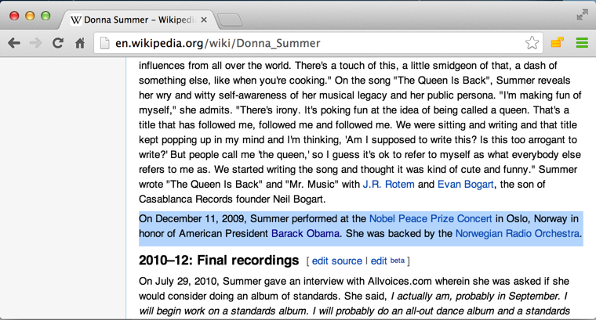
KV: Errors Can Creep in at Every Stage
Reconciliation error: (Obama, nationality, North America)
American President Barack Obama
9/2013

Slide 53
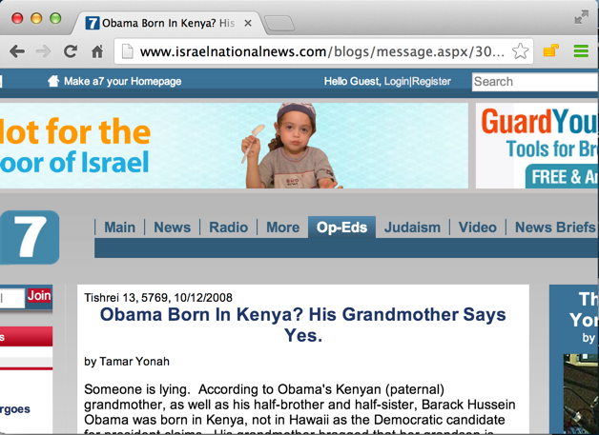
KV: Errors Can Creep in at Every Stage
Source data error: (Obama, nationality, Kenya)
Obama born in Kenya
9/2013

Slide 54
KV: Quality of Knowledge Extraction
Gold standard: Freebase
LCWA (local closed-world assumption)
  If (s,p,o) exists in Freebase : true
  Else If (s,p) exists in Freebase: false (knowledge is locally complete)
  Else unknown
The gold standard contains about 40% of the triples

Slide 55
KV: Statistics for Triple Correctness
Overall accuracy: 30%
Random sample on 25 false triples
  Triple identification errors: 11 (44%)
  Entity linkage errors: 11 (44%)
  Predicate linkage errors: 5 (20%)
  Source data errors: 1 (4%)

Slide 56
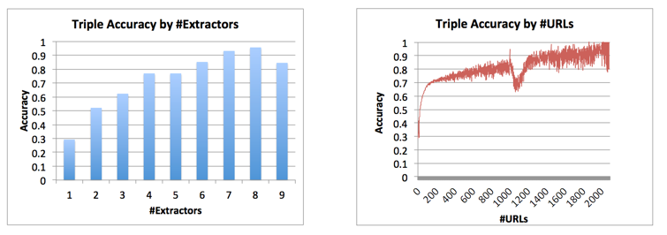
KV: Statistics for Triple Correctness
As of 11/2013

Slide 57
KV: Statistics for Extractors
12 extractors; high variety
As of 11/2013

Slide 58
Outline
Motivation
Knowledge extraction
Knowledge fusion
Interesting applications
Future directions

Slide 59
Goal: Judge Triple Correctness
Input: Knowledge triples and their provenance
  Which extractor extracts from which source
Output: a probability in [0,1] for each triple
  Probabilistic decisions vs. deterministic decisions

Slide 60
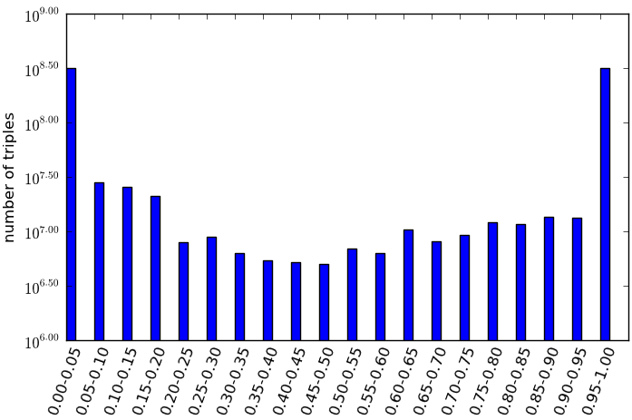
Usage of Probabilistic Knowledge
Negative training examples, and MANY EXCITING APPLICATIONS!!
Active learning, probabilistic inference, etc.
Upload to KB

Slide 61
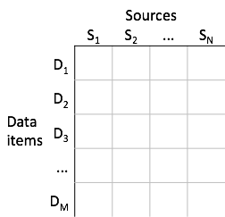
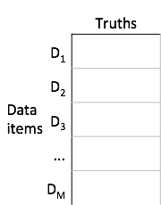
Data Fusion: Definition
Input Output

Slide 62
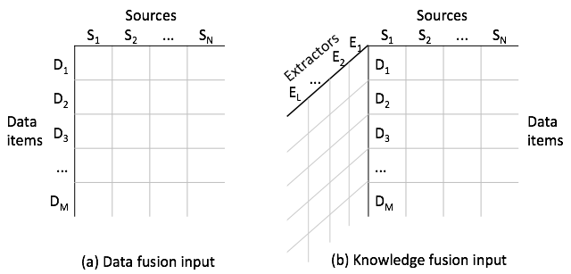
Knowledge Fusion Challenges
I. Input is three-dimensional
(S, P)

Slide 63
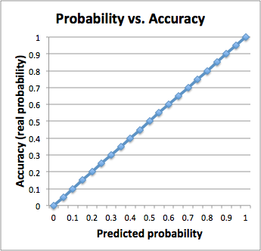
Knowledge Fusion Challenges
II. Output probabilities should be well-calibrated

Slide 64
Knowledge Fusion Challenges
III. Data are of web scale
Three orders of magnitude larger than currently published
data-fusion applications
  Size: 1.1TB
  Sources: 170K → 1B+
  Data items: 400K → 375M
  Values: 18M → 6.4B (1.6B unique)
Data are highly skewed
  #Triples / Data item: 1 – 2.7M
  #Triples / Source: 1 – 50K

Slide 65

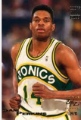


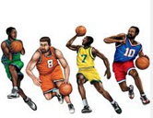
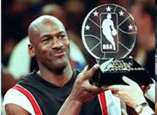
Approach I.1: Graph-Based Priors
Path 1
Path 2
Prec | 1
Rec | 0.01
F1 | 0.03
Weight | 2.62
Prec | 0.03
Rec | 0.33
F1 | 0.04
Weight | 2.19
atSchool
education
education
Sam Perkins
North Carolina
Tar Heels
profession
play
profession
Michael Jordon
Path Ranking Algorithm (PRA): Logistic regression [Lao et al., EMNLP’11]

Slide 66
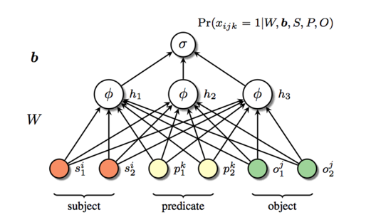
Approach I.2: Graph-Based Priors
Hidden Layer
(100 dimensions)
Predicate
Neighbors
Pred | Neighbor 1 | Neighbor 2 | Neighbor 3
children | parents 0.4 | spouse 0.5 | birth-place 0.8
brith-date | children 1.24 | gender 1.25 | parents 1.29
edu-end | job-start 1.41 | Edu-start 1.61 | job-end 1.74
Deep learning
[Dean, CIKM’14]

Slide 67

Approach II: Extraction-Based Learning
[Dong et al, KDD’14]
Features
  Square root of #sources
  mean of extraction confidence
Adaboost learning
Learning for each predicate
Instance i
Error at
Stage t
Classifier built at
Stage t-1
Error func
Weight
Learner t

Slide 68
Approach III. Multi-Layer Fusion
[Dong et al., VLDB’15]
Intuitions
  Leverage source/extractor agreements
  Trust a source/extractor with high quality
Graphical model – predict at the same time
  Extraction correctness, triple correctness
  Source accuracy, extractor precision/recall
Source/extractor hierarchy
  Break down “large” sources
  Group similar “small” sources

Slide 69
High-Level Intuition
[Dong, VLDB’09]
Researcher affiliation
 | Src1 | Src2 | Src3
Jagadish | UM | ATT | UM
Dewitt | MSR | MSR | UW
Bernstein | MSR | MSR | MSR
Carey | UCI | ATT | BEA
Franklin | UCB | UCB | UMD

Slide 70
High-Level Intuition
[Dong, VLDB’09]
Researcher affiliation
Voting: trust the majority
 | Src1 | Src2 | Src3
Jagadish | UM | ATT | UM
Dewitt | MSR | MSR | UW
Bernstein | MSR | MSR | MSR
Carey | UCI | ATT | BEA
Franklin | UCB | UCB | UMD

Slide 71
High-Level Intuition
[Dong, VLDB’09]
Researcher affiliation
 | Src1 | Src2 | Src3
Jagadish | UM | ATT | UM
Dewitt | MSR | MSR | UW
Bernstein | MSR | MSR | MSR
Carey | UCI | ATT | BEA
Franklin | UCB | UCB | UMD

Slide 72
High-Level Intuition
[Dong, VLDB’09]
Researcher affiliation
Quality-based: give higher votes to more accurate sources
 | Src1 | Src2 | Src3
Jagadish | UM | ATT | UM
Dewitt | MSR | MSR | UW
Bernstein | MSR | MSR | MSR
Carey | UCI | ATT | BEA
Franklin | UCB | UCB | UMD

Slide 73
What About Extractions
[Sigmod, 2014]
Extracted Harry Potter actors/actresses
Harry Potter | Ext1 | Ext2 | Ext3
Daniel | ✓ | ✓ | ✓
Emma | ✓ |  | ✓
Rupert | ✓ | ✓
Jonny | ✓
Eric |  |  | ✓

Slide 74
What About Extractions
[Sigmod, 2014]
Extracted Harry Potter actors/actresses
Voting: trust the majority
Harry Potter | Ext1 | Ext2 | Ext3
Daniel | ✓ | ✓ | ✓
Emma | ✓ |  | ✓
Rupert | ✓ | ✓
Jonny | ✓
Eric |  |  | ✓

Slide 75
What About Extractions
[Sigmod, 2014]
Extracted Harry Potter actors/actresses
Quality-based:
  More likely to be correct if extracted by high-precision sources
  More likely to be wrong if not extracted by high-recall sources
Harry Potter | Ext1 (high rec) | Ext2 (high prec) | Ext3 (med prec/rec)
Daniel | ✓ | ✓ | ✓
Emma | ✓ |  | ✓
Rupert | ✓ | ✓
Jonny | ✓
Eric |  |  | ✓

Slide 76
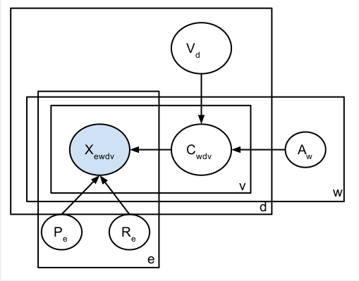
Graphical Model
[VLDB, 2015]
Observations
  X_{ewdv}: whether extractor e extracts from source w the (d,v) item-value pair
Latent variables
  C_{wdv}: whether source w indeed provides (d,v) pair
  V_{d}: the correct value(s) for d
Parameters
  A_{w}: Accuracy of source w
  P_{e}: Precision of extractor e
  R_{e}: Recall of extractor e

Slide 77
Algorithm
[VLDB, 2015]
Compute Pr(W provides T | Extractor quality)
by Bayesian analysis
E-Step
Compute Pr(T | Source quality) by Bayesian analysis
Compute source accuracy
M-Step
Compute extractor precision and recall

Slide 78
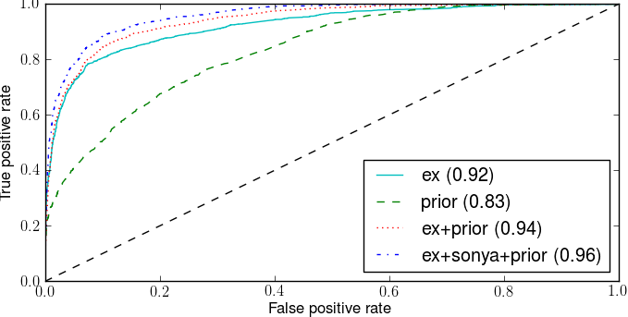
Fusion Performance

Slide 79
Outline
Motivation
Knowledge extraction
Knowledge fusion
Interesting applications
Future directions

Slide 80


Usage of Probabilistic Knowledge
Source errors: Knowledge-base trust
Extraction errors: data abnormality diagnosis
Negative training examples, and MANY EXCITING APPLICATIONS!!

Slide 81
Application I. Web Source Quality
What we have now
  Page Rank: links between Websites/Webpages
  Log based: search log and click-through rate
  Web spam
  etc.

Slide 82
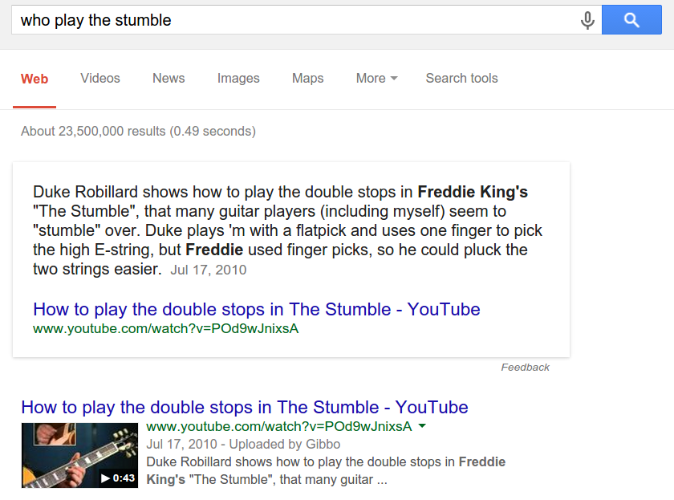
1.Tail Sources Can Be Useful
Good answer for an award-winning song

Slide 83
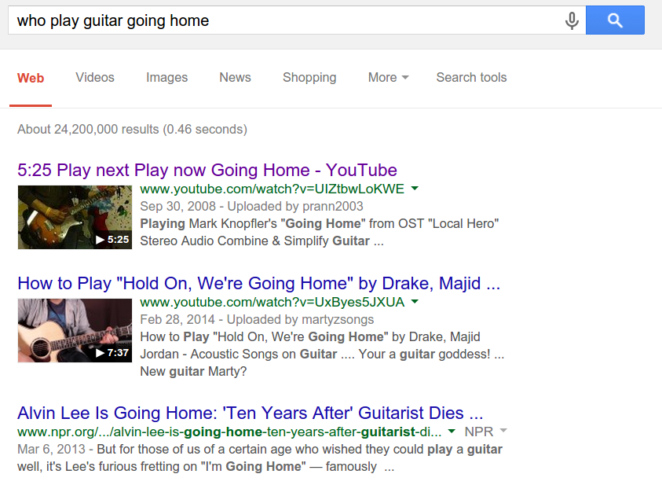
1.Tail Sources Can Be Useful
Missing answer for a not-so-popular song

Slide 84
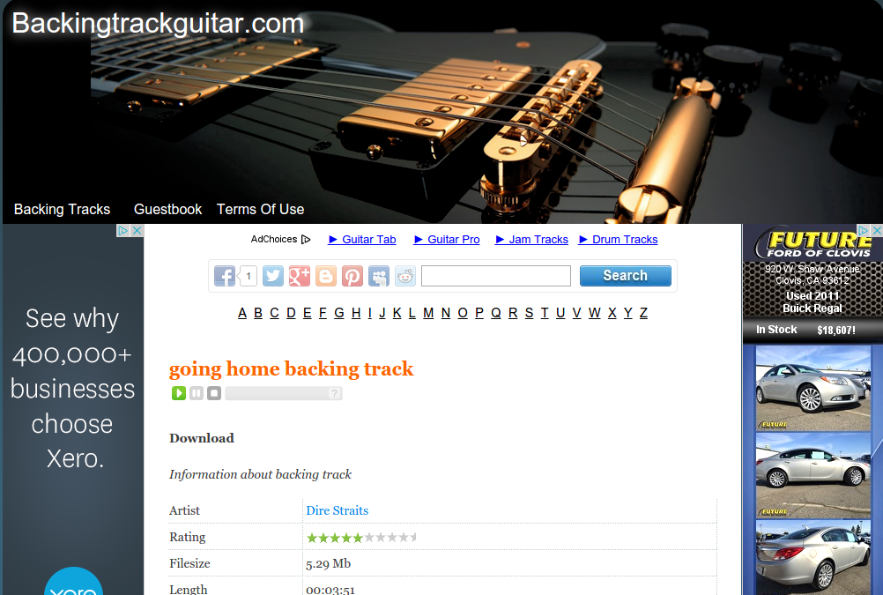
1.Tail Sources Can Be Useful
Very precise info on guitar players but low Page Rank

Slide 85
II. Popular Websites May Not Be Trustworthy
Domain
www.eonline.com
perezhilton.com
radaronline.com
www.zimbio.com
mediatakeout.com
gawker.com
www.popsugar.com
www.people.com
www.tmz.com
www.fishwrapper.com
celebrity.yahoo.com
wonderwall.msn.com
hollywoodlife.com
www.wetpaint.com
Gossip Websites
http://www.ebizmba.com/articles/gossip-websites
14 out of 15 have a PageRank among top 15% of the websites

Slide 86
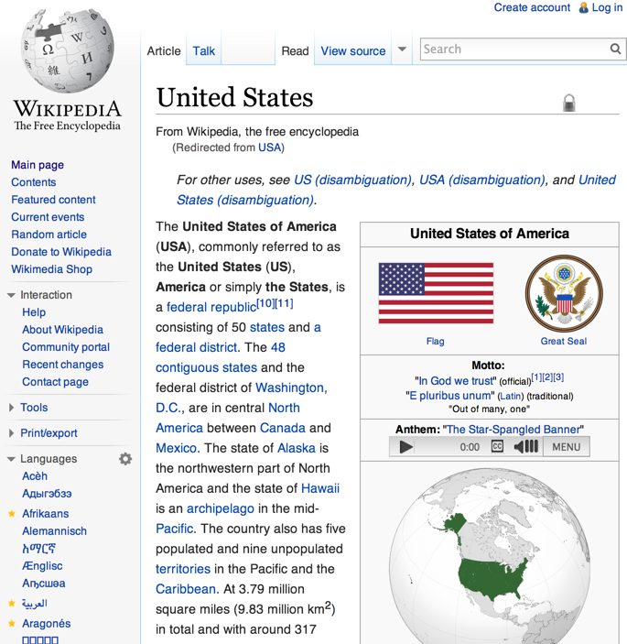
Application I. Web Source Quality
Fact 1
Fact 2
Fact 3
Fact 4
Fact 5
Fact 6
Fact 7
Fact 8
Fact 9
Fact 10
...
✓
✓
✘
✓
✘
✓
✓
✓
✓
✘
...
Accu | 0.7

Slide 87
Application I. Web Source Quality
Triple 1
Triple 2
Triple 3
Triple 4
Triple 5
Triple 6
Triple 7
Triple 8
Triple 9
Triple 10
...
1.0
0.9
0.3
0.8
0.4
0.8
0.9
1.0
0.7
0.2
...
Accu | 0.7

Slide 88
Application I. Web Source Quality
Triple Corr | Extraction Corr
Triple 1
Triple 2
Triple 3
Triple 4
Triple 5
Triple 6
Triple 7
Triple 8
Triple 9
Triple 10
...
1.0
0.9
0.3
0.8
0.4
0.8
0.9
1.0
0.7
0.2
...
1.0
1.0
1.0
1.0
0.9
0.9
0.8
0.2
0.1
0.1
...
Accu | 0.7
Accu | 0.73

Slide 89
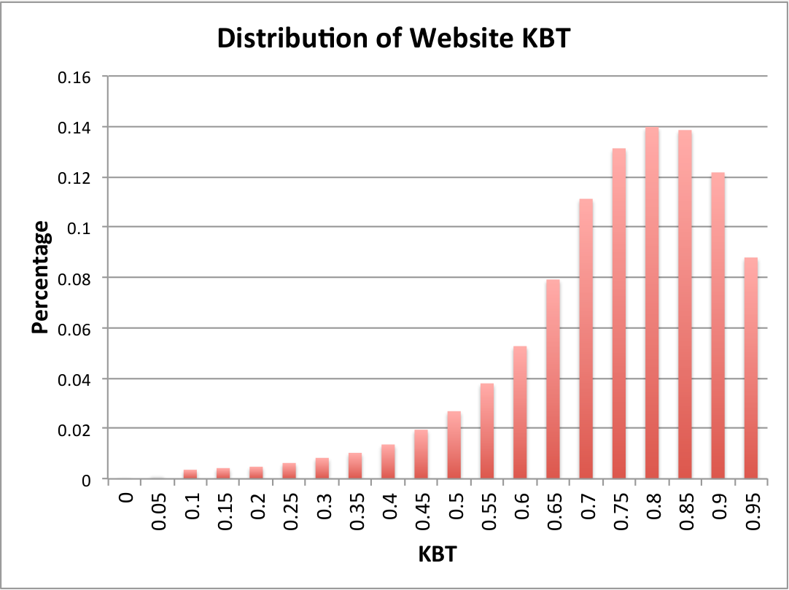
Knowledge-Based Trust (KBT)
Trustworthiness in [0,1] for 5.6M websites and 119M webpages

Slide 90
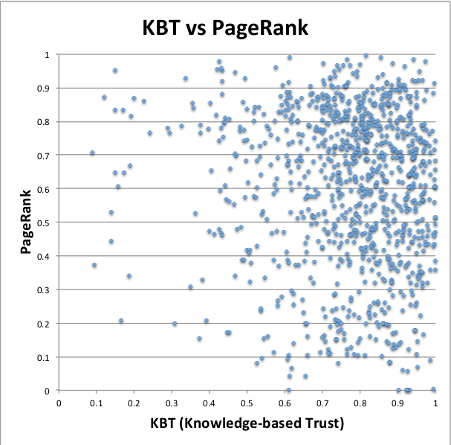
Knowledge-Based Trust vs. PageRank
Correlated scores
Often tail sources w. high trustworthiness

Slide 91
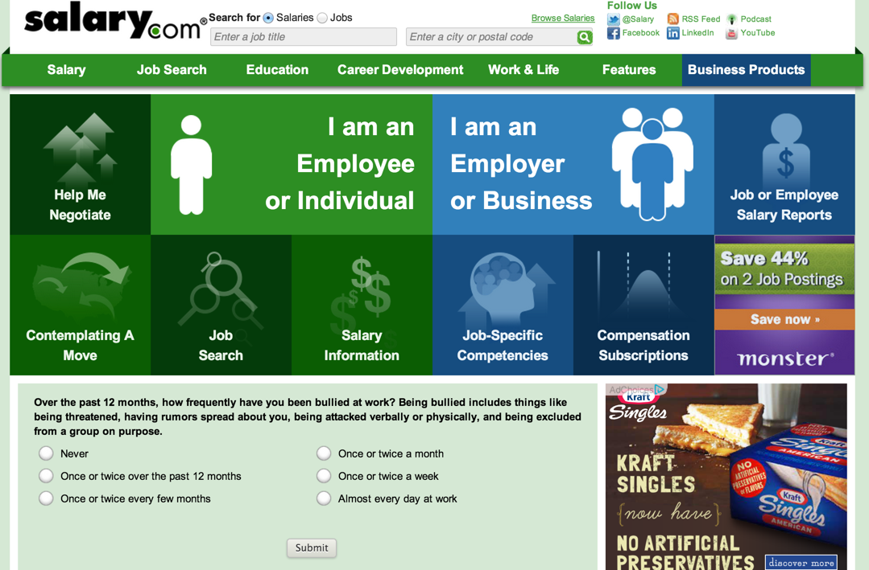
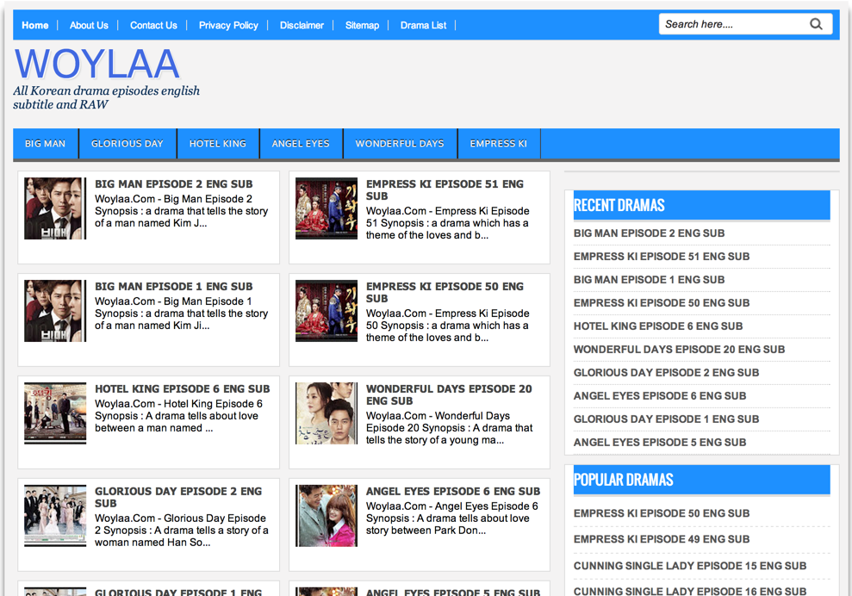
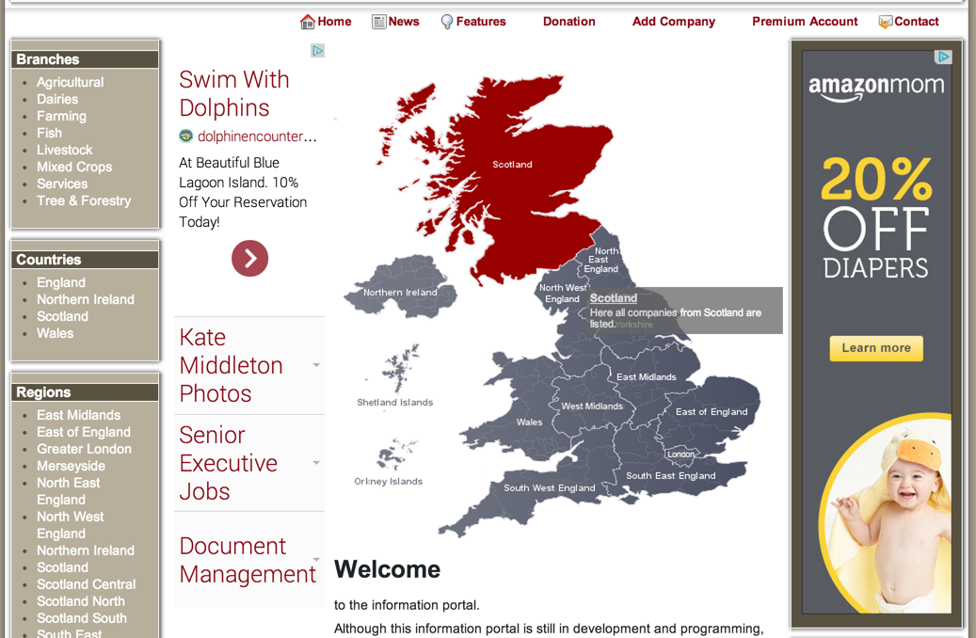
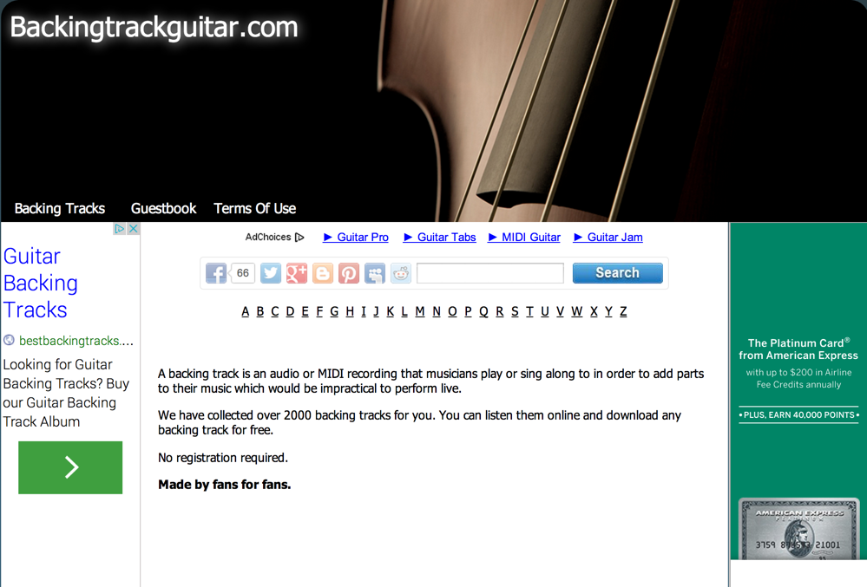
1.Tail Sources w. Low PageRank
Among 100 sampled websites, 85 are indeed trustworthy

Slide 92
Knowledge-Based Trust vs. PageRank
Correlated scores
Often sources w. low accuracy
Often tail sources w. high trustworthiness

Slide 93
II. Popular Websites May Not Be Trustworthy
Domain
www.eonline.com
perezhilton.com
radaronline.com
www.zimbio.com
mediatakeout.com
gawker.com
www.popsugar.com
www.people.com
www.tmz.com
www.fishwrapper.com
celebrity.yahoo.com
wonderwall.msn.com
hollywoodlife.com
www.wetpaint.com
Gossip Websites
http://www.ebizmba.com/articles/gossip-websites
14 out of 15 have a PageRank among top 15% of the websites
All have knowledge-based trust in bottom 50%

Slide 94

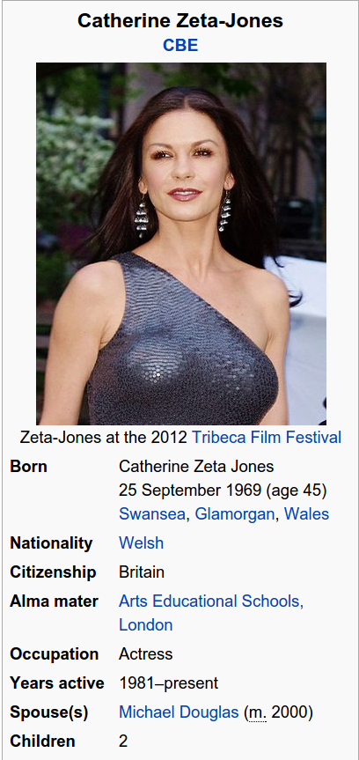

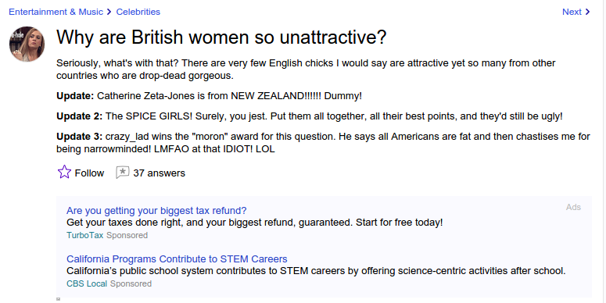
II. Popular Websites May Not Be Trustworthy

Slide 95
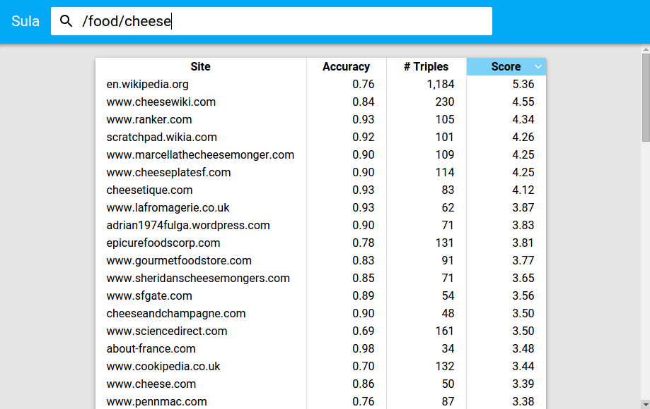
III. Website Recommendation by Vertical

Slide 96
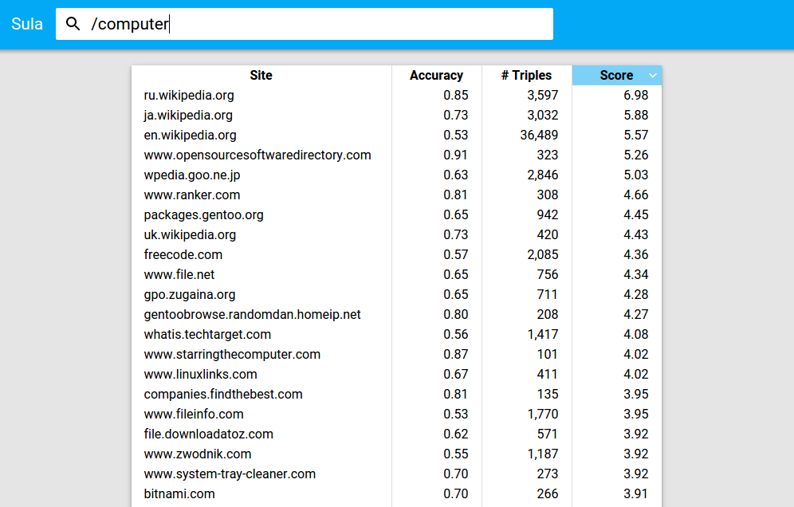
III. Website Recommendation by Vertical

Slide 97
Application II. X-Ray for Extracted Data
Goal:
  Help users analyze errors, changes and abnormalities in data
Intuitions:
  Cluster errors by features
  Return clusters with top error rates

Slide 98
Application II. X-Ray for Extracted Data
Cluster I.
  Feature: (besoccor.com, date_of_birth, 1986_02_18)
  #Triples: 630; Errs: 100%
  Reason: default value
Cluster 2.
  Feature: (ExtractorX, pred: namesakes, obj:the county)
  #Triples: 4878; Errs: 99.8%
  E.g., [Salmon P. Chase, namesakes, The County]
  Context: The county was named for Salmon P. Chase, former senator and governor of Ohio
  Reason: Unresolved coreference

Slide 99
Outline
Motivation
Knowledge extraction
Knowledge fusion
Interesting applications
Future directions

Slide 100
Extraction Readiness
Extraction is still very sparse
  74% URLs contribute fewer than 5 triples each
Extraction is of low quality
  Overall accuracy is as low as 11.5%
Imbalance between texts and semi-structured data
Combine strengths of Distant Supervision and Open IE
  Add new predicates to knowledge bases
  Role for crowdsourcing?

Slide 101
Fusion Readiness
Single-truth assumption
  Pro: filters large amount of noise
  Con: often does not hold in practice
Value similarity and hierarchy
  e.g., San Francisco vs. Oakland
Copy detection
  Existing techniques not applicable because of web-scale
Simple vs. sophisticated facts; identify different perspectives

Slide 102
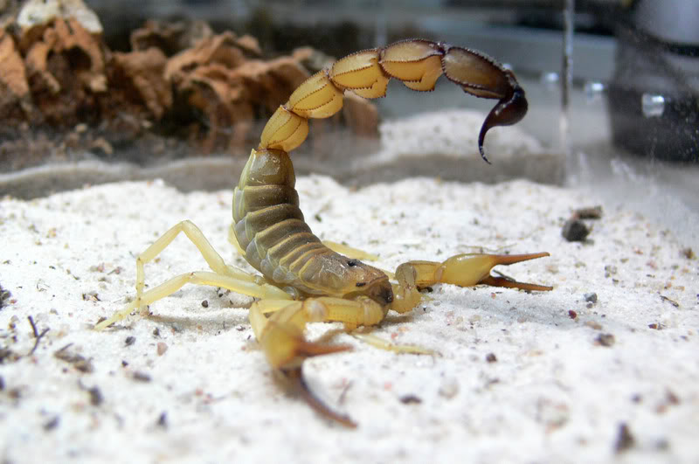
Customer Readiness
Head: well-known authorities
Long tails: limited support
Call to arms: Leave NO Valuable Data Behind

Slide 103
Takeaways
Building high quality knowledge bases is very challenging
  Knowledge extraction, knowledge fusion are critical
Much work in knowledge extraction by ML, NLP communities
  Parallels to work in data integration by the database community
Knowledge fusion is an exciting new area of research
  Data fusion techniques can be extended for this problem
A lot more research needs to be done!

Slide 104
Thank You!

