Slide 1

Knowledge Graph and Machine Learning: A Natural Synergy
Xin Luna Dong, Amazon
5/2020

Slide 2
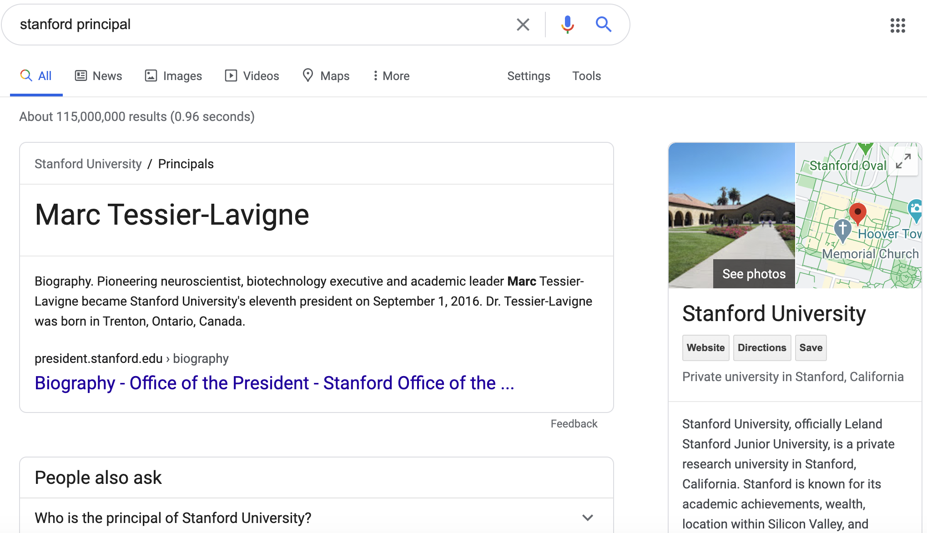
What is the Role of KGs in ML?
Thought 1: A knowledgeable search engine returns better results

Slide 3
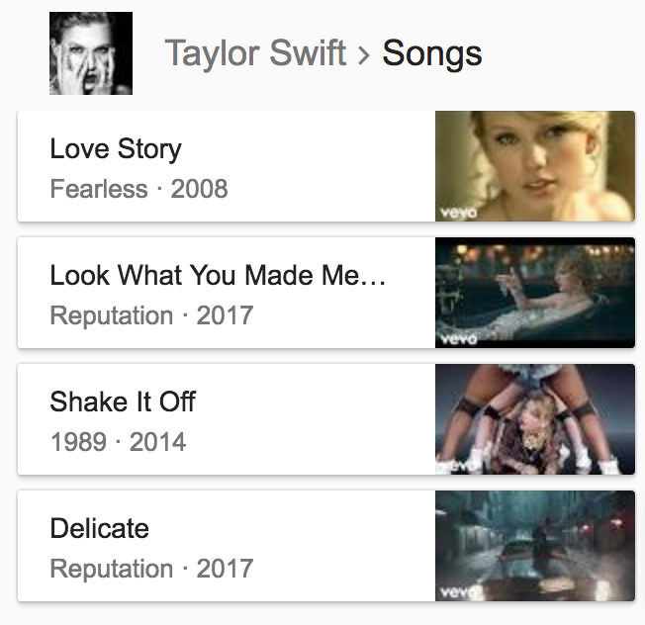


What is the Role of KGs in ML?
Thought 2: A knowledgeable personal assistant gets more things done
Alexa, play Taylor Swift in the past year

Slide 4












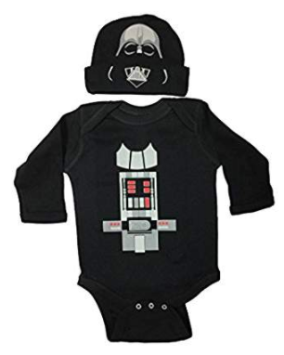



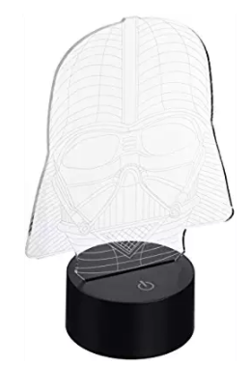

What is the Role of KGs in ML?
Thought 3: A knowledgeable recommender makes better suggestions
Which char more important?
What would people ask about boy’s clothing
Why people who bought this lamp also bought this chair?
Trend of Darth Vader lamps?

Slide 5
What is the Role of KGs in ML?
A knowledgeable search engine returns better results
A knowledgeable personal assistant gets more things done
A knowledgeable recommender makes better suggestions
The more knowledgeable, the more intelligent

Slide 6
But, How to Get Knowledgeable?
Absorb knowledge from all sources like a sponge
Align information from different sources to solve the puzzle
Separate the wheat from the chaff to tell the truth
Mine knowledge from the facts and gain wisdom
The more intelligent, the more knowledgeable

Slide 7
ML Techniques Required for a KG
Knowledge Extraction
Data extraction (NLP, Web)
Knowledge Alignment
Schema mapping (DB)
Knowledge Cleaning
Data cleaning (DB)
Knowledge Mining / KG-based Search & QA
WebTables (DB)
Wrapper induction (DB, DM-Data mining)
Entity linkage (DB, DM)
Ontology alignment (Semantic web, DM)
Universal schema (NLP)
Anomaly detection (ML, DM)
Knowledge fusion (DB, DM)
Graph mining (DM)
Knowledge embedding (DM)
Search (Search, NLP)
QA (NLP)
Text mining (DM)

Slide 8
We will next illustrate using Product Graph as an example…
Goldmine
Knowledge Graph is a for ML
Testbed

Slide 9
BTW, Who Are We?
Product Graph team @ Amazon
  >50 people, 13 scientists, 10 interns every year
  3 knowledge graphs @ Amazon
  Supporting 20+ applications
  In the past 3 years, 16 papers and 8 tutorials at KDD, ACL, NAACL, WebConf, WSDM, VLDB, etc.

Slide 10

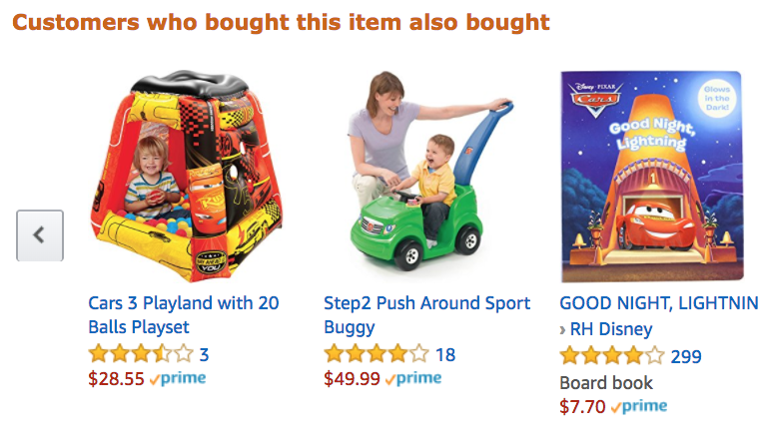
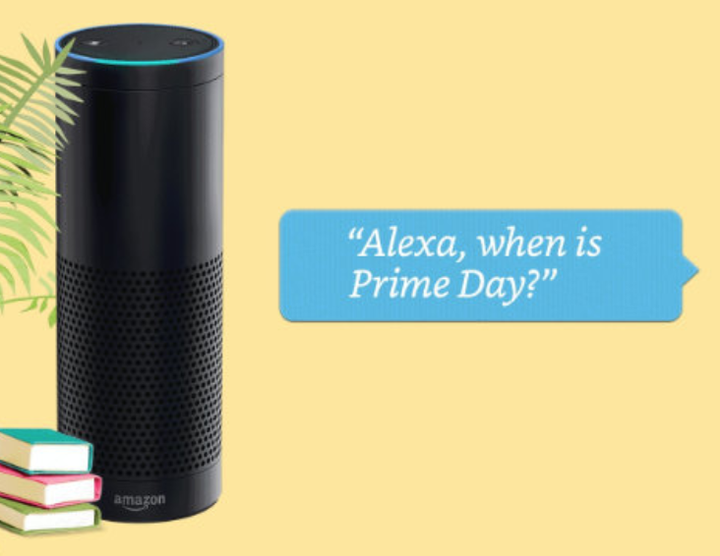
Product Graph
Mission: To answer any question about products and related knowledge in the world

Slide 11
Product Graph vs. Knowledge Graph
(A)
(B)
(C)
Generic KG
Generic KG
Generic KG
PG
PG
PG

Slide 12
Knowledge Graph Example for 2 Songs
Entity
name
“Pop”
name
genre
mid127
“Dance-pop”
name
mid345
name
“Taylor Alison Swift”
“Shake it off”
artist
name
“Taylor Swift”
Recording
type
artist
mid128
type
song_writer
birth_date
12/13/1989
“Love Story”
mid346
name
name
genre
mid129
“Country pop”
Entity type
Relationship
type
Genre
Notes:
Entity ID

Slide 13
Product Graph Example for 2 Songs
“Shake it off”
name
“Pop”
name
name
genre
mid127
“Dance-pop”
mid345
name
“Taylor Alison Swift”
artist
artist
name
“Taylor Swift”
mid128
song_writer
birth_date
12/13/1989
mid346
mid129
name
name
genre
“Country pop”
“Love Story”
type
Genre

Slide 14
Product Graph Example for 2 Songs
“Shake it off”
name
“Pop”
B0035QUXWQ
ASIN
mid567
name
name
genre
mid127
“Dance-pop”
product
B0035QUXWR
ASIN
mid568
mid345
name
“Taylor Alison Swift”
product
artist
Release
name
type
artist
mid128
“Taylor Swift”
mid569
product
Track
song_writer
birth_date
12/13/1989
product
mid570
mid346
B0067XLIG8
ASIN
product
mid129
name
name
genre
“Country pop”
B0067XLIG4
mid571
ASIN
“Love Story”
type
Genre

Slide 15
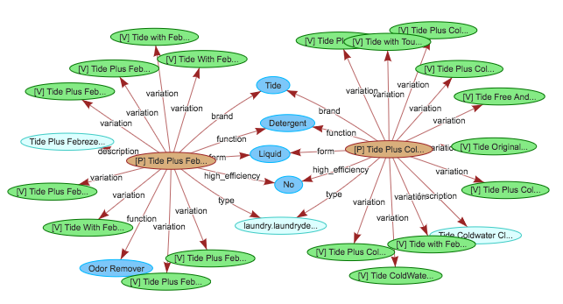
Product Graph for Retail
Amazon Confidential

Slide 16
Knowledge Graph vs. Product Graph
(A)
(B)
(C)
✅
Generic KG
Generic KG
Generic KG
PG
(Movie,
Music,
Book)
Product
Graph
(Hardline, softline,
consumables, etc.)
Movie,
Music,
Book,
etc.
PG

Slide 17
Ten Challenges in Building and Using a Product Graph

Slide 18
Structure for Rest of the Talk
Goals
  Introduce you the interesting research problems for KG
  Impress you with the many ML techniques required for KG
  Invite you to use KG as a testbed for your research
Structure
  Challenge
  Key intuition
  Key techniques

Slide 19
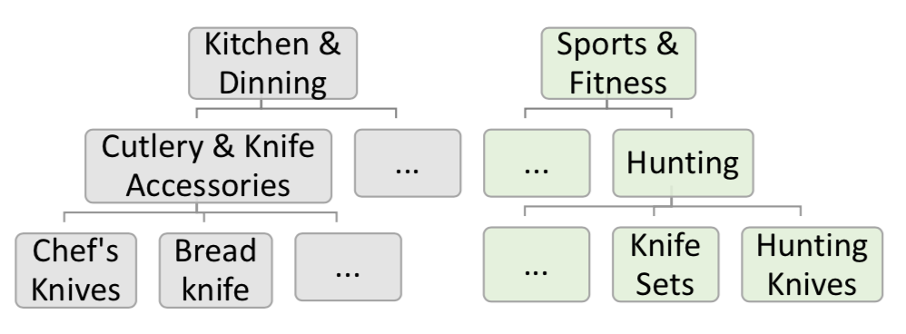
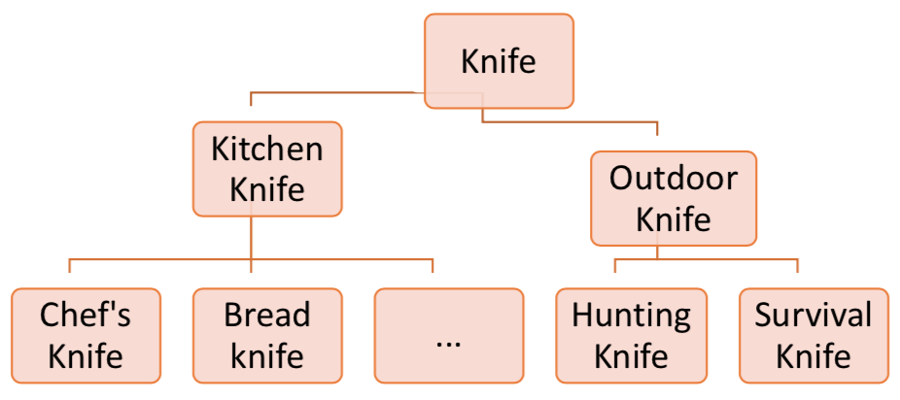
Challenge 1: A Vast Unknown Space
Do you know the types and relationships you’ll model?
  Freebase: 1500 types, 35K (type, relationship) pairs
  Products: 100K product types
Sellers’ view
Buyers’ view

Slide 20
Challenge 1: A Vast Unknown Space
Do you know the types and relationships you’ll model?
  Freebase: 1500 types, 35K (type, relationship) pairs
  Products: 100K product types, >5K product attributes
Child safety car seats | Almond
brand | flavor
style | brand
size or capacity | ingredients
maximum weight recommendation | size or capacity
color | number of items
model | energy content per serving
number of items | bar code
usage | color
bar code | scent
flavor | usage
ingredients | style
scent | model
energy content per serving | maximum weight recommendation
Important (ranked by score)
Unimportant
Inapplicable

Slide 21
Challenge 1: A Vast Unknown Space
Key intuition: behavior from both buyers and sellers
  How to find types?
    Sellers mention product types in product titles
    Customers mention product types in queries
    → Named entity recognition to extract types
  How to organize types into a taxonomy tree?
    Customers who search tea can buy green tea, black tea, oolong tea
    → Graph mining using customer behavior
  Which attributes apply to products of a particular type?
    Sellers mention important attributes in product titles, descriptions, etc.
    Customers mention important attributes in queries, reviews, Q&A, etc.
    → Behavior mining
Mao et al., OCTET: Online catalog taxonomy enrichment with self-supervision, SigKDD, 2020.
Blanco et al., AutoKnow: Self-driving knowledge collection for products of thousands of types, SigKDD, 2020.

Slide 22
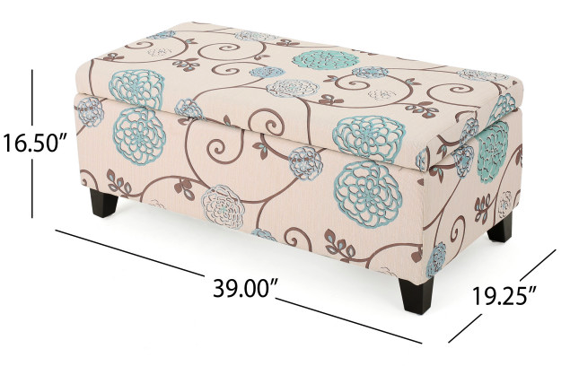
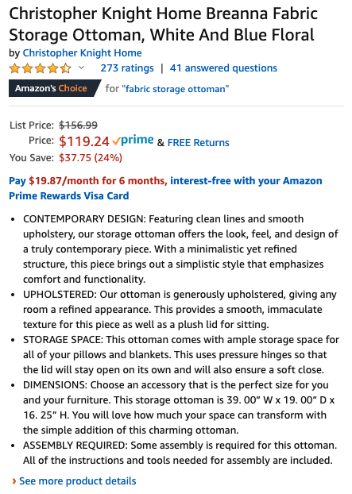
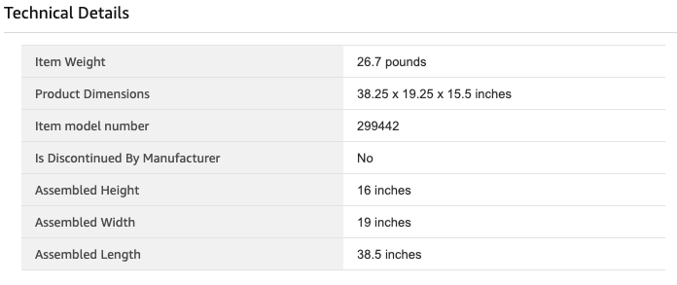
Challenge 2: Too Little Structured Data
(What if)

Slide 23
Challenge 2: Too Little Structured Data
(What if)
What you really need

Slide 24
Challenge 2: Too Little Structured Data
Key intuition: structured data hidden in texts and images
    Named entity recognition on texts
    Image processing on images
Brand
Material
Color
Zheng et al., OpenTag: Open attribute value extraction from product profiles, KDD 2018.
Blanco et al., AutoKnow: Self-driving Knowledge Collection for Products of Thousands of Types, SigKDD, 2020.

Slide 25
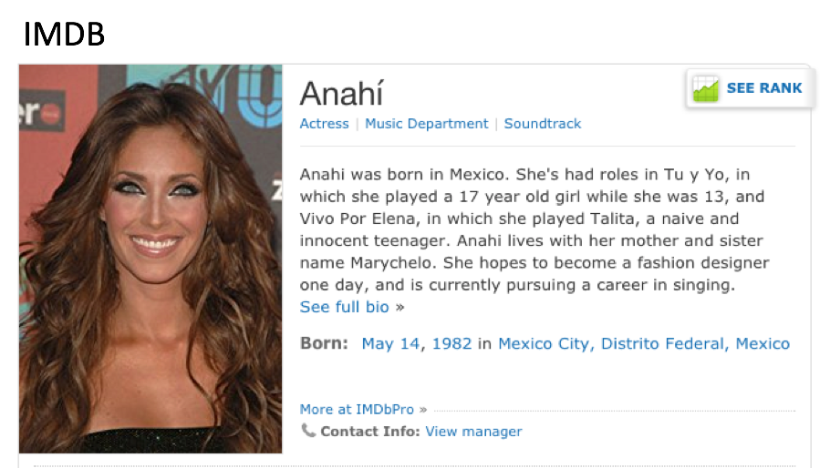
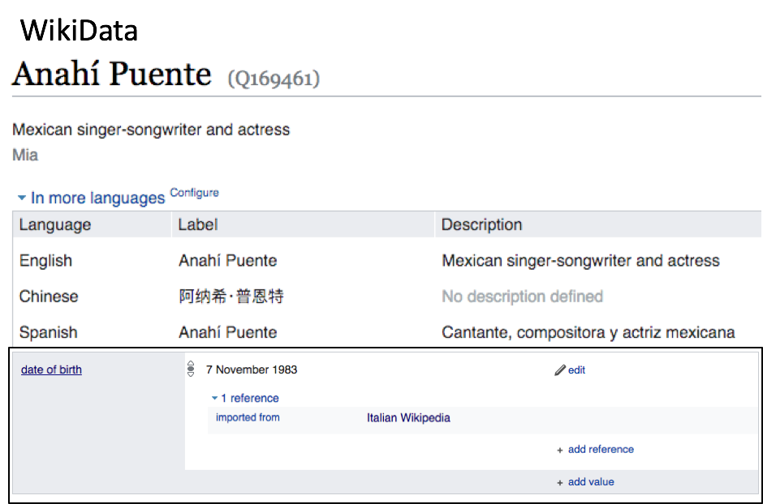
Challenge 3: Abundant but Heterogeneous Data
(What if)
Are they the same person?
Are “born” and “date of birth” the same?

Slide 26


Challenge 3: Abundant but Heterogeneous Data
(What if)
Merge?
Wikipedia
Amazon Music
pgid
pgId
title
hasID
hasTitle
hasID
“Isabelle (Album Version)”
“B075SR96F8”
“Isabelle (1959)”
“B00I2G7BRY”
length
release
hasDuration
hasReleaseDate
“PT3M14S”
“2013-11-28”
“PT3M14S”
“2014-01-15”

Slide 27
Challenge 3: Abundant but Heterogeneous Data
Key intuition: explore the neighborhood
  How to find duplicate entities?
    Compare all neighbor entities and values
    → Entity linkage, knowledge embedding
  How to find similar relationships?
    Compare entity pairs involved in the relationships
    → Universal schema, schema mapping, knowledge embedding
Zhu et al., Collective multi-type entity alignment between knowledge graphs, WebConf 2020.
Zhang et al., AutoBlock: A hands-off blocking framework for entity matching, WSDM 2020.
Zhang et al., OpenKI: Integrating open information extraction and knowledge bases with relation inference, NAACL 2019.
Trivedi et al., LinkNBed: Multi-Graph representation learning with entity linkage, ACL 2018.

Slide 28

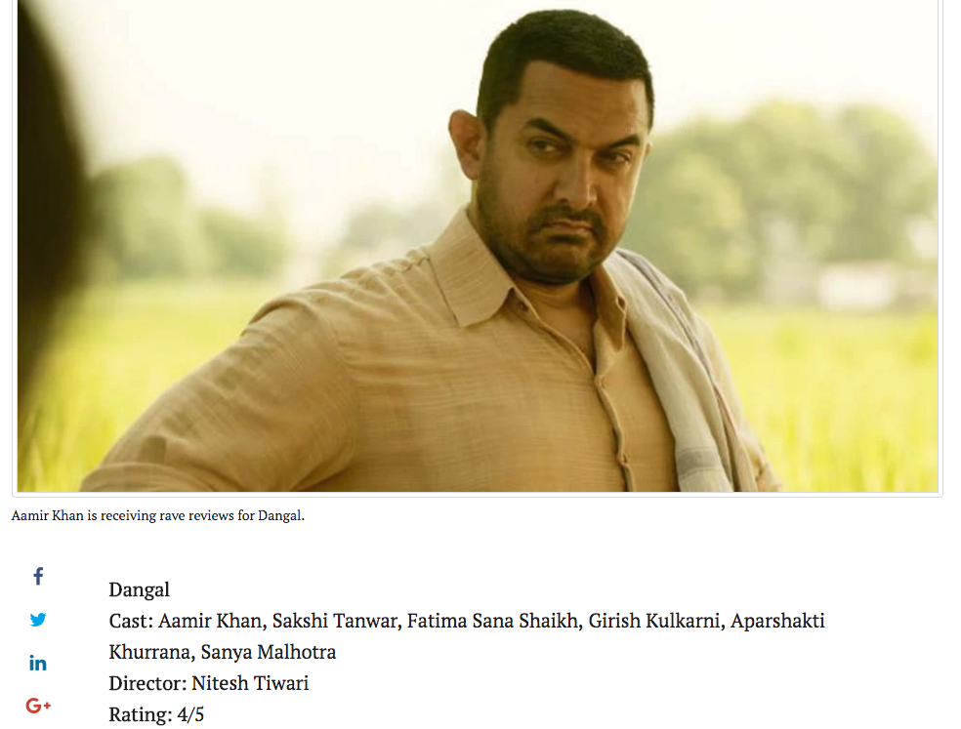
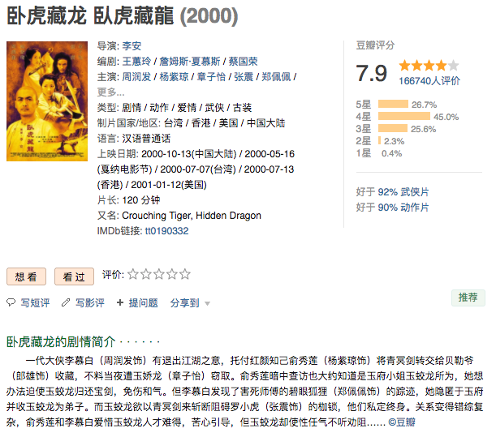
Challenge 4: Data, Data, Everywhere
(What if)
How to extract data w. different templates, languages, domains?

Slide 29
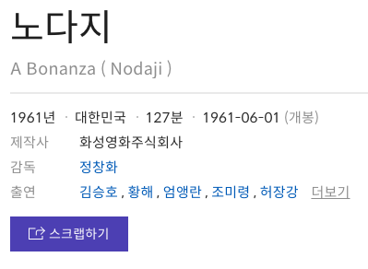
Challenge 4: Data, Data, Everywhere
Key intuition: Hidden visual patterns across websites
    Multi-model information extraction
    GNN-based embedding
    OpenIE on semi-structured data
    WebTable extraction
Lockard et al., Ceres: Distantly supervised relation extraction from the semi-structured web. VLDB, 2018.
Lockard et al., OpenCeres: When open information extraction meets the semi-structured web. NAACL, 2019.
Lockard et al., ZeroShotCeres: Zero-shot relation extraction from semi-structured webpages, ACL 2020.

Slide 30
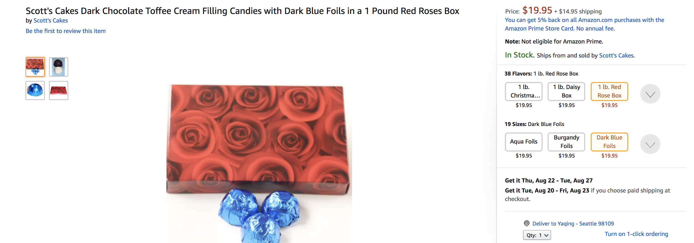
Challenge 5: Non-Trustworthy Data

Slide 31
Challenge 5: Non-Trustworthy Data
When was Anahi born?

Slide 32
Challenge 5: Non-Trustworthy Data
Key intuition: explore redundancy of data
  Are values of the same attribute in the same embedding space?
    E.g., Icecream Flavor: vanilla, chocolate, mango, Hershey’s??, beaf??
    → Anomaly detection, link prediction
  Are values across attributes consistent w. each other?
    → Data cleaning, link prediction
  Are values across sources consistent w. each other?
    → Knowledge fusion
Blanco et al., AutoKnow: Self-driving knowledge collection for products of thousands of types, SigKDD, 2020.
Dong et al., Knowledge Vault: A Web-scale approach to probabilistic knowledge fusion. SigKDD, 2014.

Slide 33
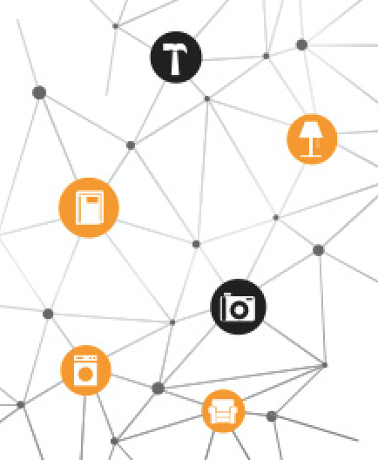
Challenge 6: A Working Solution May NOT Scale Up
Hierarchy of 100K categories
One vertical,
A few sources
Millions of sources
Behavior info from tens of applications over years

Slide 34

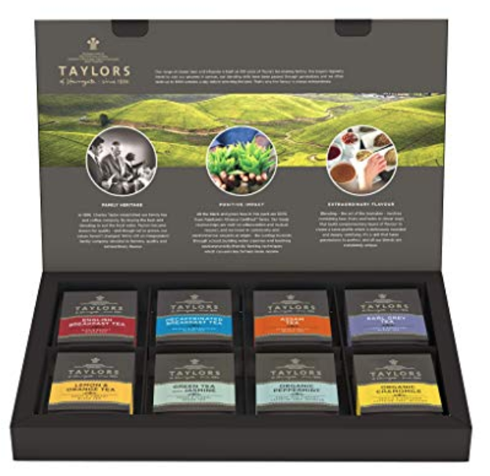
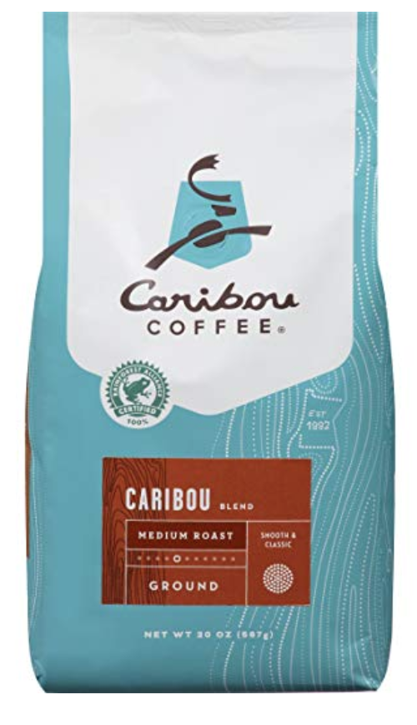



Challenge 6: A Working Solution May NOT Scale Up
100K categories require 100K+ models
    Different value vocabularies
    Different patterns to express the same attribute

Slide 35
Challenge 6: A Working Solution May NOT Scale Up
Key intuition: one size fits all
    → Conditioned attention in Neural Net
    → Data augmentation
Karamanolakis et al., TXtract: Taxonomy-aware knowledge extraction for thousands of product categories, ACL 2020.

Slide 36
Challenge 7: Never-ending Requirements for Training Data
Hierarchy of 100K categories
One vertical,
A few sources
Millions of sources
Big challenge: Limited training labels for large-scale, rich data
Behavior info from tens of applications over years

Slide 37
Challenge 7: Never-ending Requirements for Training Data
Key intuition: learn with limited labels (LLL)
    → Active learning
    → Weak learning: distant supervision, data programming
    → Semi-supervised learning: student-teacher model, data augmentation
    → Transfer learning
    → Meta-learning
Blanco et al., AutoKnow: Self-driving knowledge collection for products of thousands of types, SigKDD, 2020.
Wang et al., Automatic validation of textual attribute values in eCommerce Catalog by learning with limited labeled data, KDD’20

Slide 38
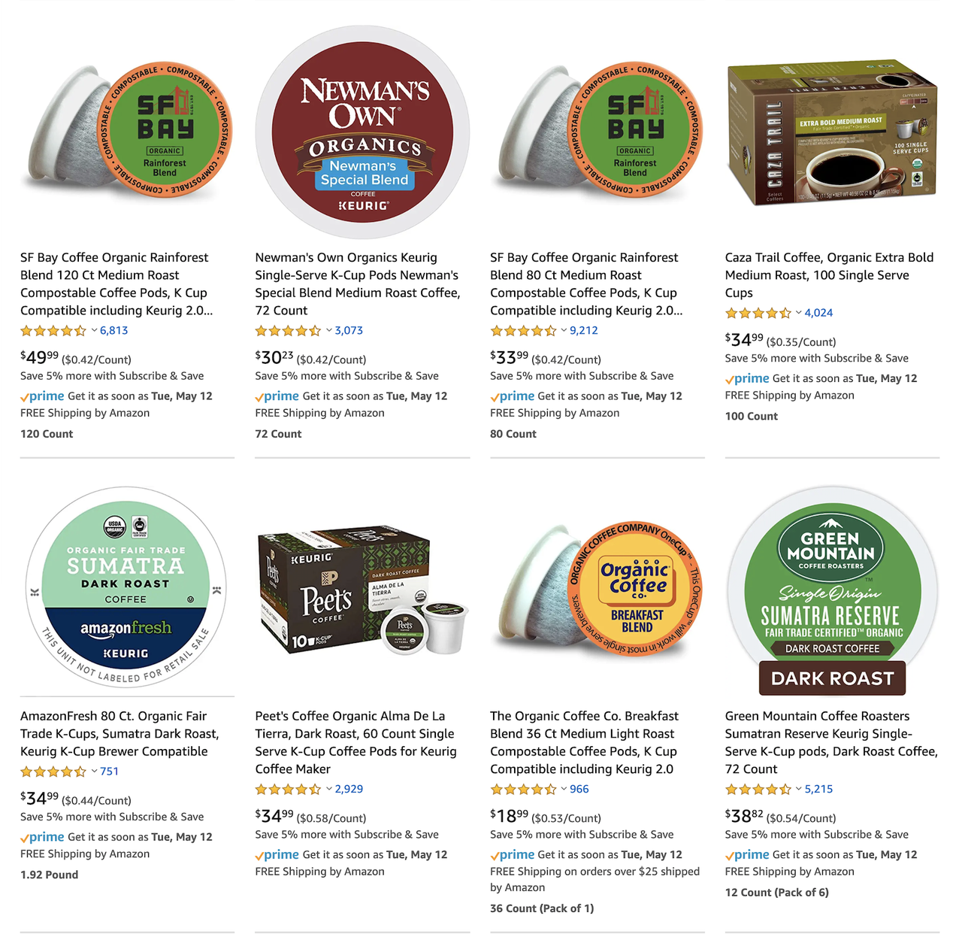
Challenge 8: Find the Needle in the Hay
Query: k cups coffee
organic dark
How to find all such products?
What if no exact match?
What if too many exact match?
✕
✕
✕
✕
✓
✓
✕
✓

Slide 39
Challenge 8: Find the Needle in the Hay
Key intuition: understand user needs
  What do customers specify?
    → Query understanding, entity linking
  Which requirement is less important?
    → Query relaxation
  How to narrow down search results?
    → Query refinement

Slide 40
Challenge 9: From Facts to Insights
Which char more important?
What would people ask about boy’s clothing
Trend of Darth Vader lamps?

Slide 41
Challenge 9: From Facts to Insights
Key intuition: Random walk under supervision
    → Graph mining w. GNN
Park et al., MultiImport: Inferring node importance in a knowledge graph from multiple input signals. SigKDD, 2020
Park et al., Estimating node importance in knowledge graphs using Graph Neural Networks. SigKDD, 2019

Slide 42
Challenge 10: Can You Explain It?
Why people who bought this lamp also bought this chair?

Slide 43
Challenge 10: Can You Explain It?
Key intuition: Form path through random walk
    → Graph mining

Slide 44
Take Aways
KG is both a goldmine and a testbed for ML
Building and using a KG involves tons of research problems, need techniques from many research areas
At Amazon, we are building a Product Graph and using web knowledge extraction to populate Alexa knowledge

Slide 45

Thank You!
Questions?

