Slide 1

Zero to One Billion:
The Journey to a Rich Product Graph
Xin Luna Dong
AmazoN
6/2021

Slide 2
Knowledge Graph Example for 2 Songs
Entity
name
“Pop”
name
genre
mid127
“Dance-pop”
name
mid345
name
“Taylor Alison Swift”
“Shake it off”
artist
name
“Taylor Swift”
Recording
type
artist
mid128
type
song_writer
birth_date
12/13/1989
“Love Story”
mid346
name
name
genre
mid129
“Country pop”
Entity type
Relationship
type
Genre
Notes:
Entity ID

Slide 3
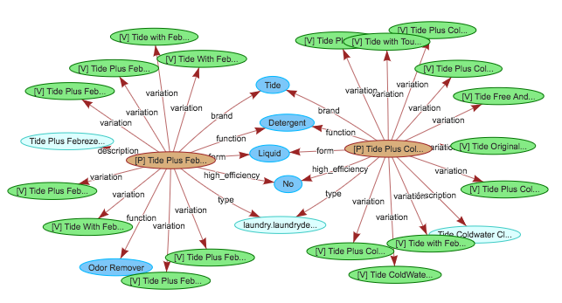
Product Graph Example for 2 Products
Amazon Confidential

Slide 4

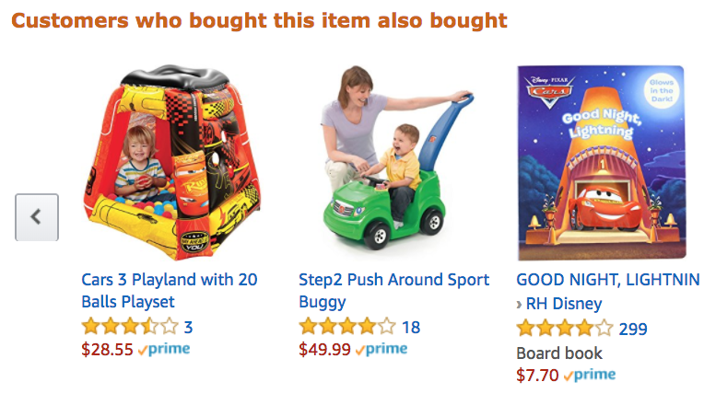
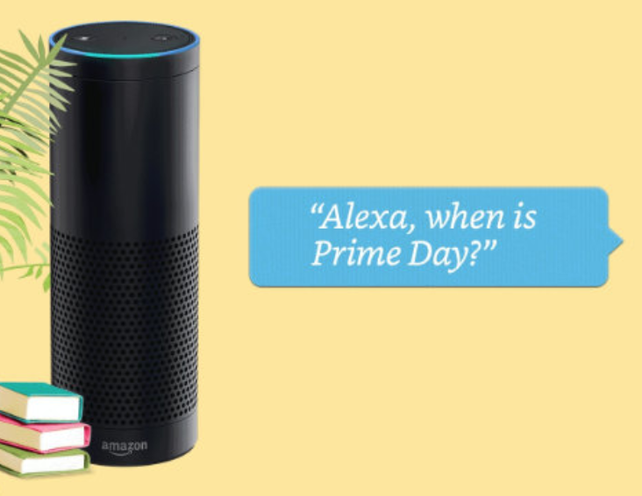
Product Graph
Mission: To answer any question about products and related knowledge in the world

Slide 5
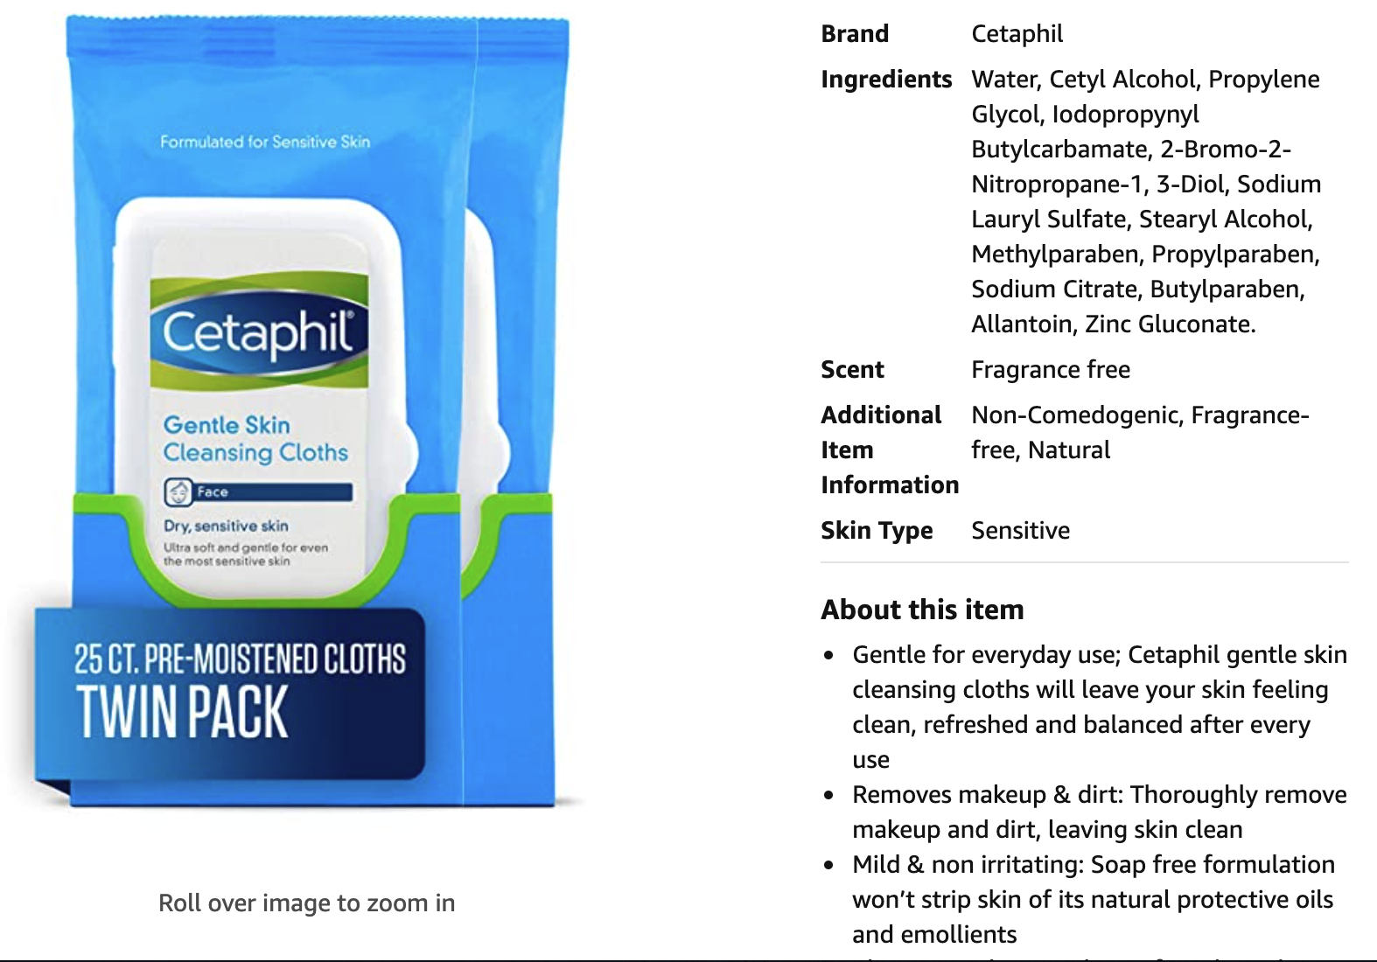
Use Case I: Providing Information

Slide 6
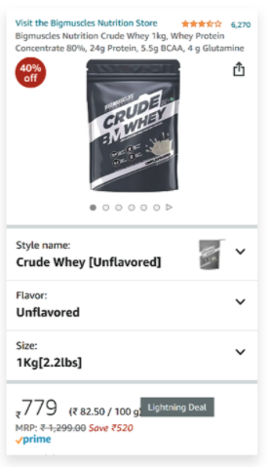
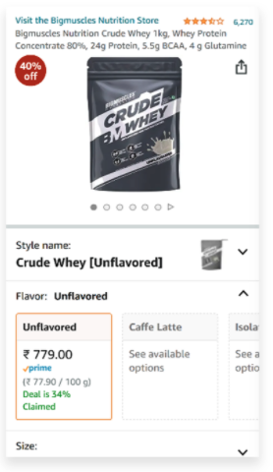
Use Case II: Providing Choices

Slide 7
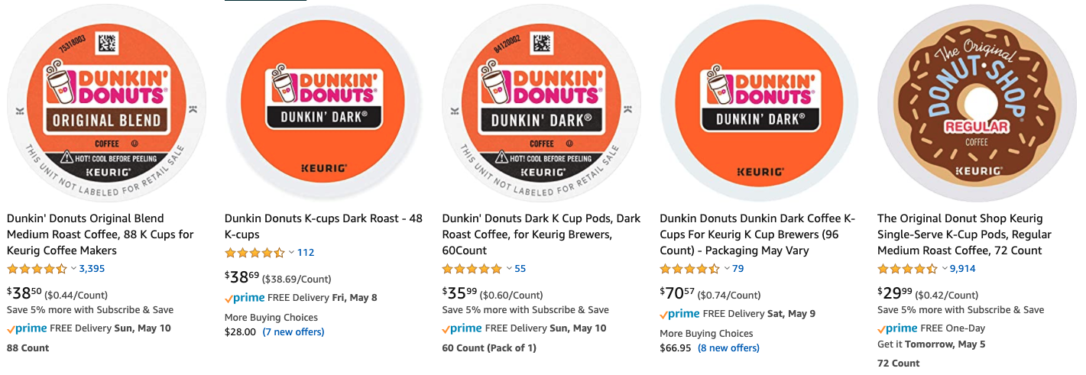
Use Case III: Improving Search

Slide 8
Use Case III: Improving Search

Slide 9
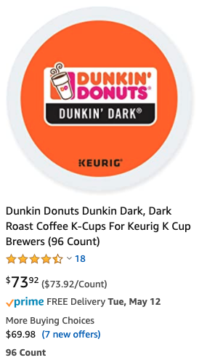
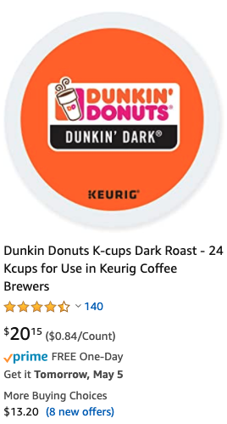
Use Case III: Improving Search

Slide 10
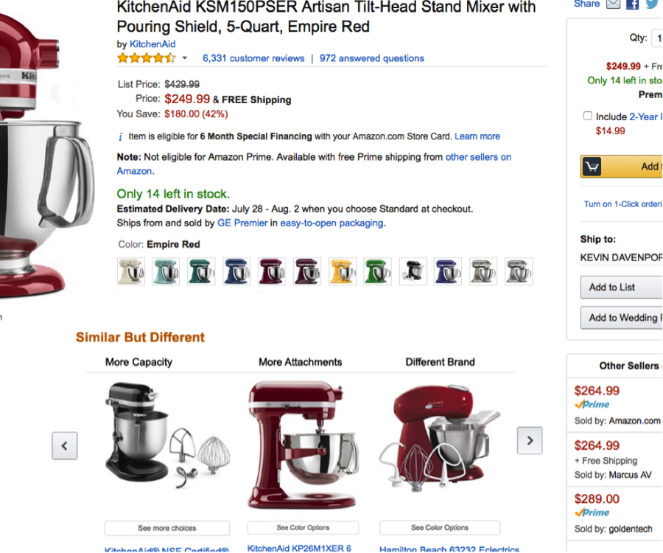
Use Case IV: Improving Recommendation

Slide 11
Product Graph vs. Knowledge Graph
(A)
(B)
(C)
Generic KG
Generic KG
Generic KG
PG
PG
PG

Slide 12
Knowledge Graph vs. Product Graph
(A)
(B)
(C)
✅
Generic KG
Generic KG
Generic KG
PG
Product
Graph
(Hardline, softline,
consumables, etc.)
Movie,
Music,
Book,
etc.
PG

Slide 13
AutoKnow: Self-Driving Product Knowledge Collection
Taxonomy
Grocery
Product KG
Grocery
Snacks
Drinks
Snacks
Drinks
Candy
User logs
Pretzels
Candy
AutoKnow
Catalog
hasType
Product | Type | Flavor | Color
Product 1 | Snacks | Cherry
Product 2 | Candy | ? | ?
Product 3 | Candy | Choc. | Gold
Prod. 1
Prod. 2
Prod. 3
flavor
flavor
color
Chocolate
Choc.
Gold
synonym
Dong et al., AutoKnow: Self-driving knowledge collection for products of thousands of types, SigKDD, 2020.

Slide 14
AutoKnow: Self-Driving Product Knowledge Collection
Taxonomy
Grocery
Product KG
Grocery
Snacks
Drinks
New Type
Snacks
Drinks
Candy
User logs
Pretzels
Candy
AutoKnow
Catalog
hasType
Product | Type | Flavor | Color
Product 1 | Snacks | Cherry
Product 2 | Candy | ? | ?
Product 3 | Candy | Choc. | Gold
Prod. 1
Prod. 2
Prod. 3
Corrected Value
color
flavor
flavor
Chocolate
Choc.
Gold
synonym
New Value
Dong et al., AutoKnow: Self-driving knowledge collection for products of thousands of types, SigKDD, 2020.

Slide 15
AutoKnow: Self-Driving Product Knowledge Collection
Taxonomy
Grocery
Product KG
Grocery
Snacks
Drinks
Snacks
Drinks
Candy
User logs
Pretzels
Candy
AutoKnow
Catalog
hasType
Product | Type | Flavor | Color
Product 1 | Snacks | Cherry
Product 2 | Candy | ? | ?
Product 3 | Candy | Choc. | Gold
● #Types ↑ 3X
● Defect rate ↓
up to 68 percent points
Prod. 1
Prod. 2
Prod. 3
flavor
flavor
color
Chocolate
Choc.
Gold
synonym
Dong et al., AutoKnow: Self-driving knowledge collection for products of thousands of types, SigKDD, 2020.

Slide 16
But, Is The Problem Harder?
Generic KG
Product
Graph
(Hardline, softline,
consumables, etc.)
Movie,
Music,
Book,
etc.

Slide 17
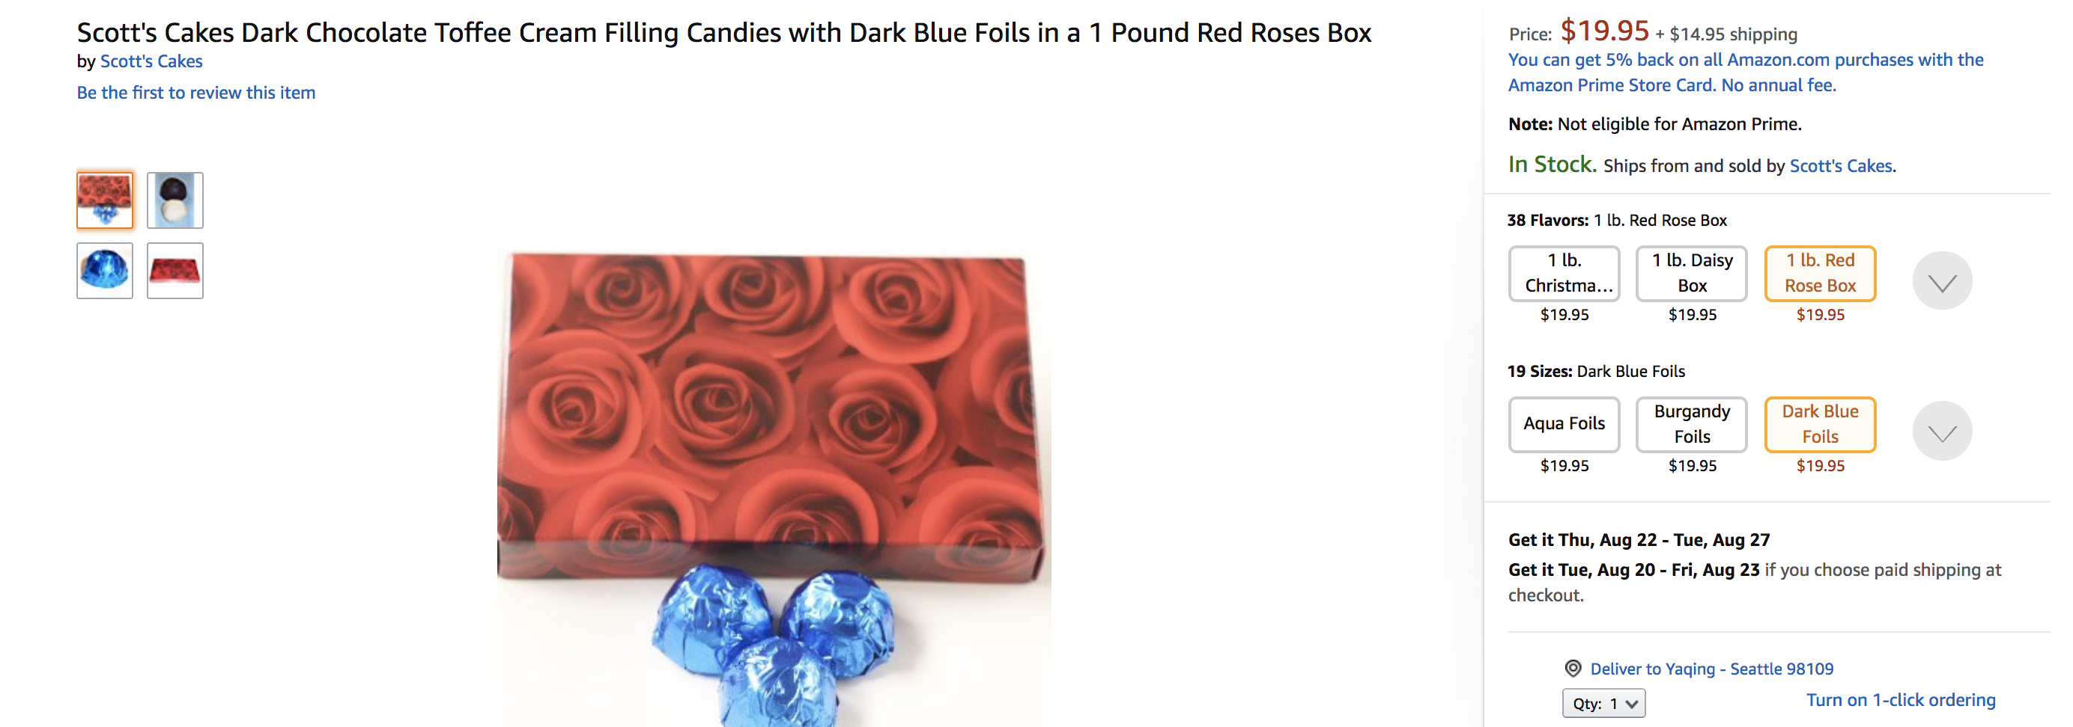
Challenges in Building Product Graph I
Sparse and noisy structured data

Slide 18
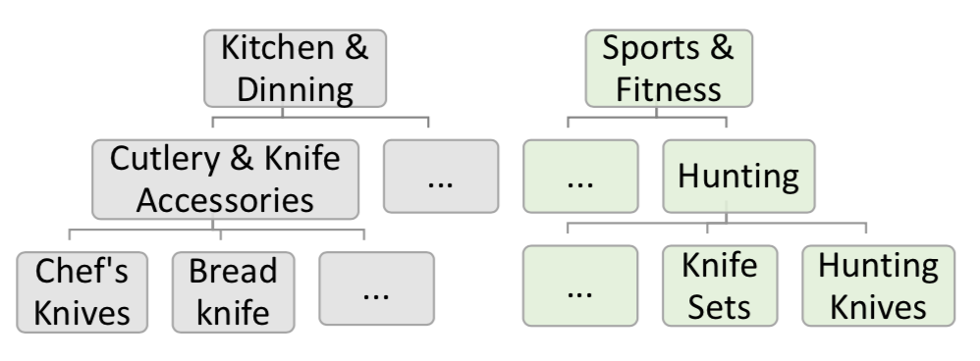
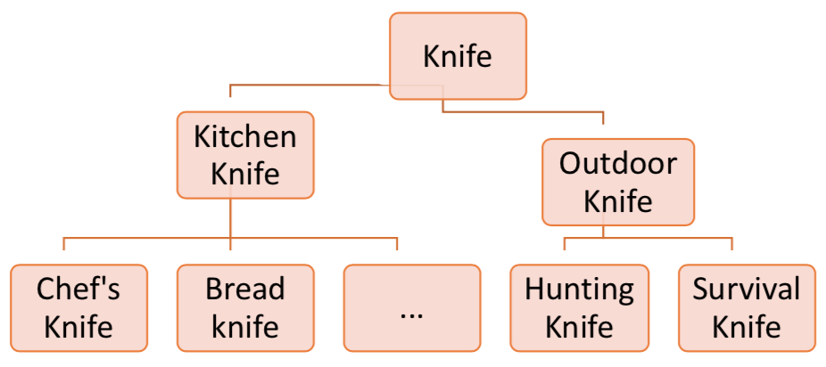
Challenges in Building Product Graph II
Extremely complex domains
    How to identify the millions of product types?
    How to organize types into a taxonomy tree?
Sellers’ view
Buyers’ view

Slide 19
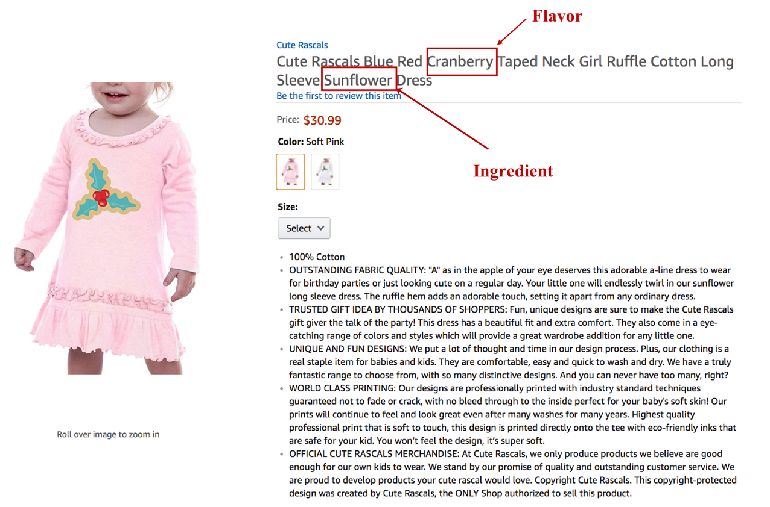
Challenges in Building Product Graph III
Big variety across product types
    Different attributes apply to different product types
    Different value vocabularies and different patterns

Slide 20

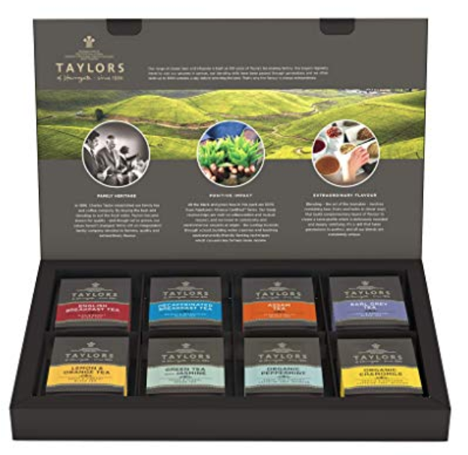
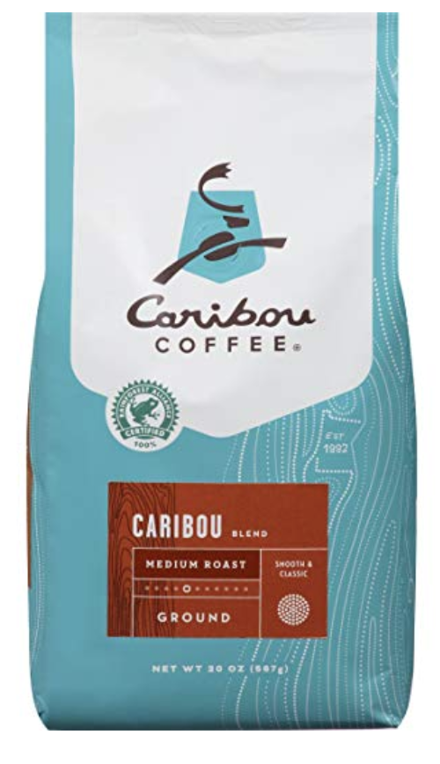



Challenges in Building Product Graph III
Big variety across product types
    Different attributes apply to different product types
    Different value vocabularies and different patterns

Slide 21

Scale Up in 3 Dimensions
Millions of categories
Thousands of attributes
Big challenge: Limited training labels for large-scale, rich data
Hundreds of languages

Slide 22
A 100-Year Project

Slide 23
Deliver the Data Business
1
0
0
0
0
0
0
0
0
0
,
,
,

Slide 24
Deliver the Data Business
1
High
precision
models

Slide 25
Deliver the Data Business
1
0
0
0
,
High
precision
models
E2E pipeline
+ AutoML
to reduce modeling cost

Slide 26
Deliver the Data Business
1
0
0
0
0
0
0
,
,
1000s categories
High
precision
models
E2E pipeline
+ AutoML
to reduce modeling cost
10s languages
100s attributes
Scale-up to reduce #models

Slide 27
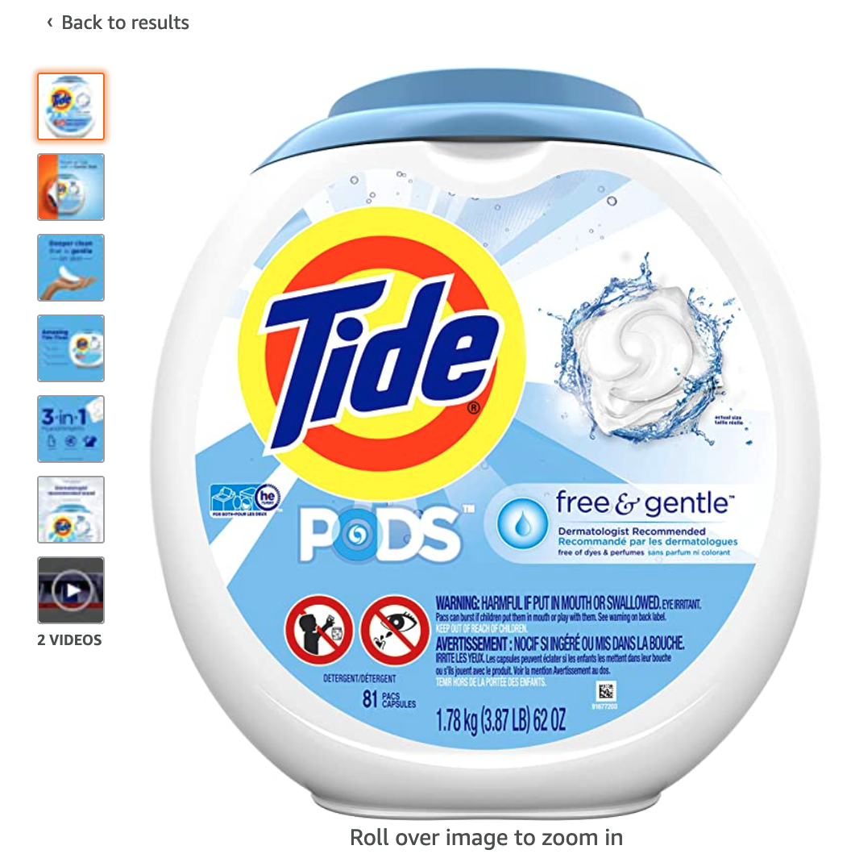
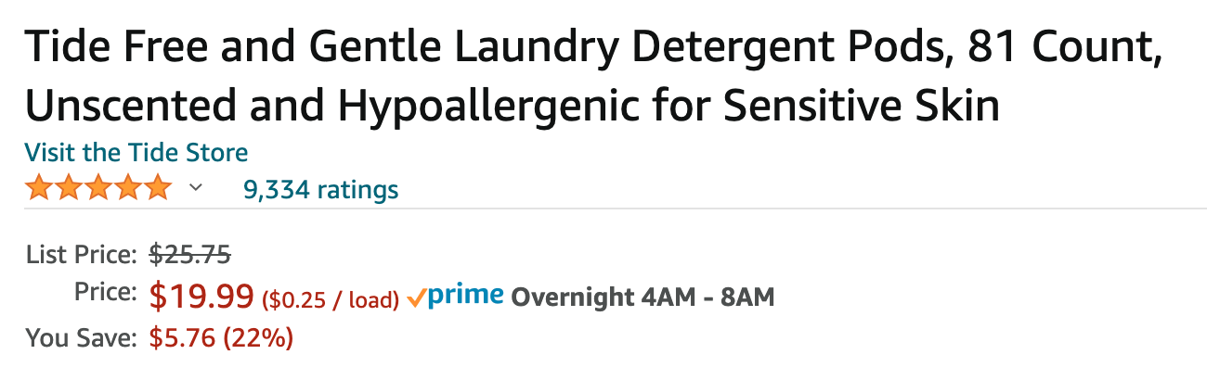
Deliver the Data Business
1
0
0
0
0
0
0
0
0
0
,
,
,
1000s categories
High
precision
models
E2E pipeline
+ AutoML
to reduce modeling cost
10s languages
100s attributes
Scale-up to reduce #models
Higher yield from multi-modal models

Slide 28

From 0 to 1: High-Quality Data

Slide 29
From Zero to One: A Core Algorithm
1
High
precision
models

Slide 30
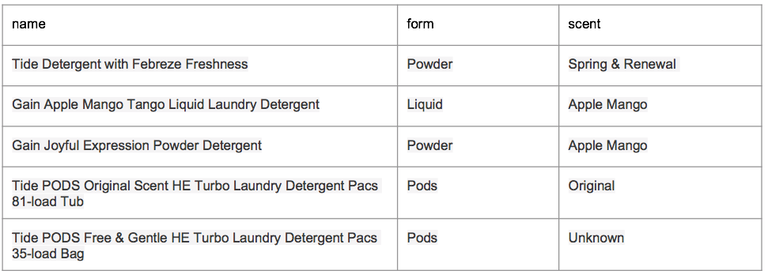

OpenTag Extraction from Product Profiles
Zheng et al., OpenTag: Open attribute value extraction from product profiles, KDD 2018.
Notes:
Change the numbers here

Slide 31
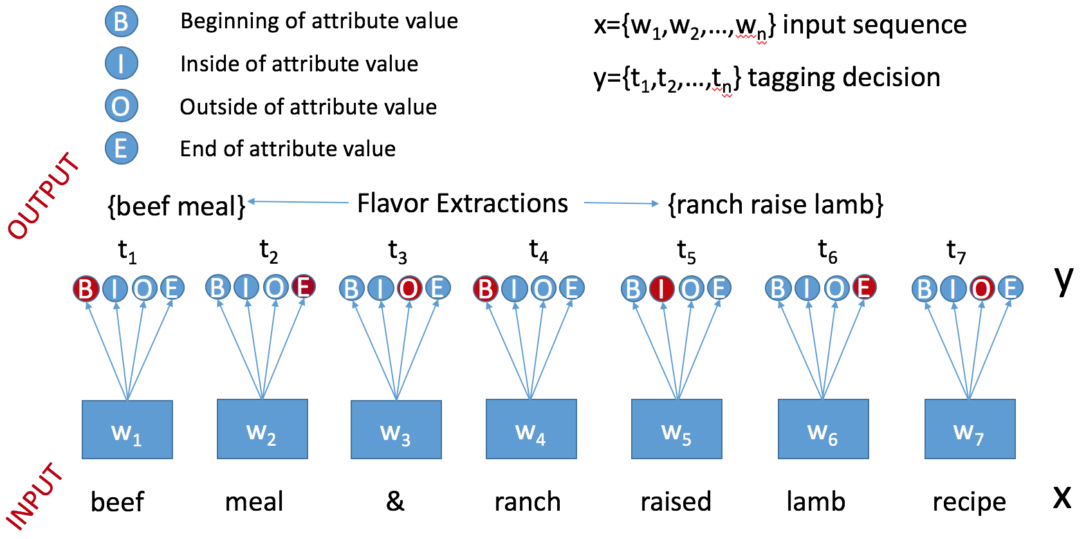
OpenTag Extraction from Product Profiles
Notes:
Change the numbers here

Slide 32
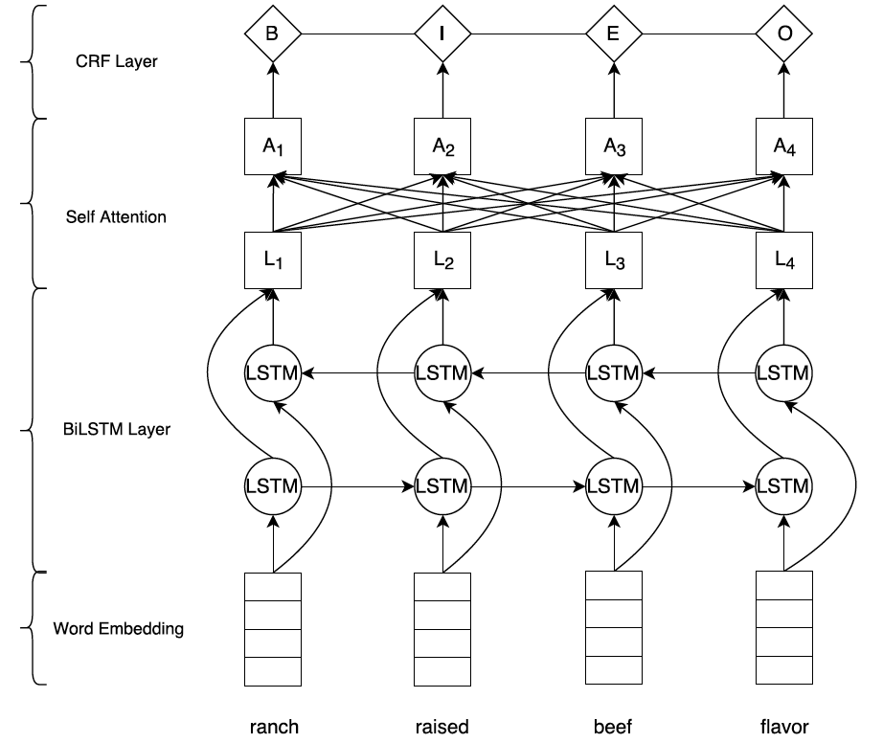
OpenTag Extraction from Product Profiles
CRF
Attention
Bi-LSTM
Word Embedding
Notes:
Change the numbers here

Slide 33
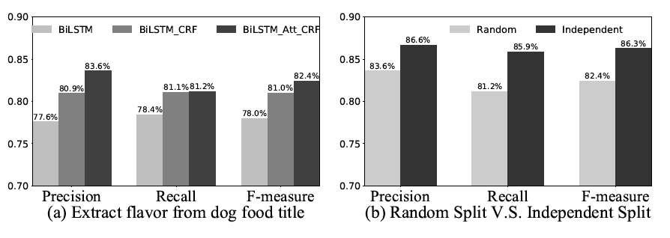
OpenTag Extraction from Product Profiles
Unknown
values
Random
values
BiLSTM+CRF+Attention obtains best results
Extraction on new values is comparable to already known values
Zheng et al., OpenTag: Open attribute value extraction from product profiles, KDD 2018.
Notes:
Change the numbers here

Slide 34



OpenTag in Practice
Train and fine-tune models
OpenTag
Understand domain and attributes, and generate LOTS OF training data
Postprocess extraction results to further improve data quality
Pre-publish evaluation as gatekeeper to guarantee high quality data

Slide 35
Still the Origin Point
Millions of categories
Thousands of attributes
Hundreds of languages

Slide 36
From 1 to 1K:
Reducing Modeling Cost

Slide 37
From 1 to 1K: E2E AutoML Pipeline
1
0
0
0
,
High
precision
models
E2E pipeline
+ AutoML
to reduce modeling cost

Slide 38
An End-to-End Pipeline
Train and fine-tune models
OpenTag
Understand domain and attributes, and generate LOTS OF training data
Postprocess extraction results to further improve data quality
Pre-publish evaluation as gatekeeper to guarantee high quality data

Slide 39
An End-to-End Pipeline
Train and fine-tune models
Automatic Training Data Generation
OpenTag
Postprocess extraction results to further improve data quality
Pre-publish evaluation as gatekeeper to guarantee high quality data
Distant supervision,
Data programming
Benchmarking

Slide 40

An End-to-End Pipeline
Train and fine-tune models
Automatic Training Data Generation
OpenTag
Deep Learning
Data Cleaning
Pre-publish evaluation as gatekeeper to guarantee high quality data
Distant supervision,
Data programming
Postprocess extraction results to further improve data quality
Benchmarking

Slide 41
An End-to-End Pipeline
Train and fine-tune models
Automatic Training Data Generation
OpenTag
Deep Learning
Data Cleaning
Scale-up pre-publish evaluation w. lower labeling needs
Distant supervision,
Data programming
Postprocess extraction results to further improve data quality
Benchmarking

Slide 42
An End-to-End Pipeline
AutoML
Automatic Training Data Generation
OpenTag
Deep Learning
Data Cleaning
Scale-up pre-publish evaluation w. lower labeling needs
Distant supervision,
Data programming
Benchmarking

Slide 43
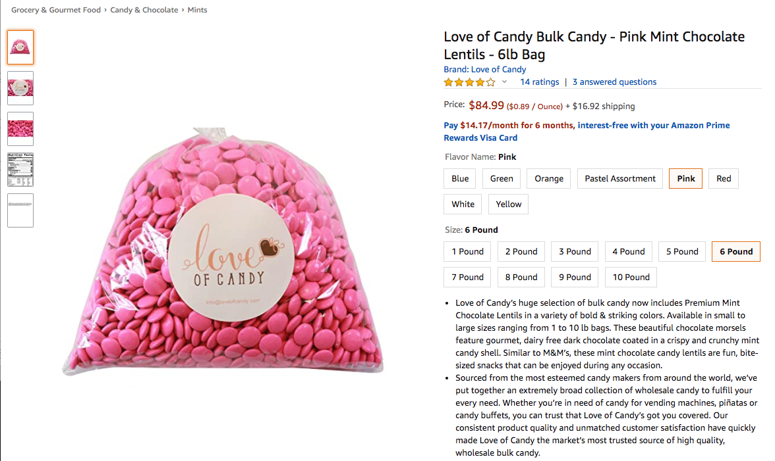
Transformer-Based Anomaly Detection
Wang et al., Automatic validation of textual attribute values in eCommerce Catalog by learning with limited labeled data, KDD’20

Slide 44
Transformer-Based Anomaly Detection
Is the flavor “Pink”?
Wang et al., Automatic validation of textual attribute values in eCommerce Catalog by learning with limited labeled data, KDD’20

Slide 45
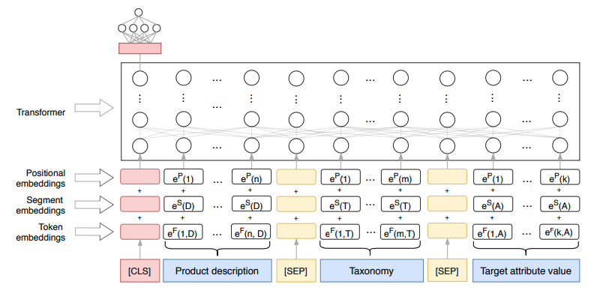
Transformer-Based Anomaly Detection
Wang et al., Automatic validation of textual attribute values in eCommerce Catalog by learning with limited labeled data, KDD’20

Slide 46
Transformer-Based Anomaly Detection
Category as input for model training
Wang et al., Automatic validation of textual attribute values in eCommerce Catalog by learning with limited labeled data, KDD’20

Slide 47
Transformer-Based Anomaly Detection
Identify 1.77MM incorrect values for Flavor and Scent for Consumables with 90% precision
Product | Attr | Value
Love of Candy Bulk Candy - Pink Mint Chocolate Lentils - 6lb Bag | Flavor | Pink
Scott's Cakes Dark Chocolate Fruit & Nut Cream Filling Candies with Burgandy Foils in a 1 Pound Snowflake Box | Flavor | 1 lb. snowflake box
Lucky Baby - Baby Blanket Envelope Swaddle Winter Wrap Coral Fleece Newborn Blanket Sleeper Infant Stroller Wrap Toddlers Baby Sleeping Bag (color 1) | Flavor | color 1
ASUTRA Himalayan Sea Salt Body Scrub Exfoliator + Body Brush (Vitamin C), 12 oz | Ultra Hydrating, Gentle, Moisturizing | All Natural & Organic Jojoba, Sweet Almond, Argan Oils | Scent | vitamin c body scrub - 12oz & body brush
Folgers Simply Smooth Ground Coffee, 2 Count (Medium Roast), 31.1 Ounce | Scent | 2Packages (Breakfast Blend, 31.1 oz)

Slide 48
From 1K to 1M: Scaling Up

Slide 49
From 1K to 1M: One Size Fits All
1
0
0
0
0
0
0
,
,
1000s categories
High
precision
models
E2E pipeline
+ AutoML
to reduce modeling cost
10s languages
100s attributes
Scale-up to reduce #models

Slide 50
Scale up for Millions of Categories
Millions of categories
Thousands of attributes
Hundreds of languages

Slide 51
Scale-up I: Millions of Categories
Option 1. Train a single model? Train/Test Distribution shift -> Invalid predictions
Karamanolakis et al., TXtract: Taxonomy-aware knowledge extraction for thousands of product categories, ACL 2020.

Slide 52
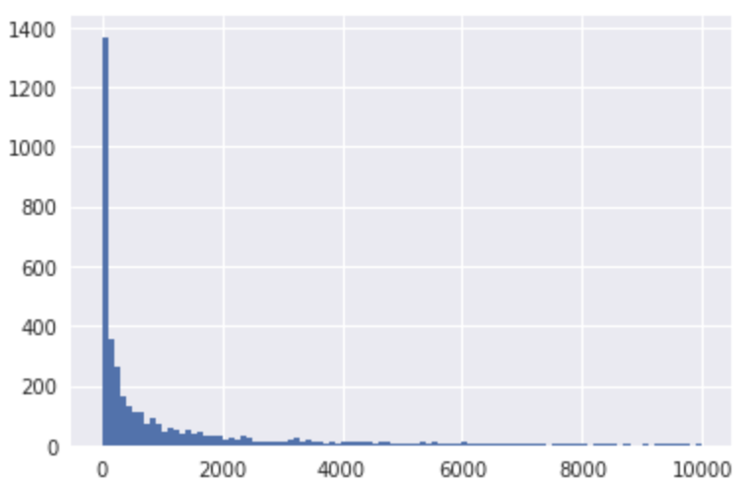
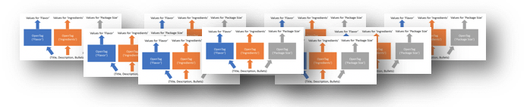
Scale-up I: Millions of Categories
Option 1. Train a single model? Train/Test Distribution shift -> Invalid predictions
Option 2. Train a model for each category?
Store/orchestrate 100K+ OpenTag models
Most categories are very sparse
Karamanolakis et al., TXtract: Taxonomy-aware knowledge extraction for thousands of product categories, ACL 2020.

Slide 53
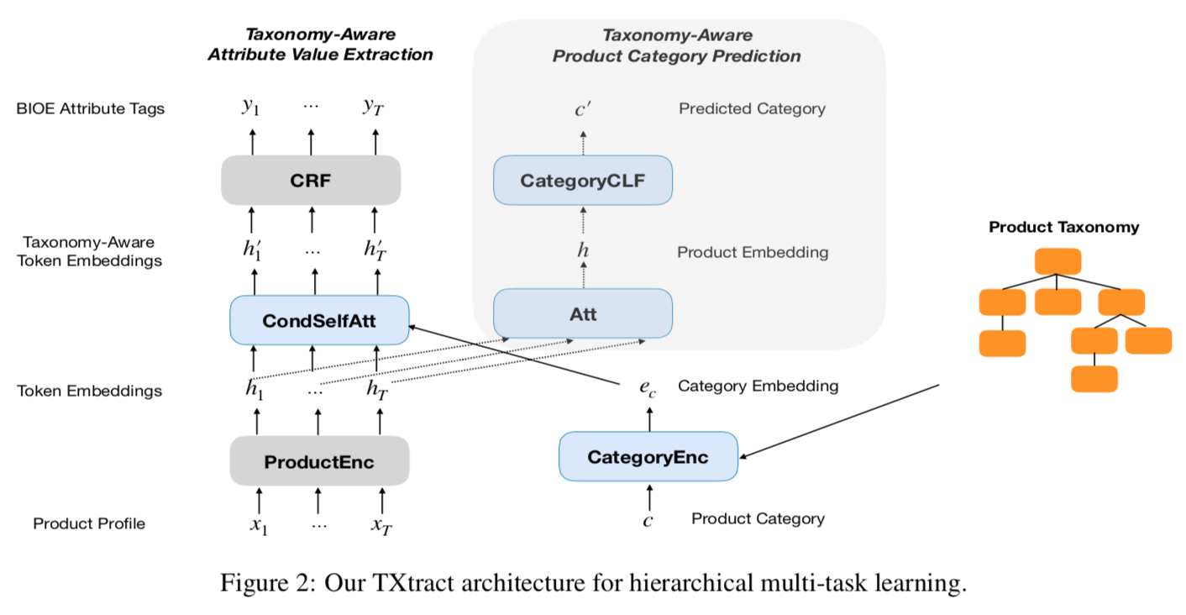
Scale-up I: Millions of Categories
Karamanolakis et al., TXtract: Taxonomy-aware knowledge extraction for thousands of product categories, ACL 2020.

Slide 54
Scale-up I: Millions of Categories
Attention conditioned on category representation
Karamanolakis et al., TXtract: Taxonomy-aware knowledge extraction for thousands of product categories, ACL 2020.

Slide 55
Scale-up I: Millions of Categories
Attention conditioned on category representation
Karamanolakis et al., TXtract: Taxonomy-aware knowledge extraction for thousands of product categories, ACL 2020.

Slide 56
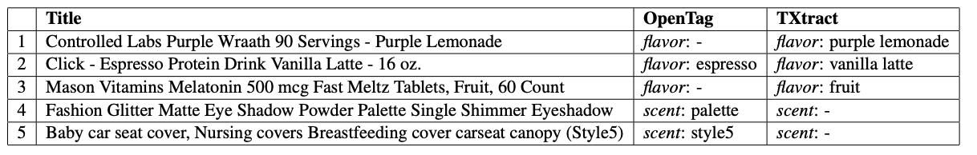
Scale-up I: Millions of Categories
Train one model on 4K categories, and improve state-of-the-art by 10.4% in F1, and by 11.7% in coverage
Karamanolakis et al., TXtract: Taxonomy-aware knowledge extraction for thousands of product categories, ACL 2020.

Slide 57
Scale up for Thousands of Attributes
Millions of categories
Thousands of attributes
Hundreds of languages

Slide 58
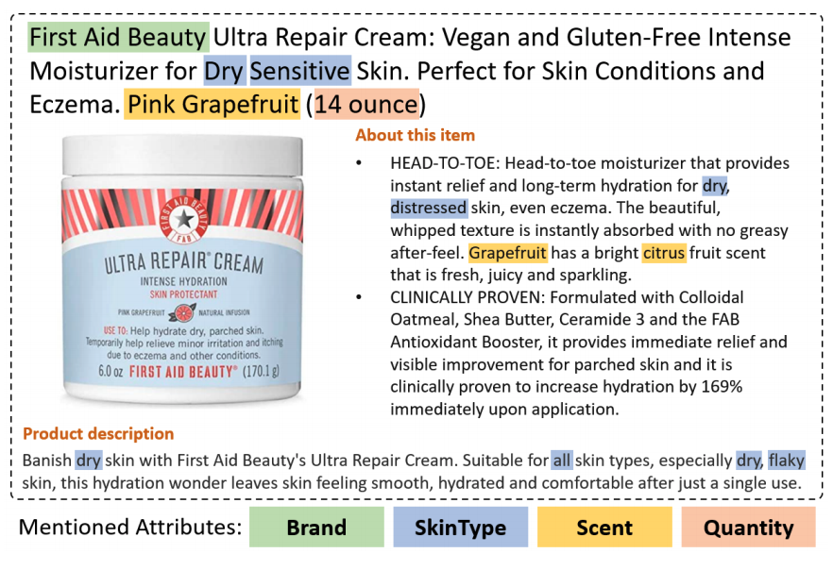
Scale-up II: Thousands of Attributes
Yan et al., AdaTag: Multi-Attribute Value Extraction from Product Profiles with Adaptive Decoding, ACL 2021.

Slide 59
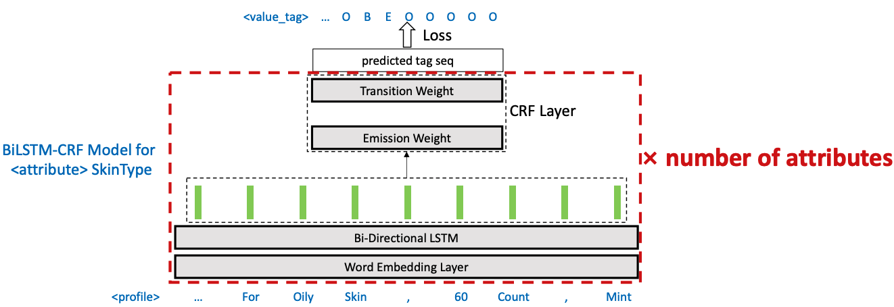
Scale-up II: Thousands of Attributes
Yan et al., AdaTag: Multi-Attribute Value Extraction from Product Profiles with Adaptive Decoding, ACL 2021.

Slide 60
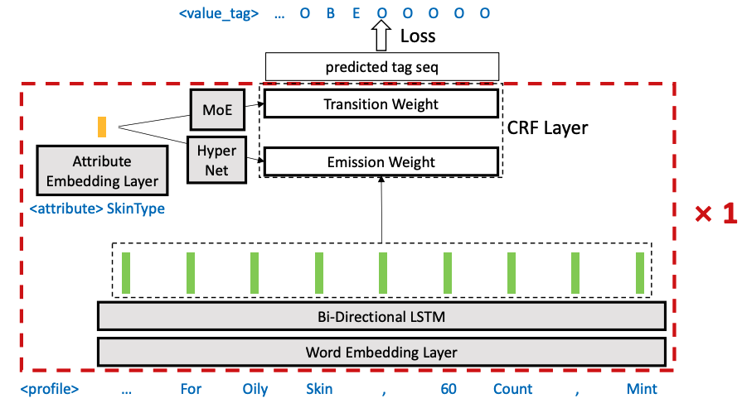
Scale-up II: Thousands of Attributes
Yan et al., AdaTag: Multi-Attribute Value Extraction from Product Profiles with Adaptive Decoding, ACL 2021.

Slide 61
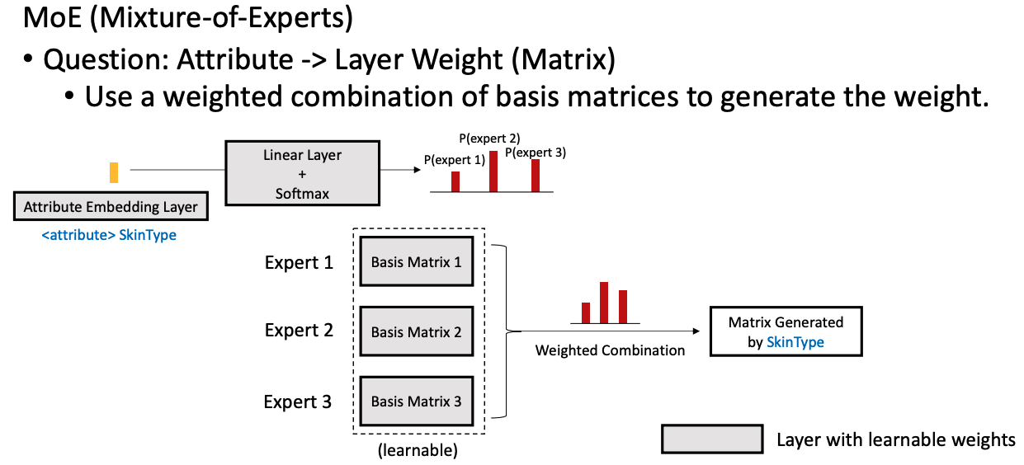
Scale-up II: Thousands of Attributes
Yan et al., AdaTag: Multi-Attribute Value Extraction from Product Profiles with Adaptive Decoding, ACL 2021.

Slide 62
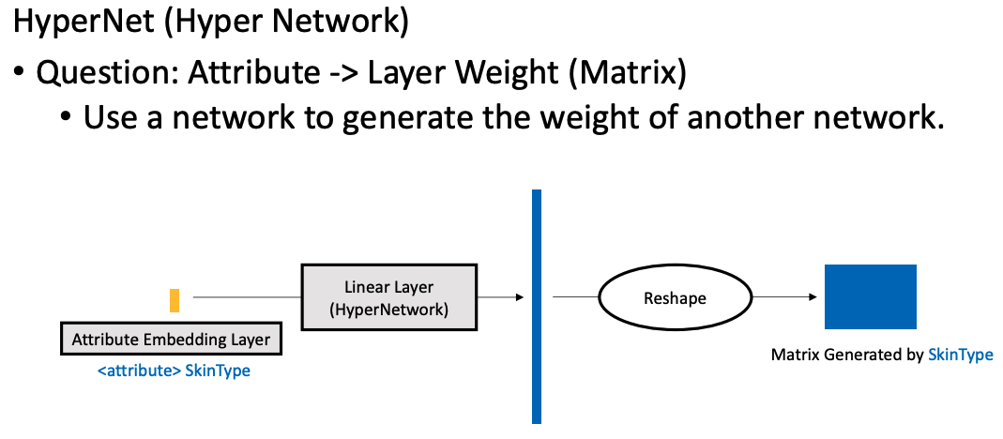
Scale-up II: Thousands of Attributes
Yan et al., AdaTag: Multi-Attribute Value Extraction from Product Profiles with Adaptive Decoding, ACL 2021.

Slide 63
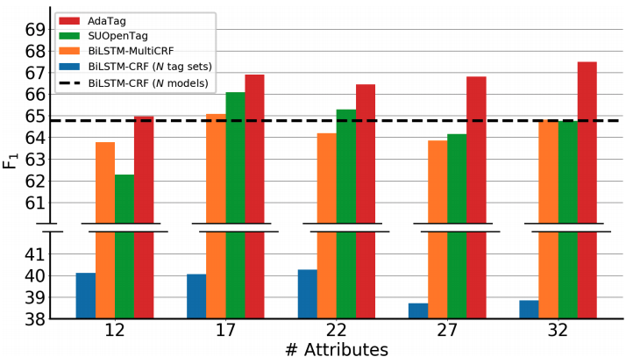
Scale-up II: Thousands of Attributes
Train one model for 32 attributes, obtaining higher quality than single-attribute models
Higher F1 than one model per attribute
One model for multiple attributes
Yan et al., AdaTag: Multi-Attribute Value Extraction from Product Profiles with Adaptive Decoding, ACL 2021.

Slide 64
From 1M to 1B:
Increasing the Yield

Slide 65
From 1M to 1B: Multi-Modal Extraction
1
0
0
0
0
0
0
0
0
0
,
,
,
1000s categories
High
precision
models
E2E pipeline
+ AutoML
to reduce modeling cost
10s languages
100s attributes
Scale-up to reduce #models
Higher yield from multi-modal models
Lin et al., PAM: Understanding product images in cross product category attribute extraction, KDD 2021.

Slide 66
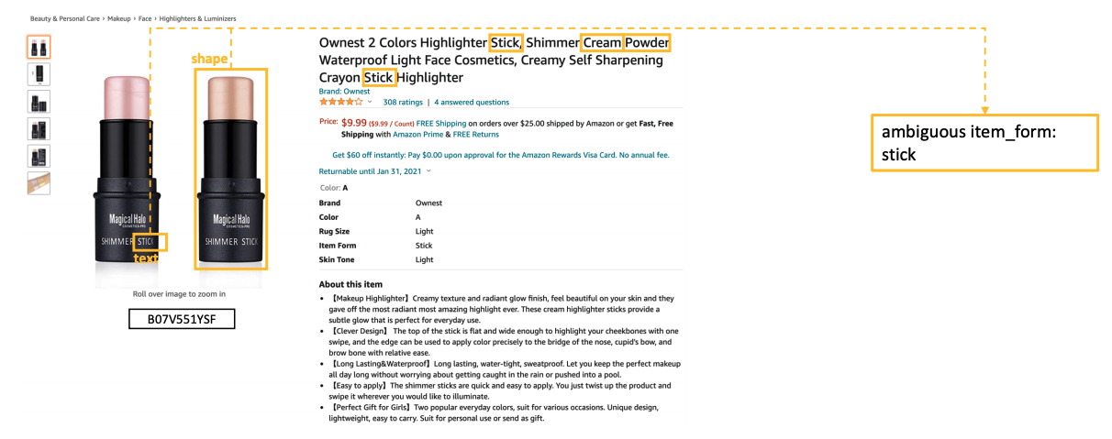
Multi-Modal Signals
Lin et al., PAM: Understanding product images in cross product category attribute extraction, KDD 2021.

Slide 67
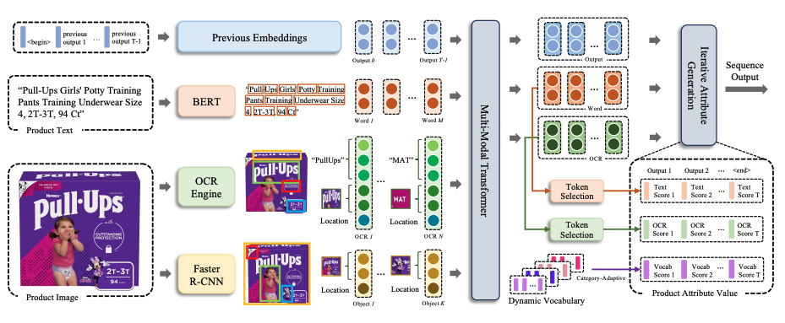
Multi-Modal Extraction
Lin et al., PAM: Understanding product images in cross product category attribute extraction, KDD 2021.

Slide 68
Multi-Modal Extraction
Lin et al., PAM: Understanding product images in cross product category attribute extraction, KDD 2021.

Slide 69
Multi-Modal Extraction
Lin et al., PAM: Understanding product images in cross product category attribute extraction, KDD 2021.

Slide 70
Multi-Modal Extraction
Lin et al., PAM: Understanding product images in cross product category attribute extraction, KDD 2021.

Slide 71
Multi-Modal Extraction
Lin et al., PAM: Understanding product images in cross product category attribute extraction, KDD 2021.

Slide 72
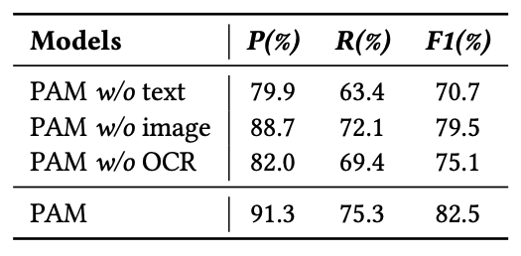
Multi-Modal Extraction
Improve over OpenTag (text-only) by 11% on F-measure
Text still plays the most important role
Lin et al., PAM: Understanding product images in cross product category attribute extraction, KDD 2021.

Slide 73
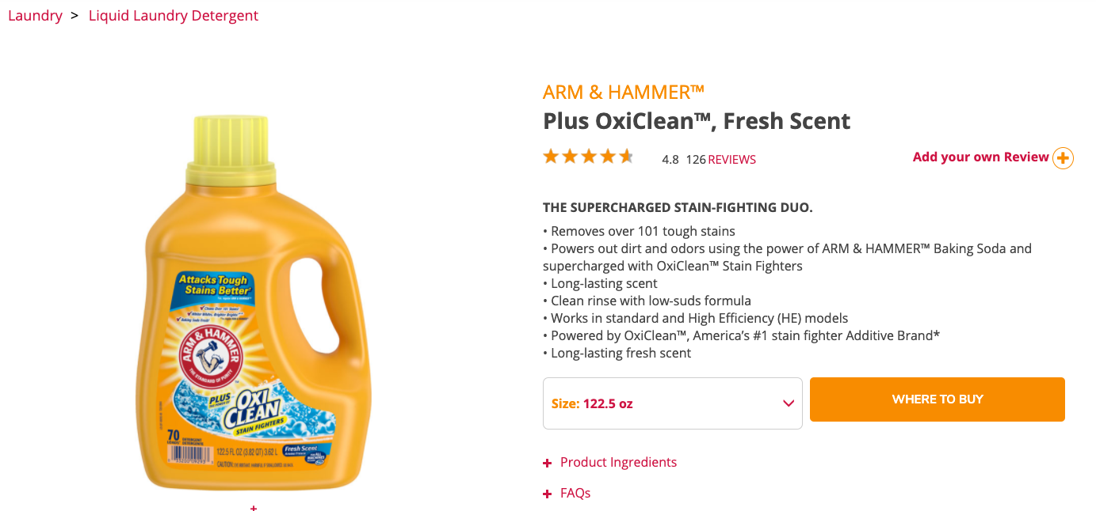
Web Extraction
Scent
ItemForm
Dong, Ceres: Harvesting Knowledge from Semi-Structured Web, Keynote at CIKM, 2020.

Slide 74
Successful vs. Not-Yet-Successful Fields in Industry
Success
NOT-YET Success
Entity linkage
Knowledge extraction (ClosedIE)
Knowledge cleaning
Knowledge-based QA
Schema mapping
  Small scale: Manual
  Large scale: “Replaced” by ClosedIE
OpenIE
  “Replaced” by Reading comprehension
Knowledge fusion
  Not fully needed yet
Knowledge inference
  Quality not high enough yet
One cannot live without it
The techniques are ready

Slide 75
Take Aways
We are building an authoritative product knowledge graph for millions of categories, thousands of attributes, and hundreds of languages
High-accuracy modeling is the first step for building an authoritative knowledge graph
AutoML E2E pipelines, one-size-fits-all solutions, and multi-modal models are critical for enriching the knowledge

Slide 76

Thank You!

