Slide 1

Self-Driving Product Understanding for Thousands of Categories
Xin Luna Dong, Amazon
10/2020

Slide 2

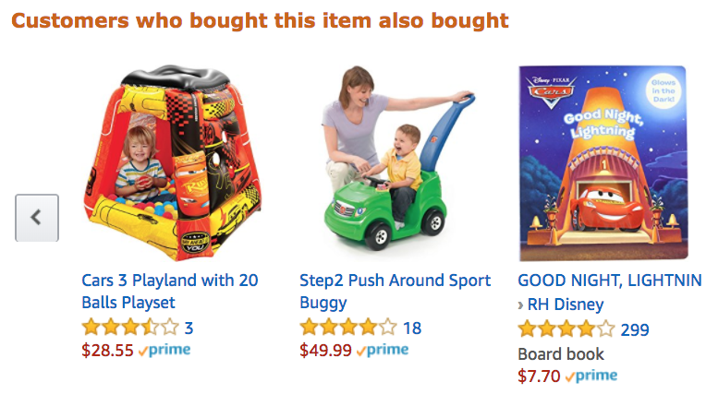
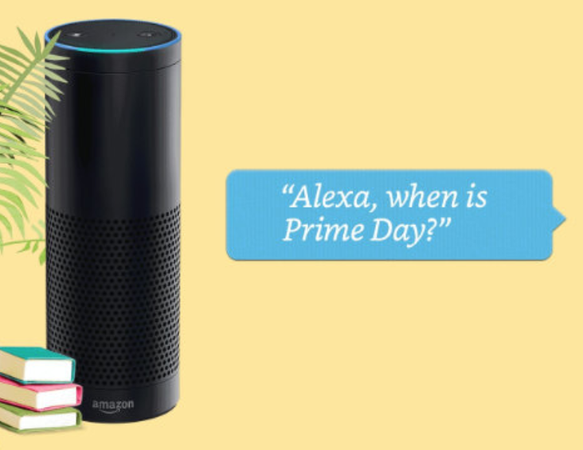
Product Graph
Mission: To answer any question about products and related knowledge in the world

Slide 3
Knowledge Graph Example for 2 Songs
Entity
name
“Pop”
name
genre
mid127
“Dance-pop”
name
mid345
name
“Taylor Alison Swift”
“Shake it off”
artist
name
“Taylor Swift”
Recording
type
artist
mid128
type
song_writer
birth_date
12/13/1989
“Love Story”
mid346
name
name
genre
mid129
“Country pop”
Entity type
Relationship
type
Genre
Notes:
Entity ID

Slide 4
Product Graph Example for 2 Songs
“Shake it off”
name
“Pop”
name
name
genre
mid127
“Dance-pop”
mid345
name
“Taylor Alison Swift”
artist
artist
name
“Taylor Swift”
mid128
song_writer
birth_date
12/13/1989
mid346
mid129
name
name
genre
“Country pop”
“Love Story”
type
Genre

Slide 5
Product Graph Example for 2 Songs
“Shake it off”
name
“Pop”
B0035QUXWQ
ASIN
mid567
name
name
genre
mid127
“Dance-pop”
product
B0035QUXWR
ASIN
mid568
mid345
name
“Taylor Alison Swift”
product
artist
Release
name
type
artist
mid128
“Taylor Swift”
mid569
product
Track
song_writer
birth_date
12/13/1989
product
mid570
mid346
B0067XLIG8
ASIN
product
mid129
name
name
genre
“Country pop”
B0067XLIG4
mid571
ASIN
“Love Story”
type
Genre

Slide 6
Product Graph for Media Products
Heterogeneous
Main challenge: Data everywhere
Key techniques
  Support ~20 Amazon Music applications; Live on Alexa QA
Sources
>90% recall @ prec=99%
Linkage
Fusion
Web
Extraction
>90% prec
Product Graph

Slide 7
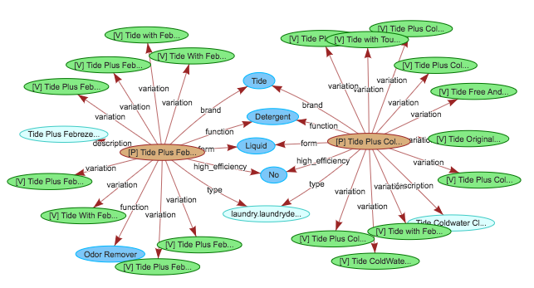
Product Graph for Retail Products
Amazon Confidential

Slide 8
Product Graph for Retail Products
Main challenge: Data everywhere
niques
e on Alexa Shopping, Detail Page, and Amazon Search

Slide 9
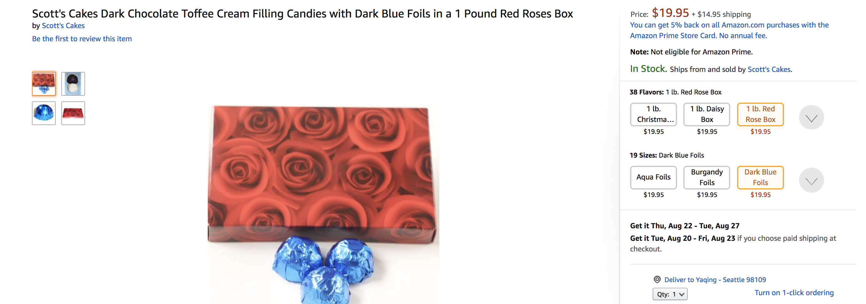
Product Graph for Retail Products

Slide 10
Product Graph for Retail Products
Sparse & Noisy
Main challenge: Data everywhere
Key techniques
Live on Alexa Shopping, Amazon Search, and Detail Page
Coverage 12X
Accuracy 8%+
Catalog
Imputation
Cleaning
Product Graph
Dong et al., AutoKnow: Self-driving knowledge collection for products of thousands of types, SigKDD, 2020.

Slide 11

How to Scale Up?

Slide 12
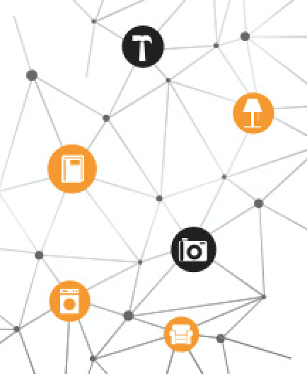
Scale Up in 3 Dimensions
Hierarchy of 100K categories
Focus of this talk
One vertical,
A few sources
Millions of sources
Big challenge: Limited training labels for large-scale, rich data
Behavior info from tens of applications over years

Slide 13

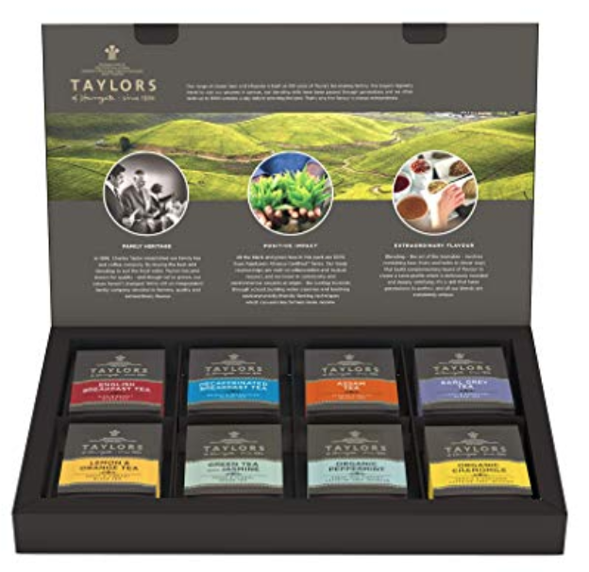
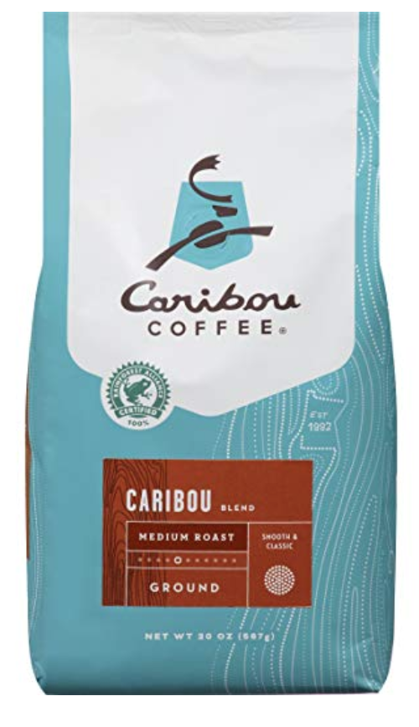



Challenges for 100K Categories (I)
Require 100K+ models
    Different value vocabularies
    Different patterns to express the same attribute

Slide 14
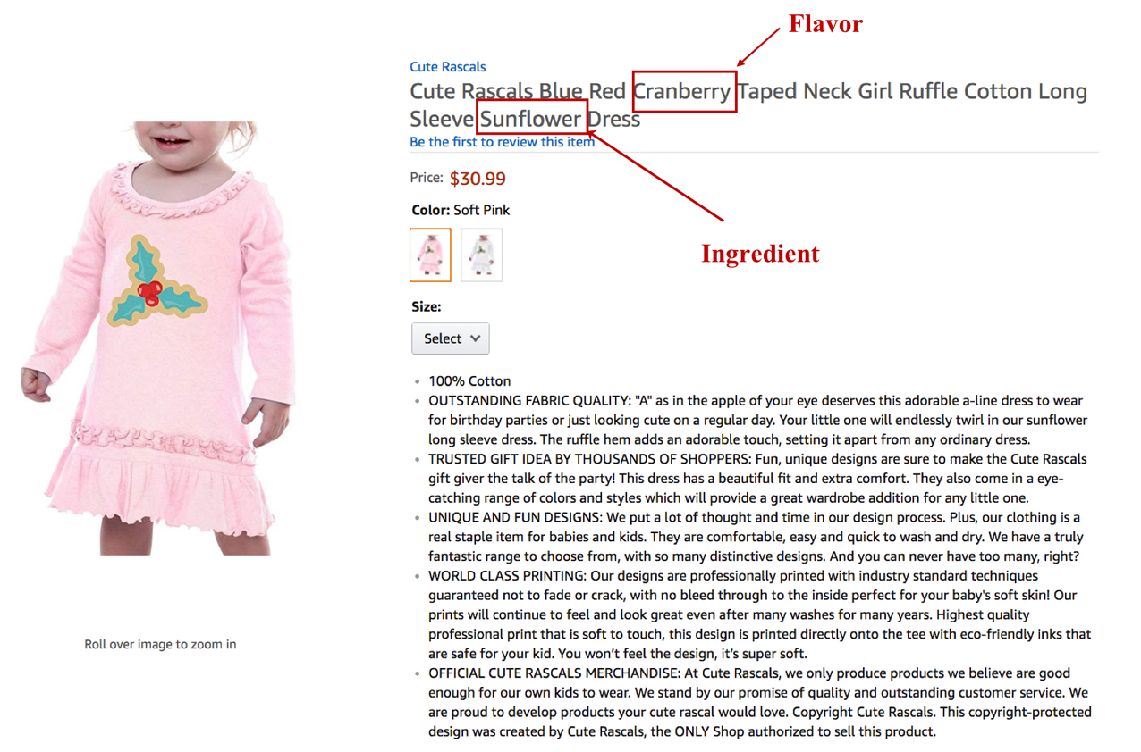
Challenges for 100K Categories (II)
Different attributes apply to different product categories
    A lot of work to manually define ontology
    Hard to catch the trend of new product categories and properties

Slide 15
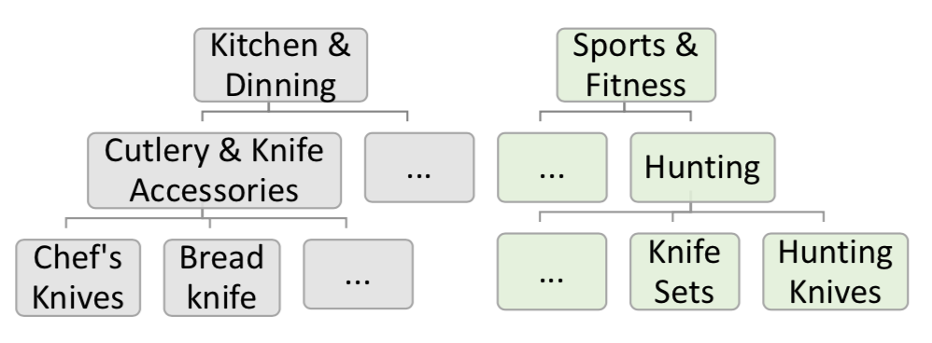
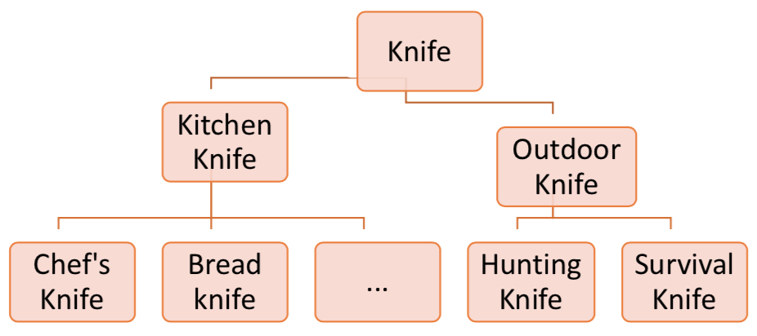
Challenges for 100K Categories (III)
It is hard to build a product taxonomy
    What are product types in customers’ language?
    How to organize types into a taxonomy tree?
Sellers’ view
Buyers’ view

Slide 16
A 100-Year Project

Slide 17
Our Solution: Self-Driving
Product Understanding

Slide 18
AutoKnow: Self-Driving Product Knowledge Collection
Taxonomy
Grocery
Product KG
Grocery
Snacks
Drinks
Snacks
Drinks
Candy
User logs
Pretzels
Candy
AutoKnow
Catalog
hasType
Product | Type | Flavor | Color
Product 1 | Snacks | Cherry
Product 2 | Candy | ? | ?
Product 3 | Candy | Choc. | Gold
Prod. 1
Prod. 2
Prod. 3
flavor
flavor
color
Chocolate
Choc.
Gold
synonym
Dong et al., AutoKnow: Self-driving knowledge collection for products of thousands of types, SigKDD, 2020.

Slide 19
AutoKnow: Self-Driving Product Knowledge Collection
Taxonomy
Grocery
Product KG
Grocery
Snacks
Drinks
New Type
Snacks
Drinks
Candy
User logs
Pretzels
Candy
AutoKnow
Catalog
hasType
Product | Type | Flavor | Color
Product 1 | Snacks | Cherry
Product 2 | Candy | ? | ?
Product 3 | Candy | Choc. | Gold
Prod. 1
Prod. 2
Prod. 3
Corrected Value
color
flavor
flavor
Chocolate
Choc.
Gold
synonym
New Value
Dong et al., AutoKnow: Self-driving knowledge collection for products of thousands of types, SigKDD, 2020.

Slide 20
AutoKnow: Self-Driving Product Knowledge Collection
Taxonomy
Grocery
Product KG
Grocery
Snacks
Drinks
Snacks
Drinks
Candy
User logs
Pretzels
Candy
AutoKnow
Catalog
hasType
Product | Type | Flavor | Color
Product 1 | Snacks | Cherry
Product 2 | Candy | ? | ?
Product 3 | Candy | Choc. | Gold
● #Types ↑ 3X
● Defect rate ↓
up to 68 percent points
Prod. 1
Prod. 2
Prod. 3
flavor
flavor
color
Chocolate
Choc.
Gold
synonym
Dong et al., AutoKnow: Self-driving knowledge collection for products of thousands of types, SigKDD, 2020.

Slide 21
AutoKnow: Self-Driving Product Knowledge Collection
Input Data
PT Taxonomy
Catalog
Behavioral Signals (e.g., search logs, reviews, Q&A)
Dong et al., AutoKnow: Self-driving knowledge collection for products of thousands of types, SigKDD, 2020.

Slide 22
AutoKnow: Self-Driving Product Knowledge Collection
Input Data
Ontology Suite
PT Taxonomy
Taxonomy Enrichment
Catalog
Behavioral Signals (e.g., search logs, reviews, Q&A)
Relation Discovery
Dong et al., AutoKnow: Self-driving knowledge collection for products of thousands of types, SigKDD, 2020.

Slide 23
AutoKnow: Self-Driving Product Knowledge Collection
Input Data
Ontology Suite
PT Taxonomy
Taxonomy Enrichment
Data Suite
Catalog
Data Imputation
Behavioral Signals (e.g., search logs, reviews, Q&A)
Relation Discovery
Data
Cleaning
Synonym Discovery
Dong et al., AutoKnow: Self-driving knowledge collection for products of thousands of types, SigKDD, 2020.

Slide 24
AutoKnow: Self-Driving Product Knowledge Collection
Input Data
Ontology Suite
Broad Graph
PT Taxonomy
Taxonomy Enrichment
Data Suite
Ontology
Catalog
Data Imputation
Relation Discovery
{product, attribute, value}
Behavioral Signals (e.g., search logs, reviews, Q&A)
Data
Cleaning
{value, synonym, value}
Synonym Discovery
Dong et al., AutoKnow: Self-driving knowledge collection for products of thousands of types, SigKDD, 2020.

Slide 25
Self-Driving to Navigate 100K Categories
Automatic: Fully ML-based
Annotation free: Weak learning based on existing Catalog data and user behavior
One-size-fits-all: Few taxonomy-aware models
Self guidance: Identify important attributes and categories to focus efforts
Dong et al., AutoKnow: Self-driving knowledge collection for products of thousands of types, SigKDD, 2020.

Slide 26
AutoKnow: Self-Driving Product Knowledge Collection
Input Data
Ontology Suite
Broad Graph
PT Taxonomy
Taxonomy Enrichment
Data Suite
Ontology
Catalog
Data Imputation
Relation Discovery
{product, attribute, value}
Behavioral Signals (e.g., search logs, reviews, Q&A)
Data
Cleaning
{value, synonym, value}
Synonym Discovery
Dong et al., AutoKnow: Self-driving knowledge collection for products of thousands of types, SigKDD, 2020.

Slide 27
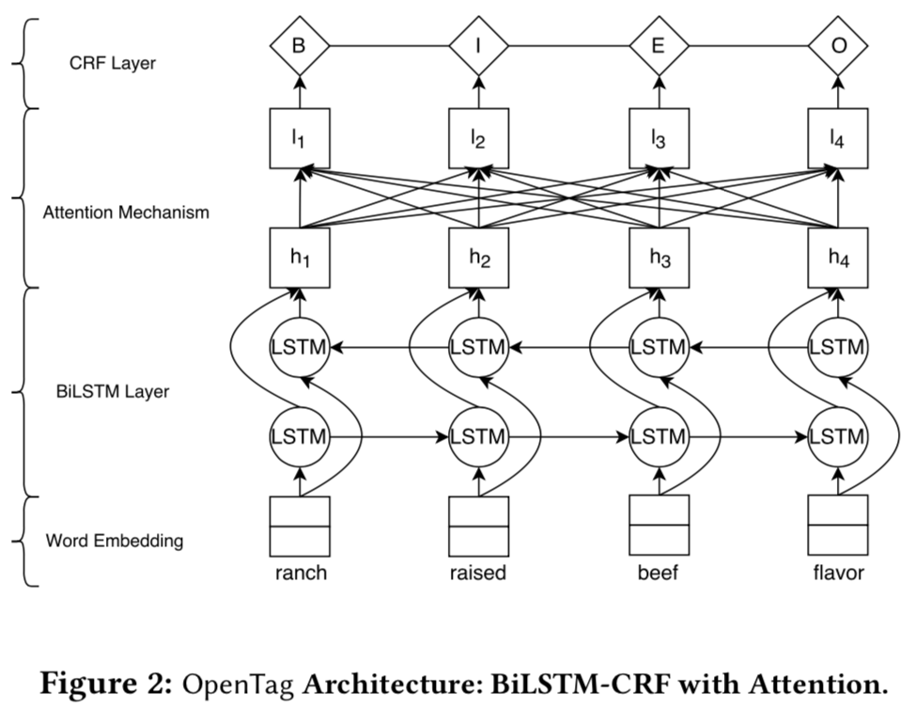
I. GNN-Based Taxonomy Enrichment
Step 1. Type extraction from product titles and queries by OpenTag tagging system
Mao et al., OCTET: Online catalog taxonomy enrichment with self-supervision, SigKDD, 2020.

Slide 28
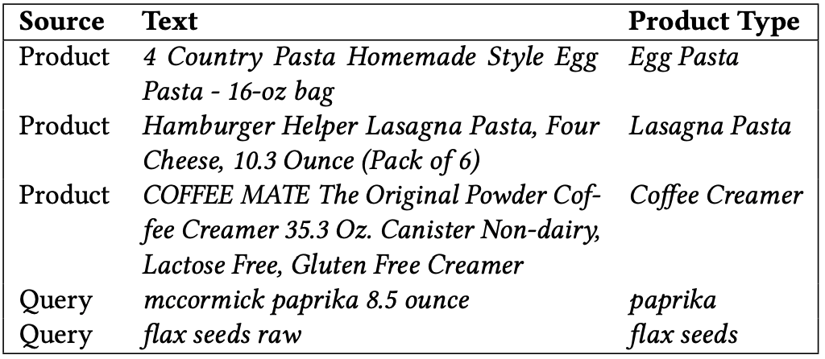
I. GNN-Based Taxonomy Enrichment
Consumables taxonomy size increases by 2.9X and improve hypernym identification F1 by 18% over state-of-the-art
Mao et al., OCTET: Online catalog taxonomy enrichment with self-supervision, SigKDD, 2020.

Slide 29
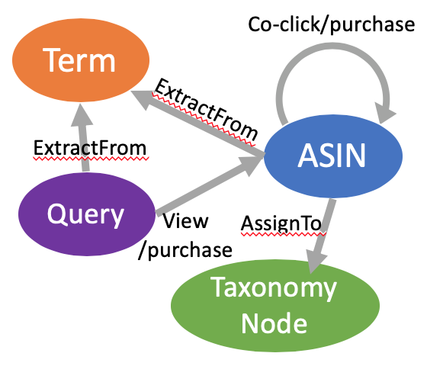
I. GNN-Based Taxonomy Enrichment
Step 2. Taxonomy expansion with hypernym discovery by Graph Neural Network
Mao et al., OCTET: Online catalog taxonomy enrichment with self-supervision, SigKDD, 2020.

Slide 30
I. GNN-Based Taxonomy Enrichment
Step 2. Taxonomy expansion with hypernym discovery by Graph Neural Network
Leveraging search behavior with GNN
Mao et al., OCTET: Online catalog taxonomy enrichment with self-supervision, SigKDD, 2020.

Slide 31



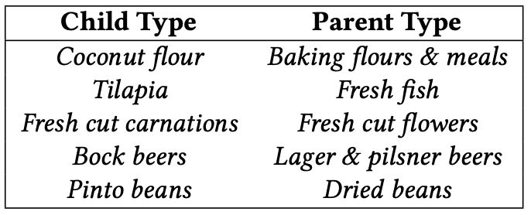

I. GNN-Based Taxonomy Enrichment
Improve hypernym identification F1 by 18% over state-of-the-art
Mao et al., OCTET: Online catalog taxonomy enrichment with self-supervision, SigKDD, 2020.

Slide 32
AutoKnow: Self-Driving Product Knowledge Collection
Input Data
Ontology Suite
Broad Graph
PT Taxonomy
Taxonomy Enrichment
Data Suite
Ontology
Catalog
Data Imputation
Relation Discovery
{product, attribute, value}
Behavioral Signals (e.g., search logs, reviews, Q&A)
Data
Cleaning
{value, synonym, value}
Synonym Discovery
Dong et al., AutoKnow: Self-driving knowledge collection for products of thousands of types, SigKDD, 2020.

Slide 33
II. Behavior-Based Attribute Importance
Child safety car seats | Almond
brand | flavor
style | brand
size or capacity | ingredients
maximum weight recommendation | size or capacity
color | number of items
model | energy content per serving
number of items | bar code
usage | color
bar code | scent
flavor | usage
ingredients | style
scent | model
energy content per serving | maximum weight recommendation
Important (ranked by score)
Unimportant
Unapplicable
Dong et al., AutoKnow: Self-driving knowledge collection for products of thousands of types, SigKDD, 2020.

Slide 34
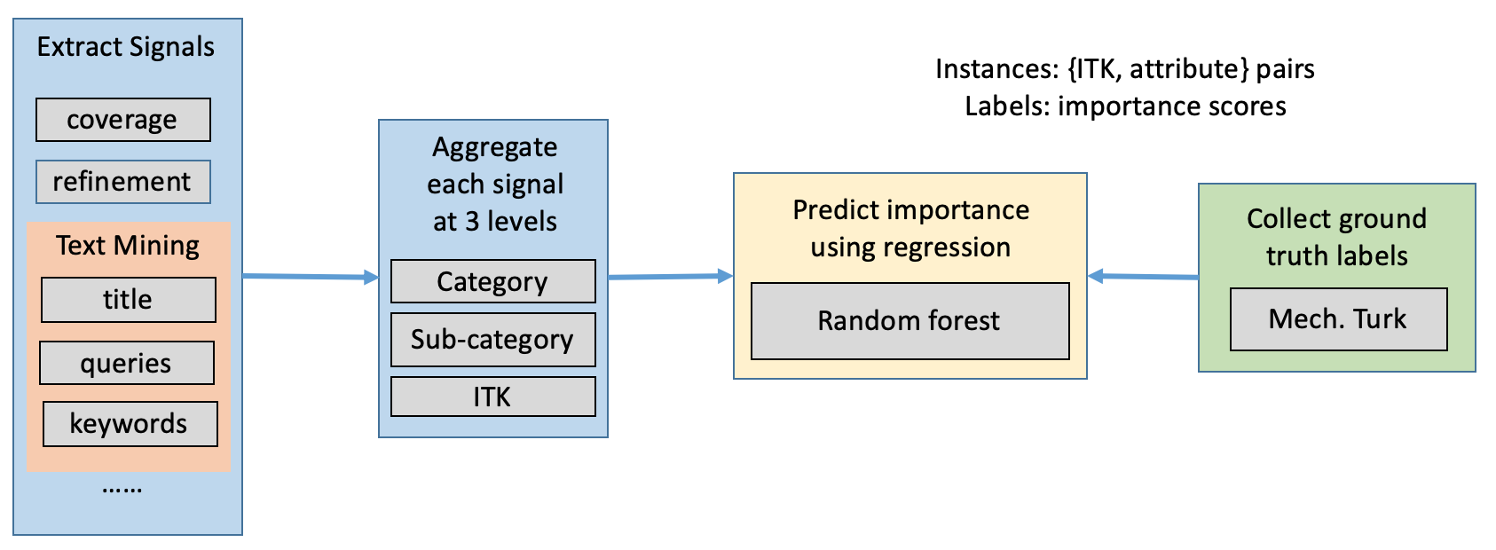
II. Behavior-Based Attribute Importance
ITK = item type keyword
Dong et al., AutoKnow: Self-driving knowledge collection for products of thousands of types, SigKDD, 2020.

Slide 35
II. Behavior-Based Attribute Importance
Leveraging various behaviors
ITK = item type keyword
Dong et al., AutoKnow: Self-driving knowledge collection for products of thousands of types, SigKDD, 2020.

Slide 36
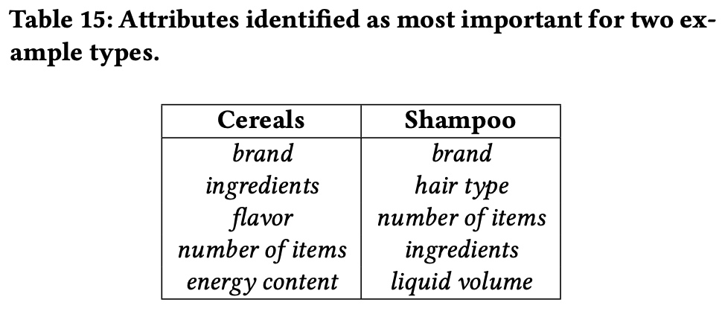



II. Behavior-Based Attribute Importance
Predict for 7.5K categories the applicability of 3K attributes with P=0.94/R=0.84, and importance with 0.74 correlation (Spearman)
Dong et al., AutoKnow: Self-driving knowledge collection for products of thousands of types, SigKDD, 2020.

Slide 37
AutoKnow: Self-Driving Product Knowledge Collection
Input Data
Ontology Suite
Broad Graph
PT Taxonomy
Taxonomy Enrichment
Data Suite
Ontology
Catalog
Data Imputation
Relation Discovery
{product, attribute, value}
Behavioral Signals (e.g., search logs, reviews, Q&A)
Data
Cleaning
{value, synonym, value}
Synonym Discovery

Slide 38




III. Value Extraction—Traditional
CRF
Captures correlations
between BIOE tags
Attention
Identifies important terms
leading to attribute values
Bi-LSTM
Captures sequence info
Word Embedding
Captures semantics of each token
OpenTag
Zheng et al., OpenTag: Open attribute value extraction from product profiles, KDD 2018.

Slide 39
III. Value Extraction—100K Categories
Option 1. Train a single model? Train/Test Distribution shift -> Invalid predictions
Karamanolakis et al., TXtract: Taxonomy-aware knowledge extraction for thousands of product categories, ACL 2020.

Slide 40
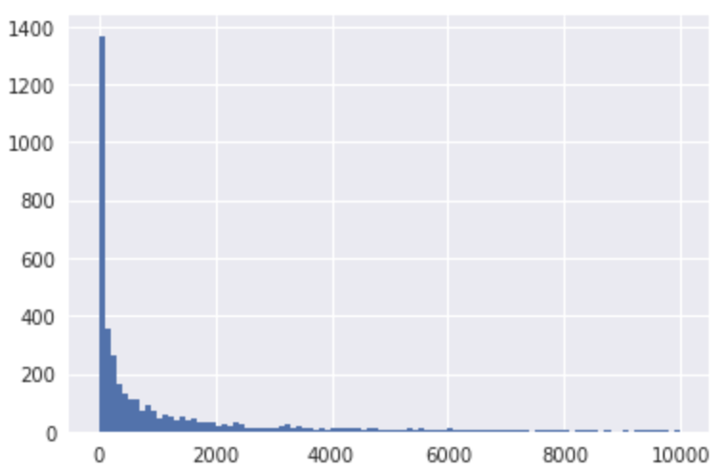
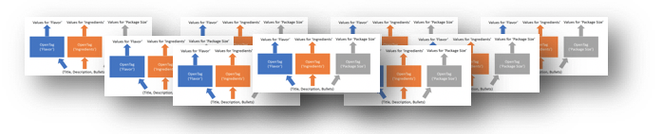
III. Value Extraction—100K Categories
Option 1. Train a single model? Train/Test Distribution shift -> Invalid predictions
Option 2. Train a model for each category?
Store/orchestrate 100K+ OpenTag models
Most categories are very sparse
Karamanolakis et al., TXtract: Taxonomy-aware knowledge extraction for thousands of product categories, ACL 2020.

Slide 41
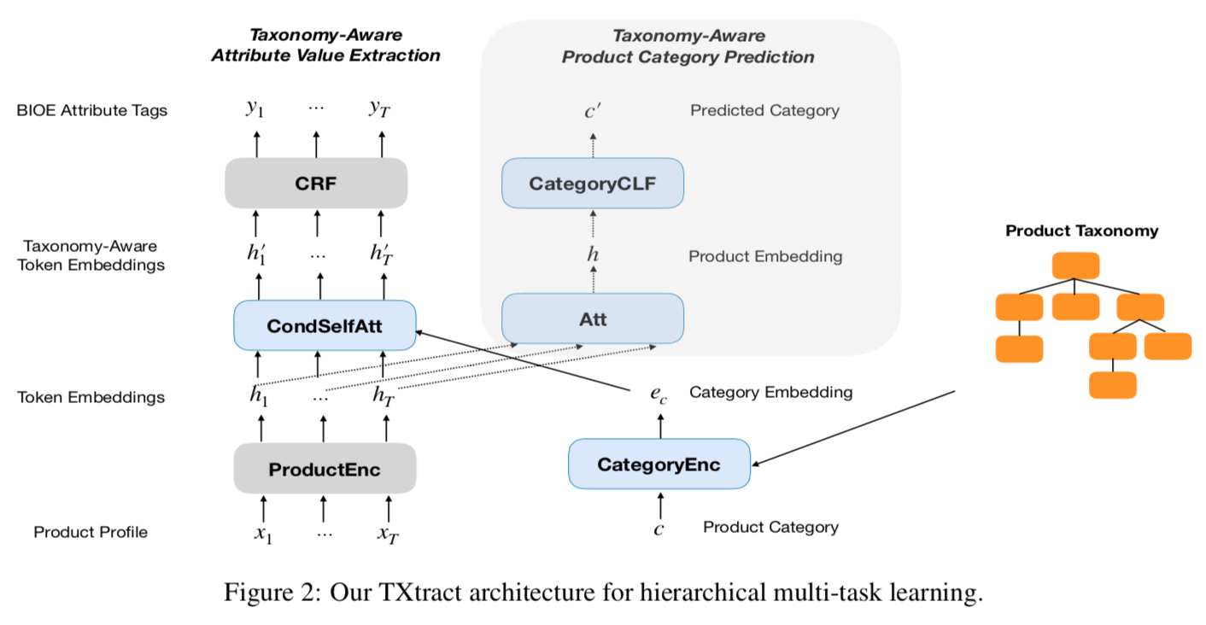
III. Value Extraction—Taxonomy-Aware
Karamanolakis et al., TXtract: Taxonomy-aware knowledge extraction for thousands of product categories, ACL 2020.

Slide 42
III. Value Extraction—Taxonomy-Aware
Karamanolakis et al., TXtract: Taxonomy-aware knowledge extraction for thousands of product categories, ACL 2020.

Slide 43
III. Value Extraction—Taxonomy-Aware
Karamanolakis et al., TXtract: Taxonomy-aware knowledge extraction for thousands of product categories, ACL 2020.

Slide 44
III. Value Extraction—Taxonomy-Aware
Attention conditioned on category representation
Karamanolakis et al., TXtract: Taxonomy-aware knowledge extraction for thousands of product categories, ACL 2020.

Slide 45
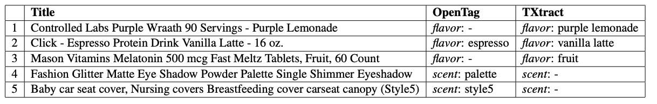


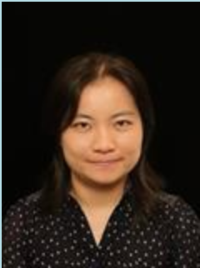

III. Value Extraction—Taxonomy-Aware
Train one model on 4K categories, and improve state-of-the-art by 10.4% in F1, and by 11.7% in coverage
Karamanolakis et al., TXtract: Taxonomy-aware knowledge extraction for thousands of product categories, ACL 2020.

Slide 46
AutoKnow: Self-Driving Product Knowledge Collection
Input Data
Ontology Suite
Broad Graph
PT Taxonomy
Taxonomy Enrichment
Data Suite
Ontology
Catalog
Data Imputation
Relation Discovery
{product, attribute, value}
Behavioral Signals (e.g., search logs, reviews, Q&A)
Data
Cleaning
{value, synonym, value}
Synonym Discovery

Slide 47
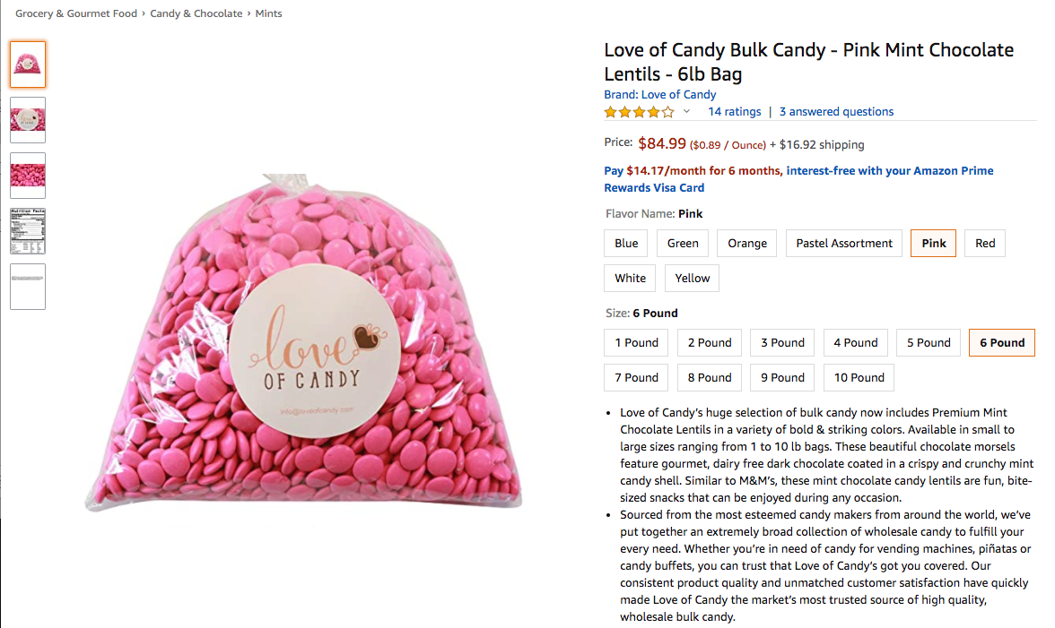
IV. Taxonomy-Aware Anomaly Detection
Wang et al., Automatic validation of textual attribute values in eCommerce Catalog by learning with limited labeled data, KDD’20

Slide 48
IV. Taxonomy-Aware Anomaly Detection
Is the flavor “Pink”?
Wang et al., Automatic validation of textual attribute values in eCommerce Catalog by learning with limited labeled data, KDD’20

Slide 49
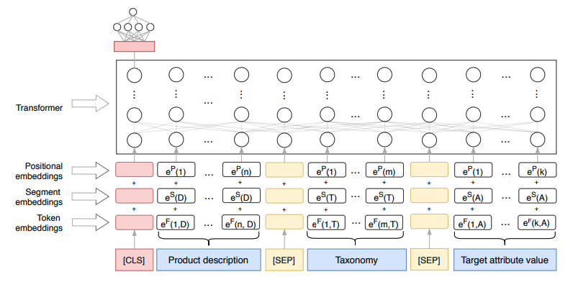
IV. Taxonomy-Aware Anomaly Detection
Wang et al., Automatic validation of textual attribute values in eCommerce Catalog by learning with limited labeled data, KDD’20

Slide 50
IV. Taxonomy-Aware Anomaly Detection
Category as input for model training
Dong et al., AutoKnow: Self-driving knowledge collection for products of thousands of types, SigKDD, 2020.

Slide 51


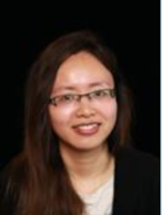
IV. Taxonomy-Aware
Anomaly Detection
Identify 1.77MM incorrect values for Flavor and Scent for Consumables with 90% precision
Product | Attr | Value
Love of Candy Bulk Candy - Pink Mint Chocolate Lentils - 6lb Bag | Flavor | Pink
Scott's Cakes Dark Chocolate Fruit & Nut Cream Filling Candies with Burgandy Foils in a 1 Pound Snowflake Box | Flavor | 1 lb. snowflake box
Lucky Baby - Baby Blanket Envelope Swaddle Winter Wrap Coral Fleece Newborn Blanket Sleeper Infant Stroller Wrap Toddlers Baby Sleeping Bag (color 1) | Flavor | color 1
ASUTRA Himalayan Sea Salt Body Scrub Exfoliator + Body Brush (Vitamin C), 12 oz | Ultra Hydrating, Gentle, Moisturizing | All Natural & Organic Jojoba, Sweet Almond, Argan Oils | Scent | vitamin c body scrub - 12oz & body brush
Folgers Simply Smooth Ground Coffee, 2 Count (Medium Roast), 31.1 Ounce | Scent | 2Packages (Breakfast Blend, 31.1 oz)

Slide 52
AutoKnow: Self-Driving Product Knowledge Collection
Input Data
Ontology Suite
Broad Graph
PT Taxonomy
Taxonomy Enrichment
Data Suite
Ontology
Catalog
Data Imputation
Relation Discovery
{product, attribute, value}
Behavioral Signals (e.g., search logs, reviews, Q&A)
Data
Cleaning
{value, synonym, value}
Synonym Discovery
Dong et al., AutoKnow: Self-driving knowledge collection for products of thousands of types, SigKDD, 2020.

Slide 53

V. Synonym Discovery
Identify 7.6K synonym pairs for flavor and scent with 92.6% precision
 | Examples
Type synonyms | spices : seasonings / spices : herbs / flowers : live plants / drink : beverage / pasta : noodles / icing : frosting / beans : peas / foods : meals / salad dressings : condiments / nut : seeds
Attribute synonyms | [Flavor] bbq : bar-b-que / pasta : linguine / sausage : chorizo / Seaweed : nori / latte : mocha / fresh mint : clean mint / supreme dark : extra dark / vanilla vortex : very vanilla
Phrase synonyms | cr2032 battery : lithium coin / toys 6 months : engage baby / minnie dress : short cocktail / mtm 50 : 50 caliber / coq10 200mg : energizing antioxidant
Dong et al., AutoKnow: Self-driving knowledge collection for products of thousands of types, SigKDD, 2020.

Slide 54
V. Synonym Discovery
Identify 7.6K synonym pairs for flavor and scent with 92.6% precision
 | Examples
Type synonyms | spices : seasonings / spices : herbs / flowers : live plants / drink : beverage / pasta : noodles / icing : frosting / beans : peas / foods : meals / salad dressings : condiments / nut : seeds
Attribute synonyms | [Flavor] bbq : bar-b-que / pasta : linguine / sausage : chorizo / Seaweed : nori / latte : mocha / fresh mint : clean mint / supreme dark : extra dark / vanilla vortex : very vanilla
Phrase synonyms | cr2032 battery : lithium coin / toys 6 months : engage baby / minnie dress : short cocktail / mtm 50 : 50 caliber / coq10 200mg : energizing antioxidant
Search log mining
Dong et al., AutoKnow: Self-driving knowledge collection for products of thousands of types, SigKDD, 2020.

Slide 55
Which ML Model Works Best?

Slide 56
Which ML Model Works Best?
Tree-based models
??
Neural network

Slide 57
Which ML Model Works Best?
Tree-based models
Knowledge
embedding,
GNN, etc.
Neural network

Slide 58
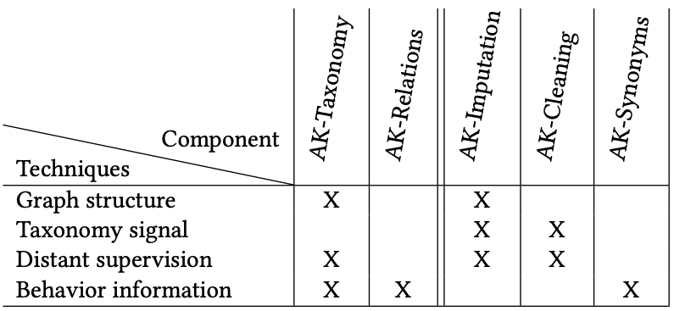
Key Techniques in AutoKnow

Slide 59
Take Aways
We need to scale up for 100K categories for building an authoritative product knowledge graph
We are investigating techniques for self-driving
end-to-end product understanding
Graph Neural Network and Learning w. limited labels play an important role in various aspects

Slide 60

Thank You!

