Slide 1
Developing and Realizing
Your Big Idea
Xin Luna Dong
SIGMOD New Researcher Symposium
Athens, Greece
June, 2011

Slide 2
Impression When I Got the Invitation
Yes, this is a very good topic and I do need advice on this
—Sure, I’ll be there.
But wait a moment…
They are asking me for advice ???!!!

Slide 3

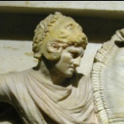
What Are My Big Ideas?
Big Ideas I’ve been working on
Alexander
Src exploration
& selection
Solomon
Copy detection
& data fusion
DataSpaces
Pay-as-you-go
data integration
SEMEX
Personal
Info Mng
Piazza-
Peer data
mng sys
Woogle
Web service
search
2001
2006
2007
2011
CHINA
UW
AT&T
Google
My Life

Slide 4
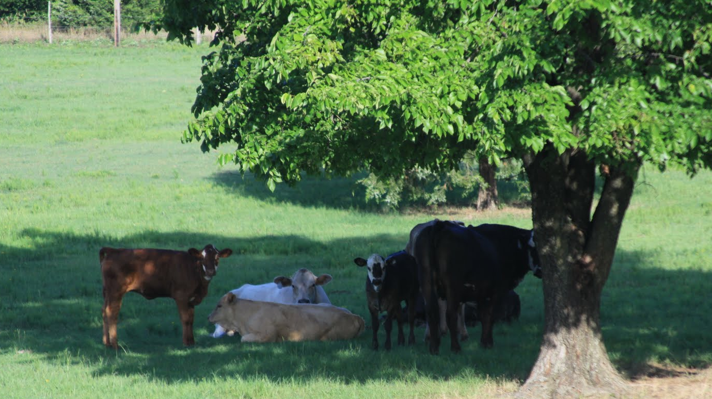
I. Do I Really Need My OWN Big Idea?
Excuse I. I’m working on a BIG IDEA for my thesis
That’s possibly more of your advisor’s big idea than your own big idea
You want to get out of the shade of your advisor;
it is hard to shine there

Slide 5
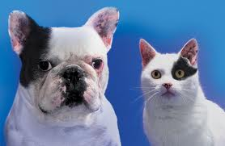
I. Do I Really Need My OWN Big Idea?
Excuse II. It’s easier to work on something I’m familiar with
The fun of research is to learn something new and work on something new.
Somewhere around every seven years make a significant, if not complete, shift in your field. –Hamming
Notes:
You may be tired
You may have used up your originality in one field

Slide 6

I. Do I Really Need My OWN Big Idea?
Excuse III. Publishing on a new field can be hard
Having your name associated with a new field is worth publishing 5 follow-up papers
  Branding yourself

Slide 7


II. How to Find a Big Idea?
First, which area do you want to look at?
  Make sure you work on something that interests you
  Don’t be too far away from your skill set
  Get the most out of my colleagues’ skill sets
+
Improving quality
of integrated data
Data Integration
Data Quality
Streaming Data
DB Exploration
Similarity Search
…

Slide 8
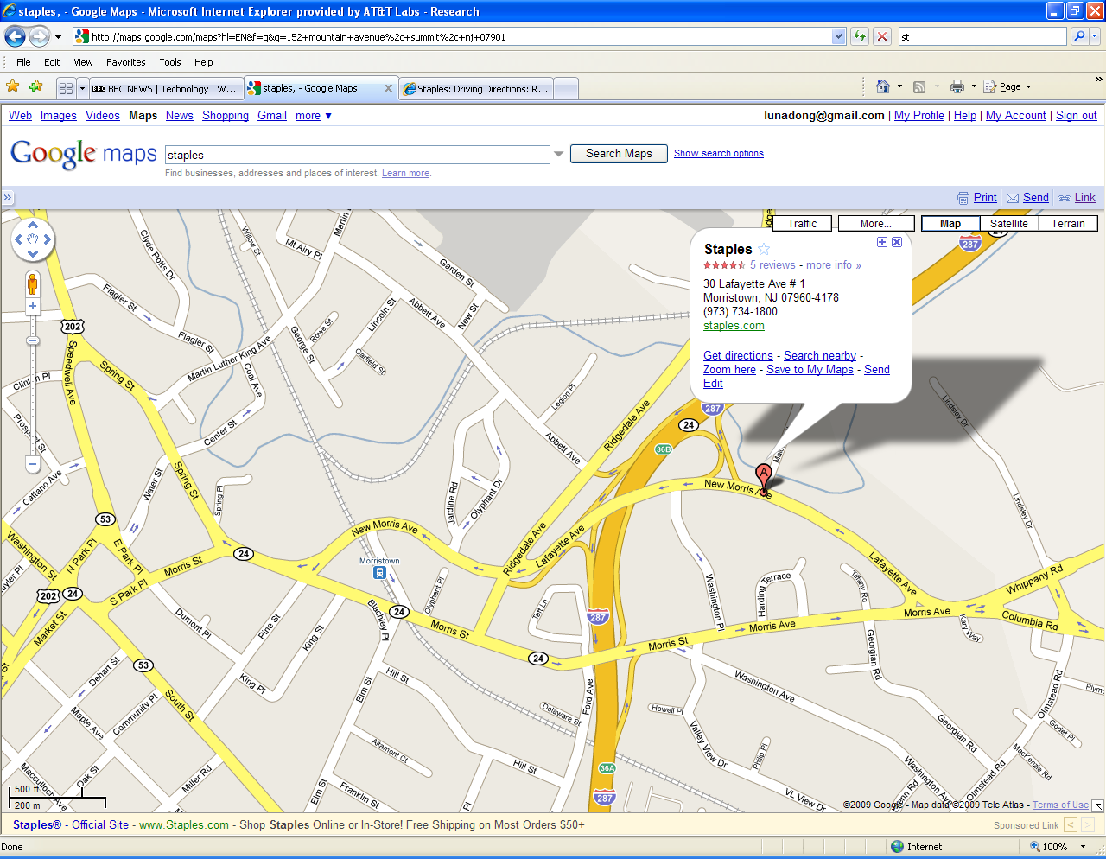

II. How to Find a Big Idea? (Cont’)
What bothers you in your life?
Solomon

Slide 9
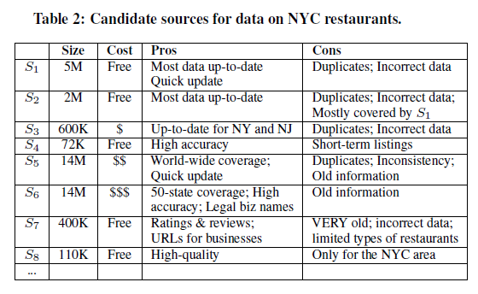
II. How to Find a Big Idea? (Cont’)
What bothers your industry partners?
Alex-ander

Slide 10
II. How to Find a Big Idea? (Cont’)
Start thinking before you graduate
  Research statement is a good starting point
Talk to others and ask for feedback
  Can you convince your colleagues, your spouse, your friends that your idea is great?
  Grant proposal helps shape the idea
  Submit to CIDR
  Go for it only if you have some intuition for solutions
Open door, open mind
    Friday afternoons - great thoughts only
    --Hamming

Slide 11
III. How to Realize Your Big Idea?
But you should spend your life here
Important & Urgent
Important & Not-urgent
Unimportant & Urgent
Unimportant & Not-urgent
You tend to spend your time here
Allocate some time for the big idea every day; E.g., every morning

Slide 12
III. How to Realize Your Big Idea?
Get your own hands dirty
  You are trained 5+ years to do your research; don’t stop and give all tasks to your students after you graduate
  Playing with data, analyzing experimental results help you gain intuitions/inspirations
But meanwhile, collaborate widely
  A lot of inspirations and good questions from colleagues
  Discussions bump up ideas
  Certainly, students help you do a lot of work

Slide 13
IV. When to Stop for the Next Big Idea?
  What’s your end goal and have you reached it?
  You possibly cannot have a big idea every year
Go beyond low-hanging fruits
  Have several sub-topics in mind from the beginning
  What have you learned from results you’ve got? Where can you improve?
  Deepen your understanding; sharpen your thought
  Keep the curiosity

Slide 14
The Solomon Project in Brief (2007)
Copy
Detection
Static detection
Dynamic detection
Applications
In Data Integration
Data fusion
Legend
Closed research
Ongoing research
New research

Slide 15
The Solomon Project in Brief (2008)
Copy
Detection
Static detection
Dynamic detection
Opinion influence
Data fusion
Applications
In Data Integration
Query answering
Legend
Record Linkage
Source Recommendation
Closed research
Ongoing research
New research

Slide 16
The Solomon Project in Brief (2009)
Static detection
[VLDB 2009a]
Copy
Detection
Global detection
Dynamic detection
[VLDB 2009b]
Opinion influence
Data fusion
[VLDB 2009a]
Applications
In Data Integration
Query answering
Online fusion
Record Linkage
Source Recommendation
Legend
Closed research
Explanation &
Visualization
Visualization
Ongoing research
Explanation
User feedback
New research

Slide 17
The Solomon Project in Brief (2010)
Static detection
[VLDB 2009a]
Copy
Detection
Global detection
[VLDB 2010a]
Dynamic detection
[VLDB 2009b]
Opinion influence
Data fusion
[VLDB 2009a]
Applications
In Data Integration
Query answering
Online fusion
Record Linkage
[VLDB 2010b]
Source Recommendation
Legend
Closed research
Explanation &
Visualization
Visualization
[VLDB 2010 demo]
Ongoing research
Explanation
User feedback
New research

Slide 18
The Solomon Project in Brief (2011)
Static detection
[VLDB 2009a]
Copy
Detection
Global detection
[VLDB 2010a]
Dynamic detection
[VLDB 2009b]
Opinion influence
Data fusion
[VLDB 2009a]
Fusion on Web
Applications
In Data Integration
Online fusion
[VLDB 2011]
Query answering
[EDBT 2011]
Record Linkage
[VLDB 2010b]
Source Recommendation
Legend
Closed research
Explanation &
Visualization
Visualization
[VLDB 2010 demo]
Ongoing research
Explanation
User feedback
New research

Slide 19
IV. When to Stop for the Next Big Idea?
Aim high: To be a good researcher, you should write one of the following three papers
  First paper in an area
  Best paper in an area
  Last paper in an area
Publication is not the end goal!

Slide 20
Take Aways
Big Idea
Open mind
Work hard
Aim high

