Slide 1
Compact Explanation of data fusion decisions
Xin Luna Dong (Google Inc.)
Divesh Srivastava (AT&T Labs-Research)
@WWW, 5/2013

Slide 2
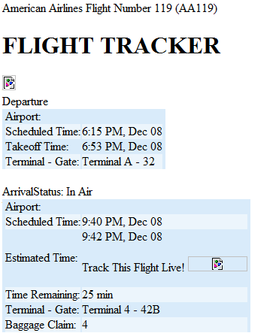
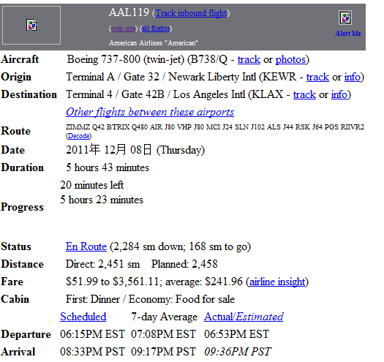
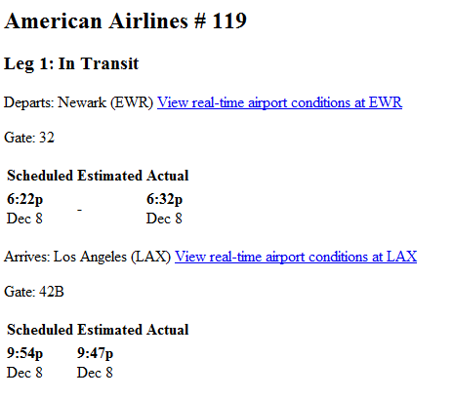
Conflicts on the Web
FlightView
FlightAware
Orbitz
6:15 PM
6:22 PM
6:15 PM
9:40 PM
9:54 PM
8:33 PM

Slide 3
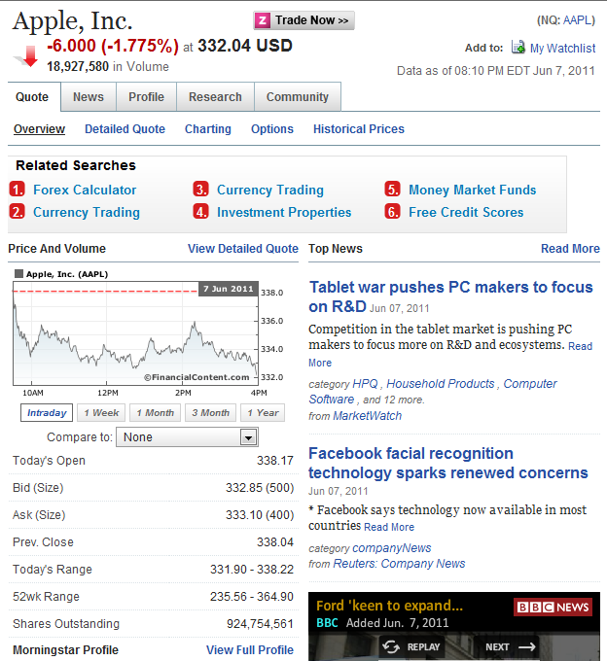
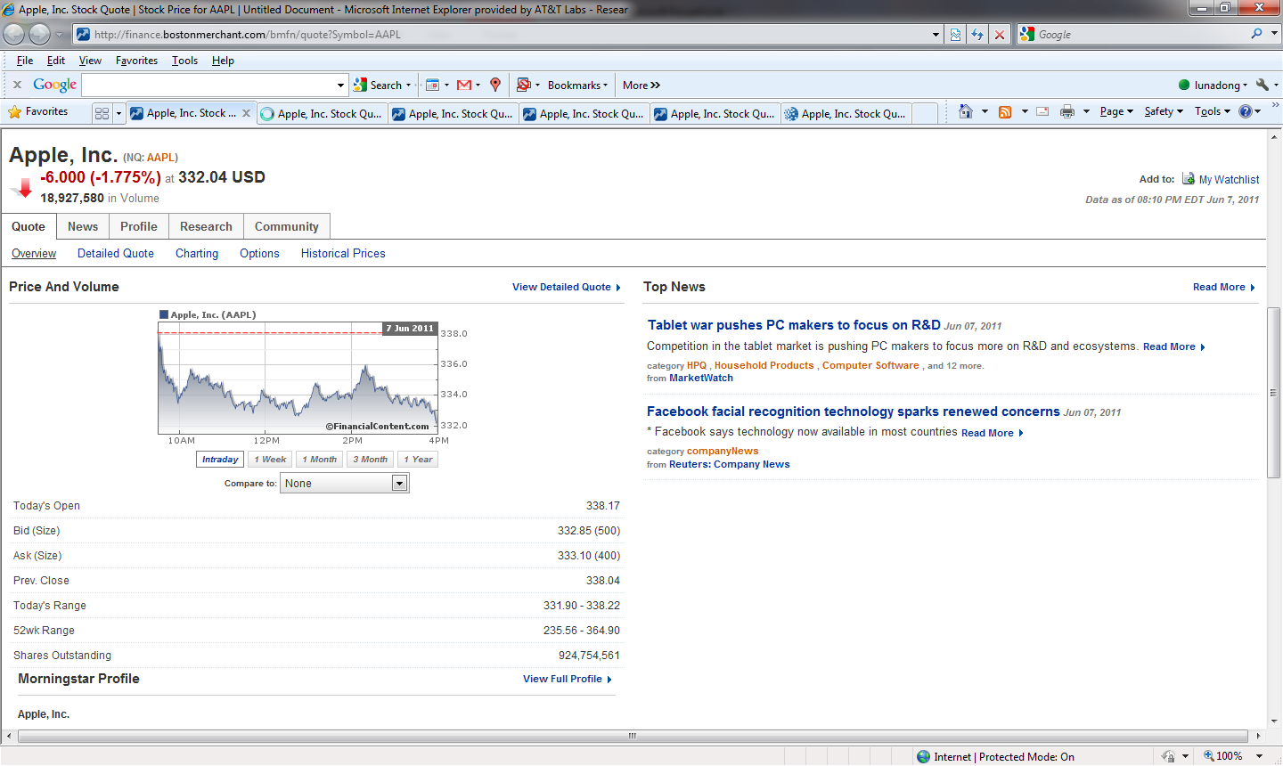
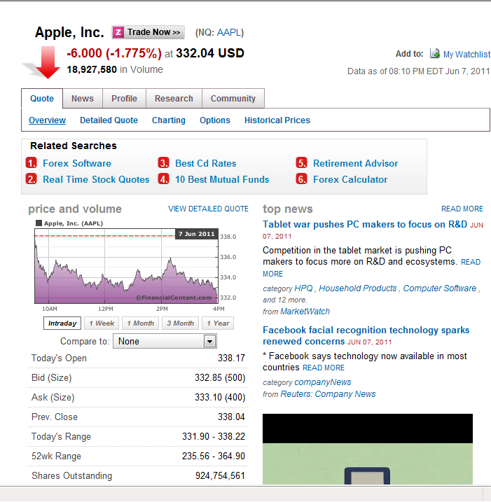
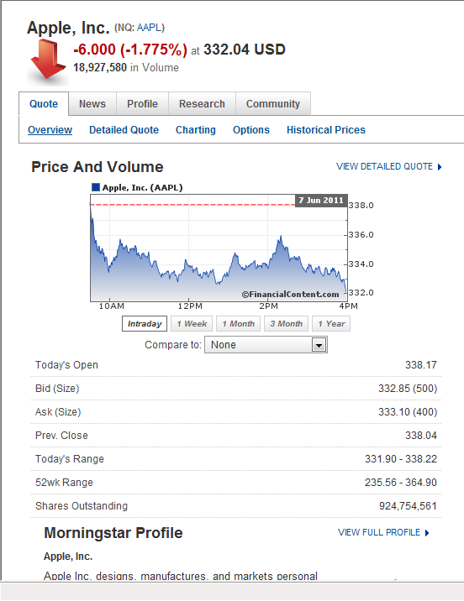
Copying on the Web

Slide 4
Data Fusion
 | S1 | S2 | S3 | S4 | S5
Stonebraker | MIT | berkeley | MIT | MIT | MS
Dewitt | MSR | msr | UWisc | UWisc | UWisc
Bernstein | MSR | msr | MSR | MSR | MSR
Carey | UCI | at&t | BEA | BEA | BEA
Halevy | Google | google | UW | UW | UW
Data fusion resolves data conflicts and finds the truth

Slide 5
Data Fusion
 | S1 | S2 | S3 | S4 | S5
Stonebraker | MIT | berkeley | MIT | MIT | MS
Dewitt | MSR | msr | UWisc | UWisc | UWisc
Bernstein | MSR | msr | MSR | MSR | MSR
Carey | UCI | at&t | BEA | BEA | BEA
Halevy | Google | google | UW | UW | UW
Data fusion resolves data conflicts and finds the truth
Naïve voting does not work well

Slide 6
Data Fusion
 | S1 | S2 | S3 | S4 | S5
Stonebraker | MIT | berkeley | MIT | MIT | MS
Dewitt | MSR | msr | UWisc | UWisc | UWisc
Bernstein | MSR | msr | MSR | MSR | MSR
Carey | UCI | at&t | BEA | BEA | BEA
Halevy | Google | google | UW | UW | UW
Data fusion resolves data conflicts and finds the truth
Naïve voting does not work well
Two important improvements
  Source accuracy
  Copy detection
  But WHY???

Slide 7
An Exhaustive but Horrible Explanation
Three values are provided for Carey’s afﬁliation.
I. If UCI is true, then we reason as follows.
Source S1 provides the correct value. Since S1 has accuracy .97, the probability that it provides this correct value is .97.
Source S2 provides a wrong value. Since S2 has accuracy .61, the probability that it provides a wrong value is 1-.61 = .39. If we assume there are 100 uniformly distributed wrong values in the domain, the probability that S2 provides the particular wrong value AT&T is .39/100 = .0039.
Source S3 provides a wrong value. Since S3 has accuracy .4, … the probability that it provides BEA is (1-.4)/100 = .006.
Source S4 either provides a wrong value independently or copies this wrong value from S3. It has probability .98 to copy from S3, so probability 1-.98 = .02 to provide the value independently; in this case, its accuracy is .4, so the probability that it provides BEA Is .006.
Source S5 either provides a wrong value independently or copies this wrong value fromS3 orS4. It has probability .99 to copy fromS3 and probability .99 to copy fromS4, so probability (1-.99)(1-.99) = .0001 to provide the value independently; in this case, its accuracy is .21, so the probability that it provides BEA is .0079.
Thus, the probability of our observed data conditioned on UCI being true is .97*.0039*.006*.006^{.02}*.0079^{.0001} = 2.1*10⁻⁵.
II. If AT&T is true, …the probability of our observed data is 9.9*10⁻⁷.
III. If BEA is true, … the probability of our observed data is 4.6*10⁻⁷.
IV. If none of the provided values is true, … the probability of our observed data is 6.3*10⁻⁹.
Thus, UCI has the maximum a posteriori probability to be true (its conditional probability is .91 according to the Bayes Rule).

Slide 8
A Compact and Intuitive Explanation
 | S1 | S2 | S3 | S4 | S5
Stonebraker | MIT | Berkeley | MIT | MIT | MS
Dewitt | MSR | MSR | UWisc | UWisc | UWisc
Bernstein | MSR | MSR | MSR | MSR | MSR
Carey | UCI | AT&T | BEA | BEA | BEA
Halevy | Google | Google | UW | UW | UW
S1, the provider of value UCI, has the highest accuracy
Copying is very likely between S3, S4, and S5, the providers of value BEA
How to generate?

Slide 9
To Some Users This Is NOT Enough
 | S1 | S2 | S3 | S4 | S5
Stonebraker | MIT | Berkeley | MIT | MIT | MS
Dewitt | MSR | MSR | UWisc | UWisc | UWisc
Bernstein | MSR | MSR | MSR | MSR | MSR
Carey | UCI | AT&T | BEA | BEA | BEA
Halevy | Google | Google | UW | UW | UW
S1, the provider of value UCI, has the highest accuracy
Copying is very likely between S3, S4, and S5, the providers of value BEA
WHY is S1 considered as the most accurate source?
WHY is copying considered likely between S3, S4, and S5?
Iterative reasoning

Slide 10

A Careless Explanation
 | S1 | S2 | S3 | S4 | S5
Stonebraker | MIT | Berkeley | MIT | MIT | MS
Dewitt | MSR | MSR | UWisc | UWisc | UWisc
Bernstein | MSR | MSR | MSR | MSR | MSR
Carey | UCI | AT&T | BEA | BEA | BEA
Halevy | Google | Google | UW | UW | UW
S1, the provider of value UCI, has the highest accuracy
  S1 provides MIT, MSR, MSR, UCI, Google, which are all correct
Copying is very likely between S3, S4, and S5, the providers of value BEA
  S3 andS4 share all ﬁve values, and especially, make the same three mistakes UWisc, BEA, UW; this is unusual for independent sources, so copying is likely

Slide 11
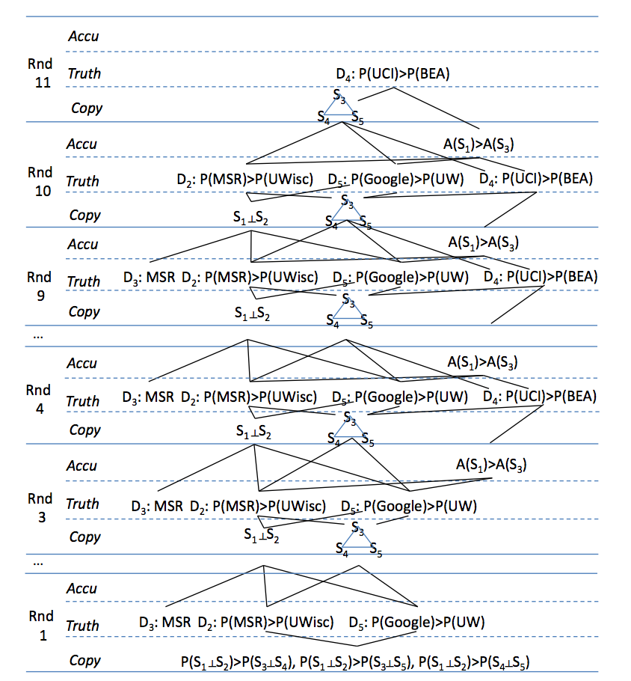
A Verbose Provenance-Style Explanation

Slide 12
A Compact Explanation
 | S1 | S2 | S3 | S4 | S5
Stonebraker | MIT | Berkeley | MIT | MIT | MS
Dewitt | MSR | MSR | UWisc | UWisc | UWisc
Bernstein | MSR | MSR | MSR | MSR | MSR
Carey | UCI | AT&T | BEA | BEA | BEA
Halevy | Google | Google | UW | UW | UW
P(UCI)> P(BEA)
A(S1)>A(S3)
P(MSR)>P(Uwisc)
P(Google)>P(UW)
Copying between S3, S4, S5
Copying is more likely between S3, S4, S5 than between S1 and S2, as the former group shares more common values
How to
generate?

Slide 13
Problem and Contributions
Explaining data-fusion decisions by
  Bayesian analysis (MAP)
  iterative reasoning
Contributions
  Snapshot explanation: lists of positive and negative evidence considered in MAP
  Comprehensive explanation: DAG where children nodes represent evidence for parent nodes
  Keys: 1) Correct; 2) Compact; 3) Efficient

Slide 14
Outline
Motivations and contributions
Techniques
  Snapshot explanations
  Comprehensive explanations
Related work and conclusions

Slide 15


Explaining the Decision
—Snapshot Explanation
MAP Analysis
How to explain ?
>
>
>
>
>

Slide 16
List Explanation
The list explanation for decision W versus an alternate decision W’ in MAP analysis is in the form of (L+, L-)
  L+ is the list of positive evidence for W
  L- is the list of negative evidence for W (positive for W’)
  Each evidence is associated w. a score
  The sum of the scores for positive evidence is higher than the sum of the scores for negative evidence
A snapshot explanation for W contains a set of list explanations, one for each alternative decision in MAP analysis

Slide 17
An Example List Explanation
 | Score | Evidence
Pos | 1.6 | S1 provides a different value from S2 on Stonebraker
 | 1.6 | S1 provides a different value from S2 on Carey
 | 1.0 | S1 uses a different format from S2 although shares the same (true) value on Dewitt
 | 1.0 | S1 uses a different format from S2 although shares the same (true) value on Bernstein
 | 1.0 | S1 uses a different format from S2 although shares the same (true) value on Halevy
 | 0.7 | The a priori belief is that S1 is more likely to be independent of S2
Problems
  Hidden evidence: e.g., negative evidence—S1 provides the same value as S2 on Dewitt, Bernstein, Halevy
  Long lists: #evidence in the list <= #data items + 1

Slide 18
Experiments on AbeBooks Data
AbeBooks Data:
  894 data sources (bookstores)
  1265*2 data items (book name and authors)
  24364 listings
Four types of decisions
  Truth discovery
  Copy detection
  Copy direction
  Copy pattern (by books or by attributes)

Slide 19
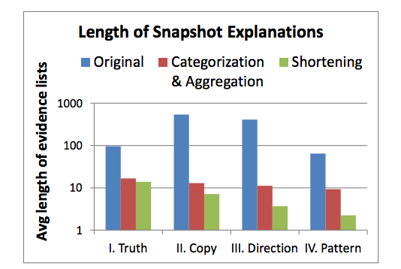
Length of Snapshot Explanations

Slide 20
Categorizing and Aggregating Evidence
 | Score | Evidence
Pos | 1.6 | S1 provides a different value from S2 on Stonebraker
 | 1.6 | S1 provides a different value from S2 on Carey
 | 1.0 | S1 uses a different format from S2 although shares the same (true) value on Dewitt
 | 1.0 | S1 uses a different format from S2 although shares the same (true) value on Bernstein
 | 1.0 | S1 uses a different format from S2 although shares the same (true) value on Halevy
 | 0.7 | The a priori belief is that S1 is more likely to be independent of S2
Classifying and aggregating evidence
Separating evidence

Slide 21
Improved List Explanation
 | Score | Evidence
Pos | 3.2 | S1 provides different values from S2 on 2 data items
 | 3.06 | Among the items for which S1 and S2 provide the same value, S1 uses different formats for 3 items
 | 0.7 | The a priori belief is that S1 is more likely .7 to be independent of S2
Neg | 0.06 | S1 provides the same true value for 3 items as S2
Problems
  The lists can still be long:
  #evidence in the list <= #categories

Slide 22
Length of Snapshot Explanations

Slide 23
Length of Snapshot Explanations
Shortening by one order of magnitude

Slide 24
Shortening Lists
Example: lists of scores
  L+ = {1000, 500, 60, 2, 1}
  L- = {950, 50, 5}
Good shortening
  L+ = {1000, 500}
  L- = {950}
Bad shortening I
  L+ = {1000, 500}
  L- = {}
Bad shortening II
  L+ = {1000}
  L- = {950}
No negative evidence
Only slightly stronger

Slide 25

Shortening Lists by Tail Cutting
Example: lists of scores
  L+ = {1000, 500, 60, 2, 1}
  L- = {950, 50, 5}
Shortening by tail cutting
  5 positive evidence and we show top-2: L+ = {1000, 500}
  3 negative evidence and we show top-2: L- = {950, 50}
  Correctness: Score_{pos} >= 1000+500 > 950+50+50 >= Score_{neg}
Tail-cutting problem: minimize
  s+t
  such that

Slide 26


Shortening Lists by Difference Keeping
Example: lists of scores
  L+ = {1000, 500, 60, 2, 1}
  L- = {950, 50, 5}
  Diff(Score_{pos,} Score_{neg}) = 558
Shortening by difference keeping
  L+ = {1000, 500}
  L- = {950}
  Diff(Score_{pos,} Score_{neg}) = 550 (similar to 558)
Difference-keeping problem: minimize
  such that

Slide 27
A Further Shortened List Explanation
 | Score | Evidence
Pos (3 evid- ence) | 3.2 | S1 provides different values from S2 on 2 data items
Neg | 0.06 | S1 provides the same true value for 3 items as S2
Choosing the shortest lists generated by tail cutting and difference keeping

Slide 28
Length of Snapshot Explanations

Slide 29
Length of Snapshot Explanations
Further shortening by half

Slide 30
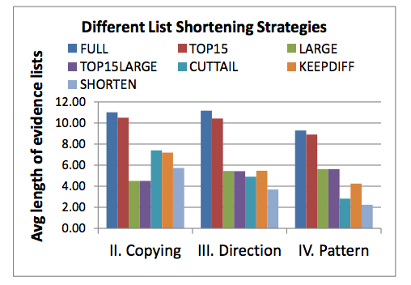
Length of Snapshot Explanations
TOP-K does not shorten much
Thresholding on scores shortens a lot of but makes a lot of mistakes
Combining tail cutting and diff keeping is effective and correct

Slide 31
Outline
Motivations and contributions
Techniques
  Snapshot explanations
  Comprehensive explanations
Related work and conclusions

Slide 32
Explaining the Explanation
—Comprehensive Explanation

Slide 33
DAG Explanation
The DAG explanation for iterative MAP decision W is a DAG (N, E, R)
  N: Each node represents a decision and its list explanations
  E: Each edge indicates that the decision in the child node is positive evidence for that of the parent node
  R: The root node represents decision W

Slide 34
Full Explanation DAG
Problem: huge when #iterations is large
  Many repeated sub-graphs

Slide 35
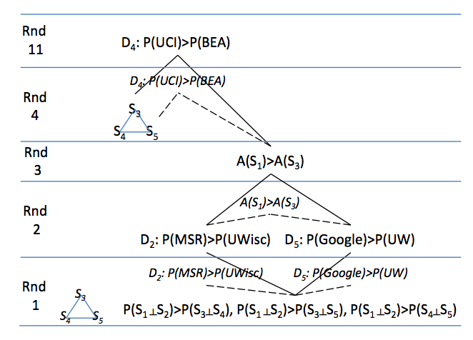
Critical-Round Explanation DAG
The critical round of decision W@Round#m is the first round before Round#m when W is made (i.e., not W is made in the previous round or Round#1).
For each decision W@Round#m, only show its evidence in W’s critical round.

Slide 36
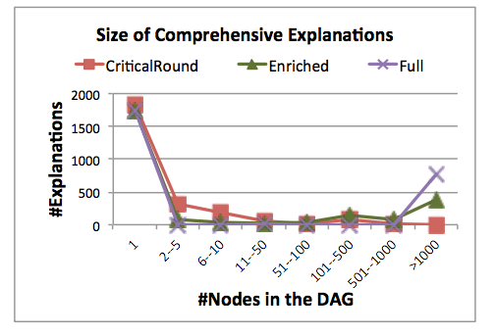
Size of Comprehensive Explanations
Critical-round DAG explanations are significantly smaller
Full DAG explanations can often be huge

Slide 37
Related Work
Explanation for data-management tasks
  Queries [Buneman et al., 2008][Chapman et al., 2009]
  Workflows [Davidson et al., 2008]
  Schema mappings [Glavic et al., 2010]
  Information extraction [Huang et al., 2008]
Explaining evidence propagation in Bayesian network [Druzdzel, 1996][Lacave et al., 2000]
Explaining iterative reasoning [Das Sarma et al., 2010]

Slide 38
Conclusions
Many data-fusion decisions are made through iterative MAP analysis
Explanations
  Snapshot explanations list positive and negative evidence in MAP analysis (also applicable for other MAP analysis)
  Comprehensive explanations trace iterative reasoning (also applicable for other iterative reasoning)
Keys: Correct, Compact, Efficient

Slide 39
THANK you!
Fusion data sets: lunadong.com/fusionDataSets.htm

