Slide 1




Fusing Data with Correlations
Ravali Pochampally, Anish Das Sarma, Luna Dong,
Alexandra Meliou, Divesh Srivastava
AT&T Research

Slide 2
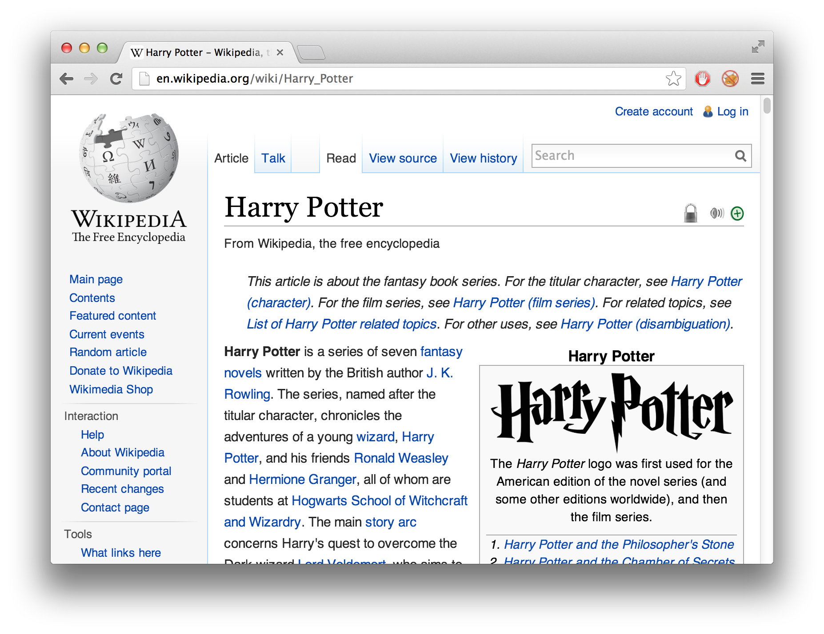
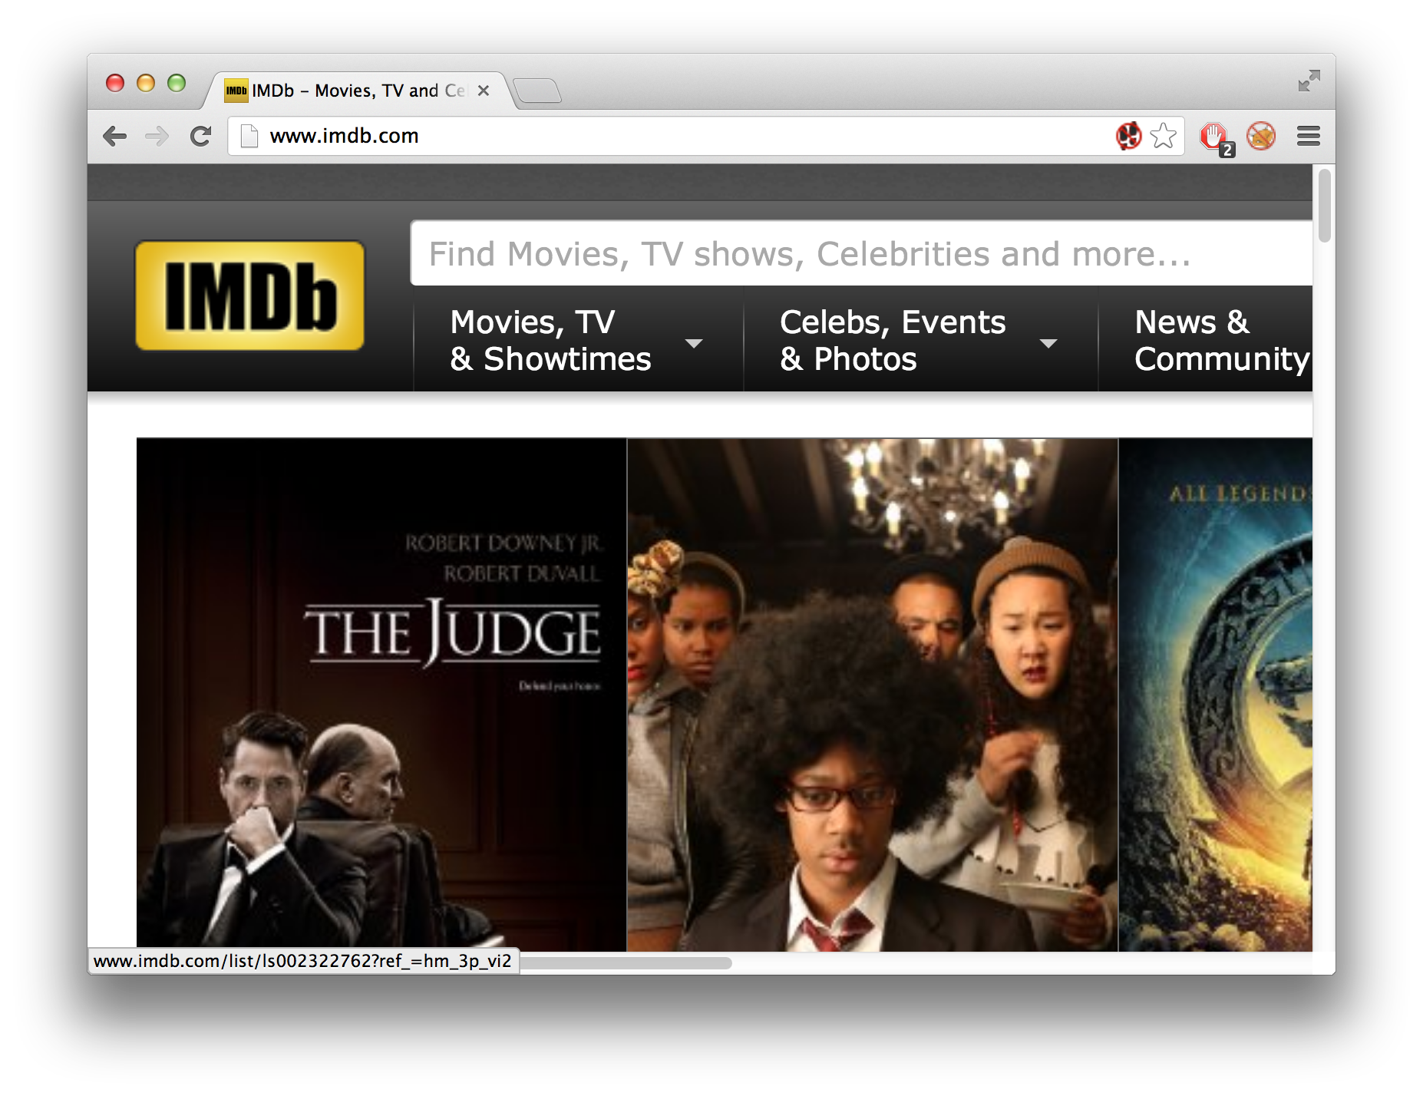
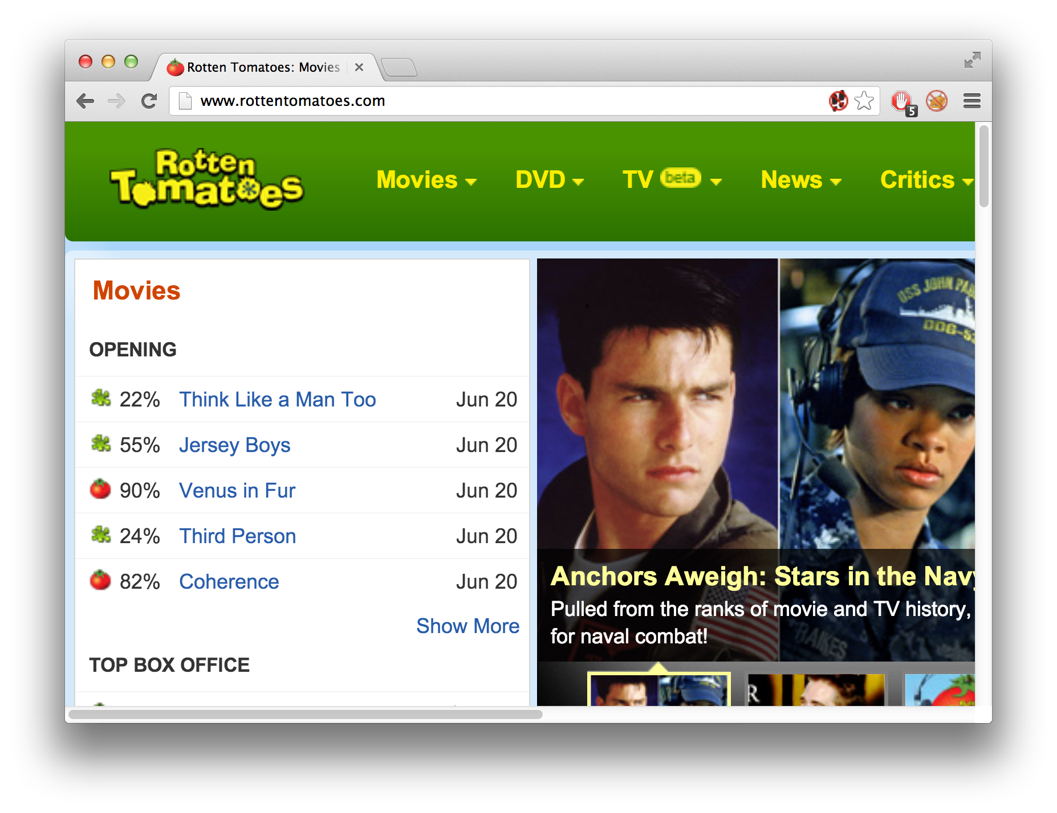
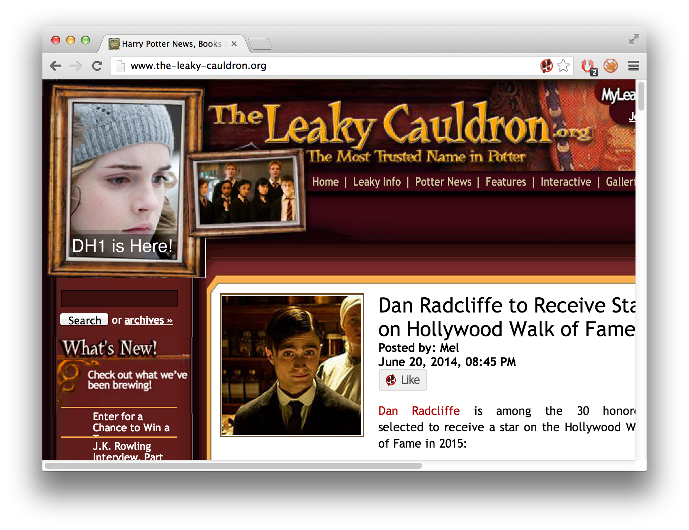
Fusion in web data extraction
extractor
extractor
extractor
extractor
extractor
<subject,predicate,object>
<subject,predicate,object>
<subject,predicate,object>
<subject,predicate,object>
<subject,predicate,object>
<subject,predicate,object>
<subject,predicate,object>
<subject,predicate,object>
<subject,predicate,object>
<subject,predicate,object>
<subject,predicate,object>
<subject,predicate,object>
<subject,predicate,object>
<subject,predicate,object>
<subject,predicate,object>
<subject,predicate,object>
<subject,predicate,object>
<subject,predicate,object>
<subject,predicate,object>
<subject,predicate,object>
<subject,predicate,object>
<subject,predicate,object>
How can we purge wrong triples from the dataset?
Applications:
Building knowledge bases, answer questions, facilitate data mining
Notes:
Imagine that you have a large collection of web sources that you process using multiple extraction systems to derive facts. These facts are usually knowledge triples in the form of subject-predicate-object, for example: Daniel Radcliff - played role - Harry Potter. Unfortunately, extractors often make mistakes, and some of the extracted knowledge triples are incorrect. The problem that we want to solve, is how to identify and remove these wrong triples from the dataset.
This problem is very important in many applications such as builging knowledge bases, answering questions, facilitating data mining, etc.

Slide 3
The data fusion problem
Contribution:
Fusion techniques that consider source quality and correlations
bad
good
Knowledge triple | S₁ | S₂ | S₃ | S₄
<Daniel Radcliffe, played role, Harry Potter> | ✓ | ✓ |  | ✓
<Daniel Radcliffe, spouse, Bonnie Wright> | ✓ | ✓
<Daniel Radcliffe, acted in, Frankenstein> |  |  | ✓
<Emma Watson, acted in, Harry Potter> | ✓ | ✓ | ✓
<J. K. Rowling, acted in, Harry Potter> | ✓ | ✓ | ✓
<Richard Harris, played role, Dumbledore> |  |  |  | ✓
<Michael Gambon, played role, Dumbledore> |  |  | ✓
<Tim Burton, directed, Harry Potter> | ✓ | ✓ |  | ✓
<Daniel Craig, acted in, Harry Potter> | ✓ | ✓
<Rupert Grint, acted in, Harry Potter> |  |  | ✓ | ✓
✗
✗
✗
✗
correlated
anti-correlated
Notes:
So, why is this problem challenging? Perhaps we can use simple voting techniques: only accept a triple as true if it is returned by a large portion of the extractors. Unfortunately, these approaches often behave poorly:
Bad web sources that copy from each other, or low-quality extractors that are otherwise correlated, can lead us to accept incorrect results. At the same time, we may end up rejecting correct triples derived by good extractors, if these triples do not appear in other extractor outputs.
Our contribution in this work is to provide fusion techniques that consider the quality of different sources and their correlations, which can be used to derive high-quality datasets.

Slide 4

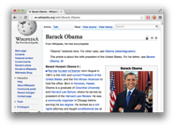

This talk
2 techniques
PrecRec:
consider source quality
PrecRecCorr:
consider correlations
extractor
extractor
approximations
evaluation
future directions
extractor
extractor
extractor
extractor
extractor
<subject,predicate,object>
<subject,predicate,object>
<subject,predicate,object>
<subject,predicate,object>
<subject,predicate,object>
<subject,predicate,object>
<subject,predicate,object>
<subject,predicate,object>
<subject,predicate,object>
<subject,predicate,object>
<subject,predicate,object>
<subject,predicate,object>
<subject,predicate,object>
<subject,predicate,object>
<subject,predicate,object>
<subject,predicate,object>
<subject,predicate,object>
<subject,predicate,object>
<subject,predicate,object>
<subject,predicate,object>
<subject,predicate,object>
<subject,predicate,object>
<subject,predicate,object>
<subject,predicate,object>
<subject,predicate,object>
<subject,predicate,object>
<subject,predicate,object>
diagnosis

Slide 5
High-level intuition
source quality | correlations | evaluation | future directions
Researcher affiliation
 | S₁ | S₂ | S₃
Jagadish | UMich | ATT | UMich
Dewitt | MSR | MSR | UWisc
Bernstein | MSR | MSR | MSR
Carey | UCI | ATT | BEA
Franklin | UCB | UCB | UMD

Slide 6
High-level intuition
source quality | correlations | evaluation | future directions
Researcher affiliation
 | S₁ | S₂ | S₃
Jagadish | UMich | ATT | UMich
Dewitt | MSR | MSR | UWisc
Bernstein | MSR | MSR | MSR
Carey | UCI | ATT | BEA
Franklin | UCB | UCB | UMD
Voting: Trust the majority

Slide 7
High-level intuition
source quality | correlations | evaluation | future directions
Researcher affiliation
 | S₁ | S₂ | S₃
Jagadish | UMich | ATT | UMich
Dewitt | MSR | MSR | UWisc
Bernstein | MSR | MSR | MSR
Carey | UCI | ATT | BEA
Franklin | UCB | UCB | UMD
Quality-based: More votes to accurate sources

Slide 8
Source quality in extraction
source quality | correlations | evaluation | future directions
Actors/actresses in “Harry Potter” films
 | S₁ | S₂ | S₃
Daniel Radcliffe | ✓ | ✓
Emma Watson | ✓ | ✓ | ✓
J. K. Rowling |  |  | ✓
Daniel Craig | ✓
Rupert Grint | ✓ |  | ✓
✗
✗
high
recall
high
precision
med
prec/rec
Considering source quality:
-- More likely to be correct if extracted by high-precision source.
-- More likely to be wrong if not extracted by high-recall source.

Slide 9
Source quality metrics
source quality | correlations | evaluation | future directions
Recall:
False positive rate:
probability to return a true triple
probability to return a false triple
A source is good if r_{i} > q_{i}

Slide 10
Accounting for quality
source quality | correlations | evaluation | future directions
Compute score for each triple:
  If extracts it, multiply by
    Good source higher score
    Bad source lower score
  If does not extract it, multiply by
    Good source lower score
    Bad source higher score

Slide 11
Correlation scenarios
source quality | correlations | evaluation | future directions
Triple provided by good sources with recall r and FPR q
Copying:
Overlapping
  On true triples:
  On false triples:
Complementary sources:
Correlations capture richer information than copying relationships

Slide 12
Correlation in web extraction
source quality | correlations | evaluation | future directions
[Dong et al. PVLDB 2014]
Significant negative correlation
Notes:
The Kappa measure is considered as a more robust measure than merely measuring the intersection, as it takes into account the intersection that can happen even in case of independence. A positive Kappa measure indicates positive correlation; a negative one indicates negative correlation; and one close to 0 indicates independence. Among the 66 pairs of extractors, 53% of them are independent. Five pairs of sources are positively correlated (but the kappa measures are very close to 0), as they apply the same extraction techniques (sometimes only differ in parameter settings) or investigate the same type of Web contents. We observe negative correlation on 40% of the pairs; they are often caused by considering different types of Web contents, but sometimes even extractors on the same type of Web contents can be highly anti-correlated when they apply different techniques

Slide 13
Considering correlations
source quality | correlations | evaluation | future directions
Positive correlation:
Negative correlation:
joint recall
Exact solution:
We can express these probabilities using an exponential number of correlation parameters

Slide 14
Aggressive approximation
source quality | correlations | evaluation | future directions
Partial independence assumptions
correlation between S_{i} and the other sources
linear number of parameters
But: low accuracy

Slide 15
Approximation levels
source quality | correlations | evaluation | future directions
no independence assumptions
high accuracy
exponential size
exact solution
add parameters
closer approximation
elastic approximation
trade efficiency for accuracy
partial independence assumptions
aggressive approximation
low accuracy
linear size

Slide 16
Elastic approximation
source quality | correlations | evaluation | future directions
3 steps
3 iterations achieve
near-optimal accuracy
Iterations of the elastic approximation

Slide 17
Comparisons
source quality | correlations | evaluation | future directions
Our techniques: PrecRec & PrecRecCorr
Union-K
  A triple is correct if at least K% of sources provide it
3-Estimate [Galland et al. WSDM 2010]
  Iteratively computes trustworthiness
LTM [Zhao et al. PVLDB 2012]
  Uses graphical models and Gibbs sampling

Slide 18
Three real-world datasets
source quality | correlations | evaluation | future directions
Restaurant:
  [Marian et al. DE Bull, 2011]
  7 sources
  93 triples
Book:
  [Dong et al. PVLDB, 2009]
  879 sources
  225 triples
ReVerb:
  [Fader et al. EMNLP, 2011]
  6 extractors
  2407 triples

Slide 19
Restaurant
source quality | correlations | evaluation | future directions

Slide 20
Book
source quality | correlations | evaluation | future directions

Slide 21
ReVerb
source quality | correlations | evaluation | future directions

Slide 22
Synthetic data: low precision
source quality | correlations | evaluation | future directions

Slide 23
Synthetic data: high precision
source quality | correlations | evaluation | future directions

Slide 24
Synthetic data: low recall
source quality | correlations | evaluation | future directions

Slide 25
Synthetic data: correlations
source quality | correlations | evaluation | future directions

Slide 26
Error diagnosis
source quality | correlations | evaluation | future directions
<subject,predicate,object>
<subject,predicate,object>
<subject,predicate,object>
<subject,predicate,object>
<subject,predicate,object>
<subject,predicate,object>
<subject,predicate,object>
<subject,predicate,object>
<subject,predicate,object>
<subject,predicate,object>
<subject,predicate,object>
<subject,predicate,object>
<subject,predicate,object>
<subject,predicate,object>
<subject,predicate,object>
<subject,predicate,object>
<subject,predicate,object>
<subject,predicate,object>
<subject,predicate,object>
<subject,predicate,object>
<subject,predicate,object>
<subject,predicate,object>
<subject,predicate,object>
<subject,predicate,object>
<subject,predicate,object>
<subject,predicate,object>
<subject,predicate,object>

Slide 27
Contributions
Fusion techniques that consider source quality and correlations
The number of correlation parameters grows exponentially, but we provide a scalable solution
Evaluation on real-world and synthetic data shows that our techniques are more effective than the state-of-the-art

Slide 28
The data fusion problem
Naïve approach:
Simple majority voting achieves relatively low precision and recall
Knowledge triple | S₁ | S₂ | S₃ | S₄ | S₅
<Daniel Radcliffe, played role, Harry Potter> | ✓ | ✓ |  | ✓ | ✓
<Daniel Radcliffe, spouse, Bonnie Wright> | ✓ | ✓
<Daniel Radcliffe, acted in, Frankenstein> |  |  | ✓
<Emma Watson, acted in, Harry Potter> |  | ✓ | ✓ | ✓ | ✓
<J. K. Rowling, acted in, Harry Potter> |  | ✓ | ✓
<Richard Harris, played role, Dumbledore> | ✓ |  |  | ✓ | ✓
<Michael Gambon, played role, Dumbledore> | ✓ | ✓ | ✓
<Tim Burton, directed, Harry Potter> | ✓ | ✓ |  | ✓ | ✓
<Daniel Craig, acted in, Harry Potter> | ✓ | ✓ |  | ✓ | ✓
<Rupert Grint, acted in, Harry Potter> | ✓ |  | ✓ | ✓ | ✓
✗
✗
✗
✗
Notes:
\begin{tabular}{|c|c|c|c|c|c|c|c|}
\hline
{\bf ID} & {\bf KnowledgeTriple} & {\bf Correct?} & $\mathbf{S_1}$ & $\mathbf{S_2}$ & $\mathbf{S_3}$ & $\mathbf{S_4}$ & $\mathbf{S_5}$\\
\hline
$\mathbf{t_1}$ & \triple{Obama,profession,president} & Yes & \checkmark & \checkmark & & \checkmark & \checkmark \\
\hline
$\mathbf{t_2}$ & \triple{Obama,died,1982} & No & \checkmark & \checkmark & & & \\
\hline
$\mathbf{t_3}$ & \triple{Obama,profession,lawyer} & Yes & & & \checkmark & & \\
\hline
$\mathbf{t_4}$ & \triple{Obama,religion,Christian} & Yes & & \checkmark & \checkmark & \checkmark & \checkmark \\
\hline
$\mathbf{t_5}$ & \triple{Obama,age,50} & No & & \checkmark & \checkmark & & \\ \hline
$\mathbf{t_6}$ & \triple{Obama,support,White Sox} & Yes & \checkmark & & & \checkmark & \checkmark \\
\hline
$\mathbf{t_7}$ & \triple{Obama,spouse,Michelle} & Yes & \checkmark & \checkmark & \checkmark & & \\
\hline
$\mathbf{t_8}$ & \triple{Obama,administered by,John G. Roberts} & No & \checkmark & \checkmark & & \checkmark & \checkmark \\
\hline
$\mathbf{t_9}$ & \triple{Obama,surgical operation,05/01/2011} & No & \checkmark & \checkmark & & \checkmark & \checkmark \\
\hline
$\mathbf{t_{10}}$ & \triple{Obama,profession,community organizer} & Yes & \checkmark & & \checkmark & \checkmark & \checkmark \\
\hline
\end{tabular}
%%%%%%%%%%%%%%%%%%%%%%%%%%%%%%%%%%%
\begin{tabular}{|c|c|c|c|c|c|c|}
\hline
{\bf ID} & {\bf KnowledgeTriple} & $\mathbf{S_1}$ & $\mathbf{S_2}$ & $\mathbf{S_3}$ & $\mathbf{S_4}$ & $\mathbf{S_5}$\\
\hline
$\mathbf{t_1}$ & \triple{Obama,profession,president} & \checkmark & \checkmark & & \checkmark & \checkmark \\
\hline
$\mathbf{t_2}$ & \triple{Obama,died,1982} & \checkmark & \checkmark & & & \\
\hline
$\mathbf{t_3}$ & \triple{Obama,profession,lawyer} & & & \checkmark & & \\
\hline
$\mathbf{t_4}$ & \triple{Obama,religion,Christian} & & \checkmark & \checkmark & \checkmark & \checkmark \\
\hline
$\mathbf{t_5}$ & \triple{Obama,age,50} & & \checkmark & \checkmark & & \\ \hline
$\mathbf{t_6}$ & \triple{Obama,support,White Sox} & \checkmark & & & \checkmark & \checkmark \\
\hline
$\mathbf{t_7}$ & \triple{Obama,spouse,Michelle} & \checkmark & \checkmark & \checkmark & & \\
\hline
$\mathbf{t_8}$ & \triple{Obama,administered by,John G. Roberts} & \checkmark & \checkmark & & \checkmark & \checkmark \\
\hline
$\mathbf{t_9}$ & \triple{Obama,surgical operation,05/01/2011} & \checkmark & \checkmark & & \checkmark & \checkmark \\
\hline
$\mathbf{t_{10}}$ & \triple{Obama,profession,community organizer} & \checkmark & & \checkmark & \checkmark & \checkmark \\
\hline
\end{tabular}
\begin{tabular}{c|}
\hline
Correct?\\
\hline
Yes\\
\hline
No\\
\hline
Yes\\
\hline
Yes\\
\hline
No\\
\hline
Yes\\
\hline
Yes\\
\hline
No\\
\hline
No\\
\hline
Yes\\
\hline
\end{tabular}

Slide 29
Extracting web data
extractor
extractor
extractor
extractor
extractor
<subject,predicate,object>
<subject,predicate,object>
<subject,predicate,object>
<subject,predicate,object>
<subject,predicate,object>
<subject,predicate,object>
<subject,predicate,object>
<subject,predicate,object>
<subject,predicate,object>
<subject,predicate,object>
<subject,predicate,object>
<subject,predicate,object>
<subject,predicate,object>
<subject,predicate,object>
<subject,predicate,object>
<subject,predicate,object>
<subject,predicate,object>
<subject,predicate,object>
<subject,predicate,object>
<subject,predicate,object>
<subject,predicate,object>
<subject,predicate,object>
<subject,predicate,object>
<subject,predicate,object>
<subject,predicate,object>
<subject,predicate,object>
<subject,predicate,object>
Different extractors can extract different data from the same document

Slide 30
Semantics
Triple independence
  If a source provides triple t₁, it is independent of whether it provides t₂.
Open-world
  If a triple is not provided by a source, it is considered unknown, rather than false.

Slide 31
Independence assumption
source quality | correlations | evaluation | future directions
Assumes source independence!
Do we need to worry about correlations?

Slide 32
Experimental evaluation
source quality | correlations | evaluation | future directions
Effectiveness:
  Comparison with state-of-the-art techniques on real-world data
Efficiency:
  Evaluation of the approximation algorithms
Pushing the limits with synthetic data

Slide 33
Execution time
source quality | correlations | evaluation | future directions
Notes:
\begin{tabular}{lrrr}
\toprule
\textbf{time(sec)} & \reverb & \restaurant &\book\\
\midrule
\union-25 & 0.39 & 0.56 & 3.86\\
\union-50 & 0.14 & 0.32 & 3.71\\
\union-75 & 0.11 & 0.35 & 3.00\\
\estimate & 0.7 & 0.06 & 39\\
\ltm (10 iter) & 49 & 5.3 & 3791\\
\precrec & 2.6 & 0.3 & 35\\
\preccorr & 124 & 5.4 & 6786\\
\preccorr-\textsc{lvl3} & 79 & 2.25 & 2452\\
\bottomrule
\\
\end{tabular}

