Slide 1
Global Detection of
Complex Copying Relationships
Between Sources
Xin Luna Dong
AT&T Labs-Research
Joint work w. Laure Berti-Equille, Yifan Hu, Divesh Srivastava
@VLDB’2010
Notes:
5+2+5+10+5+1

Slide 2
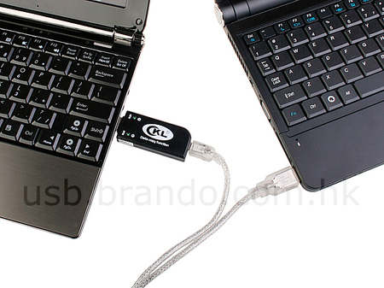
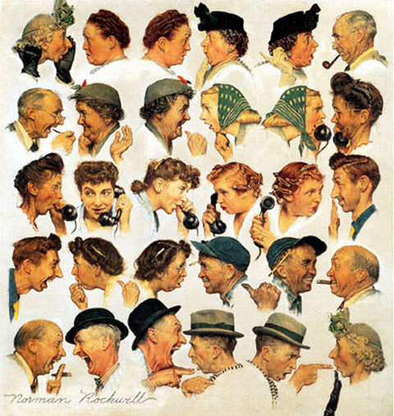

Information Propagation Becomes Much Easier with the Web Technologies

Slide 3






False Information Can Be Propagated
Posted by Andrew Breitbart
In his blog
…
Notes:
On July 19, 2010, Shirley Sherrod was forced to resign from her position as Georgia State Director of Rural Development for the United States Department of Agriculture^{[1]} after conservative blogger Andrew Breitbart posted video excerpts of Sherrod's address at a March 2010 NAACP event to his website.^{[2]} The NAACP condemned her remarks, and U.S. government officials called on her to resign. However, upon review of the unedited video in context, the NAACP, White House officials, and Tom Vilsack, the Secretary of Agriculture, apologized and Sherrod was offered a new position.
The first news outlet to report on the Breitbart video was FoxNews.com, which posted an article about the story on its website.^{[16][14]} The New York City affiliate for CBS also posted a report on its website later that afternoon.^{[14]} The Atlanta Journal Constitution newspaper's related website also soon picked up the story.^{[17]} In addition, the story was picked up and reported widely in the blogosph
According to Sherrod, that afternoon she received numerous demands from government officials to submit her resignation, demands that she characterized as harrassment.^{[18]} In response to a call from USDA deputy undersecretary Cheryl Cook, Sherrod submitted her resignation via email. Sherrod claims that Cook told her White House officials wanted her to quit immediately because the controversy was "going to be on Glenn Beck tonight^{[18]} ", a claim disputed by White House Press Secretary Robert Gibbs.^{[6]}ere.^{[14]}

Slide 4
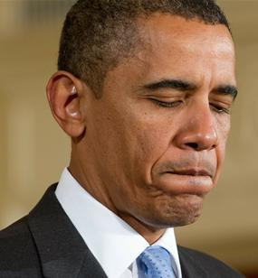
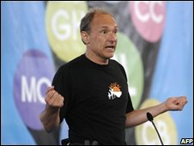
We now live in this media culture where something goes up on YouTube or a blog and everybody scrambles. - Barack Obama
The Internet needs a way to help people separate rumor from real science.
– Tim Berners-Lee

Slide 5
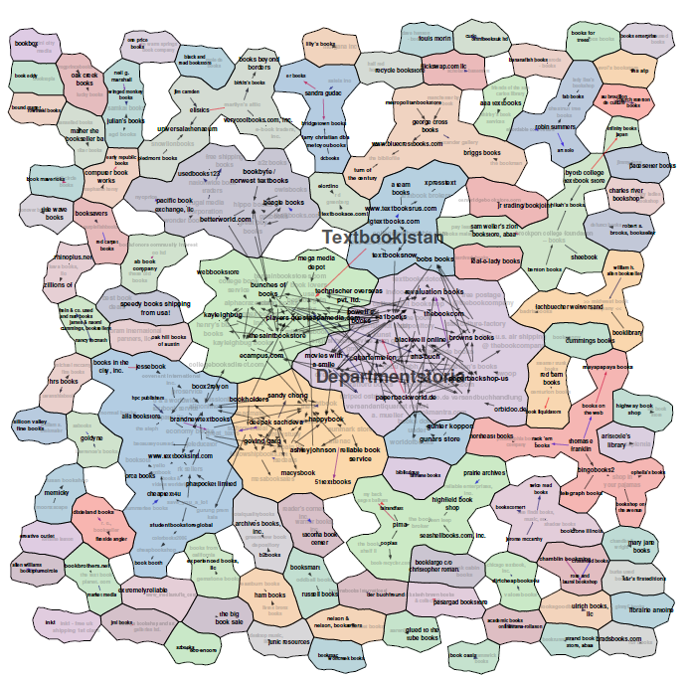
Large-Scaled Copying on Structured Data
(Copying of AbeBooks Data)
Data collected from AbeBooks
[Yin et al., 2007]

Slide 6
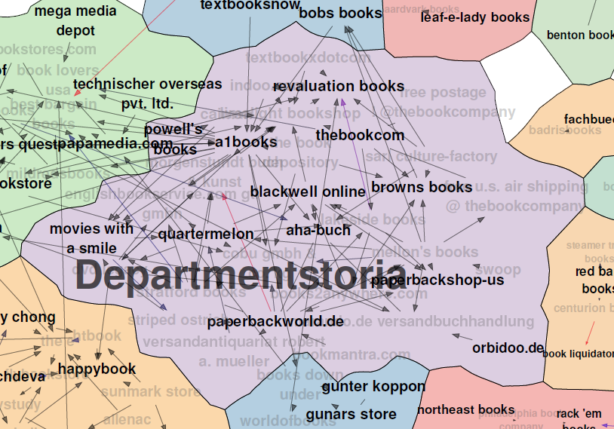
Observation I. Intuitively Meaningful Clusters According to the Copying Relationships

Slide 7
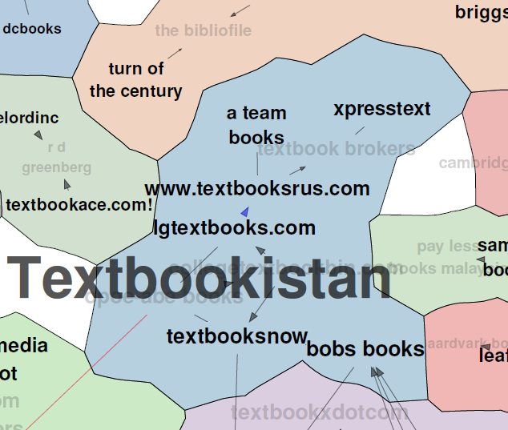
Observation I. Intuitively Meaningful Clusters According to the Copying Relationships

Slide 8
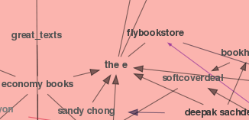
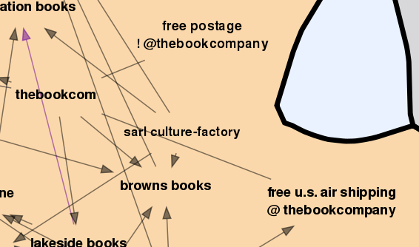
Observation II. Complex Copying Relationships
Co-copying

Slide 9
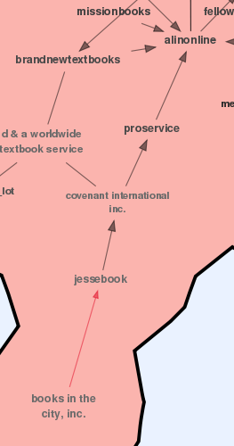
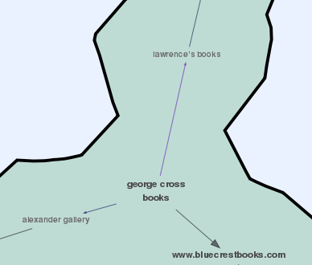
Observation II. Complex Copying Relationships
Multi-source
copying
Transitive copying

Slide 10
Understanding Complex Copying Relationships
Benefits
  Business purpose: data are valuable
  In-depth data analysis: information dissemination
  Improve data integration: truth discovery, entity resolution, schema mapping, query optimization
Current techniques make local decisions
[Dong et al., 09a][Dong et al., 09b][Blanco et al., 10]
  Cannot distinguish co-copying, transitive copying, direct copying from multiple sources

Slide 11
Our Contributions
Local Detection
Global Detection
More accurate decisions on copying direction (important for global detection)
  Glean information from completeness, formatting
  Consider correlated copying: e.g., a source copying the name of a book can also copy its author list
Global detection of copying
  Discovering co-copying and transitive copying

Slide 12
Outline
Motivation and contributions
Problem definition and techniques
Experimental results
Related work and conclusions
Local Detection
Global Detection
Intuitions
Techniques

Slide 13
Problem Definition—Input
Objects: a real-world entity, described by a set of attributes
  Each associated w. a true value
Sources: each providing data for a subset of objects
Input
Src | ISBN | Name | Author
S1 | 1 | IPV6: Theory, Protocol, and Practice | Loshin, Peter
 | 2 | Web Usability: A User-Centered Design Approach | Lazar, Jonathan
S2 | 1 | IPV4: Theory, Protocol, and Practice | -
 | 2 | Web Usability: A User | Jonathan Lazar
S3 | 1 | IPV6: Theory, Protocol, and Practice | Loshin, Peter
 | 2 | Web Usability: A User | Jonathan Lazar
S4 | 1 | IPV6: Theory, Protocol, and Practice | Loshin
 | 2 | Web Usability: A User | Lazar
Missing values
Incorrect
values
Different formats

Slide 14
Problem Definition—Output
For each S1, S2, decide pr of S1 copying directly from S2
  A copier copies all or a subset of data
  A copier can add values and verify/modify copied values—independent contribution
  A copier can re-format copied values—still considered as copied
Src | ISBN | Name | Author
S1 | 1 | IPV6: Theory, Protocol, and Practice | Loshin, Peter
 | 2 | Web Usability: A User-Centered Design Approach | Lazar, Jonathan
S2 | 1 | IPV4: Theory, Protocol, and Practice | -
 | 2 | Web Usability: A User | Jonathan Lazar
S3 | 1 | IPV6: Theory, Protocol, and Practice | Loshin, Peter
 | 2 | Web Usability: A User | Jonathan Lazar
S4 | 1 | IPV6: Theory, Protocol, and Practice | Loshin
 | 2 | Web Usability: A User | Lazar
S1
S2
S3
S4

Slide 15
Intuitions for Local Copying Detection
Pr(Ф(S1)|S1→S2) >> Pr(Ф(S1)|S1⊥S2) S1→S2
Overlap on unpopular values → Copying
Changes in quality of different parts of data →Copying direction
[VLDB’09] Consider
correctness of data

Slide 16
Correctness of Data as Evidence for Copying
Src | ISBN | Name | Author
S1 | 1 | IPV6: Theory, Protocol, and Practice | Loshin, Peter
 | 2 | Web Usability: A User-Centered Design Approach | Lazar, Jonathan
S2 | 1 | IPV4: Theory, Protocol, and Practice | -
 | 2 | Web Usability: A User | Jonathan Lazar
S3 | 1 | IPV6: Theory, Protocol, and Practice | Loshin, Peter
 | 2 | Web Usability: A User | Jonathan Lazar
S4 | 1 | IPV6: Theory, Protocol, and Practice | Loshin
 | 2 | Web Usability: A User | Lazar
S1
S2
S3
S4

Slide 17
Intuitions for Local Copying Detection
Pr(Ф(S1)|S1→S2) >> Pr(Ф(S1)|S1⊥S2) S1→S2
Overlap on unpopular values → Copying
Changes in quality of different parts of data →Copying direction
[VLDB’09] Consider
correctness of data
Consider additional
evidence

Slide 18
Formatting as Evidence for Copying
Src | ISBN | Name | Author
S1 | 1 | IPV6: Theory, Protocol, and Practice | Loshin, Peter
 | 2 | Web Usability: A User-Centered Design Approach | Lazar, Jonathan
S2 | 1 | IPV4: Theory, Protocol, and Practice | -
 | 2 | Web Usability: A User | Jonathan Lazar
S3 | 1 | IPV6: Theory, Protocol, and Practice | Loshin, Peter
 | 2 | Web Usability: A User | Jonathan Lazar
S4 | 1 | IPV6: Theory, Protocol, and Practice | Loshin
 | 2 | Web Usability: A User | Lazar
S1
S2
S3
S4
SubValues
Different formats

Slide 19
Intuitions for Local Copying Detection
Pr(Ф(S1)|S1→S2) >> Pr(Ф(S1)|S1┴S2) S1->S2
Overlap on unpopular values → Copying
Changes in quality of different parts of data →Copying direction
[VLDB’09] Consider
correctness of data
Consider additional
evidence
Consider correlated copying

Slide 20
Correlated Copying
 | K | A1 | A2 | A3 | A4
O1 | S | S | S | D | D
O2 | S | D | S | S | D
O3 | S | S | D | S | D
O4 | S | S | S | D | S
O5 | S | D | S | S | S
 | K | A1 | A2 | A3 | A4
O1 | S | S | S | S | S
O2 | S | S | S | S | S
O3 | S | S | S | S | S
O4 | S | D | D | D | D
O5 | S | D | D | D | D
17 same values, and 8 different values
17 same values, and 8 different values
Copying
S: Two sources providing the same value
D: Two sources providing different values

Slide 21
Intuitions for Local Copying Detection
Pr(Ф(S1)|S1->S2) >> Pr(Ф(S1)|S1┴S2) S1->S2
Overlap on unpopular values → Copying
Changes in quality of different parts of data →Copying direction
[VLDB’09] Consider
correctness of data
Consider additional
evidence
Consider correlated copying

Slide 22
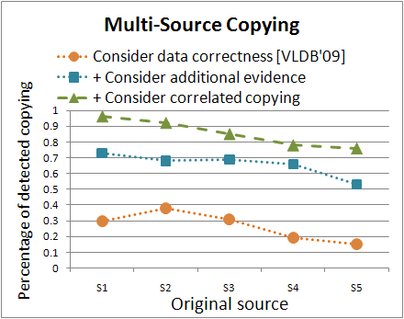
Experimental Results for Local Copying Detection on Synthetic Data

Slide 23
Outline
Motivation and contributions
Problem definition and techniques
Experimental results
Related work and conclusions
Local Detection
Global Detection
Intuitions
Techniques
✓

Slide 24
Multi-Source Copying? Co-copying? Transitive Copying?
S1{V1-V100}
(V81-V100 are popular values)
{V1-V50,
V101-V130}
S2
S3
{V51-V130}
Multi-source copying
S1{V1-V100}
S1{V1-V100}
S2
S3
S2
S3
{V21-V50,
V81-V100}
{V1-V50}
{V21-V70}
{V1-V50}
Co-copying
Transitive copying

Slide 25
Multi-Source Copying? Co-copying? Transitive Copying?
S1{V1-V100}
(V81-V100 are popular values)
{V1-V50,
V101-V130}
S2
S3
{V51-V130}
Multi-source copying
S1{V1-V100}
S1{V1-V100}
S2
S3
S2
S3
{V21-V50,
V81-V100}
{V1-V50}
{V21-V70}
{V1-V50}
Co-copying
Transitive copying
Local copying detection results

Slide 26
Multi-Source Copying? Co-copying? Transitive Copying?
S1{V1-V100}
(V81-V100 are popular values)
{V1-V50,
V101-V130}
S2
S3
{V51-V130}
Multi-source copying
S1{V1-V100}
S1{V1-V100}
S2
S3
S2
S3
{V21-V50,
V81-V100}
{V1-V50}
{V21-V70}
{V1-V50}
Co-copying
Transitive copying
- Looking at the copying probabilities?

Slide 27
Multi-Source Copying? Co-copying? Transitive Copying?
S1{V1-V100}
(V81-V100 are popular values)
1
1
{V1-V50,
V101-V130}
S2
S3
{V51-V130}
1
Multi-source copying
S1{V1-V100}
S1{V1-V100}
1
1
1
1
S2
S3
S2
S3
{V21-V50,
V81-V100}
{V1-V50}
{V21-V70}
{V1-V50}
1
1
Co-copying
Transitive copying
X Looking at the copying probabilities?
- Counting shared values?

Slide 28
Multi-Source Copying? Co-copying? Transitive Copying?
S1{V1-V100}
(V81-V100 are popular values)
50
50
{V1-V50,
V101-V130}
S2
S3
{V51-V130}
30
Multi-source copying
S1{V1-V100}
S1{V1-V100}
50
50
50
50
S2
S3
S2
S3
{V21-V50,
V81-V100}
{V1-V50}
{V21-V70}
{V1-V50}
30
30
Co-copying
Transitive copying
X Looking at the copying probabilities?
X Counting shared values?
- Comparing the set of shared values?

Slide 29
Multi-Source Copying? Co-copying? Transitive Copying?
S1{V1-V100}
(V81-V100 are popular values)
V1-V50
V51-V100
{V1-V50,
V101-V130}
S2
S3
{V51-V130}
V101-V130
Multi-source copying
S1{V1-V100}
S1{V1-V100}
V1-V50
V21-V70
V1-V50
V21-V50, V81-V100
S2
S3
S2
S3
{V21-V50,
V81-V100}
{V1-V50}
{V21-V70}
{V1-V50}
V21-V50
V21-V50
Co-copying
Transitive copying
X Looking at the copying probabilities?
X Counting shared values?
- Comparing the set of shared values?

Slide 30
Multi-Source Copying? Co-copying? Transitive Copying?
S1{V1-V100}
(V81-V100 are popular values)
V1-V50
V51-V100
{V1-V50,
V101-V130}
S2
S3
{V51-V130}
V101-V130
Multi-source copying
S1{V1-V100}
S1{V1-V100}
V1-V50
V21-V70
V1-V50
V21-V50, V80-V100
S2
S3
S2
S3
{V21-V50,
V81-V100}
{V1-V50}
{V21-V70}
{V1-V50}
V21-V50
V21-V50
Co-copying
V21-V50 shared by 3 sources
Transitive copying
X Looking at the copying probabilities?
X Counting shared values?
X Comparing the set of shared values?
We need to reason for each data item in a principled way!
Notes:
Not enough to look at only agg info

Slide 31
Global Copying Detection
First find a set of copyings R that significantly influence the rest of the copyings
  How to find such R?
Adjust copying probability for the rest of the copyings: P(S1→S2|R)
  How to compute P(S1→S2|R)?

Slide 32
Computing P(S1→S2|R)
Pr(Ф(S1)|S1→S2) >> Pr(Ф(S1)|S1⊥S2) S1→S2
Replace Pr(Ф(S1)|S1⊥S2) everywhere with Pr(Ф(S1)|S1⊥S2, R)
For each O.A, consider sources associated with S1 in R
  S_{f}(O.A)—sources providing the same value in the same format on O.A as S1
  S_{v}(O.A)—sources providing the same value in a different format on O.A as S1
  P_{f}/P_{v} – Probability that S1 does not copy O.A from any source in S_{f}(O.A)/S_{v}(O.A)
  Pr(Ф _{O.A}(S1)|S1->S2, R)
  =(1-P_{f}P_{v})+P_{f}P_{v} Pr(Ф_{O.A} (S1)|S1⊥S2)

Slide 33
Multi-Source Copying? Co-copying? Transitive Copying?
S1{V1-V100}
(V81-V100 are popular values)
V1-V50
V51-V100
?
{V1-V50,
V101-V130}
S2
S3
{V51-V130}
V101-V130
Multi-source copying
R={S3→S1}, Pr(Ф(S3))= Pr(Ф(S3)|R) for V101-V130
S1{V1-V100}
S1{V1-V100}
?
X
V1-V50
V21-V70
V1-V50
V21-V50, V81-V100
X
?
S2
S3
S2
S3
{V21-V50,
V81-V100}
{V1-V50}
{V21-V70}
{V1-V50}
V21-V50
V21-V50
Co-copying
Transitive copying
R={S3→S1},
Pr(Ф(S3))<<Pr(Ф(S3)|R)
for V21-V50
R={S3→S2},
Pr(Ф(S3))<<Pr(Ф(S3)|R) for V21-V50
Pr(Ф(S3)) is high for V81-V100

Slide 34

Finding R
R (most influential copying relationships)
Maximize
Finding R is NP-complete
(Reduction from HITTING SET problem)
We need a fast greedy algorithm

Slide 35
Greedy Algorithm for Finding R
Goal: Maximize
Intuitions
  For each source, find the most “influential” sources from which it copies
  Order the original sources by their accumulated influence on others, and iteratively add each corresponding copying to R unless one of the following holds
  Prune copyings that have less accumulated influence on others than being affected by others
  Prune copyings that can be significantly influenced by the already selected copyings
E.g., P(S4→S1)-P(S4→S1|S4→S3)=.8,
P(S4→S2)-P(S4→S2|S4→S3)=.8
P(S4→S3)-P(S4→S3|S4→S1)=.5,
P(S4→S3)-P(S4→S3|S4→S2)=.5
S1
S2
X
X
S3
S4
Accumulated influence: .8+.8=1.6

Slide 36
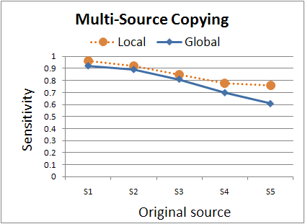
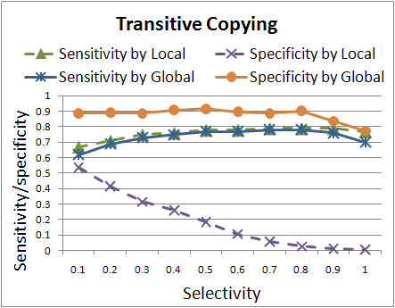
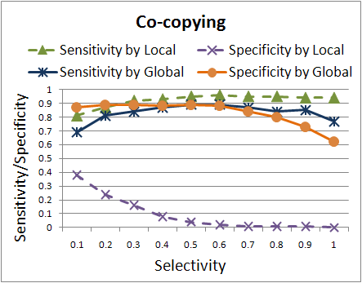
Experimental Results for Global Detection on Synthetic Data
Sensitivity: Percentage of copying that are identified w. correct direction
Specificity: Percentage of non-copying that are identified as so

Slide 37
Outline
Motivation and contributions
Problem definition and techniques
Experimental results
Related work and conclusions
Local Detection
Global Detection
Intuitions
Techniques
✓
✓

Slide 38
Experimental Setup
Dataset: Weather data
  18 weather websites
  for 30 major USA cities
  collected every 45 minutes for a day
  33 collections, so 990 objects
  28 distinct attributes
Challenges
  No true/false notion, only popularity
  Frequent updates—up-to-date data may not have been copied at crawling
  Complete data and standard formatting—lack evidence from completeness & formatting

Slide 39



















Golden Standard

Slide 40
Silver Standard

Slide 41
Results of Global Detection
✓
✓
✓
✓
✓
✓
✓
✓
✓
✓
✓

Slide 42
Results of Local Detection
✓
✓
✓
✓
✓
✓
✓
✓
✓
✓
✓
✓

Slide 43
Experiment Results
Measure: Precision, Recall, F-measure
  C: real copying; D: detected copying
Enriched improves over Corr when true/false notion does apply
Methods | Precision | Recall | F-measure
Corr (Only correctness) | .5 | .43 | .46
Enriched (More evidence) | 1 | .14 | .25
Local (correlated copying) | .33 | .86 | .48
Global (global detection) | .79 | .79 | .79
Transitive/co-copying
not removed
Ignoring evidence from
correlated copying

Slide 44
Related Work
Copying detection
  Texts/Programs [Schleimer et al., 03][Buneman, 71]
  Videos [Law-To et al., 07]
  Structured sources
    [Dong et al., 09a] [Dong et al., 09b]: Local decision
    [Blanco et al., 10]: Assume a copier must copy all attribute values of an object
Data provenance [Buneman et al., PODS’08]
  Focus on effective presentation and retrieval
  Assume knowledge of provenance/lineage

Slide 45
Conclusions and Future Work
Conclusions
  Improve previous techniques for pairwise copying detection by
    plugging in different types of copying evidence
    considering correlations between copying
  Global detection for eliminating co-copying and transitive copying
Ongoing and future work
  Categorization and summarization of the copied instances
  Visualization of copying relationships [VLDB’10 demo]

Slide 46
Global Detection of
Complex Copying Relationships
Between Sources
http://www2.research.att.com/~yifanhu/SourceCopying/

