Slide 1
MIDAS: Finding the Right Web Sources to Fill Knowledge Gaps
Xiaolan Wang, Alexandra Meliou, UMass
Xin Luna Dong, Amazon
Yang Li, Google
@ICDE, April 2019

Slide 2
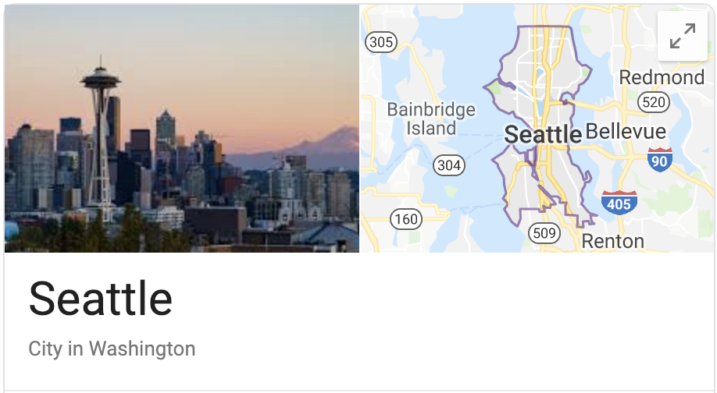



What is Knowledge Base?
Triples as (subject, predicate, object)
(Amazon, /organization/company/headquarters, Seattle)
(Amazon, /organization/company/founded, July 05, 1994)
(Amazon, /organization/company/product, Amazon Alexa)
(Amazon, /organization/company/subsidiary, Whole Food Market)
July 5, 1994
Founded
Product
Headquarters
Subsidiaries

Slide 3
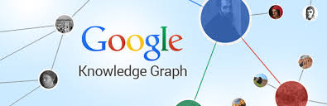


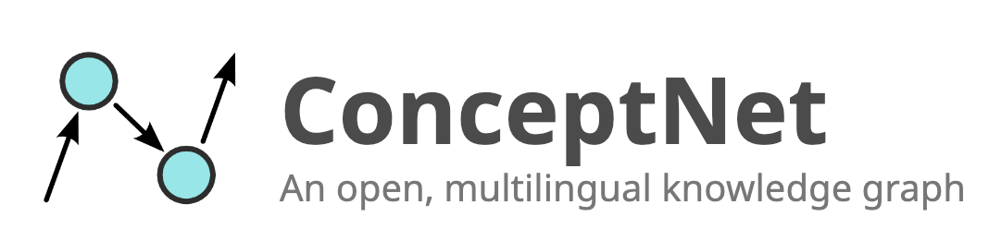
Knowledge Bases and their Applications

Slide 4

Knowledge Bases and their Applications
Come to tomorrow’s keynote

Slide 5
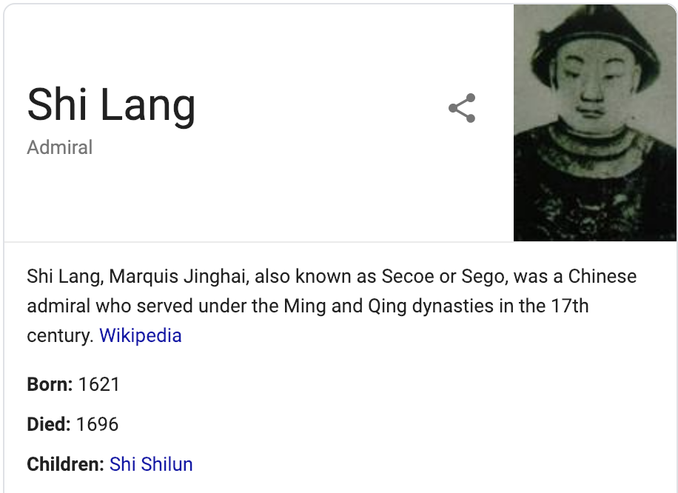


Existing Knowledge Bases are far from complete
E.g., Google Knowledge Graph (70B triples¹) failed to provide enough facts for some search entries.
Facts are largely missing!
Entity not in knowledge base!
Limited Facts for existing entities
1. https://www.pcmag.com/encyclopedia/term/69597/google-knowledge-graph
Notes:
ICDE 2019 is not included in KB;
Missing facts for a (less famous) chinese admiral (Shi Lang, 施琅) in 17th century.

Slide 6
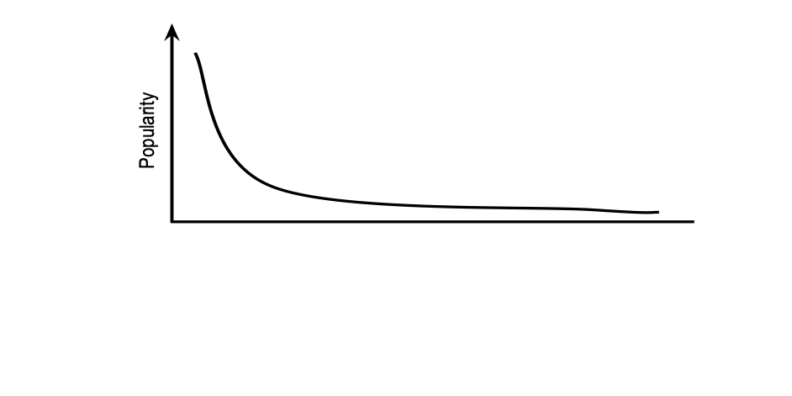


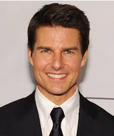


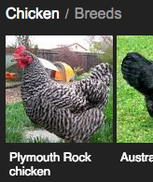




Existing Knowledge Bases are far from complete
Head facts:
Easy to find and validate :)
Missing long tail facts:
Hard to find and validate :(
?
Existing KB
Notes:
Head facts: politics, best selling books, celebrities, albums, famous sightseeings;
Long tail facts: roller coasters, video game characters, chicken breeds, academic conferences.

Slide 7

Existing Knowledge Bases are far from complete
Head facts:
Easy to find and validate :)
How to Fill this Gap?
Missing long tail facts:
Hard to find and validate :(
?
Existing KB
A gap between existing KB and the web sources

Slide 8

Existing attempts to fill the gap
Automated process
Fully automated
Bad accuracy
Trained
Extraction
System
Triples
…

Slide 9

Existing attempts to fill the gap
Automated process
Fully automated
Bad accuracy
Trained
Extraction
System
Triples
…
<learned patterns>
<learned patterns>
<learned patterns>
<learned patterns>
<learned patterns>
<learned patterns>
<learned patterns>
<learned patterns>
<learned patterns>
<learned patterns>
<learned patterns>
<learned patterns>
<learned patterns>
<learned patterns>
<learned patterns>
Manually
selected
sources
Labeled
facts
Triples
A major
bottleneck
Learned
Patterns
Semi-automated
Good accuracy
Industrial standard

Slide 10
Existing attempts to fill the gap
Automated process
Trained
Extraction
System
Triples
…
<learned patterns>
<learned patterns>
<learned patterns>
<learned patterns>
<learned patterns>
<learned patterns>
<learned patterns>
<learned patterns>
<learned patterns>
<learned patterns>
<learned patterns>
<learned patterns>
<learned patterns>
<learned patterns>
<learned patterns>
Manually
selected
sources
Labeled
facts
Triples
Learned
Patterns
Industrial standard

Slide 11
MIDAS: fill the gap by recommending web sources
Automated process
+
Triples
Automatically
selected
sources
Resolve the
bottleneck
MIDAS
<learned patterns>
<learned patterns>
<learned patterns>
<learned patterns>
<learned patterns>
<learned patterns>
<learned patterns>
<learned patterns>
<learned patterns>
<learned patterns>
<learned patterns>
<learned patterns>
<learned patterns>
<learned patterns>
<learned patterns>
Manually
selected
sources
Labeled
facts
Triples
Learned
Patterns
Industrial standard

Slide 12
Example -- Fill the Gap by extracted triples
Automatically extracted facts from website:
http://space.skyrocket.de
<Project Mercury, category, space program>
<Project Mercury, started, 1959>
<Project Mercury, sponsor, NASA>
<Project Gemini, category, space program>
<Project Gemini, sponsor, NASA>
<Altas, category, rocket family>
<Altas, sponsor, NASA>
Notes:
Let’s first take a look at the extracted triples, and see how they can help identify the gap.
Here, we demonstrate a small snippet of triples/facts extracted from a website with space program information. Eg, Project Mercury is a space program started at 1959 by NASA is equivalently represented by three triples/facts. For simplicity, we can equally represent the extracted triples in a table where each row represent facts about one entity, and each column represent a predicate/attribute of the entity.

Slide 13
Example -- Fill the Gap by extracted triples
Automatically extracted facts from website:
http://space.skyrocket.de
<Project Mercury, category, space program>
<Project Mercury, started, 1959>
<Project Mercury, sponsor, NASA>
<Project Gemini, category, space program>
<Project Gemini, sponsor, NASA>
<Altas, category, rocket family>
<Altas, sponsor, NASA>
Each non-empty cell represents a triple
Entity | Category | Started | Sponsor
Project Mercury | space program | 1959 | NASA
Project Gemini | space program |  | NASA
Atlas | rocket family |  | NASA
Notes:
For simplicity, we can equally represent the extracted triples in a table where each row represent facts about one entity, and each column represent a predicate/attribute of the entity.

Slide 14
Example -- Fill the Gap by extracted triples
Automatically extracted facts from website:
http://space.skyrocket.de
<Project Mercury, category, space program>
<Project Mercury, started, 1959>
<Project Mercury, sponsor, NASA>
<Project Gemini, category, space program>
<Project Gemini, sponsor, NASA>
<Altas, category, rocket family>
<Altas, sponsor, NASA>
Present in Existing KB
Entity | Category | Started | Sponsor
Project Mercury | space program | 1959 | NASA
Project Gemini | space program |  | NASA
Atlas | rocket family |  | NASA
Present in Existing KB
Notes:
Highlighted facts

Slide 15
Example -- Fill the Gap by extracted triples
Automatically extracted facts from website:
http://space.skyrocket.de
Entity | Category | Started | Sponsor
Project Mercury | space program | 1959 | NASA
Project Gemini | space program |  | NASA
Atlas | rocket family |  | NASA
Extracted triples describe
the content in a web source
in various granularities

Slide 16
Example -- Fill the Gap by extracted triples
Automatically extracted facts from website:
http://space.skyrocket.de
Entity | Category | Started | Sponsor
Project Mercury | space program | 1959 | NASA
Project Gemini | space program |  | NASA
Atlas | rocket family |  | NASA
Entities with <sponsor = NASA>
represents a slice of content:
Entities that are sponsored by NASA

Slide 17
Example -- Fill the Gap by extracted triples
Automatically extracted facts from website:
http://space.skyrocket.de
Entity | Category | Started | Sponsor
Project Mercury | space program | 1959 | NASA
Project Gemini | space program |  | NASA
Atlas | rocket family |  | NASA
Entities with <sponsor=NASA & category=space program>
represents a slice of content:
Space programs that are sponsored by NASA

Slide 18
Example -- Fill the Gap by extracted triples
Automatically extracted facts from website:
http://space.skyrocket.de
Entity | Category | Started | Sponsor
Project Mercury | space program | 1959 | NASA
Project Gemini | space program |  | NASA
Atlas | rocket family |  | NASA
Entities with <sponsor=NASA & category=rocket family>
represents a slice of content:
Rocket family that are sponsored by NASA
Notes:
The combination of a predicate and a object value forms a slice property; and a conjunction of properties describes and defines the content in a web source, which we call a web source slice. In a web source, there are many slices with different granularity.

Slide 19
Example -- Fill the Gap by extracted triples
Automatically extracted facts from website:
http://space.skyrocket.de
Where
Entity | Category | Started | Sponsor
Project Mercury | space program | 1959 | NASA
Project Gemini | space program |  | NASA
Atlas | rocket family |  | NASA
Present in Existing KB
What
Slice
<sponsored=NASA>
7 triples in total;
2 triples are new.
Slice
<sponsored=NASA &
category=S. P. >
5 triples in total;
0 triples are new.
Slice
<sponsored=NASA &
category=R. F. >
2 triples in total;
2 triples are new.
Notes:
The combination of an attribute and a object value forms a predicate; and a conjunction of predicates describes and defines the content in a web source, which we call a web source slice. In a web source, there are many slices with different granularities. By comparing triples covered by these slices with triples in the existing KB, we are able to find the knowledge gap. This slice, combined with the corresponding web source, suggests what to extract from where for augmenting the existing knowledge base.

Slide 20
The problem
Input:
  Extracted triples and their provenance
  Existing KB
<Project Mercury, category, space program>
<Project Mercury, started, 1959>
<Project Mercury, sponsor, NASA>
<Project Gemini, category, space program>
<Project Gemini, sponsor, NASA>
<Altas, category, rocket family>
<Altas, sponsor, NASA>
Existing KB
Output:
  Web source slices
Slice condition: <sponsored=NASA & category=R. F. >
URL: http://space.skyrocket.de
Problem: find good slices in web sources.

Slide 21

Objective function: web source slice quality
A customizable profit function:
The Profit of a set of slices
The Gain: the number of triples that are new to existing KB.
The Cost: the estimated cost for extracting covered triples
Notes:
Due to time constraints, we skip the details. Please refer to our paper for detailed description.

Slide 22
Algorithm: a two-phrase algorithm
Major challenge: # of slices grows exponentially!
<Project Mercury, category, space program>
<Project Mercury, started, 1959>
<Project Mercury, sponsor, NASA>
<Project Gemini, category, space program>
<Project Gemini, sponsor, NASA>
<Altas, category, rocket family>
<Altas, sponsor, NASA>

Slide 23
Two-phase Algorithm (cont.)
Phrase 1 Derive candidate slices:
  Initialize the hierarchy with slices define dy entities
Project Mercury
Project Gemini
Atlas

Slide 24
Two-phase Algorithm (cont.)
Phrase 1 Derive candidate slices:
  Initialize the hierarchy with slices define dy entities
  Search for candidates in bottom-up fashion
Entities sponsored by NASA
Space program sponsored by NASA
Rocket family sponsored by NASA
Project Mercury
Project Gemini
Atlas

Slide 25
Two-phase Algorithm (cont.)
Phrase 1 Derive candidate slices:
  Initialize the hierarchy with slices define dy entities
  Search for candidates in bottom-up fashion
  Calculate statistics and prune undesired slices on-the-fly
Entities sponsored by NASA
Space program sponsored by NASA
Rocket family sponsored by NASA
Project Mercury
Project Gemini
Atlas

Slide 26

Two-phase Algorithm (cont.)
Phrase 1 Derive candidate slices:
  Initialize the hierarchy with slices define dy entities
  Search for candidates in bottom-up fashion
  Calculate statistics and prune undesired slices on-the-fly
Phrase 2 Select final slices in top-down fashion
Entities sponsored by NASA
START
Space program sponsored by NASA
Rocket family sponsored by NASA
STOP
Project Mercury
Project Gemini
Atlas
Notes:
Due to time constraint, we skipped a lot of details. Please refer to the paper for details.

Slide 27
Algorithm: a two-phrases algorithm
Major challenge: # of slices grows exponentially!
<Project Mercury, category, space program>
<Project Mercury, started, 1959>
<Project Mercury, sponsor, NASA>
<Project Gemini, category, space program>
<Project Gemini, sponsor, NASA>
<Altas, category, rocket family>
<Altas, sponsor, NASA>
Our two-phase solution:
Highly parallelizable
Fast in practice
Highly effective

Slide 28
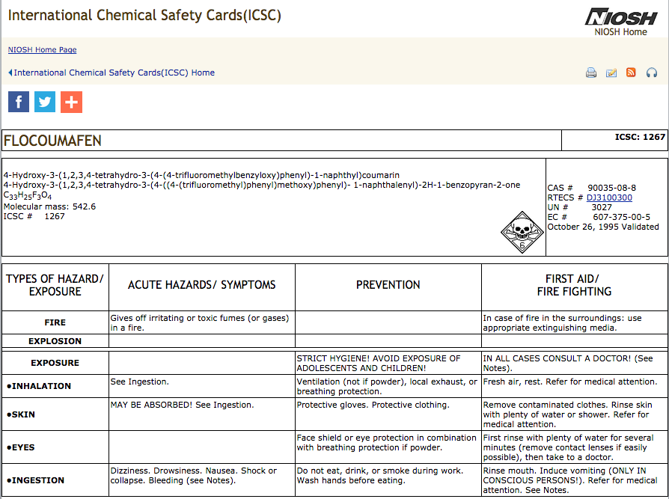
Real-world example (KV extractions)
source: http://www.cdc.gov/niosh/ipcsneng/
Slice: <category=/chemistry/chemical_compound>

Slide 29
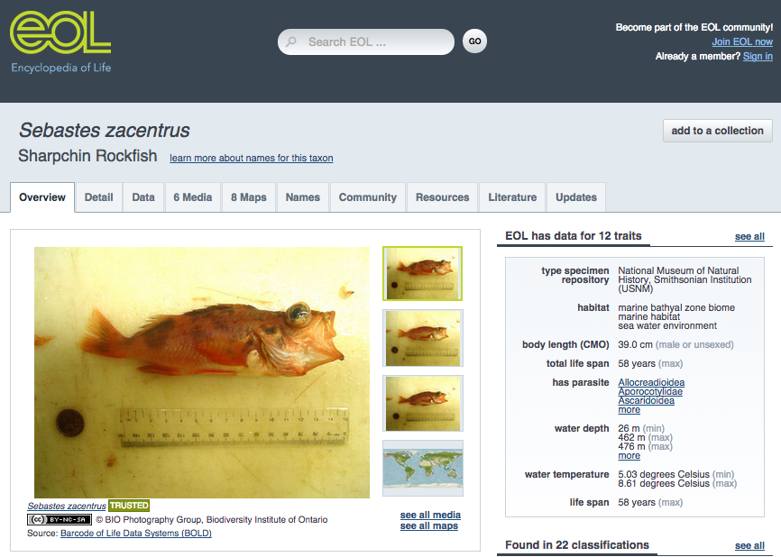
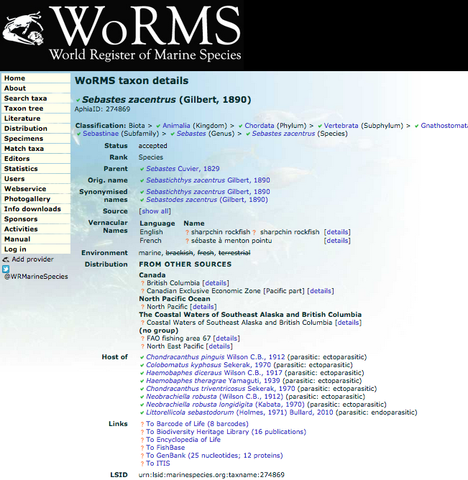
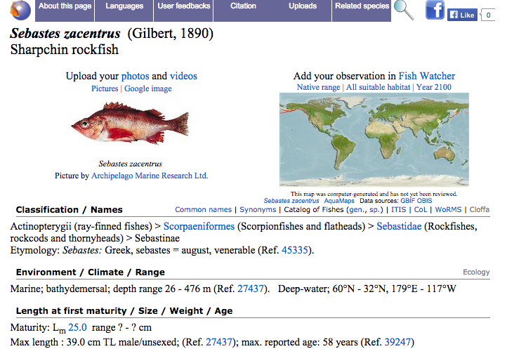
Real-world example cont’ (KV extractions)
source: http://www.marinespecies.org
Slice: <category = biology &
organism classification=marine species>

Slide 30
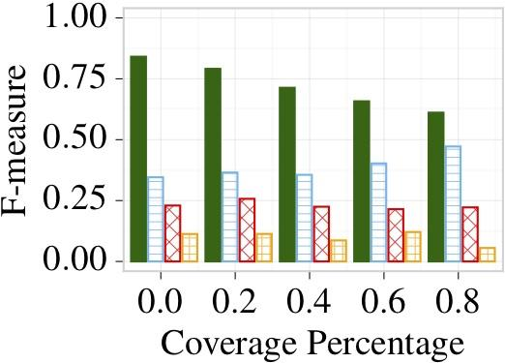
Evaluation
Reverb_slim dataset¹
MIDAS
Agglomerative clustering
Existing KB covers increasing number of triples
859K extracted triples; 33K distinct predicates; from 100 selected web sources

Slide 31
Evaluation
Reverb_slim dataset¹
MIDAS
Greedy
Existing KB covers increasing number of triples
859K extracted triples; 33K distinct predicates; from 100 selected web sources

Slide 32
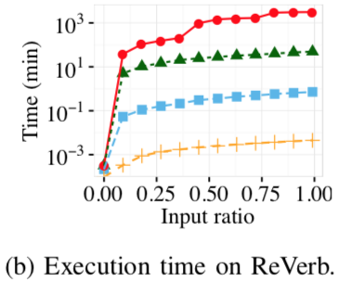
Evaluation
Reverb_slim dataset¹
Agglomerative clustering
MIDAS
Greedy
859K extracted triples; 33K distinct predicates; from 100 selected web sources

Slide 33
Conclusions
MIDAS learns from automatic knowledge extractions to suggest web sources for fine-tuning.
MIDAS is able to derive good web source recommendations for real-world large-scale knowledge base.
However, we should continue our investigation for automatic knowledge extraction! :-)
THANK YOU!

