Slide 1
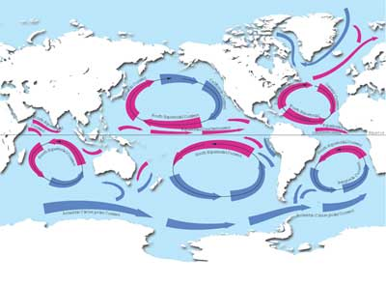
Discovery and Application of Source Dependence
Laure Berti (Universite de Rennes 1), Anish Das Sarma (Stanford), Xin Luna Dong (AT&T), Amelie Marian (Rutgers) , Divesh Srivastava (AT&T)

Slide 2
STRUCTURE IS NOT
THE WHOLE STORY!!!

Slide 3
Challenges that Data Integration Faces
Data Conflicts
Instance Heterogeneity
Structure Heterogeneity

Slide 4


Challenges that Data Integration Faces
Data Conflicts
Instance Heterogeneity
Structure Heterogeneity
Schema matching
Model management
Query answering using views
Information extraction

Slide 5
Challenges that Data Integration Faces
Scissors
Data Conflicts
Instance Heterogeneity
Structure Heterogeneity
Paper Scissors
String matching (edit distance, token-based, etc.)
Object matching (aka. record linkage, reference reconciliation, …)

Slide 6
Challenges that Data Integration Faces
Scissors
Data Conflicts
Instance Heterogeneity
Structure Heterogeneity
Glue
Data fusion
Truth discovery

Slide 7
Existing Solutions Assume Independence of Data Sources
However, advanced technologies, such as the Web, eases copying of data between data sources.
Such copying can significantly affect effectiveness of existing techniques.
Data Conflicts
Instance Heterogeneity
Structure Heterogeneity
Assume INDEPENDENCE
of data sources
Data fusion
Truth discovery
String matching (edit distance, token-based, etc.)
Object matching (aka. record linkage, reference reconciliation, …)
Schema matching
Model management
Query answering using views
Information extraction

Slide 8
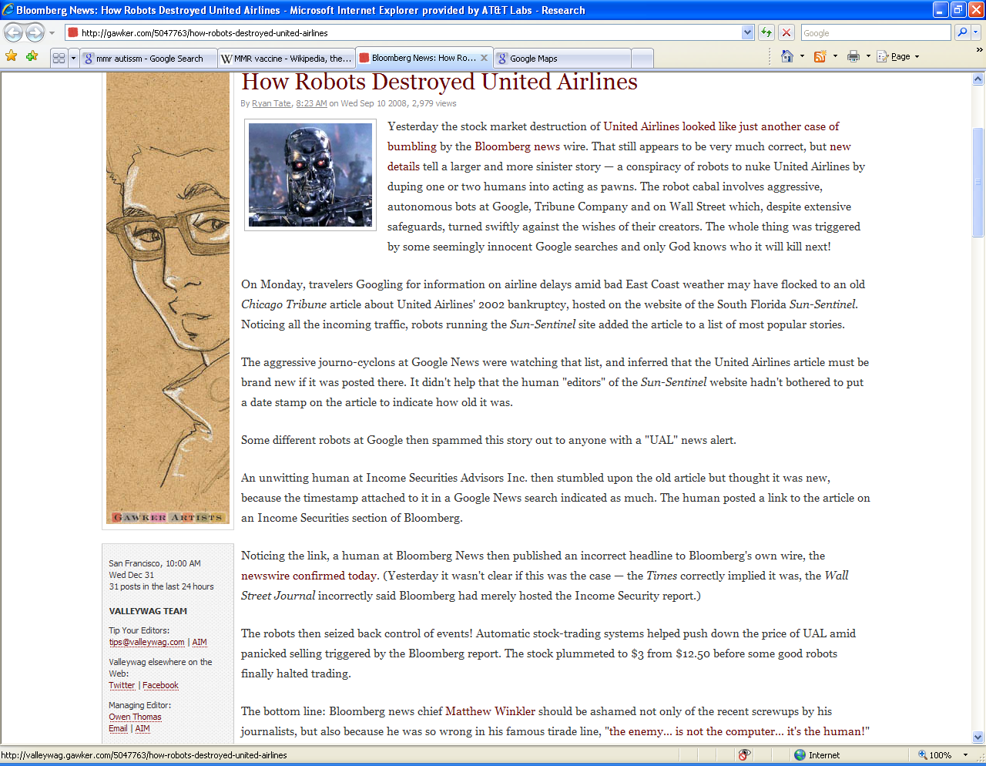
False Information on the Web
UA’s bankruptcy
Chicago Tribune, 2002
Sun-Sentinel.com
Google News
Bloomberg.com
The UAL stock plummeted to $3 from $12.5

Slide 9
How to Find the Truth?
Naïve voting: among conflicting values, choose the one that is asserted by the most number of data sources
However,
“A lie told often enough becomes the truth.”
— Vladimir Lenin
Identify dependence between data sources:
  One source copies from other sources
  Opinion by one source is influenced by others

Slide 10
I. Identifying Dependence bet. Sources
Intuition I: decide dependence (w/o direction)
  Let D1, D2 be data from two sources. D1 and D2 are dependent if
  Pr(D1, D2) <> Pr(D1) * Pr(D2).

Slide 11
Dependence?
Are Source 1 and Source 2 dependent?
Not necessarily
Source 1 on USA Presidents:
1st : George Washington
2nd : John Adams
3rd : Thomas Jefferson
4th : James Madison
…
41st : George H.W. Bush
42nd : William J. Clinton
43rd : George W. Bush
44th: Barack Obama
Source 2 on USA Presidents:
1st : George Washington
2nd : John Adams
3rd : Thomas Jefferson
4th : James Madison
…
41st : George H.W. Bush
42nd : William J. Clinton
43rd : George W. Bush
44th: Barack Obama
✓
✓
✓
✓
✓
✓
✓
✓

Slide 12
Dependence?
-- Common Errors
Are Source 1 and Source 2 dependent?
Very likely
Source 1 on USA Presidents:
1st : George Washington
2nd : Benjamin Franklin
3rd : Tom Jefferson
4th : Abraham Lincoln
…
41st : George W. Bush
42nd : Hillary Clinton
43rd : Mickey Mouse
44th: Barack Obama
Source 2 on USA Presidents:
1st : George Washington
2nd : Benjamin Franklin
3rd : Tom Jefferson
4th : Abraham Lincoln
…
41st : George W. Bush
42nd : Hillary Clinton
43rd : Mickey Mouse
44th: John McCain
✓
✗
✗
✗
✗
✗
✗

Slide 13
I. Identifying Dependence bet. Sources
Intuition I: decide dependence (w/o direction)
  Let D1, D2 be data from two sources. D1 and D2 are dependent if
  Pr(D1, D2) <> Pr(D1) * Pr(D2).
Intuition II: decide copying direction
  Let F be a property function of the data; e.g., accuracy of data. D1 is likely to be dependent on D2 if
  |F(D1 ∩ D2)-F(D1-D2)| > |F(D1 ∩ D2)-F(D2-D1)| .

Slide 14
Dependence?
-- Different Accuracy
Are Source 1 and Source 2 dependent?
S1 more likely to be a copier
Source 1 on USA Presidents:
1st : George Washington
2nd : John Adams
3rd : Thomas Jefferson
4th : Abraham Lincoln
…
41st : George W. Bush
42nd : Hillary Clinton
43rd : George W. Bush
44th: John McCain
Source 2 on USA Presidents:
1st : George Washington
2nd : Benjamin Franklin
3rd : Tom Jefferson
4th : Abraham Lincoln
…
41st : George W. Bush
42nd : Hillary Clinton
43rd : Mickey Mouse
44th: John McCain
✓
✓
✗
✓
✗
✗
✗
✗
✓
✗
✗

Slide 15
II. Applying Dependence bet. Sources in DI
Data Conflicts
Instance Heterogeneity
Structure Heterogeneity
Query
Answering
Data
Fusion
Record
Linkage
Truth discovery
Integrating probabilistic data
Improve record linkage
Distinguish bet wrong values and alter representations
Query optimization
Improve schema matching
Source Recom-mendation
Recommend trustworthy , up-to-date, and independent sources

Slide 16
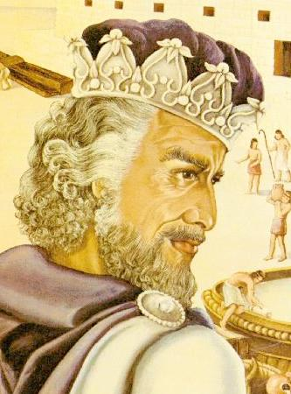
Research Agenda:
Solomon
Data Conflicts
Instance Heterogeneity
Structure Heterogeneity
Discovery
Discovery of copying for update history
Applications
Truth discovery
Record linkage
Source recommendation
…
Discovery of opinion influence in reviews
Discovery of copying for snapshots of data
Query optimization
…

Slide 17
Related Work
Data provenance [Buneman et al., PODS’08]
  Assume knowledge of provenance/lineage
  Focus on effective presentation and retrieval
Opinion pooling [Clemen&Winkler, 1985]
  Combine pr distributions from multiple experts
  Again, assume knowledge of dependence
Detect plagiarism of programs [Schleimer, Sigmod’03]
  Unstructured data

Slide 18
Thank you!

Slide 19
Discovering Dependence Between Sources
Challenges
  Accurate sources: independently provide true values
  Different coverage and expertise:
  specialist srcs v.s. generalist srcs
  Lazy copiers and slow providers
  Partial dependence: copy only a subset of data, reformat some of the copied values, provide some info independently, etc.
  Correlated information: common interest/belief system
  Incomplete observations: hidden data, undiscovered sources, missing updates, etc.
Sub-problems
  Discovery of copying for snapshots of data
    Sharing common false data
    Different accuracy on common data and distinct data
  Discovery of copying for update history
    Same updates in close enough time frame
    Different accuracy on pre-provided data and post-provided data
  Discovery of opinion influence in ratings
  …

Slide 20
App I. Data Fusion w. Source Dependence
Truth discovery
  Decide one true value for each object.
  Challenge: interdependence between truth discovery and dependence detection.
Integrating probabilistic data
  Generate a probabilistic distribution of possible values for each object.
  Challenge: the dependence between sources may also be probabilistic.
Finding consensus opinions in recommendation systems.
Data Conflicts
Instance Heterogeneity
Structure Heterogeneity

Slide 21
App II. Record Linkage w. Source Dependence
Record linkage
  Knowledge of dependence bet. sources can improve record linkage.
Challenges
  Again, interdependence between record linkage and dependence detection.
  Distinguish alternative representations and wrong values; e.g.,
  Xin Dong (official name)
  Luna Dong (alternative)
  Xin Deng (wrong value)
Data Conflicts
Instance Heterogeneity
Structure Heterogeneity

Slide 22
App III. Query Answering w. Source Dependence
Query Answering
  Optimization: avoid visiting sources dependent on, or having been copied by, source already visited.
  Online query answering: first return partially computed answers and then update the answers as querying more sources; need to order sources so as to provide complete and accurate answers from the beginning.
Schema matching
  Knowledge of dependence bet. sources can improve schema matching.
Data Conflicts
Instance Heterogeneity
Structure Heterogeneity

