Slide 1
A Time Machine for Information:
Looking Back to Look Forward
Luna Dong
Google Inc.
Wang-Chiew Tan
University of California, Santa Cruz

Slide 2







Motivation
Electronically available data are growing at a record pace.
  2.5 exabytes according to IBM, 2.5 billion GB of data was generated everyday in 2012.
  --- Source: BBC, “Big Data: Are you ready for blast off?”, 2014.
  Enterprise (personnel records, business transactions, …)
  Public (websites, social media: blogs, tweets, …)
  Required by regulation (financial filings, real estate transactions, …)
Notes:
There are lots of data.

Slide 3

Data is Important
Intelligence and insights can be derived from data.
Bain & Company reports companies that have adopted big data analytics “have gained significant leads over the rest of the corporate world”.
  --- Source: BBC, “Big Data: Are you ready for blast off?”, 2014.
Notes:
And they are important

Slide 4
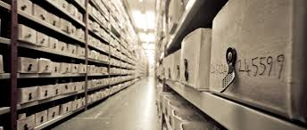
Loooong Data is Even
More Important
Long data – “datasets that have massive historical sweep – taking you from the dawn of civilization to present day.”
--- Source: Wired “Stop hyping big data and start paying attention to ‘long data’ ” Jan 29, 2013.
“Overlooking long data may limit a company’s ability to connect with its customers.”
--- Source: InformationWeek “Big Data, Meet Long Data”, April 1, 2013.

Slide 5
Why is Long Data Important?
Long data provides the right perspective.
Understanding of what is “normal” over time.
  Earth is flat vs. Earth is spherical.
Tertius Chandler’s Four Thousand Years of Urban Growth
  Exhaustive dataset of city populations over millennia. Tremendous potential to learn about ourselves.
Long data provides the potential to audit and understand.
  When did Dr. Z prescribe drug X to patient Y and for how long?
  What stocks did Richie Rich sell/purchase in the first quarter of 2013? Who else bought/sold similar stocks during the same time period?
Notes:
What is normal over time, what is normal at a current time.
Flat earth – until about 425 BC. Herodotus casts doubts on the flat earth belief. After the Greek philosophers Pythagoras, in the 6th century BC, and Parmenides, in the 5th, recognized that the Earth is spherical, the spherical view spread rapidly in the Greek world.

Slide 6
Enrich Data with Long Data
It’s possible to build and maintain a historical profile of just about anything and everything.
  People: corporate officers, public officials, job applicants, …
  Places: countries, cities, properties, …
  Things: proteins, genes, …
Numerous efforts on building historical profiles of entities
  Yago, Microsoft Knowledge Panel, TimeMachine [Althoff et al. KDD 2015] from Google, building integrated profiles (financial case study) [Burdick et al. IEEE Data Eng. Bulletin 2011], Personalized timeline of historic events [Graus et al. OKCon 2013], Twitter timeline generation [Li and Cardie WWW 2014], GDELT, Web Archive, SEC, …
Notes:
Enrich big data with long data.
Give examples. Yago, Microsoft Knowledge panel, KDD paper, … etc. research just starting. (end of section 2.1 in tutorial2.pdf)

Slide 7
Example Time Machine
[Althoff et al. KDD 15]
Timeline about Robert Downey Jr. (from KG)
ZOOM
Box = Event
RDJr was award-nominated for Ally McBeal in 2000.
http://cs.stanford.edu/~althoff/timemachine/
Notes:
Here is one example from … that is focused on understanding the past. We will see more examples on using the past to understand the future towards the end of this tutorial.
It shows the timeline for Robert Downey JR. generated according to Freebase data
Each box is an important event in his life; for example, Ally McBeal
Each event has a description, which we show in the next slide
One can also zoom in to a small time period

Slide 8
Example Time Machine
[Althoff et al. KDD 15]
Timeline about Robert Downey Jr. (from KG)
Event description
Now including e.g. Sherlock Holmes
http://cs.stanford.edu/~althoff/timemachine/
Notes:
After zooming into the recent 10 years, we see secondary events such as Sherlock Holmes
This timeline was generating by selecting events from 1000+ events related to Robert Downey Jr.; the selection maximized importance, content variety, and temporal balance. For temporal balance, we make sure we show important events throughout the timeline, rather than cluttering events at the peak time period.
Unfortunately we don’t yet have for torso or tail entities.
Torso entities/tail entities = entities that are not very well-known

Slide 9
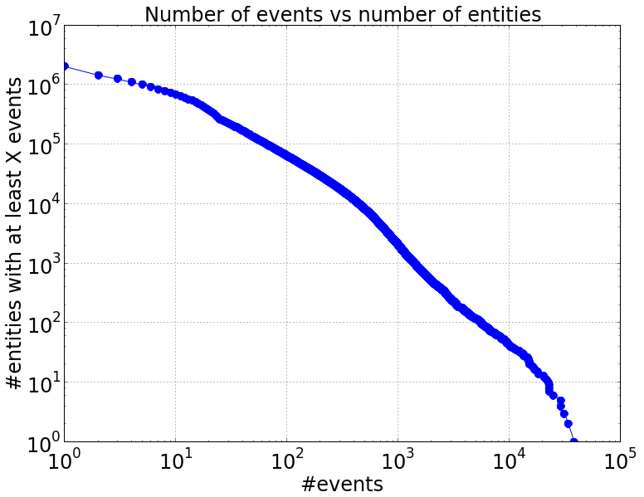
Distribution of #Events
[Althoff et al. KDD 15]
1k+ entities with 1k+ events
680k entities with 10+ events
http://cs.stanford.edu/~althoff/timemachine/
Notes:
But the timeline will only be interesting and informative when we have a lot of events for every entity and when the information is accurate. Unfortunately we don’t yet have for torso or tail entities (entities on the left-hand side). The majority has no more than 100 events.

Slide 10

Prevalent Method for Keeping Long Data
Data archival: Keep a copy of every meaningful snapshot of dynamic data. E.g., Internet Archive
Does not link or fuse entities across different snapshots of different data sources.
Notes:
Give examples. Internet archive. LOCKS system.

Slide 11
The Challenges
Create an integrated view of data (long or not)
  Big
  Inconsistent and imprecise
  Distributed
Create a time machine for data:
  Allows one to understand when a fact is true, for how long, and even when the fact was discovered.
Focus of this tutorial:
  How to extract, link, and fuse temporal data?
Notes:
Add “definition” of what we mean by building a time machine. Timeline to support search and exploration or to predict the trend. Focus on how to collect the data.

Slide 12

A Typical (Temporal) Data Integration Pipeline
Archive
Tooling for analysis (e.g., query, visualization, explanations)
Mapping &
Exchange
Cleaning
Linking
Fusion
Extraction
Unstructured
data sources
Structured data
Structured data
Legend
User input
Flow of data
Notes:
Emphasize this is not an absolute pipeline. Modules can occur in a different order and may be repeated. We think of fusion as part of cleaning in our context although they may be separate steps.

Slide 13
Roadmap
Introduction and Motivation
Connecting back to Temporal Databases
Extraction
Linking
Fusion
Conclusion

Slide 14
Connecting back to
Temporal Databases

Slide 15
Temporal Databases
Motivated also by the need to keep historical data. E.g., Needed by almost every business for legal reasons.
Conventional DBs:
  DB captures only the current state.
  Transactions update the database to a new state. Old state is not kept.
Temporal DBs:
  Time is central to the DB system. DB captures current and past states.
  Retrieval to past states (i.e., snapshots).

Slide 16
Temporal Databases (cont’d)
Significant prior work on temporal databases and temporal query languages.
E.g., Temporal DBs [Snodgrass, Ahn 86], TSQL2 [Snodgrass 95], [Chomicki and Toman 05], …
Bi-temporal databases
  DB2 10, Oracle 12c Flashback/Total Recall, SAP HANA, Teradata, …
  Temporal features can be found in SQL:2011.
Notes:
Bi temporal databases were introducted to keep track of two notions of time (mostly needed for business or legal reasons). It is not important to know when Anna owns her new car but when she informed her car insurance when she bought her new car.

Slide 17
Bi-temporal Databases
Two notions of time:
Application time (aka Valid time):
  The time a fact is true in the real world.
System time (aka Transaction time):
  The time a fact is entered into a database system.
  Can only increase.
See Temporal database entries for Encyclopedia of Database Systems, 2009. [Jensen, Snodgrass 09]
Bi-temporal dbs not an immediate fit for temporal data integration.

Slide 18

Social Media Example
Anna’s
Tweet
March 28, 11.01am. Anna: I am at SFMOMA …
Integrated profile of Anna’s timeline and location on March 28:
11.01-12noon: @SFMoma.
12noon-1.15pm: @Fleur De Lys.
1.15pm onwards: @SFMoma.
Anna’s
Tweet
March 28, 1.15pm.
Anna: At SFMOMA enjoying the Matisse!
Jessica’s blog
I met Anna at Fleur De Lys on March 28 at 12 noon for lunch… enjoyed a delicious Chocolate Tartlet!
Notes:
Make retrieve time the same as tweet time.

Slide 19


Where was Anna on March 28?
Anna: Twitter
Anna: Twitter
Jessica’s blog
1
@SFMoma
Since: Mar 28, 11:01am
Extracted: Mar 30, 12pm
2
@SFMoma
Since: Mar 28, 1:15pm
Extracted: Mar 30, 2pm
3
Anna@Fleur De Lys
Since: Mar 28, 12noon
Extracted: Mar 29
Use bitemporal databases to form an integrated profile of Anna’s timeline and location from pieces of information above.
Match “Since” to valid time, “Retrieved” to transaction time.

Slide 20
Where was Anna on March 28?
Anna: Twitter
Anna: Twitter
Jessica’s blog
1
@SFMoma
Valid: Mar 28, 11.01am
Trans.: Mar 30, 12pm
2
@SFMoma
Valid: Mar 28, 1.15pm
Trans.: Mar 30, 2pm
3
Anna@Fleur De Lys
Valid: Mar 28, 12noon
Trans.: Mar 29
Use bitemporal databases to form an integrated profile of Anna’s timeline and location from pieces of information above.
Match “Since” to valid time, “Retrieved” to transaction time.
Assume information is entered into bitemporal database the moment it was retrieved.
Assume later information (i.e., information with later valid time) takes precedence.
3
1
2
Notes:
Last bullet: What this means is that you trust information with a later transaction timestamp. If you have to decide between whether Anna is at location A or B at a time instant, pick the one with a later transaction time stamp.

Slide 21
Where is Anna on March 28? (cont’d)
This transaction occurred on Mar 29.
Jessica’s blog
3
Anna@Fleur De Lys
Valid: Mar 28, 12noon
Transaction: Mar 29
UPDATE DB FOR PORTION OF BUSINESS_TIME
FROM ’Mar 28 12:00pm’ to CURRENT DATE
SET LOCATION= ’Fleur Dy Lys’,
WHERE NAME = ’Anna’
VALID TIME
Name | Location | Valid. S | Valid. E | Trans. S | Trans. E
Anna | Fleur De Lys | Mar 28 12pm | --- | Mar 29 | ---

Slide 22
Where is Anna on March 28? (cont’d)
This transaction occurred on Mar 30, 12pm.
Anna: Twitter
1
@SFMoma
Valid: Mar 28, 11.01am
Trans.: Mar 30, 12pm
UPDATE DB FOR PORTION OF BUSINESS_TIME
FROM ’Mar 28 11:01am’ to ‘Mar 28 12:00pm’
SET LOCATION= ’SFMoma’,
WHERE NAME = ’Anna’
1
Application logic outside bi-temporal DBs is required to infer the end time of the valid time interval, if any.

Slide 23
Where is Anna on March 28? (cont’d)
This transaction occurred on Mar 30, 12pm.
Anna: Twitter
1
@SFMoma
Valid: Mar 28, 11.01am
Trans.: Mar 30, 12pm
UPDATE DB FOR PORTION OF BUSINESS_TIME
FROM ’Mar 28 11:01am’ to ‘Mar 28 12:00pm’
SET LOCATION= ’SFMoma’,
WHERE NAME = ’Anna’
1
Name | Location | Valid. S | Valid. E | Trans. S | Trans. E
Anna | Fleur De Lys | Mar 28 12pm | --- | Mar 29 | ---

Slide 24
Where is Anna on March 28? (cont’d)
This transaction occurred on Mar 30, 12pm.
Anna: Twitter
1
@SFMoma
Valid: Mar 28, 11.01am
Trans.: Mar 30, 12pm
UPDATE DB FOR PORTION OF BUSINESS_TIME
FROM ’Mar 28 11:01am’ to ‘Mar 28 12:00pm’
SET LOCATION= ’SFMoma’,
WHERE NAME = ’Anna’
1
Name | Location | Valid. S | Valid. E | Trans. S | Trans. E
Anna | Fleur De Lys | Mar 28 12pm | --- | Mar 29 | Mar 30 12pm
Anna | SFMoma | Mar 28 11:01am | Mar 28 12pm | Mar 30 12pm | ---
Anna | Fleur De Lys | Mar 28 12pm | --- | Mar 30 12pm | ---

Slide 25
Where is Anna on March 28? (cont’d)
Anna: Twitter
This transaction occurred on Mar 30, 2pm.
2
@SFMoma
Valid: Mar 28, 1.15pm
Trans.: Mar 30, 2pm
2
UPDATE DB FOR PORTION OF BUSINESS_TIME
FROM ’Mar 28 1:15pm’ to CURRENT DATE
SET LOCATION= ’SFMoma’
WHERE NAME = ’Anna’
Application logic outside bi-temporal dbs is required to infer the end time of the valid time interval, if any.

Slide 26
Where is Anna on March 28? (cont’d)
Anna: Twitter
This transaction occurred on Mar 30, 2pm.
2
@SFMoma
Valid: Mar 28, 1.15pm
Trans.: Mar 30, 2pm
2
UPDATE DB FOR PORTION OF BUSINESS_TIME
FROM ’Mar 28 1:15pm’ to CURRENT DATE
SET LOCATION= ’SFMoma’
WHERE NAME = ’Anna’
Name | Location | Valid. S | Valid. E | Trans. S | Trans. E
Anna | Fleur De Lys | Mar 28 12pm | --- | Mar 29 | Mar 30 12pm
Anna | SFMoma | Mar 28 11:01am | 03/28/15 12pm | Mar 30 12pm | ---
Anna | Fleur De Lys | Mar 28 12pm | --- | Mar 30 12pm | Mar 30 2pm
Anna | Fleur De Lys | Mar 28 12pm | 03/28/15 1:15pm | Mar 30 2pm | ---
Anna | SFMoma | Mar 28 1:15pm | --- | Mar 30 2pm | ---

Slide 27
Adjustments Based on Application Logic
Jessica’s blog
Anna@Fleur De Lys
Valid: Mar 28, 12noon
Transaction: Mar 29
Valid time
Mar 28 1:15pm
Mar 28 12pm
Fleur De Lys
Mar 28 11:01am
Mar 29
Mar 30 12pm
Mar 30 2pm
Transaction time

Slide 28
Adjustments Based on Application Logic
Jessica’s blog
Anna@Fleur De Lys
Valid: Mar 28, 12noon
Transaction: Mar 29
Valid time
Mar 28 1:15pm
Anna: Twitter
@SFMoma
Valid: Mar 28, 11.01am
Trans.: Mar 30, 12pm
Mar 28 12pm
Fleur De Lys
SFMoma
Mar 28 11:01am
Mar 29
Mar 30 12pm
Mar 30 2pm
Transaction time

Slide 29
Adjustments Based on Application Logic
Jessica’s blog
Anna@Fleur De Lys
Valid: Mar 28, 12noon
Transaction: Mar 29
Valid time
SFMoma
Mar 28 1:15pm
Anna: Twitter
@SFMoma
Valid: Mar 28, 11.01am
Trans.: Mar 30, 12pm
Mar 28 12pm
Fleur De Lys
SFMoma
Anna: Twitter
Mar 28 11:01am
@SFMoma
Valid: Mar 28, 1.15pm
Trans.: Mar 30, 2pm
Mar 29
Mar 30 12pm
Mar 30 2pm
Transaction time

Slide 30
Where was Anna on March 28?
Anna’s profile is adjusted based on preferences and constraints as new information arrives.
  Prefer: information with a later valid timestamp.
  Temporal Key Constraint: Anna can only be at one location at any time point.
Notes:
If we prefer information from Twitter all the time, then we will never conclude that Anna was at Fleur Dy Lys at any time instant. She is at SFMoma all the time.

Slide 31
Other Considerations
What about other preferences and constraints?
  Prefer information from one source to another.
  Prefer information with a later transaction time.
  Prefer information authored by A, otherwise prefer information with a later timestamp.
  A person can have at most one phone number before 2000, one or more phone numbers after 2000.
Are the results of preference-based integration identical?
Coming soon in this tutorial: Fusion/Cleaning.
Notes:
If we prefer information from Twitter all the time, then we will never conclude that Anna was at Fleur De Lys at any time instant. She is at SFMoma all the time.

Slide 32
Desiderata – Beyond Bi-temporal DBs
Declarative specification of (temporal) preferences and constraints.
  Avoid additional application logic over bi-temporal databases.
  Beyond bi-temporal databases.
Obtain the same integrated outcome regardless of order of integration.
Talk today:
  “Preference-aware Integration of Temporal Data”
  Alexe, Roth, T…
  Research Session 6 (Kings 2): Information Integration.

Slide 33
Extraction

Slide 34


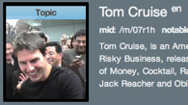


Extraction for Conventional Data
Distant supervision
  Training
  Extraction
Pattern 1: X “born” Y
→ (X, /people/person
/date_of_birth, Y)
(Brad Pitt, /people/person/date_of_birth, 12/18/1963
Notes:
One popular method to extract facts from texts and DOM trees is Distant Supervision
Phase I. Training
- From Freebase we know Tom Cruise has date of birth 7/3/1962
From the sentence in Wikipedia, we see the mention of “Tom Cruise” and “July 3, 1962”.
After seeing a lot of positive and negative examples, we learn Pattern 1
Phase II. Inference
When we see another sentence “XXX, (born YYY)” we apply the model and extract (XXX, date_of_birth, YYY)

Slide 35
Why NOT Immediately Working for Temporal Data?
Need to identify explicit and implicit occurrences of temporal phrases in text.
  “On May 15, ….”, “Last week, …”
Difficult to correctly associate entity mentions with time/time interval, even if explicit.
  “Bob visited Hawaii last year.”
  “At the same time last year, Bob’s car broke down. <long story about how Bob found bought a new car, found a new job, relocated> He moved to San Francisco soon after.”
Editing time provides extra clue. E.g., Wikipedia
Notes:
Explicit: On the 3rd Sunday of March… still explicit but less direct.
The previous example assumes that the entities and time are identified and known to be associated somehow.
Text (e.g., news, emails, social media) contains vast amount of information centered around entities (e.g., people, companies …) over time.
Log entries of changes.

Slide 36
YAGO’s Temporal Fact Extraction:
A Case Study [Wang et al., ACL 2012]
Goal: Automate the construction of large knowledge bases with facts that may be ephemeral.
Extract facts involving two entities and a temporal expression. E.g.,
  WorksForClub(Beckham, RMadrid)@[2003,2008)
  Beckham played for Real Madrid from 2003 to 2007.
Notes:
This work does not really address all the issues we raised earlier but …
only going to focus on one case study to give a sense of what is an example process of temporal fact extraction. A very high level overview.

Slide 37
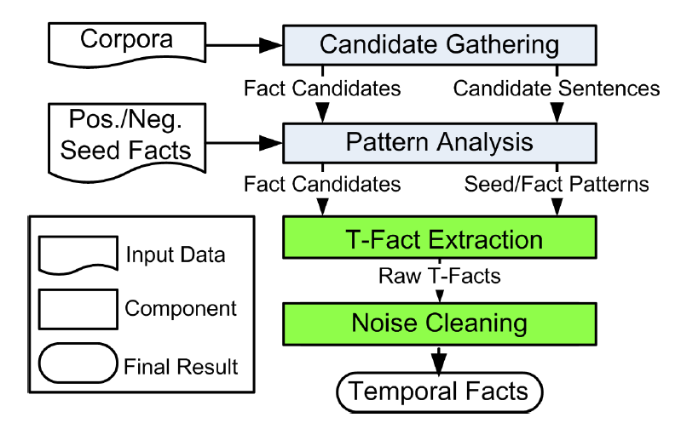
System Overview: A 4-step Process
Notes:
Four phases:
Collect candidate sentences
Mines patterns from candidate sentences
Extracts temporal facts from sentences utilizing patterns
Cleaning: remove noisy facts by enforcing constraints

Slide 38
System Overview: A 4-step process
1. Candidate Fact Generation
  Input: Corpus
  Output: All sentences comprising of at least 2 entities and a temporal expression.
YAGO is used for entity recognition and disambiguation. [Hoffart et al. EMNLP 2011]

Slide 39
System Overview: A 4-step process
2. Pattern Analysis:
  A pattern is an n-gram based feature vector.
  Formed by replacing entities with their types. E.g.,
    “Beckham signed for Real Madrid from Manchester United in 2003.” becomes
    “<SoccerPlayer> sign for <Club> from …”
Notes:
Strong patterns are patterns above a minimum threshold.

Slide 40
System Overview: A 4-step process
2. Pattern Analysis (cont’d):
  Input: Positive/Negative seed facts, candidate sentences.
    Seed facts= valid/incorrect fact of the relation. (Provided)
  Output: Fact candidates, seed/fact patterns.
    Strength of a seed pattern = a function of frequency that pattern occurs w.r.t. positive seed facts and frequency that pattern occurs w.r.t. negative seed.
    Entity pairs that occurs in strong patterns are fact candidates for the next stage.
Notes:
Candidate sentences are from previous step.
Seed facts. Positive seed and negative seed facts are provided as part of the input. Used to determine the strength of a pattern.
Strong patterns are patterns above a minimum threshold.

Slide 41
System Overview: A 4-step process
3. T-Fact Extraction:
  Raw T-facts extracted using Label Propagation method of [Talukdar, Crammer, PKDD 09] and [Wang et al., CIKM 11].
  E.g., WorksForClub(Beckham, RMadrid)@[2003,2008), WorksForClub(Beckham, LAGalaxy)@[2003-2012).
Notes:
Positive seed and negative seed facts are derived by humans.
Strong patterns are patterns above a minimum threshold.

Slide 42
System Overview: A 4-step process
4. Cleaning of Fact Candidates:
  Compute a consistent subset of T-facts w.r.t. temporal constraints. E.g.,
    Intra-fact constraints: E.g., Joining a sports club before leaving a sports club.
    Inter-fact constraints: E.g., A person is married only to one other person at any point in time.
    Done by an Integer Linear Program (ILP) formulation.

Slide 43
Linkage

Slide 44
Linkage for Conventional Data—Three Steps
Input: A set of records

Slide 45
Linkage for Conventional Data—Three Steps
Each block consists of records that MAY refer to the same entity
Blocking
Pairwise Matching
Clustering

Slide 46
Linkage for Conventional Data—Three Steps
Blocking
Pairwise Matching
Clustering
Each line indicates that the two records are similar

Slide 47
Linkage for Conventional Data—Three Steps
Blocking
Pairwise Matching
Clustering
Output: A set of clusters, each representing a real-world entity

Slide 48

Why NOT Working for Temporal Data?
DBLP
r1: Xin Dong
R. Polytechnic Institute
r4: Xin Luna Dong
University of Washington
r2: Xin Dong
University of Washington
r5: Xin Luna Dong
AT&T Labs-Research
r3: Xin Dong
University of Washington
r6: Xin Luna Dong
AT&T Labs-Research
1991
2004
2005
2006
2007
2008
2009
2010
2011
Who authored what?
r11: Dong Xin
Microsoft Research
r9: Dong Xin
Microsoft Research
r12: Dong Xin
Microsoft Research
r10: Dong Xin
University of Illinois
r7: Dong Xin
University of Illinois
r8:Dong Xin
University of Illinois

Slide 49
Why NOT Working for Temporal Data?
DBLP
r1: Xin Dong
R. Polytechnic Institute
r4: Xin Luna Dong
University of Washington
Each red circle represents a real-world entity over time
r2: Xin Dong
University of Washington
r5: Xin Luna Dong
AT&T Labs-Research
r3: Xin Dong
University of Washington
r6: Xin Luna Dong
AT&T Labs-Research
1991
2004
2005
2006
2007
2008
2009
2010
2011
Ground Truth
r11: Dong Xin
Microsoft Research
r9: Dong Xin
Microsoft Research
r12: Dong Xin
Microsoft Research
r10: Dong Xin
University of Illinois
r7: Dong Xin
University of Illinois
r8:Dong Xin
University of Illinois

Slide 50
Why NOT Working for Temporal Data?
DBLP
r1: Xin Dong
R. Polytechnic Institute
r4: Xin Luna Dong
University of Washington
Each red circle represents a real-world entity over time
r2: Xin Dong
University of Washington
r5: Xin Luna Dong
AT&T Labs-Research
r3: Xin Dong
University of Washington
r6: Xin Luna Dong
AT&T Labs-Research
1991
2004
2005
2006
2007
2008
2009
2010
2011
Traditional solution 1:
high value consistency
r11: Dong Xin
Microsoft Research
r9: Dong Xin
Microsoft Research
r12: Dong Xin
Microsoft Research
r10: Dong Xin
University of Illinois
r7: Dong Xin
University of Illinois
r8:Dong Xin
University of Illinois

Slide 51
Why NOT Working for Temporal Data?
DBLP
r1: Xin Dong
R. Polytechnic Institute
r4: Xin Luna Dong
University of Washington
Each red circle represents a real-world entity over time
r2: Xin Dong
University of Washington
r5: Xin Luna Dong
AT&T Labs-Research
r3: Xin Dong
University of Washington
r6: Xin Luna Dong
AT&T Labs-Research
1991
2004
2005
2006
2007
2008
2009
2010
2011
Traditional solution 2:
using similar names
r11: Dong Xin
Microsoft Research
r9: Dong Xin
Microsoft Research
r12: Dong Xin
Microsoft Research
r10: Dong Xin
University of Illinois
r7: Dong Xin
University of Illinois
r8:Dong Xin
University of Illinois

Slide 52
But There ARE Opportunities
Smooth transition in one attribute, despite evolution of another
ID | Name | Affiliation | Co-authors | Year
r1 | Xin Dong | R. Polytechnic Institute | Wozny | 1991
r2 | Xin Dong | University of Washington | Halevy, Tatarinov | 2004
r7 | Dong Xin | University of Illinois | Han, Wah | 2004
r3 | Xin Dong | University of Washington | Halevy | 2005
r4 | Xin Luna Dong | University of Washington | Halevy, Yu | 2007
r8 | Dong Xin | University of Illinois | Wah | 2007
r9 | Dong Xin | Microsoft Research | Wu, Han | 2008
r10 | Dong Xin | University of Illinois | Ling, He | 2009
r11 | Dong Xin | Microsoft Research | Chaudhuri, Ganti | 2009
r5 | Xin Luna Dong | AT&T Labs-Research | Das Sarma, Halevy | 2009
r6 | Xin Luna Dong | AT&T Labs-Research | Naumann | 2010
r12 | Dong Xin | Microsoft Research | He | 2011

Slide 53
But There ARE Opportunities
Erratic changes in an attribute value are quite unlikely
ID | Name | Affiliation | Co-authors | Year
r1 | Xin Dong | R. Polytechnic Institute | Wozny | 1991
r2 | Xin Dong | University of Washington | Halevy, Tatarinov | 2004
r7 | Dong Xin | University of Illinois | Han, Wah | 2004
r3 | Xin Dong | University of Washington | Halevy | 2005
r4 | Xin Luna Dong | University of Washington | Halevy, Yu | 2007
r8 | Dong Xin | University of Illinois | Wah | 2007
r9 | Dong Xin | Microsoft Research | Wu, Han | 2008
r10 | Dong Xin | University of Illinois | Ling, He | 2009
r11 | Dong Xin | Microsoft Research | Chaudhuri, Ganti | 2009
r5 | Xin Luna Dong | AT&T Labs-Research | Das Sarma, Halevy | 2009
r6 | Xin Luna Dong | AT&T Labs-Research | Naumann | 2010
r12 | Dong Xin | Microsoft Research | He | 2011

Slide 54
But There ARE Opportunities
Typically, there is continuity of history; i.e., no big gaps in time
ID | Name | Affiliation | Co-authors | Year
r1 | Xin Dong | R. Polytechnic Institute | Wozny | 1991
r2 | Xin Dong | University of Washington | Halevy, Tatarinov | 2004
r7 | Dong Xin | University of Illinois | Han, Wah | 2004
r3 | Xin Dong | University of Washington | Halevy | 2005
r4 | Xin Luna Dong | University of Washington | Halevy, Yu | 2007
r8 | Dong Xin | University of Illinois | Wah | 2007
r9 | Dong Xin | Microsoft Research | Wu, Han | 2008
r10 | Dong Xin | University of Illinois | Ling, He | 2009
r11 | Dong Xin | Microsoft Research | Chaudhuri, Ganti | 2009
r5 | Xin Luna Dong | AT&T Labs-Research | Das Sarma, Halevy | 2009
r6 | Xin Luna Dong | AT&T Labs-Research | Naumann | 2010
r12 | Dong Xin | Microsoft Research | He | 2011

Slide 55
Key Solution 1: Time Decay [Li et al., VLDB’11]
High penalty for value disagreement over a short time period
ID | Name | Affiliation | Co-authors | Year
r1 | Xin Dong | R. Polytechnic Institute | Wozny | 1991
r2 | Xin Dong | University of Washington | Halevy, Tatarinov | 2004
r7 | Dong Xin | University of Illinois | Han, Wah | 2004
r3 | Xin Dong | University of Washington | Halevy | 2005
r4 | Xin Luna Dong | University of Washington | Halevy, Yu | 2007
r8 | Dong Xin | University of Illinois | Wah | 2007
r9 | Dong Xin | Microsoft Research | Wu, Han | 2008
r10 | Dong Xin | University of Illinois | Ling, He | 2009
r11 | Dong Xin | Microsoft Research | Chaudhuri, Ganti | 2009
r5 | Xin Luna Dong | AT&T Labs-Research | Das Sarma, Halevy | 2009
r6 | Xin Luna Dong | AT&T Labs-Research | Naumann | 2010
r12 | Dong Xin | Microsoft Research | He | 2011

Slide 56
Key Solution 1: Time Decay [Li et al., VLDB’11]
Lower penalty for value disagreement over a long time period
ID | Name | Affiliation | Co-authors | Year
r1 | Xin Dong | R. Polytechnic Institute | Wozny | 1991
r2 | Xin Dong | University of Washington | Halevy, Tatarinov | 2004
r7 | Dong Xin | University of Illinois | Han, Wah | 2004
r3 | Xin Dong | University of Washington | Halevy | 2005
r4 | Xin Luna Dong | University of Washington | Halevy, Yu | 2007
r8 | Dong Xin | University of Illinois | Wah | 2007
r9 | Dong Xin | Microsoft Research | Wu, Han | 2008
r10 | Dong Xin | University of Illinois | Ling, He | 2009
r11 | Dong Xin | Microsoft Research | Chaudhuri, Ganti | 2009
r5 | Xin Luna Dong | AT&T Labs-Research | Das Sarma, Halevy | 2009
r6 | Xin Luna Dong | AT&T Labs-Research | Naumann | 2010
r12 | Dong Xin | Microsoft Research | He | 2011

Slide 57
Key Solution 1: Time Decay [Li et al., VLDB’11]
High reward for value agreement across a small time gap
ID | Name | Affiliation | Co-authors | Year
r1 | Xin Dong | R. Polytechnic Institute | Wozny | 1991
r2 | Xin Dong | University of Washington | Halevy, Tatarinov | 2004
r7 | Dong Xin | University of Illinois | Han, Wah | 2004
r3 | Xin Dong | University of Washington | Halevy | 2005
r4 | Xin Luna Dong | University of Washington | Halevy, Yu | 2007
r8 | Dong Xin | University of Illinois | Wah | 2007
r9 | Dong Xin | Microsoft Research | Wu, Han | 2008
r10 | Dong Xin | University of Illinois | Ling, He | 2009
r11 | Dong Xin | Microsoft Research | Chaudhuri, Ganti | 2009
r5 | Xin Luna Dong | AT&T Labs-Research | Das Sarma, Halevy | 2009
r6 | Xin Luna Dong | AT&T Labs-Research | Naumann | 2010
r12 | Dong Xin | Microsoft Research | He | 2011

Slide 58
Key Solution 1: Time Decay [Li et al., VLDB’11]
Lower reward for value agreement across a big time gap
ID | Name | Affiliation | Co-authors | Year
r1 | Xin Dong | R. Polytechnic Institute | Wozny | 1991
r2 | Xin Dong | University of Washington | Halevy, Tatarinov | 2004
r7 | Dong Xin | University of Illinois | Han, Wah | 2004
r3 | Xin Dong | University of Washington | Halevy | 2005
r4 | Xin Luna Dong | University of Washington | Halevy, Yu | 2007
r8 | Dong Xin | University of Illinois | Wah | 2007
r9 | Dong Xin | Microsoft Research | Wu, Han | 2008
r10 | Dong Xin | University of Illinois | Ling, He | 2009
r11 | Dong Xin | Microsoft Research | Chaudhuri, Ganti | 2009
r5 | Xin Luna Dong | AT&T Labs-Research | Das Sarma, Halevy | 2009
r6 | Xin Luna Dong | AT&T Labs-Research | Naumann | 2010
r12 | Dong Xin | Microsoft Research | He | 2011

Slide 59
Key Solution 1: Time Decay [Li et al., VLDB’11]
Disagreement decay
  Disagreement decay of attribute A over time ∆t is the probability that an entity changes its A-value within time ∆t.
Agreement decay
  Agreement decay of attribute A over time ∆t is the probability that different entities share the same A-value within time ∆t.

Slide 60
Key Solution 1: Time Decay [Li et al., VLDB’11]
Decay curves of address learnt from European Patent data
Patent records: 1871
Real-world inventors: 359
In years: 1978 - 2003
Disagreement decay
Agreement decay

Slide 61
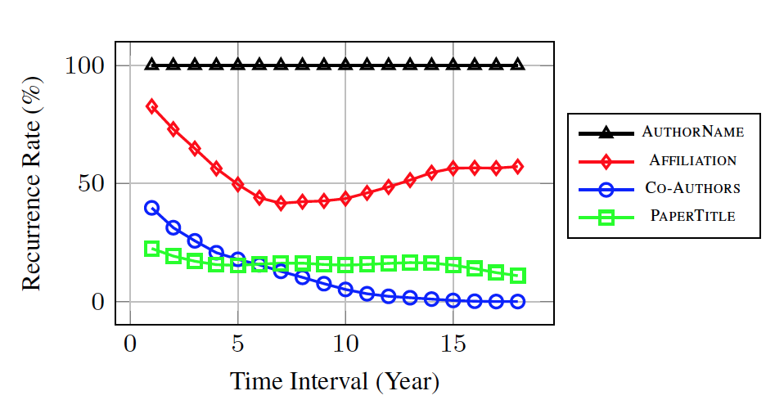
Extensions for Time Decay
Time Decay
[Li et al. VLDB’11]
Recurrence Rate
[Chiang et al. Sigmod’14]
Transition Probability
[Li et al. Sigmod’15]
Recurrence rate learnt from DBLP

Slide 62
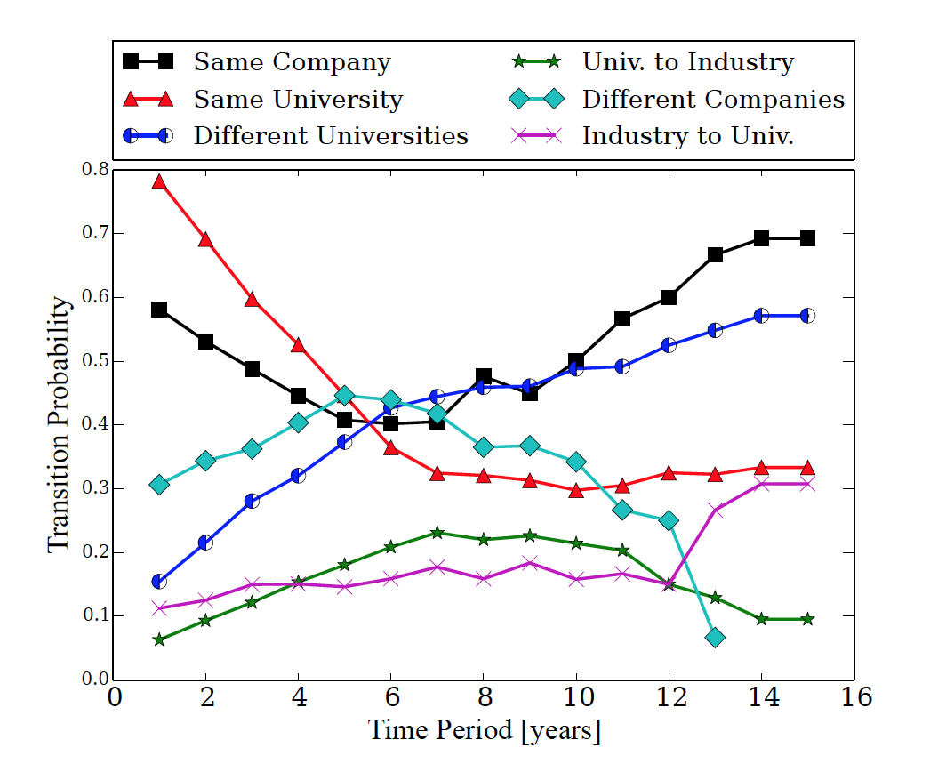
Extensions for Time Decay
Time Decay
[Li et al. VLDB’11]
Recurrence Rate
[Chiang et al. Sigmod’14]
Transition Probability
[Li et al. Sigmod’15]
Transition probabilities learnt from DBLP

Slide 63
Key Solution 2: Two-Stage Temporal Clustering
[Li et al. VLDB’11]
Stage 1. Consider records in temporal order
Stage 2. EM adjustment considering value consistency and record continuity
r7
DongXin@UI -2004
C3
Stage 1
r8
DongXin@UI -2007
r9
DongXin@MSR -2008
C4
r10
DongXin@UI -2009
C5
r11
DongXin@MSR -2009
Put into a different cluster because penalizing erratic changes
r12
DongXin@MSR -2011

Slide 64
Key Solution 2: Two-Stage Temporal Clustering
[Li et al. VLDB’11]
Stage 1. Consider records in temporal order
Stage 2. EM adjustment considering value consistency and record continuity
r7
DongXin@UI -2004
C3
Stage 2
Once r8 is merged to C4, r7 has higher continuity with C4
r8
DongXin@UI -2007
r8 has higher continuity with C4
r9
DongXin@MSR -2008
C4
r10
DongXin@UI -2009
C5
r11
DongXin@MSR -2009
r12
DongXin@MSR -2011
r10 has higher continuity with C4

Slide 65
Extensions for Two-Stage Clustering
Adjusted Binding
[Li et al. VLDB’11]
Static1st, Dynamic 2nd
[Chiang et al.VLDB’14]
Source-Aware Clustering
[Li et al. Sigmod’15]
r7
DongXin@UI -2004
C3
Static
Stage
r8
DongXin@UI -2007
r9
DongXin@MSR -2008
C4
r10
DongXin@UI -2009
r11
DongXin@MSR -2009
r12
DongXin@MSR -2011

Slide 66
Extensions for Two-Stage Clustering
Adjusted Binding
[Li et al. VLDB’11]
Static1st, Dynamic 2nd
[Chiang et al. VLDB’14]
Source-Aware Clustering
[Li et al. Sigmod’15]
r7
DongXin@UI -2004
C3
C3/4
Dynamic
Stage
r8
DongXin@UI -2007
r9
DongXin@MSR -2008
C4
r10
DongXin@UI -2009
r11
DongXin@MSR -2009
r12
DongXin@MSR -2011

Slide 67
Extensions for Two-Stage Clustering
Adjusted Binding
[Li et al. VLDB’11]
Static1st, Dynamic 2nd
[Chiang et al. VLDB’14]
Source-Aware Clustering
[Li et al. Sigmod’15]
r7
DongXin@UI -2004
C3
Stage I
r8
DongXin@UI -2007
r9
DongXin@MSR -2008
C4
r10
DongXin@UI -2009
C5
r11
DongXin@MSR -2009
Put into two different clusters because the record is likely to be stale
r12
DongXin@MSR -2011

Slide 68
Extensions for Two-Stage Clustering
Adjusted Binding
[Li et al. VLDB’11]
Static1st, Dynamic 2nd
[Chiang et al. VLDB’14]
Source-Aware Clustering
[Li et al. Sigmod’15]
r7
DongXin@UI -2004
C3
Stage 2
Transition has high pr
r8
DongXin@UI -2007
r9
DongXin@MSR -2008
C4
r10
DongXin@UI -2009
C5
r11
DongXin@MSR -2009
r12
DongXin@MSR -2011
Transition has high pr, but the value is stale

Slide 69
Key Questions to Ask
Finer-granularity trend: Worthwhile?
  How much benefit?
  How much more expensive?
  Robust to noise?
  What about lack of training data?
Two-stage clustering: Robust?
  How to fix early errors in the later stage?
  Robust to erroneous data?

Slide 70
Fusion and Cleaning

Slide 71
Fusion/Cleaning for Conventional Data—Two Dimensions
Fusion (Multi-Source)
E.g., returning MAX(heights) and AVG(weights).
Rule-based Data Fusion
Truth Discovery
Constraint-based Data Repairing
?
Rule
Based
Learning
Based
E.g., finding the maximum subset of tuples that satisfy a set of given constraints (e.g., CFD)
Cleaning (Single-Source)

Slide 72
Truth Discovery for Conventional Data
 | S1 | S2 | S3
Stonebraker | MIT | UCB | MIT
Dewitt | MSR | MSR | Wisc
Bernstein | MSR | MSR | MSR
Carey | UCI | AT&T | BEA
Halevy | Google | Google | UW

Slide 73
Truth Discovery for Conventional Data
 | S1 | S2 | S3
Stonebraker | MIT | UCB | MIT
Dewitt | MSR | MSR | Wisc
Bernstein | MSR | MSR | MSR
Carey | UCI | AT&T | BEA
Halevy | Google | Google | UW
Vote in favor of values provided by more sources

Slide 74
Truth Discovery for Conventional Data
 | S1 | S2 | S3
Stonebraker | MIT | UCB | MIT
Dewitt | MSR | MSR | Wisc
Bernstein | MSR | MSR | MSR
Carey | UCI | AT&T | BEA
Halevy | Google | Google | UW
Vote in favor of values provided by more sources
Give higher vote to a more trustworthy source

Slide 75
Why NOT Working for Temporal Data?
 | S1 | S2 | S3
Stonebraker (Ѳ, UCB), (02, MIT) | (03, MIT) | (00, UCB) | (01, UCB) (06, MIT)
Dewitt (Ѳ, Wisc), (08, MSR) | (00, Wisc) (09, MSR) | (00, UW) (01, Wisc) (08, MSR) | (01, UW) (02, Wisc)
Bernstein (Ѳ, MSR) | (00, MSR) | (00, MSR) | (01, MSR)
Carey (Ѳ, Propell), (02, BEA), (08, UCI) | (04, BEA) (09, UCI) | (05, AT&T) | (06, BEA)
Halevy (Ѳ, UW), (05, Google) | (00, UW) (07, Google) | (00, Wisc) (02, UW) (05, Google) | (01, Wisc) (06, UW)
Out-of-date!
Out-of-date!
ERR!
Out-of-date!
Slow publishing!
True values can evolve over time
Low-quality data can be caused by different reasons

Slide 76
But There ARE Opportunities
 | S1 | S2 | S3
Stonebraker (Ѳ, UCB), (02, MIT) | (03, MIT) | (00, UCB) | (01, UCB) (06, MIT)
Dewitt (Ѳ, Wisc), (08, MSR) | (00, Wisc) (09, MSR) | (00, UW) (01, Wisc) (08, MSR) | (01, UW) (02, Wisc)
Bernstein (Ѳ, MSR) | (00, MSR) | (00, MSR) | (01, MSR)
Carey (Ѳ, Propell), (02, BEA), (08, UCI) | (04, BEA) (09, UCI) | (05, AT&T) | (06, BEA)
Halevy (Ѳ, UW), (05, Google) | (00, UW) (07, Google) | (00, Wisc) (02, UW) (05, Google) | (01, Wisc) (06, UW)
Update history
Partial order; e.g., single→married→divorced

Slide 77
Key Solution 1. Data Currency
[Fan et al. PODS’11, Fan et al. ICDE’13]
Rule-based Data Fusion
Truth Discovery
Constraint-based Data Repairing
?
 | S1 | S2 | S3
Stonebraker (02, MIT) | MIT | UCB | UCB MIT
Dewitt (08, MSR) | Wisc MSR | UW Wisc MSR | UW Wisc
Bernstein (Ѳ, MSR) | MSR | MSR | MSR
Carey (08, UCI) | BEA UCI | AT&T | BEA
Halevy (05, Google) | UW Google | Wisc UW Google | Wisc UW
Input: Data w/o timestamps
Output: Current values
What if there are even NO timestamps?

Slide 78
Key Solution 1. Data Currency
[Fan et al. PODS’11, Fan et al. ICDE’13]
Rule-based Data Fusion
Truth Discovery
Constraint-based Data Repairing
?
 | S1 | S2 | S3
Stonebraker (02, MIT) | MIT | UCB | UCB MIT
Dewitt (08, MSR) | Wisc MSR | UW Wisc MSR | UW Wisc
Bernstein (Ѳ, MSR) | MSR | MSR | MSR
Carey (08, UCI) | BEA UCI | AT&T | BEA
Halevy (05, Google) | UW Google | Wisc UW Google | Wisc UW
Input: Data w/o timestamps
Output: Current values
Currency constraints; (shameless) e.g., affiliation moves always
  from Univ. to Industry
  from East to West in the same category

Slide 79
Key Solution 2. Preference-Aware Union
[Alexe et al. PVLDB’14]
Rule-based Data Fusion
Truth Discovery
Constraint-based Data Repairing
?
 | S1 | S2 | S3
Stonebraker (Ѳ, UCB), (02, MIT) | (03, MIT) | (00, UCB) | (01, UCB) (06, MIT)
Dewitt (Ѳ, Wisc), (08, MSR) | (00, Wisc) (09, MSR) | (00, UW) (01, Wisc) (08, MSR) | (01, UW) (02, Wisc)
Bernstein (Ѳ, MSR) | (00, MSR) | (00, MSR) | (01, MSR)
Carey (Ѳ, Propell), (02, BEA), (08, UCI) | (04, BEA) (09, UCI) | (05, AT&T) | (06, BEA)
Halevy (Ѳ, UW), (05, Google) | (00, UW) (07, Google) | (00, Wisc) (02, UW) (05, Google) | (01, Wisc) (06, UW)
Input: Data w timestamps
Output: Current values
Always prefer latest update
Alternative: always prefer latest update from S1

Slide 80
Key Solution 3. Temporal Fusion
[Dong et al. VLDB’09]
Exact
ness
Cove
rage
Fresh
ness
Accuracy
How many transitions are captured
How many transitions are
not mis-captured
Rule-based Data Fusion
Truth Discovery
Constraint-based Data Repairing
?
How quickly transitions are captured
Input: Data w. timestamps
Output: Life spans
Mis-capturable
Mis-capturable
Mis-capturable
Mis-capturable
Mis-capturable
UWisc
Capturable
Capturable
Capturable
MSR
Capturable
Dewitt
Ѳ(2000)
2008
UW
⊥
UWisc
S
2003
2005
2007
Mis-captured
Mis-captured
Captured
Coverage = #Captured/#Capturable (e.g., ¼=.25)
Exactness = 1-#Mis-Captured/#Mis-Capturable (e.g., 1-2/5=.6)
Freshness(Δ) = #(Captured w. length<=Δ)/#Captured (e.g., F(0)=0, F(1)=0, F(2)=1/1=1…)

Slide 81
Key Solution 3. Temporal Fusion
[Dong et al. VLDB’09]
Rule-based Data Fusion
Truth Discovery
Constraint-based Data Repairing
?
Decide the initial
value v₀
(Bayesian model)
Decide the next transition (t,v)
(Bayesian model)
Terminate when no more transition
Input: Data w. timestamps
Output: Life spans
Quality (CEF-measure) computation
Lifespan
Discovery

Slide 82
Key Solution 3. Temporal Fusion
[Dong et al. VLDB’09]
Rule-based Data Fusion
Truth Discovery
Constraint-based Data Repairing
?
 | S1 | S2 | S3
Halevy (Ѳ, UW), (05, Google) | (00, UW) (07, Google) | (00, UWisc) (02, UW) (05, Google) | (01, UWisc) (06, UW)
Lifespan for Halevy and CEF-measure for S1 and S2
Rnd | Halevy | C(S1) | E(S1) | F(S1,0) | F(S1,1) | C(S2) | E(S2) | F(S2,0) | F(S2,1)
0 |  | .99 | .95 | .1 | .2 | .99 | .95 | .1 | .2
1 | (Ѳ, Wisc) (2002, UW) (2003, Google) | .97 | .94 | .27 | .4 | .57 | .83 | .17 | .3
2 | (Ѳ, UW) (2002, Google) | .92 | .99 | .27 | .4 | .64 | .8 | .18 | .27
3 | (Ѳ, UW) (2005, Google) | .92 | .99 | .27 | .4 | .64 | .8 | .25 | .42
Input: Data w. timestamps
Output: Life spans
Higher completeness, exactness and freshness

Slide 83
Extensions for Temporal Fusion
Temporal Fusion
[Dong et al. VLDB’09]
Dynamic Copy Detection [Dong et al. VLDB’09]
Semi-Makovian
[Pal et al.WWW’12]
Rule-based Data Fusion
Truth Discovery
Constraint-based Data Repairing
?
 | S1 | S2 | S3 | S4 | S5
Stonebraker (00, UCB), (02, MIT) | (03, MIT) | (00, UCB) | (01, UCB) (06, MIT) | (05, MIT) | (03, UCB) (05, MS)
Dewitt (00, Wisc), (08, MSR) | (00, Wisc) (09, MSR) | (00, UW) (01, Wisc) (08, MSR) | (01, UW) (02, Wisc) | (05, Wisc) | (03, UW) (05, ⊥) (07, Wisc)
Bernstein (00, MSR) | (00, MSR) | (00, MSR) | (01, MSR) | (07, MSR) | (03, MSR)
Carey (00, Propell), (02, BEA), (08, UCI) | (04, BEA) (09, UCI) | (05, AT&T) | (06, BEA) | (07, BEA) | (07, BEA)
Halevy (00, UW), (05, Google) | (00, UW) (07, Google) | (00, Wisc) (02, UW) (05, Google) | (01, Wisc) (06, UW) | (05, UW) | (03, Wisc) (05, Google) (07, UW)
Input: Data w. timestamps
Output:
Life spans
Copying
Copying is likely if 1) They make common mistakes
2) Overlapping updates are performed after real values have changed

Slide 84
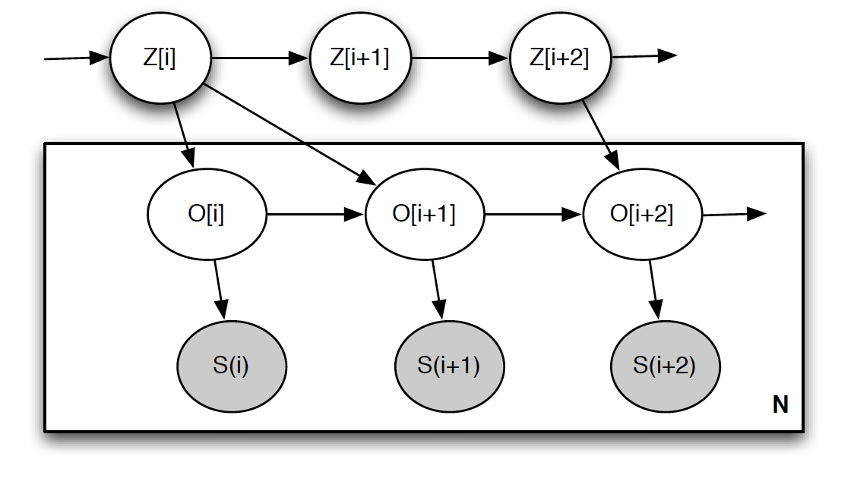
Extensions for Temporal Fusion
Temporal Fusion
[Dong et al. VLDB’09]
Dynamic Copy Detection [Dong et al. VLDB’09]
Semi-Makovian Model
[Pal et al. WWW’12]
Rule-based Data Fusion
Truth Discovery
Constraint-based Data Repairing
?
Not really an extension
Real-World
Change
Input: Data w. timestamps
Output: Life spans
Source
Observation
Source
Update
Markov model encodes domain knowledge like currency constraints
Assuming only minor mistakes like mis-spellings

Slide 85
Key Questions to Ask
Rule-based: Generic?
  How generic should the rules be?
    Preference vs. Currency constraints
  How many constraints are necessary?
  How tolerant to exceptions?
Learning-based: Expressive?
  How expressive should the model be?
  Again, Expense vs. Benefit?

Slide 86
Applications

Slide 87
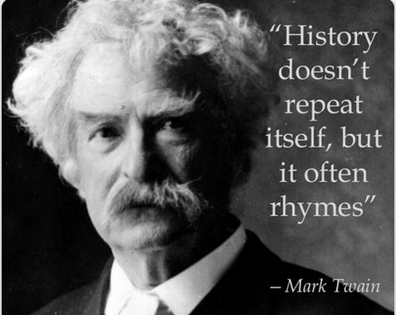
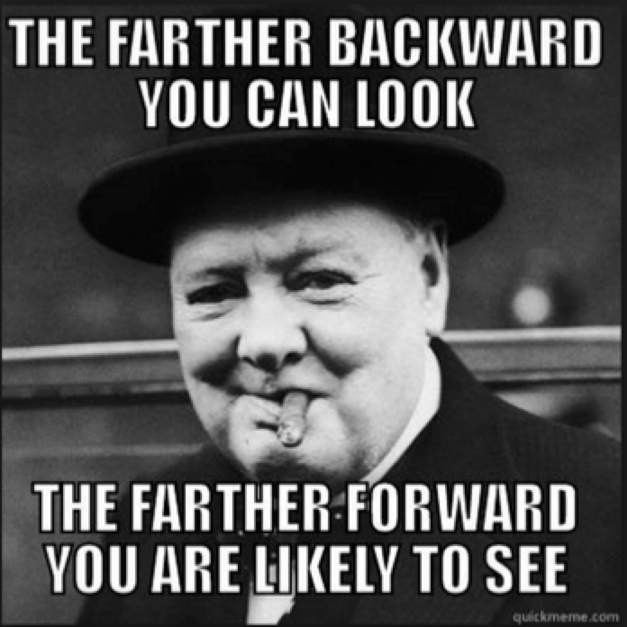
Applications on Looooooong Data
History search and exploration: Looking back--history
Trend visualization and discovery: Looking back--rhymes
Future prediction: Looking forward

Slide 88
History Exploration Ex 1. Time Machine
[Althoff et al. KDD 15]
Timeline about Robert Downey Jr. (from KG)
ZOOM
Box = Event
RDJr was award-nominated for Ally McBeal in 2000.
http://cs.stanford.edu/~althoff/timemachine/
Notes:
Here is one example from … that is focused on understanding the past. We will see more examples on using the past to predict the future towards the end of this tutorial.
It shows the timeline for Robert Downey JR. generated according to Freebase data
Each box is an important event in his life; for example, Ally McBeal
Each event has a description, which we show in the next slide
One can also zoom in to a small time period

Slide 89
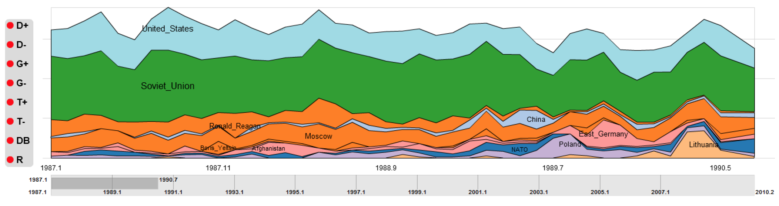
History Exploration Ex 2. Entity Timelines
[Mazeika et al CIKM’11]
Timeline about Mikhail Gorbachev (from NYTimes)

Slide 90
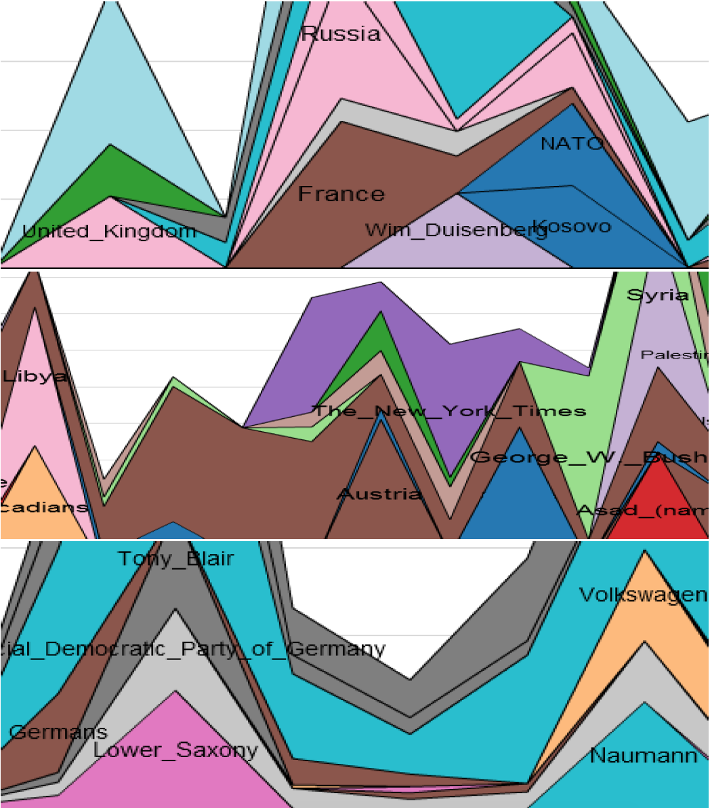
History Exploration Ex 2. Entity Timelines
[Mazeika et al CIKM’11]
Timeline about Chirac vs. Schröder (from NYTimes)
Common between
Chirac and Schröder
Special for Chirac
Special for Schröder

Slide 91
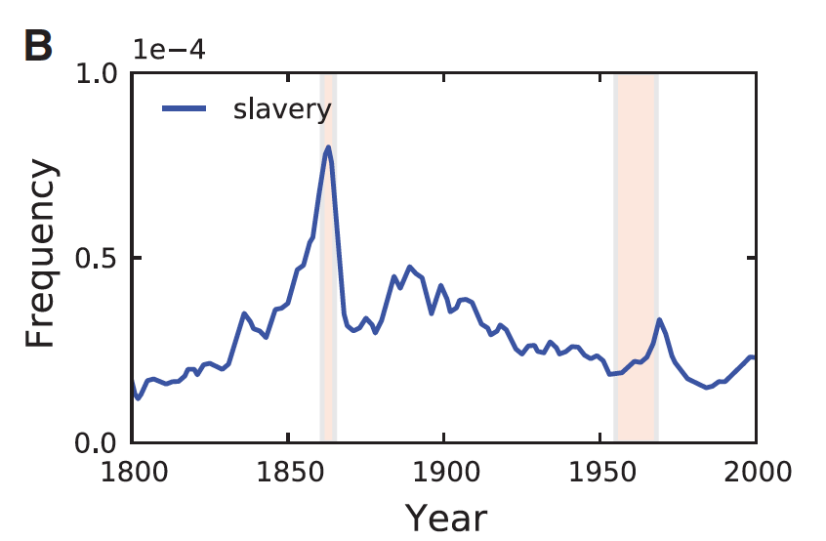
Historical Trend Ex 1. Culturomics
Usage frequency of “slavery”
(from 5 million Google Books)
[Michel et al. Science’11]
Civil
War
Civil rights
movement

Slide 92
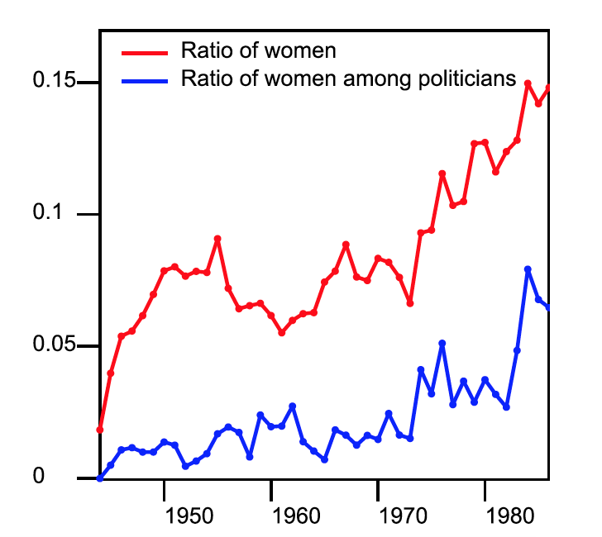
Historical Trend Ex 2. Timely Yago
[Suchanek and Weikum
VLDB’14]
Gender Gap (from Le Monde news)

Slide 93
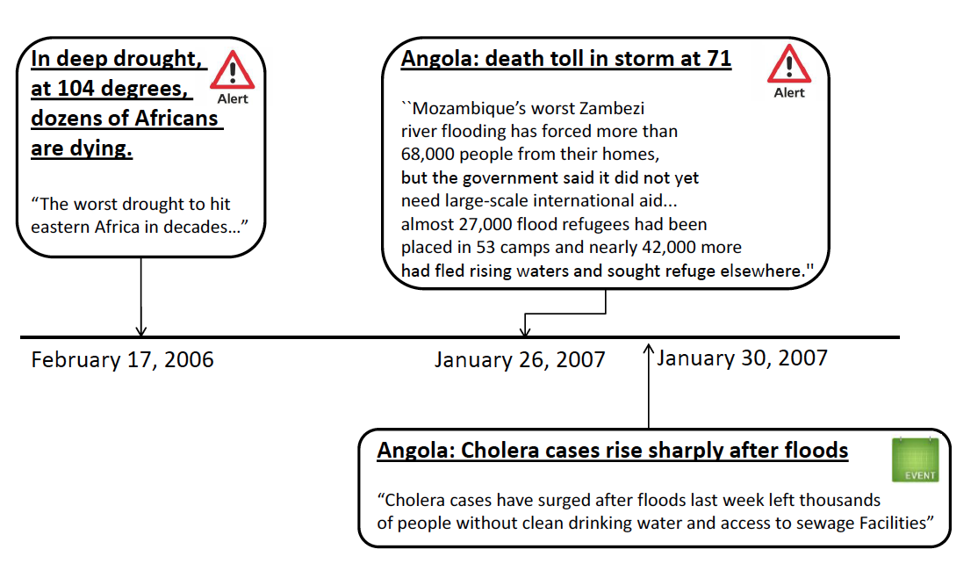
Future Prediction Ex 1. Event Prediction
[Radinsky and Horvitz, JAIR’13]
Automatic alert for upcoming cholera

Slide 94
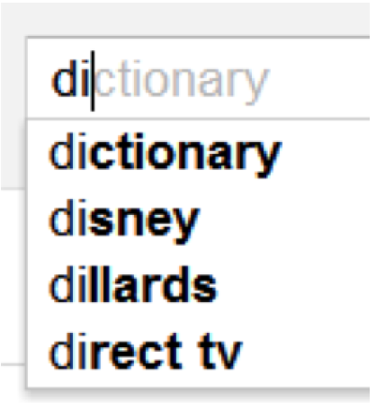
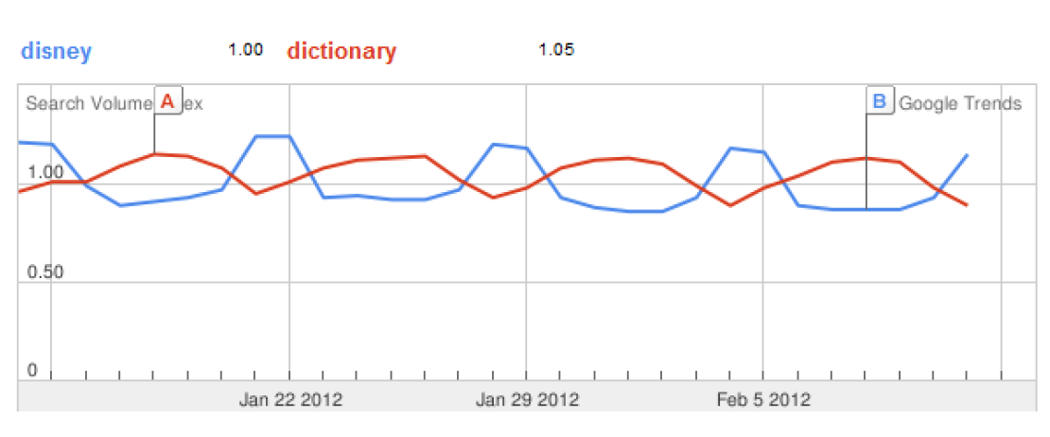
Future Prediction Ex 2. Web Behavioral Dynamics
Auto-completion for search “di…”
[Radinsky et al. WSDM’13]
Weekends

Slide 95
Open Research Areas

Slide 96
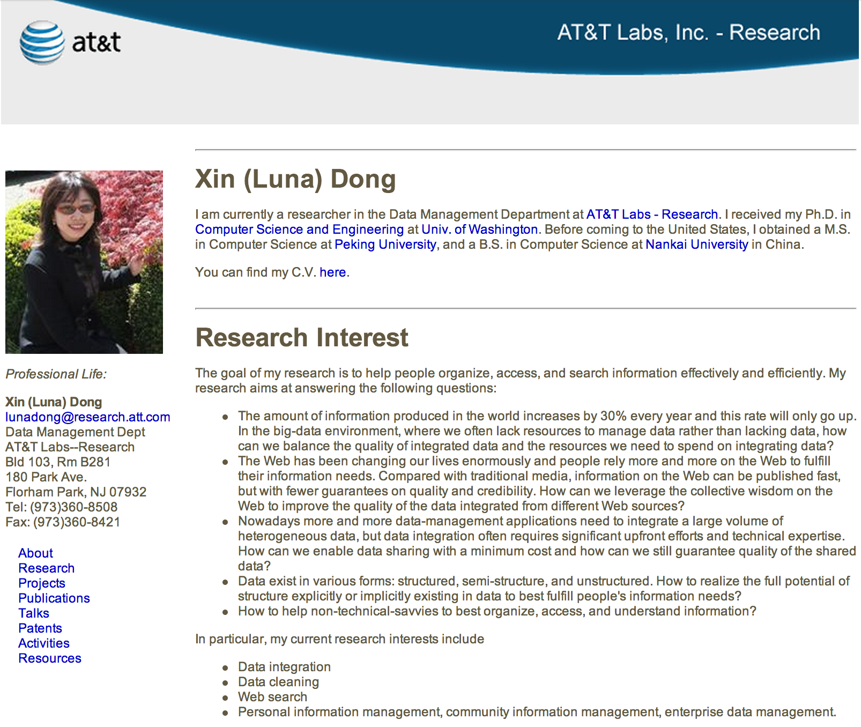
I. Connect the Dots and Recover History
www2.research.att.com/~lunadong till 1/2013
I am currently a researcher … at AT&T Labs

Slide 97
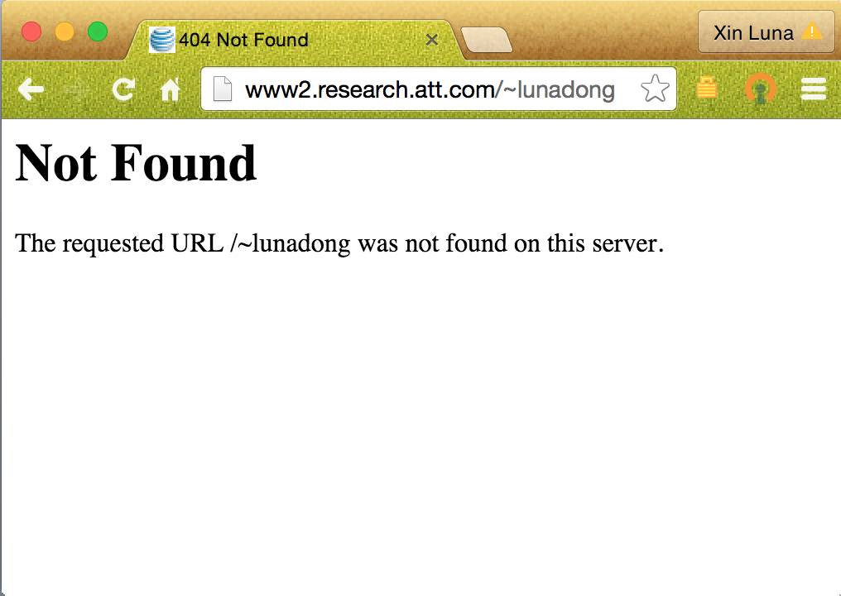
I. Connect the Dots and Recover History
www2.research.att.com/~lunadong since 2/2013

Slide 98
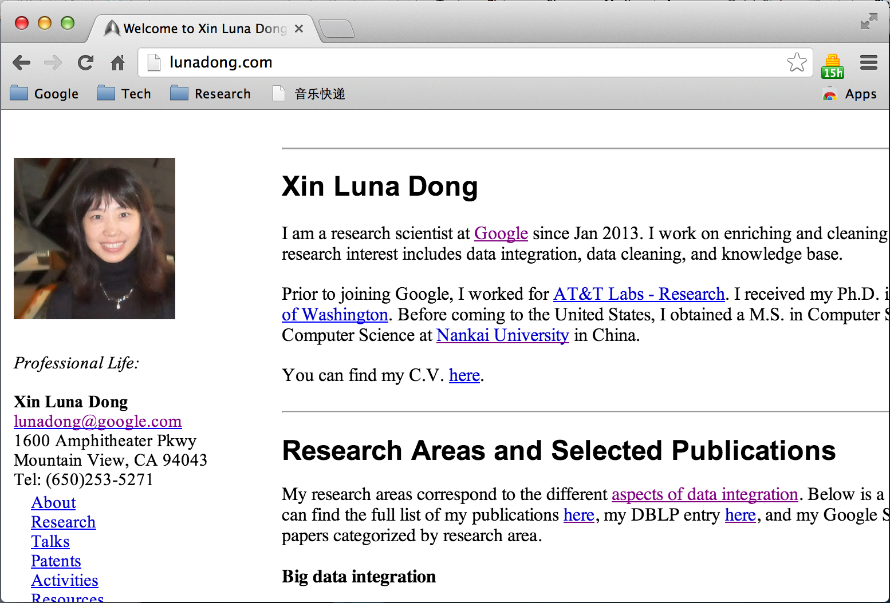
I. Connect the Dots and Recover History
Lunadong.com since 3/2013
I am … at Google since Jan 2013
Prior to joining Google, I worked for AT&T Labs…

Slide 99
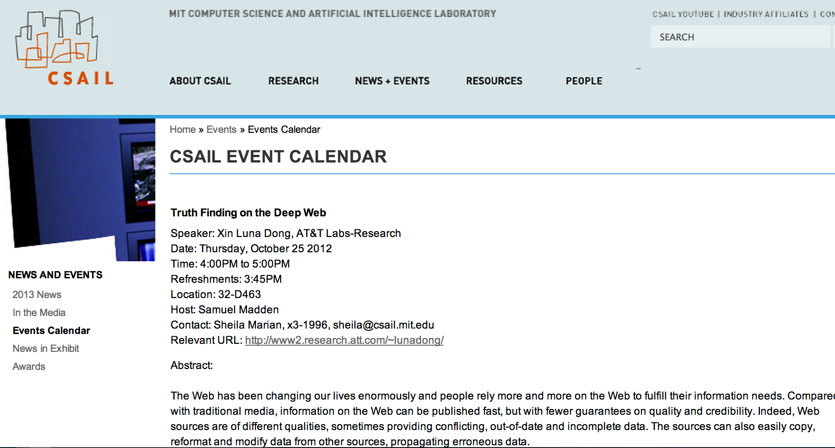
I. Connect the Dots and Recover History
www.csail.mit.edu/events/eventcalendar/
Speaker: Xin Luna Dong, At&T Labs
Date: Thursday, October 25 2012

Slide 100
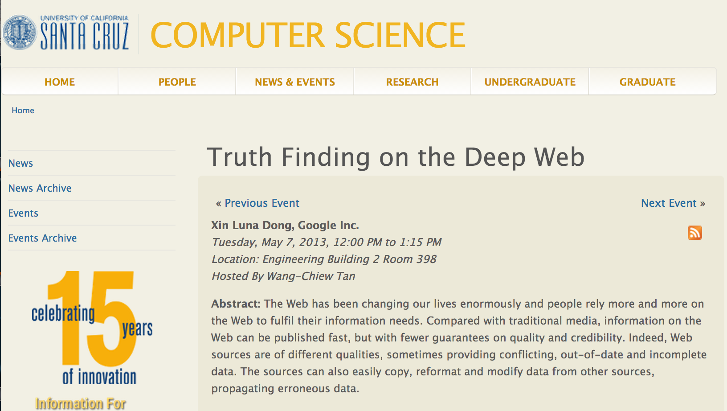
I. Connect the Dots and Recover History
www.cs.ucsc.edu/events/event/
Xin Luna Dong, Google Inc.
Tuesday, May 7, 2013

Slide 101
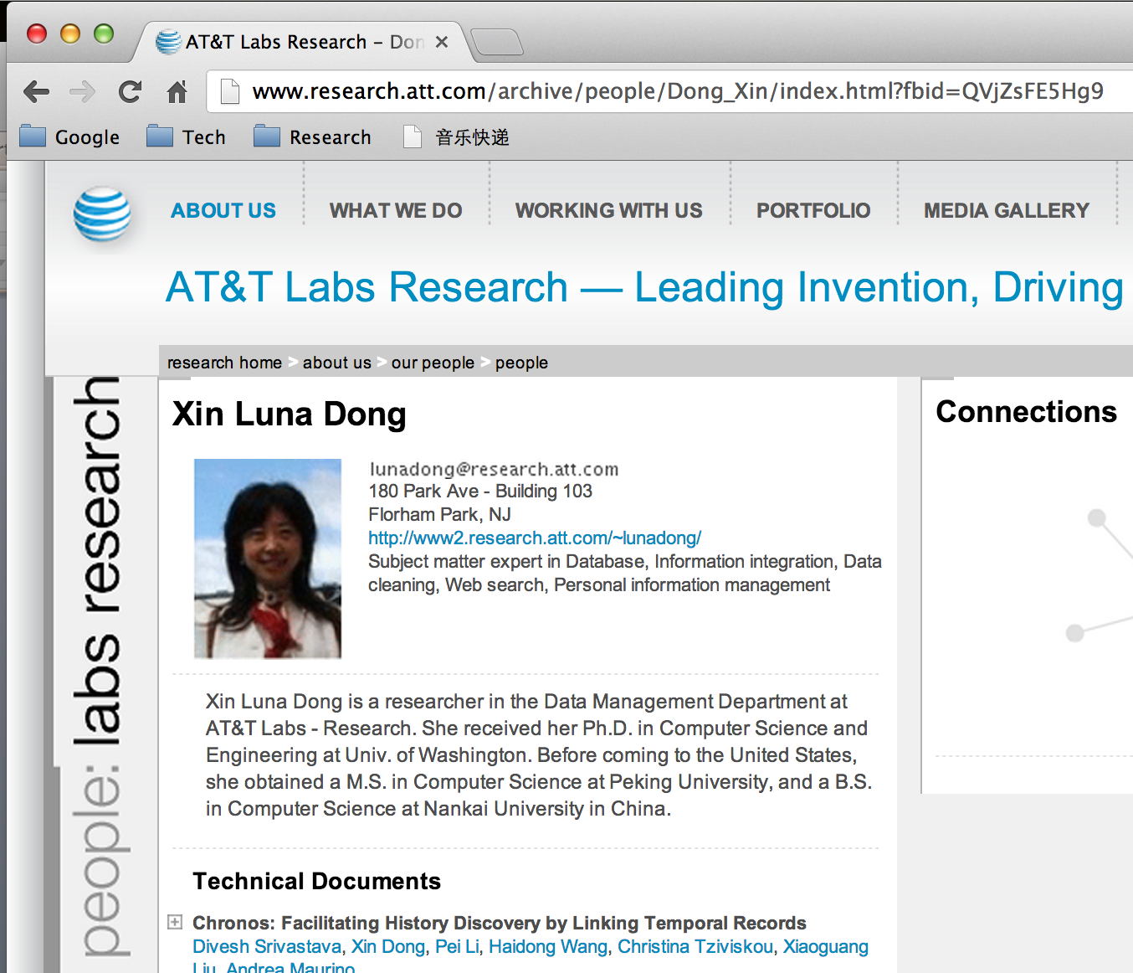
I. Connect the Dots and Recover History
www.research.att.com/archive/people/ in 2013
Out-of-date info

Slide 102
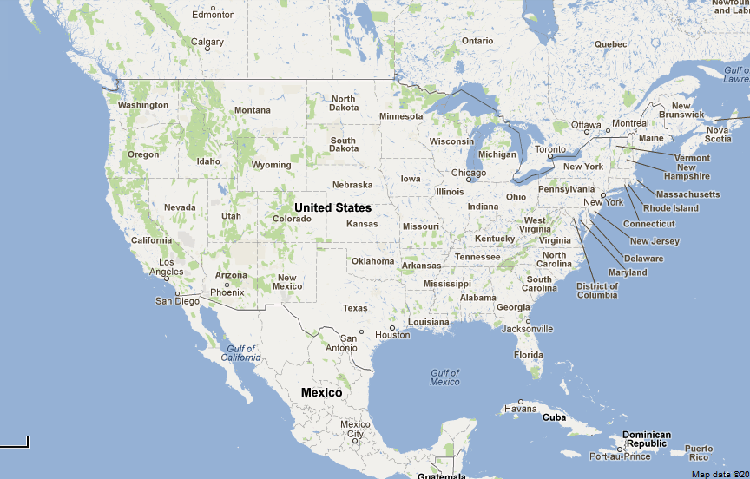
I. Connect the Dots and Recover History
2006
2007
1/2013

Slide 103
II. Distinguish Fact Evolution and
Perspective Evolution
(earth, shape, ?)
500 BC
Perspective
Flat
Sphere
Fact
Cloud of dust
Sphere
4.5 billions years ago

Slide 104
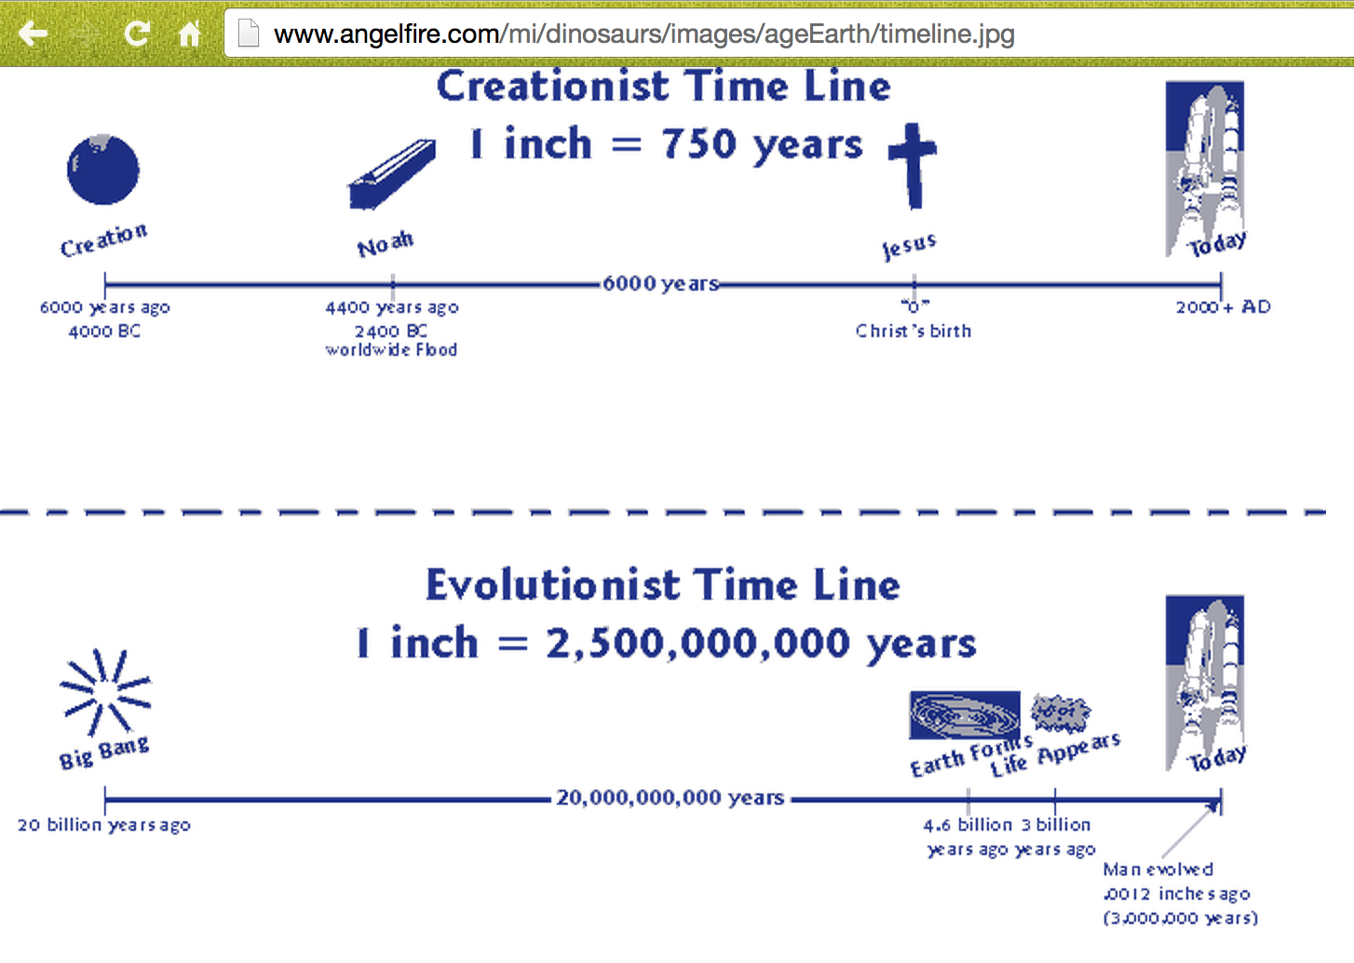
II. Distinguish Fact Evolution and
Perspective Evolution
http://www.angelfire.com/

Slide 105
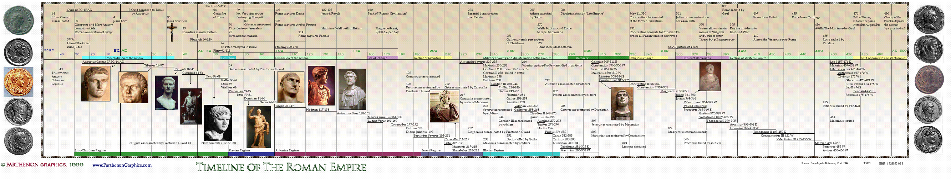
III. Building History for Collective Entities
History of Roma (http://chaos1.hypermart.net/)

Slide 106
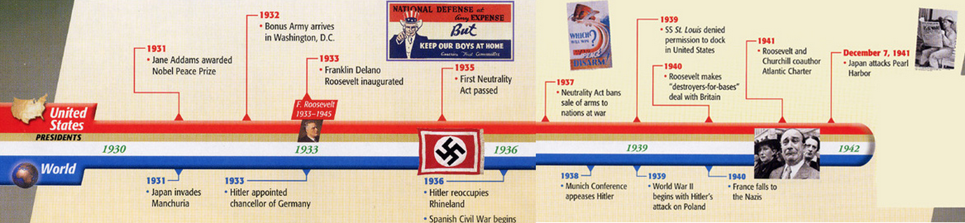
III. Building History for Collective Entities
History of World War II (http://www.lrwieland.com/)

Slide 107
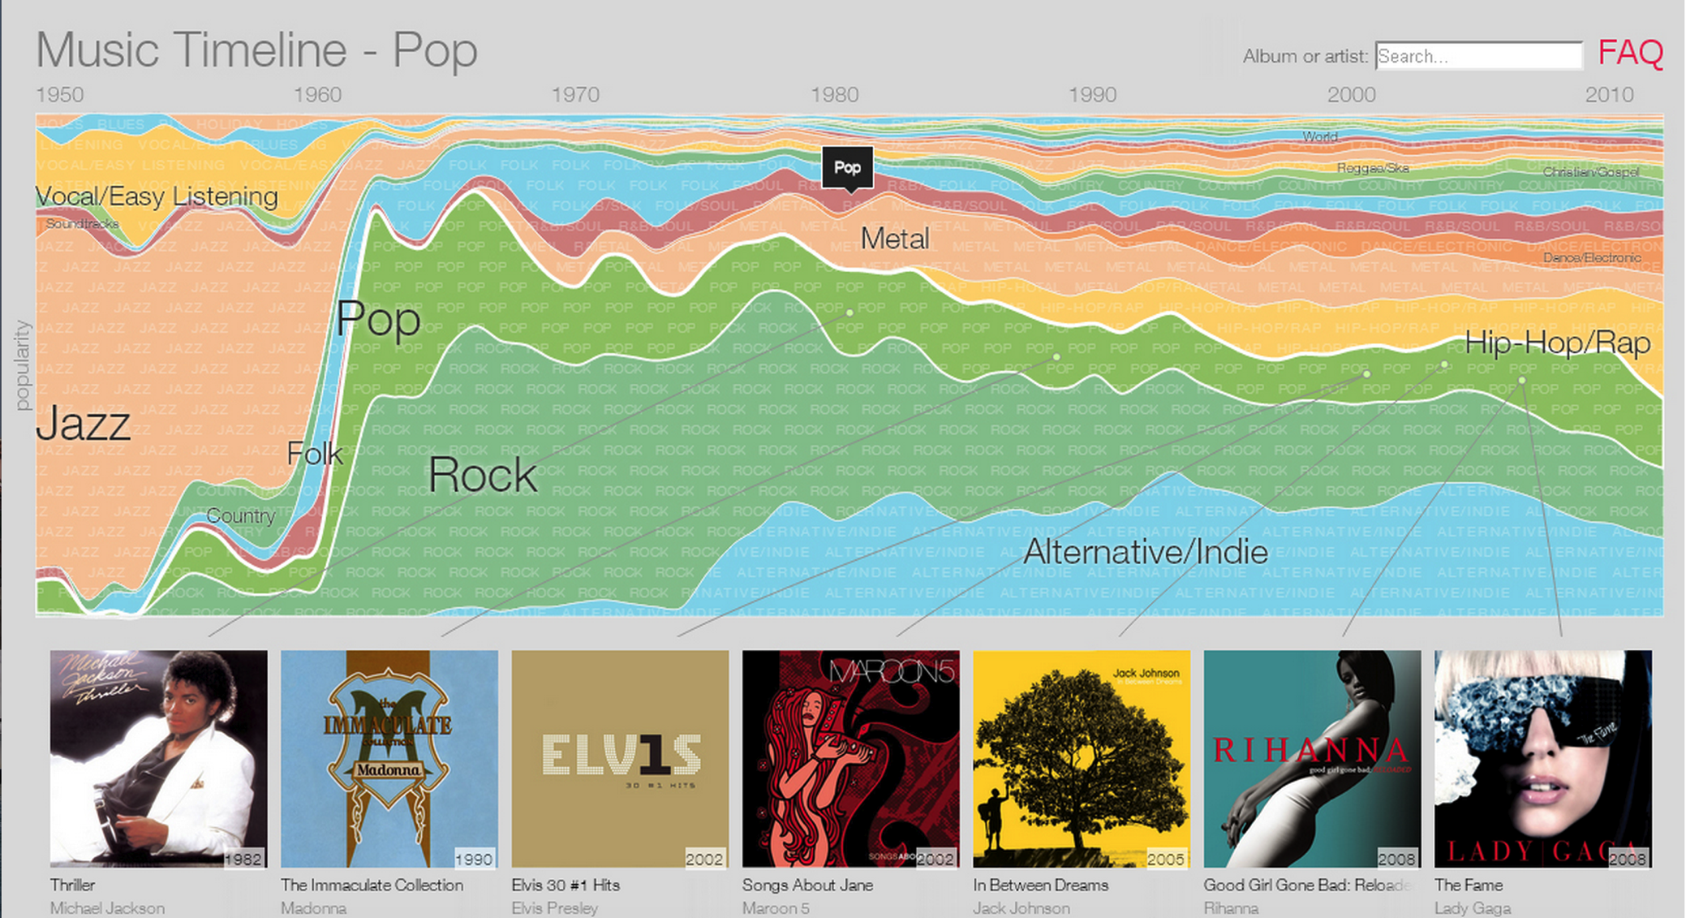
III. Building History for Collective Entities
History of Music (Google Music Timeline)

Slide 108
IV. Foundational Framework for
Temporal Data Integration
Earlier foundational work are largely time-agnostic
  mapping/data exchange
  conflict resolution
  query answering in inconsistent and incomplete databases
Is there a principled framework for
  managing inconsistent temporal data (without necessarily resolving all conflicts)?
  managing incompleteness in temporal data that may vary with time?
Notes:
While there is a substantial body of work on temporal text extraction and temporal entity resolution, earlier foundational work on mapping and data exchange, conflict resolution, and query answering
in inconsistent and incomplete databases have been largely time-agnostic.

Slide 109
Conclusions
From Big data to Loooooong data
  History search and exploration
  Trend discovery
  Future prediction
Foundation
  Collect, integrate, and clean temporal data
Many exciting research topics!

Slide 110
THANK YOU!

Slide 111
Where is Anna? (cont’d)
Answer to this question depends on the order in which facts are entered into the database.
1
2
3
Anna is at Fleur De Lys since Mar 28, 12 noon.
3
2
1
Anna is at SFMoma since Mar 28, 11.01am.
1
3
2
Anna is at SFMoma since Mar 28, 1.15pm.
The “right” answer: On March 28, Anna was at
  SFMoma from 11.01am to 12noon.
  Fleur De Lys from 12noon to 1.15pm.
  SFMoma from 1.15pm till now.

Slide 112
Foundational Framework for
Temporal Data Integration: Challenges
Abstract versus concrete views [Chomicki 94]
  Abstract: Semantics
    Works(Anna, Apple, 2005), W(Anna, Apple, 2006), …, W(Anna, Apple, 2015)
  Concrete: Implementation
    Works(Anna, Apple, [2005,2015])
  Concrete: Efficient representation of facts. Finite representation of possibly infinite tuples.

