Slide 1
Truth Finding on the Deep WEB
Xin Luna Dong
Google Inc.
4/2013

Slide 2
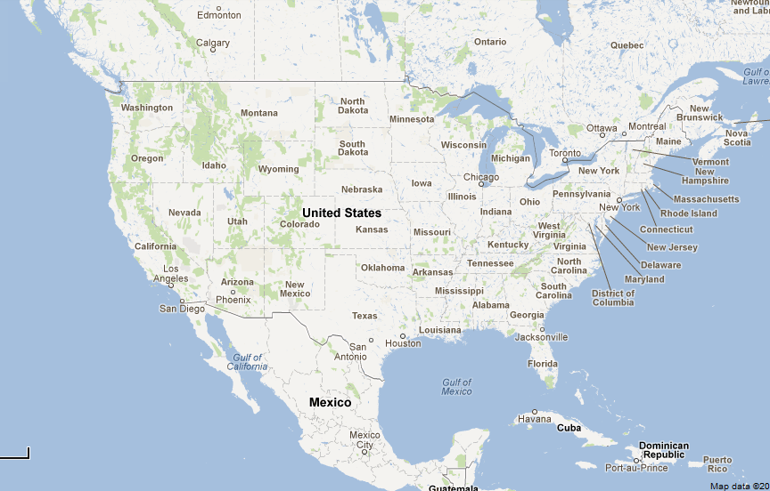
Why Was I Motivated 5+ Years Ago?
2007
7/2009

Slide 3
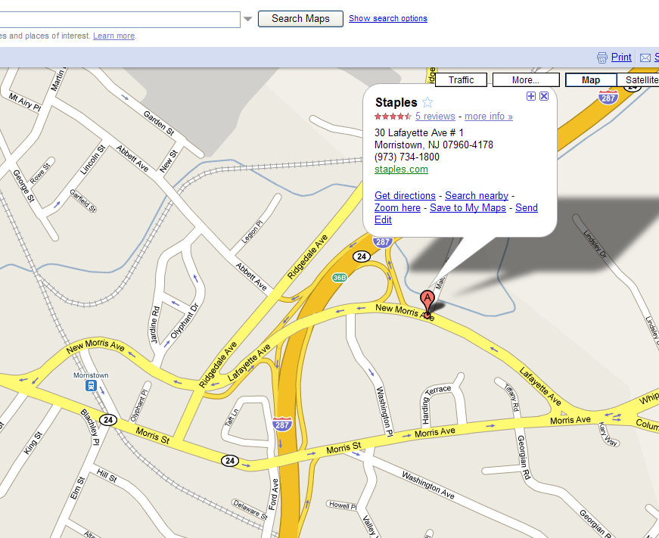

Why Was I Motivated? –Erroneous Info
7/2009

Slide 4
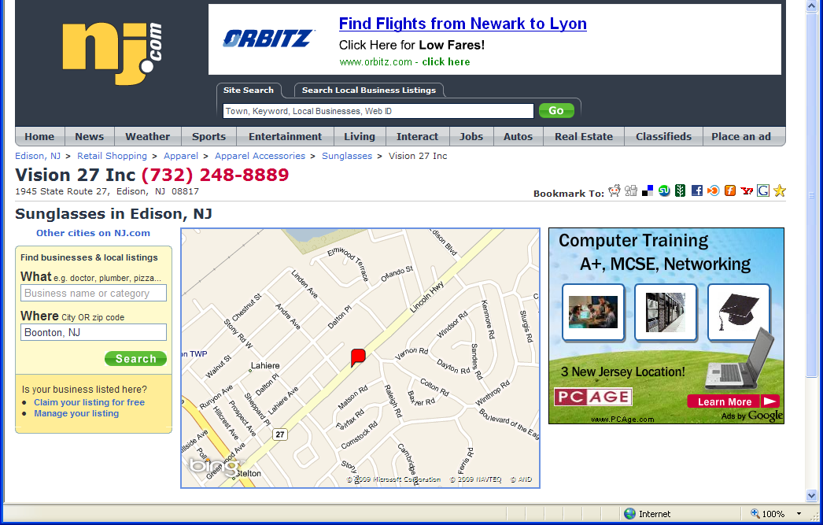
Why Was I Motivated?—Out-Of-Date Info
7/2009

Slide 5
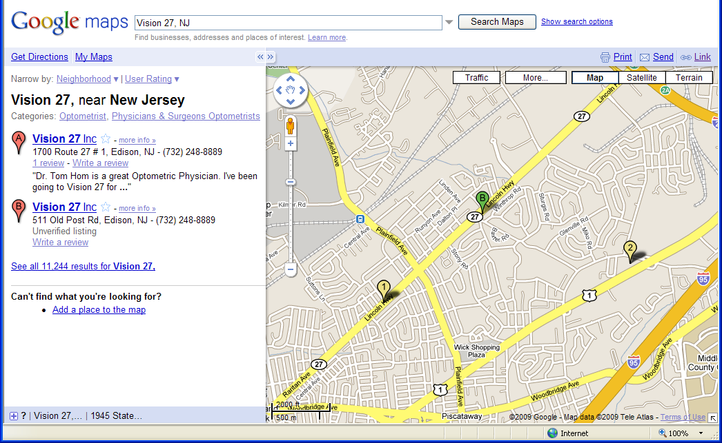
Why Was I Motivated?—Out-Of-Date Info
7/2009

Slide 6
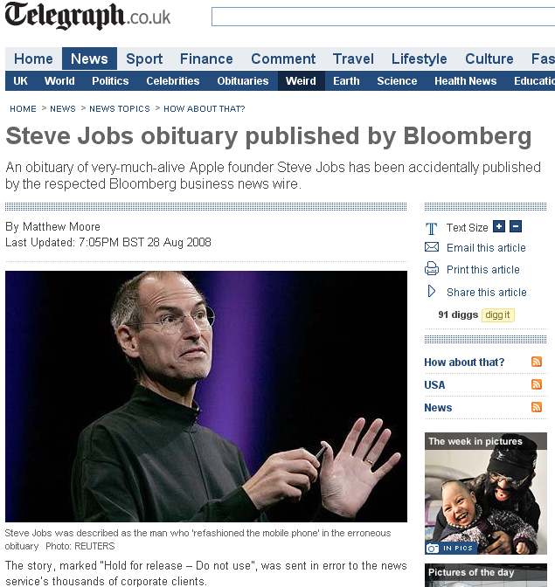
Why Was I Motivated?—Ahead-Of-Time Info
The story, marked “Hold for release – Do not use”, was sent in error to the news service’s thousands of corporate clients.

Slide 7


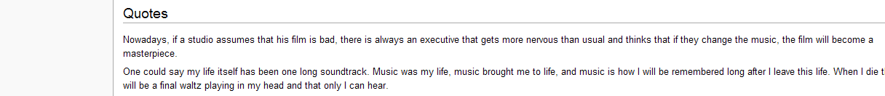
Why Was I Motivated?—Rumors
Maurice Jarre (1924-2009) French Conductor and Composer
“One could say my life itself has been one long soundtrack. Music was my life, music brought me to life, and music is how I will be remembered long after I leave this life. When I die there will be a final waltz playing in my head and that only I can hear.”
2:29, 30 March 2009
Notes:
While I expected online blogs and maybe some smaller papers to use the quote, I did not think it would have a major impact. I was wrong. Quality newspapers in England, India, America and as far away as Australia had my words in their reports of Jarre’s death. I was shocked that highly respected newspapers would use material from Wikipedia without first sourcing and referencing it properly.

Slide 8
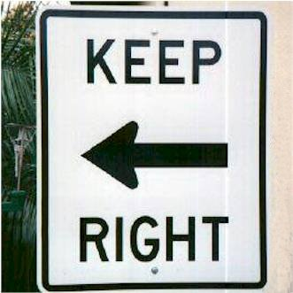
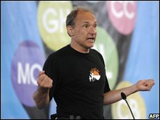
Wrong information can be just as bad as lack of information.
The Internet needs a way to help people separate rumor from real science.
– Tim Berners-Lee

Slide 9
ARE DEEp-web data consistent & reliable?
[PVLDB, 2013]

Slide 10
Study on Two Domains
 | #Sources | Period | #Objects | #Local-attrs | #Global-attrs | Considered items
Stock | 55 | 7/2011 | 1000*20 | 333 | 153 | 16000*20
Flight | 38 | 12/2011 | 1200*31 | 43 | 15 | 7200*31
Stock
  Search “stock price quotes” and “AAPL quotes”
  Sources: 200 (search results)→89 (deep web)→76 (GET method) →55 (none javascript)
  1000 “Objects”: a stock with a particular symbol on a particular day
    30 from Dow Jones Index
    100 from NASDAQ100 (3 overlaps)
    873 from Russel 3000
  Attributes: 333 (local) → 153 (global) → 21 (provided by > 1/3 sources) → 16 (no change after market close)
Data sets available at lunadong.com/fusionDataSets.htm

Slide 11
Study on Two Domains
 | #Sources | Period | #Objects | #Local-attrs | #Global-attrs | Considered items
Stock | 55 | 7/2011 | 1000*20 | 333 | 153 | 16000*20
Flight | 38 | 12/2011 | 1200*31 | 43 | 15 | 7200*31
Flight
  Search “flight status”
  Sources: 38
    3 airline websites (AA, UA, Continental)
    8 airport websites (SFO, DEN, etc.)
    27 third-party webistes (Orbitz, Travelocity, etc.)
  1200 “Objects”: a flight with a particular flight number on a particular day from a particular departure city
    Departing or arriving at the hub airports of AA/UA/Continental
  Attributes: 43 (local) → 15 (global) → 6 (provided by > 1/3 sources)
    scheduled dept/arr time, actual dept/arr time, dept/arr gate
Data sets available at lunadong.com/fusionDataSets.htm

Slide 12
Study on Two Domains
 | #Sources | Period | #Objects | #Local-attrs | #Global-attrs | Considered items
Stock | 55 | 7/2011 | 1000*20 | 333 | 153 | 16000*21
Flight | 38 | 12/2011 | 1200*31 | 43 | 15 | 7200*31
Why these two domains?
  Belief of fairly clean data
  Data quality can have big impact on people’s lives
Resolved heterogeneity at schema level and instance level
Data sets available at lunadong.com/fusionDataSets.htm

Slide 13
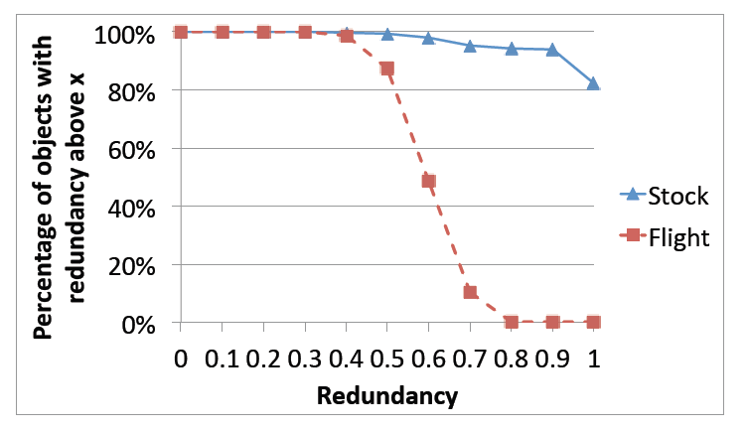
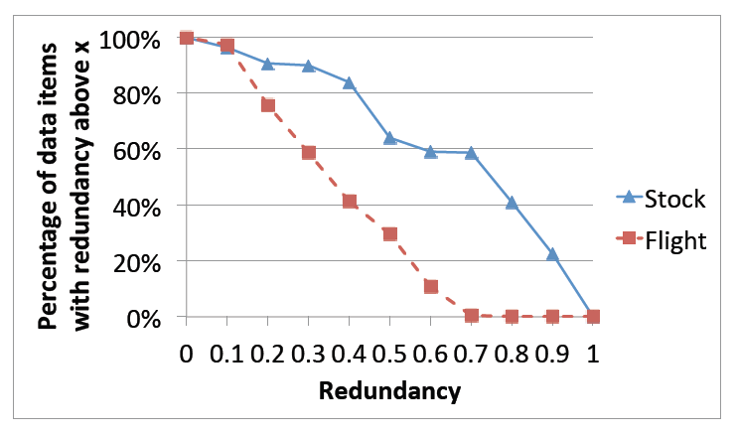
Q1. Are There a Lot of Redundant Data on the Deep Web?
✓

Slide 14
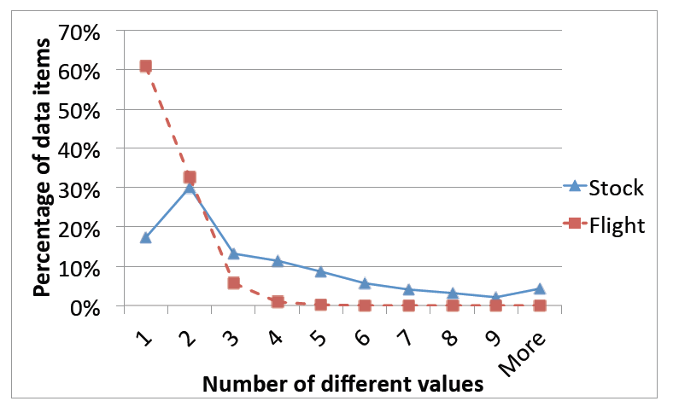
Q2. Are the Data Consistent?
✗
Inconsistency on 70% data items
  Tolerance to 1% difference

Slide 15
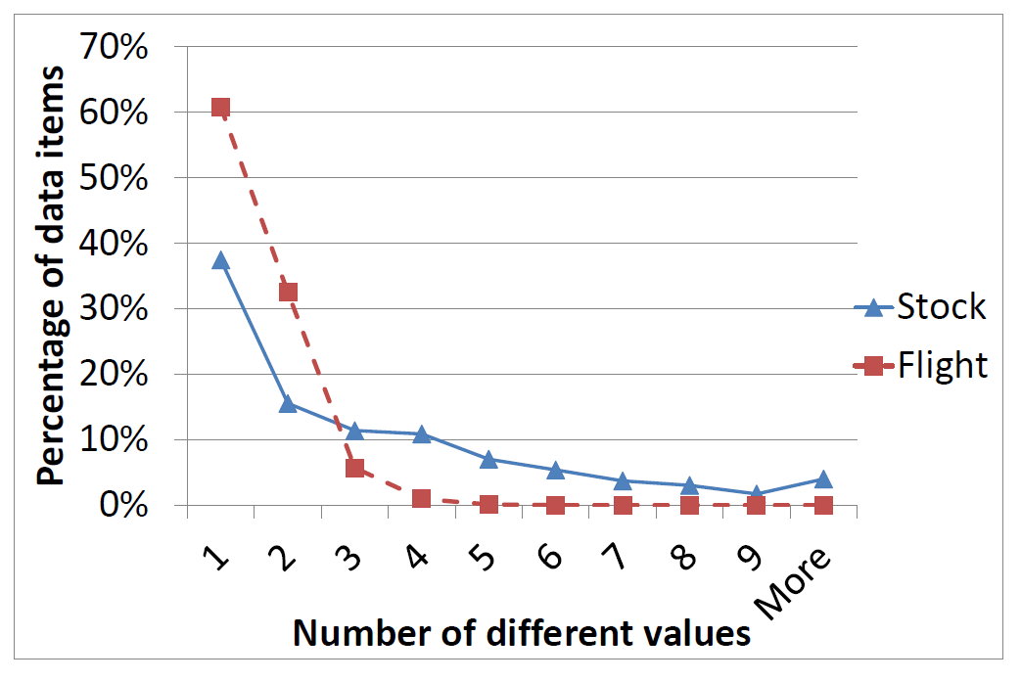
Q2. Are the Data Consistent?
Inconsistency on 50% data items after removing StockSmart

Slide 16
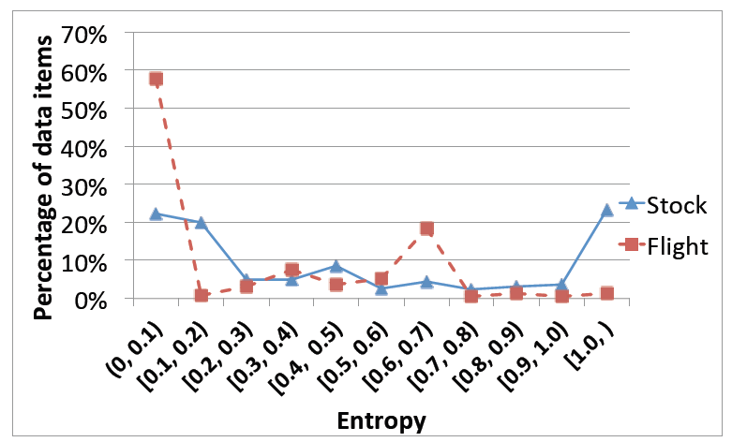
Q2. Are the Data Consistent? (II)
Entropy measures distribution of different values
Quite low entropy: one value provided often among others

Slide 17
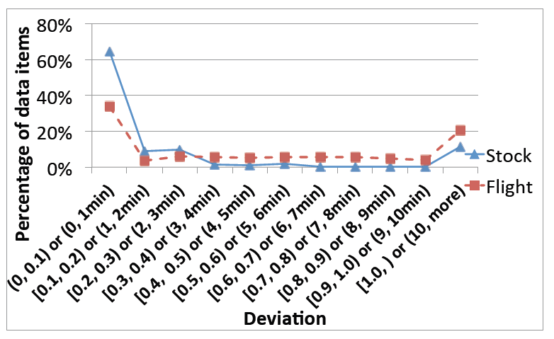
Q2. Are the Data Consistent? (III)
Deviation measures difference of numerical values
High deviation: 13.4 for Stock, 13.1 min for Flight

Slide 18
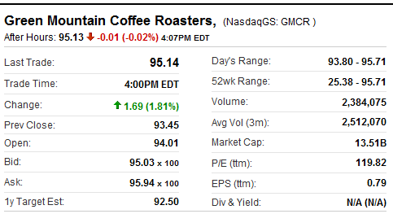
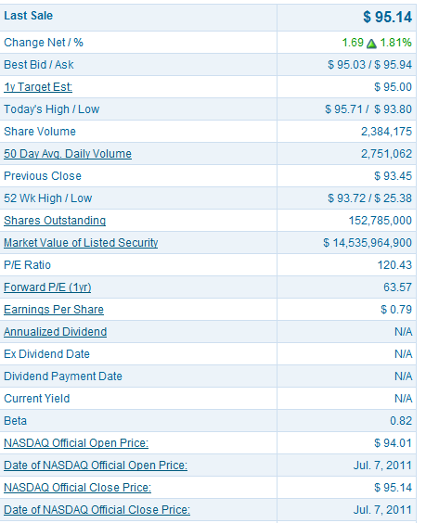
Why Such Inconsistency?
— I. Semantic Ambiguity
Day’s Range: 93.80-95.71
Yahoo! Finance
Nasdaq
52wk Range: 25.38-95.71
52 Wk: 25.38-93.72

Slide 19
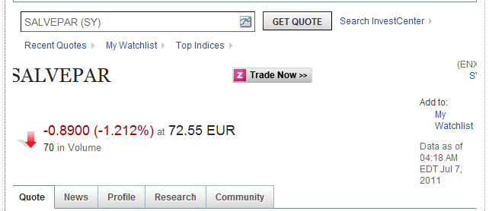
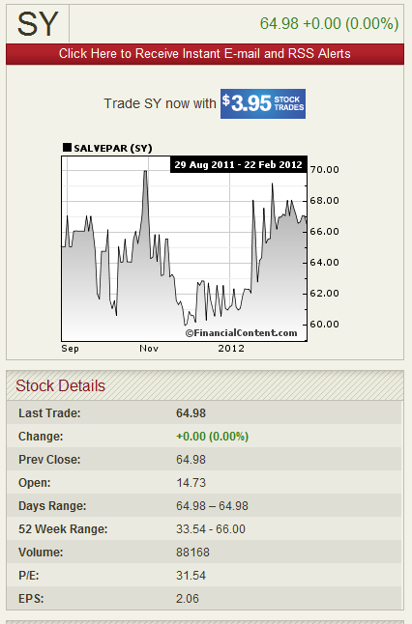
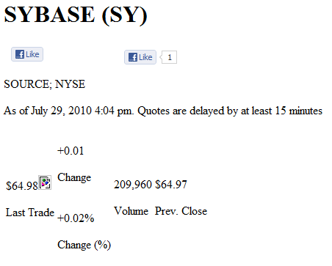
Why Such Inconsistency?
— II. Instance Ambiguity

Slide 20
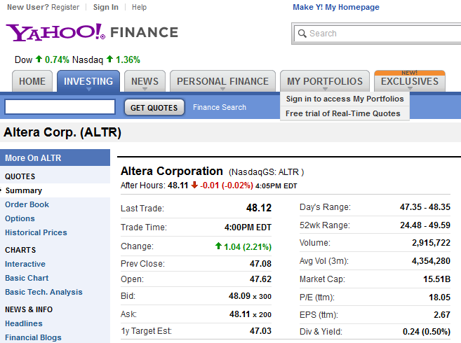
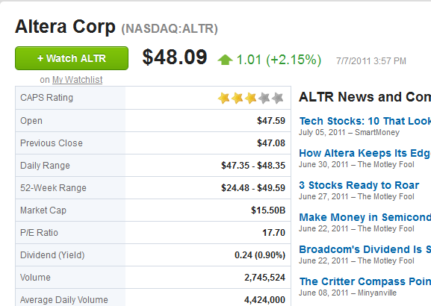
Why Such Inconsistency?
— III. Out-of-Date Data
4:05 pm
3:57 pm

Slide 21
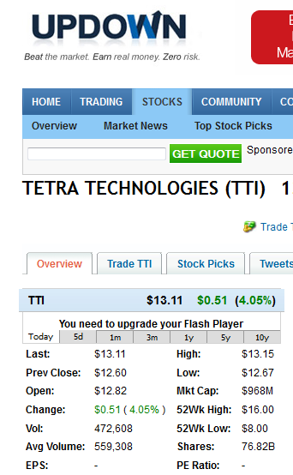
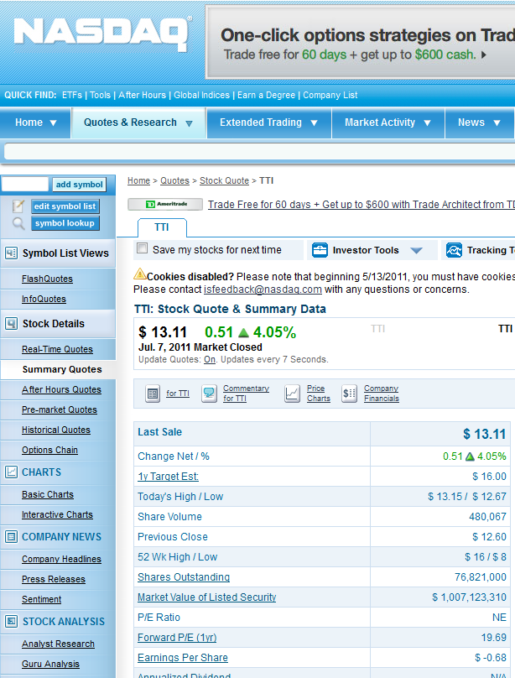
Why Such Inconsistency?
— IV. Unit Error
76.82B
76,821,000

Slide 22
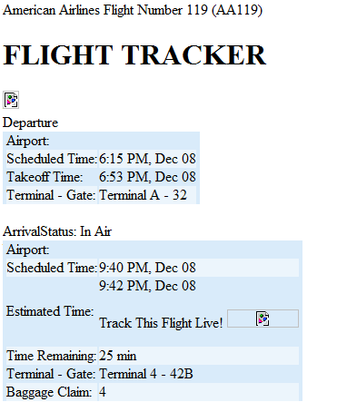
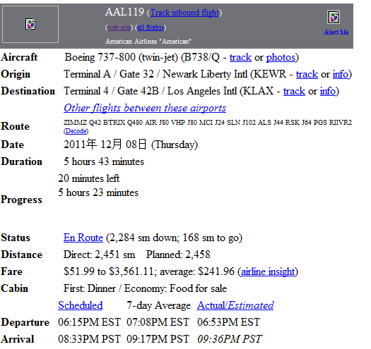
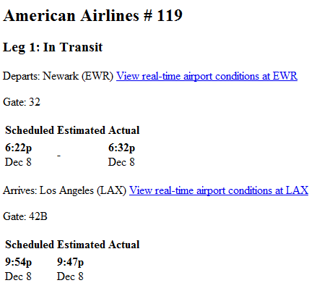
Why Such Inconsistency?
— V. Pure Error
FlightView
FlightAware
Orbitz
6:15 PM
6:22 PM
6:15 PM
9:40 PM
9:54 PM
8:33 PM

Slide 23
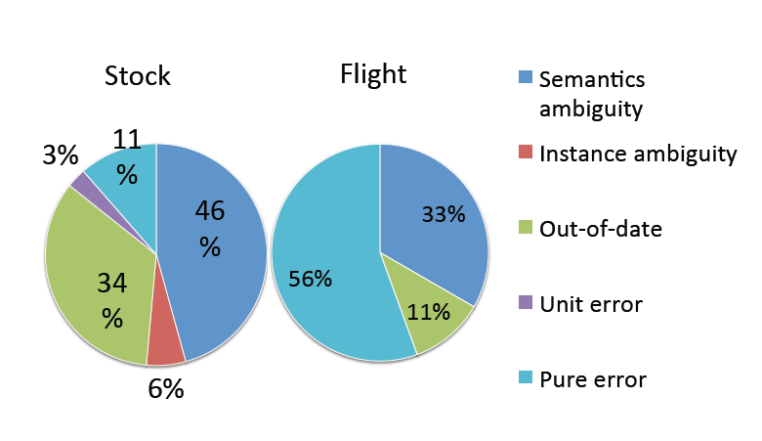
Why Such Inconsistency?
Random sample of 20 data items and 5 items with the largest #values in each domain

Slide 24
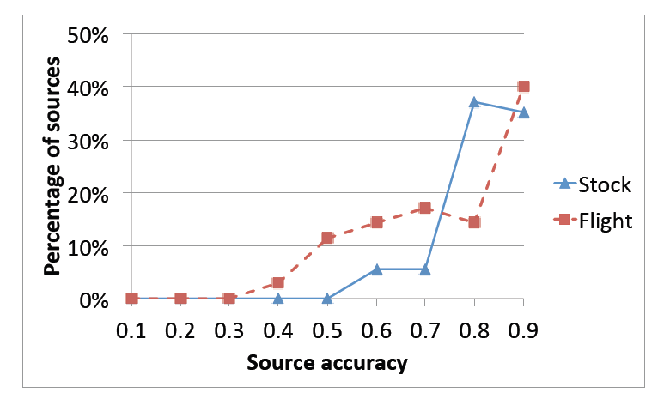
Q3. Is Each Source of High Accuracy?
✗
Not high on average: .86 for Stock and .8 for Flight
Gold standard
  Stock: vote on data from Google Finance, Yahoo! Finance, MSN Money, NASDAQ, Bloomberg
  Flight: from airline websites

Slide 25
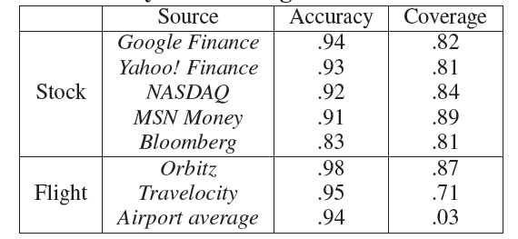
Q3-2. Are Authoritative Sources of High Accuracy?
✗
Reasonable but not so high accuracy
Medium coverage

Slide 26
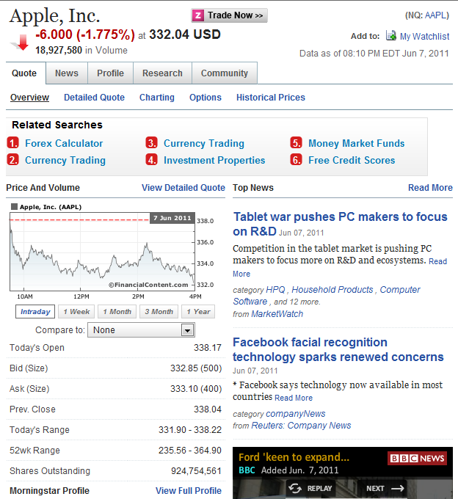
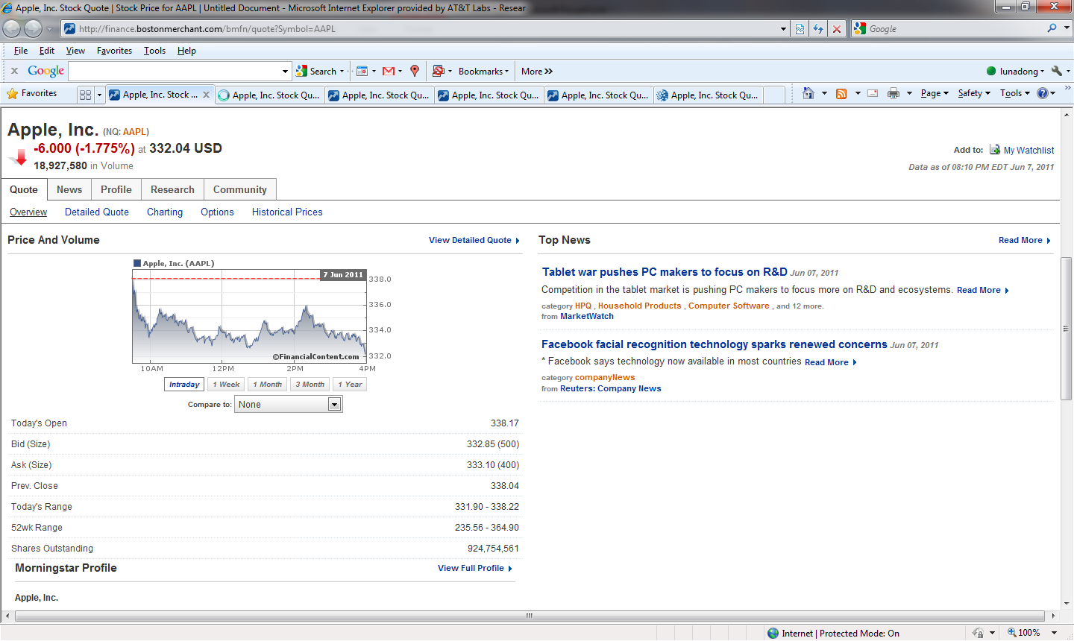
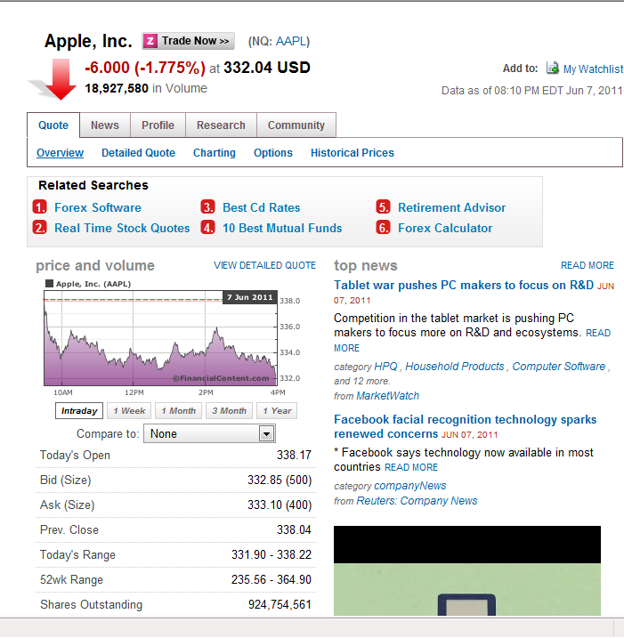
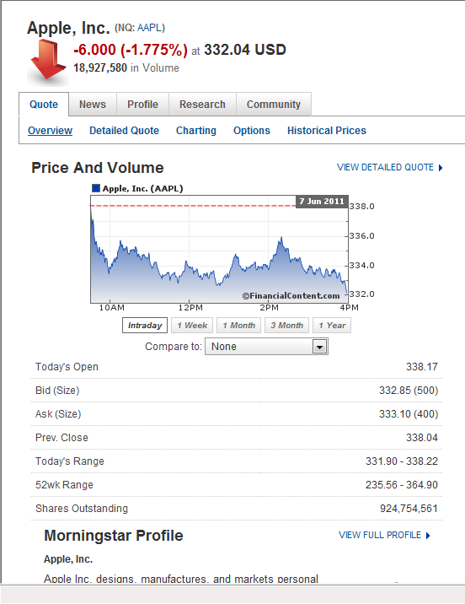
Q4. Is There Copying or Data Sharing Between Web Sources?
✓

Slide 27
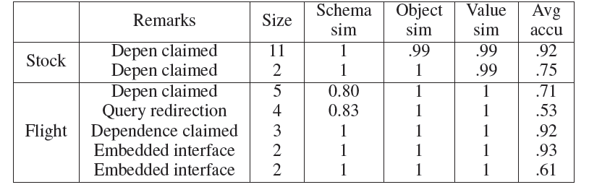
Q4-2. Is Copying or Data Sharing Mainly on Accurate Data?
✗

Slide 28
How to Resolve Inconsistency
(Data Fusion)?

Slide 29
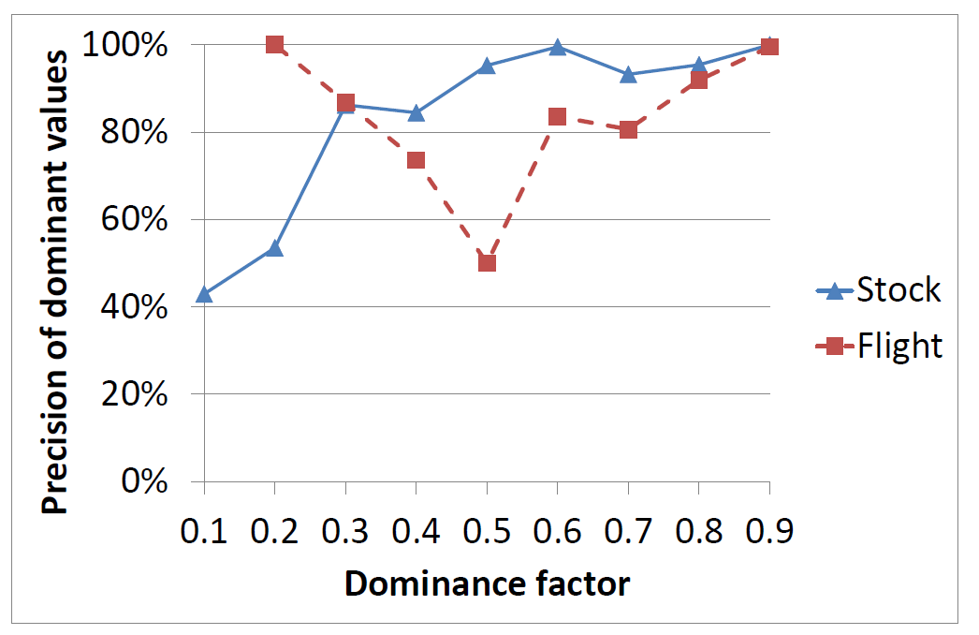
Baseline Solution: Voting
Only 70% correct values are provided by over half of the sources
Voting precision:
  .908 for Stock; i.e., wrong values for 1500 data items
  .864 for Flight; i.e., wrong values for 1000 data items

Slide 30
Improvement I. Leveraging Source Accuracy
 | S1 | S2 | S3
Stonebraker | MIT | Berkeley | MIT
Dewitt | MSR | MSR | UWisc
Bernstein | MSR | MSR | MSR
Carey | UCI | AT&T | BEA
Halevy | Google | Google | UW

Slide 31
Improvement I. Leveraging Source Accuracy
 | S1 | S2 | S3
Stonebraker | MIT | Berkeley | MIT
Dewitt | MSR | MSR | UWisc
Bernstein | MSR | MSR | MSR
Carey | UCI | AT&T | BEA
Halevy | Google | Google | UW
Higher accuracy;
More trustable
Naïve voting obtains an accuracy of 80%

Slide 32
Improvement I. Leveraging Source Accuracy
 | S1 | S2 | S3
Stonebraker | MIT | Berkeley | MIT
Dewitt | MSR | MSR | UWisc
Bernstein | MSR | MSR | MSR
Carey | UCI | AT&T | BEA
Halevy | Google | Google | UW
Higher accuracy;
More trustable
Challenges:
How to decide source accuracy?
2. How to leverage accuracy in voting?
Considering accuracy obtains an accuracy of 100%

Slide 33
Computing Source Accuracy
Source Accuracy: A(S)
  -values provided by S
  P(v)-pr of value v being true
How to compute P(v)?

Slide 34
Applying Source Accuracy in Data Fusion
Input:
  Data item D
  Dom(D)={v₀,v₁,…,v_{n}}
  Observation Ф on D
Output: Pr(v_{i} true|Ф) for each i=0,…, n (sum up to 1)
According to the Bayes Rule, we need to know
Pr(Ф|v_{i} true)
  Assuming independence of sources, we need to know
  Pr(Ф(S) |v_{i} true)
  If S provides v_{i} : Pr(Ф(S) |v_{i} true) =A(S)
  If S does not provide v_{i} : Pr(Ф(S) |v_{i} true) =(1-A(S))/n
Challenge: How to handle inter-dependence between source accuracy and value probability?

Slide 35
Data Fusion w. Source Accuracy
Properties
A value provided by more accurate sources has a higher probability to be true
Assuming uniform accuracy, a value provided by more sources has a higher probability to be true
Source accuracy
Source vote count
Value vote count
Value probability
Continue until source accuracy converges

Slide 36
Example
 | S1 | S2 | S3
Stonebraker | MIT | Berkeley | MIT
Dewitt | MSR | MSR | UWisc
Bernstein | MSR | MSR | MSR
Carey | UCI | AT&T | BEA
Halevy | Google | Google | UW
Value vote count | Carey
 | UCI | AT&T | BEA
Round 1 | 1.61 | 1.61 | 1.61
Round 2 | 2.40 | 1.89 | 1.42
Round 3 | 3.05 | 2.16 | 1.26
Round 4 | 3.51 | 2.23 | 1.19
Round 5 | 3.86 | 2.20 | 1.18
Round 6 | 4.17 | 2.15 | 1.19
Round 7 | 4.47 | 2.11 | 1.20
Round 8 | 4.76 | 2.09 | 1.20
Accuracy | S1 | S2 | S3
Round 1 | .69 | .57 | .45
Round 2 | .81 | .63 | .41
Round 3 | .87 | .65 | .40
Round 4 | .90 | .64 | .39
Round 5 | .93 | .63 | .40
Round 6 | .95 | .62 | .40
Round 7 | .96 | .62 | .40
Round 8 | .97 | .61 | .40

Slide 37
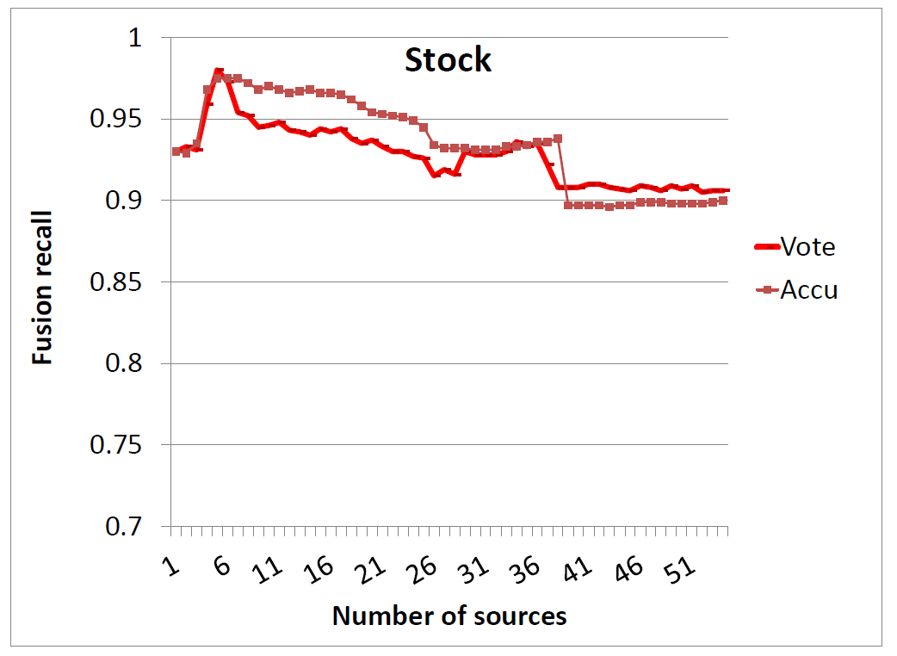
Results on Stock Data
Sources ordered by recall (coverage * accuracy)
Accu obtains a final precision (=recall) of .900, worse than Vote (.908)
With precise source accuracy as input, Accu obtains final precision of .910

Slide 38
Data Fusion w. Value Similarity
Source accuracy
Source vote count
Value vote count
Value probability
  Consider value similarity

Slide 39
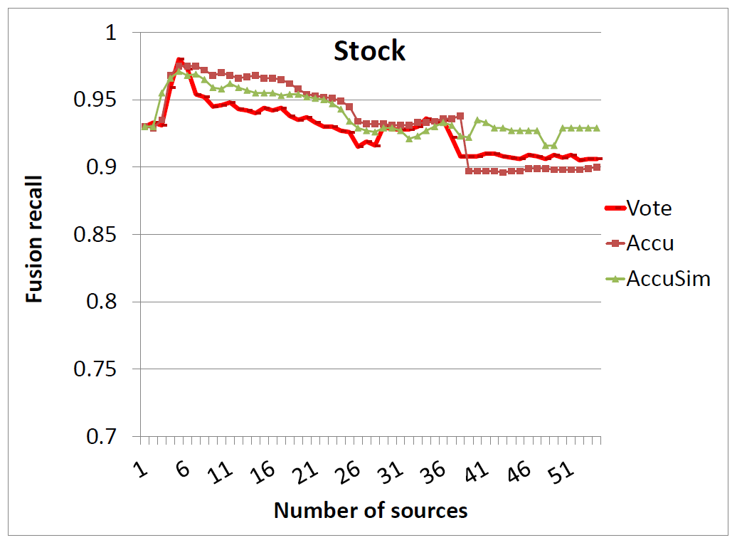
Results on Stock Data (II)
AccuSim obtains a final precision of .929, higher than Vote (.908)
  This translates to 350 more correct values

Slide 40
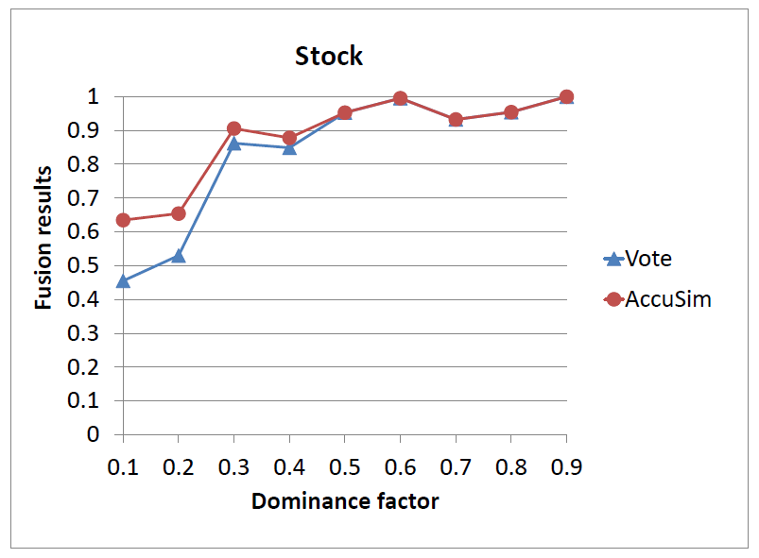
Results on Stock Data (III)

Slide 41
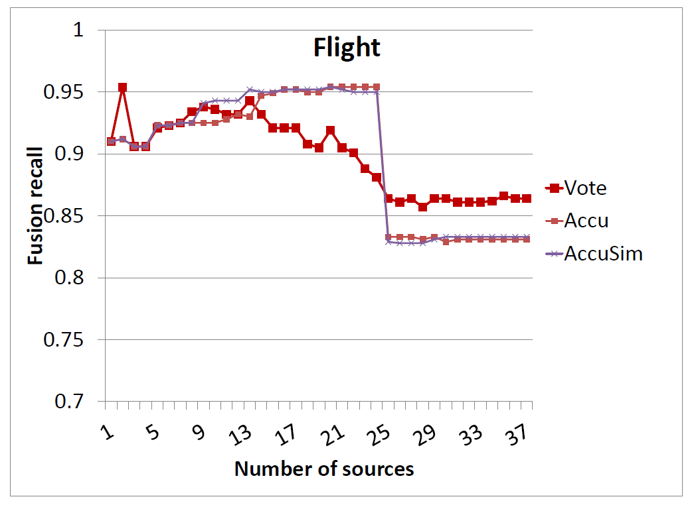
Results on Flight Data
Accu/AccuSim obtains a final precision of .831/.833, both lower than Vote (.857)
With precise source accuracy as input, Accu/AccuSim obtains final recall of .91/.952
WHY??? What is that magic source?

Slide 42
Copying or Data Sharing Can Happen on Inaccurate Data

Slide 43
 | S1 | S2 | S3 | S4 | S5
Stonebraker | MIT | Berkeley | MIT | MIT | MS
Dewitt | MSR | MSR | UWisc | UWisc | UWisc
Bernstein | MSR | MSR | MSR | MSR | MSR
Carey | UCI | AT&T | BEA | BEA | BEA
Halevy | Google | Google | UW | UW | UW
Naïve voting works only if data sources are independent.

Slide 44
 | S1 | S2 | S3 | S4 | S5
Stonebraker | MIT | Berkeley | MIT | MIT | MS
Dewitt | MSR | MSR | UWisc | UWisc | UWisc
Bernstein | MSR | MSR | MSR | MSR | MSR
Carey | UCI | AT&T | BEA | BEA | BEA
Halevy | Google | Google | UW | UW | UW
Higher accuracy;
More trustable
Consider source accuracy can be worse when there is copying

Slide 45
Improvement II. Ignoring Copied Data
 | S1 | S2 | S3 | S4 | S5
Stonebraker | MIT | Berkeley | MIT | MIT | MS
Dewitt | MSR | MSR | UWisc | UWisc | UWisc
Bernstein | MSR | MSR | MSR | MSR | MSR
Carey | UCI | AT&T | BEA | BEA | BEA
Halevy | Google | Google | UW | UW | UW
It is important to detect copying and ignore copied values in fusion

Slide 46
Challenges in Copy Detection
1. Sharing common data does not in itself imply copying.
2. With only a snapshot it is hard to decide which source is a copier.
 | S1 | S2 | S3 | S4 | S5
Stonebraker | MIT | Berkeley | MIT | MIT | MS
Dewitt | MSR | MSR | UWisc | UWisc | UWisc
Bernstein | MSR | MSR | MSR | MSR | MSR
Carey | UCI | AT&T | BEA | BEA | BEA
Halevy | Google | Google | UW | UW | UW
3. A copier can also provide or verify some data by itself, so it is inappropriate to ignore all of its data.

Slide 47
High-Level Intuitions for Copy Detection
Pr(Ф(S1)|S1→S2) >> Pr(Ф(S1)|S1⊥S2) S1→S2
Intuition I: decide dependence (w/o direction)
  For shared data, Pr(Ф(S1)|S1⊥S2) is low
  e.g., incorrect value

Slide 48


Copying?
Not necessarily
Name: Alice Score: 5
A
C
D
C
B
D
B
A
B
C
Name: Bob Score: 5
A
C
D
C
B
D
B
A
B
C
✓
✓
✓
✓
✓
✓
✓
✓
✓
✓
✓
✓
✓
✓
✓
✓
✓
✓
✓
✓

Slide 49


Copying?—Common Errors
Very likely
Name: Mary Score: 1
A
B
B
D
A
C
C
D
E
C
Name: John Score: 1
A
B
B
D
A
C
C
D
E
B
✓
✓
✗
✗
✗
✗
✗
✗
✗
✗
✗
✗
✗
✗
✗
✗
✗
✗
✓
✗

Slide 50
High-Level Intuitions for Copy Detection
Pr(Ф(S1)|S1→S2) >> Pr(Ф(S1)|S1⊥S2) S1→S2
Intuition I: decide dependence (w/o direction)
  For shared data, Pr(Ф(S1)|S1⊥S2) is low
  e.g., incorrect data
Intuition II: decide copying direction
  Let F be a property function of the data
  (e.g., accuracy of data)
  |F(Ф(S1) ∩ Ф(S2))-F(Ф(S1)-Ф(S2))|
  > |F(Ф(S1) ∩ Ф(S2))-F(Ф(S2)-Ф(S1))| .

Slide 51
Copying?—Different Accuracy
John copies from Alice
Name: Alice Score: 3
B
B
D
D
B
D
D
A
B
C
Name: John Score:1
B
B
D
D
B
C
C
D
E
B
✗
✗
✗
✗
✓
✓
✗
✗
✓
✓
✓
✗
✗
✗
✓
✗
✗
✗
✓
✗

Slide 52
Copying?—Different Accuracy
Alice copies from John
Name: Alice Score: 3
A
B
B
D
A
D
B
A
B
C
Name: John Score: 1
A
B
B
D
A
C
C
D
E
B
✓
✓
✗
✗
✗
✗
✗
✗
✗
✗
✓
✗
✓
✗
✓
✗
✓
✗
✓
✗

Slide 53
Copy Detection
Intuition I. If two sources share a lot of false values, they are more likely to be dependent.
S1 ∩ S2
Different Values
Same Values
TRUE
FALSE

Slide 54
Bayesian Analysis – Basic
S1 ∩ S2
Different Values O_{d}
Same Values
TRUE O_{t}
FALSE O_{f}
Observation: Ф
Goal: Pr(S1⊥S2| Ф), Pr(S1∼S2| Ф) (sum up to 1)
According to the Bayes Rule, we need to know
Pr(Ф|S1⊥S2), Pr(Ф|S1∼S2)
Key: computing Pr(Ф(O)|S1⊥S2), Pr(Ф(O)|S1∼S2)
for each O∈S1 ∩ S2

Slide 55
Bayesian Analysis – Probability Computation
S1 ∩ S2
Different Values O_{d}
Same Values
TRUE O_{t}
FALSE O_{f}
Pr | Independence | Dependence
O_{t}
O_{f}
O_{d}
<
<
>
ε-error rate; n-#wrong-values; c-copy rate

Slide 56
Considering Source Accuracy
Intuition II. S1 is more likely to copy from S2, if the accuracy of the common data is highly different from the accuracy of S1.
Pr | Independence | Dependence
O_{t}
O_{f}
O_{d}

Slide 57
Considering Source Accuracy
Intuition II. S1 is more likely to copy from S2, if the accuracy of the common data is highly different from the accuracy of S1.
Pr | Independence | S1 Copies S2 | S2 Copies S1
O_{t}
O_{f}
O_{d}
≠
≠

Slide 58
Data Fusion w. Copying
Source accuracy
Source vote count
Value vote count
Value probability
Consider dependence
I(S)- Pr of independently providing value v

Slide 59
Combining Accuracy and Dependence
Step 2
Truth
Discovery
Source-accuracy
Computation
Copy
Detection
Step 3
Step 1
Theorem: w/o accuracy, converges
Observation: w. accuracy, converges when #objs >> #srcs

Slide 60
Example Con’t
 | S1 | S2 | S3 | S4 | S5
Stonebraker | MIT | Berkeley | MIT | MIT | MS
Dewitt | MSR | MSR | UWisc | UWisc | UWisc
Bernstein | MSR | MSR | MSR | MSR | MSR
Carey | UCI | AT&T | BEA | BEA | BEA
Halevy | Google | Google | UW | UW | UW
S₁
UCI
AT&T
.87
.2
S1
S2
S₂
.2
.99
S₃
BEA
.99
S3
S₄
.99
S₅
Copying Relationship
S4
S5
(1-.99*.8=.2)
(.2²)
Round 1
Truth Discovery

Slide 61
Example Con’t
 | S1 | S2 | S3 | S4 | S5
Stonebraker | MIT | Berkeley | MIT | MIT | MS
Dewitt | MSR | MSR | UWisc | UWisc | UWisc
Bernstein | MSR | MSR | MSR | MSR | MSR
Carey | UCI | AT&T | BEA | BEA | BEA
Halevy | Google | Google | UW | UW | UW
S₁
UCI
AT&T
.14
S1
S2
S₂
.08
S₃
.49
BEA
.49
.49
.49
S3
.49
S₄
.49
S₅
Copying Relationship
S4
S5
Round 2
Truth Discovery

Slide 62
Example Con’t
 | S1 | S2 | S3 | S4 | S5
Stonebraker | MIT | Berkeley | MIT | MIT | MS
Dewitt | MSR | MSR | UWisc | UWisc | UWisc
Bernstein | MSR | MSR | MSR | MSR | MSR
Carey | UCI | AT&T | BEA | BEA | BEA
Halevy | Google | Google | UW | UW | UW
UCI
S₁
AT&T
.12
S1
S2
S₂
.06
S₃
.49
BEA
.49
.49
.49
S3
.49
S₄
.49
S₅
Copying Relationship
S4
S5
Round 3
Truth Discovery

Slide 63
Example Con’t
 | S1 | S2 | S3 | S4 | S5
Stonebraker | MIT | Berkeley | MIT | MIT | MS
Dewitt | MSR | MSR | UWisc | UWisc | UWisc
Bernstein | MSR | MSR | MSR | MSR | MSR
Carey | UCI | AT&T | BEA | BEA | BEA
Halevy | Google | Google | UW | UW | UW
UCI
AT&T
S₁
.10
S1
S2
S₂
.05
S₃
.49
BEA
.49
.48
.50
S3
.48
S₄
.50
S₅
Copying Relationship
S4
S5
Round 4
Truth Discovery

Slide 64
Example Con’t
 | S1 | S2 | S3 | S4 | S5
Stonebraker | MIT | Berkeley | MIT | MIT | MS
Dewitt | MSR | MSR | UWisc | UWisc | UWisc
Bernstein | MSR | MSR | MSR | MSR | MSR
Carey | UCI | AT&T | BEA | BEA | BEA
Halevy | Google | Google | UW | UW | UW
UCI
AT&T
S₁
.09
S1
S2
S₂
.04
S₃
.49
BEA
.49
.47
.51
S3
.47
S₄
.51
S₅
Copying Relationship
S4
S5
Round 5
Truth Discovery

Slide 65
Example Con’t
 | S1 | S2 | S3 | S4 | S5
Stonebraker | MIT | Berkeley | MIT | MIT | MS
Dewitt | MSR | MSR | UWisc | UWisc | UWisc
Bernstein | MSR | MSR | MSR | MSR | MSR
Carey | UCI | AT&T | BEA | BEA | BEA
Halevy | Google | Google | UW | UW | UW
UCI
AT&T
S₁
S1
S2
S₂
.49
S₃
.49
.44
.55
BEA
.55
S3
S₄
.44
S₅
S4
S5
Copying Relationship
Round 13
Truth Discovery

Slide 66
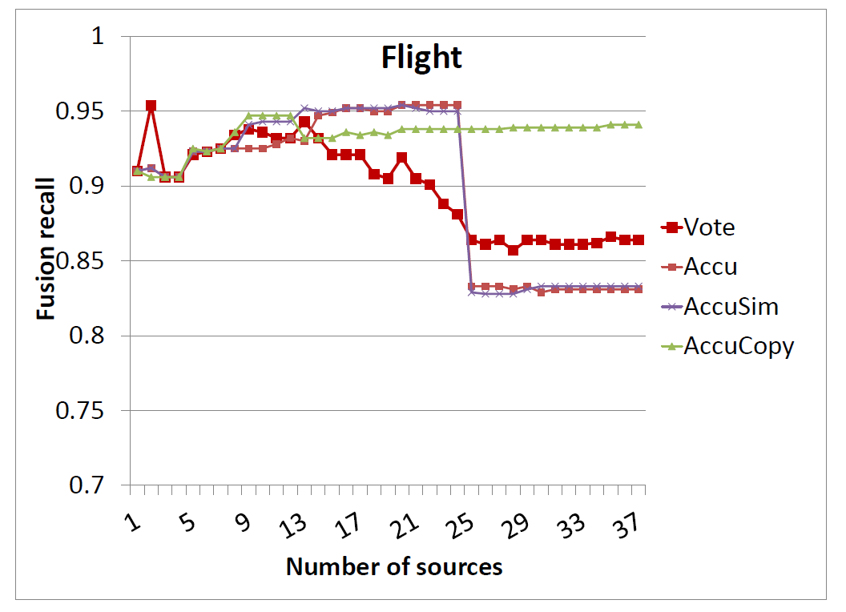
Results on Flight Data
AccuCopy obtains a final precision of .943, much higher than Vote (.864)
  This translates to 570 more correct values

Slide 67
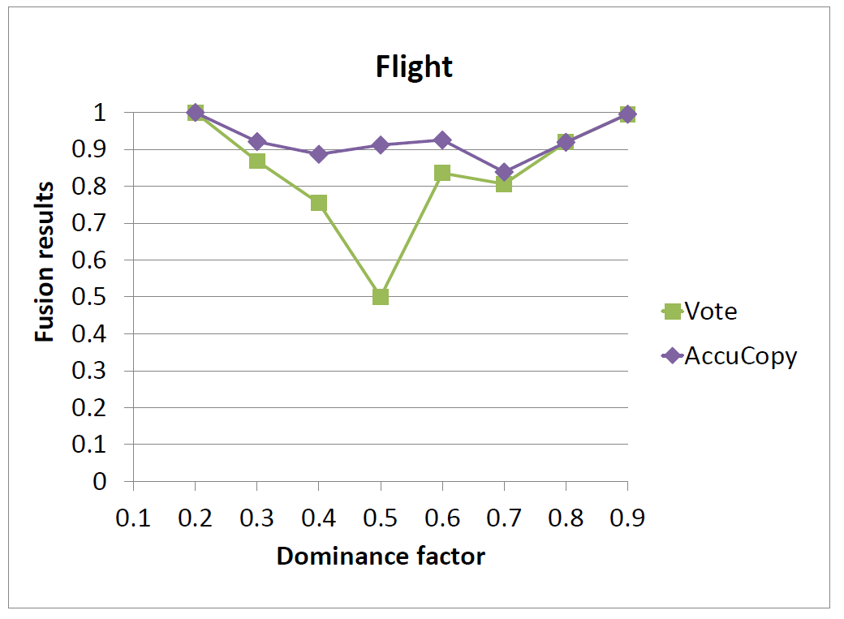
Results on Flight Data (II)

Slide 68
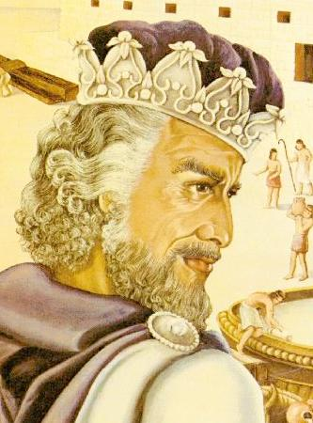
Solomon: Seeking the Truth Via Copy Detection

Slide 69
Data Integration Faces 3 Challenges
Data Conflicts
Instance Heterogeneity
Structure Heterogeneity

Slide 70


Data Integration Faces 3 Challenges
Data Conflicts
Instance Heterogeneity
Structure Heterogeneity

Slide 71
Data Integration Faces 3 Challenges
Scissors
Data Conflicts
Instance Heterogeneity
Structure Heterogeneity
Paper Scissors

Slide 72
Data Integration Faces 3 Challenges
Scissors
Data Conflicts
Instance Heterogeneity
Structure Heterogeneity
Glue

Slide 73
Existing Solutions Assume Independence of Data Sources
Data Conflicts
Instance Heterogeneity
Structure Heterogeneity
Assume INDEPENDENCE
of data sources
Data fusion
Truth discovery
String matching (edit distance, token-based, etc.)
Object matching (aka. record linkage, reference reconciliation, …)
Schema matching
Model management
Query answering using views
Information extraction

Slide 74
Source Dependence Adds A New Dimension to Data Integration
Data Conflicts
Instance Heterogeneity
Structure Heterogeneity
Query
Answering
Data
Fusion
Record
Linkage
Truth discovery
Integrating probabilistic data
Improve record linkage
Distinguish bet wrong values and alter representations
Query optimization
Improve schema matching
Source Recom-mendation
Recommend trustworthy , up-to-date, and independent sources

Slide 75
Solomon Project
Copy detection
Applications in
data integration
Local detection
[VLDB’09a]
Global detection
[VLDB’10a]
Detection w. dynamic data [VLDB’09b]
Visualization
[VLDB’10 demo]
Decision explanation
[WWW’13]
Truth discovery
[VLDB’09a][VLDB’09b]
Query answering
[VLDB’11][EDBT’11]
Record linkage
[VLDB’10b]
Visualization and decision explanation
Solomon

Slide 76
I. Copy Detection
Local Detection
Global Detection [VLDB’10a]
Large-Scale
Detection
Consider correctness
of data [VLDB’09a]
Consider additional evidence [VLDB’10a]
Consider correlated copying [VLDB’10a]
Consider updates [VLDB’09b]

Slide 77
II. Data Fusion
Consider source accuracy and copying [VLDB’09a]
Consider formatting
[VLDB’13a]
Fusing Pr data
Consider value popularity
[VLDB’13b]
Evolving values
[VLDB’09b]

Slide 78
Considering Popularity of Values

Slide 79
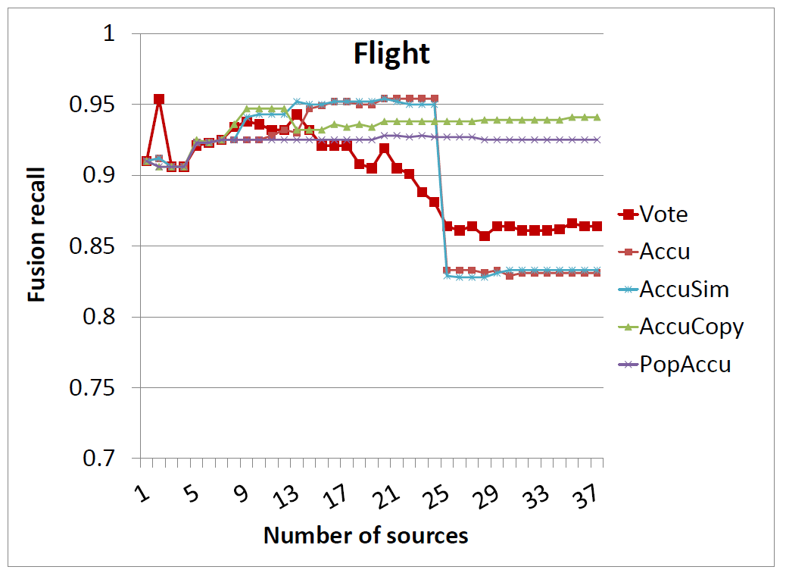
Considering Popularity of Values
Even without considering copying and value similarity, PopAccu obtains fairly good results (recall = .925)
Theorem: PopAccu is monotonic under independence assumption (i.e., precision does not decrease as sources being added)

Slide 80
Computed CEF-Measure
Sources | Coverage | Exactness | Freshness | #Closed-rest
MenuPages | .66 | .98 | .85 | 35
TasteSpace | .44 | .97 | .30 | 123
NYMagazine | .43 | .99 | .52 | 69
NYTimes | .44 | .98 | .38 | 75
ActiveDiner | .44 | .96 | .93 | 81
TimeOut | .42 | .996 | .64 | 45
SavoryCities | .26 | .99 | .42 | 34
VillageVoice | .22 | .94 | .40 | 47
FoodBuzz | .18 | .93 | .36 | 65
NewYork | .14 | .92 | .43 | 34
OpenTable | .12 | .92 | .40 | 11
DiningGuide | .1 | .90 | .10 | 52
GoogleMaps | - | - | - | 228

Slide 81
Contributions of Various Components
Method | Ever-existing | Closed |  |  | #Rnds | Time(s)
 | #Rest | Prec | Rec | F-msr
ALL | - | .60 | 1.0 | .75 | - | -
ALL2 | - | .94 | .34 | .50 | - | -
Naïve | 1192 | .70 | .93 | .80 | 1 | 158
CEF | 5068 | .83 | .88 | .85 | 7 | 637
CopyCEF | 5186 | .86 | .87 | .86 | 6 | 1408
Google | - | .84 | .19 | .30 | - | -
CEF and CopyCEF obtain High precision and recall
Google Map lists a lot of out-of-business restaurants

Slide 82
II. Data Fusion
Offline Fusion
Online Fusion [VLDB’11]
Consider source accuracy and copying [VLDB’09a]
Consider formatting
[VLDB’13a]
Fusing Pr data
Consider value popularity
[VLDB’13b]
Evolving values
[VLDB’09b]

Slide 83
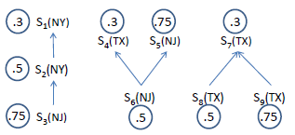
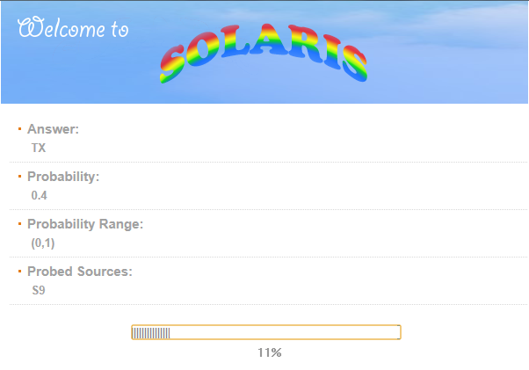
Online Data Fusion [VLDB’11]
  Where is AT&T Shannon Research Labs?

Slide 84
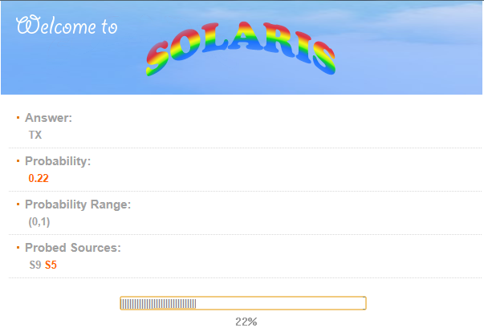
Online Data Fusion [VLDB’11]
  Where is AT&T Shannon Research Labs?

Slide 85
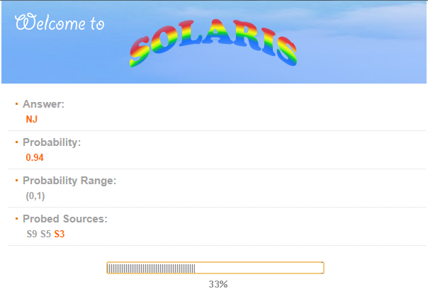
Online Data Fusion [VLDB’11]
  Where is AT&T Shannon Research Labs?

Slide 86
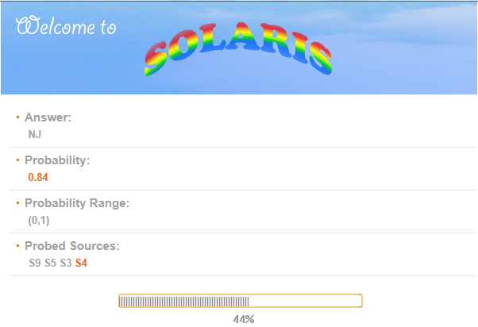
Online Data Fusion [VLDB’11]
  Where is AT&T Shannon Research Labs?

Slide 87
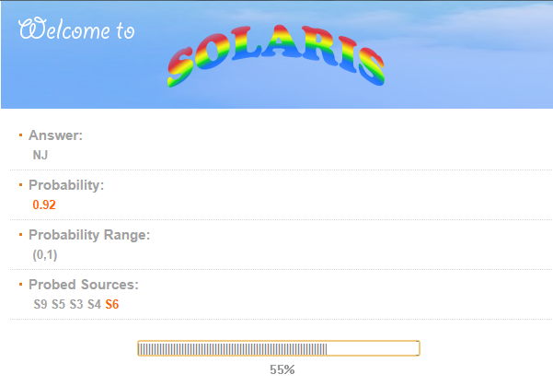
Online Data Fusion [VLDB’11]
  Where is AT&T Shannon Research Labs?

Slide 88
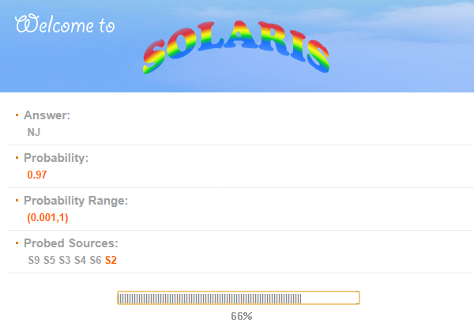
Online Data Fusion [VLDB’11]
  Where is AT&T Shannon Research Labs?

Slide 89

Online Data Fusion [VLDB’11]
  Where is AT&T Shannon Research Labs?

Slide 90

Online Data Fusion [VLDB’11]
  Where is AT&T Shannon Research Labs?
Quickly find answers
Computing probabilities
Source ordering

Slide 91
III. Visualization [VLDB Demo’2010]

Slide 92

The Solomon Project in Brief (2007)
Copy
Detection
Static detection
Dynamic detection
Applications
In Data Integration
Data fusion
Legend
Closed research
Ongoing research
New research

Slide 93
The Solomon Project in Brief (2008)
Copy
Detection
Static detection
Dynamic detection
Opinion influence
Data fusion
Applications
In Data Integration
Query answering
Legend
Record Linkage
Source Recommendation
Closed research
Ongoing research
New research

Slide 94
The Solomon Project in Brief (2009)
Static detection
[VLDB 2009a]
Global detection
Copy
Detection
Dynamic detection
[VLDB 2009b]
Opinion influence
Data fusion
[VLDB 2009a]
Applications
In Data Integration
Query answering
Online fusion
Record Linkage
Source Recommendation
Legend
Closed research
Explanation &
Visualization
Visualization
Ongoing research
Explanation
User feedback
New research

Slide 95

The Solomon Project in Brief (2010)
Static detection
[VLDB 2009a]
Global detection
[VLDB 2010a]
Copy
Detection
Dynamic detection
[VLDB 2009b]
Opinion influence
Data fusion
[VLDB 2009a]
Applications
In Data Integration
Query answering
Online fusion
Record Linkage
[VLDB 2010b]
Source Recommendation
Legend
Closed research
Explanation &
Visualization
Visualization
[VLDB 2010 demo]
Ongoing research
Explanation
User feedback
New research

Slide 96
The Solomon Project in Brief (2011)
Static detection
[VLDB 2009a]
Global detection
[VLDB 2010a]
Copy
Detection
Dynamic detection
[VLDB 2009b]
Opinion influence
Data fusion
[VLDB 2009a]
Fusion on Web
Applications
In Data Integration
Online fusion
[VLDB 2011]
Query answering
[EDBT 2011]
Record Linkage
[VLDB 2010b]
Source Recommendation
Legend
Closed research
Explanation &
Visualization
Visualization
[VLDB 2010 demo]
Ongoing research
Explanation
User feedback
New research

Slide 97
The Solomon Project in Brief (2012)
Static detection
[VLDB 2009a]
Global detection
[VLDB 2010a]
Copy
Detection
Dynamic detection
[VLDB 2009b]
Web-scale Copy Detection
Opinion influence
Fusing Pr Data
Data fusion
[VLDB 2009a]
Fusion on Web
[Under revision for PVLDB]
Applications
In Data Integration
Query answering
[EDBT 2011]
Online fusion
[VLDB 2011]
Record Linkage
[VLDB 2010b]
Source Recom
[Under revision for PVLDB]
Legend
Closed research
Explanation &
Visualization
Visualization
[VLDB 2010 demo]
Ongoing research
Explanation
[Under submission]
New research
User feedback

Slide 98
What’s Next?

Slide 99
Why Am I Motivated NOW?
2007
2013
7/2009

Slide 100

Harvesting Knowledge from the Web
The most important Google story this year was the launch of the Knowledge Graph. This marked the shift from a first-generation Google that merely indexed the words and metadata of the Web to a next-generation Google that recognizes discrete things and the relationships between them.
- ReadWrite 12/27/2012

Slide 101


Impact of Google KG on Search
3/31/2013

Slide 102










Where is the Knowledge From?
DOM-tree extractors for Deep Web
Crowdsourcing
Source-specific
wrappers
Free-text extractors
Web tables & Lists

Slide 103
Challenges in Building the Web-Scale KG
Essentially a large-scale data extraction & integration problem
  Extracting triples
  Reconciling entities
  Mapping relations
  Resolving conflicts
  Detecting malicious sources/users
Errors can creep in at every stage
But we require a high precision of knowledge
Data extraction
Record linkage
Schema mapping
Data fusion
Spam detection
>99%

Slide 104
New Challenges for Data Fusion
Handle errors from different stages of data integration
Fusion for multi-truth data items
Fusing probabilistic data
Active learning by crowdsourcing
Quality diagnose for contributors (extractors, mappers, etc.)
Combination of schema mapping, entity resolution, and data fusion
Etc.

Slide 105
Related Work
Copy detection [VLDB’12 Tutorial]
  Texts, programs, images/videos, structured sources
Data provenance [Buneman et al., PODS’08]
  Focus on effective presentation and retrieval
  Assume knowledge of provenance/lineage
Data fusion [VLDB’09 Tutorial, VLDB’13]
  Web-link based (HUB, AvgLog, Invest, PooledInvest) [Roth et al., 2010-2011]
  IR based (2-Estimates, 3-Estimates, Cosine) [Marian et al., 2010-2011]
  Bayesian based (TruthFinder) [Han, 2007-2008]

Slide 106
Take-Aways
Web data is not fully trustable and copying is common
Copying can be detected using statistical approaches
Leveraging source accuracy, copying relationships, and value similarity can improve fusion results
Important and more challenging for building Web-scale knowledge bases

Slide 107












Acknowledgements
Laure Berti-Equille
(Institute of Research for Development, France)
Xuan Liu
(Singapore National Univ.)
Xian Li
(SUNY Binhamton)
Amelie Marian
(Rutgers Univ.)
Anish Das Sarma
(Google)
Beng Chin Ooi
(Singapore National Univ.)
Ken Lyons
(AT&T Research)
Divesh Srivastava
(AT&T Research)
Alon Halevy
(Google)
Yifan Hu
(AT&T Research)
Remi Zajac
(AT&T Research)
Songtao Guo
(AT&T Interactive)

Slide 108
Solomon: Seeking the Truth Via Copy Detection
http://lunadong.com
Fusion data sets: lunadong.com/fusionDataSets.htm

