Slide 1
Truth Finding on the Deep WEB: Is the Problem Solved
Xian Li (SUNY@Binghamton→Cisco)
Xin Luna Dong (AT&T→Google)
Kenneth Lyons (AT&T Labs-Research)
Weiyi Meng (SUNY@Binghamton)
Divesh Srivastava (AT&T Labs-Research)
VLDB’2013

Slide 2
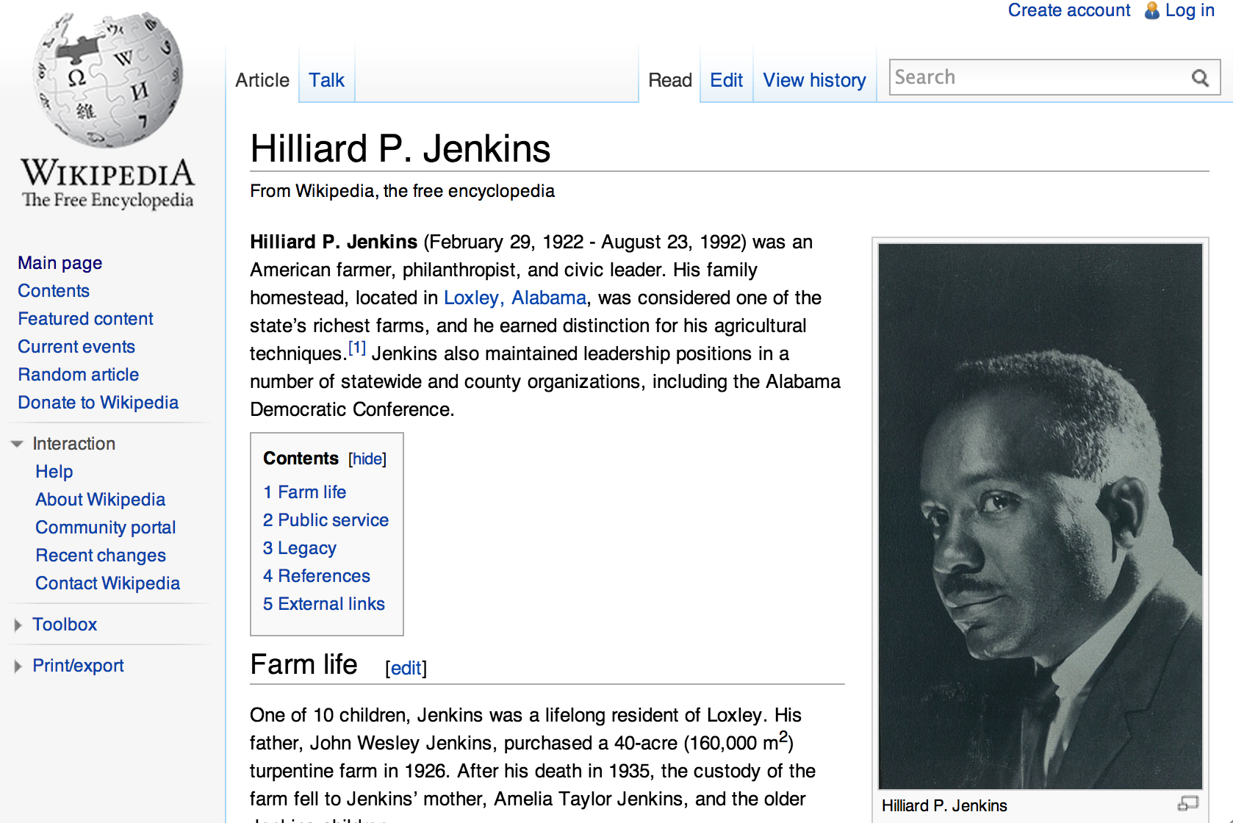
February 29, 1922

Slide 3
ARE DEEp-web data consistent & reliable?

Slide 4
Study on Two Domains
 | #Sources | Period | #Objects | #Local-attrs | #Global-attrs | Considered items
Stock | 55 | 7/2011 | 1000*20 | 333 | 153 | 16000*20
Flight | 38 | 12/2011 | 1200*31 | 43 | 15 | 7200*31
Stock
  Search “stock price quotes” and “AAPL quotes”
  Sources: 200 (search results)→89 (deep web)→76 (GET method) →55 (none JavaScript)
  1000 “Objects”: a stock with a particular symbol on a particular day
    30 from Dow Jones Index
    100 from NASDAQ100 (3 overlaps)
    873 from Russell 3000
  Attributes: 333 (local) → 153 (global) → 21 (provided by > 1/3 sources) → 16 (no change after market close)

Slide 5
Study on Two Domains
 | #Sources | Period | #Objects | #Local-attrs | #Global-attrs | Considered items
Stock | 55 | 7/2011 | 1000*20 | 333 | 153 | 16000*20
Flight | 38 | 12/2011 | 1200*31 | 43 | 15 | 7200*31
Flight
  Search “flight status”
  Sources: 38
    3 airline websites (AA, UA, Continental)
    8 airport websites (SFO, DEN, etc.)
    27 third-party websites (Orbitz, Travelocity, etc.)
  1200 “Objects”: a flight with a particular flight number on a particular day from a particular departure city
    Departing or arriving at the hub airports of AA/UA/Continental
  Attributes: 43 (local) → 15 (global) → 6 (provided by > 1/3 sources)
    scheduled dept/arr time, actual dept/arr time, dept/arr gate

Slide 6
Study on Two Domains
 | #Sources | Period | #Objects | #Local-attrs | #Global-attrs | Considered items
Stock | 55 | 7/2011 | 1000*20 | 333 | 153 | 16000*21
Flight | 38 | 12/2011 | 1200*31 | 43 | 15 | 7200*31
Why these two domains?
  Belief of fairly clean data
  Data quality can have big impact on people’s lives
Resolved heterogeneity at schema level and instance level

Slide 7
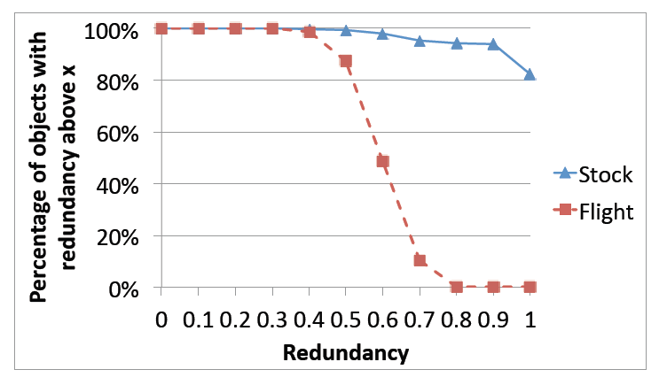
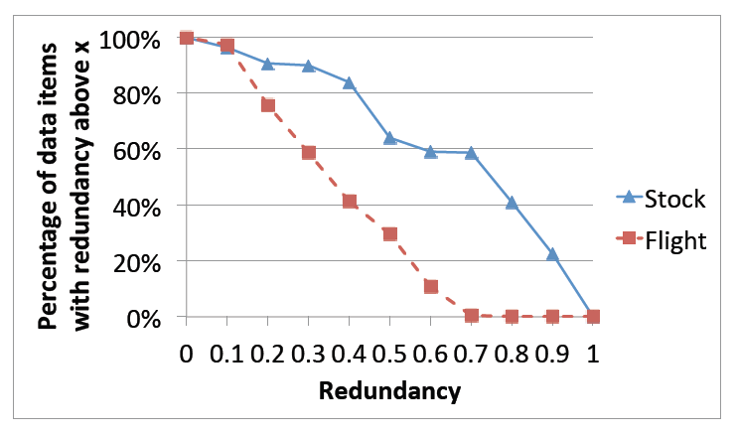
Q1. Are There a Lot of Redundant Data on the Deep Web?
✓

Slide 8
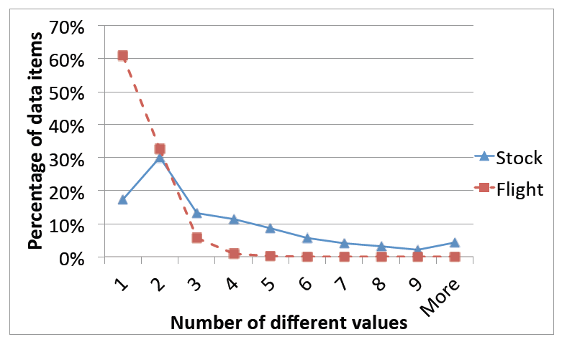
Q2. Are the Data Consistent?
✗
Inconsistency on 70% data items
  Tolerance to 1% difference

Slide 9
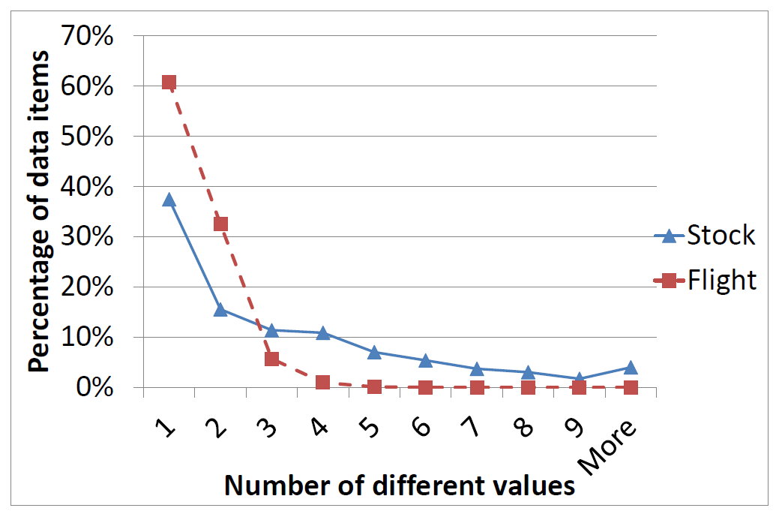
Q2. Are the Data Consistent?
✗
Inconsistency on 50% data items after removing StockSmart

Slide 10
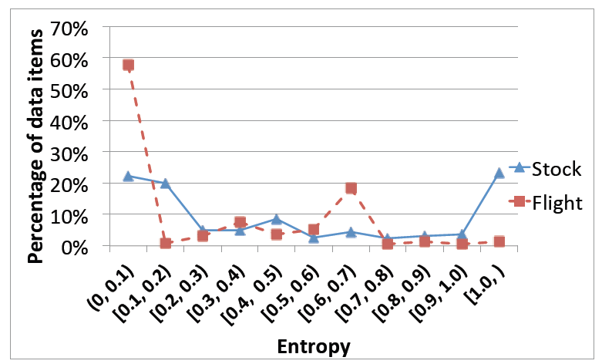
Q2. Are the Data Consistent? (II)
Entropy measures distribution of different values
Quite low entropy: one value provided more often than others

Slide 11
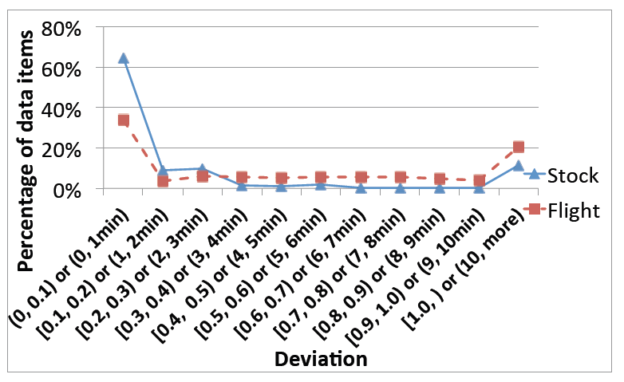
Q2. Are the Data Consistent? (III)
Deviation measures difference of numerical values
High deviation: 13.4 for Stock, 13.1 min for Flight

Slide 12
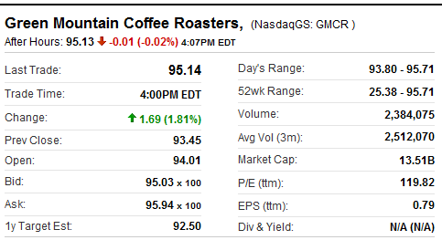
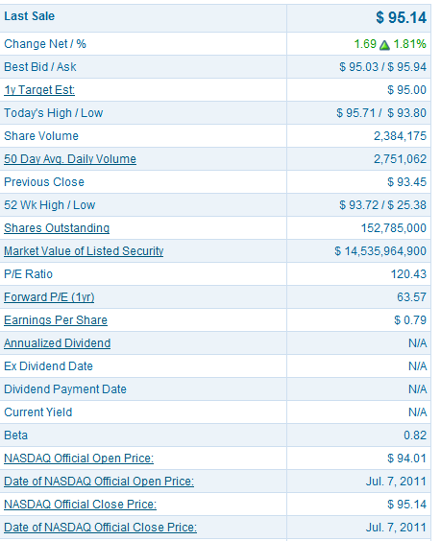
Why Such Inconsistency?
— I. Semantic Ambiguity
Day’s Range: 93.80-95.71
Yahoo! Finance
Nasdaq
52wk Range: 25.38-95.71
52 Wk: 25.38-93.72

Slide 13
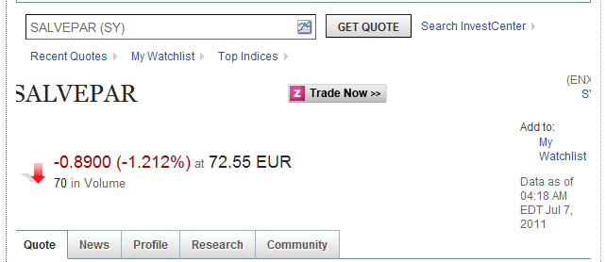
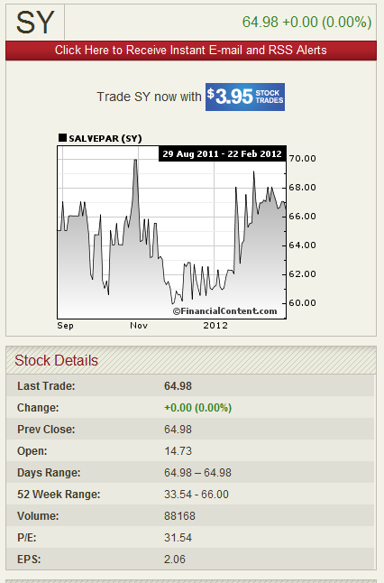
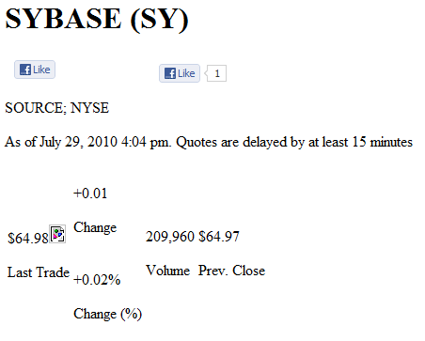
Why Such Inconsistency?
— II. Instance Ambiguity

Slide 14
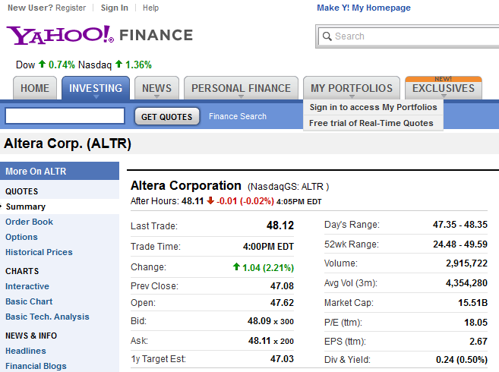
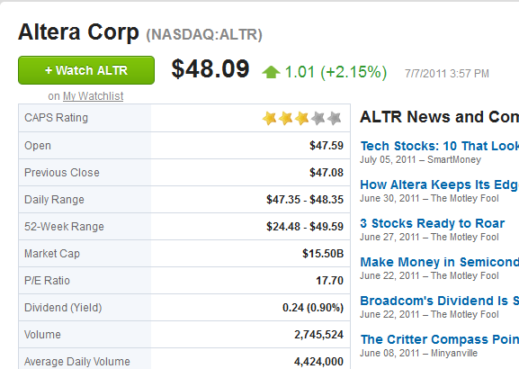
Why Such Inconsistency?
— III. Out-of-Date Data
4:05 pm
3:57 pm

Slide 15
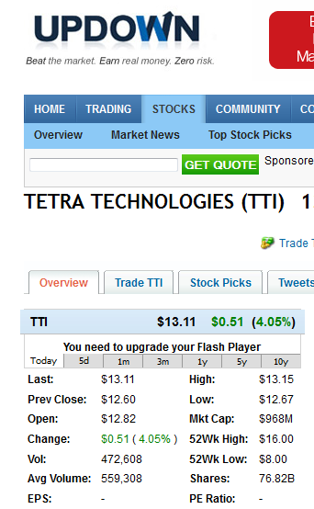
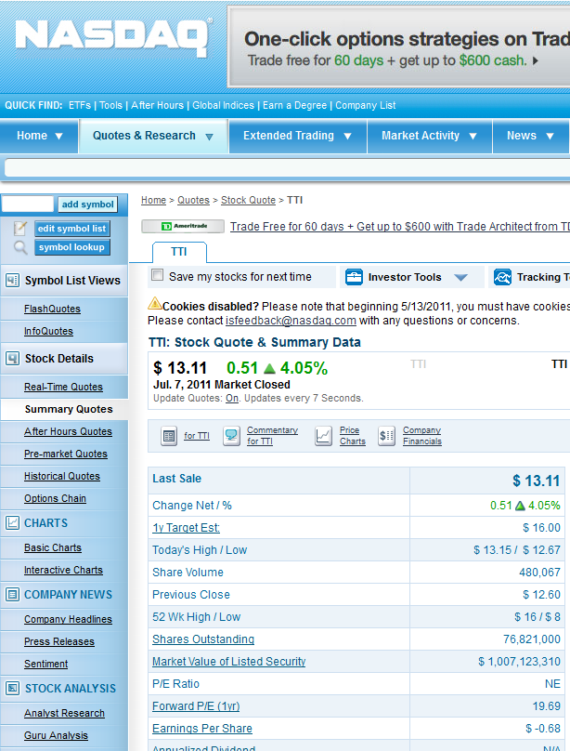
Why Such Inconsistency?
— IV. Unit Error
76.82B
76,821,000

Slide 16
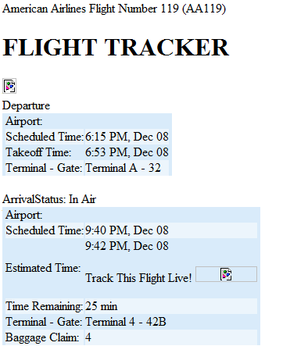
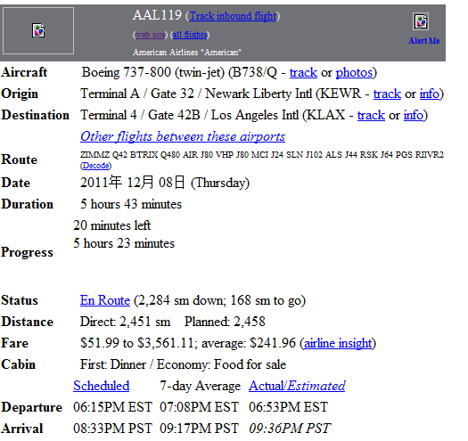
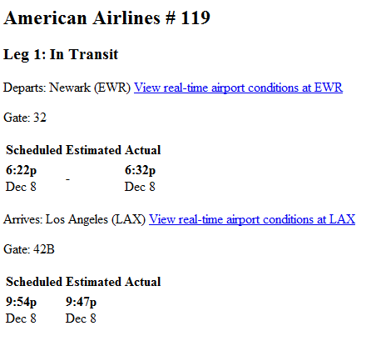
Why Such Inconsistency?
— V. Pure Error
FlightView
FlightAware
Orbitz
6:15 PM
6:22 PM
6:15 PM
9:40 PM
9:54 PM
8:33 PM

Slide 17
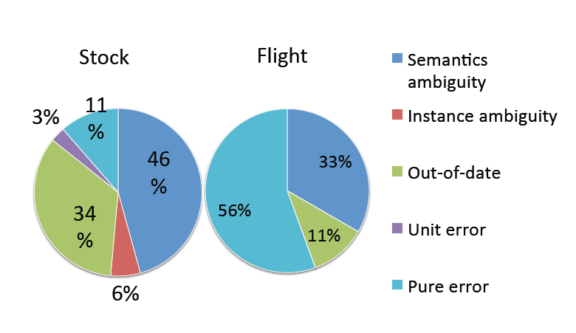
Why Such Inconsistency?
Random sample of 20 data items and 5 items with the largest #values in each domain

Slide 18
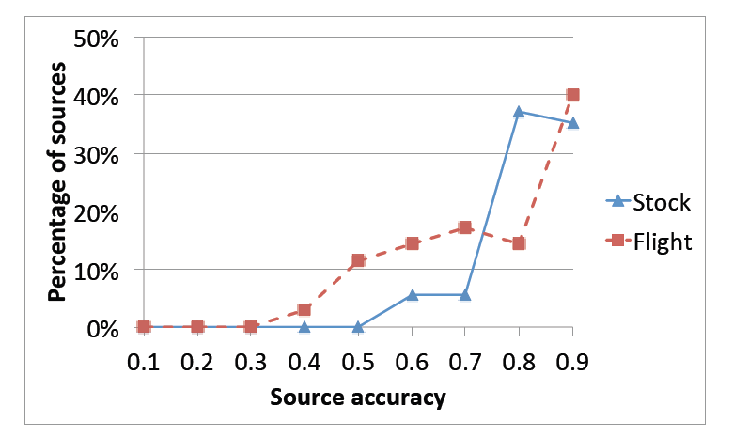
Q3. Is Each Source of High Accuracy?
✗
Not high on average: .86 for Stock and .8 for Flight
Gold standard
  Stock: vote on data from Google Finance, Yahoo! Finance, MSN Money, NASDAQ, Bloomberg
  Flight: from airline websites

Slide 19
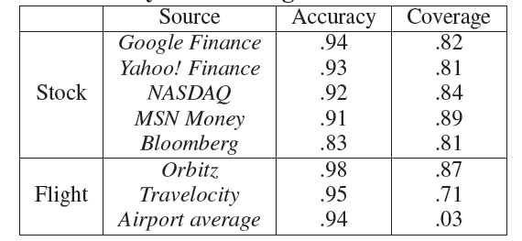
Q3-2. Are Authoritative Sources of High Accuracy?
✗
Reasonable but not so high accuracy
Medium coverage

Slide 20
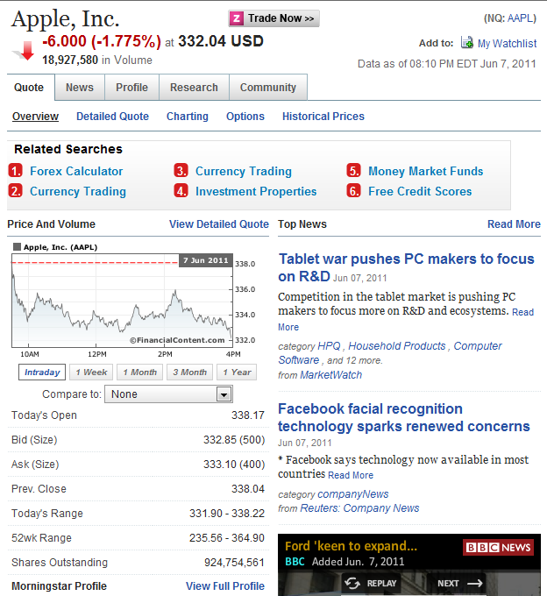
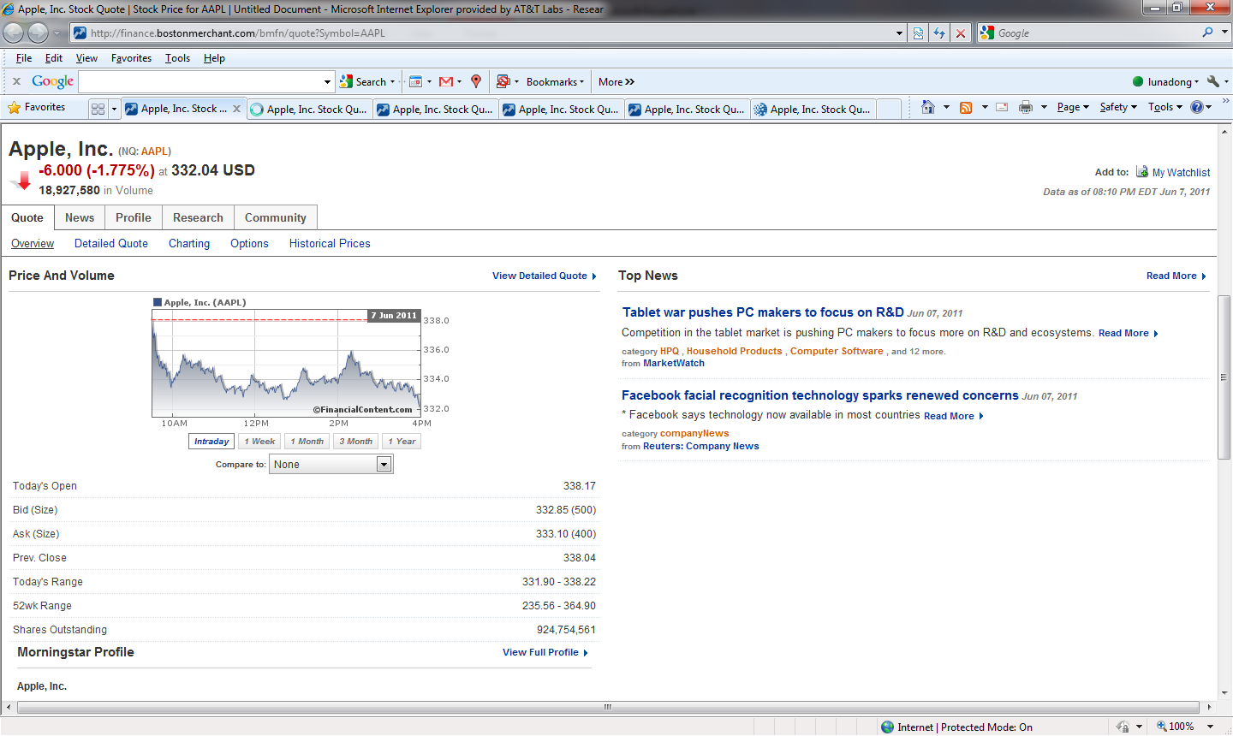
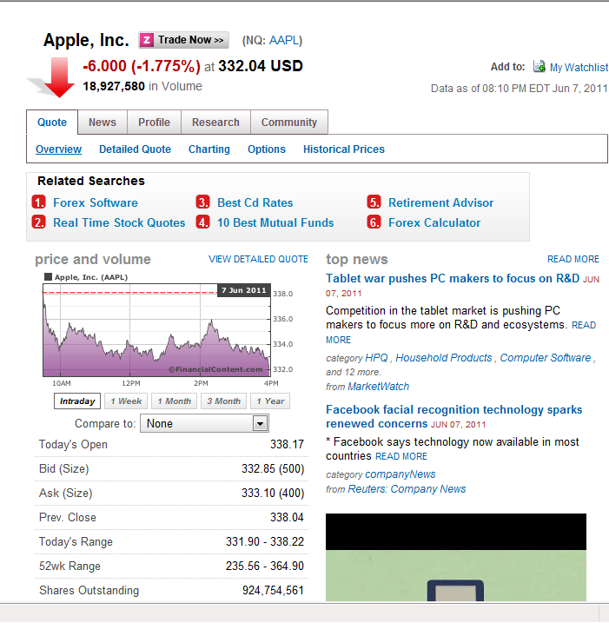
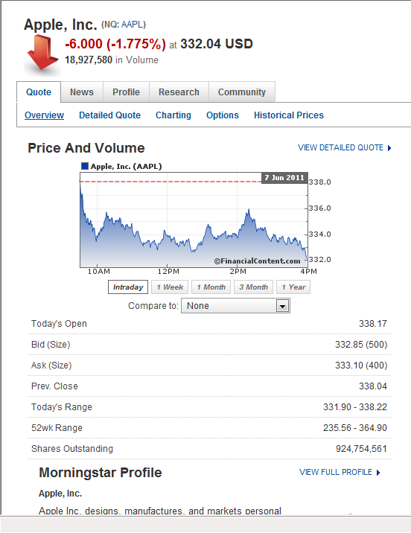
Q4. Is There Copying or Data Sharing Between Deep-Web Sources?
✓

Slide 21
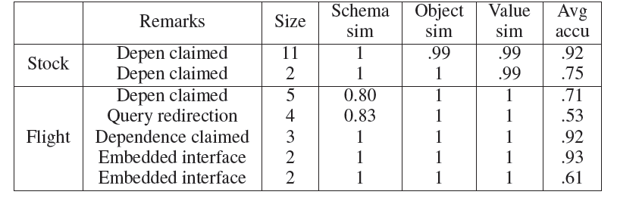
Q4-2. Is Copying or Data Sharing Mainly on Accurate Data?
✗

Slide 22
How to Resolve Inconsistency
(Data Fusion)?

Slide 23
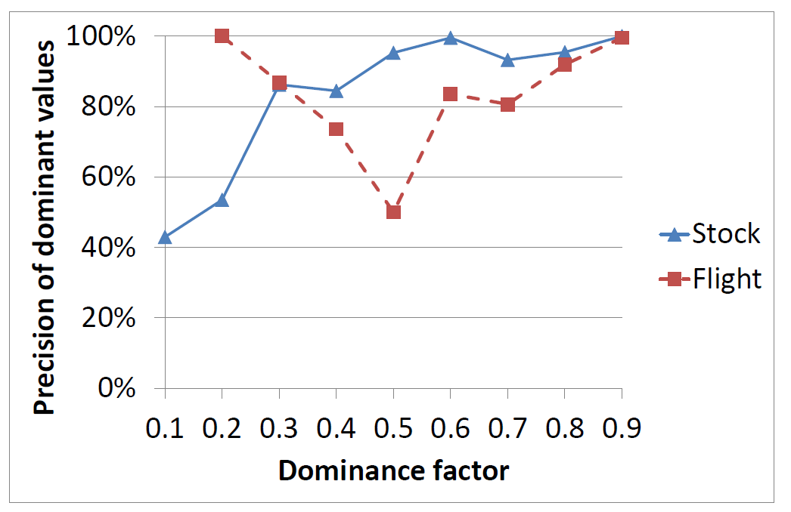
Basic Solution: Voting
Only 70% correct values are provided by over half of the sources
Voting precision:
  .908 for Stock; i.e., wrong values for 1500 data items
  .864 for Flight; i.e., wrong values for 1000 data items

Slide 24
Improvement I. Leveraging Source Accuracy
 | S1 | S2 | S3
Flight 1 | 7:02PM | 6:40PM | 7:02PM
Flight 2 | 5:43PM | 5:43PM | 5:50PM
Flight 3 | 9:20AM | 9:20AM | 9:20AM
Flight 4 | 9:40PM | 9:52PM | 8:33PM
Flight 5 | 6:15PM | 6:15PM | 6:22PM

Slide 25
Improvement I. Leveraging Source Accuracy
 | S1 | S2 | S3
Flight 1 | 7:02PM | 6:40PM | 7:02PM
Flight 2 | 5:43PM | 5:43PM | 5:50PM
Flight 3 | 9:20AM | 9:20AM | 9:20AM
Flight 4 | 9:40PM | 9:52PM | 8:33PM
Flight 5 | 6:15PM | 6:15PM | 6:22PM
Higher accuracy;
More trustable
Naïve voting obtains an accuracy of 80%

Slide 26
Improvement I. Leveraging Source Accuracy
 | S1 | S2 | S3
Flight 1 | 7:02PM | 6:40PM | 7:02PM
Flight 2 | 5:43PM | 5:43PM | 5:50PM
Flight 3 | 9:20AM | 9:20AM | 9:20AM
Flight 4 | 9:40PM | 9:52PM | 8:33PM
Flight 5 | 6:15PM | 6:15PM | 6:22PM
Higher accuracy;
More trustable
Challenges:
How to decide source accuracy?
2. How to leverage accuracy in voting?
Considering accuracy obtains an accuracy of 100%

Slide 27
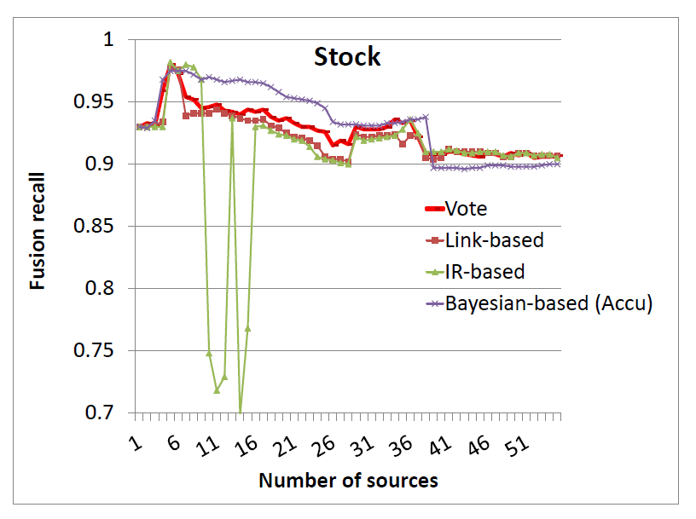
Results on Stock Data (I)
Sources ordered by recall (coverage * accuracy)
Among various methods, the Bayesian-based method (Accu) performs best at the beginning, but in the end obtains a final precision (=recall) of .900, worse than Vote (.908)

Slide 28
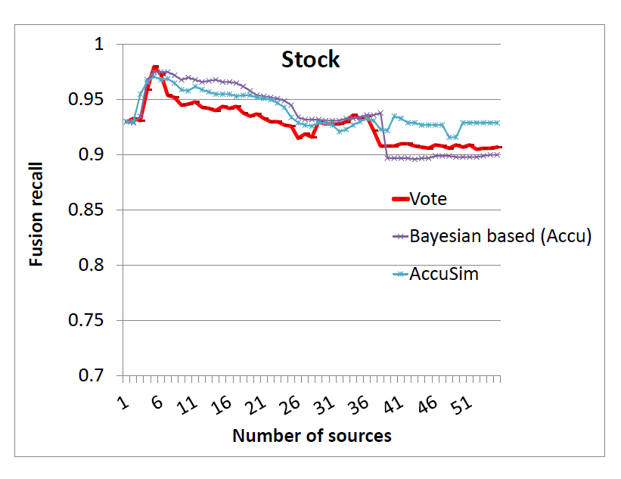
Results on Stock Data (II)
AccuSim obtains a final precision of .929, higher than Vote and any other method (around .908)
  This translates to 350 more correct values

Slide 29
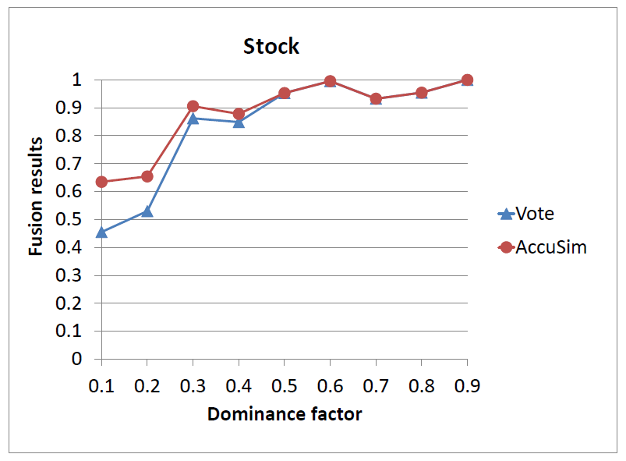
Results on Stock Data (III)

Slide 30
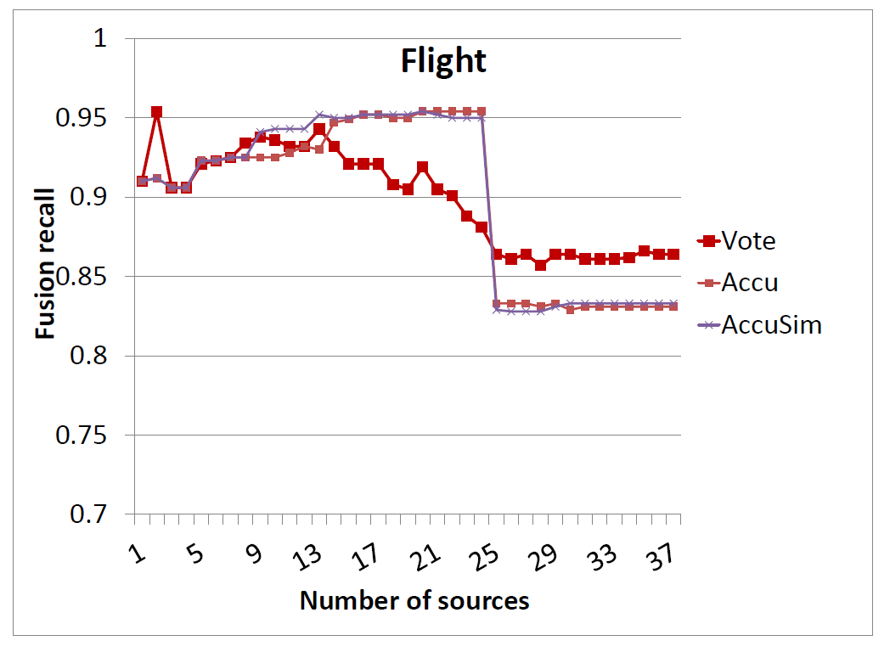
Results on Flight Data
Accu/AccuSim obtains a final precision of .831/.833, both lower than Vote (.857)
WHY??? What is that magic source?

Slide 31
Copying or Data Sharing Can Happen on Inaccurate Data

Slide 32
 | S1 | S2 | S3 | S4 | S5
Flight 1 | 7:02PM | 6:40PM | 7:02PM | 7:02PM | 8:02PM
Flight 2 | 5:43PM | 5:43PM | 5:50PM | 5:50PM | 5:50PM
Flight 3 | 9:20AM | 9:20AM | 9:20AM | 9:20AM | 9:20AM
Flight 4 | 9:40PM | 9:52PM | 8:33PM | 8:33PM | 8:33PM
Flight 5 | 6:15PM | 6:15PM | 6:22PM | 6:22PM | 6:22PM
Naïve voting works only if data sources are independent.

Slide 33
 | S1 | S2 | S3 | S4 | S5
Flight 1 | 7:02PM | 6:40PM | 7:02PM | 7:02PM | 8:02PM
Flight 2 | 5:43PM | 5:43PM | 5:50PM | 5:50PM | 5:50PM
Flight 3 | 9:20AM | 9:20AM | 9:20AM | 9:20AM | 9:20AM
Flight 4 | 9:40PM | 9:52PM | 8:33PM | 8:33PM | 8:33PM
Flight 5 | 6:15PM | 6:15PM | 6:22PM | 6:22PM | 6:22PM
Higher accuracy;
More trustable
Considering source accuracy can be worse when there is copying

Slide 34
Improvement II. Ignoring Copied Data
 | S1 | S2 | S3 | S4 | S5
Flight 1 | 7:02PM | 6:40PM | 7:02PM | 7:02PM | 8:02PM
Flight 2 | 5:43PM | 5:43PM | 5:50PM | 5:50PM | 5:50PM
Flight 3 | 9:20AM | 9:20AM | 9:20AM | 9:20AM | 9:20AM
Flight 4 | 9:40PM | 9:52PM | 8:33PM | 8:33PM | 8:33PM
Flight 5 | 6:15PM | 6:15PM | 6:22PM | 6:22PM | 6:22PM
Challenges:
How to detect copying?
2. How to leverage copying in voting?
It is important to detect copying and ignore copied values in fusion

Slide 35
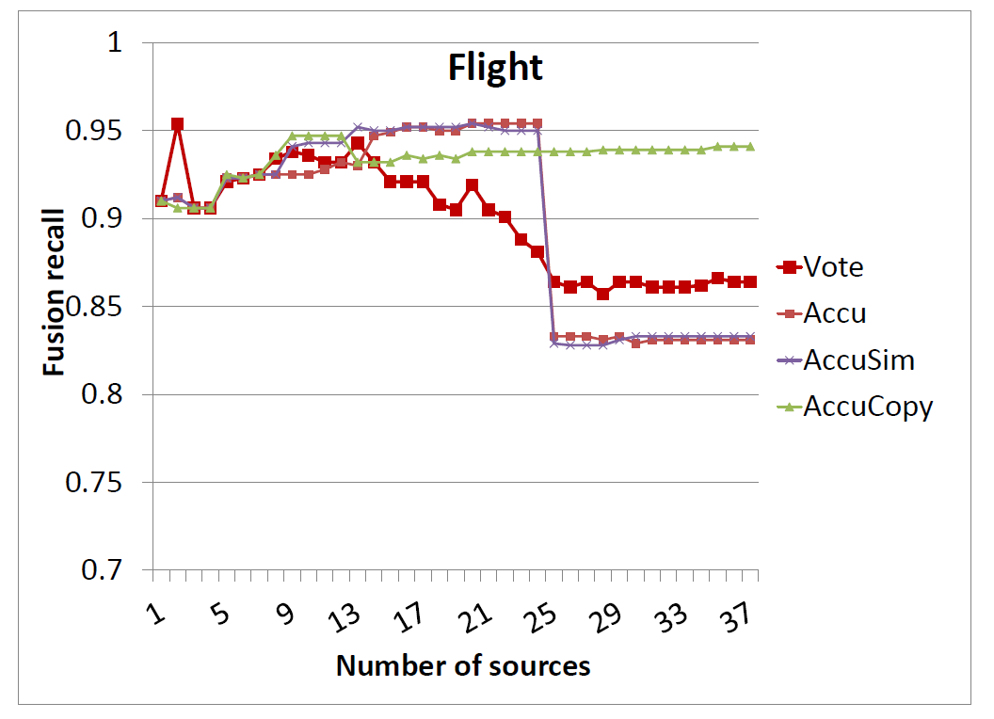
Results on Flight Data
AccuCopy obtains a final precision of .943, much higher than Vote (.864)
  This translates to 570 more correct values

Slide 36
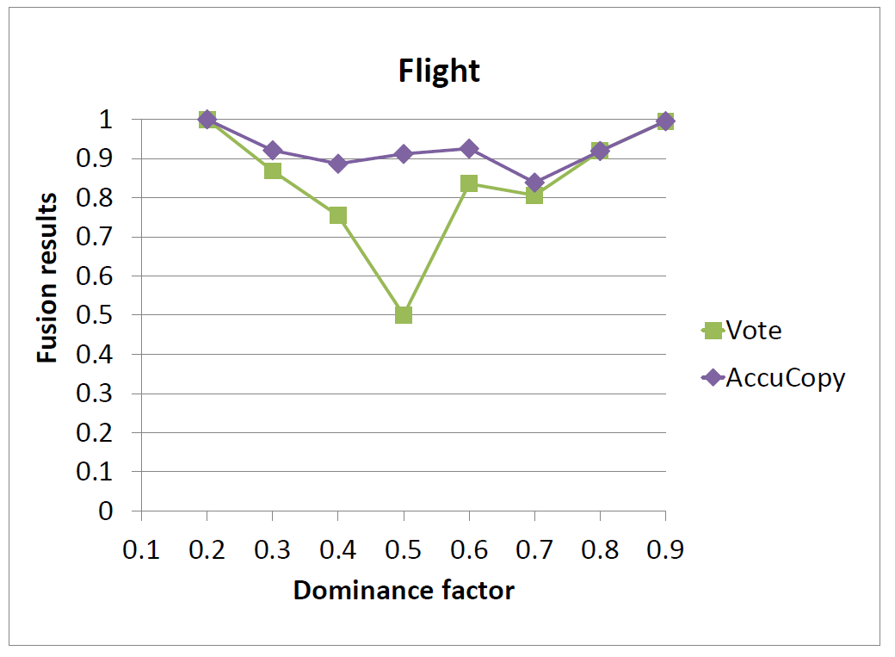
Results on Flight Data (II)

Slide 37
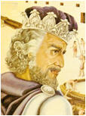
Take-Aways
Web data is not fully trustable, Web sources have different accuracy, and copying is common
Leveraging source accuracy, copying relationships, and value similarity can improve truth finding
Data sets downloadable from
http://lunadong.com/fusionDataSets.html

Slide 38
Thank you!!!
http://lunadong.com/fusionDataSets.html

